Slide 1
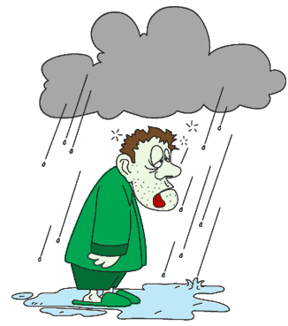
‘Feeling Under The Weather’
Carolina Fonseca Píriz
Colegio Giner de los ríos
2014-15

Slide 2
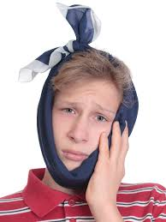
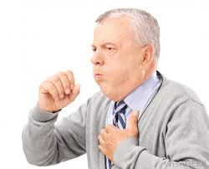
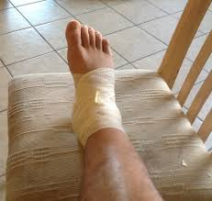
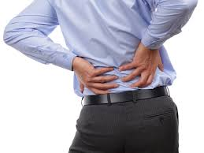


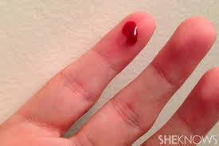
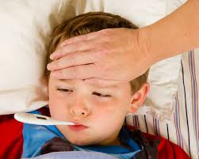
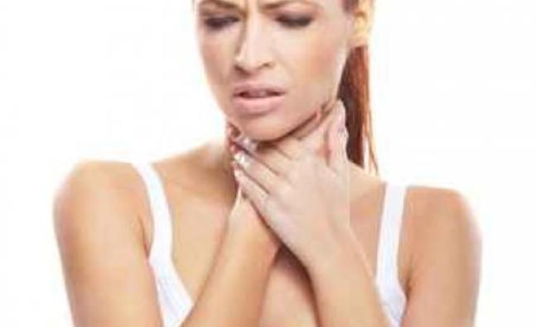
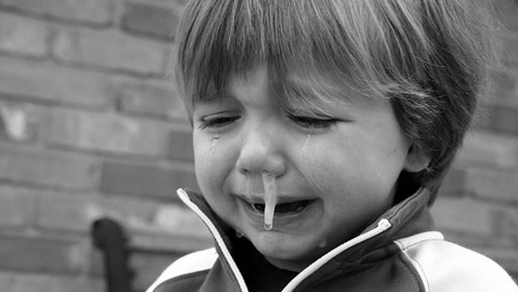
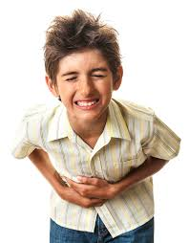

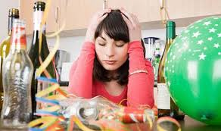

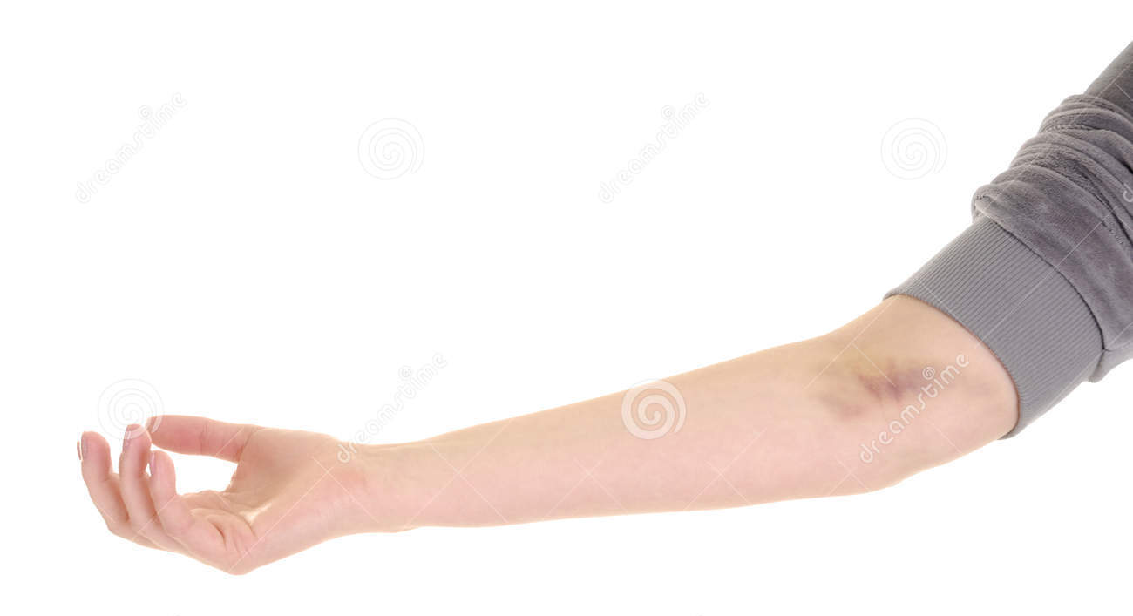

Slide 3

P: Good morning, doctor.
D: Good morning, what seems to be the problem?
P: I have a terrible stomachache.
D: What are your symptoms?
P: Every time I eat I feel sick, my stomach hurts and I want to vomit.
D: How long have you been feeling ill?
P: I have been feeling ill for the last three weeks. What should I do?
D: Have you been eating unhealthy food?
P: Well… the truth is that I have been eating too many sweets, chocolates and pizzas these months, but from the moment I started to feel ill, I have tried to eat more healthy food, but the pain is still there. What do you recommend?
D: Mmm… if you don’t want to have a heart attack or an ulcer, you should change your eating habits, you should give up eating sweets and avoid heavy, salty or greasy food such as pizza or french fries. Instead, you should eat more salads and vegetables.
P: Ok. Is there anything I can take?
D: Yes, I have written down in the prescription the medicines you have to take. You will take the pills for seven days. And remember, try to have a balanced diet and drink a lot of water! I hope you recover soon!
P: Ok, Thank you, doctor. Bye!

Slide 4



Your Turn!

