Slide 1
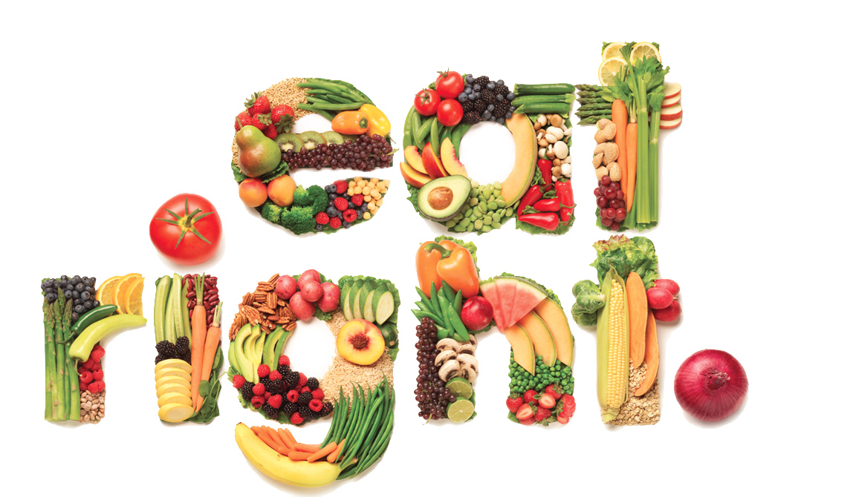
Healthy Habits
Carolina Fonseca píriz
Colegio Giner de los ríos
2014-15

Slide 2
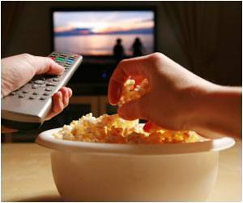
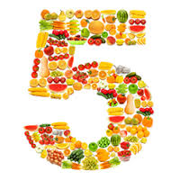
Agree or Disagree?
‘Eating more than 5 a day brings no extra benefits’
  NHS. Wednesday, July 30, 2014.
‘Watch less TV to prevent obesity’
  NHS. Tuesday, Sep. 23, 2014.

Slide 3
What is the meaning of …?
Overating
Eating more than the body needs.
Substances that the body needs to incorporate in order to grow and live.
Name given to the meat of the pig.
Cut into small pieces.
Cook something in the oven.
Name given to the meat of the cow.
Someone who does not eat meat.
Main ingredient of a classic salad.
Substance in food that makes you put on weight.
Products with lots of sugar.
Highly flavoured, cointaining lots of spices.
To be very hungry.
Limitation on the amount of food that a person eats in order to improve his/her health.
Nutrients
Vegetarian
Spicy
Overating
Chop
Lettuce
Roast
Go on a diet
Beef
Fats
Starving
Sweets
Pork
Nutrients
Pork
Chop
Roast
Beef
Vegetarian
Lettuce
Fats
Sweets
Spicy
Starving
Go on a diet

Slide 4
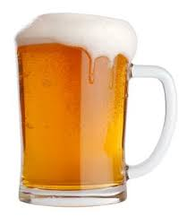
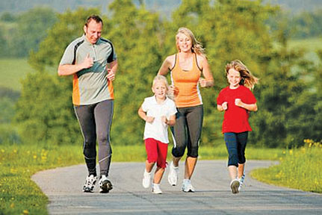
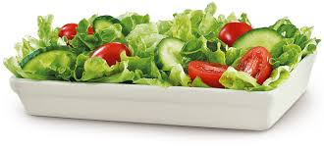
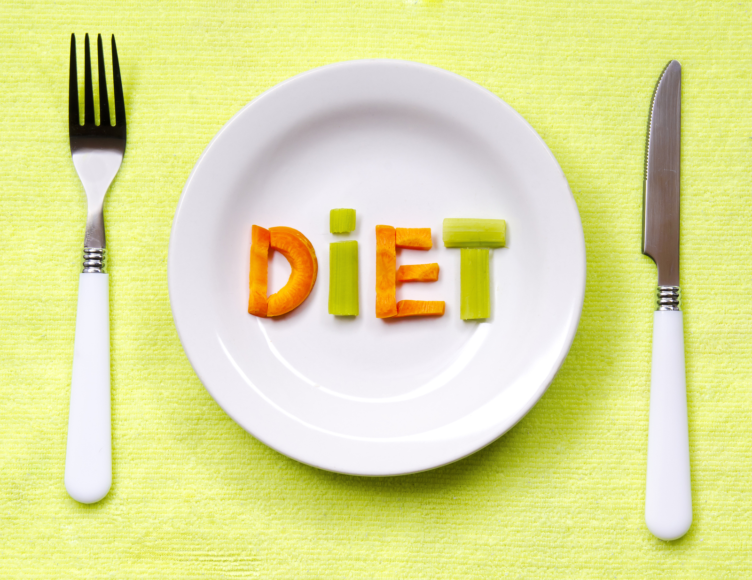

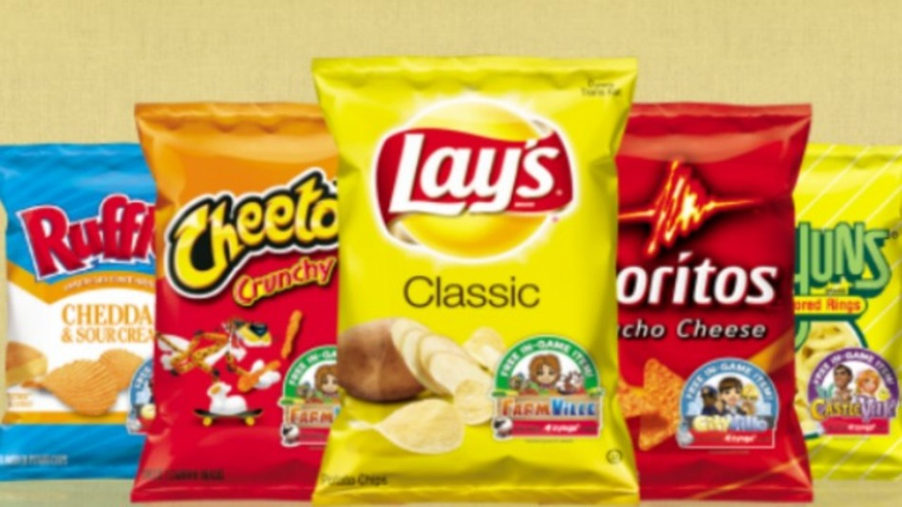
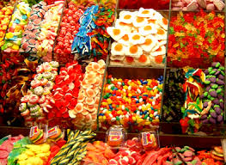
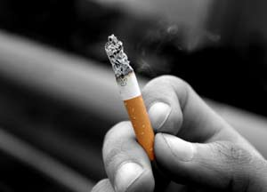
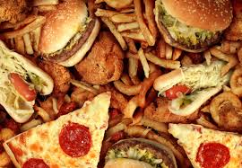
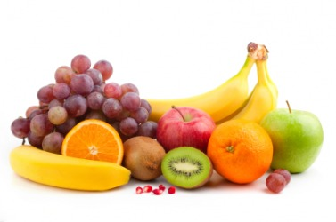
Healthy or Unhealthy?

Slide 5

What about you? Do you have heatlhy habits? What are your likes or Dislikes?
Useful Expressions
I can’t stand…
I’m (not) really fond of…
I’m (not) very keen on…
There is nothing I enjoy more than…
What I like the most is…
I hate/ I quite like…
I’d prefer/ I’d rather…
I should/ shouldn’t …
I should try (to) …

Slide 6
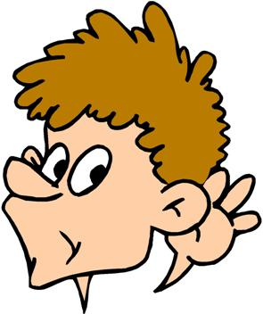

Healthy Lifestyle
Are the following statements TRUE OR FALSE?
The daughther is not hungry.
The mother is resting in bed.
The father has prepared the dinner perfectly.
The father added some apples to the pizza.
The pizza is salty and burnt.
False
True
False
False
True

Slide 7

Reading: A long healthy life
Unit 2, page 28
Look for words or expressions in the text that mean the same as…
Looking for
The normal or recommended amount of food that a person should take
Good for health, having a good effect
Many different studies or investigations
To be completely sure about something
Searching
Average amount
Beneficial
A great deal of research
Strongly believe
2. Which expressions can you identify in the text meaning ‘a lot of’?

Slide 8

