Slide 1

GOOD HABITS

Slide 2
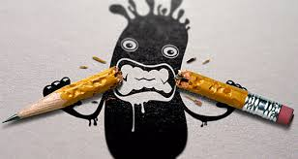
1ºPay atention in class.
2ºTake down notes.

Slide 3

3ºwrite down the date in your folder every day.
4ºask your teacher if you don´t understant.

Slide 4

5ºkeep your desk clear and organised.
6ºchek your schedule daily.

Slide 5

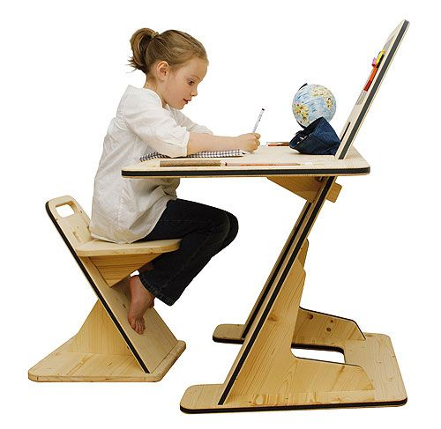
7ºwhen you study at home turn off the tv and and your mobile phone.
8ºrevise a little bit every day.

