Slide 1
MARGARET THATCHER
Carmen Merino Currás 2ºA

Slide 2
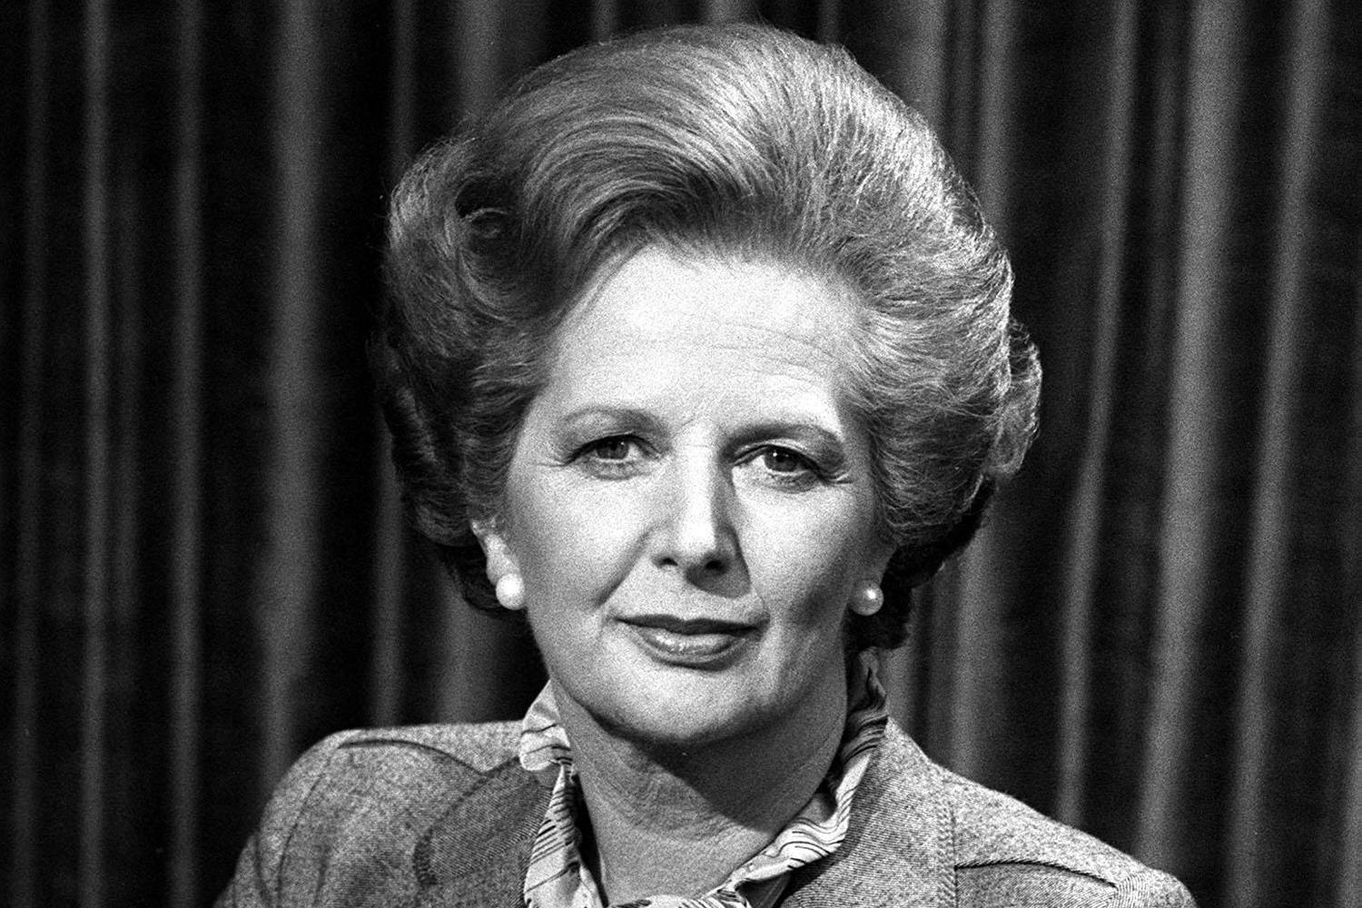
Margaret Hilda Thatcher was born in Grantham, on October 13, 1925. She had a sister called Muriel. Their father was a businessman.

Slide 3
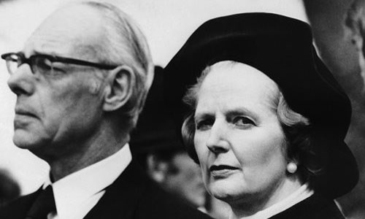
She married Denis Thatcher on March 28, 1942 at St. Mary´s Church.

Slide 4
A Soviet journalist gave her the nickname “Iron Lady”.
She belonged to the Conservative Party.
She was the first woman to lead a major political party in the UK.
She wasn´t a candidate in the 1955 general elections as it came fairly soon after the birth of her children.
The name given to her policies was Thatcherism.

Slide 5
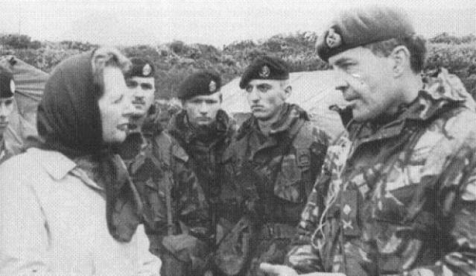
The Falklands War took place in 1982. UK fought against Argentina . UK won the war.

Slide 6
Teacher was one of the few Conservative MPs to support Leo Abse´s Bill to decriminalize male homosexuality. She voted in favour of David Steel's bill to legalise abortion.
She was called “milk snatcher” because she imposed public expenditure cuts on the state education system, resulting in the abolition of free milk for schoolchildren aged seven to eleven.

Slide 7
The famous actor Laurence Olivier helped her to suppress her Lincolnshire accent.
She became Prime Minister on May 4, 1979.
As Prime Minister she met Queen Elizabeth II weekly to discuss government business.
The miners´ strike brought the biggest confrontation between the trade unions and her government.

Slide 8
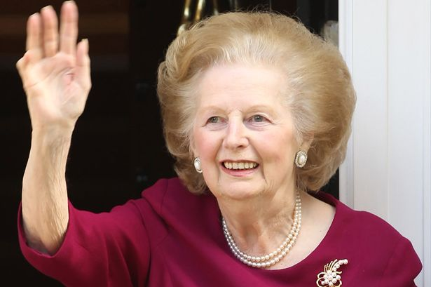

Slide 9
She died on the morning of 8 April 2013 at the aged of 87 after suffering a stroke. She had been staying at a suit in the Ritz Hotel in London since December 2012 after having difficulty with stair at her Chester Square home.
Details of her funeral were agreed with her in advance. In line with her wishes she received a ceremonial funeral, including full military honours, with a church service at St. Paul´s Cathedral on 17 April.

