Slide 1
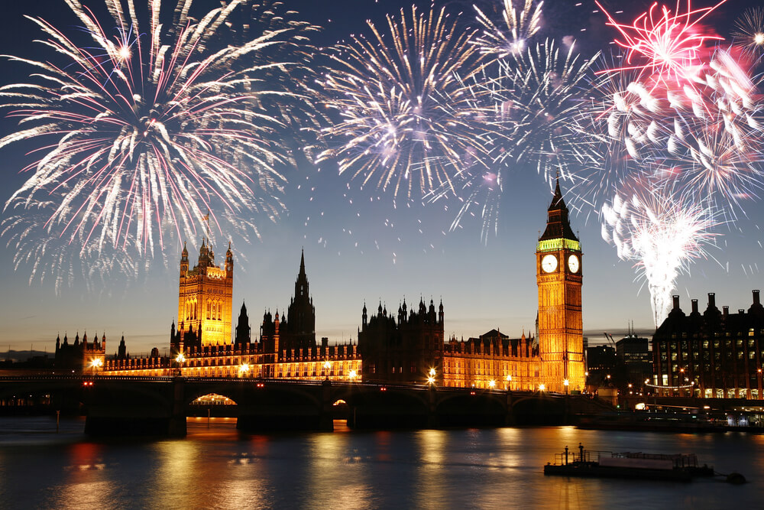
Bonfire Night/ Guy Fawkes Night

Slide 2
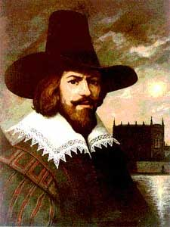
Who was Guy Fawkes?
He was born on April 13th, 1570.
He was born and raised in York, England.
His father died when he was eight years old.
His mother remarried a Catholic man.
Later, he moved to Spain to fight on the Catholic side of the Eighty Years War.
After he returned, he was introduced to Robert Catesby.

Slide 3
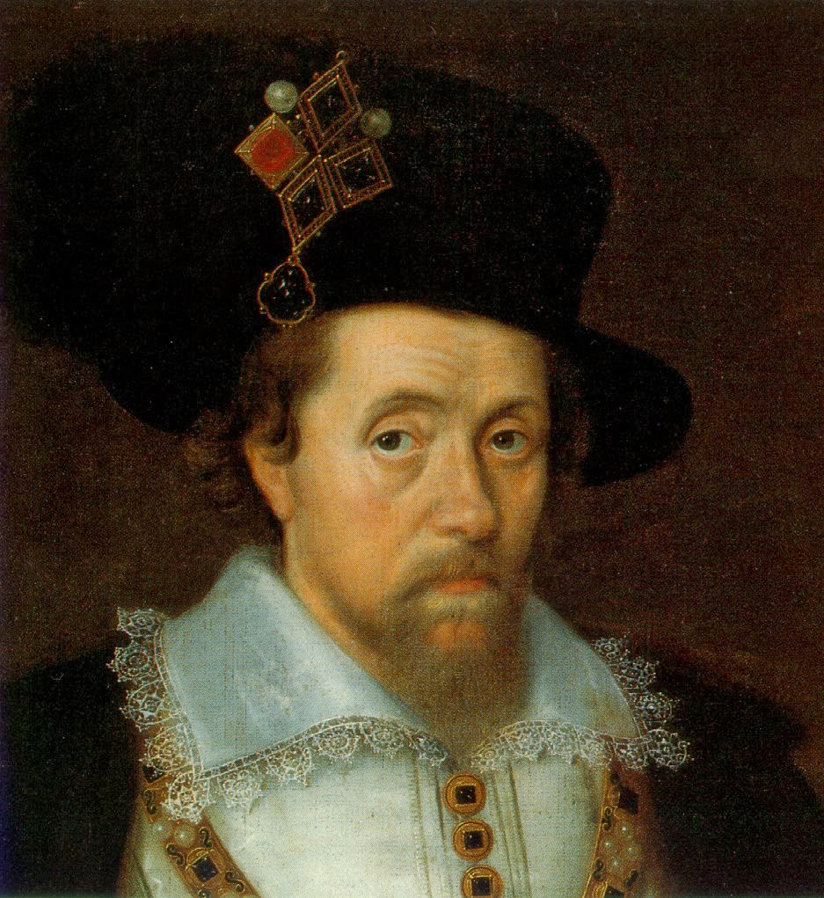
Who was Robert Catesby?
Robert Catesby was an English Catholic.
He was the leader of a group of Catholics in England.
In England, Catholics were a minority. King James I was less tolerant of Catholicism and more tolerant of Protestantism.
Guy Fawkes, Robert Catesby, and the English Catholics wanted to see a Catholic revolution in England.

Slide 4
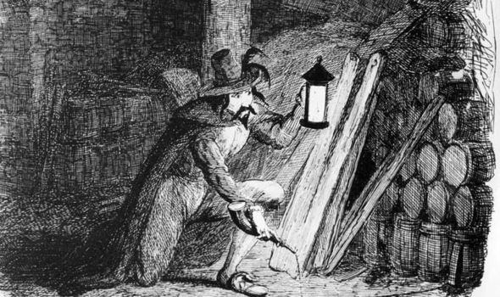
The Gunpowder Plot
This group planned the Gunpowder Plot, which was a plan to kill King James I of England and the entire House of Lords.
If their plan was successful, the king would be replaced by a Catholic Monarch.
They dug tunnels underneath the parliament and placed barrels of gunpowder beneath the House of Lords.
On November 5th, 1605, Guy Fawkes was caught guarding the barrels of gunpowder.
He was arrested and executed.

Slide 5
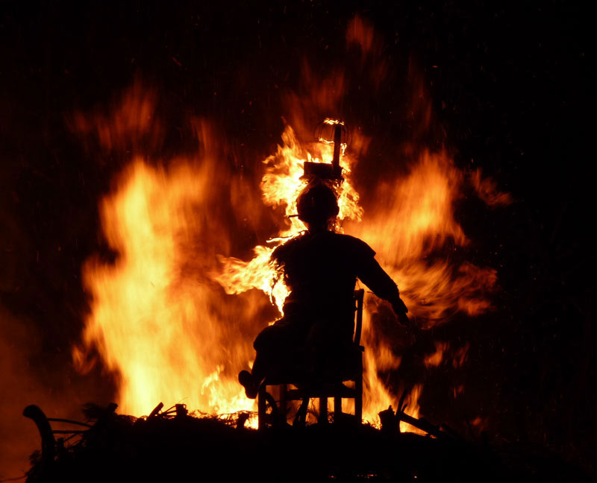
Modern Holiday
People in England celebrate Guy Fawkes night every year on November 5th.
They light bonfires all over the country to remember that the Parliament had not exploded.
They create a guy every year to burn in the fire.
The people eat festive food and watch fireworks during the bonfire.

Slide 6
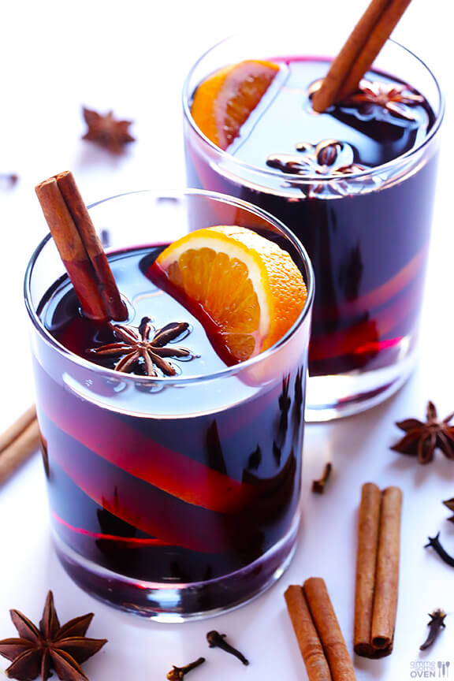
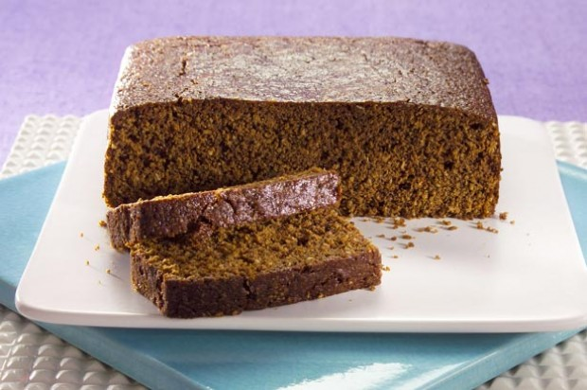
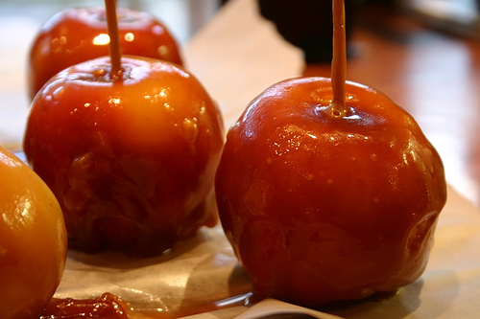
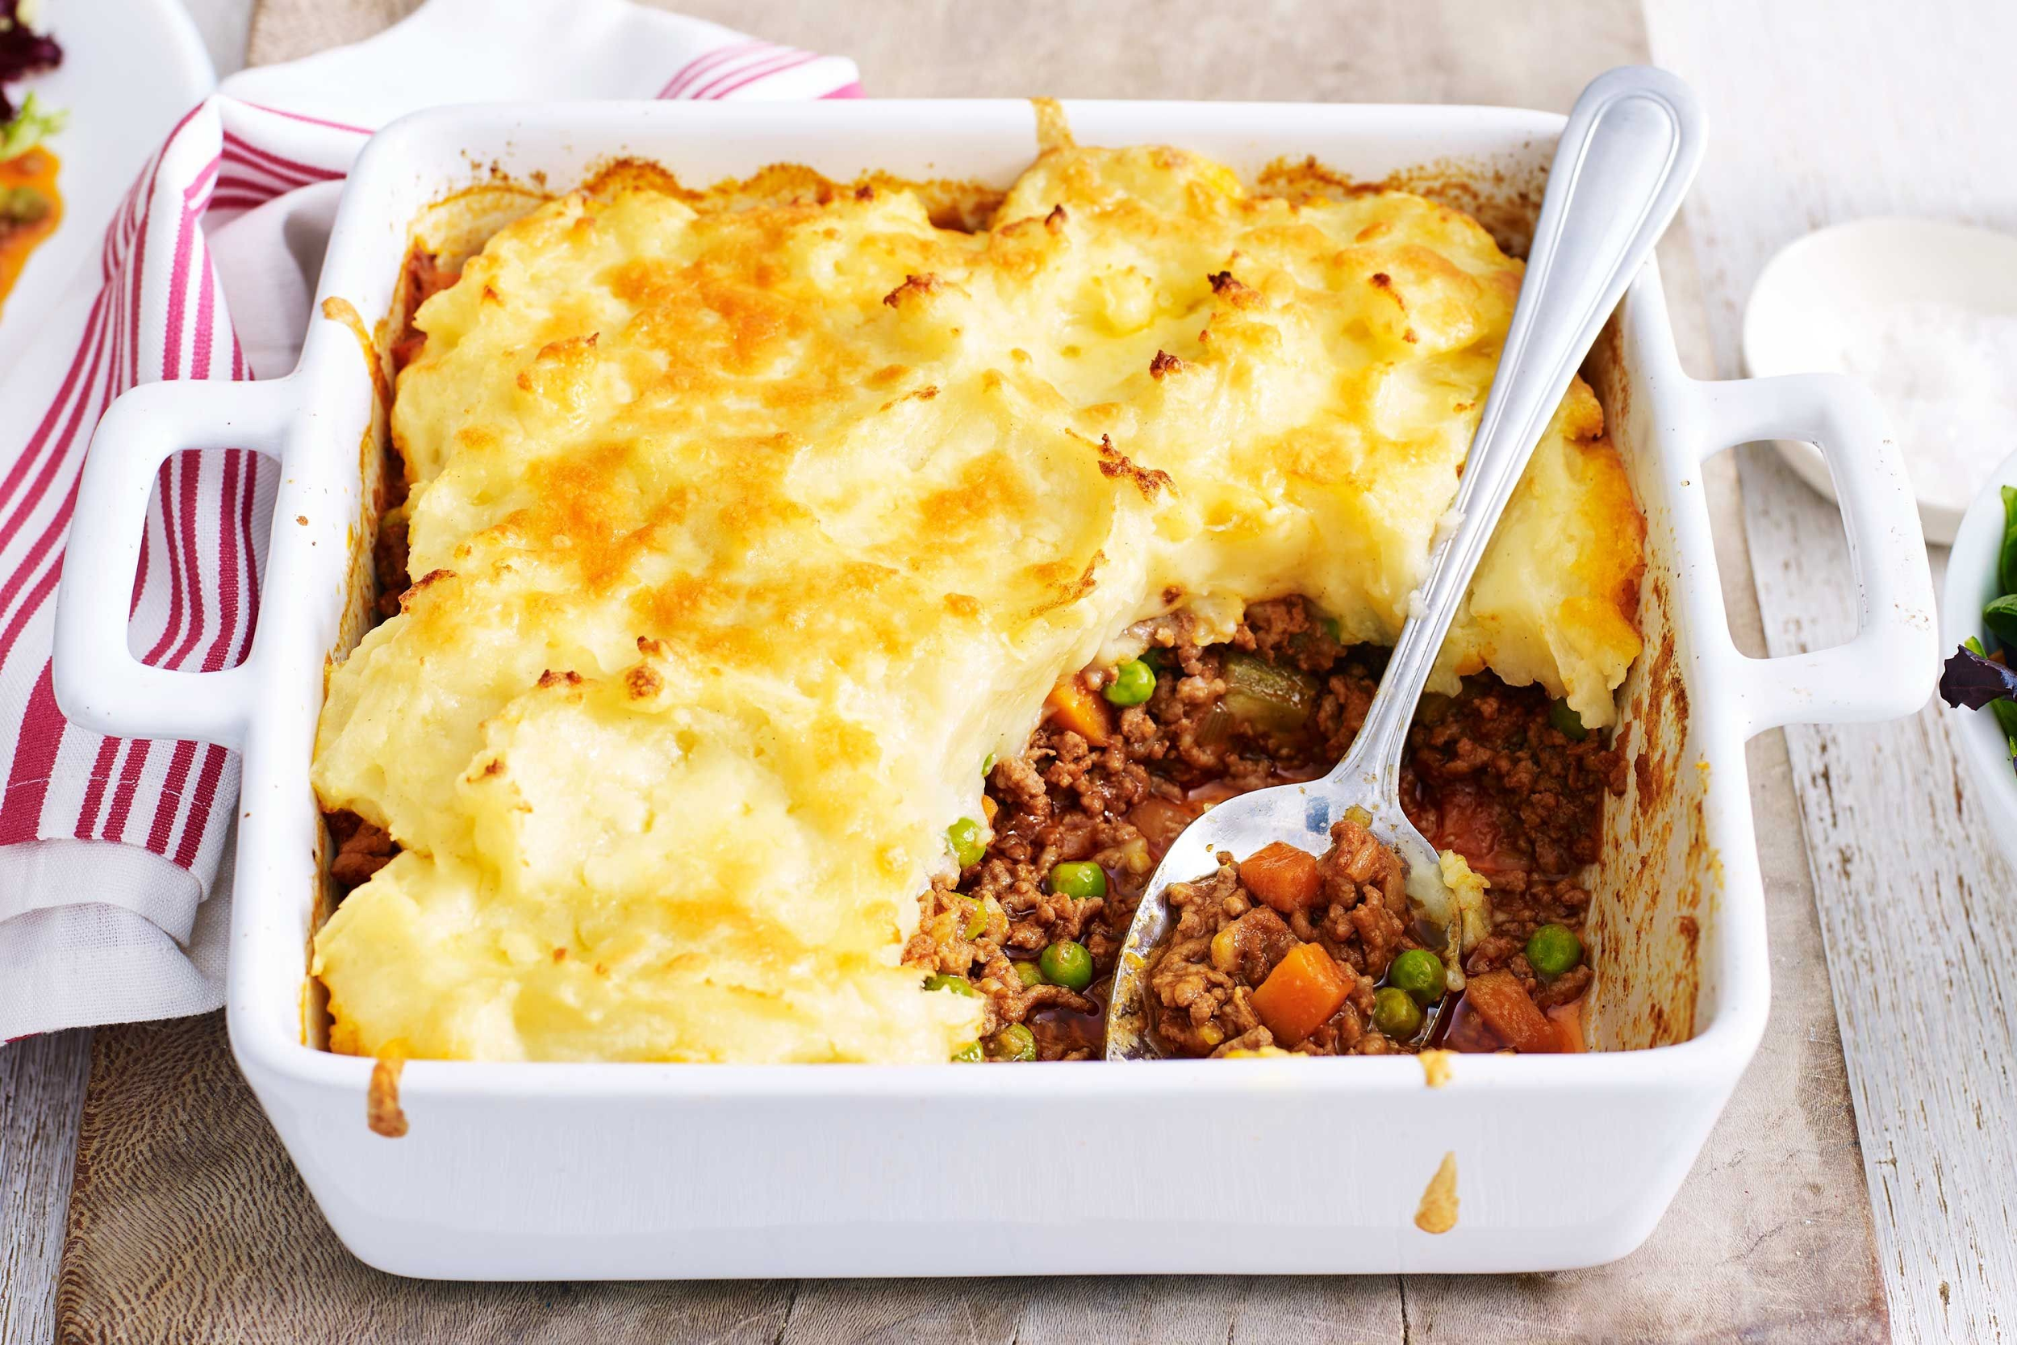
Popular Food
Parkin
Hot wine
Toffee Apples
Shepherd’s Pie

Slide 7
https://www.youtube.com/watch?v=4CA9pD3pVA4

Slide 8
What day is Bonfire Night celebrated?
It is celebrated on the fifth of November

Slide 9
What country celebrates Bonfire Night?
England celebrates Bonfire Night

Slide 10
Who was the leader of the English Catholic group responsible for the Gunpowder Plot?
The leader of the English Catholic group responsible for the Gunpowder Plot was Robert Catesby.

Slide 11
Who was caught guarding the barrels of gunpowder on November 5th?
Guy Fawkes was caught guarding the barrels of gunpowder on the fifth of November.

Slide 12
Was Guy Fawkes a Protestant or a Catholic?
Guy Fawkes was a Catholic.

Slide 13
Who was the King of England in 1605?
James I was the King of England in 1605.

Slide 14
Which war did Guy Fawkes fight in?
Guy Fawked fought in the Eighty Years War.

Slide 15
What do British people do during Guy Fawkes Night?
People watch fireworks, eat special food and make bonfires.

Slide 16
What do British people eat during Guy Fawkes night?
They eat toffee apples, Sheperd’s pie and parkin, and they drink hot wine.

