Slide 1

Sustainable Development
Carmen Meiriño

Slide 2
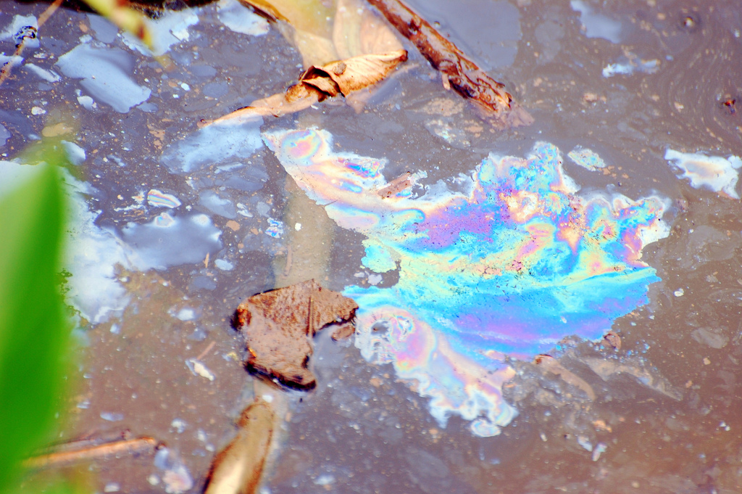
Photo: Steve Snodgrass

Slide 3
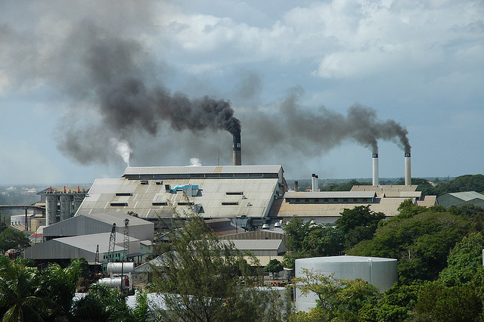
Photo by Mary

Slide 4
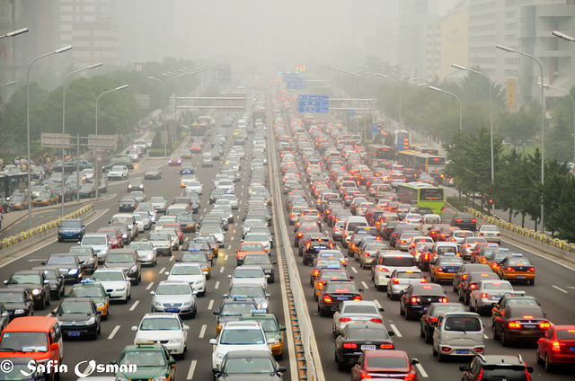

Slide 5
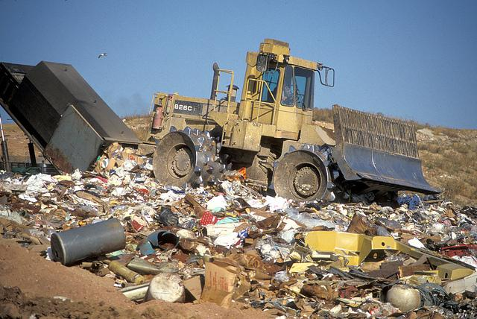
Photo by Wisconsin Dept of Natural Resources

Slide 6
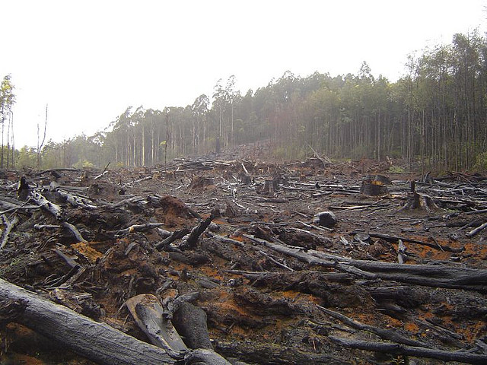
Photo: Crustmania

Slide 7
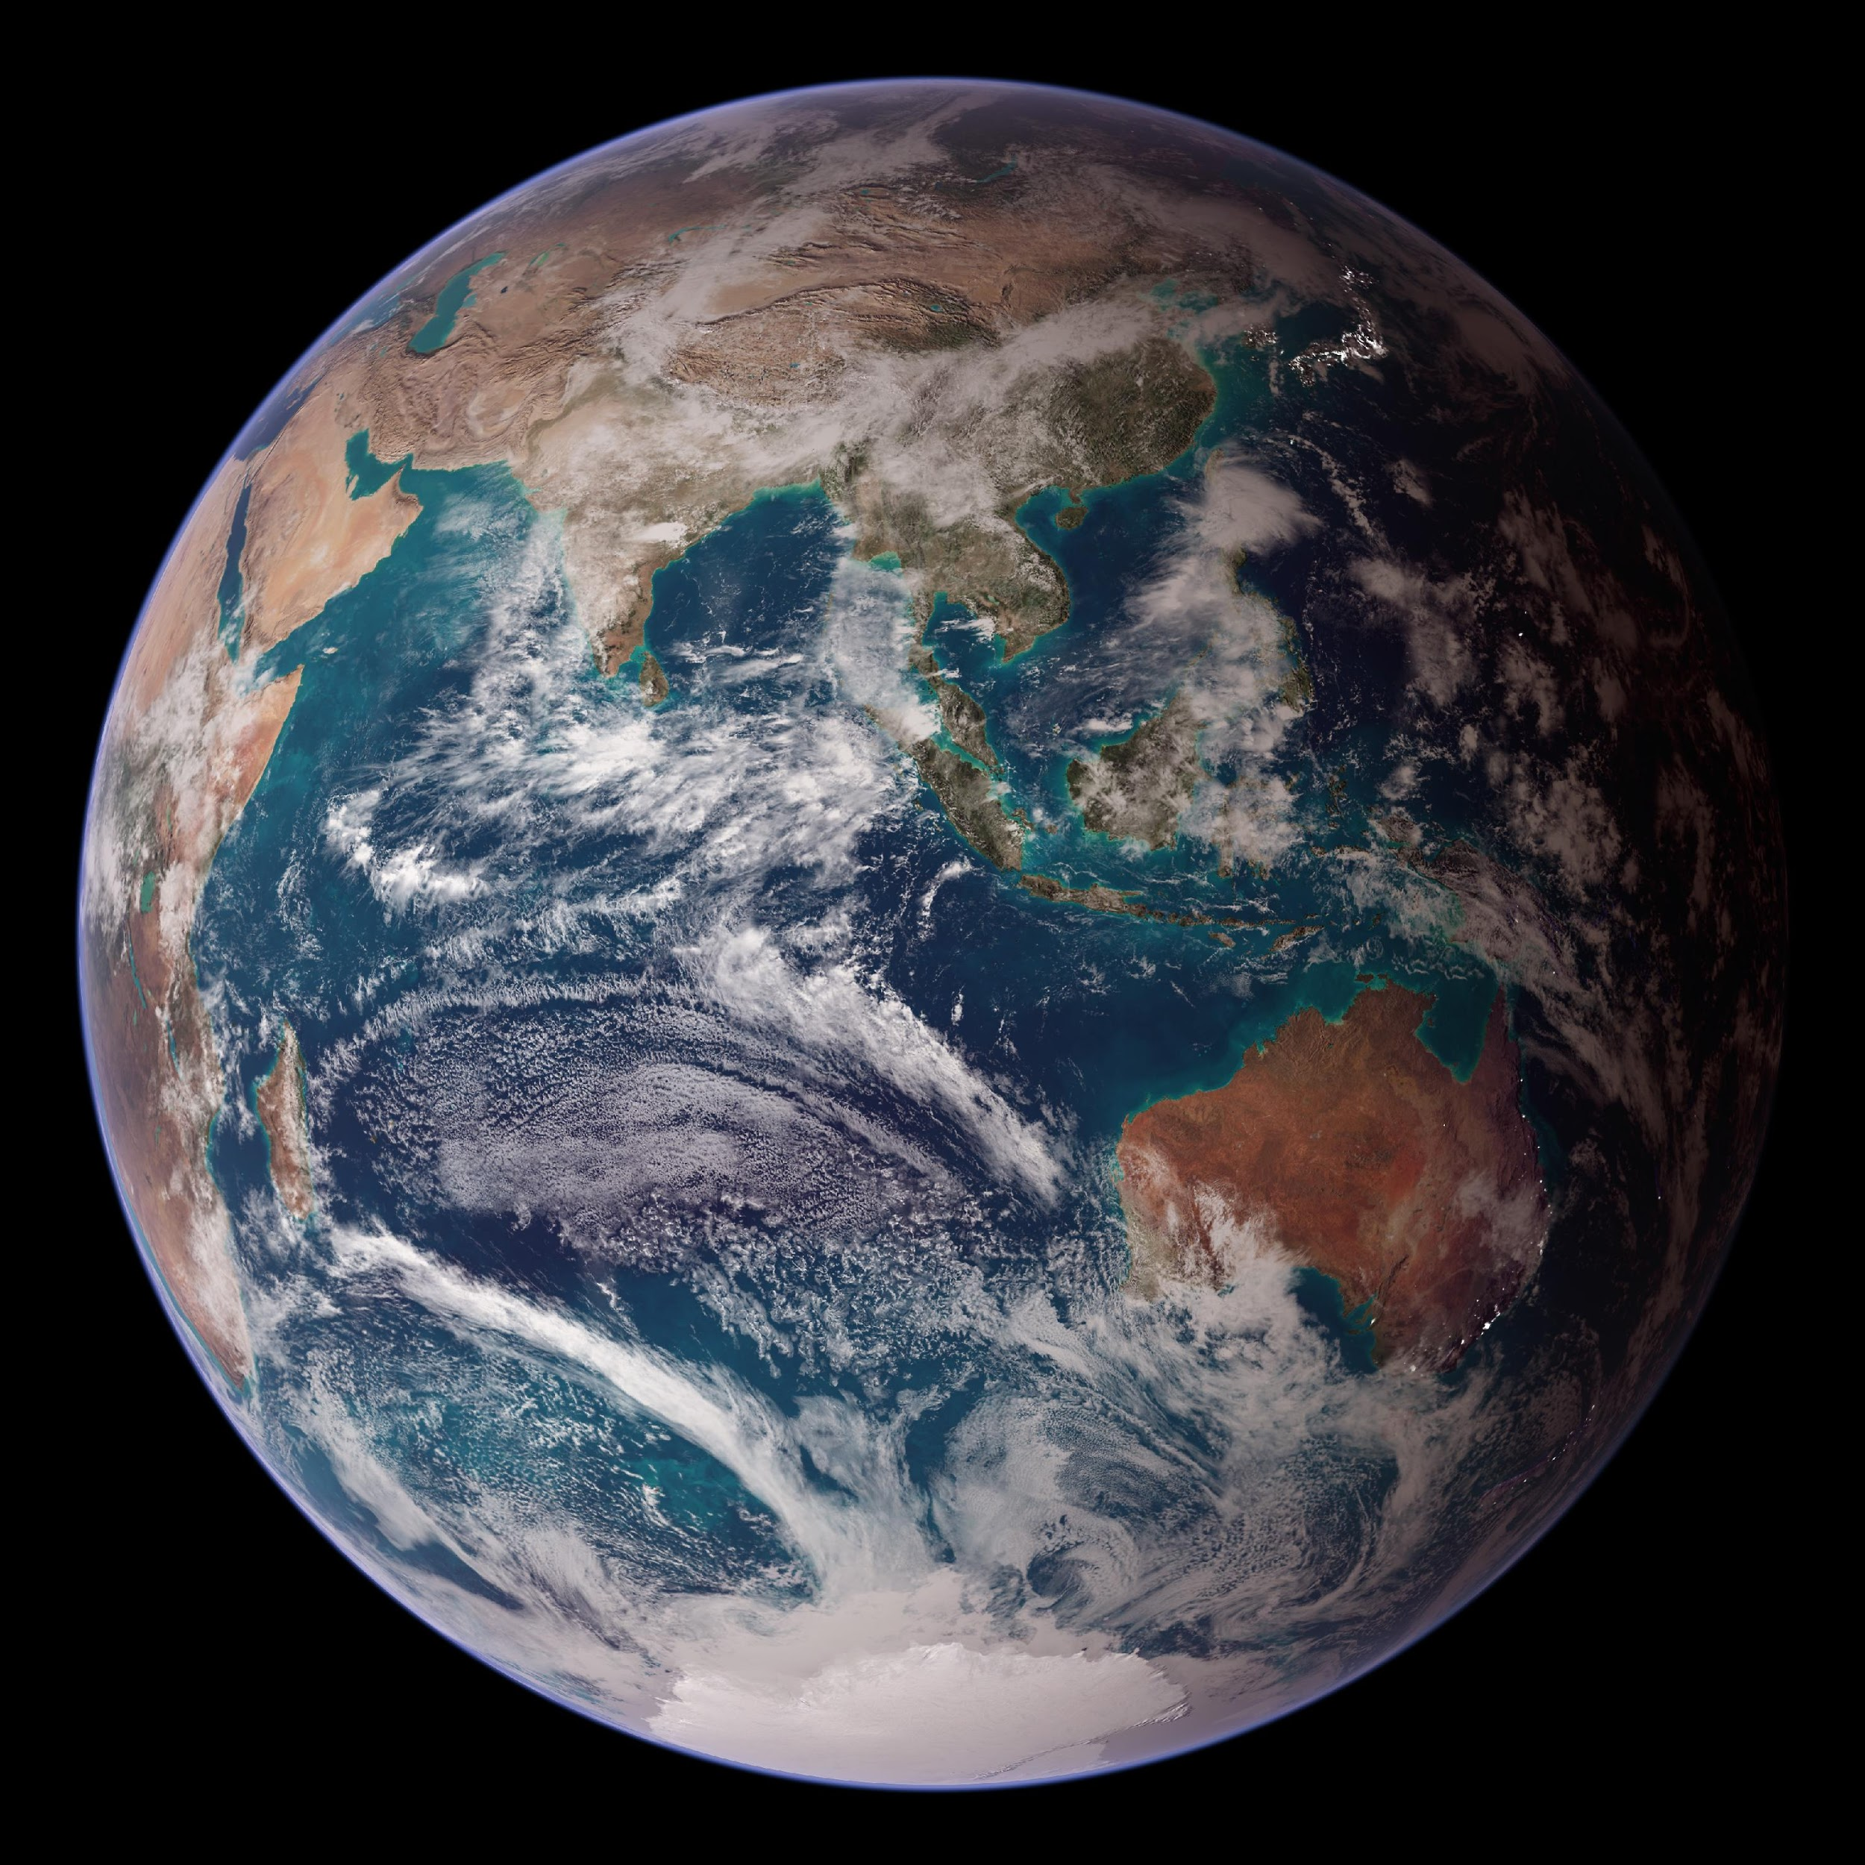
Photo: NASA/Goddard Space Flight Center/Reto/Stöckli

Slide 8
Sustainable Development
Improving our quality of life without damaging the quality of life of future generations

Slide 9
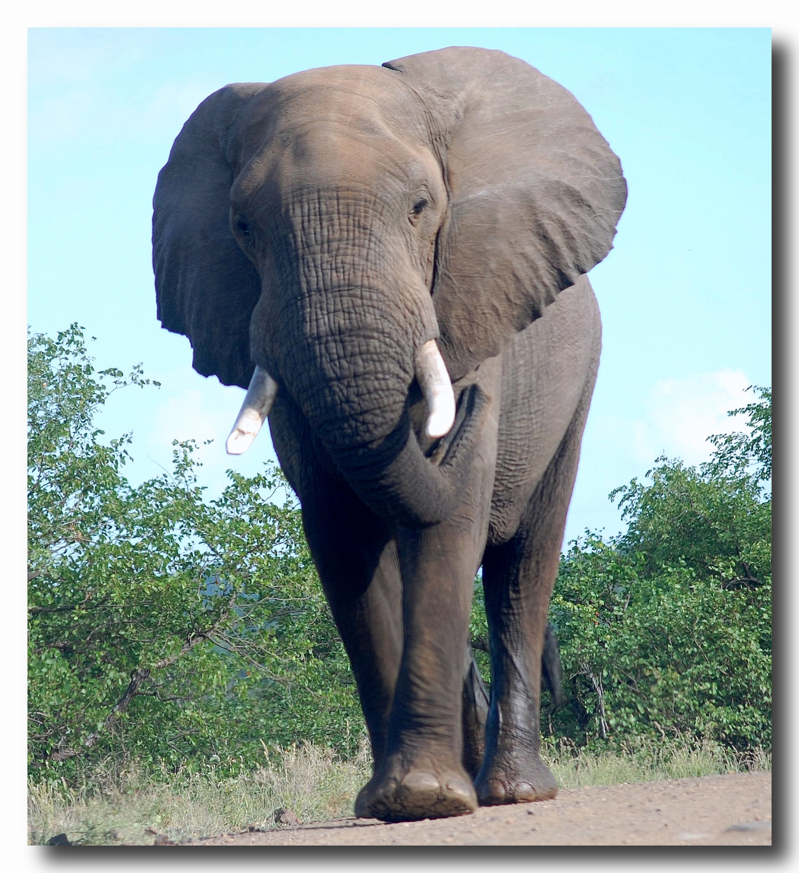
Every day about 60,000 tonnes of rubbish are thrown away in Spain =
Photo: André van Rooyen
the weight of 20,000 African elephants!

Slide 10
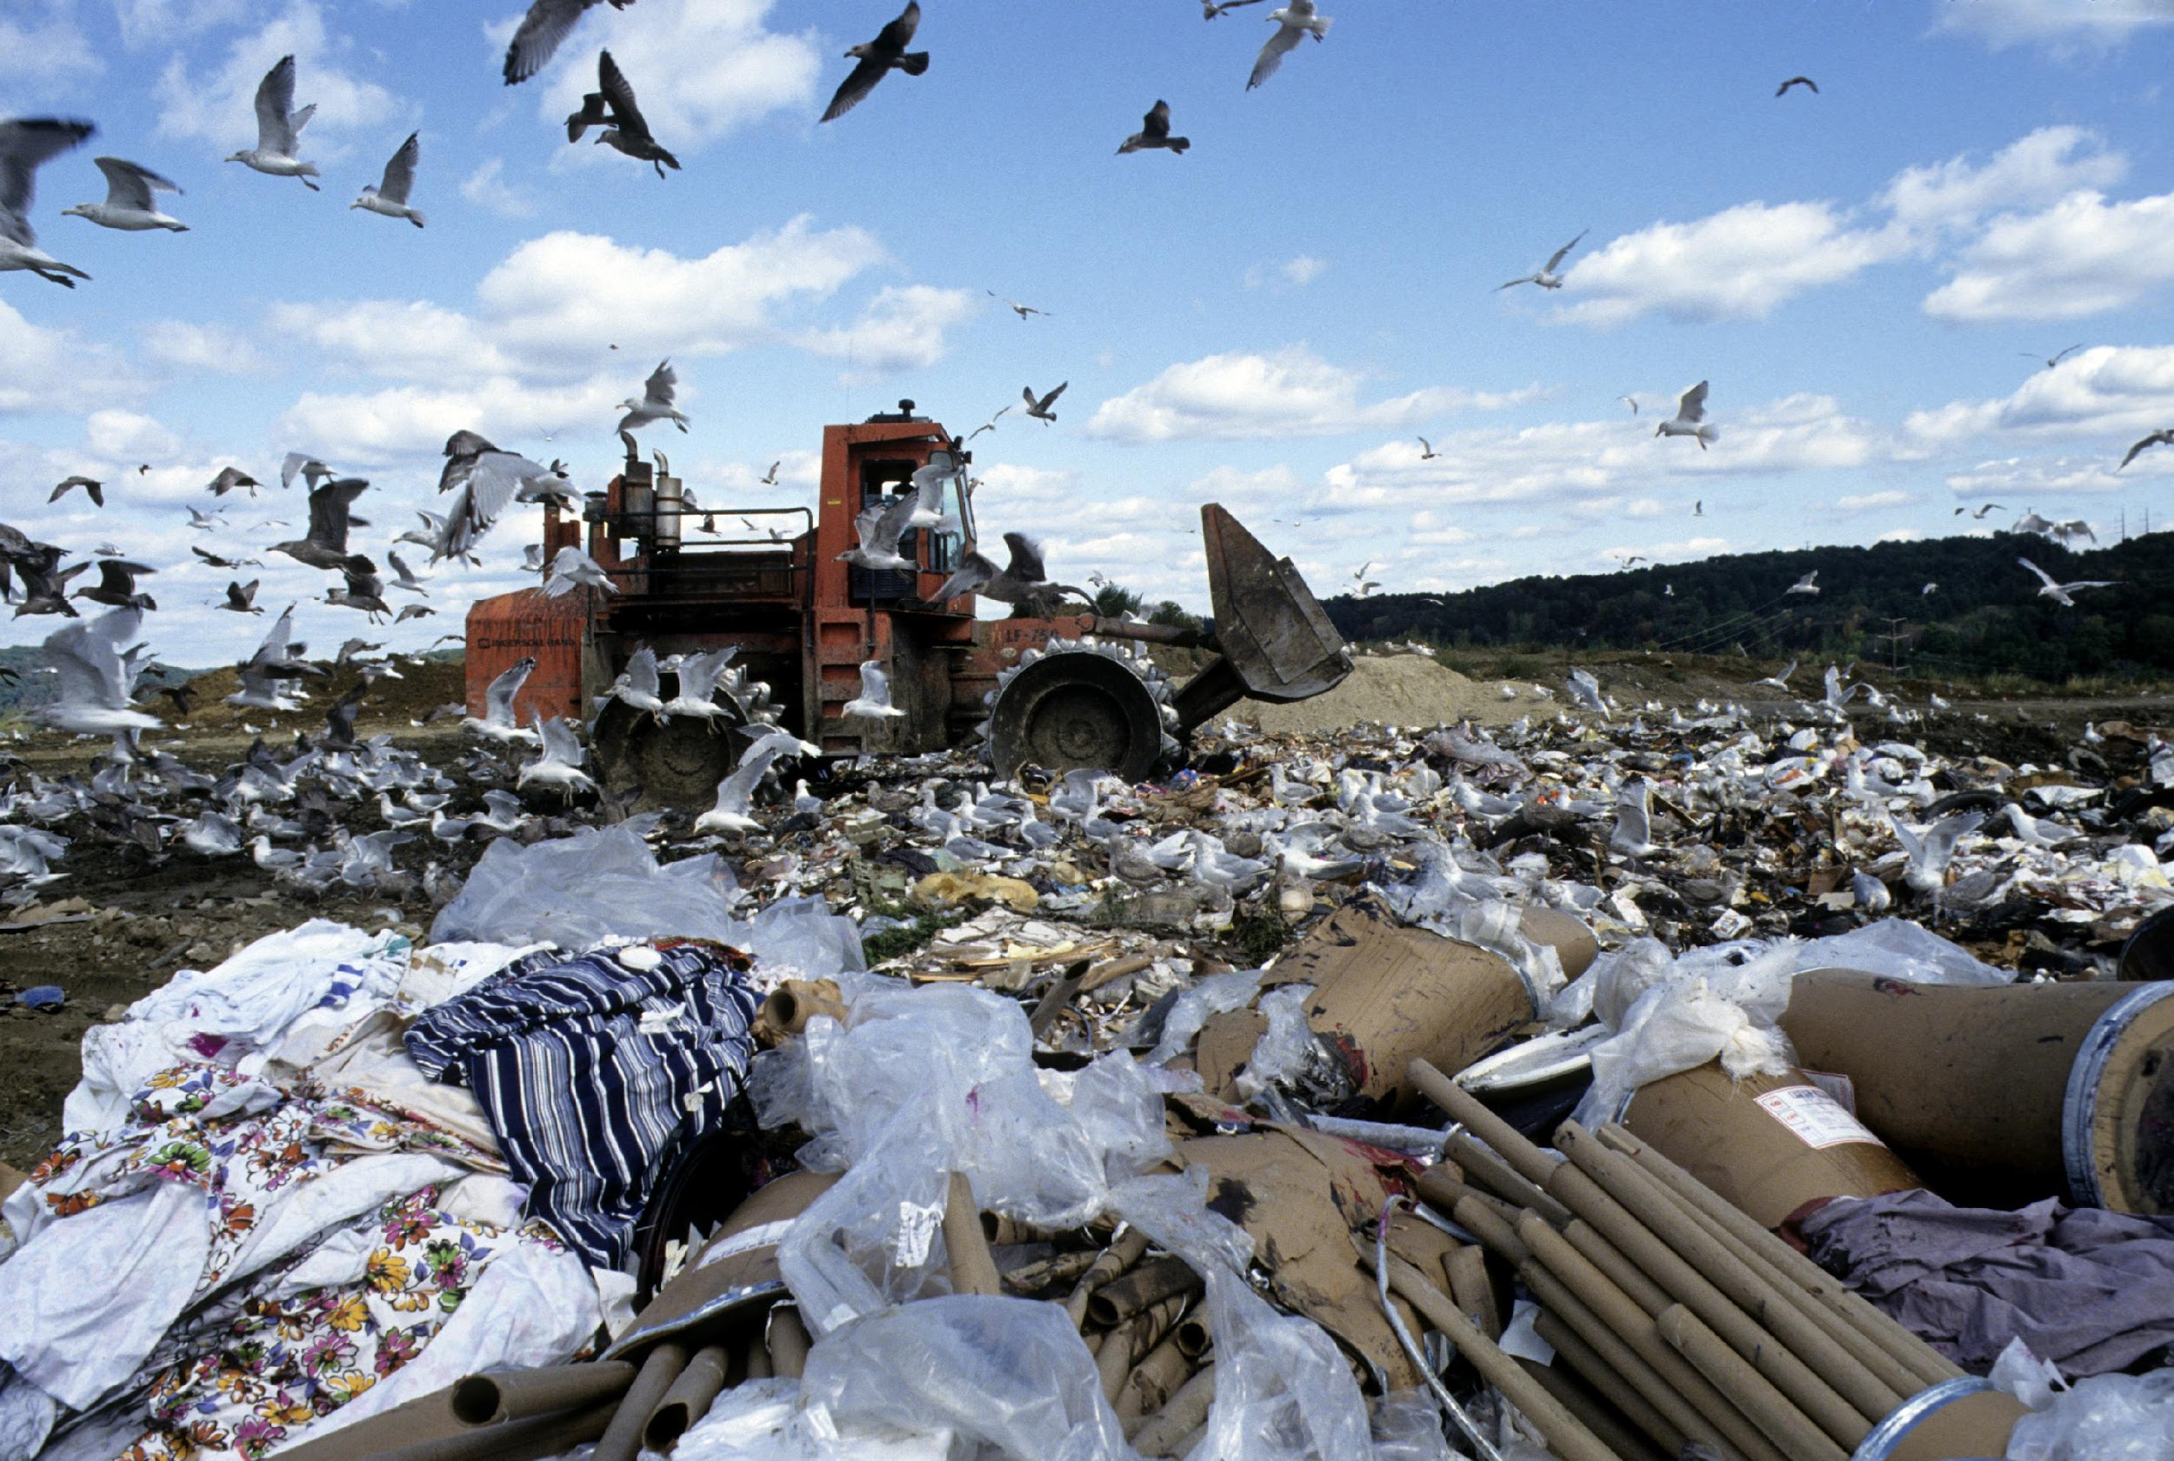
Photo: United Nations

Slide 11
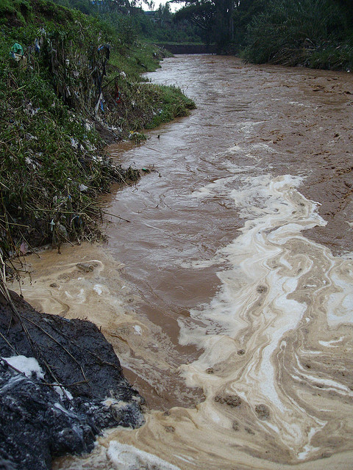
Water Pollution
Photo: Magnus Franklin

Slide 12
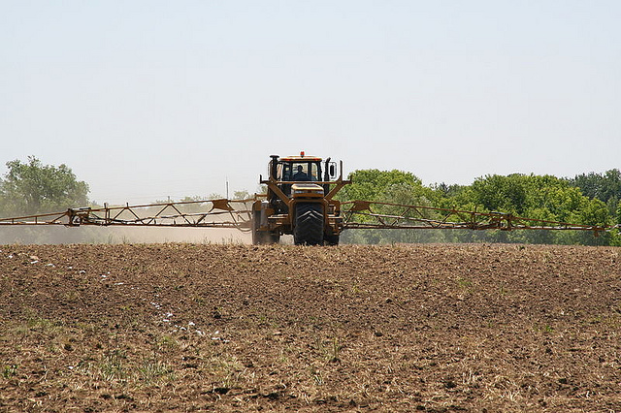
Photo: Eutrophication&hypoxia

Slide 13
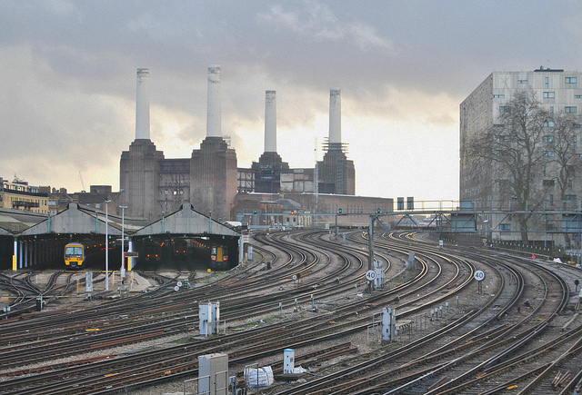
Battersea Power Station
Photo: Loco Steve

Slide 14
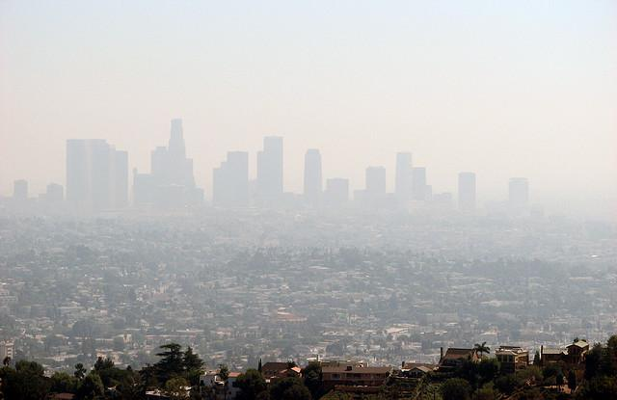
Smog over Los Angeles, California
Photo: Ben Amstutz

Slide 15
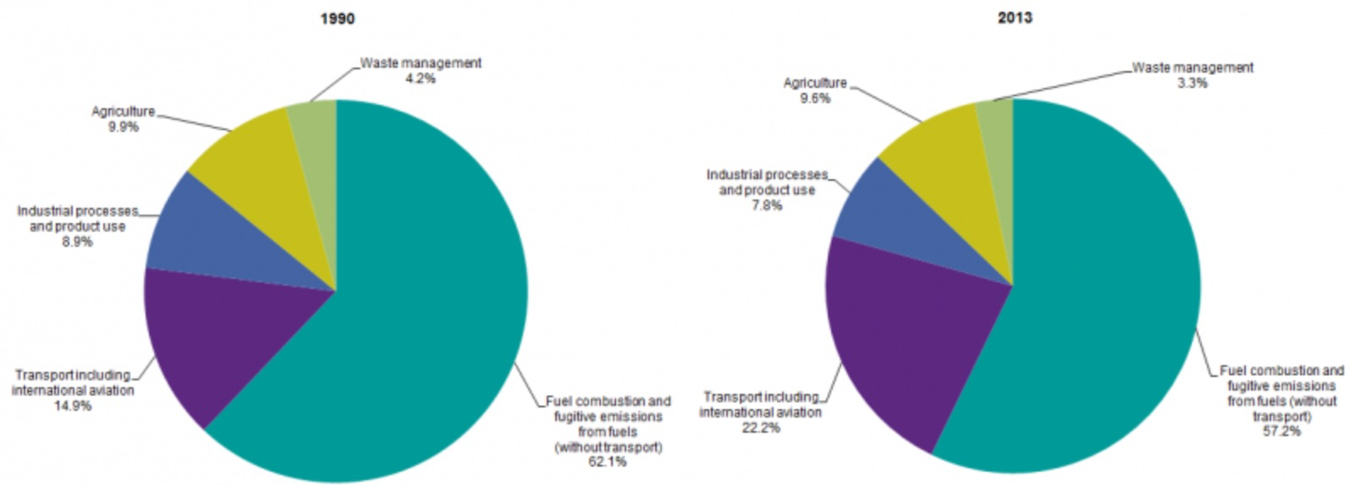
Greenhouse gas emissions
Eu-28
From: http://ec.europa.eu/eurostat/statistics-explained/index.php/File:Greenhouse_gas_emissions,_analysis_by_source_sector,_EU-28,_1990_and_2013_(percentage_of_total)_new.png

Slide 16
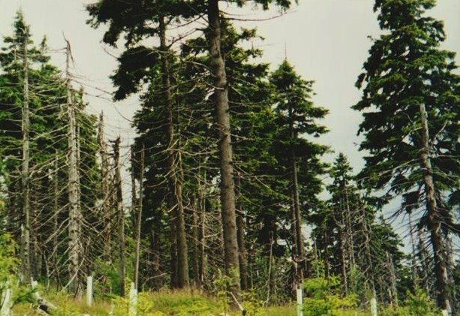
A dead forest, Czech Republic
Photo: Ramon Boersboek

Slide 17
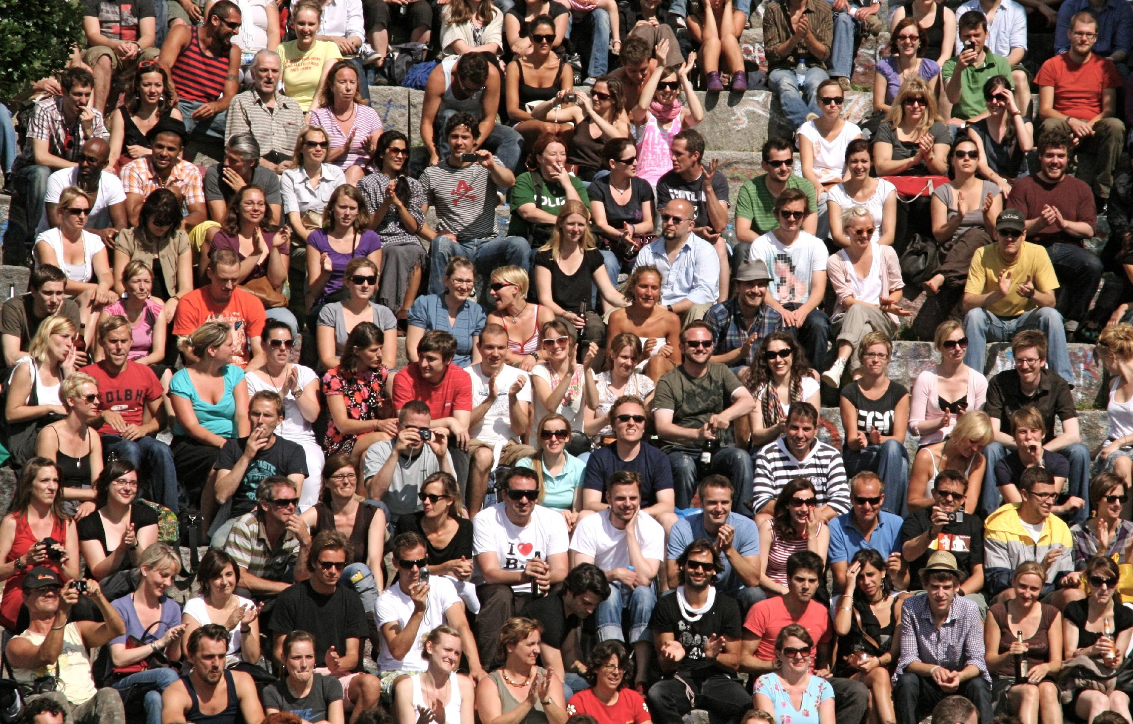
Population Growth
What is the current world population?
7.2 billion
What was the world’s
population in 1950?
2.5 billion
Photo: Espen Sundve

Slide 18
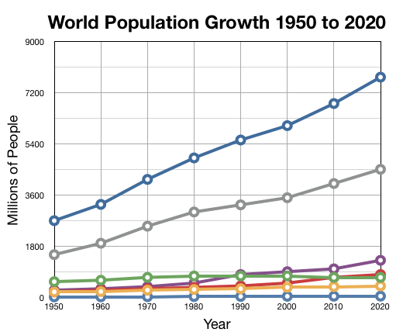
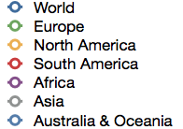

Slide 19

Resources
Since 1950 the richest 1/5 of the population has doubled its consumption of energy, meat, timber, steel and copper per person.
Photo:rubyblossom

Slide 20
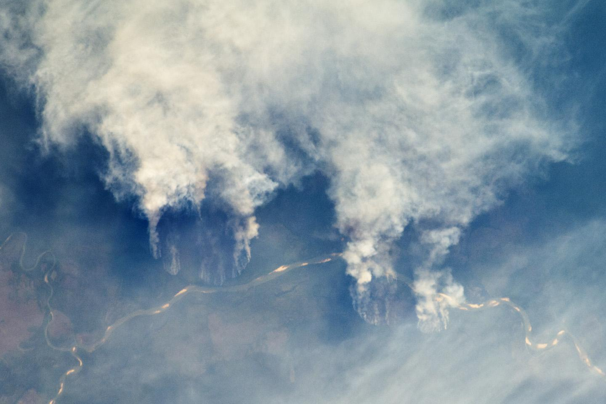
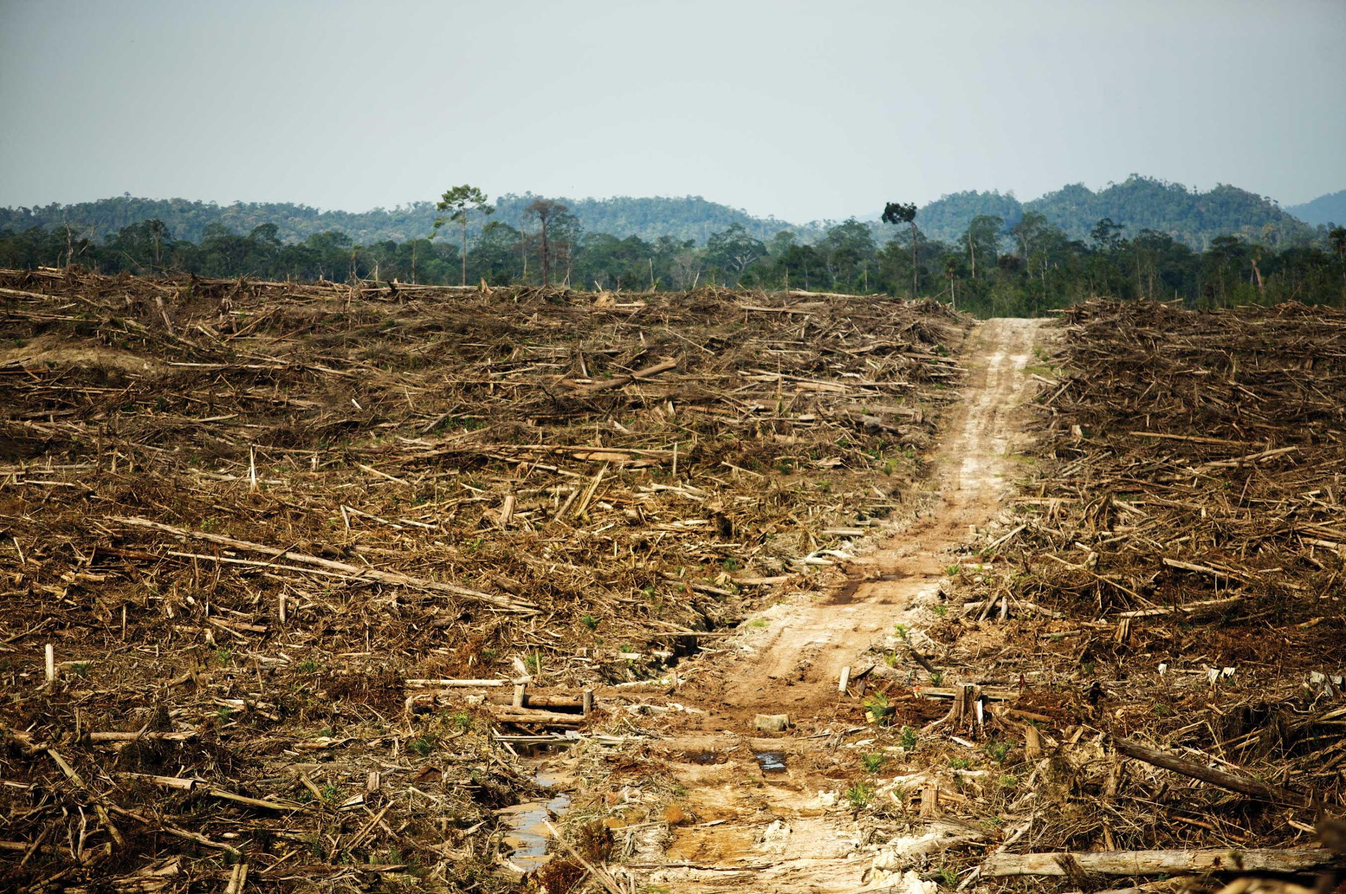
Photo: NASA’s Earth Observatory
Deforestation:
The clearing of trees, transforming a forest into cleared land
Photo: Rainforest Action Network

Slide 21
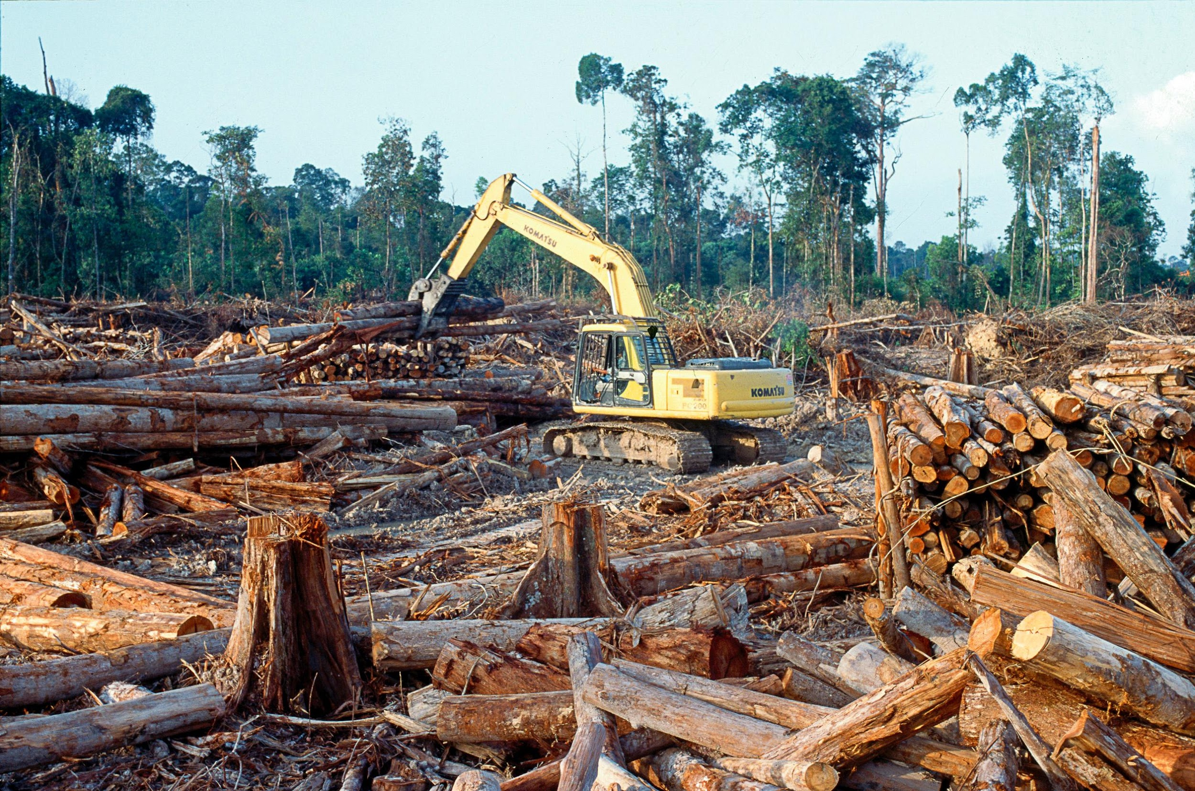
Photo: Rainforest Action Network

Slide 22
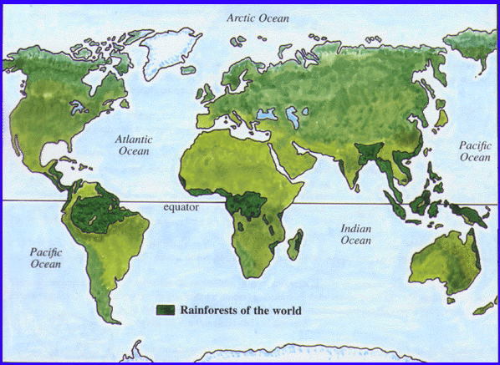
Photo: art-of-vee.com

Slide 23
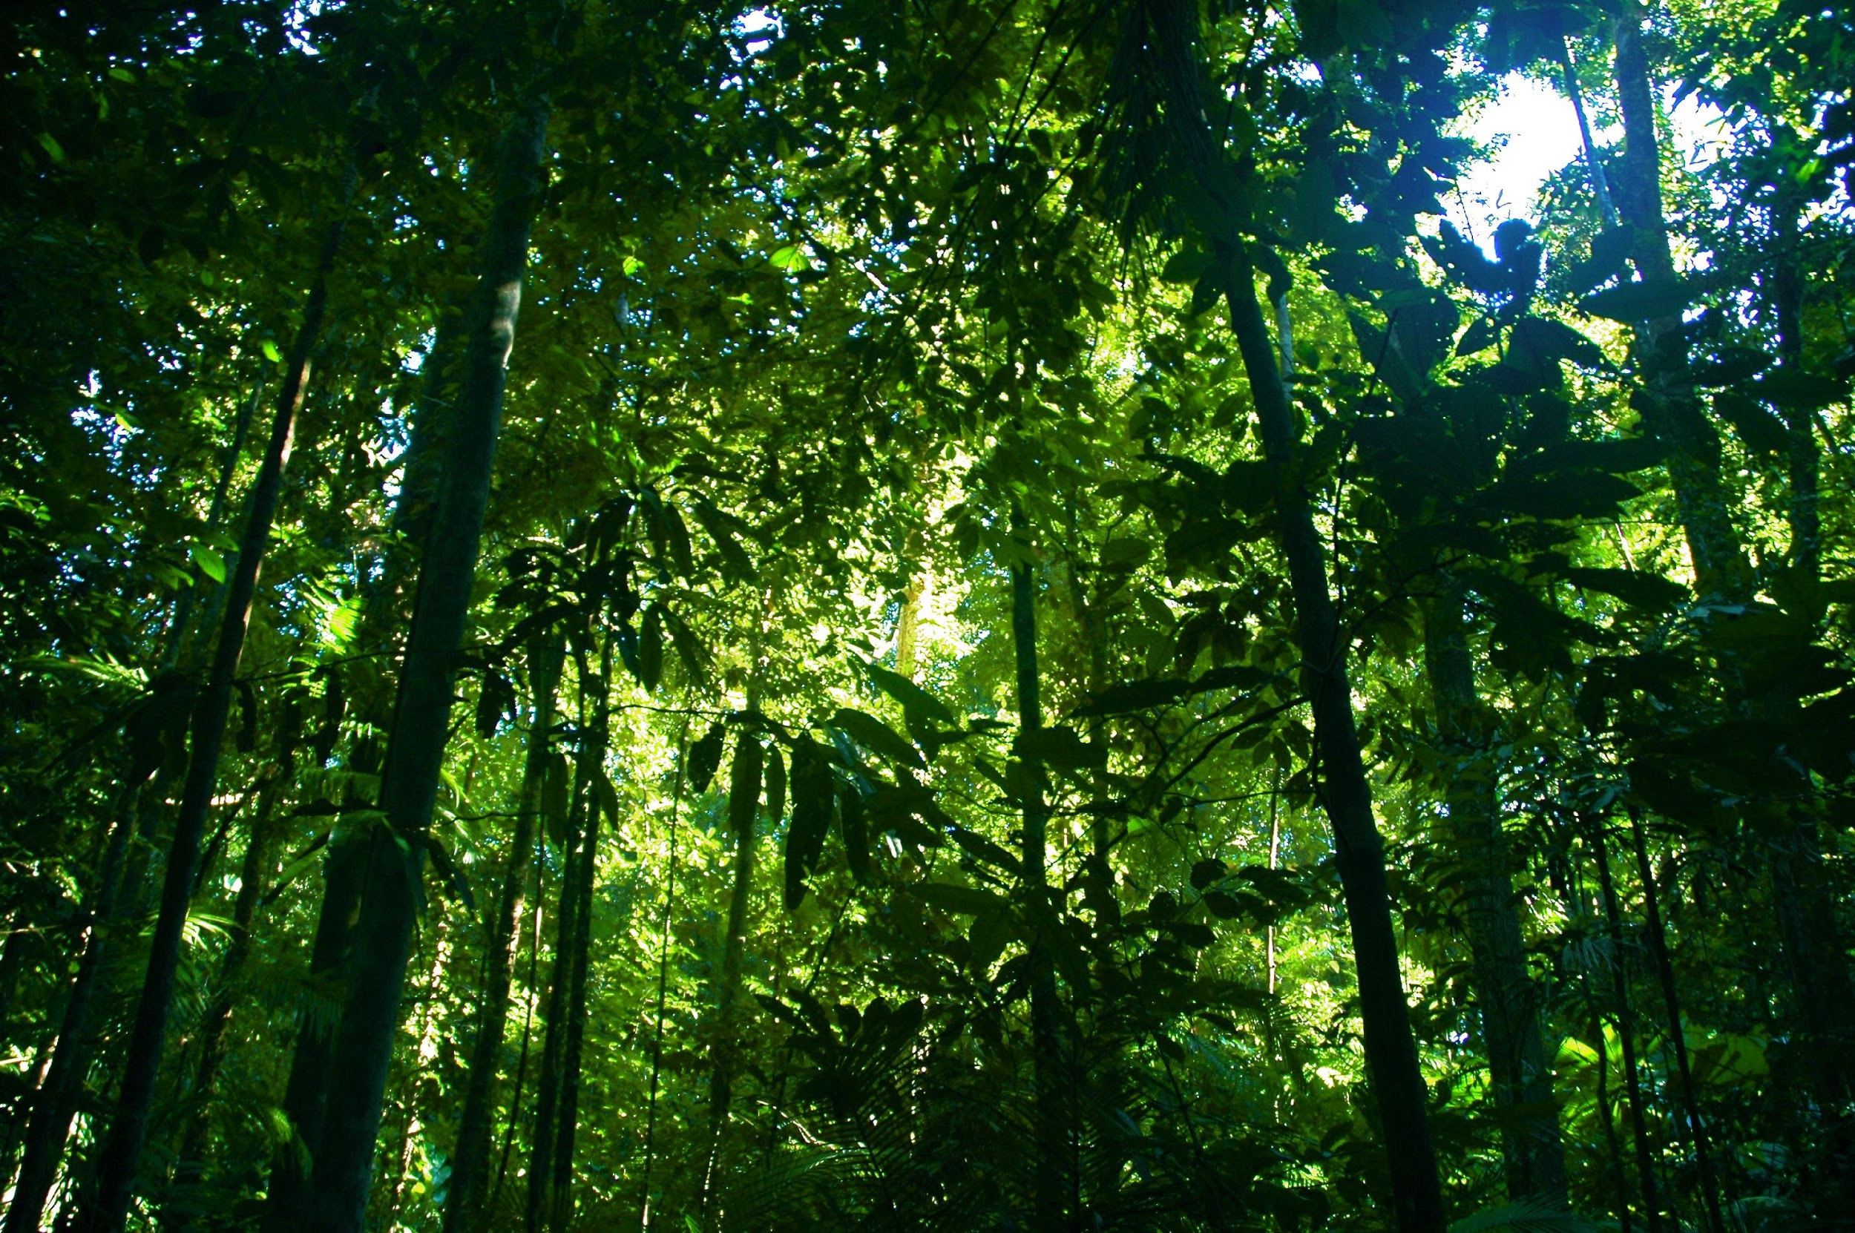
Photo: Ben Britten
Over half the world’s plant and animal species live in rainforests.

Slide 24

¼ of medicines’ ingredients were first found in rainforest plants.
Photo: NVinacco

Slide 25
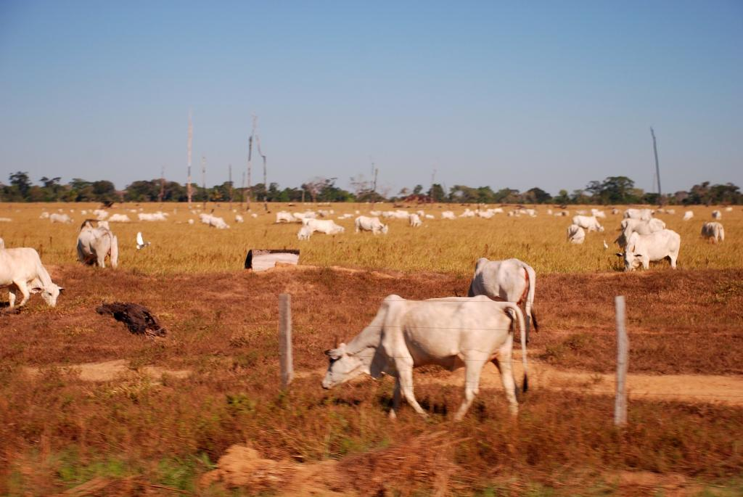
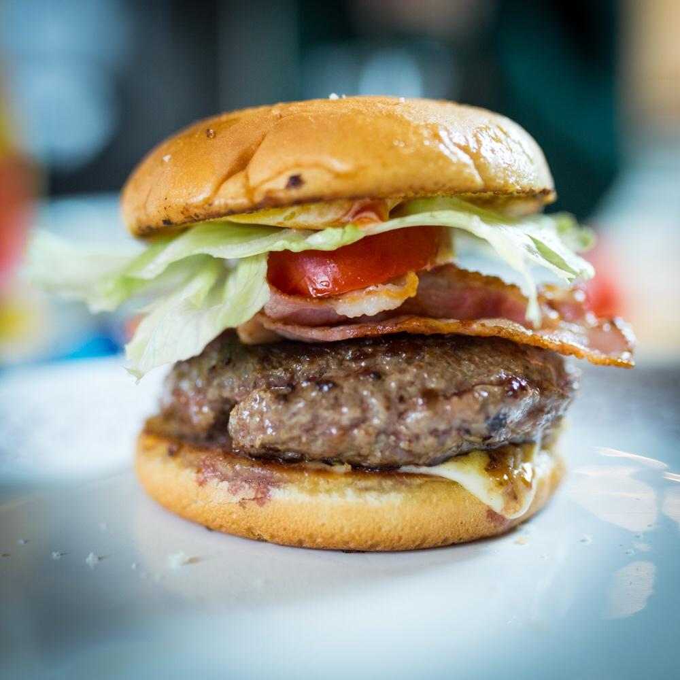
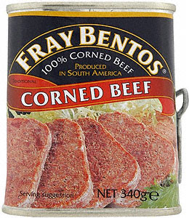

Brazil
Photo: Joelle Hernandez
70% of the deforested area is cattle pasture.
Photo: Michael J Moeller
Photo: Paul Townsend
Photo: Nick Saltmarsh

Slide 26
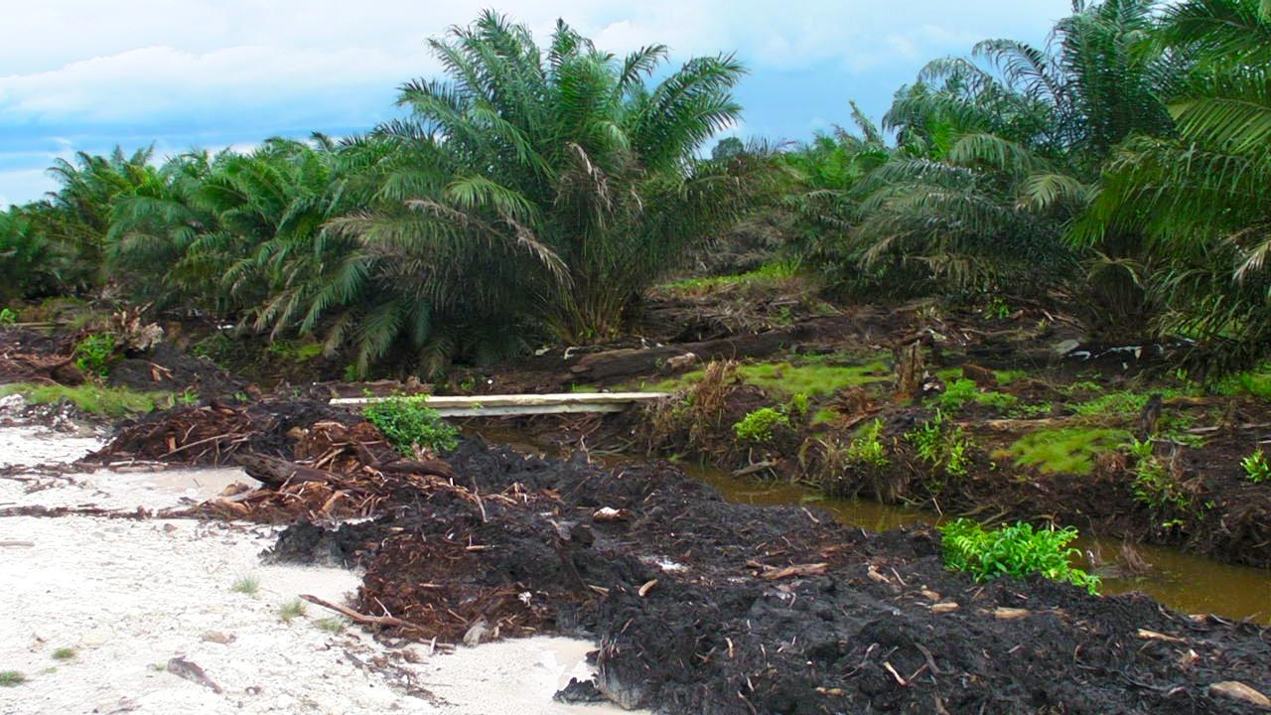
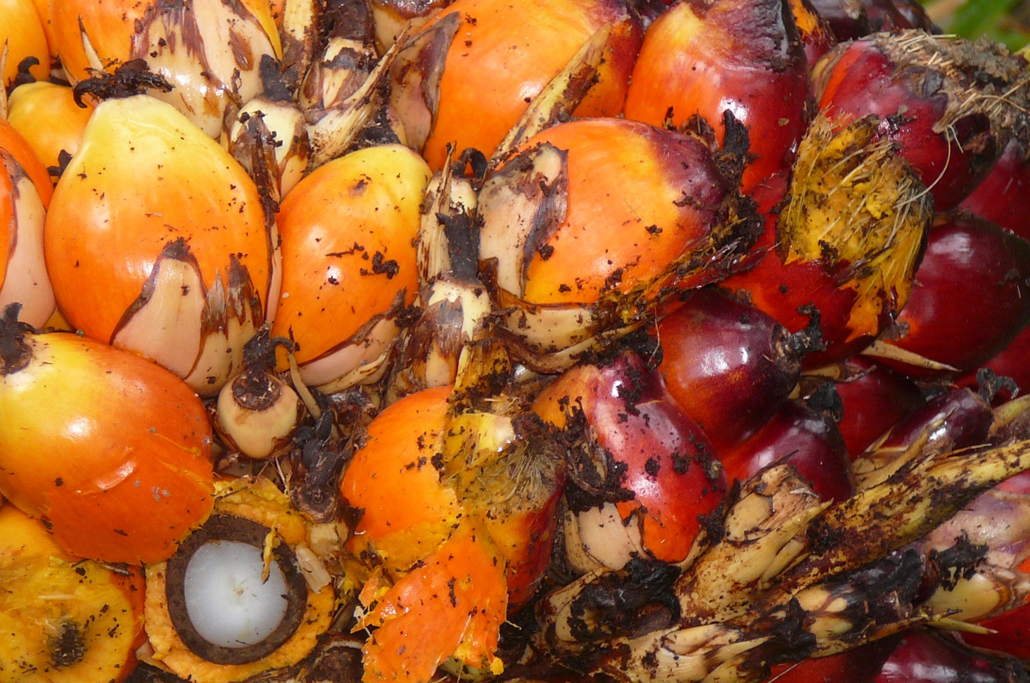
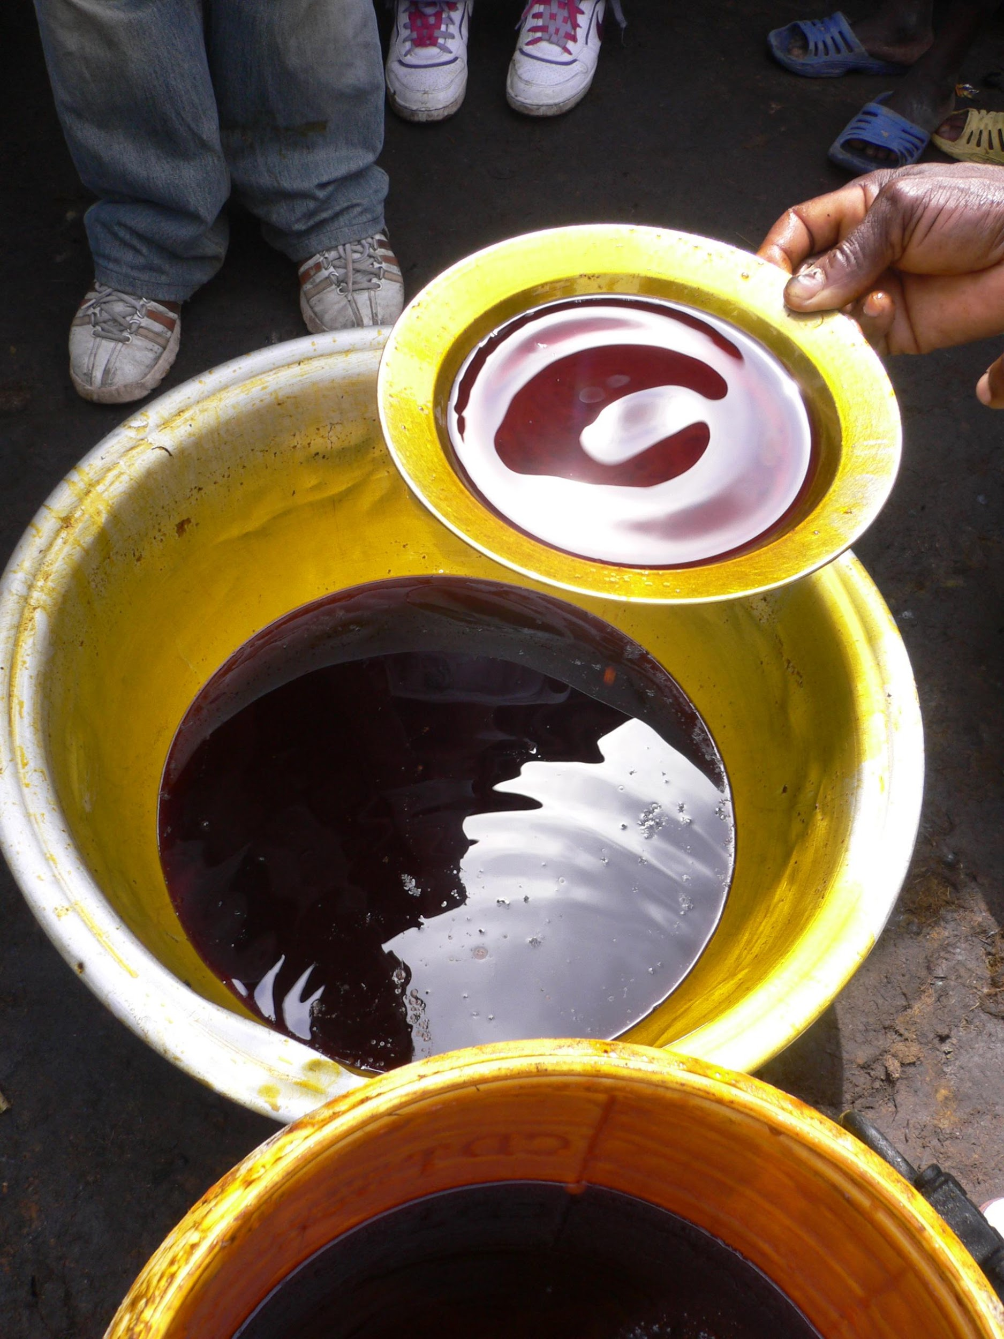
Palm Oil Plantation
Photo: R.A.N.
Photo: oneVillage Initiative
Photo: Rainforest Action Network

Slide 27

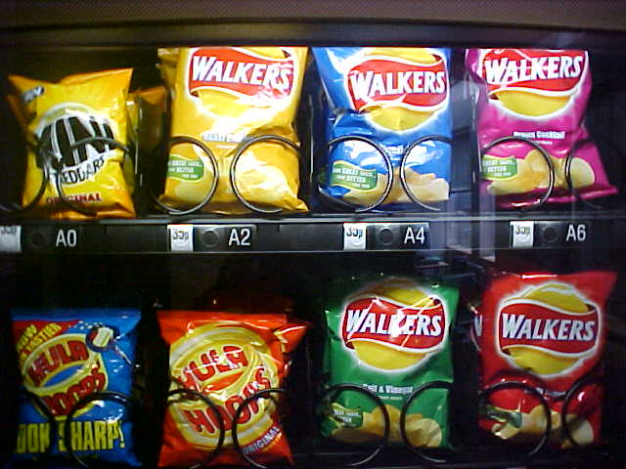

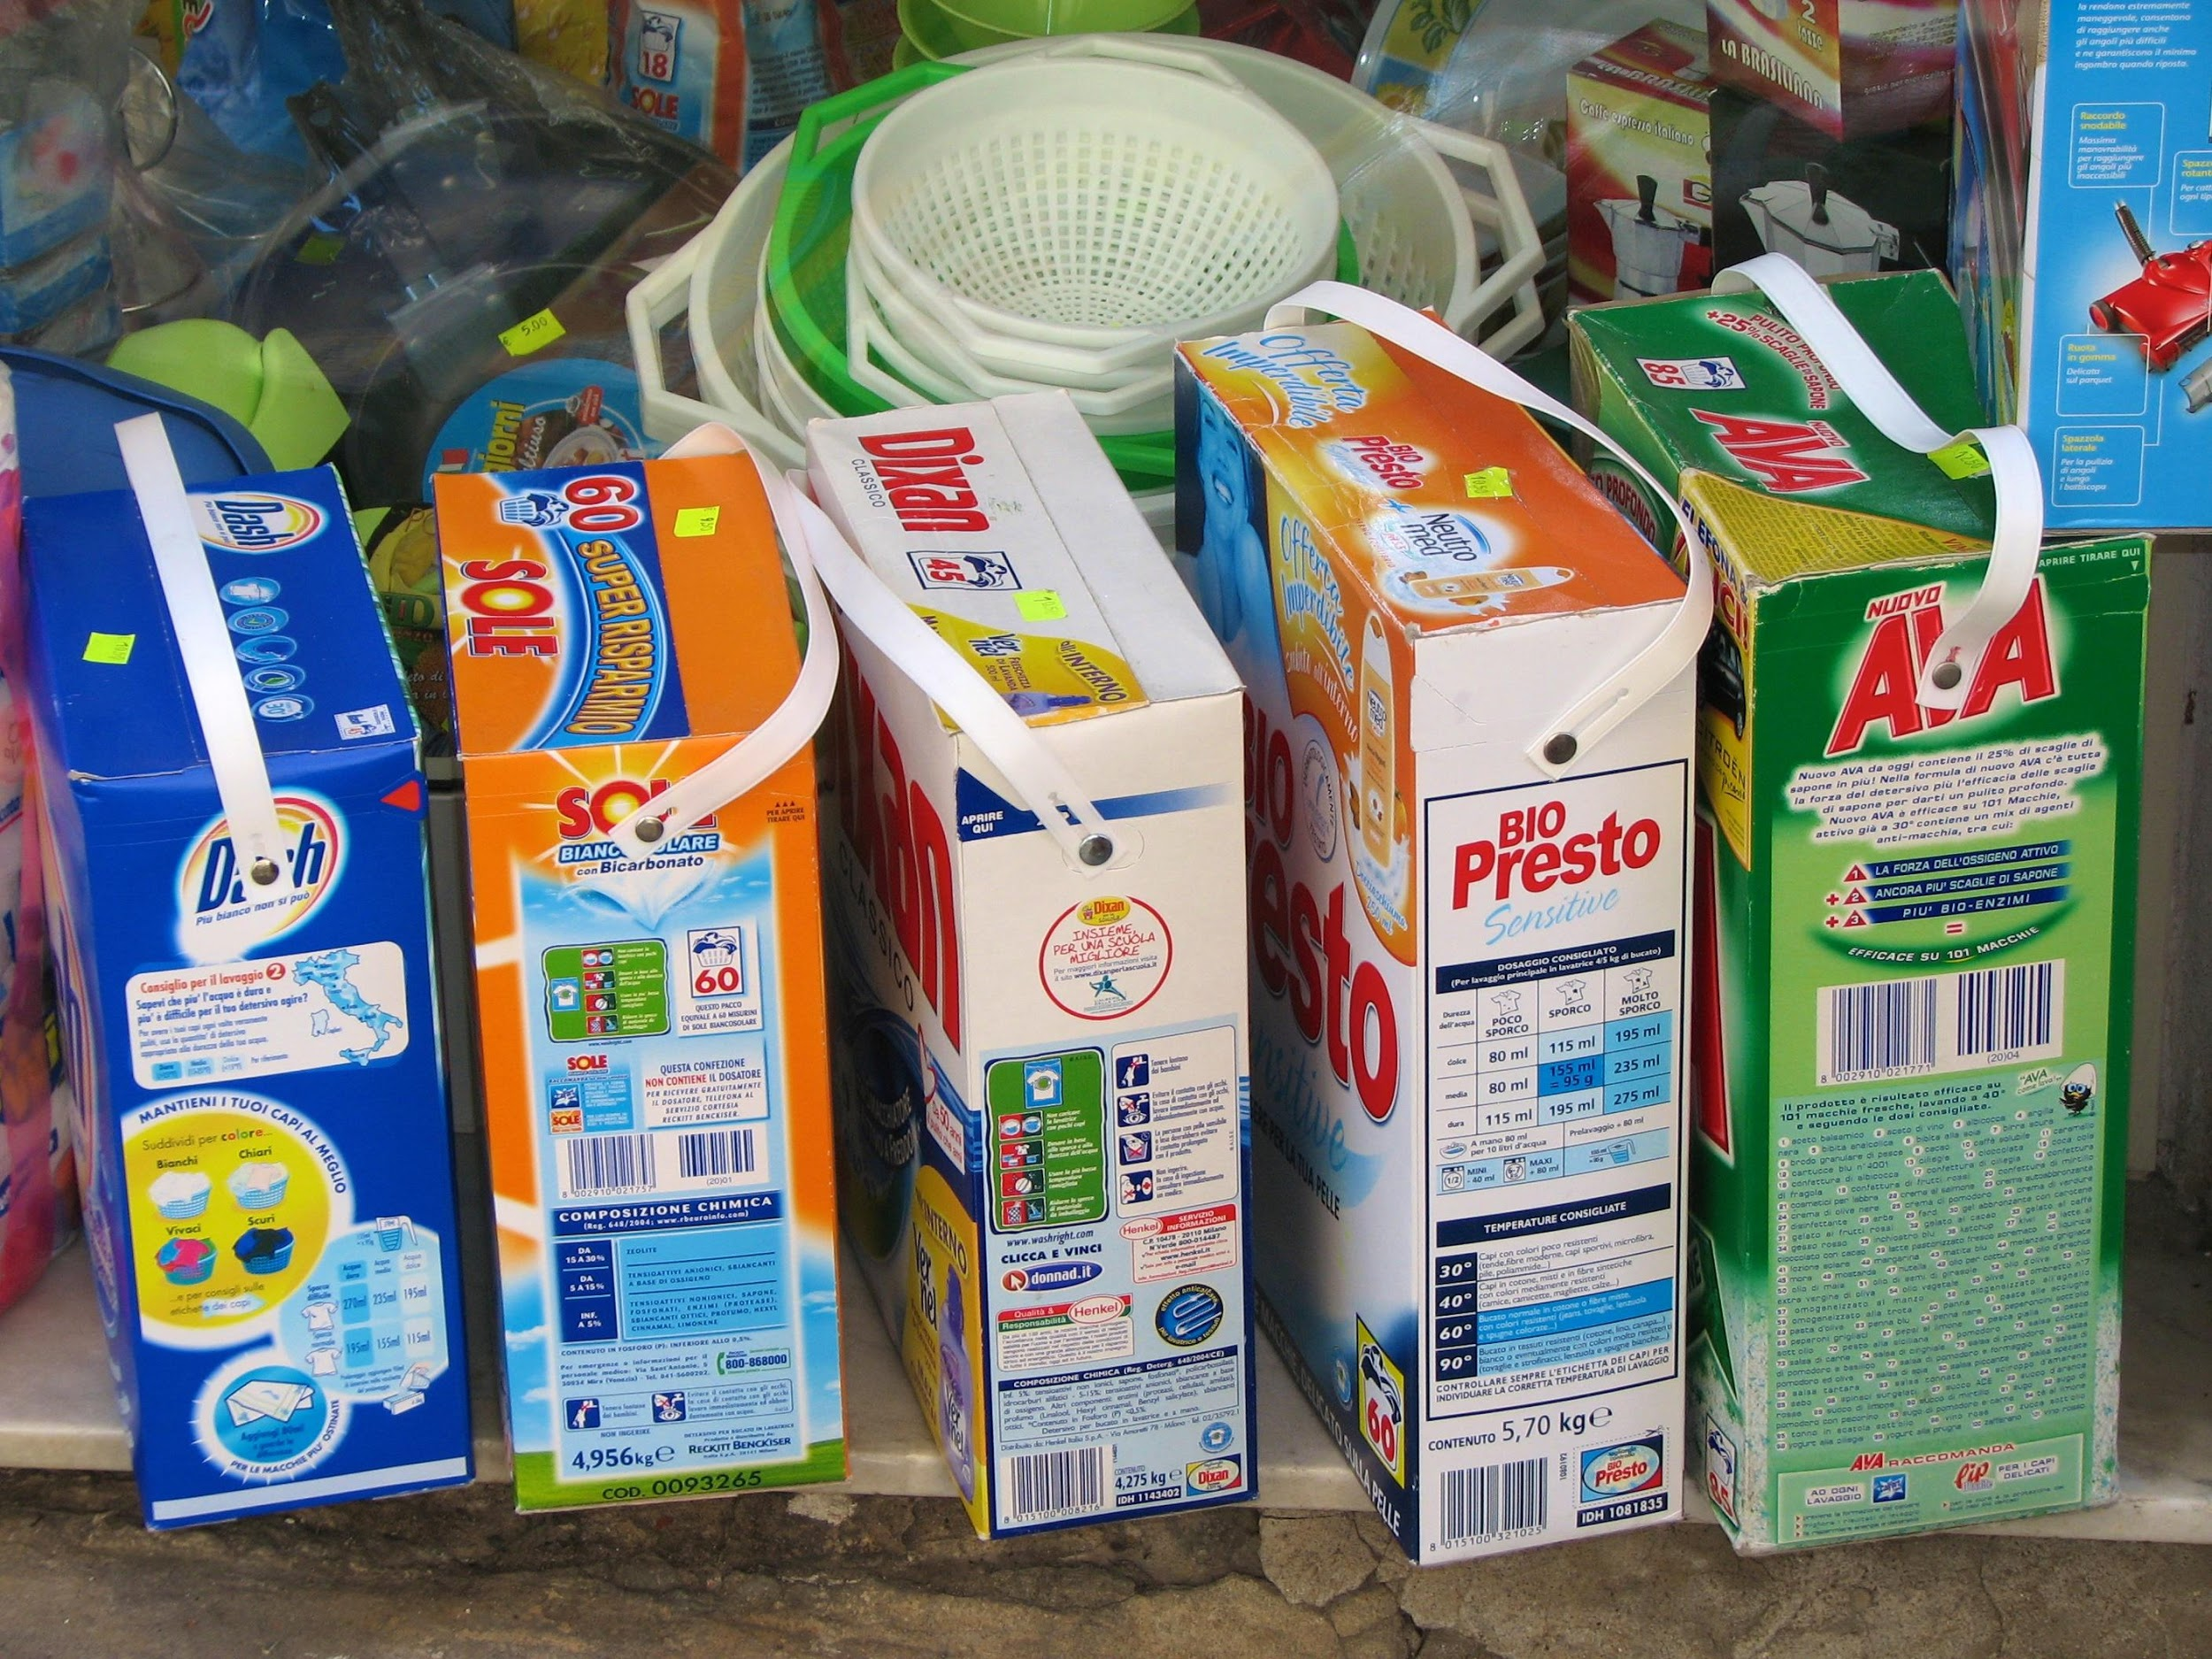
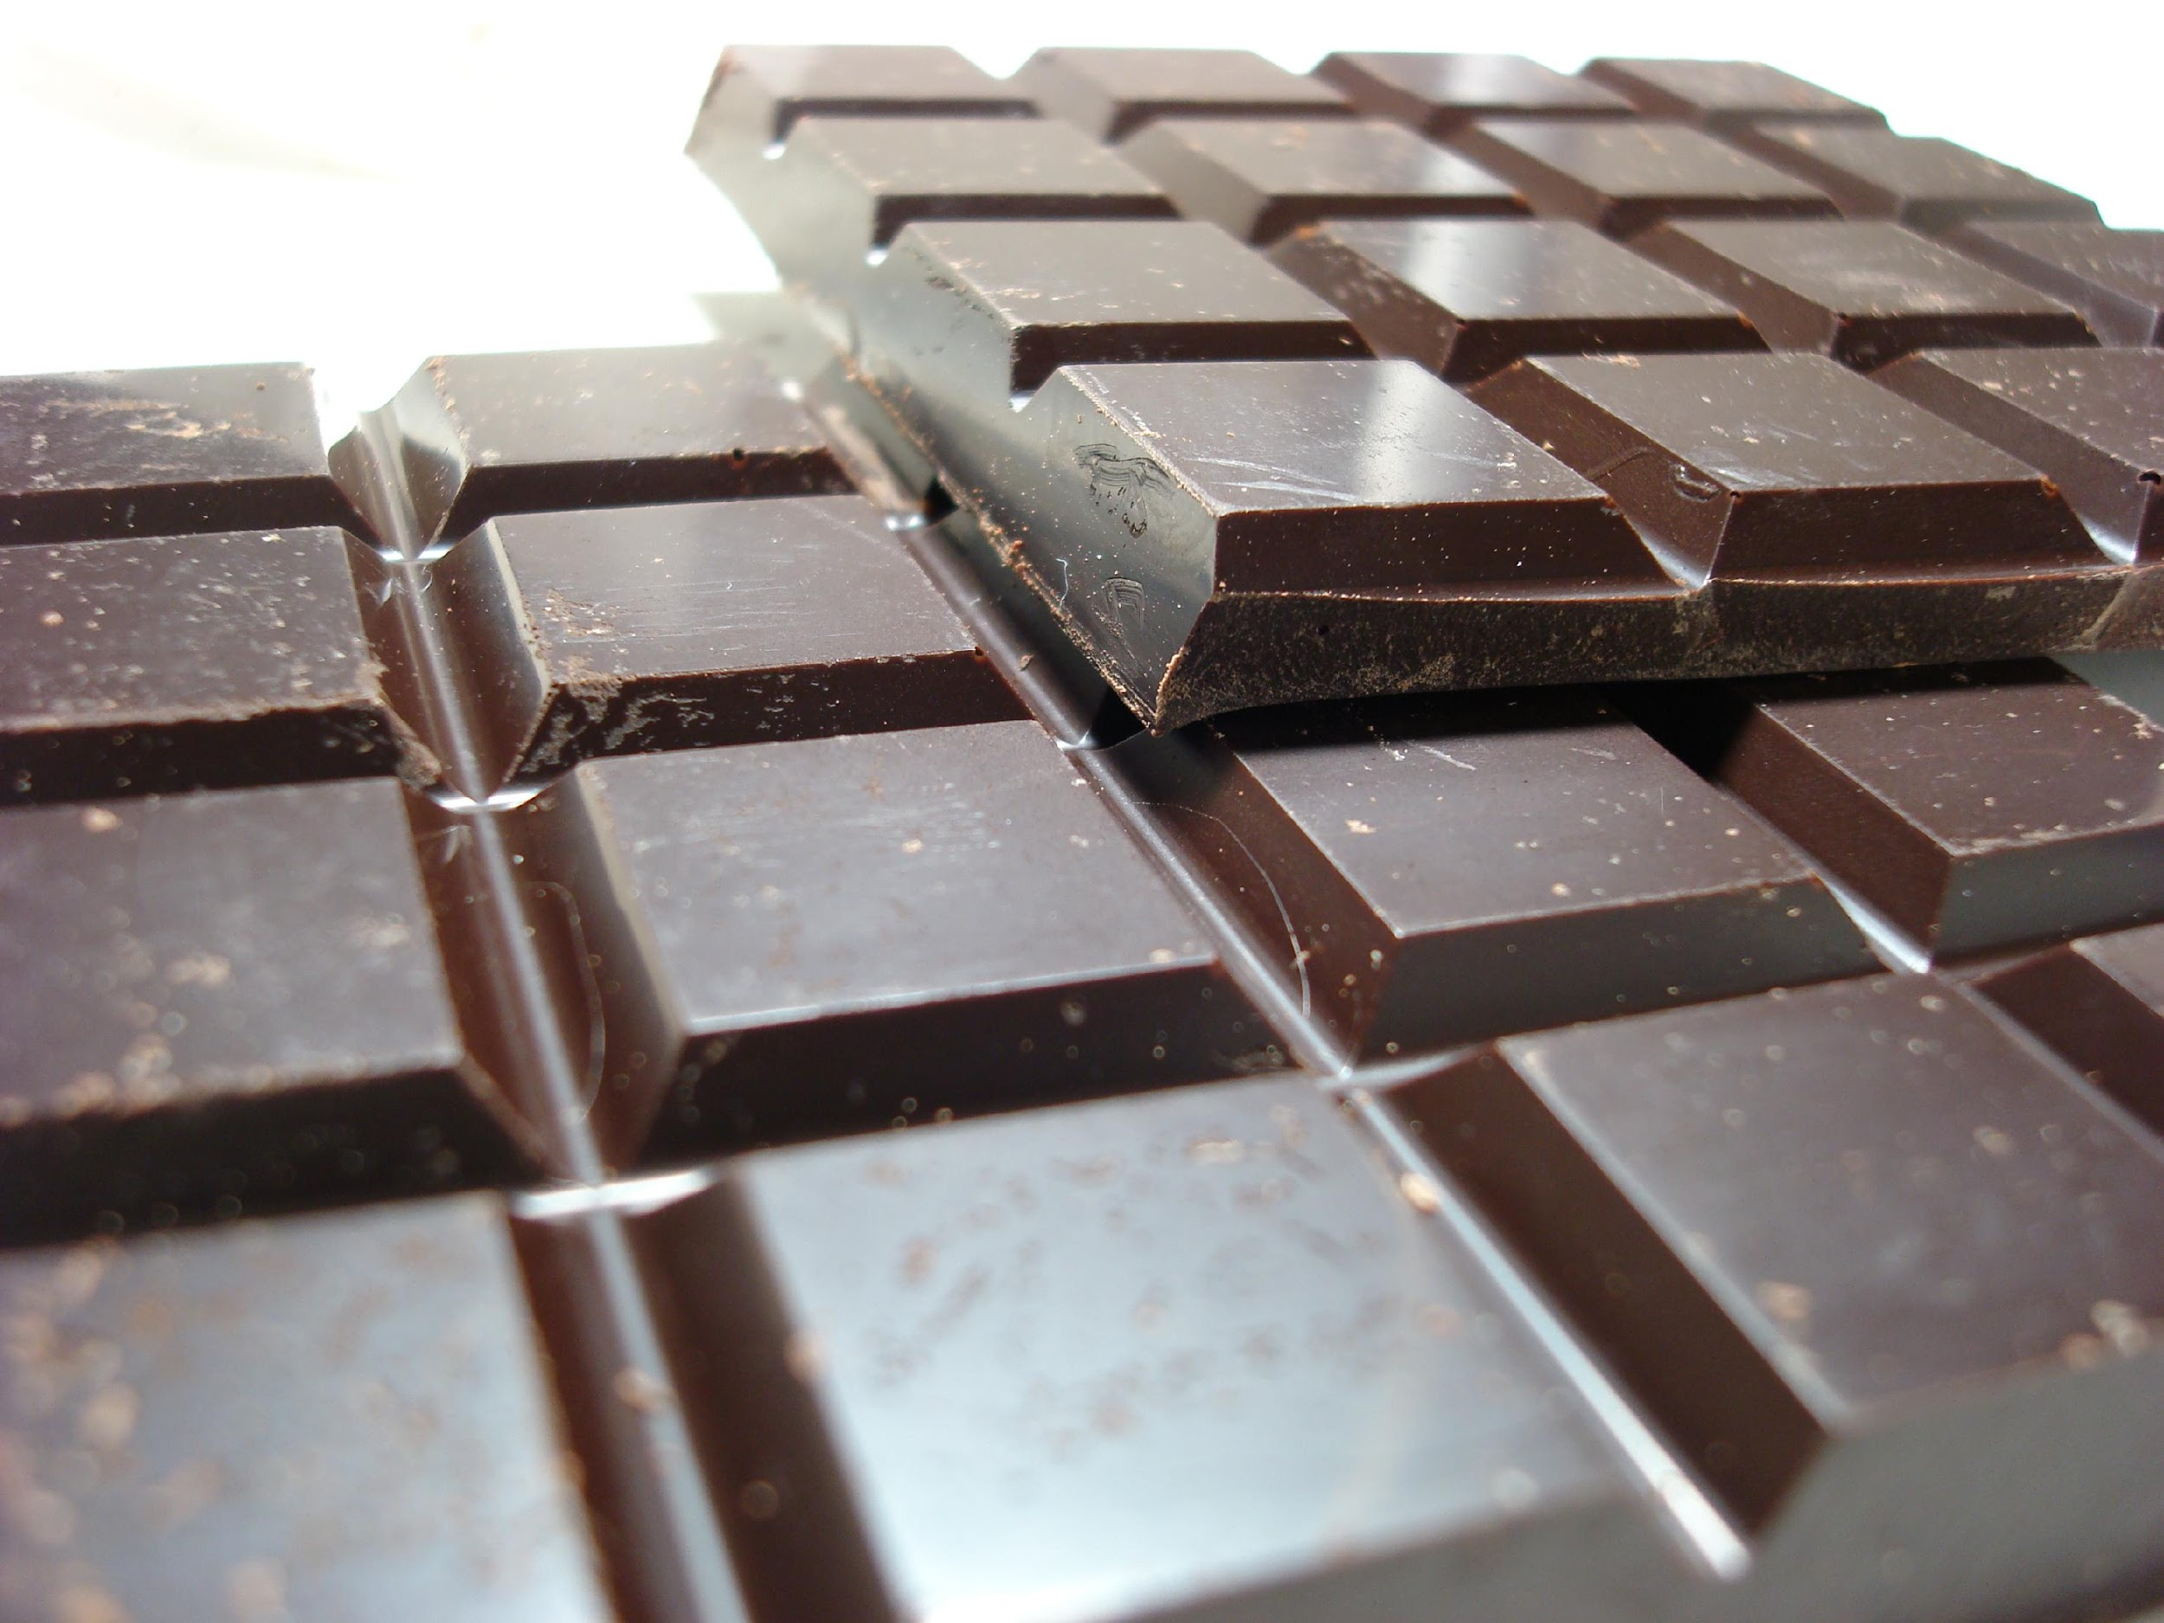
Photo: Dan Taylor
Photo: Roberto Verso
Photo:jo.schz
Photo: John Loo
Photo: Tim Sackton

Slide 28
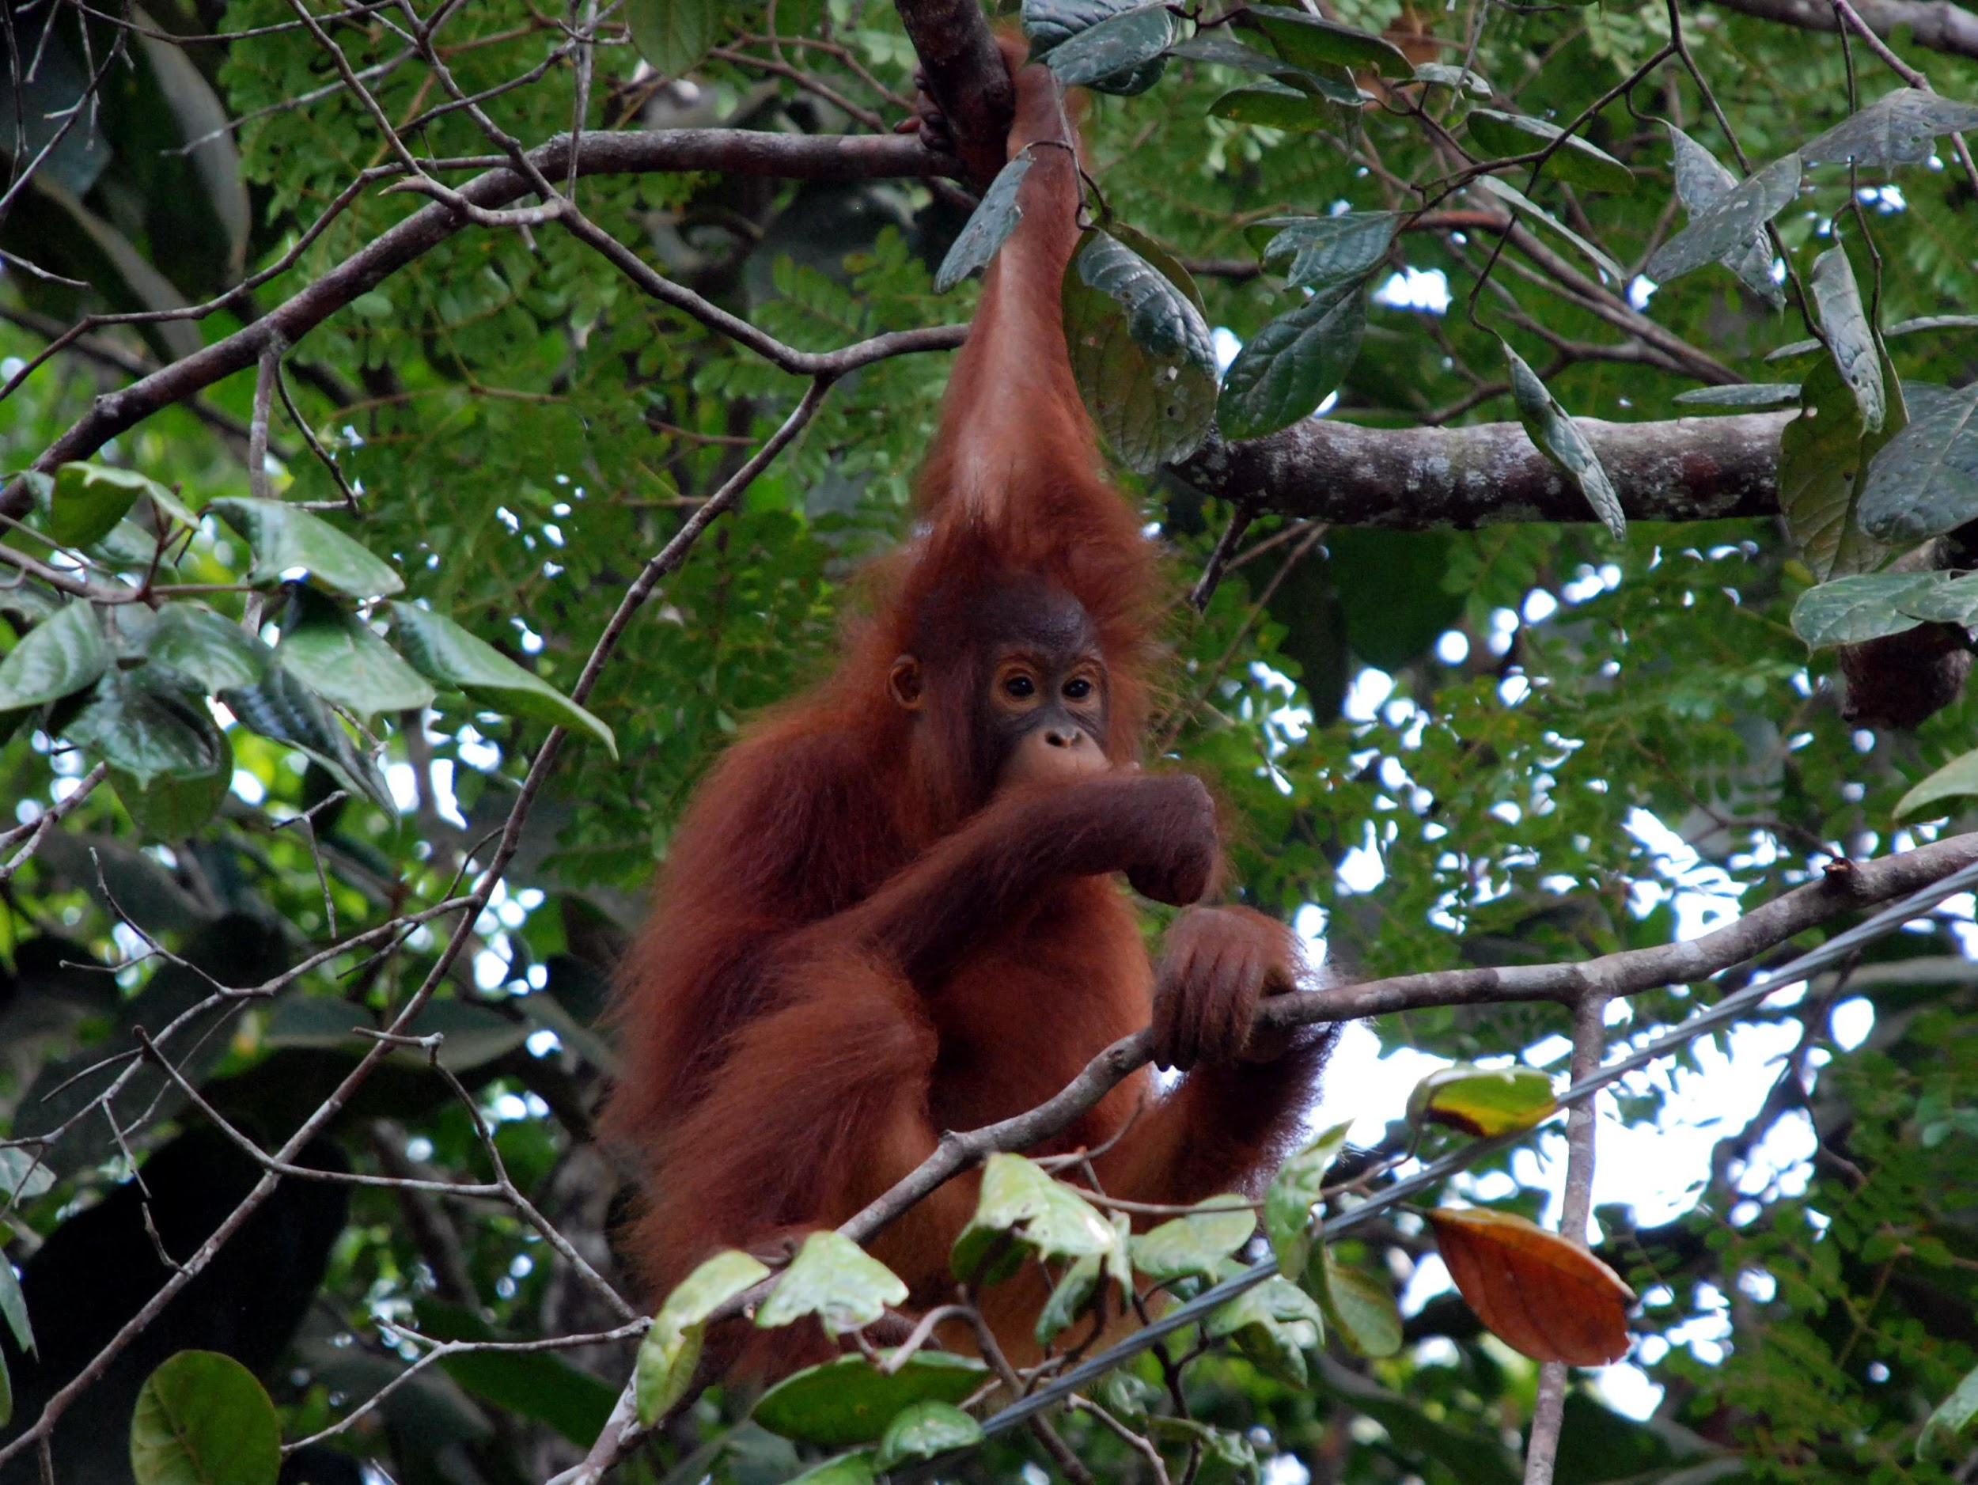
Orangutan
Photo: Seb Ruiz

Slide 29
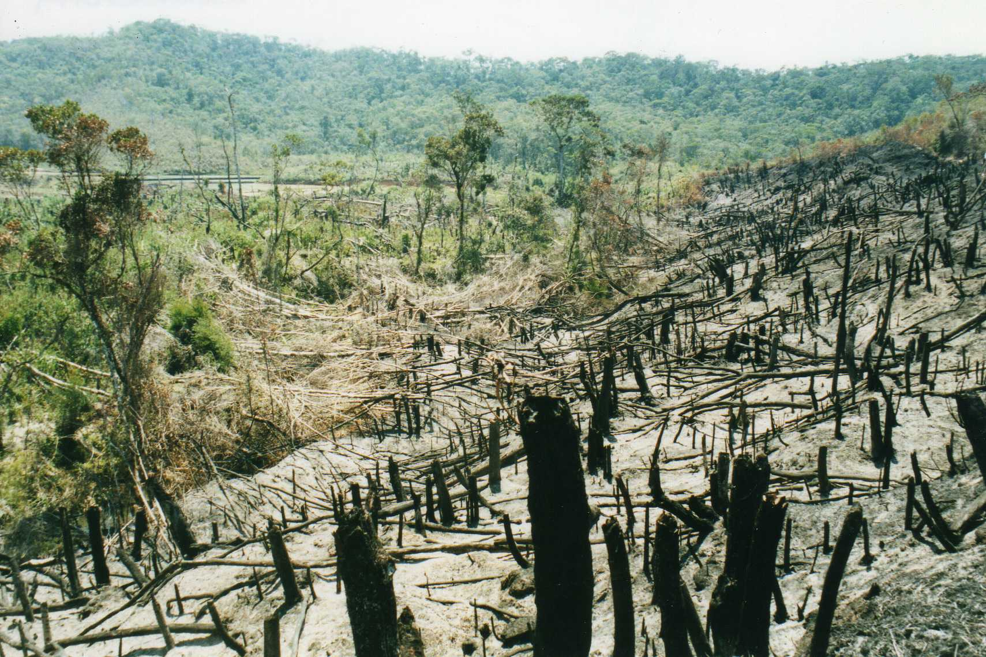
Deforestation
Photo: Leonora Enkling
causes more carbon emissions than all the cars, planes and trains in the world!

Slide 30

‘The Mark of Responsible Forestry’

Slide 31

UN-REDD
‘Reducing emissions from deforestation and degradation’
www.un-redd.org

Slide 32

30 - 40 litres
Photo: Steven Depolo
6 – 10 litres
Photo: Brian Herzog

Slide 33
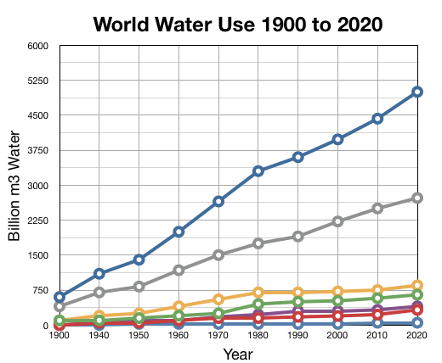

Slide 34

Photo: Pieter Vanhaecke
Photo: Fred Dawson
Photo: Liz West
Photo: Sean Wallis
Photo: Luis Vásquez

Slide 35
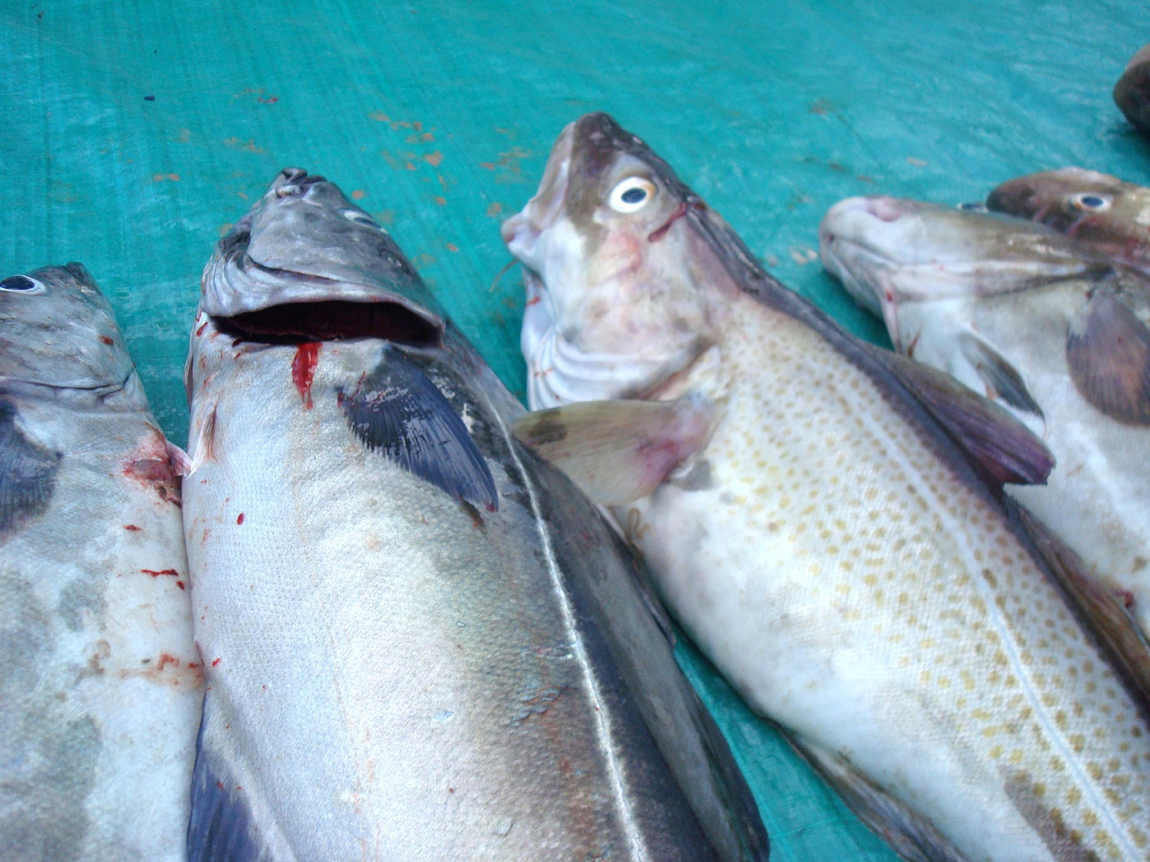

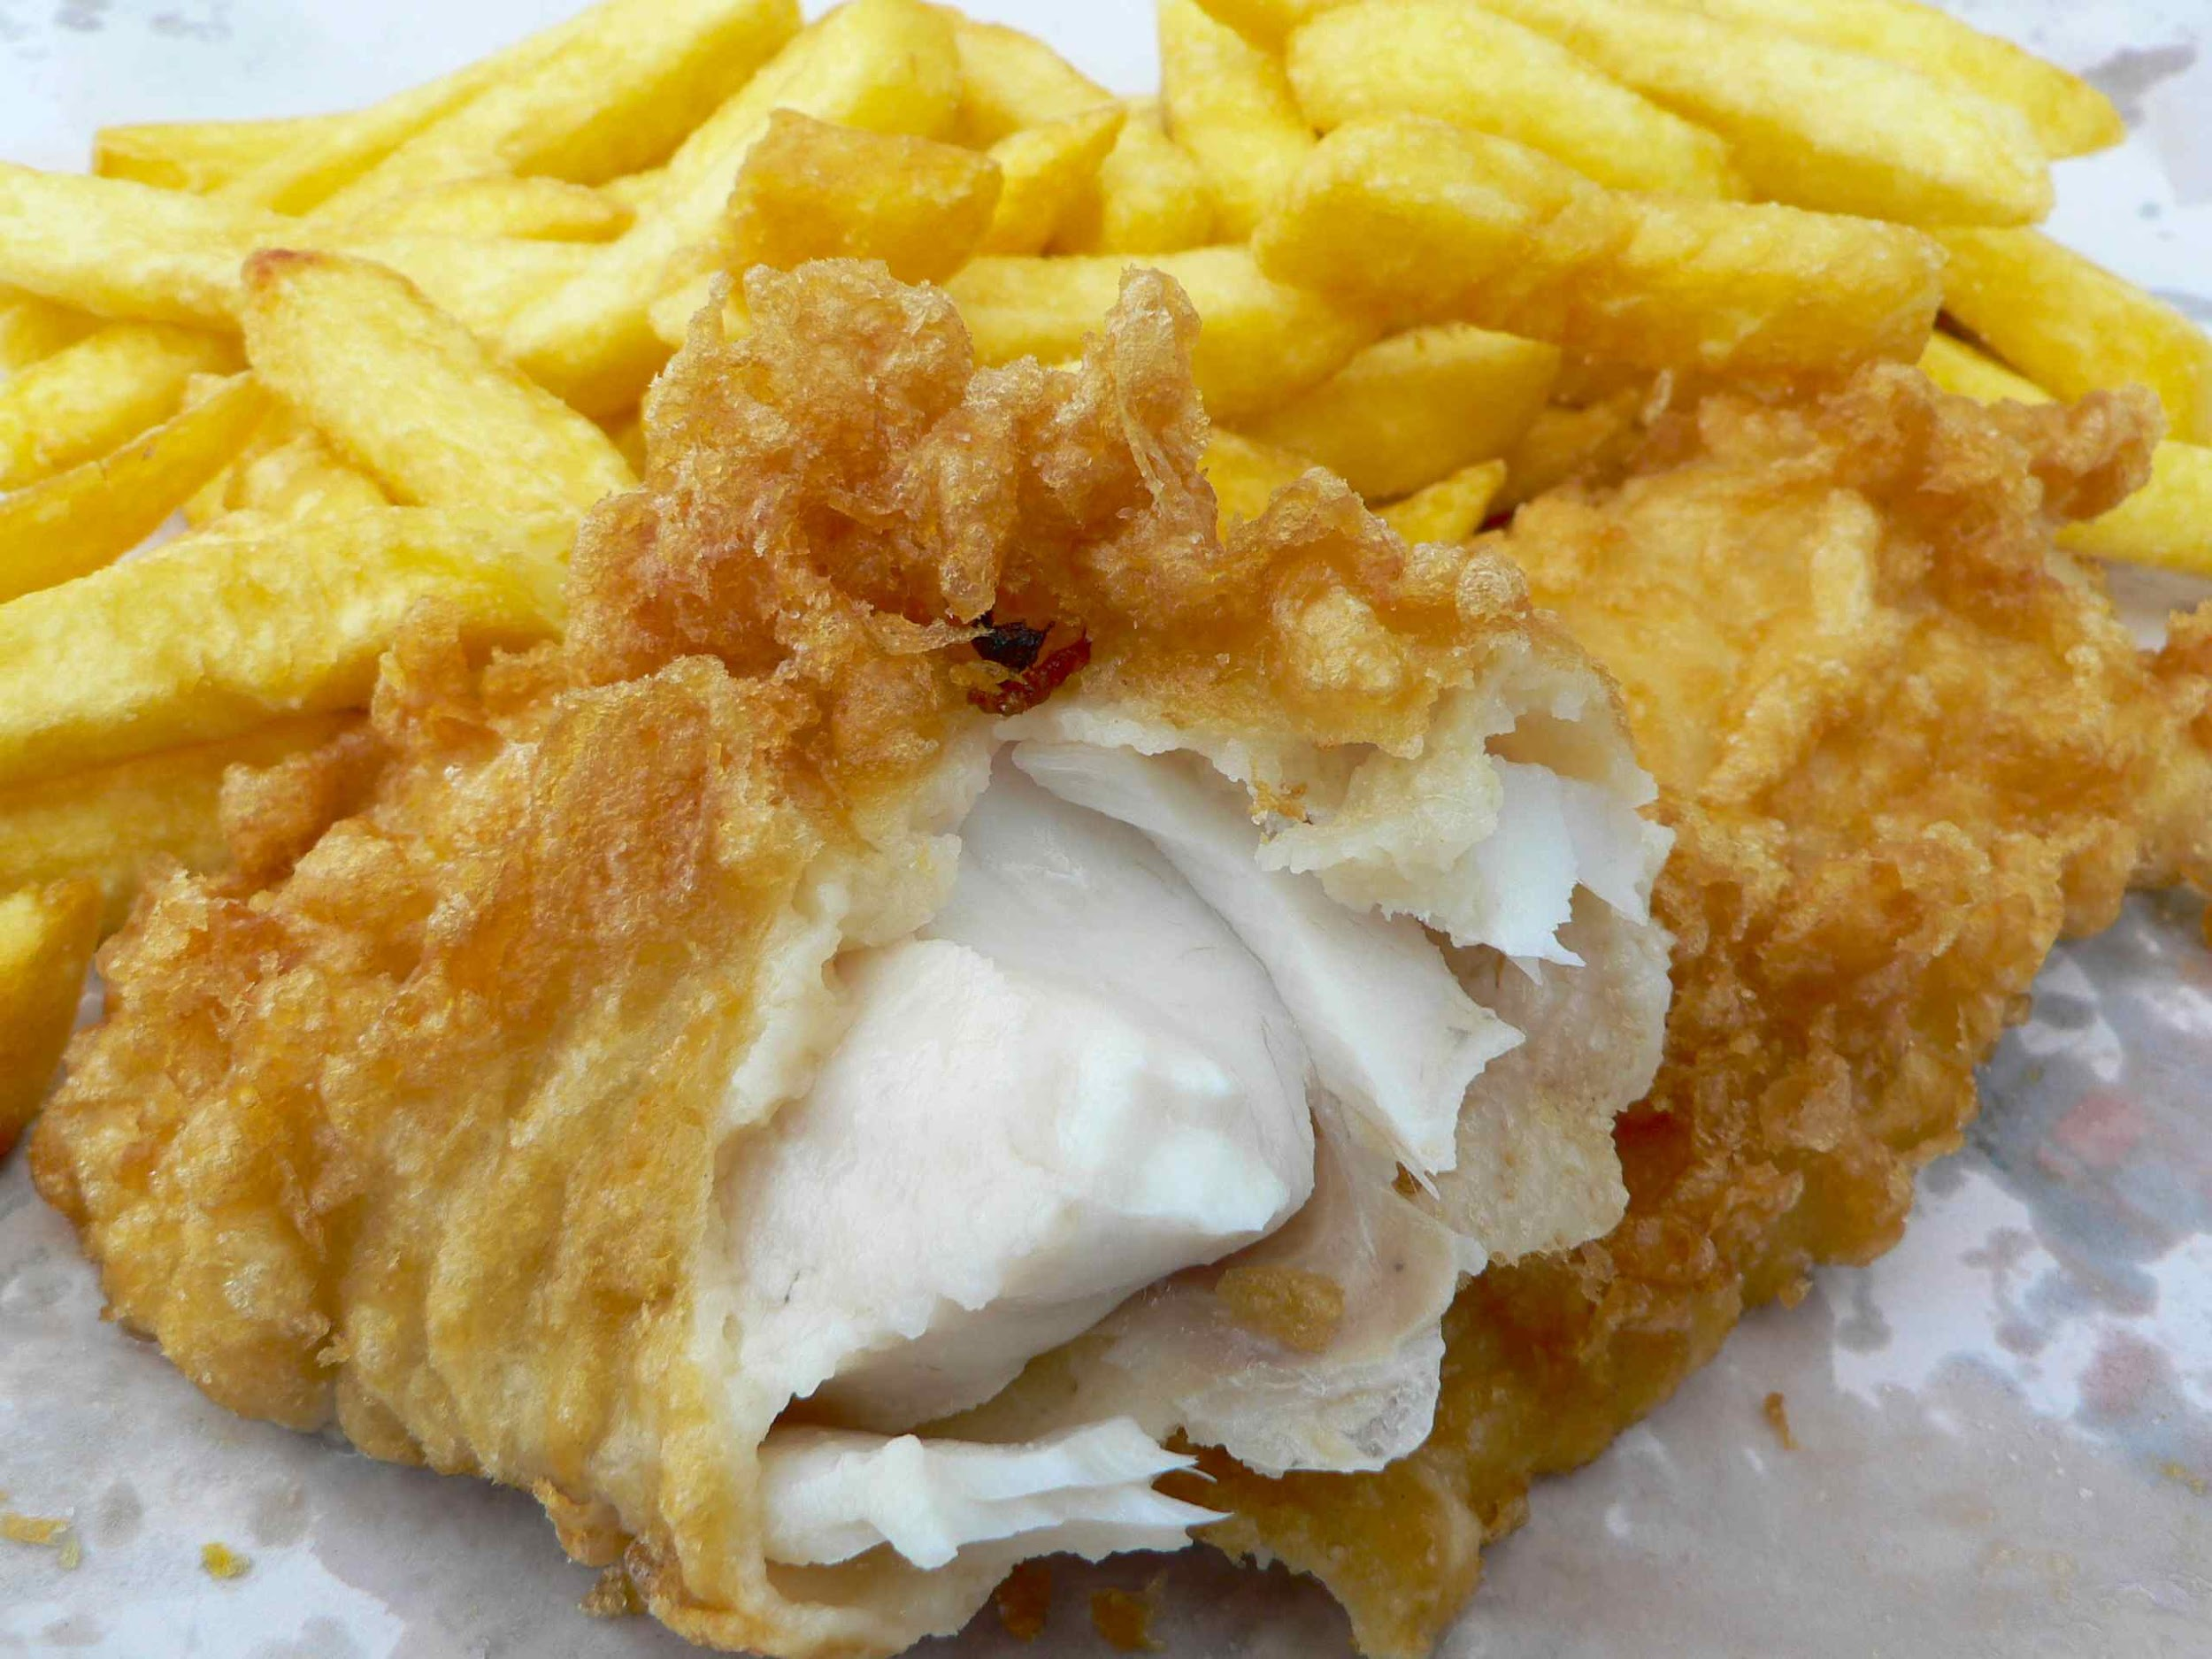
Photo: Wayne Marshall
Photo: Sandy Austin

Slide 36
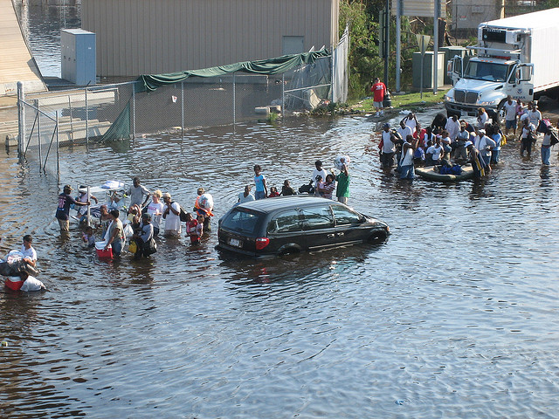
Hurricane Katrina, New Orleans, 2005
Photo: News Muse

Slide 37
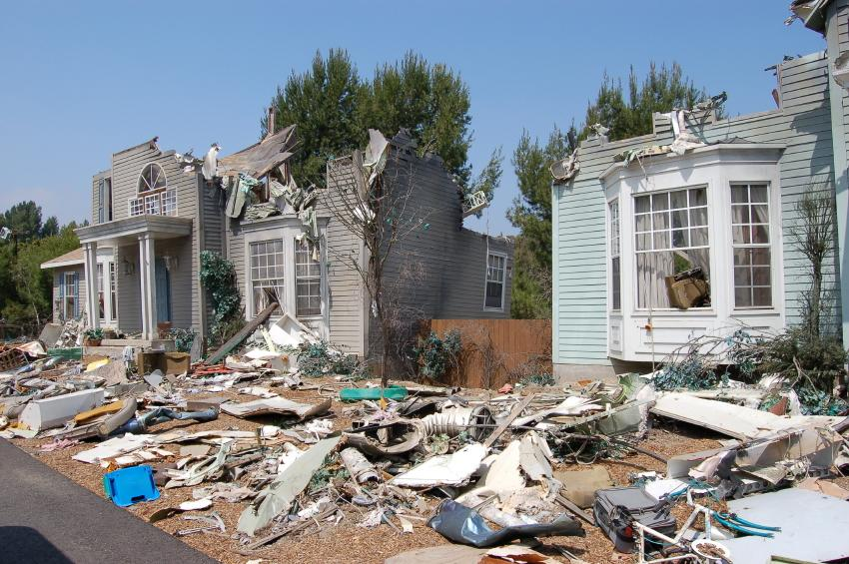
Hurricane Katrina, 2005

Slide 38
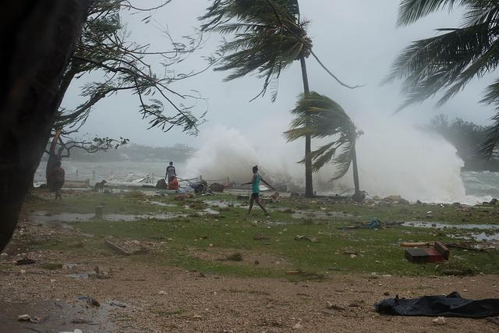
Cyclone Pam, Vanuatu, March 2015
European Commission DG ECHO

Slide 39
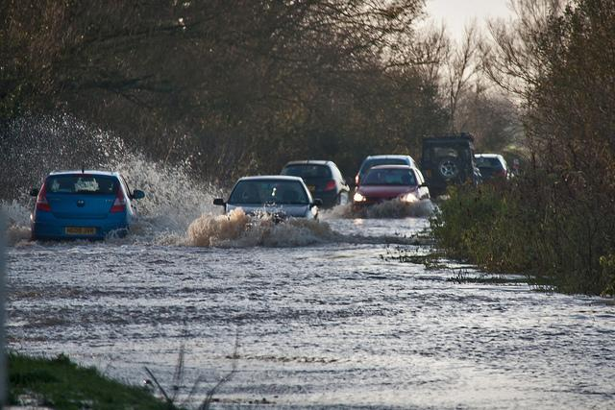
Somerset Levels, November 2012 Chaos on the A361
Photo: Mark Robinson

Slide 40
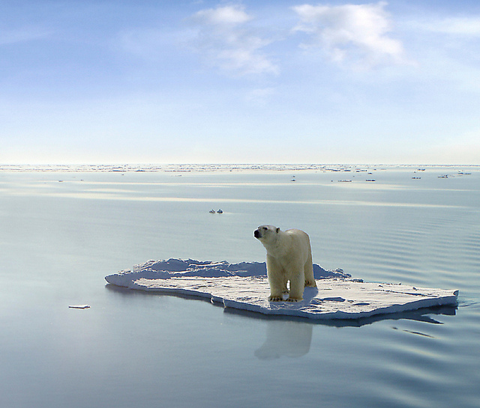
This polar bear managed to get on one of the last ice floes floating in the Arctic Sea
Photo: Gerard Van der Leun

Slide 41
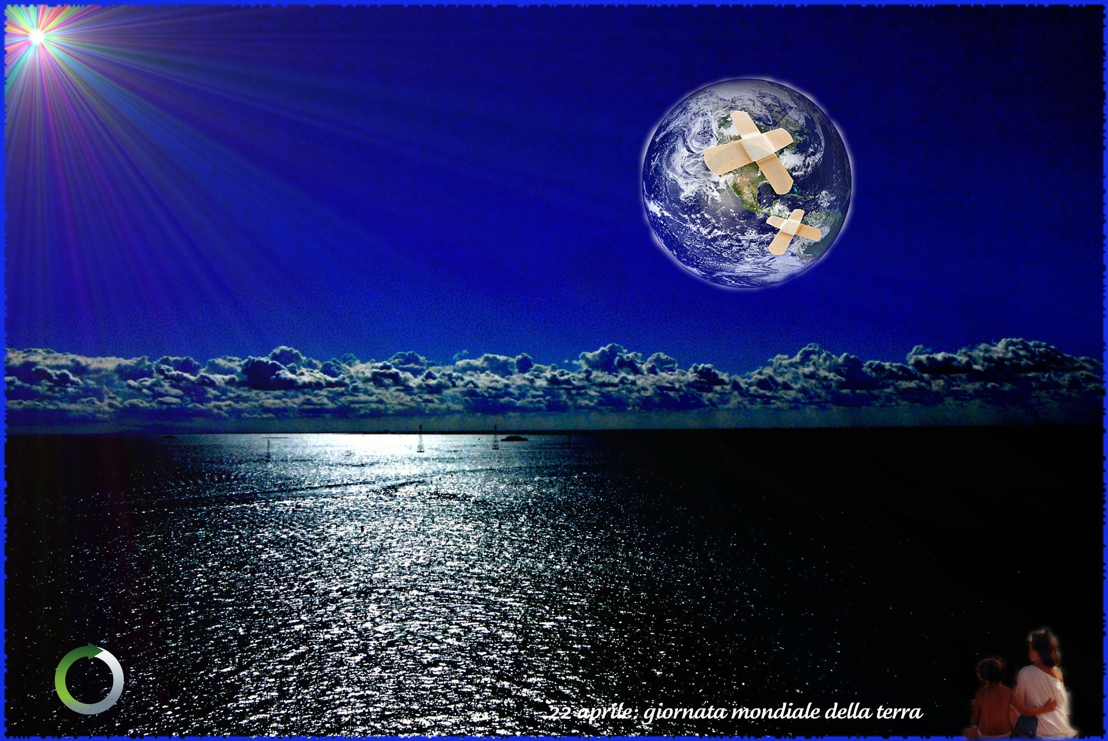
Photo: Riccardo Francessconi

Slide 42
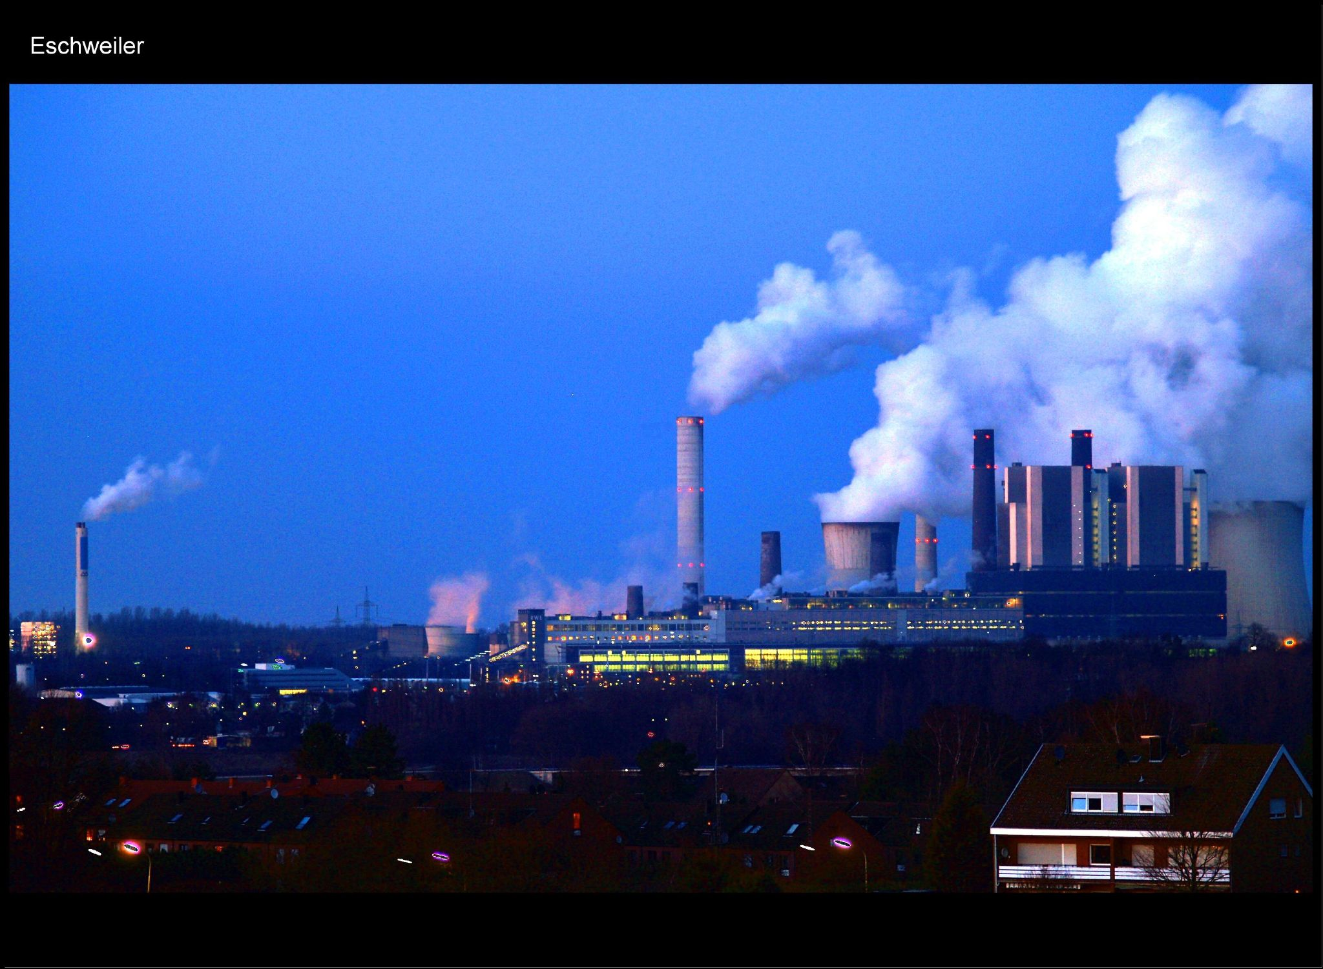
Carbon Dioxide
Photo: Oliver Wald

Slide 43

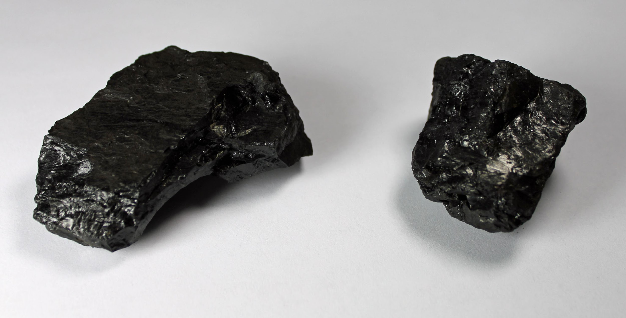
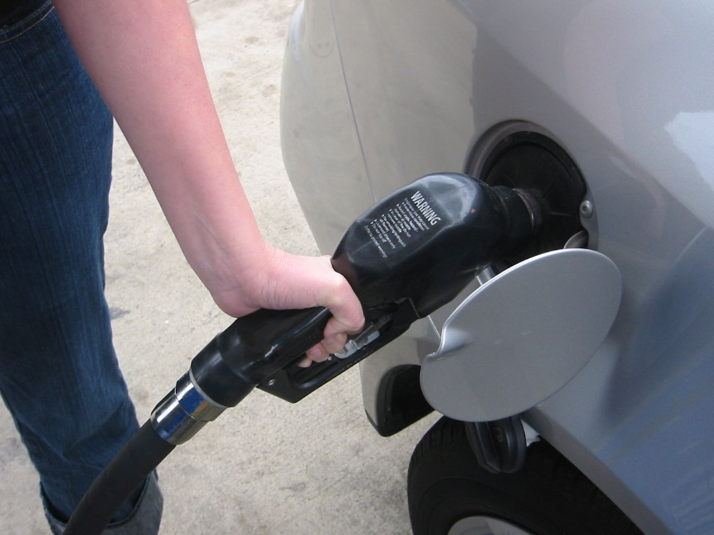
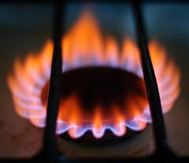
Fossil Fuels
Coal
Coal
Photo: Jeffrey Beall
Photo: futureatlas.com
Petrol & Diesel
(Oil)
Gas
Photo: Ilya
Photo: Tom Blackwell

Slide 44
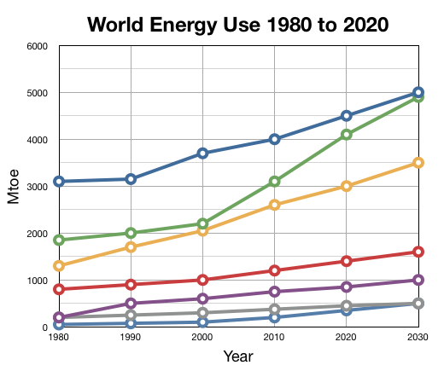
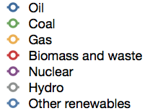

Slide 45
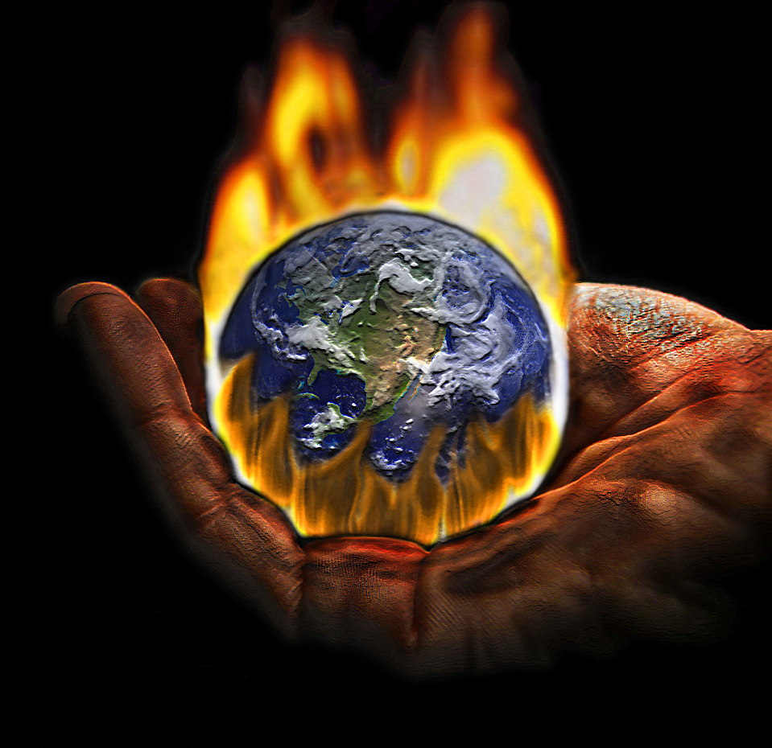
Click here for greenhouse effect video
Photo: Roberto Rizzato

Slide 46
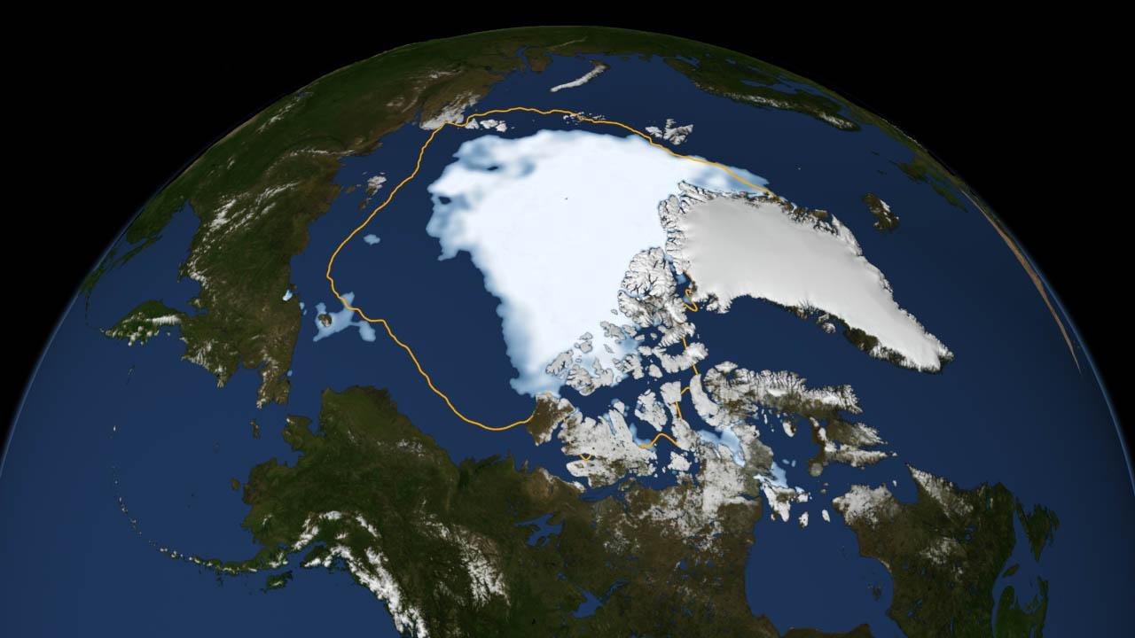
Arctic sea ice 2012
Average minimum Arctic sea ice 1979 to 2010
Photo: Scientific Visualization Studio, NASA Goddard Space Flight Center

Slide 47

Photo: Martha de Jong-Lantink

Slide 48

Climate Change
Photo: Smudge 9000

Slide 49

Wind power
1 wind turbine =
electricity for
1,000 homes.
Photo: reynermedia

Slide 50


Solar power
Photovoltaic Cells
Photo: Elliott Brown
Photo: Robert Pittman

Slide 51

Concentrated solar power
Photo: Green MPs

Slide 52

Hydro-electric dam
70% of the Earth’s surface is covered in water

