Slide 1
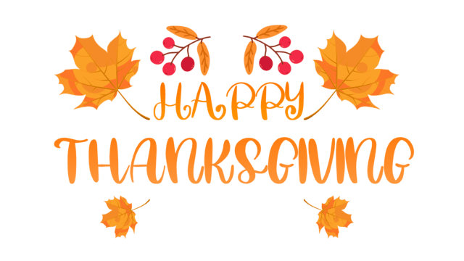

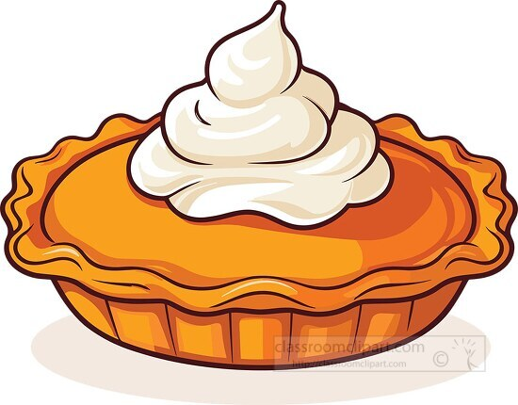
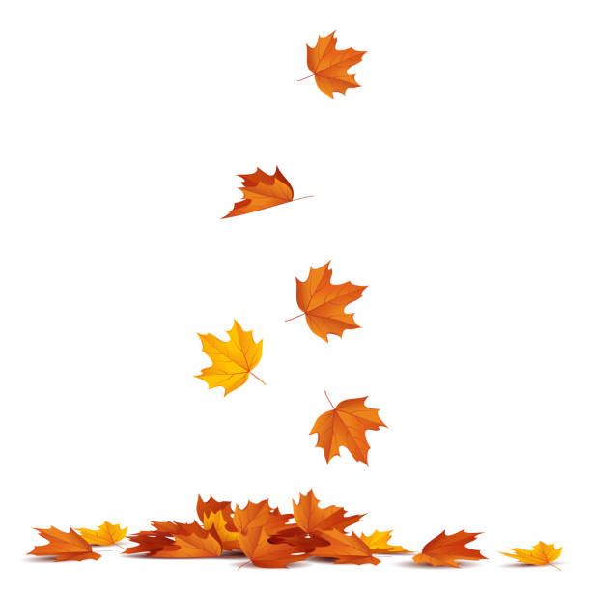

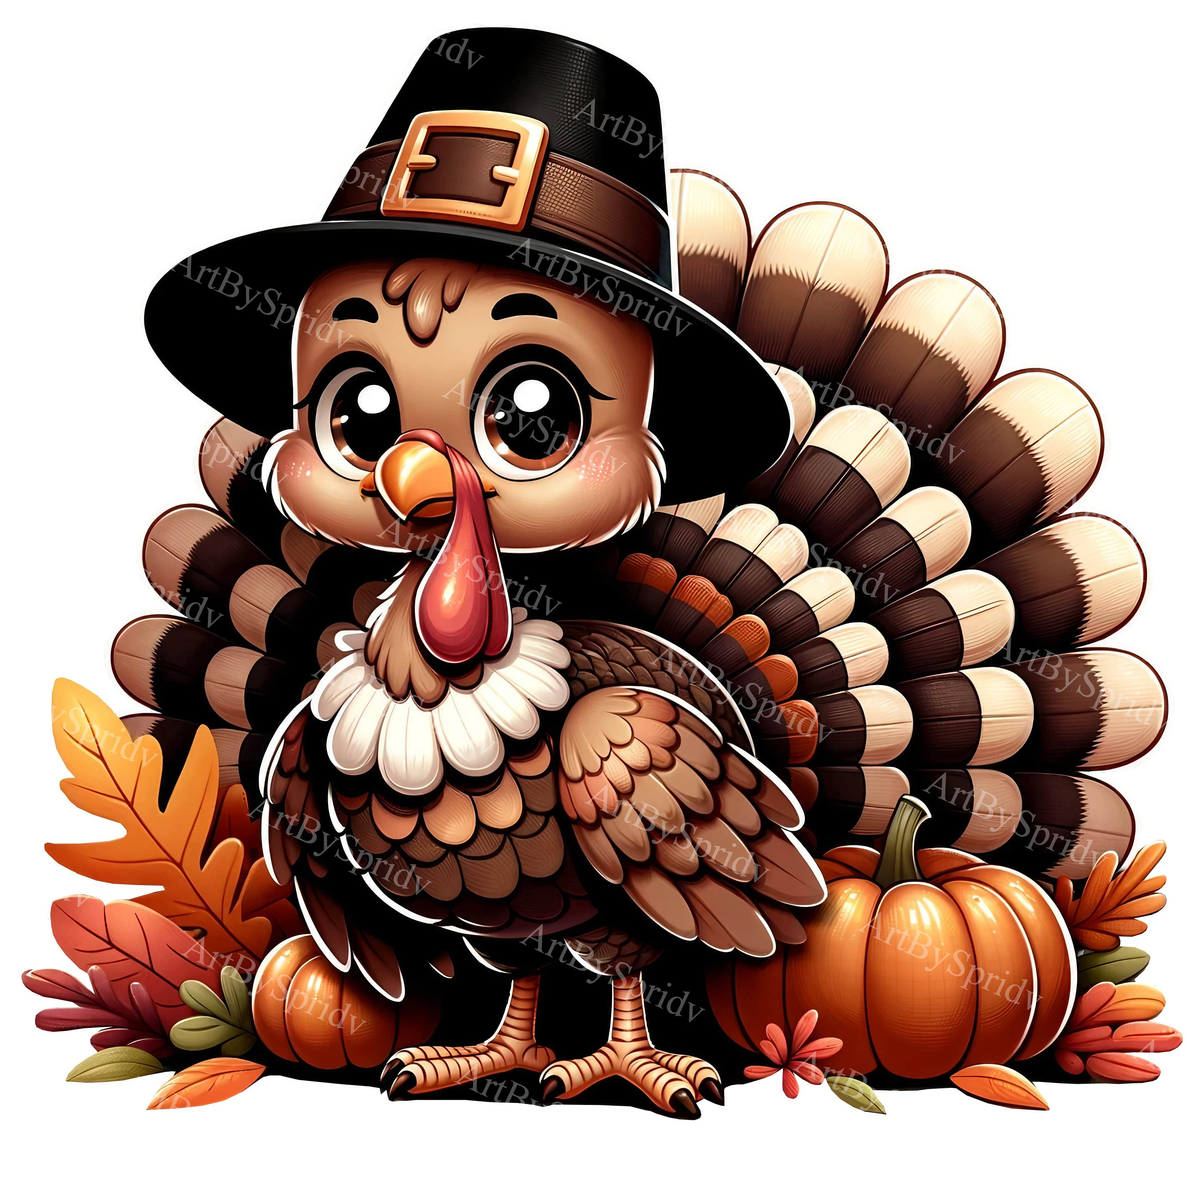
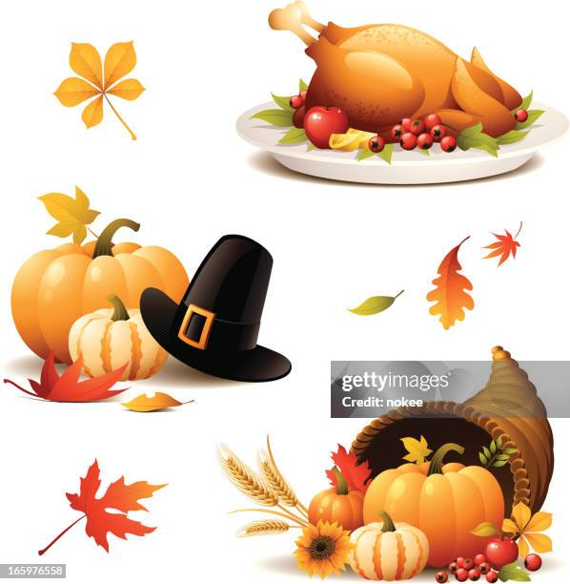
THANKSGIVING!!

Slide 2
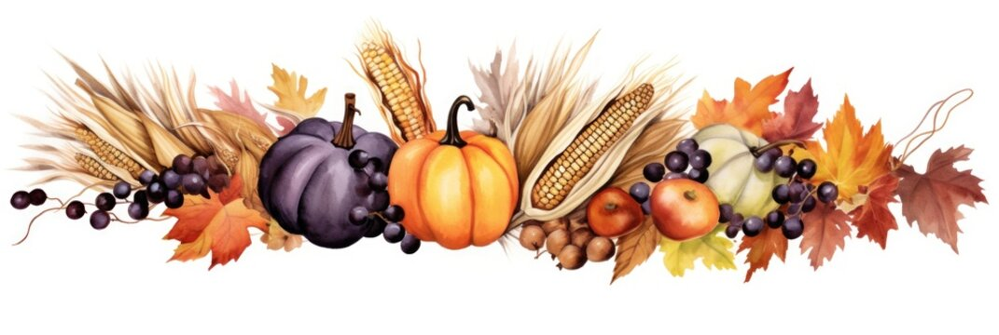
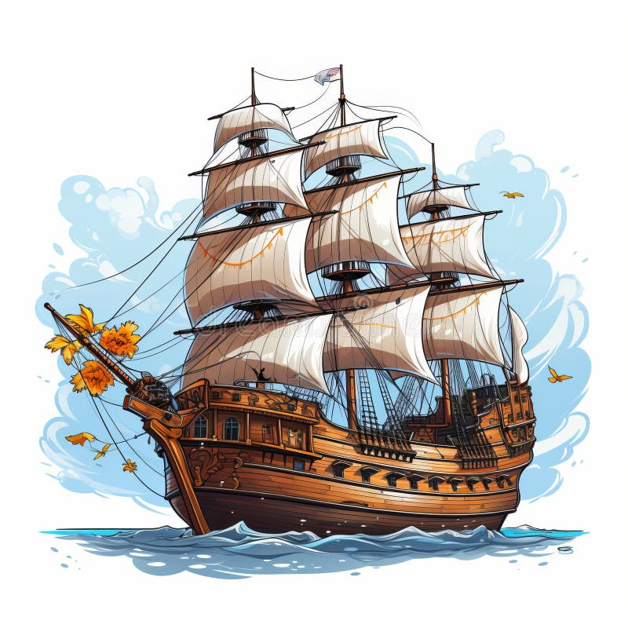
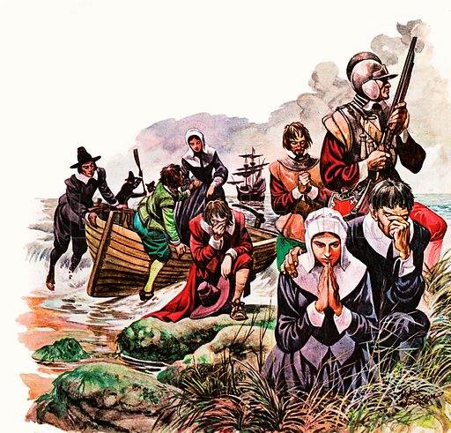
History of Thanksgiving
In 1620, Pilgrims sail from England to North America
They got sick from the journey, and many died.
Of 102 Pilgrims, only 50 survived the first winter

Slide 3
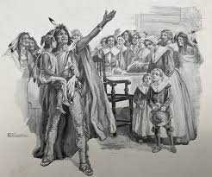
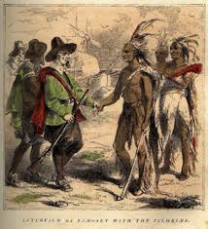
History of Thanksgiving
The Wampanoag Tribe helped the Pilgrims, teaching them many things:
-How to grow crops
-How and where to hunt
-Cooking practices
-Different types of medicine

Slide 4
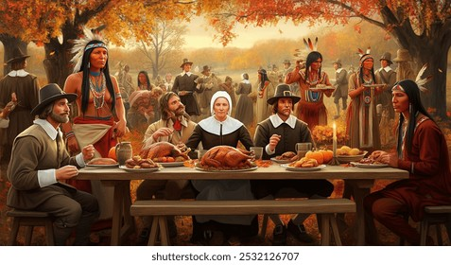
The First Thanksgiving!
In November 1621, colonists and the Wampanoag tribe shared an Autumn harvest feast to give thanks!

Slide 5
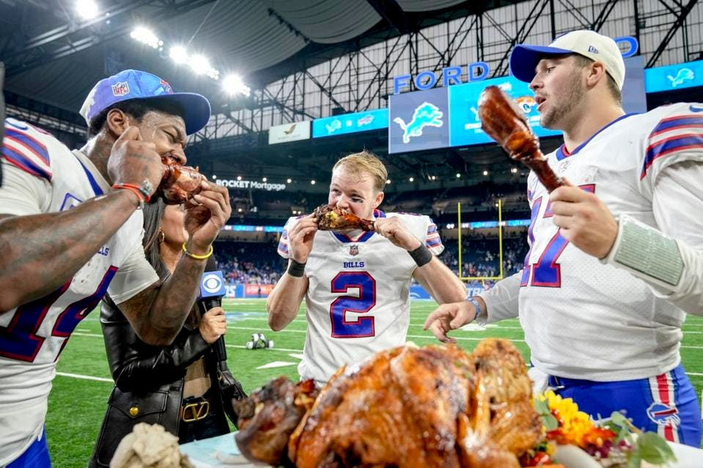
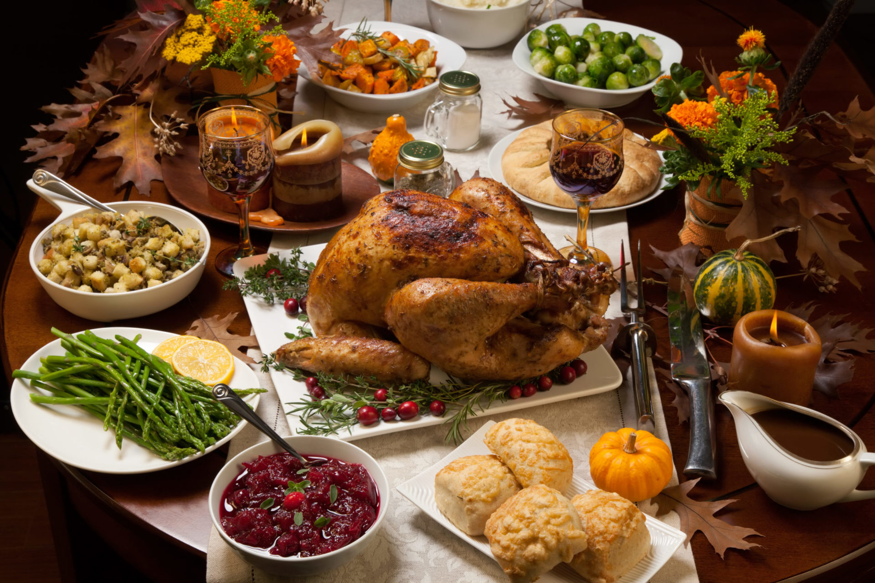
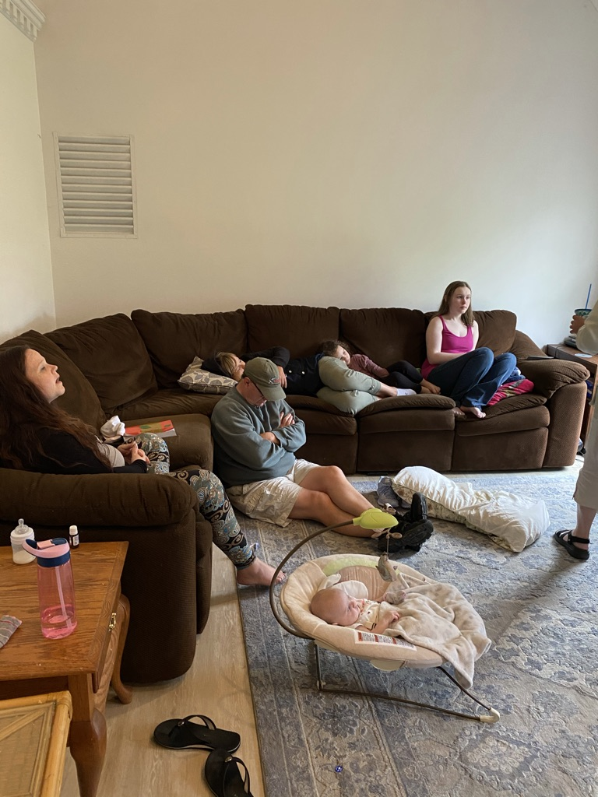
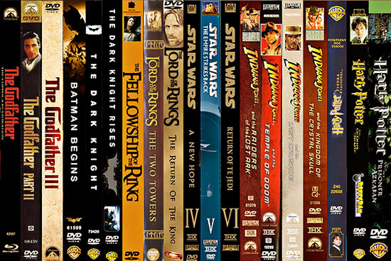
Thanksgiving Today
Today, Thanksgiving is celebrated all over the US!
American Football game every year!
National Holiday!
4-Day Weekend!
A huge meal is prepared!
Movie Marathons
Family members come from all over the country!

Slide 6
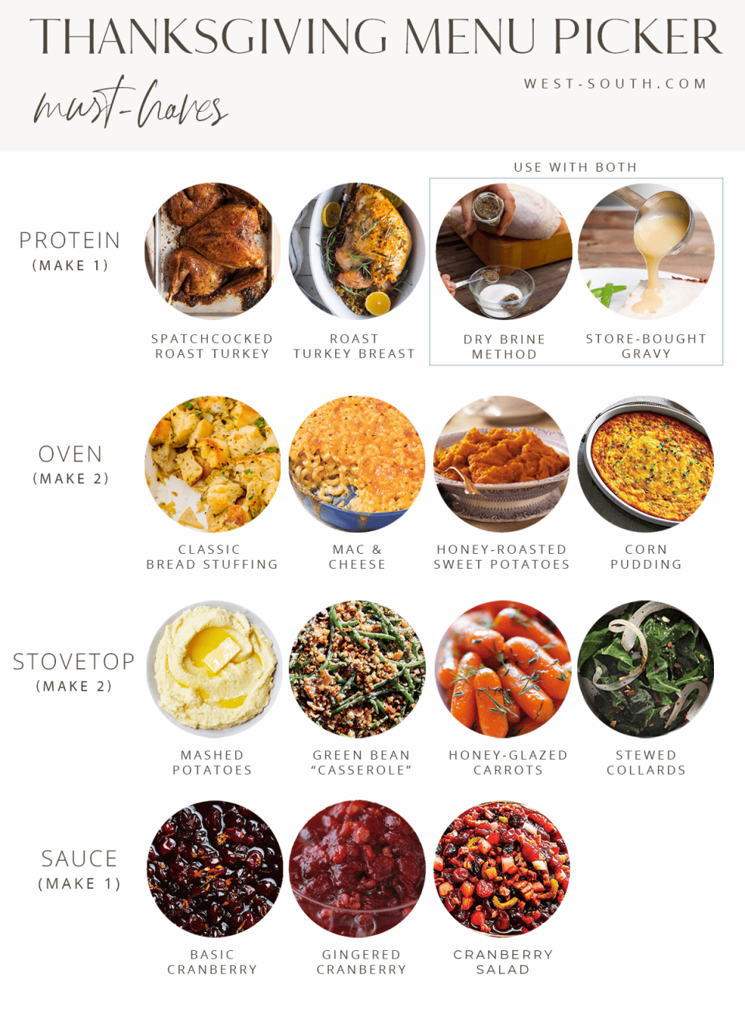
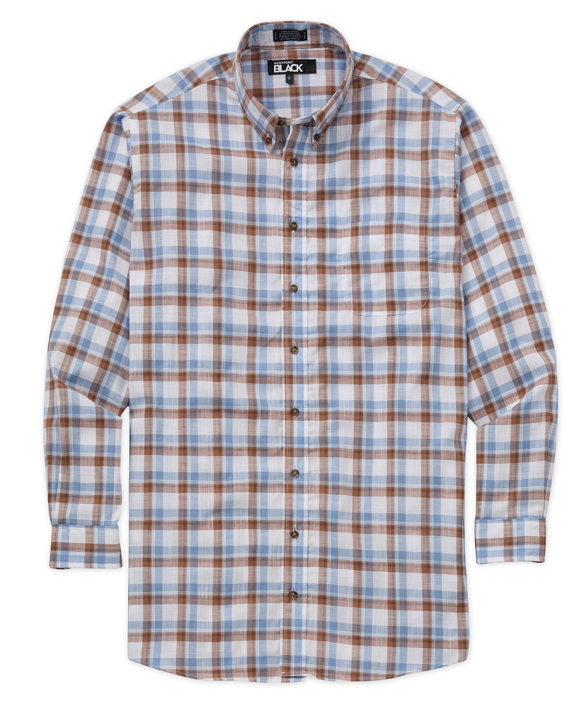
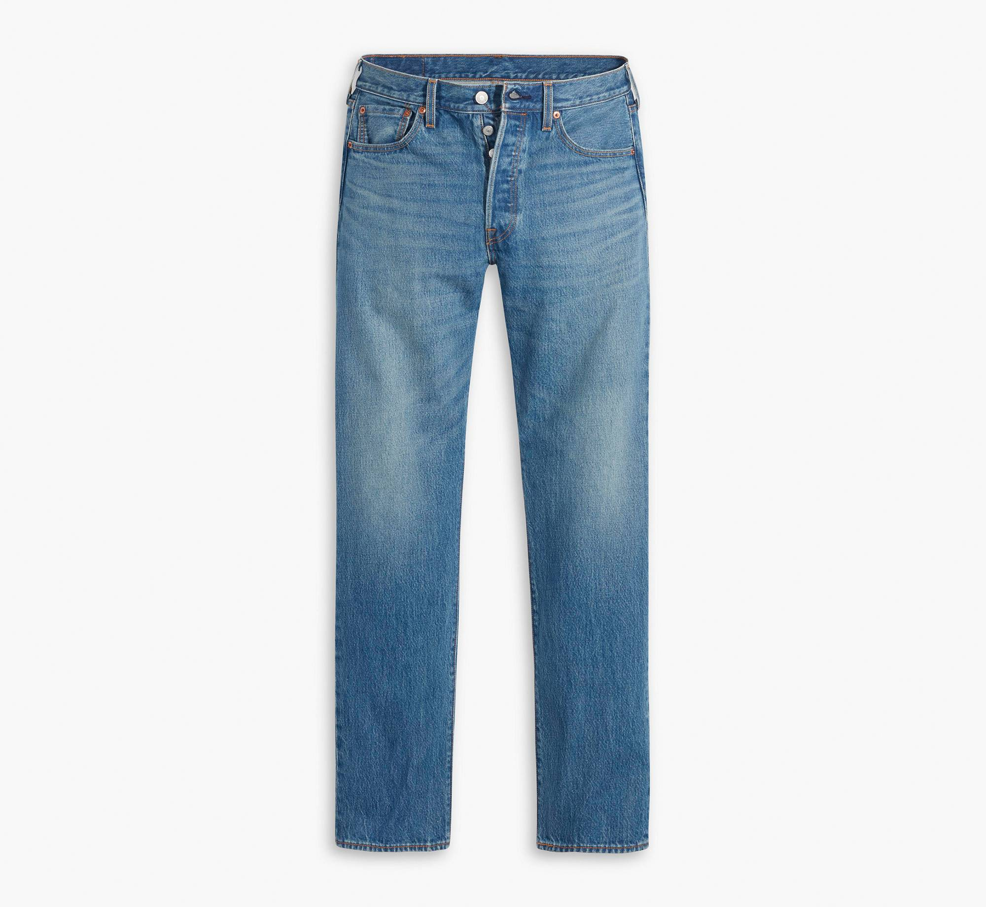
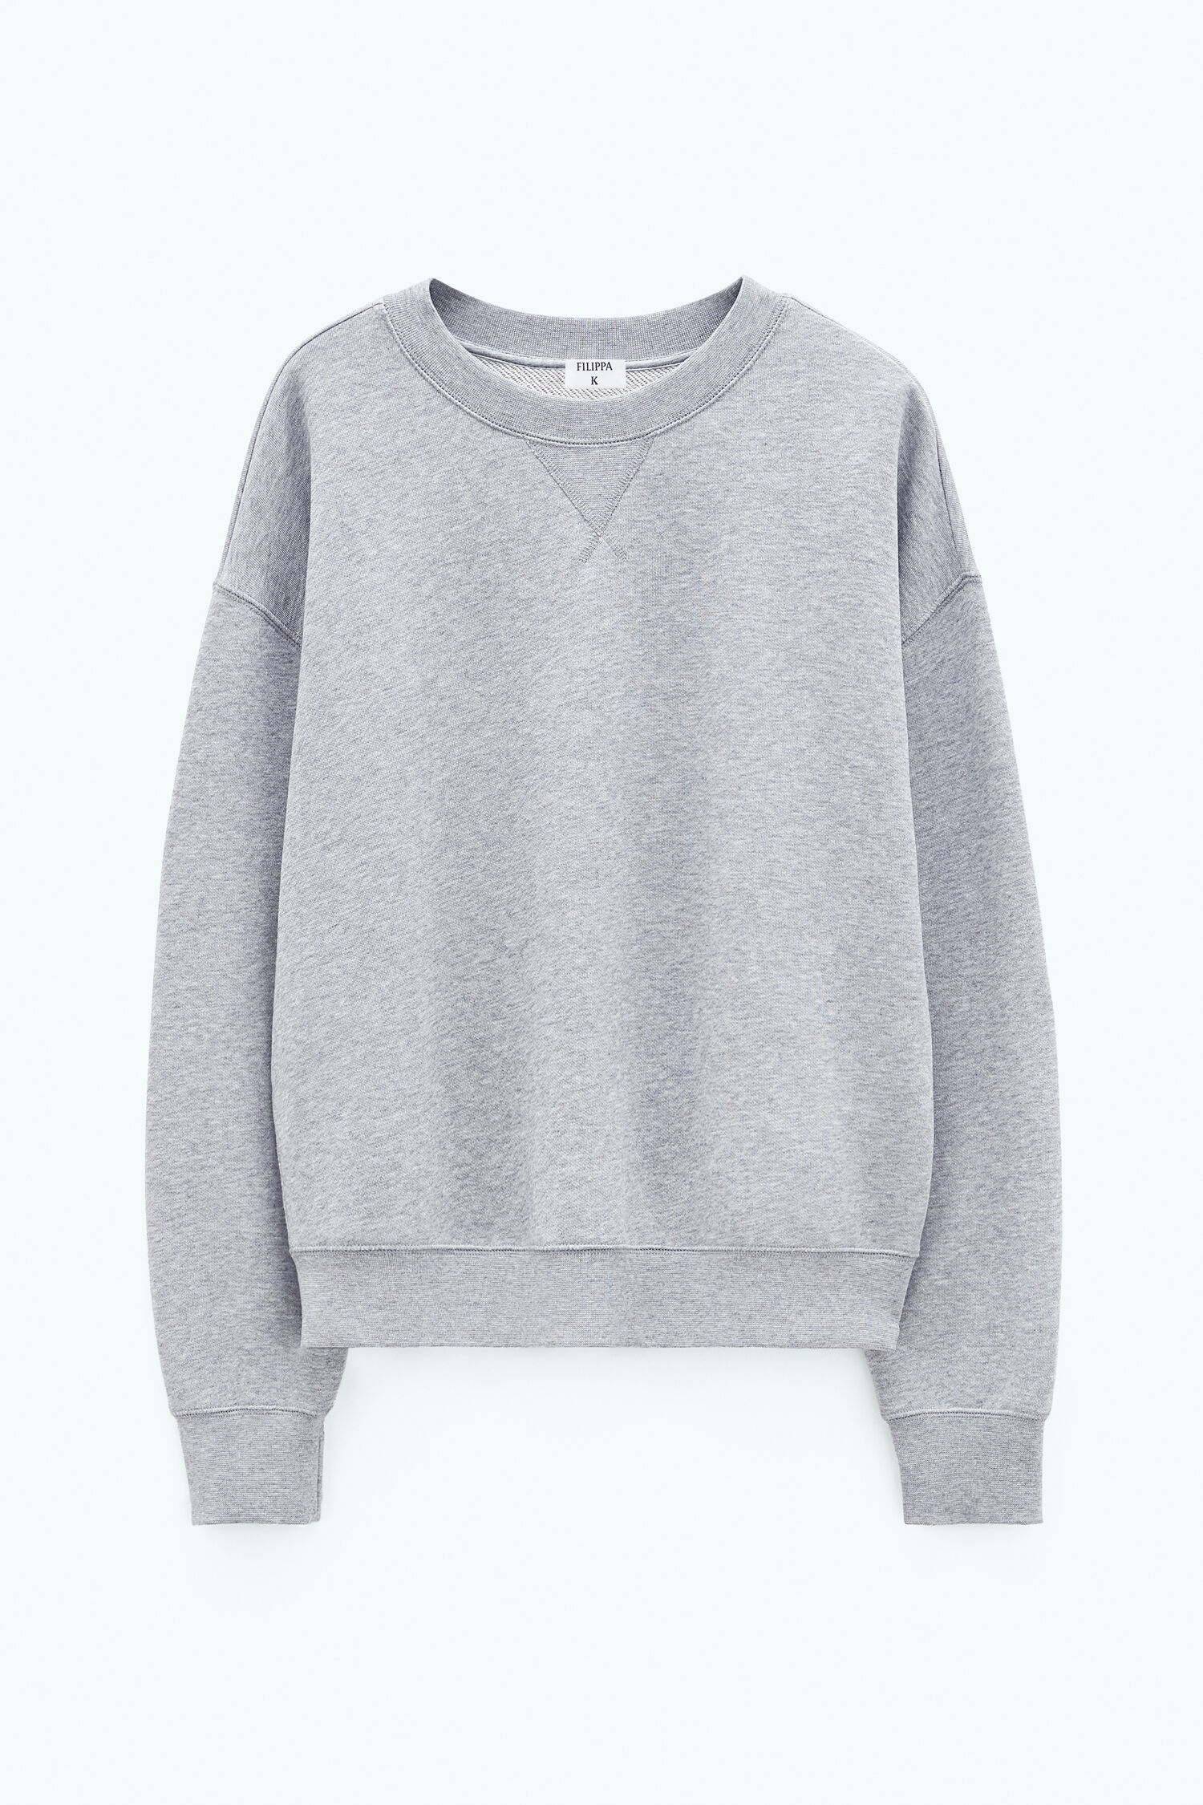

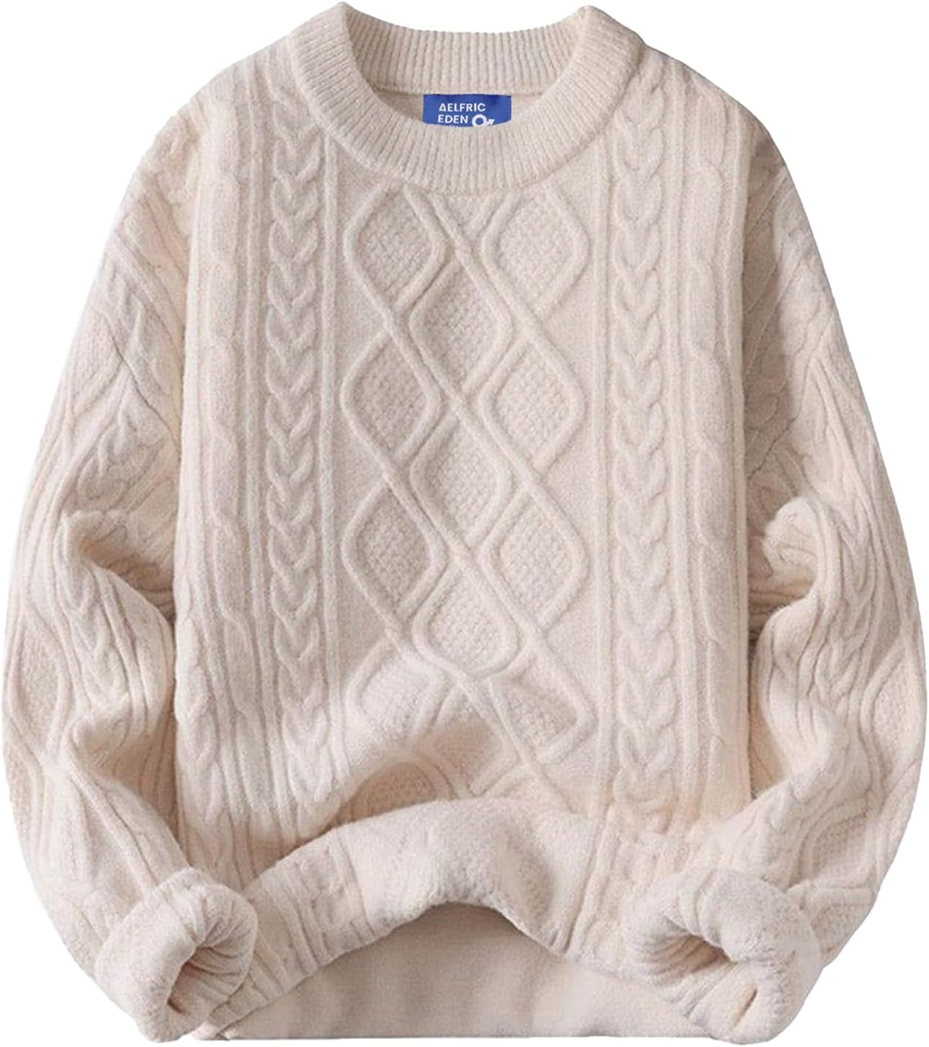
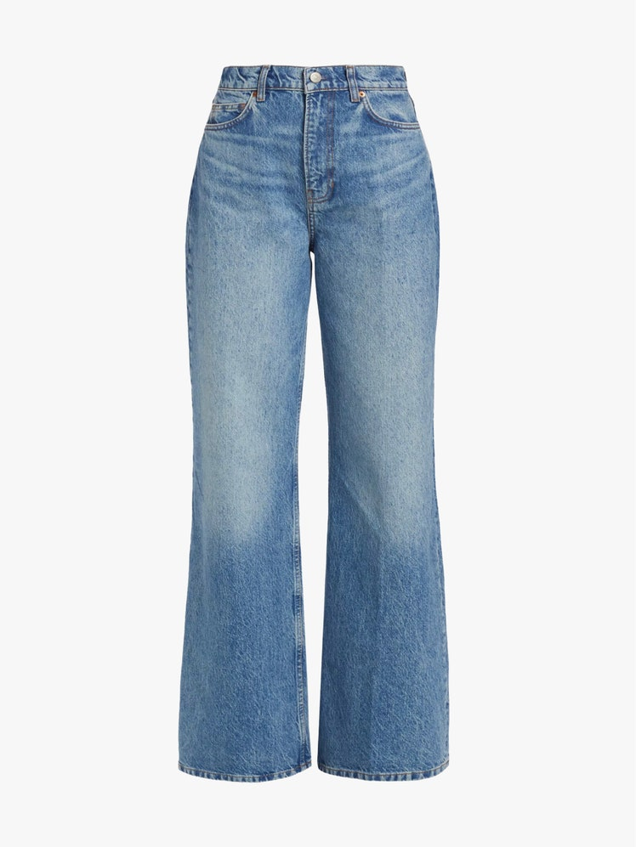
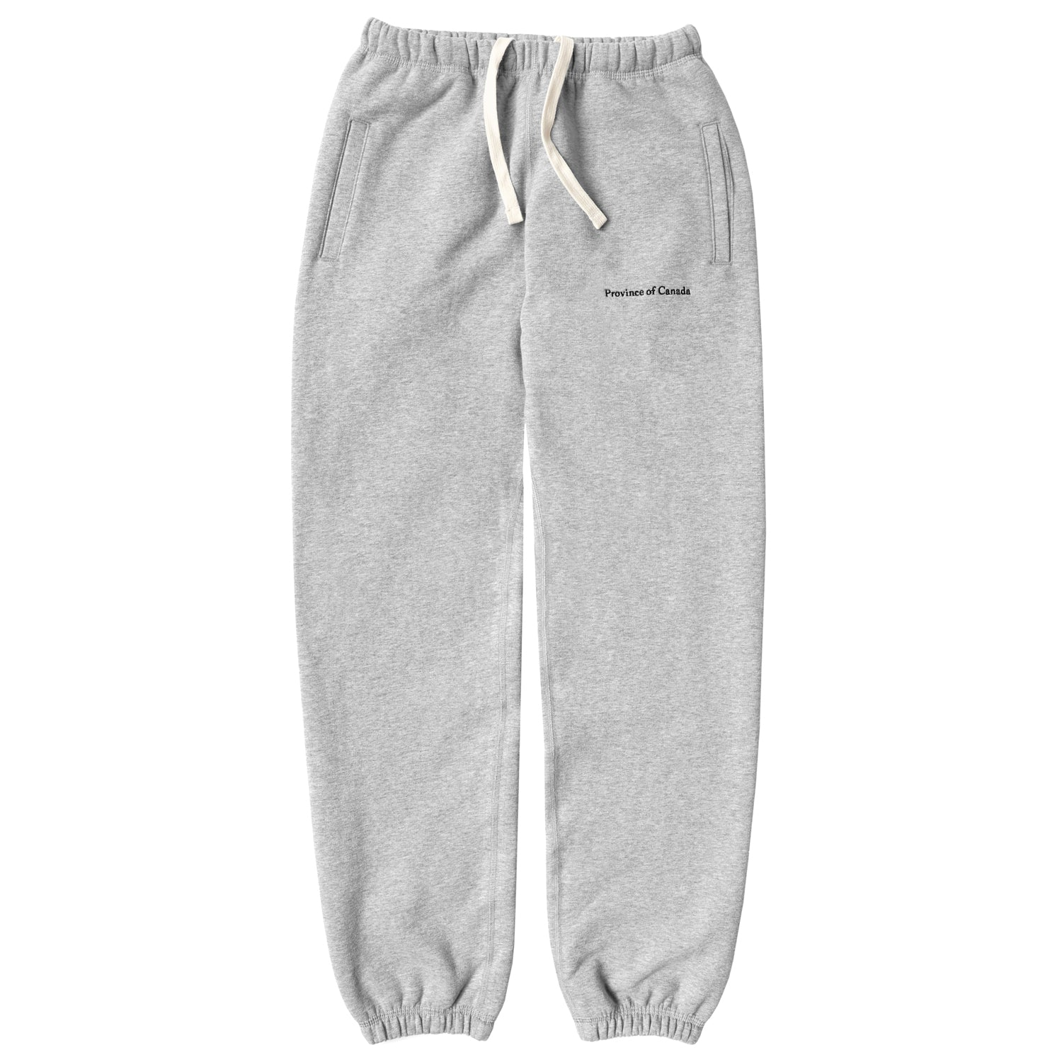
Thanksgiving Today
Clothing
On Thanksgiving Day, we wear something nice!
On the weekend, we wear something comfy

Slide 7
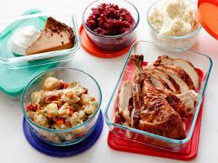
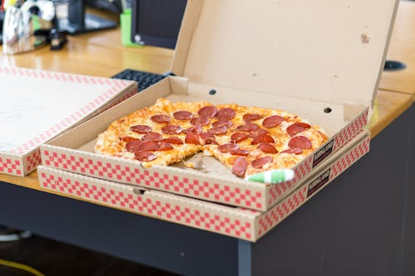
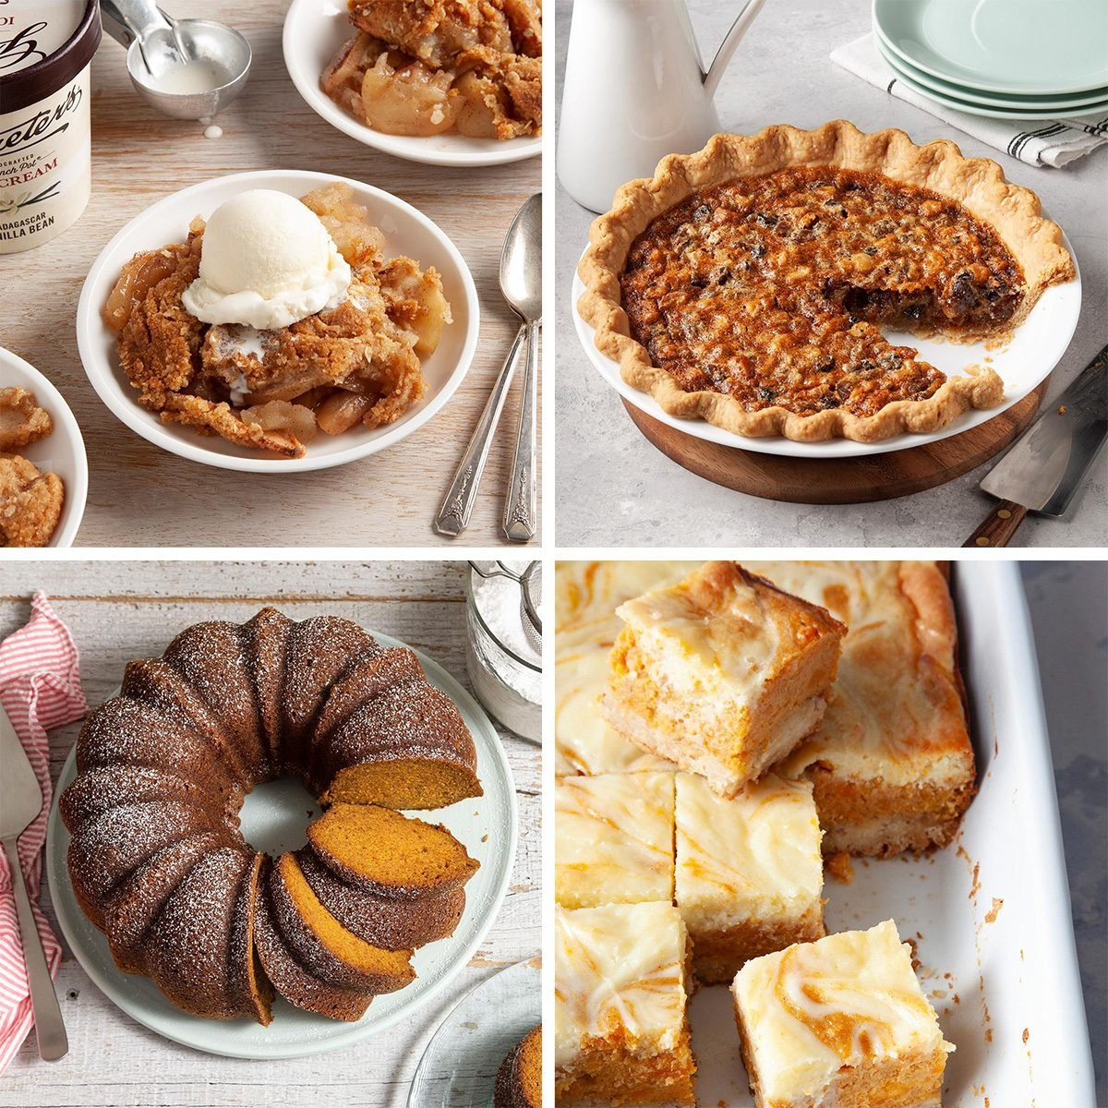
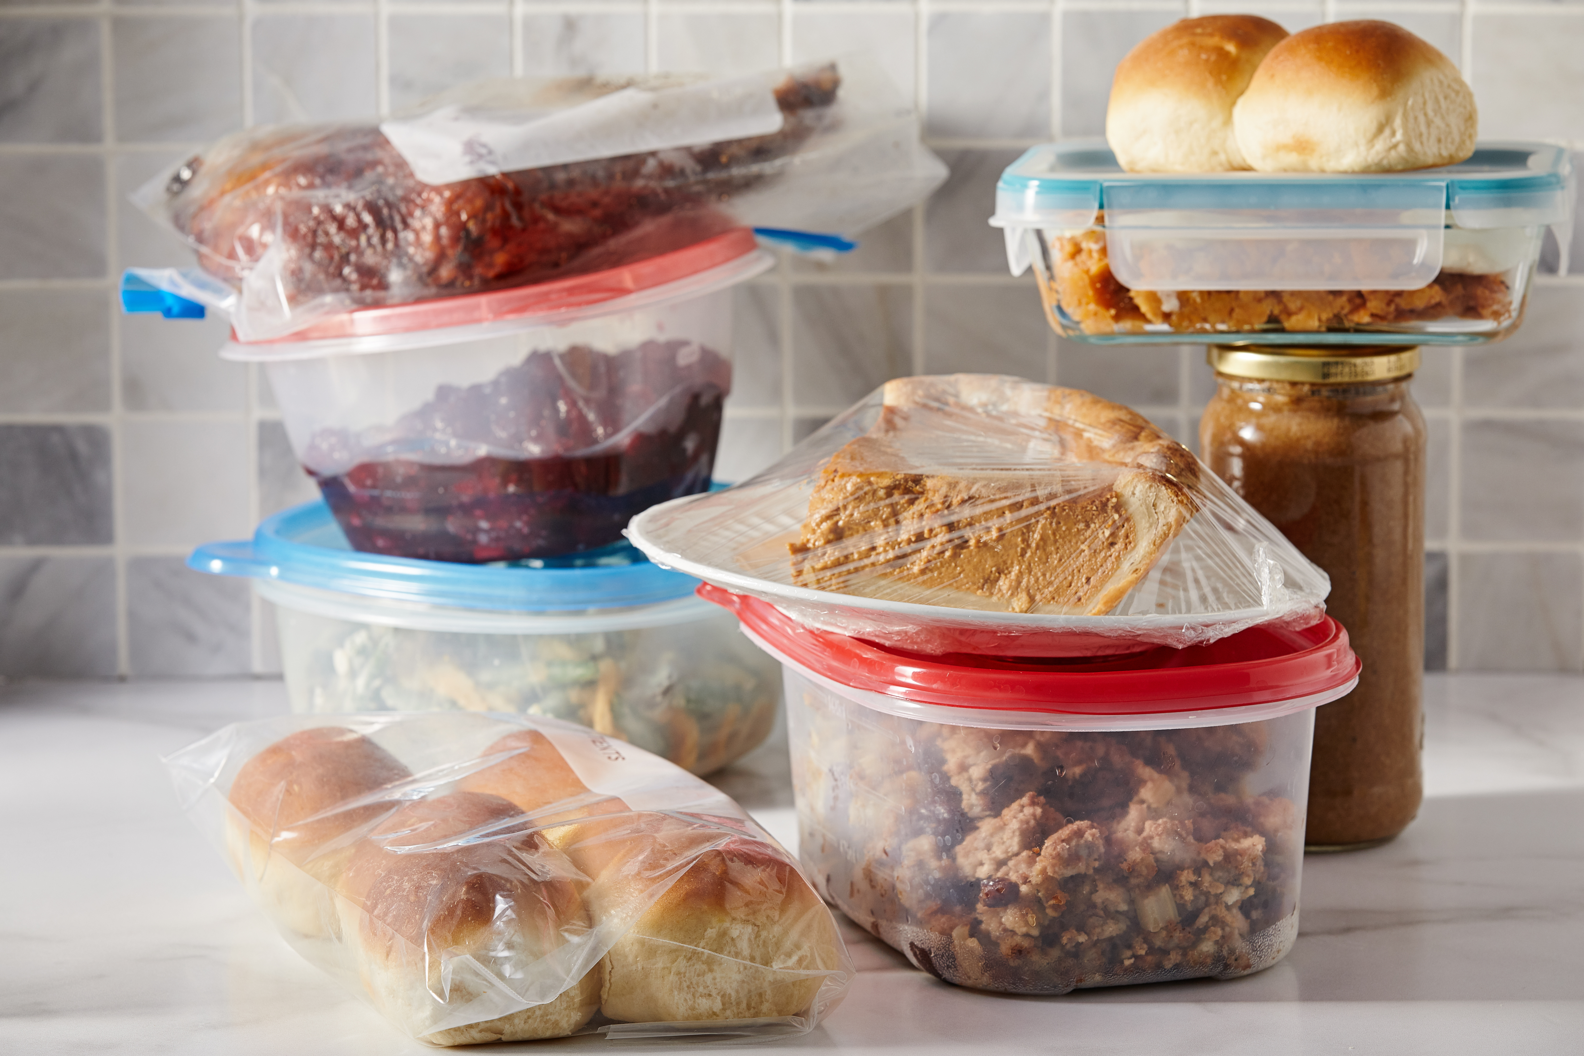
Thanksgiving Today
Don’t forget about leftovers on the weekend…
…or pizza…
…or dessert!

Slide 8


What Thanksgiving is Really About
Thanksgiving is all about gratitude!
Four days of sleeping, eating, drinking, watching TV with family, and remembering just how fortunate we are!!

Slide 9

Thank You Notes!
Write a short letter to someone you are thankful for!
EXAMPLE:
Title: I’m Thankful For [Person’s name] (my mom, dad, teacher, etc.)
Dear [Name],
I am thankful for you because ________________.
You make me smile when you ________________.
One thing I appreciate about you is ________________.
I will always remember when you ________________.
Sincerely,
[Your Name]

Slide 10
Word Search!
Find the words related to Thanksgiving in your worksheet!

