Slide 1
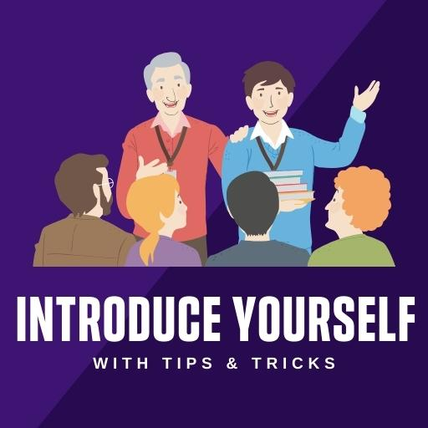
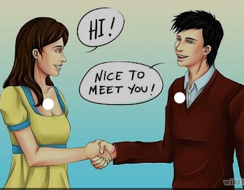

Slide 2
WHAT´S YOUR NAME?
HELLO (EVERYONE/EVERYBODY)!
My name is Roberto and My surname is López.
You can call me Rober
But everybody calls me Rober
But my family/my friends call me Rober

Slide 3
HOW OLD ARE YOU?
I am 22 ( twenty-two ) (years old)
I am around 20 (years old)
I am over 20 (years old)
I am in my (early/late) twenties /thirties….

Slide 4
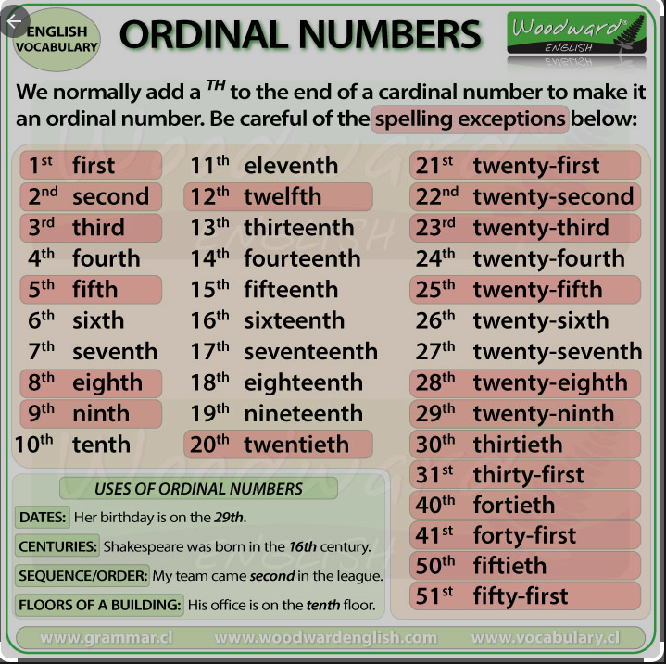
WHERE ARE YOU FROM?
I am from Galicia
I was born in A coruña on 2nd July 2000
But I live in Betanzos
with my family.

Slide 5
What are your likes and dislikes?
I like all colours but I prefer “orange “, the colour of energy .
I love salads but I hate / can´t stand spicy food.
I like animals but I don´t have any pet and I am afraid of snakes
I enjoy listening to music, watching films and series.

Slide 6
Do you like sport ?
I am (not) interested in sport.
I do karate /pilates
I play tennis, golf….
I go running / windsurfing ….
I am bored with football !
I think that football is boring !
In my free time, I love cooking

Slide 7
What would you like to do in the future?
In the future, my dream job is
to be / become a teacher / a policeman / a carpenter……
to work in a school / an office / a workshop……
In the future, I would like …
To be ….
To work in ….

Slide 8
THAT´S ALL FOR NOW !
THANK YOU FOR LISTENING
I HOPE TO LEARN MORE ENGLISH THIS YEAR
GOODBYE

