Slide 1
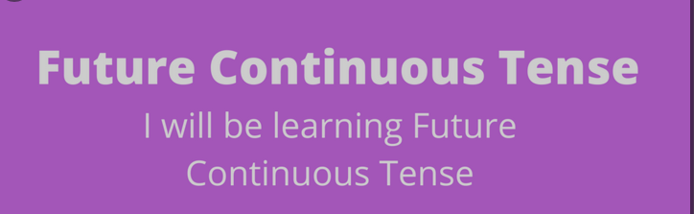
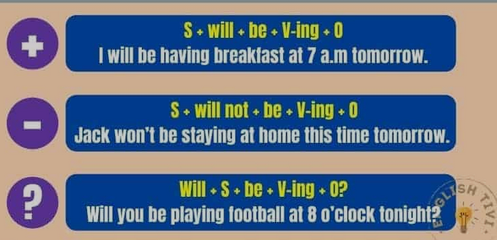

Slide 2
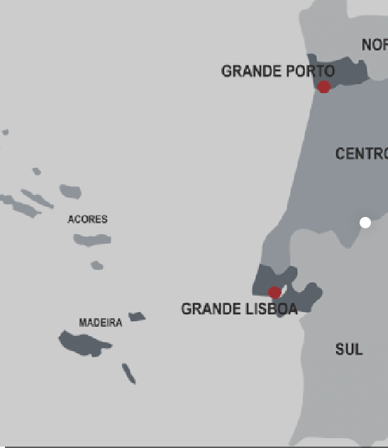
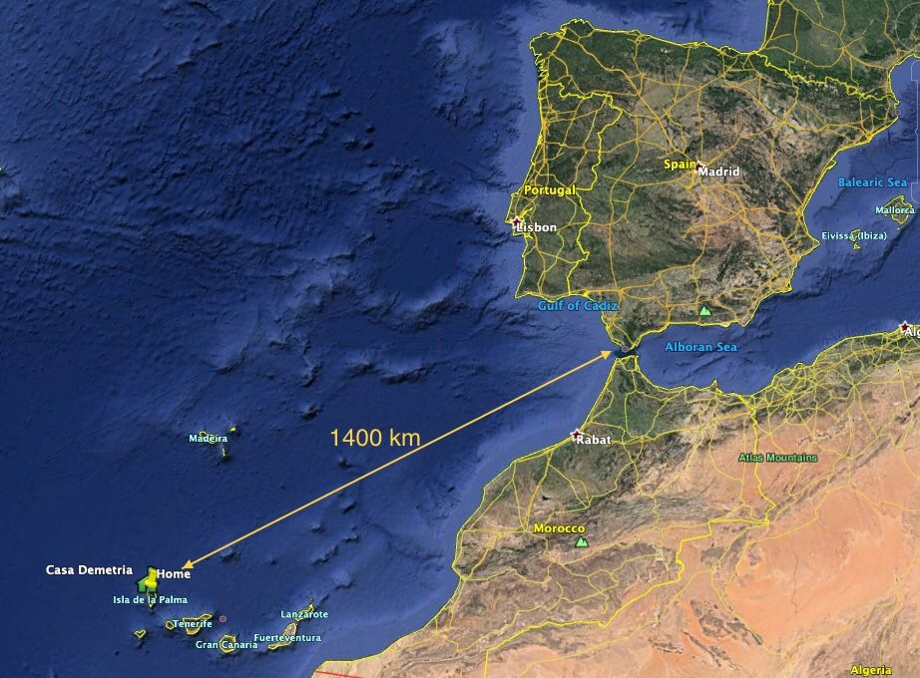
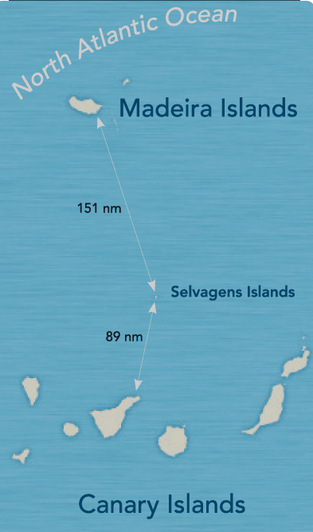
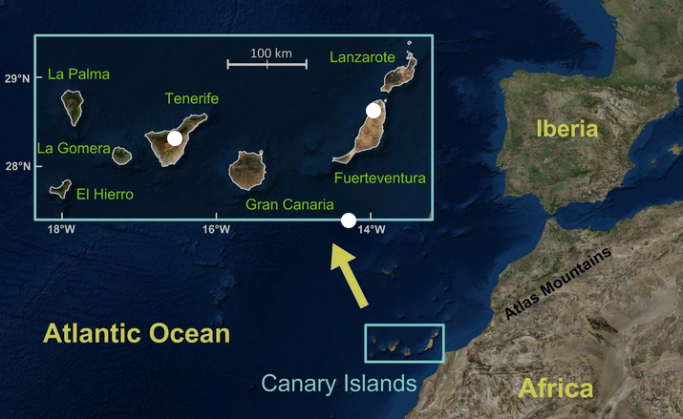

Slide 3
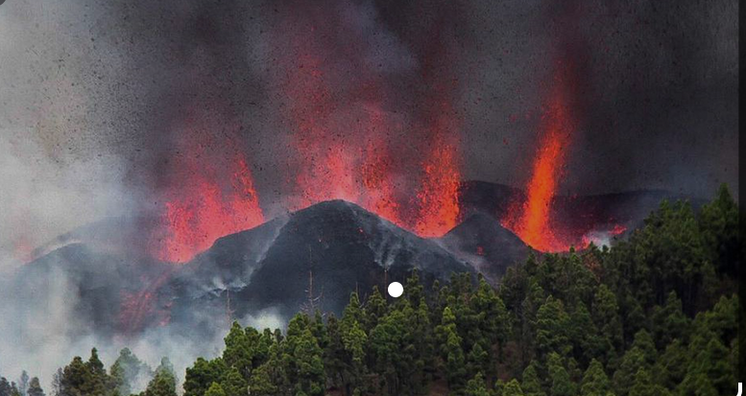
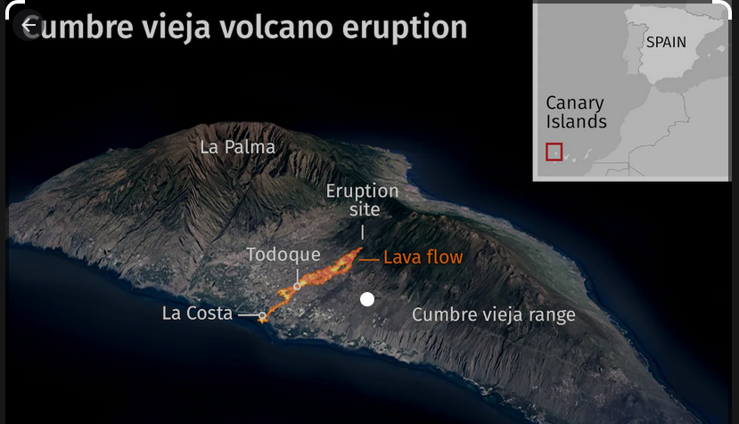
Nobody will forget an eruption at the Cumbre Vieja volcanic range, in the Spanish island of La Palma in the Canary Islands. It lasted 85 days from 19 September to 13 December 2021. it has been the longest known eruption of a volcano on La Palma.
The eruption caused the evacuation of around 7,000 people, and the lava flow was about 3.5 kilometer wide and about 6.2 kilometer long. It reached the sea, destroying more than 3,000 buildings

Slide 4
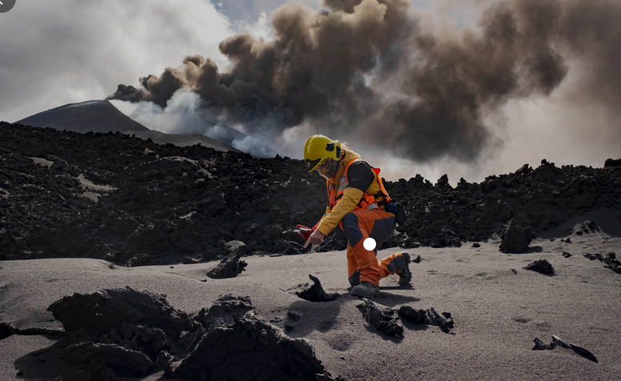
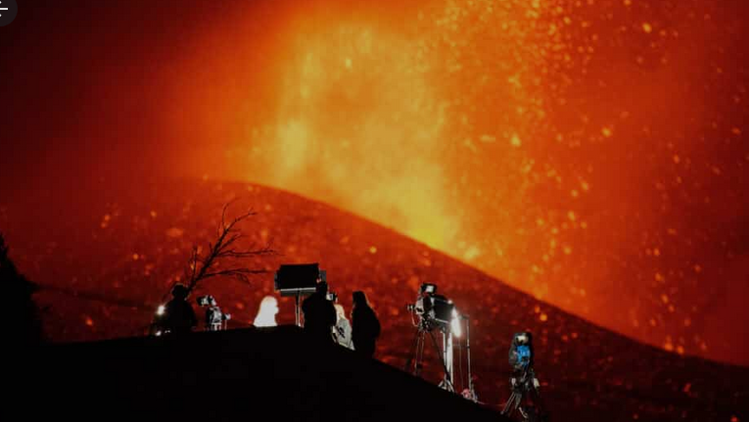
Complete the sentences.Use the future continuous
For the next few years, a group of vulcanologists …………………………..(live ) in la Palma.
Where …………………(they/stay )?
Well, they ……………………….(stay) in Santa Cruz, the capital of the island.But they ………………………
(not enjoy ) a holiday.
They ………………………..(work ) hard to know more about this volcano. They ……………………..(use) scientific instruments and research and they ……………………………….(send) their reports to labs in New York and in Iceland.

Slide 5
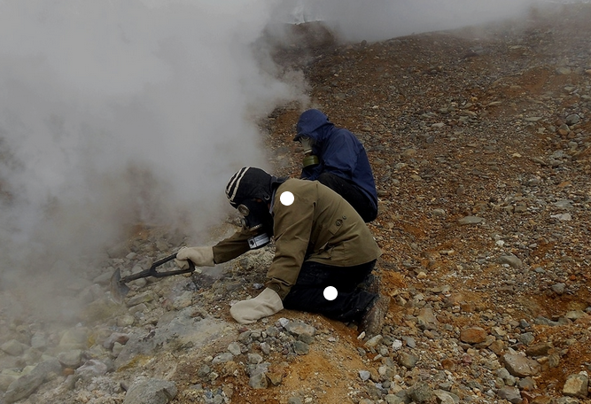
Complete the sentences.Use the future continuous
Next year Mathew …………………………..(study) Geology and volcanology at university.
He …………………………..( work ) hard because he wants to pass his exams .
When …………………..( he/take ) his final exams?
Well, he ………………..(do) his final exams in June but after that, he ………………(look for ) a job as a volcanologist.
He …………………(not work ) in England because England has no volcanos. So probably he ………………………..(fly) to La Palma to work!
What will you be doing next year ?

Slide 6
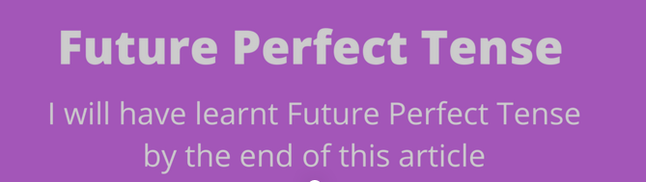
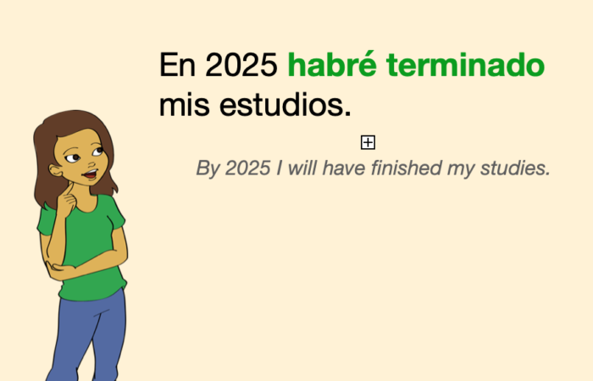

Slide 7


Slide 8
Complete with future perfect.
By 2030…..
I will ……………………(leave ) home.
I will …………………... (finish ) my studies.
I …………………………….(learn) to speak English.
I……………………………... ( get ) a job.
I …………………………….. (leave ) my home town.
I……………………………… ( buy ) my own flat!!
I hope volcanologists will ……………………..(discover) wnen Cumbre Vieja is next going to erupt !!

Slide 9
