Slide 1

Do you agree or not?

Slide 2
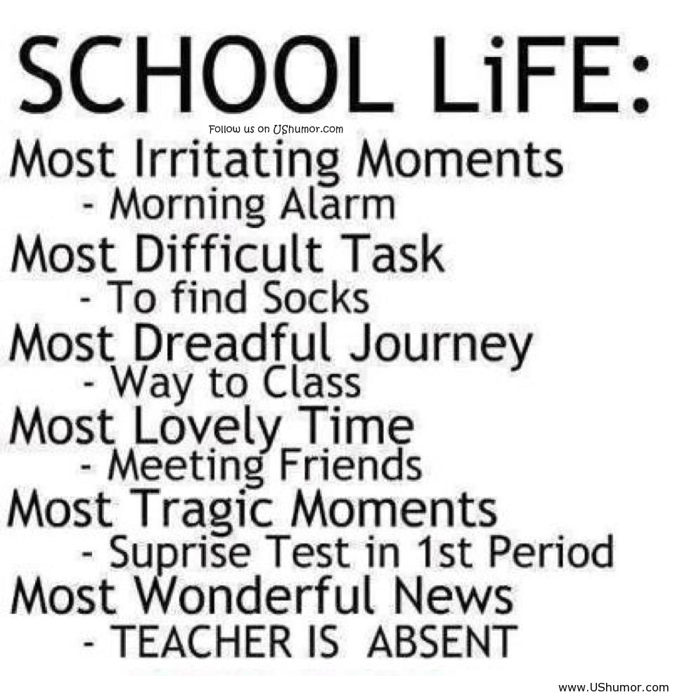

Slide 3
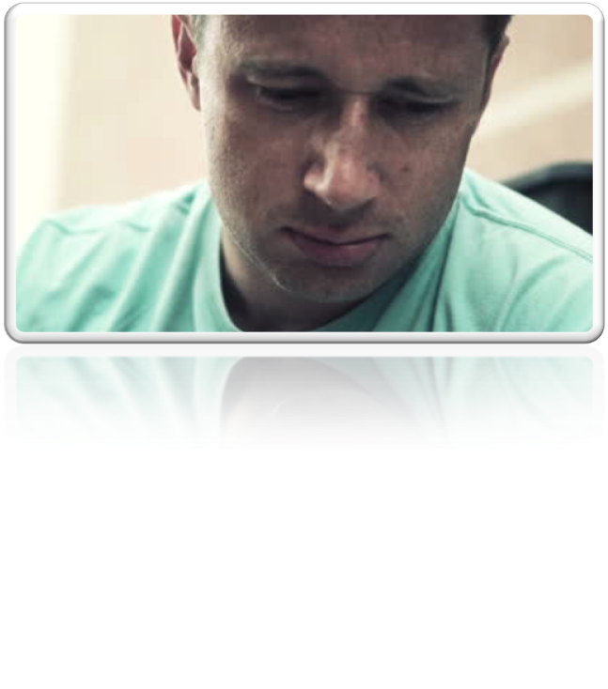
Poor man…!
What happened to him?

Slide 4
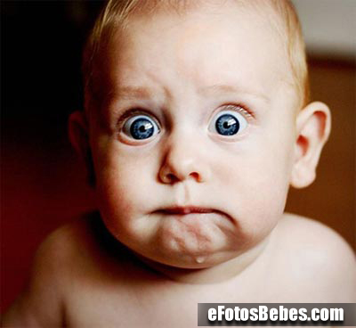
Firady was an auwfl day for Rboret. He fnisheid wrok ltae and tehn he had smoe porbelms on his way hmoe. The traiffcc was heviaer than eevr and it was gitteng fgogy. So he was ralley dleaeyd and terid!
And wehn he fainlly
got hmoe, he culdno’t
bileeve his eeys!

Slide 5
‘When I arrived home,
I realized I had been burgled! The burglars …

Slide 6
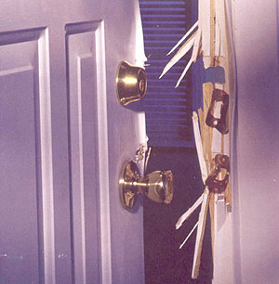
had broken …

Slide 7
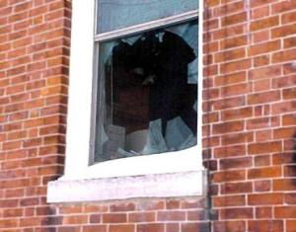
had smashed …

Slide 8
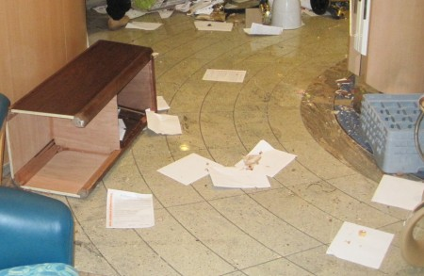
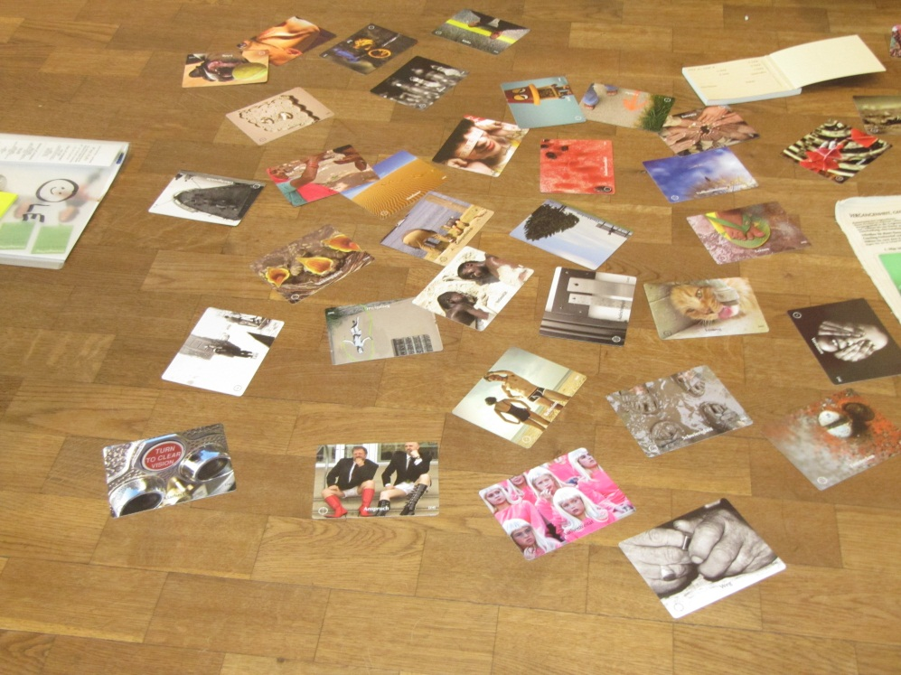
had scattered ……
on the floor

Slide 9
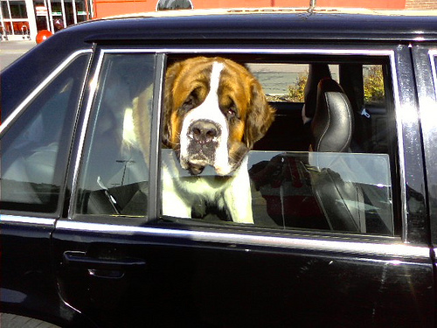
had locked …

Slide 10
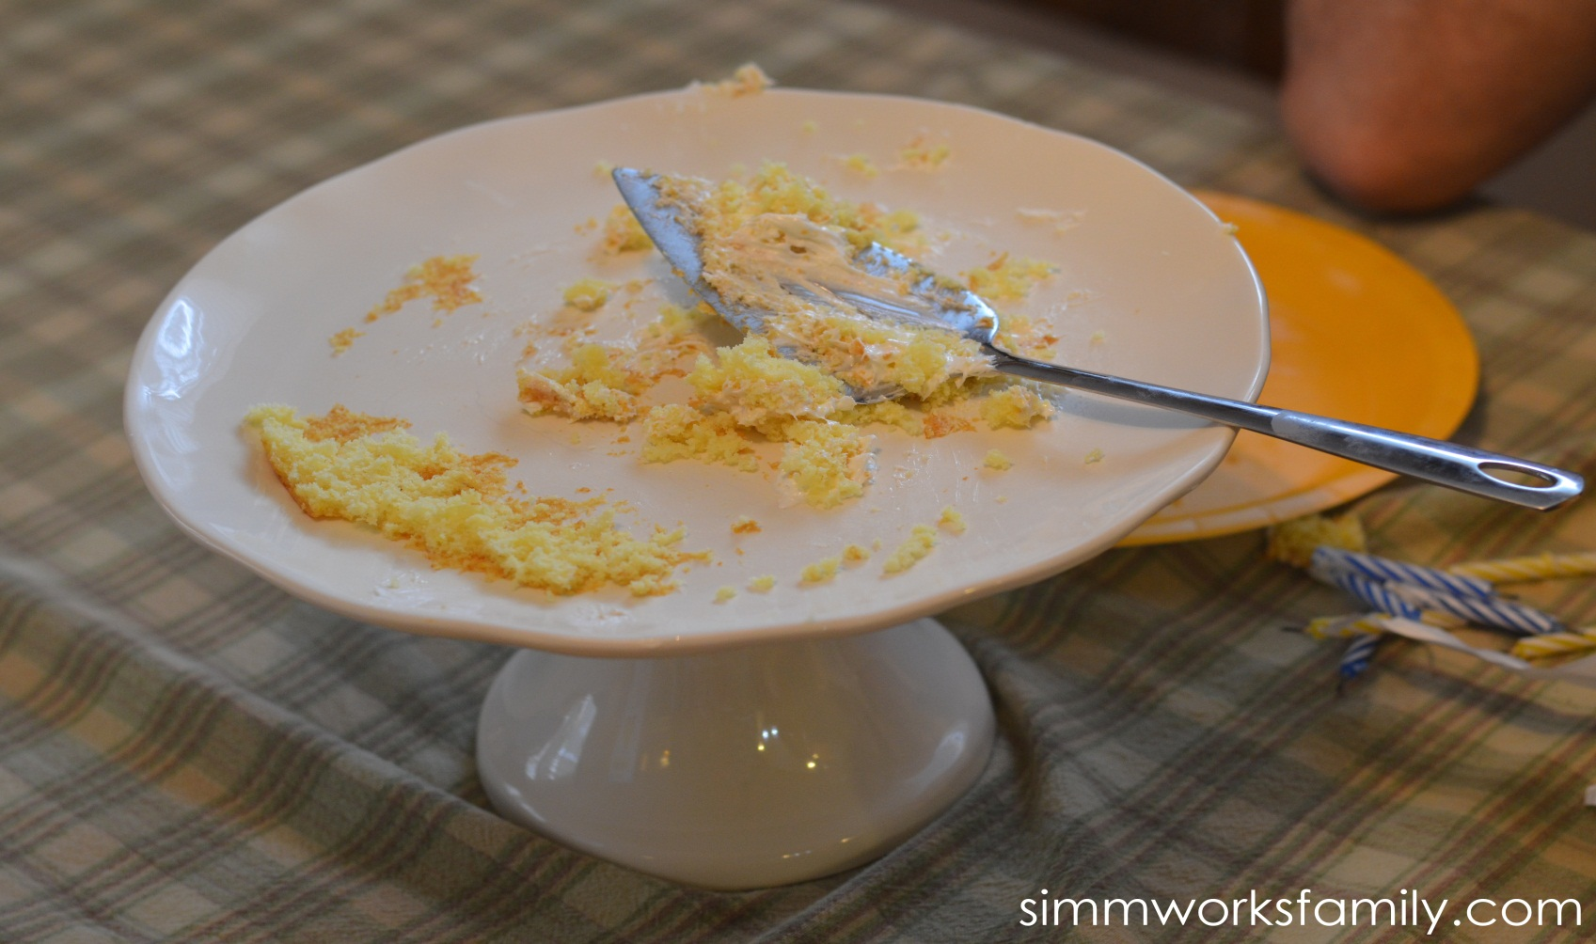
had eaten…

Slide 11
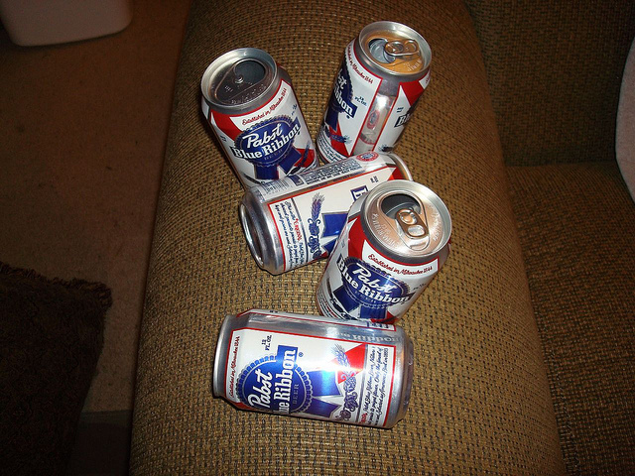
had
(drink)
...

Slide 12
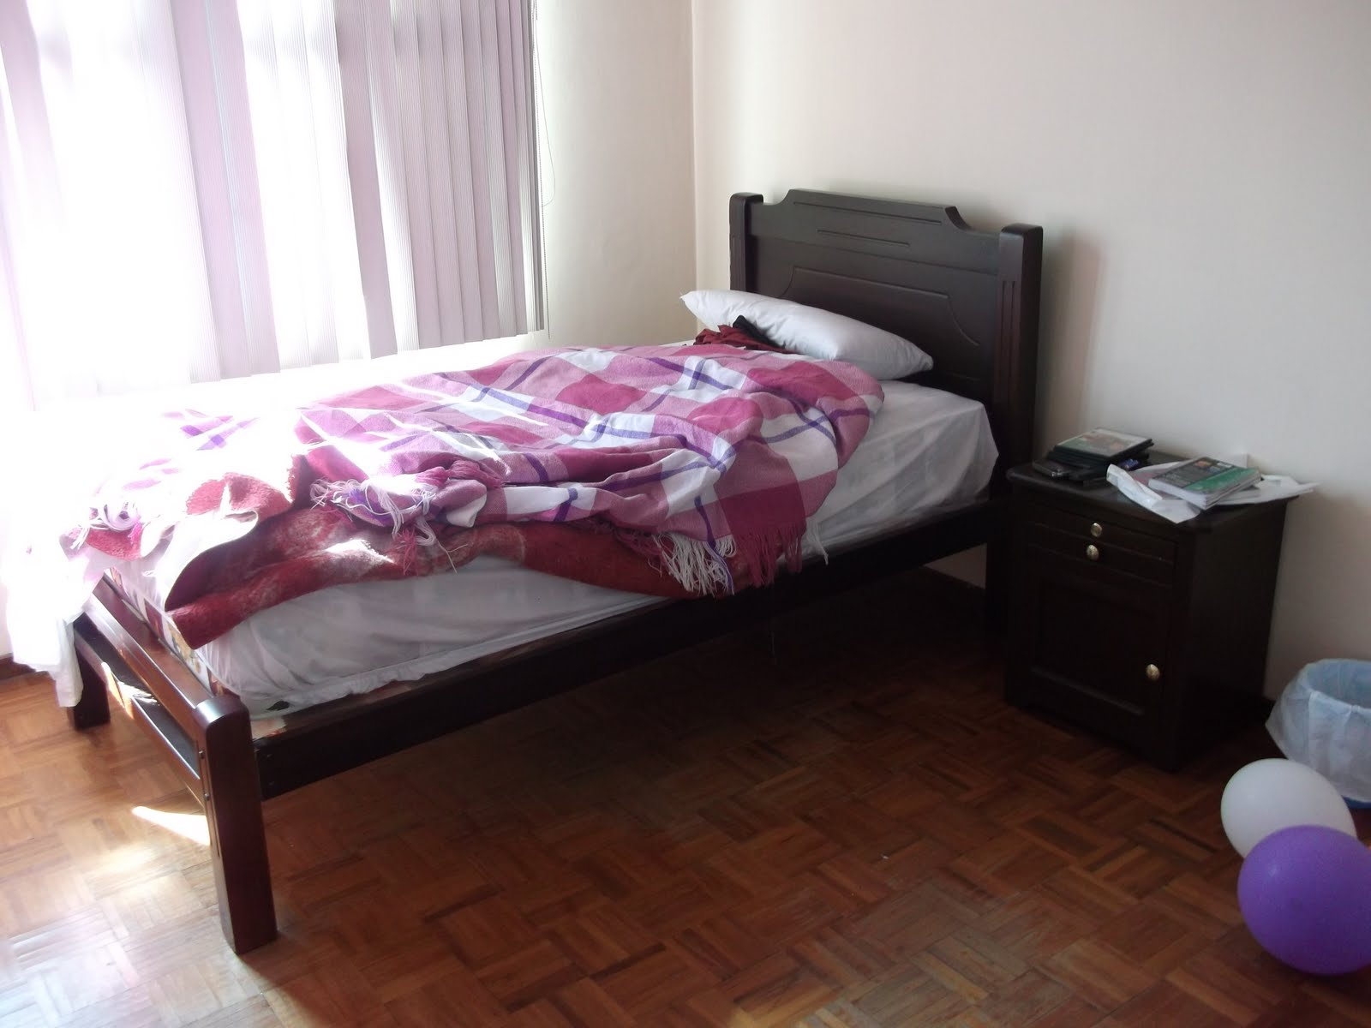
had (sleep) …

Slide 13
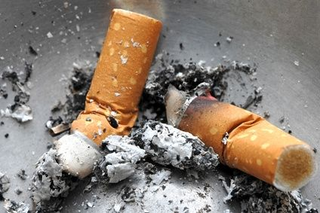
had (smoke) …

Slide 14
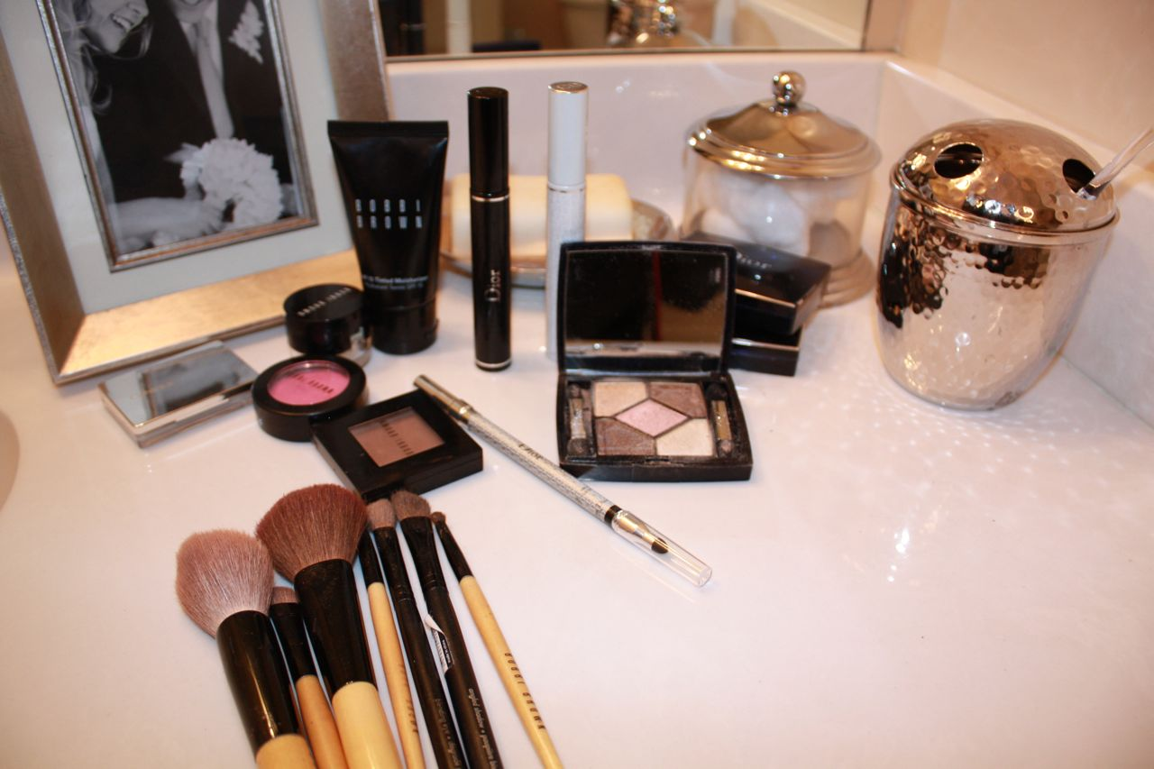
had (use) …

Slide 15
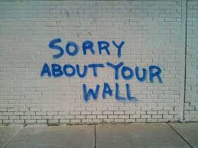
had
(write)
…

Slide 16
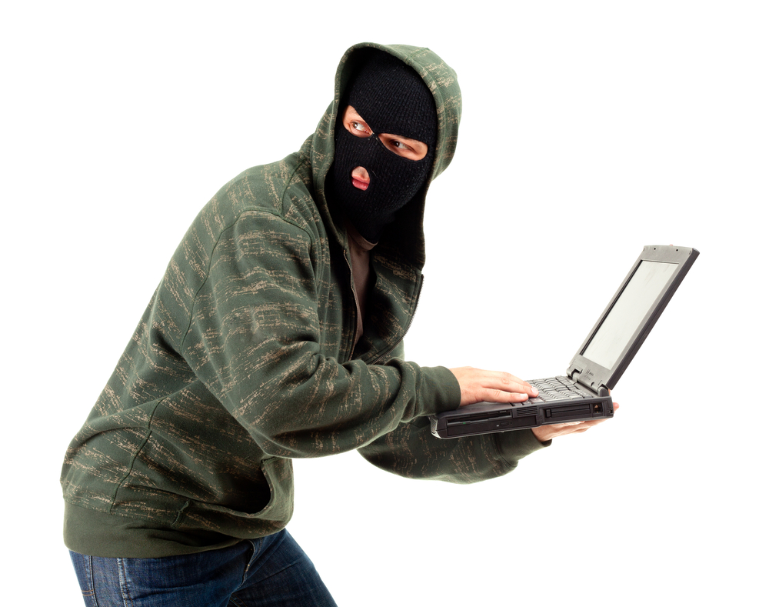
had
(steal)
…’

Slide 17
Poor Robert,
he will have to install an alarm system as soon as possible!

Slide 18


Slide 19


