Slide 1
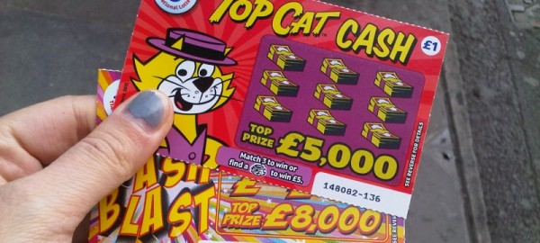
Diana ……….(buy) a scratch card on the way to the office

Slide 2
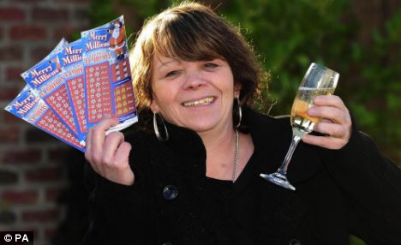
When she…..(arrive) at the office, she …(scratch) off the numbers and was delighted. She was the winner of 1 million pounds. She ….(orderer) champagne for her friends and …..(phone) her boyfriend

Slide 3
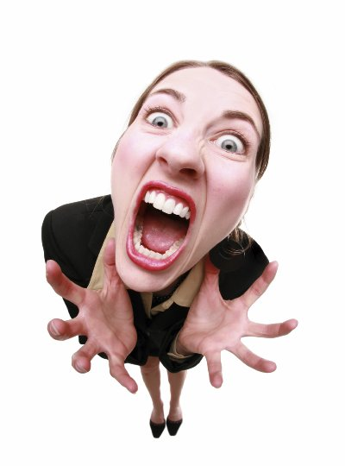
She ……(go) to see her boss and was very rude to him. She …..(resign) from her job for ever!!

Slide 4
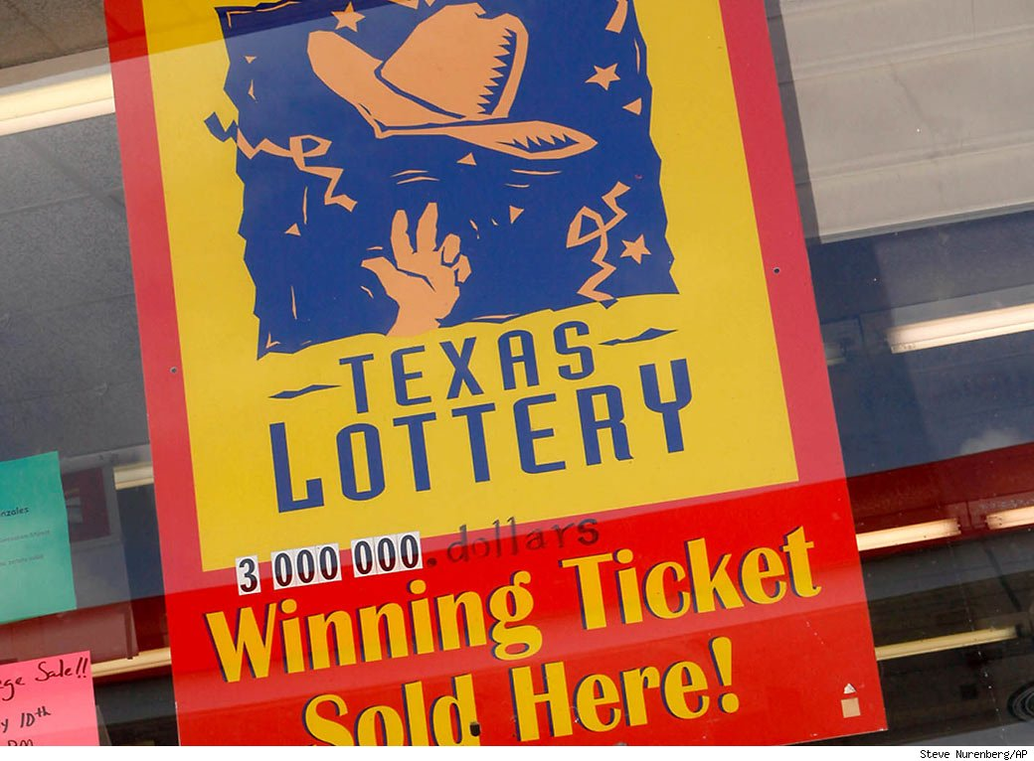
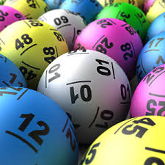
But when she ……(phone) the lottery company, they …..(tell) her that she didn´t have the winning number

Slide 5
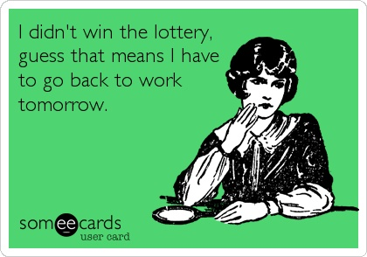
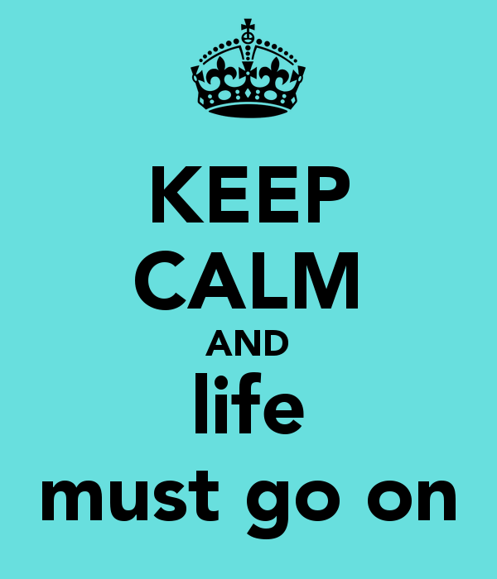
Diana….(feel) very embarrassed and …(go) to see her boss again. He….(feel) sorry for her and finally, she ……(can) go back to work

