Slide 1
Building Inclusive Societies through Enriching Plurilingual and Pluricultural Education”
CEFR/CV: Piloting new descriptor scales from a proposed extended version of the CEFR illustrative descriptors
Liceo Statale « Giorgio Spezia » Piloting Report

Slide 2
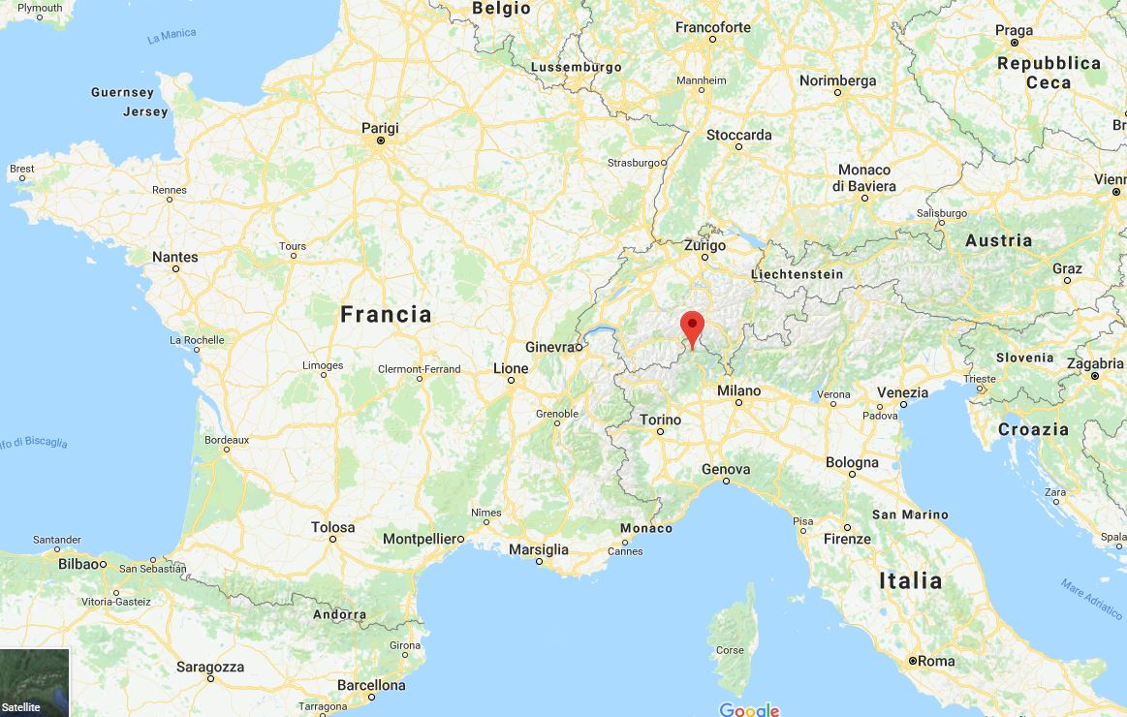
DOMODOSSOLA, PIEDMONT, ITALY

Slide 3
Liceo Statale « Giorgio Spezia »
http://liceospezia.eu/
Upper Secondary State School, student age range: 14/19
LEARNERS CURRENT SCHOOL YEAR: 669
STAFF: 95
FOUR SPECIALIZATIONS: SCIENCE, LANGUAGES, CLASSICS, SOCIAL STUDIES AND ECONOMY
LANGUAGES: ENGLISH, FRENCH, GERMAN, LATIN AND GREEK

Slide 4
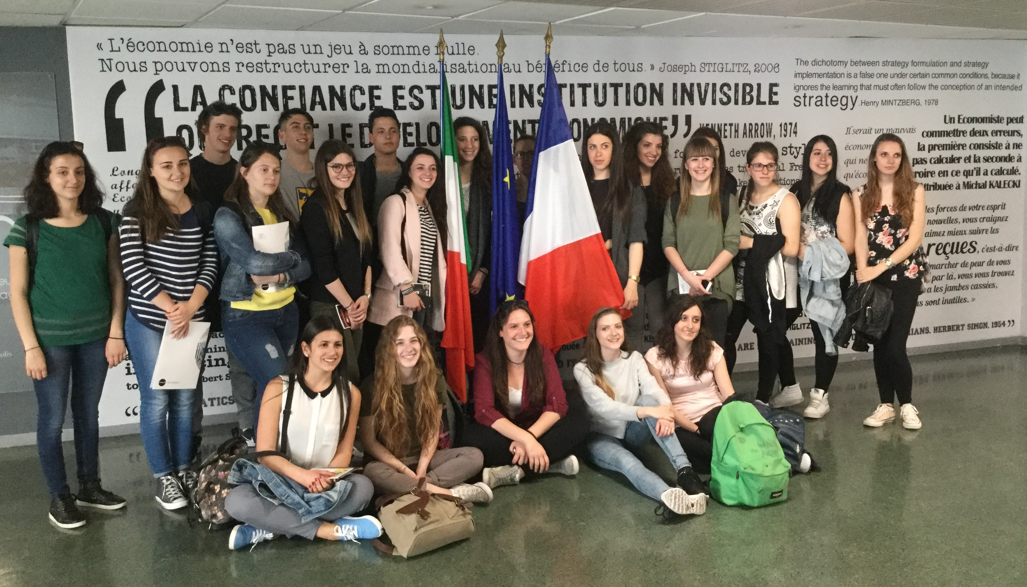
PROMOTING PLURILINGUAL AND PLURICULTURAL EDUCATION

Slide 5
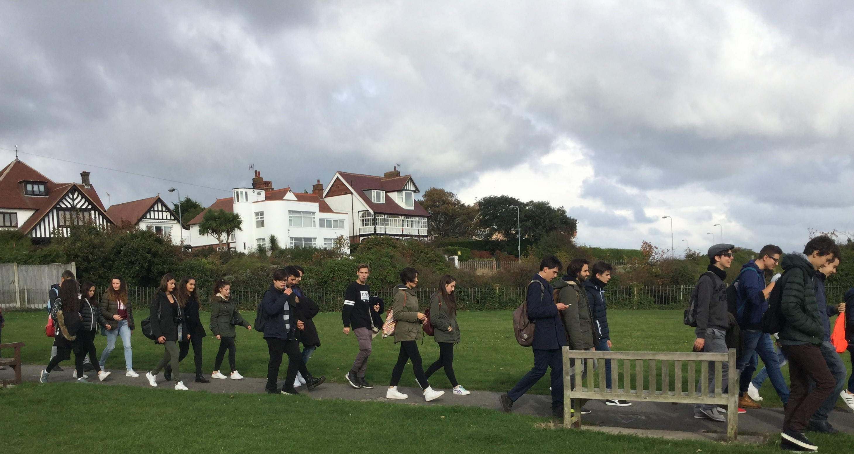
PROMOTING PLURILINGUAL AND PLURICULTURAL EDUCATION

Slide 6
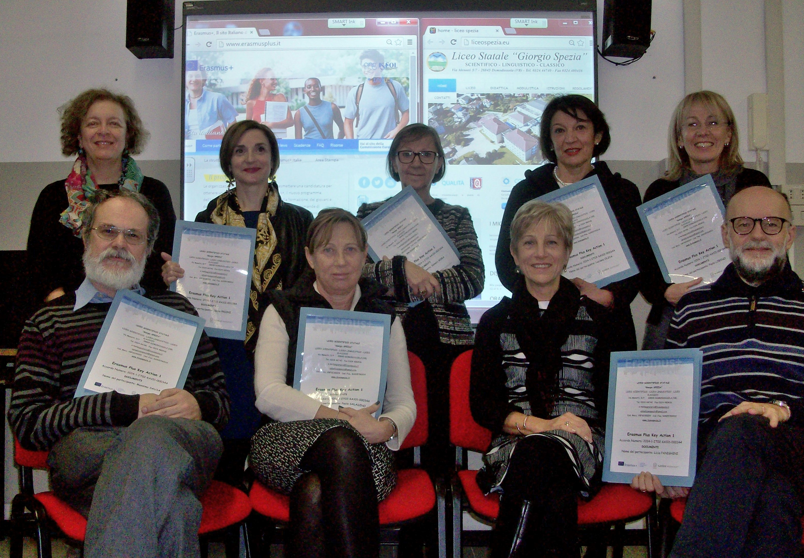
PROMOTING PLURILINGUAL AND PLURICULTURAL EDUCATION

Slide 7
PILOTING THE DESCRIPTORS
Number of classes in the pilot: 4 classes (93 students specializing in science):
Two fourth-years (IV BS & CS) and two third-years (III AS & CS)
Three hours per week
CEFR LEVEL: B1/B2
Scale(s) piloted:
    Reading as a leisure activity
    Expressing a personal response to literature (including film)
    Analysis and criticism of literature (including film)

Slide 8
PILOTING THE DESCRIPTORS -
PROCEDURE AND IMPACT
PROCEDURE
Assessing students’ appreciation of literature and film (conversation):
Expressing a personal response to literature (including film);
Comprehension and analysis of an unseen literary sample in the case of fourth years.
A text previously read together in class was given to third years.
IMPACT
Reflection on marking habits;
Importance of reading as a leisure activity;
More precise and performance-oriented in my assessment;
Assessment from the point of view of the can-do descriptors.
SUMMARY: The descriptors helped me to be more concentrated on the assessment from the point of view of the can-do descriptors and better evaluate the students’ performances rather than their knowledge of content.

Slide 9
PILOTING THE DESCRIPTORS -
ACTIVITIES & MATERIALS
ACTIVITIES:
Two different literary units per two classes.
Listening comprehension and note-taking;
Reading and listening;
Reading comprehension exercises;
Guided analysis of literary excerpts.
MATERIALS:
PowerPoint presentations;
Textbook;
DVDs;
CDs;
Online resources (BBC).

Slide 10
PILOTING THE DESCRIPTORS
MEDIA/BIBLIOGRAPHY & SITOGRAPHY
BIBLIOGRAPHY :
Textbook: Spiazzi, M., Tavella, M., Performer Compact, Zanichelli;
DVD: Elizabeth by Shekar Khapur;
DVD: Romeo + Juliet by Baz Luhrman;
DVD: Shakespeare in Love by John Madden;
DVD: Gulliver’s Travels by Rob Letterman;
Play: Hamlet, the musical By Palketto Stage
SITOGRAPHY:
http://www.bbc.co.uk/education/topics/z3vjmnb
http://www.bbc.co.uk/schools/gcsebitesize/english_literature/dramahamlet/
http://www.bbc.co.uk/schools/gcsebitesize/english_literature/dramaromeojuliet/
http://www.bbc.co.uk/education/guides/zfndmp3/revision/1
http://www.palchetto.it/stagione-teatrale/hamlet-the-musical
https://americanliterature.com/author/daniel-defoe/book/robinson-crusoe/summary

