Slide 1
Launching Conference for the CEFR Companion Volume with New Descriptors
Anthony Green
University of Bedfordshire

Slide 2
Key aspects of the CEFR for teaching and learning
innovative areas
  filling gaps in descriptor scales in 2001 publication
  fleshing out mediation and plurilingual/ pluricultural competence
building on success and responding to users:
  incorporating signing
  more fully defining ‘plus levels’
  new ‘Pre-A1’ level
  adding to scales for listening and reading
  descriptors for other communicative activities - online interaction, using telecommunications, expressing reactions to creative text and literature
enriching description at A1, and at C levels, particularly C2

Slide 3
Key aspects of the CEFR for teaching and learning
The CEFR in language education (p.27): the action-oriented approach (p.26)
CEFR is neutral (‘does not prescribe any particular pedagogic approach’, ‘raises questions rather than answering them’) BUT ‘not educationally neutral’
Presents language user/learner as ‘social agent,’ acting in social world; exerting agency in learning process.
A paradigm shift in both course planning and teaching, promoting learner engagement and autonomy.
Notes:
Wording is confusing ‘pedagogically neutral’, but not ‘educationally neutral’
the teaching and learning
process is driven by action, that it is action oriented.
It also clearly suggests planning backwards from learners’ real life communicative needs, with consequent alignment between curriculum, teaching and assessment.

Slide 4
Paradigm shift
The CEFR is… (p.28)
a tool to facilitate educational reform projects
a tool to assist the planning of curricula, courses and examinations by working backwards from what the users/learners need to be able to do in the language
shift away from
  syllabuses based on linear progression through language structures, or predetermined set of notions and functions
  deficiency perspective focusing on what the learners have not yet acquired.
shift towards
  syllabuses based on needs analysis, oriented towards real-life tasks and constructed around purposefully selected notions and functions.
  proficiency perspective guided by ‘Can do’ descriptors

Slide 5
‘Work backwards’ from needs profiles
…but users will need to look elsewhere for process
Notes:
Blue box with two options on p.42

Slide 6
Descriptors (p.23)
newly developed illustrative descriptor scales alongside existing ones;
schematic tables provided - grouping scales belonging to the same category (communicative language activities or aspects of competence);
short rationale presented for each scale, explaining thinking behind categorisation

Slide 7
Descriptors further explained
Descriptors are (p.41)
Illustrative: merely illustrations of competence in the area concerned at the different levels.
Focus on aspects that are new and salient; do not attempt to describe everything relevant in a comprehensive manner.
They remain open-ended and incomplete.
Illustrative descriptors are one source for the development of standards appropriate to the context concerned;
descriptors are not in themselves offered as standards

Slide 8
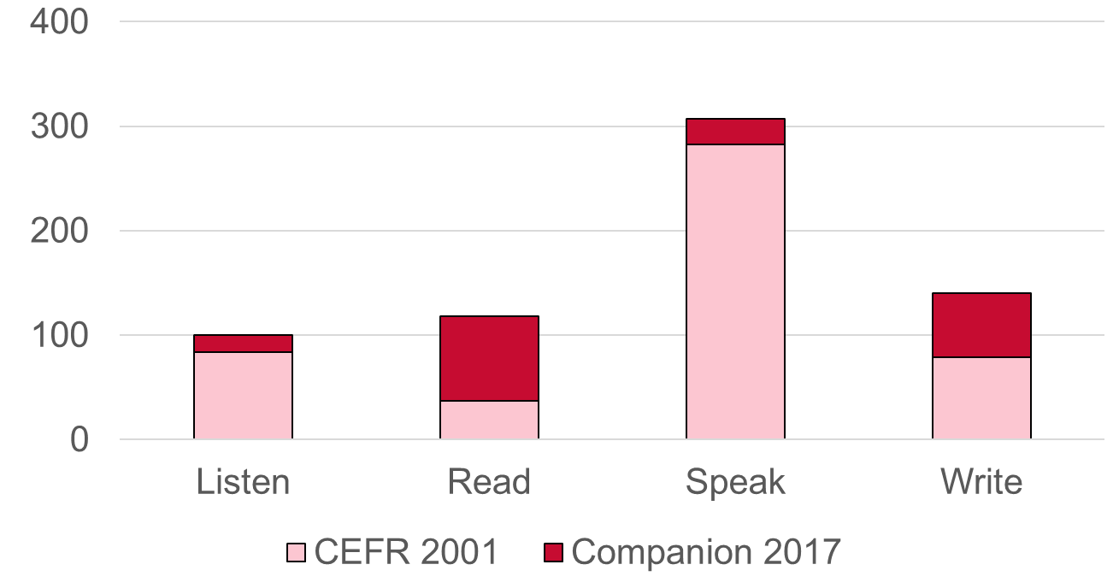
Descriptors by skill

Slide 9
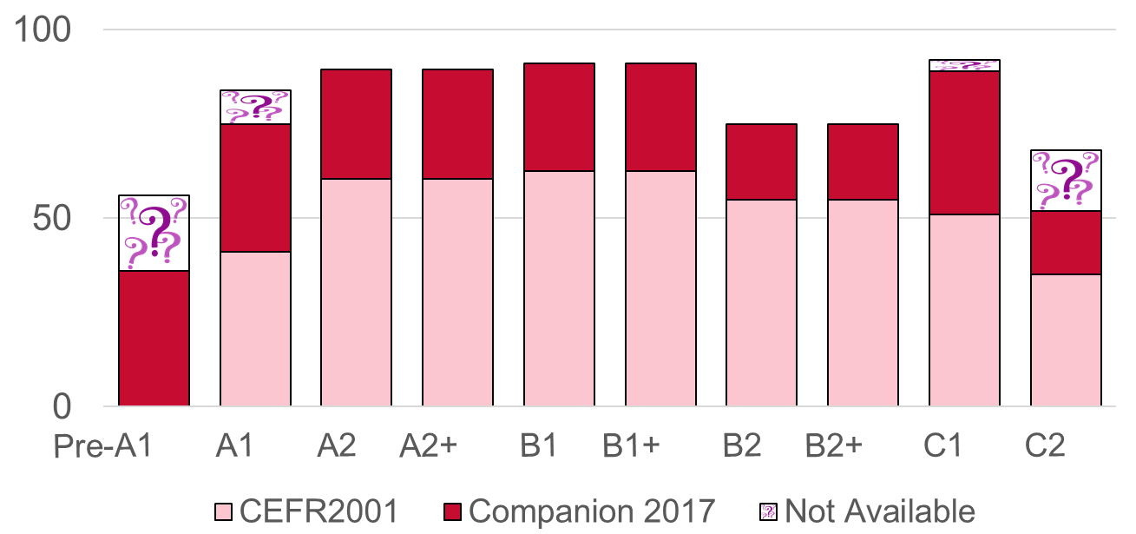
Descriptors by level
No descriptor available
 | 2001 | 2018
C2 | 25 | 19
C1 | 9 | 4
Notes:
7 new scales and pre-A1 level

Slide 10
Descriptor changes
15 descriptors adapted (7 at C2) across 12 scales
13 native speakers eliminated
Phonology intelligible rather than nativelike
Scaling back on absolutes:
  Has no difficulty with Can understand with ease virtually any kind of spoken language
Notes:
Native speakers – speakers of the target language

Slide 11
Elaboration of scales – conceptual bases
Overall phonological control
Intelligibility key factor for discriminating between levels. Focus on effort required from interlocutor to decode speaker’s message. Explicit mention of accent at all levels.
Key concepts operationalized in the scale include the following:
intelligibility: how much effort is required from the interlocutor to decode the speaker’s message;
the extent of influence from other languages spoken;
control of sounds;
control of prosodic features.

Slide 12
Appendix 6 – Examples of use in different domains for descriptors of online interaction and mediation activities
Can explain (in Language B) the relevance of specific information given in a particular section of a long, complex text (written in Language A).
PERSONAL | PUBLIC | OCCUPATIONAL | EDUCATIONAL
in an article, website, book or talk face-to-face/ online concerning current affairs or an area of personal interest or concern | from presentations at public meetings, from public documents explaining policy changes, political speeches | a business report, article, regulation or workplace policy | an article, book, reference book or lecture/presentation

Slide 13
Qualities of descriptors: what are the design principles?
Retain inconsistent wording: catch/ recognize/ follow/ understand etc.
Designing descriptors – what does a CEFR descriptor need to provide for users? What goes into a descriptor with definiteness, clarity, brevity & independence?
A task
A speech act/ speech event/ activity?
Themes/ topics/ situations?
Nature of input? Nature of output?
Performance qualities and limitations?
Restrictions, conditions and constraints?

