Slide 1

Completing the CEFR descriptive scheme: the CEFR Companion Volume
Brian North, Eurocentres Foundation

Slide 2
Presentation outline
Completing the descriptive scheme
Operationalising the scheme with new scales for:
- online interaction
- mediation (including reactions to creative text)
- plurilingual and pluricultural competence
- signing competences
Updating the 2001 set of scales
(including adding a few new scales)
Reinforcing the CEFR message
- learning, teaching, assessment

Slide 3
Presentation outline
Completing the descriptive scheme
Operationalising the scheme with new scales for:
- online interaction
- mediation (including reactions to creative text)
- plurilingual and pluricultural competence
- signing competences
Updating the 2001 set of scales
(including adding a few new scales)
Reinforcing the CEFR message
- learning, teaching, assessment

Slide 4
Presentation outline
Completing the descriptive scheme
Operationalising the scheme with new scales for:
- online interaction
- mediation (including reactions to creative text)
- plurilingual and pluricultural competence
- signing competences
Updating the 2001 set of scales
(including adding a few new scales)
Reinforcing the CEFR message
- learning, teaching, assessment

Slide 5
Four modes not Four skills
“Communication is an integral part of tasks where participants engage in
  interaction,
  production,
  reception,
  mediation,
  or a combination of two or more of these”
  (CEFR, p. 157)

Slide 6
CEFR descriptive scheme
Communicative language proficiency
General competences
Communicative language activities
Communicative language strategies
Communicative language competences
Declarative knowledge
Savoir
Skills and know-how
Savoir-faire
Existential competence
Savoir-être
Linguistic
Sociolinguistic
Pragmatic
Reception
Production
Interaction
Reception
Production
Interaction
Ability to learn
Savoir apprendre
Mediation
Mediation

Slide 7
CEFR descriptive scheme
Communicative language proficiency
General competences
Communicative language activities
Communicative language strategies
Communicative language competences
Declarative knowledge
Savoir
Skills and know-how
Savoir-faire
Existential competence
Savoir-être
Linguistic
Sociolinguistic
Pragmatic
Reception
Production
Interaction
Reception
Production
Interaction
Ability to learn
Savoir apprendre
Mediation
Mediation

Slide 8
Reception
Production

Slide 9
Listening
Reading
Speaking
Writing
Production

Slide 10
Reception
Production

Slide 11
Learner
Reception
Production
PrSpeaker/Hearerructi

Slide 12
Learner
Reception
Production
PrSpeaker/Hearerructi
FCode:
accuracy / fluency

Slide 13
Learner
Reception
Production
PrSpeaker/Hearerructi
FCode:
accuracy / fluency
Mobilising linguistic resources

Slide 14
Learner
Reception
Production
PrSpeaker/Hearerructi
FCode:
accuracy / fluency
Mobilising linguistic resources

Slide 15
Learner
Reception
Interaction
Production
PrSpeaker/Hearerructi
FCode:
accuracy / fluency
Mobilising linguistic resources

Slide 16
Learner
Social agent
Reception
Interaction
Production
PrSpeaker/Hearerructi
FCode:
accuracy / fluency
Mobilising linguistic resources

Slide 17
Learner
Social agent
Reception
Interaction
Production
PrSpeaker/Hearerructi
PrParticipantructi
FCode:
accuracy / fluency
Mobilising linguistic resources

Slide 18
Learner
Social agent
Reception
Interaction
Production
PrSpeaker/Hearerructi
PrParticipantructi
FCode:
accuracy / fluency
Negotiation of meaning
Mobilising linguistic resources

Slide 19
Learner
Social agent
Reception
Interaction
Mediation
Production
PrSpeaker/Hearerructi
PrParticipantructi
FCode:
accuracy / fluency
Negotiation of meaning
Mobilising linguistic resources

Slide 20
Learner
Social agent
Reception
Interaction
Mediation
Production
PrSpeaker/Hearerructi
PrParticipantructi
PrSocial agentructi
FCode:
accuracy / fluency
Negotiation of meaning
Mobilising linguistic resources

Slide 21
Learner
Social agent
Reception
Interaction
Mediation
Production
PrSpeaker/Hearerructi
PrParticipantructi
PrSocial agentructi
FCode:
accuracy / fluency
Negotiation of meaning
Co-construction of meaning
Mobilising linguistic resources

Slide 22
Learner
Social agent
Reception
Interaction
Mediation
Production
PrSpeaker/Hearerructi
PrParticipantructi
PrSocial agentructi
FCode:
accuracy / fluency
Negotiation of meaning
Co-construction of meaning
Mobilising linguistic resources
Mobilising general and linguistic competences

Slide 23
1960s-80s
21st century
Reception
Interaction
Mediation
Production
PrSpeaker/Hearerructi
PrParticipantructi
PrSocial agentructi
FCode:
accuracy / fluency
Negotiation of meaning
Co-construction of meaning
Mobilising linguistic resources
Mobilising general and linguistic competences

Slide 24
User/learner as social agent
Reception
Interaction
Mediation
Production
PrSpeaker/Hearerructi
PrParticipantructi
PrSocial agentructi
FCode: complexity,
accuracy / fluency
Negotiation of meaning
Co-construction of meaning
Mobilising linguistic resources
Mobilising general and linguistic competences

Slide 25
User/learner as social agent
Reception
Interaction
Mediation
Production
PrSpeaker/Hearerructi
PrParticipantructi
PrSocial agentructi
FCode: complexity,
accuracy / fluency
Negotiation of meaning
Co-construction of meaning
Mobilising general, plurilingual and pluricultural competences

Slide 26
Paradigm shift
The full operationalisation of the CEFR descriptive scheme implies:
a significant paradigm shift in language education

Slide 27
Paradigm shift
BEYOND: TO:
grammar use
language as code language as action/collaboration
four skills integrated modes of communic.
producing/receiving constructing meaning
unidimensional view multidimensional view
school subject life trajectory
native speaker proficient speaker
multilingualism plurilingualism
elitist education inclusive education

Slide 28
Presentation outline
Completing the descriptive scheme
Operationalising the scheme with new scales for:
- online interaction
- mediation (including reactions to creative text)
- plurilingual and pluricultural competence
- signing competences
Updating the 2001 set of scales
(including adding a few new scales)
Reinforcing the CEFR message
- learning, teaching, assessment

Slide 29
Process
Development (January 2014 – February 2015)
Validation (February 2015 – Febr 2016)
Analysis, revision (February – May 2016)
Consultation (June 2016 – February 2017)
Piloting (January – July 2017)
Finalisation (August-October 2017)

Slide 30
Process
Development (January 2014 – February 2015)
Validation (February 2015 – Febr 2016)
Analysis, revision (February – May 2016)
Consultation (June 2016 – February 2017)
Piloting (January – July 2017)
Finalisation (August-October 2017)

Slide 31
Consultation
Expert meeting (June 2015 & 2016)
Pre-consultation expert survey (August 2016)
Expert meeting (September 2016)
Main consultation (Oct 2016-Feb 2017)
  Member states
  Institutions: NGOs, cultural institutes, networks
  Individuals: survey participants, experts 500/800)
  Written submissions: (associations)

Slide 32
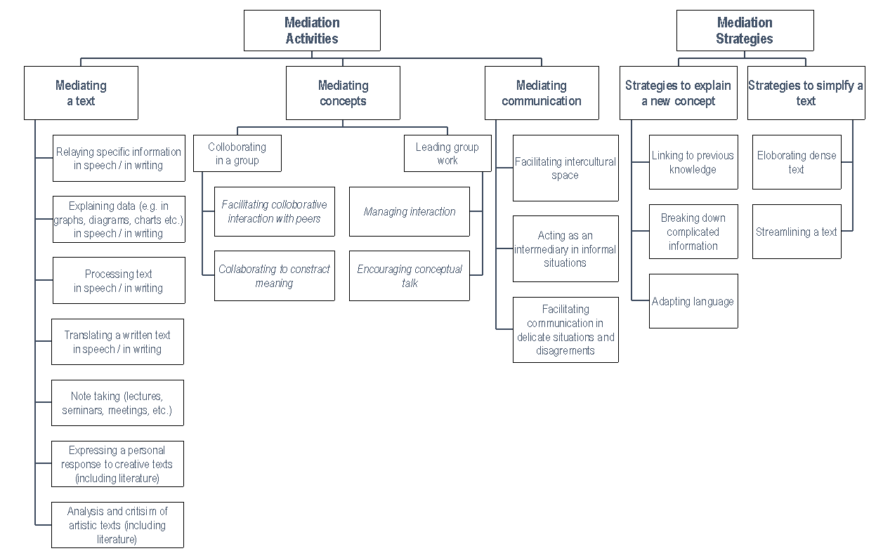
Mediation scales
  Mediating a text
  Relaying specific information
  Explaining data (e.g. in graphs)
  Processing text
  Translating written text
  Listening & note-taking
  Expressing a personal response to creative text (including literature)
  Analysis and criticism of creative text (including literature)
  Mediating concepts
  Facilitating collaborative interaction with peers
  Collaborating to construct meaning
  Managing interaction
  Encouraging conceptual
  thought
  Mediating communication
  Facilitating pluricultural space
  Acting as an intermediary
  Facilitating communication in delicate situations / disputes
  Mediation strategies
  Linking to previous knowledge
  Breaking down complicated information
  Adapting language
  Elaborating a dense text
  Streamlining a text
  Plurilingual/cultural competence
  Building on pluricultural repertoire
  Plurilingual comprehension
  Building on plurilingual repertoire

Slide 33
Mediation scales
  Mediating a text
  Relaying specific information
  Explaining data (e.g. in graphs)
  Processing text
  Translating written text
  Listening & note-taking
  Expressing a personal response to creative text (including literature)
  Analysis and criticism of creative text (including literature)
  Mediating concepts
  Facilitating collaborative interaction with peers
  Collaborating to construct meaning
  Managing interaction
  Encouraging conceptual
  thought
  Mediating communication
  Facilitating pluricultural space
  Acting as an intermediary
  Facilitating communication in delicate situations / disputes
  Mediation strategies
  Linking to previous knowledge
  Breaking down complicated information
  Adapting language
  Elaborating a dense text
  Streamlining a text

Slide 34
Mediation scales
  Mediating a text
  Relaying specific information
  Explaining data (e.g. in graphs)
  Processing text
  Translating written text
  Listening & note-taking
  Expressing a personal response to creative text (including literature)
  Analysis and criticism of creative text (including literature)
  Mediating concepts
  Facilitating collaborative interaction with peers
  Collaborating to construct meaning
  Managing interaction
  Encouraging conceptual
  thought
  Mediating communication
  Facilitating pluricultural space
  Acting as an intermediary
  Facilitating communication in delicate situations / disputes
  Mediation strategies
  Linking to previous knowledge
  Breaking down complicated information
  Adapting language
  Elaborating a dense text
  Streamlining a text

Slide 35
Mediation scales

Slide 36
Examples for domains
ONLINE Conversation & DISCUSSION |  | SITUATION (& ROLES)
 |  | PERSONAL | PUBLIC | OCCUPATIONAL | EDUCATIONAL
A1 | Can write very simple messages and personal online postings as a series of very short sentences about hobbies, likes/dislikes, etc., relying on the aid of a translation tool. | making contact online with remote friends and / or family - also as a possible language classroom simulation | public postings to a festival / event website - also as a possible language classroom simulation | as a contributor to a simple departmental social feed - also as a possible language classroom simulation | in a Q&A section of a school learning platform - also as a possible language classroom simulation
 | Can use formulaic expressions and combinations of simple words to post short positive and negative reactions to simple online postings and their embedded links and media, and can respond to further comments with standard expressions of thanks and apology. | making contact online with remote friends and / or family - also as a possible language classroom simulation |  |  | in a Q&A section of a school learning platform - also as a possible language classroom simulation

Slide 37
Sign Language scales
Signing competence
Linguistic
Pragmatic
Sociolinguistic
Sign language repertoire
Diagrammatical accuracy
Sign text structure
Setting and perspectives
Presence and effect
Signing fluency
Sociolinguistic appropriateness and cultural repertoire

Slide 38
Presentation outline
Completing the descriptive scheme
Operationalising the scheme with new scales for:
- online interaction
- mediation (including reactions to creative text)
- plurilingual and pluricultural competence
Updating the 2001 set of scales
(including adding a few new scales)
Reinforcing the CEFR message
- learning, teaching, assessment

Slide 39
Changes to 2001 Descriptors
No changes except when necessary
C-level enrichment
Pre-A1 & A1 enrichment
Plus levels filled out
Phonology – scale replaced
Native speaker - removed
Improvement of French translation

Slide 40
New Phonological Control Analytic Scale
Overall phonological control
Update to existing CEFR scale, foregrounding intelligibility
Sound recognition and articulation
Re: articulation, accentedness & intelligibility
Prosodic features
Re: prosody and intelligibility

Slide 41
New Phonological Control Analytic Scale
OVERALL PHONOLOGICAL CONTROL
B1: Pronunciation is generally intelligible; can approximate intonation and stress at both utterance and word levels. However, accent is usually influenced by other language(s)he/she speaks.
SOUND RECOGNITION AND ARTICULATION:
B1: Is generally intelligible throughout, despite regular mispronunciation of individual sounds and words he/she is less familiar with.
PROSODIC FEATURES
B1: Can convey his/her message in an intelligible way in spite of a strong influence on stress, intonation and/or rhythm from other language(s) he/she speaks.

Slide 42
2001 scales – new ones
RECEPTION:
Reading as a leisure activity
PRODUCTION:
Sustained monologue: Giving information
INTERACTION:
Using telecommunications

Slide 43
2001 scales – Rationales
Reading as a leisure activity involves fiction and nonfiction, literature, magazine and newspaper articles, blogs, biographies, etc.
Key concepts operationalized:
length, variety of texts and whether there are illustrations;
type of texts, from simple descriptions to contemporary and classical writings in different genres;
topics, from everyday topics to a full range of abstract and literary topics;
type of language: from simple to stylistically complex;
ease of reading: from guessing with the help of images, to appreciating the full variety of texts;
depth of understanding: from understanding in outline to understanding implicit meaning.

Slide 44
Changes to 2001 Descriptors

Slide 45
Presentation outline
Completing the descriptive scheme
Operationalising the scheme with new scales for:
- online interaction
- mediation (including reactions to creative text)
- plurilingual and pluricultural competence
Updating the 2001 set of scales
(including adding a few new scales)
Reinforcing the CEFR message
- learning, teaching, assessment

Slide 46
needs analysis
and
needs profiles

Slide 47
Needs Profile

Slide 48
proficiency profile
not just
proficiency level

Slide 49
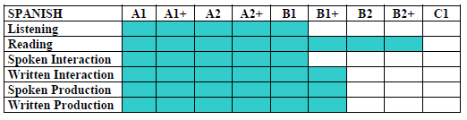
Proficiency Profile

Slide 50
Uses of the descriptors
relating learning aims to real world language use, thus giving a framework to action-oriented learning
providing transparent ‘signposting’ to learners, parents, sponsors
offering a ‘menu’ to negotiate priorities with adult learners in a process of ongoing needs analysis
suggesting classroom tasks to teachers, usually tasks that will involve activities described in several descriptors
introducing criterion-referenced assessment with the criteria relating to an external framework (CEFR)
→ teacher assessment / self-assessment

Slide 51
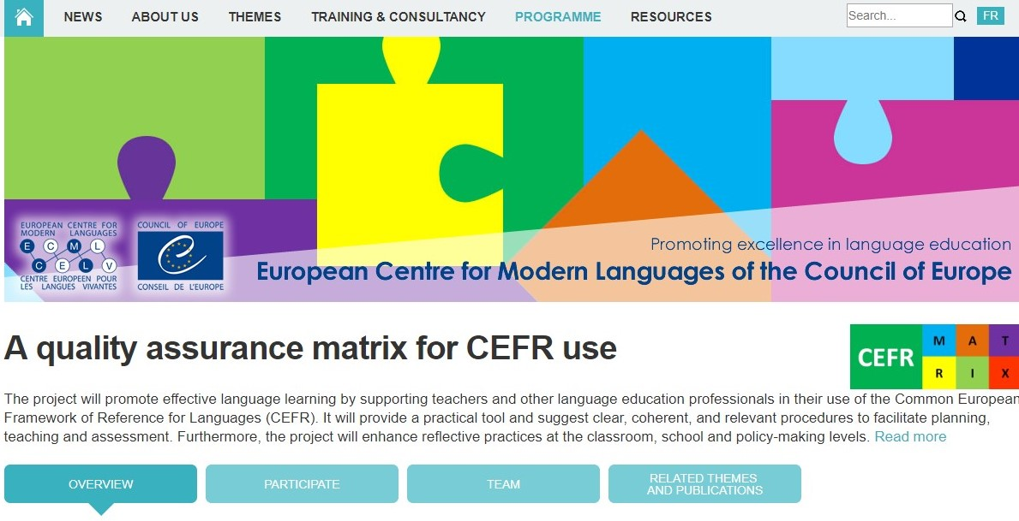
QualiMatrix project
online tool to help plan and/or self-audit CEFR implementation
Planning / Implementation / Evaluation / Reflection
Responses to questions generate graphic profiles & feedback
30+ Examples of promising practices

Slide 52
QualiMatrix project
online tool to help plan and/or self-audit CEFR implementation
Planning / Implementation / Evaluation / Reflection
Responses to questions generate graphic profiles & feedback
30+ Examples of promising practices

Slide 53
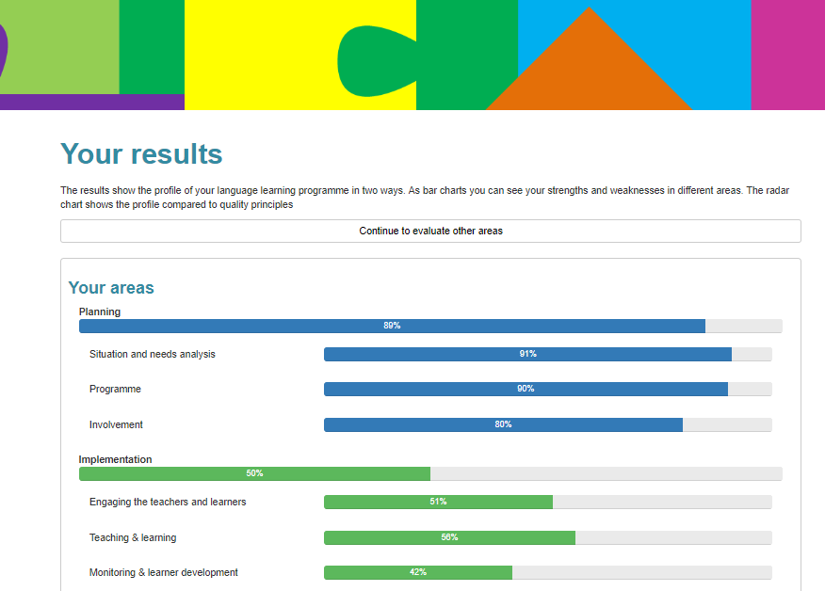
QualiMatrix project

Slide 54
Conclusions
The CEFR Companion Volume:
underlines core messages of the CEFR for teaching and learning
provides descriptors that can inspire more integrated, richer, collaborative classroom tasks
encourages the promotion of cross-linguistic mediation and the plurilingual/pluricultural competence it requires

Slide 55
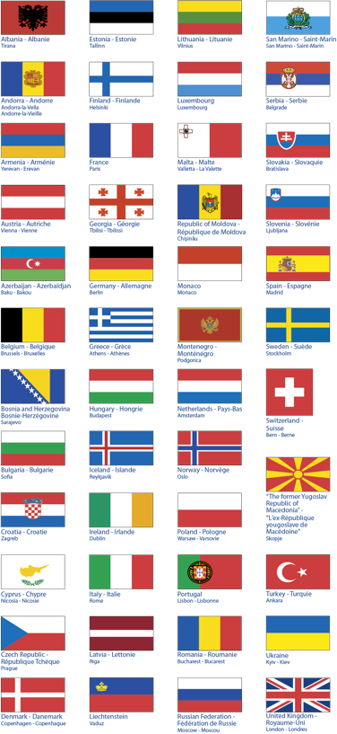
merci grazie gracias tesçekkurler
danke faleminderit obrigado
thank you efcharisto

