Slide 1

Where do you stand?
Education
Notes:
https://owlcation.com/academia/100-Debate-Topics - credit

Slide 2
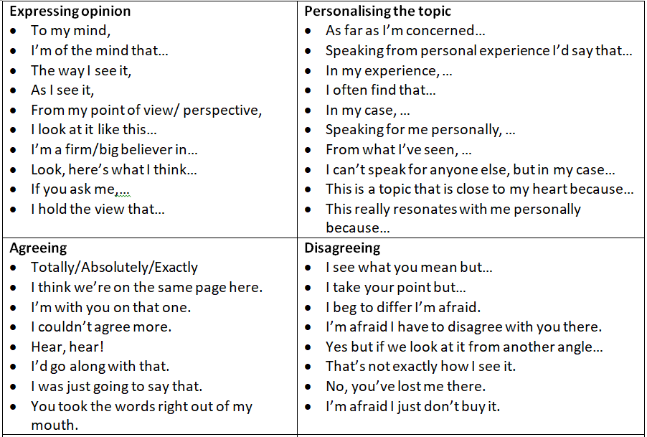
A college/university degree is essential for getting a good job.

Slide 3
Student loans are exploitative.

Slide 4
Boarding school is harmful to students.

Slide 5
University should be free for everyone.

Slide 6
Homework should be abolished.

Slide 7
Maths & science are more important than music and art.

Slide 8
Homeschooling is better than traditional schooling.

Slide 9
Private schools should be banned.

Slide 10
School uniforms should be mandatory.

Slide 11
School does not prepare students for life in the real world.

Slide 12
Students should be taught life skills such as filling in a tax return.

Slide 13
Studying a foreign language should be compulsory.

Slide 14
Teachers should be paid as much as doctors.

Slide 15
Schools should have armed guards.

Slide 16
School has got easier since I was a child.

Slide 17
Corporal punishment should be allowed in schools to improve discipline.

Slide 18
Students should be grouped based on their ability in all subjects.

