Slide 1

DIRECT AND INDIRECT SPEECH

Slide 2

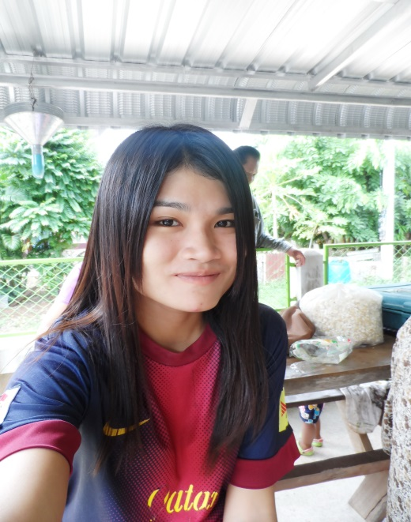
BY
MISS WAREE ARDKAMON
B.BD. 3.4
ID.NO. 5480108426

Slide 3
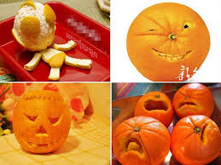
You can answer the question "What did he/she say?" in two ways:
by repeating the words spoken (direct speech)
by reporting the words spoken (indirect or reported speech).

Slide 4
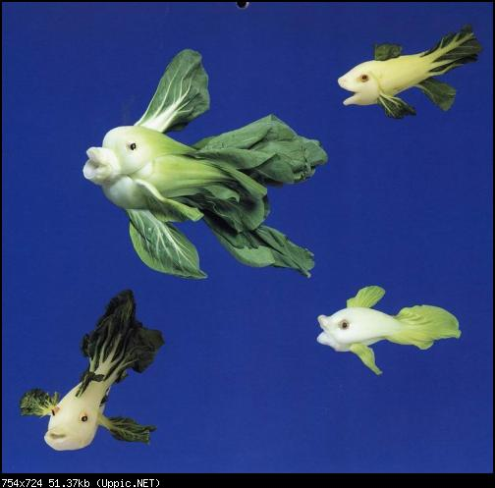
Direct Speech
Direct speech repeats, or quotes, the exact words spoken. When we use direct speech in writing, we place the words spoken between inverted commas ("....") and there is no change in these words. We may be reporting something that's being said NOW (for example a telephone conversation), or telling someone later about a previous conversation
Examples
She says "What time will you be home?"
She said "What time will you be home?" and I said "I don't know! "
"There's a fly in my soup!" screamed Simone.
John said, "There's an elephant outside the window."

Slide 5

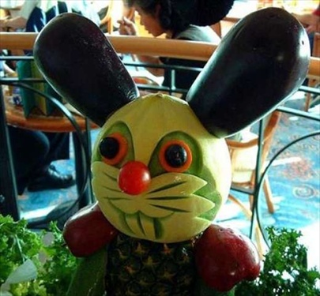
Reported Speech
Reported speech is usually used to talk about the past, so we normally change the tense of the words spoken. We use reporting verbs like 'say', 'tell', 'ask', and we may use the word 'that' to introduce the reported words. Inverted commas are not used.
Examples
She said, "I saw him." She said that she had seen him.
'That' may be omitted: She told him that she was happy.
She told him she was happy.
'Say' and 'tell':
Use 'say' when there is no indirect object: He said that he was tired. Always use 'tell' when you say who was being spoken to (i.e. with an indirect object): He told me that he was tired.
'Talk' and 'speak' are used:
- to describe the action of communicating: He talked to us.
She was speaking on the telephone.
with 'about' to refer to what was said: He talked (to us) about his parents.

Slide 6

Tense Changes When Using Reported Speech
Direct Speech | Indirect Speech
Present simple Tense | Past simple Tense
Present continuous Tense | Past continuous Tense
Past simple Tense | Past perfect Tense
Past Continuous Tense | Past Perfect Continuous Tense
Present perfect Tense | Past perfect Tense
Future simple Tense (will) | Future in past forms Tense (would)
Can | Could
May | Might
Shall | Should
Must | Had to

Slide 7

Time Changes When Using Reported Speech
Direct Speech | Indirect Speech
ago | before, earlier
a year/month ago | a year/month before, the previous year/month
last… (night/week/moth/year) | the…before, the previous…
next… (night/week/moth/year) | the following…, the…after
now | then, at that time
the day before yesterday | two days before
the day after tomorrow | Later in two days time, two days late
today | that day
tomorrow | the following day, the next day
tonight | that night
yesterday | the day before, the previous day

Slide 8
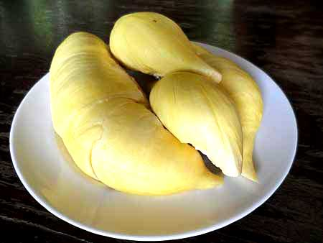
Place Changes When Using Reported Speech
Direct Speech | Indirect Speech
here | there
these | those
this | that

Slide 9

Question Forms and Reported Speech
1)Normal word order is used in reported questions, that is, the subject comes before the verb, and it is not necessary to use ‘ do' or 'did':
"Where does Peter live?" She asked him where Peter lived.
2)Yes / no questions: This type of question is reported by using
'ask' + 'if / whether + clause:
"Do you speak English?" He asked me if I spoke English.
"Are you British or American?" He asked me whether I was British or American.
"Is it raining?" She asked if it was raining.
3)Question words: this type of question is reported by using 'ask' (or another verb like 'ask') + question word + clause. The clause contains the question, in normal word order and with the necessary tense change.
" What is your name?" he asked me. He asked me what my name was.
"How old is your mother?", he asked. He asked how old her mother was.

Slide 10

ORDERS, REQUESTS, SUGGESTIONS
1)When we want to report an order or request, we can use a verb like 'tell' with a to-clause.
Example
He told me to go away.
The pattern is verb + indirect object + to-clause.
(The indirect object is the person spoken to.)
Other verbs used to report orders and requests in this way are: command, order, warn, ask, advise, invite, beg, teach, forbid.
Examples
The doctor said to me, "Stop smoking!". The doctor told me to stop smoking.
"Get out of the car!" said the policeman. The policeman ordered him to get out of the car.
"Could you please be quiet," she said. She asked me to be quiet.
The man with the gun said to us, "Don't move!" The man with the gun warned us not to move.

Slide 11
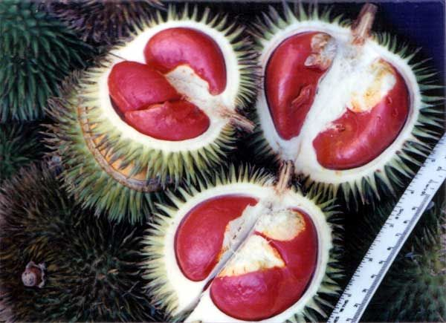
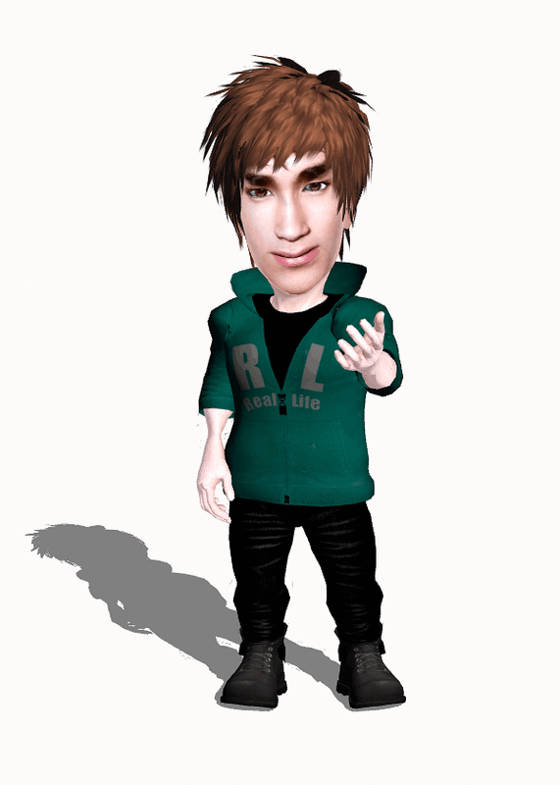
2) Requests for objects are reported using the pattern ask + for + object:
Examples
"Can I have an apple?", she asked. She asked for an apple
"Can I have the newspaper, please?" He asked for the newspaper.
"May I have a glass of water?" he said. He asked for a glass of water.
"Sugar, please." She asked for the sugar.
"Could I have three kilos of onions?" He asked for three kilos of onions.

Slide 12

3)Suggestions are usually reported with a that-clause. 'That' and 'should' are optional in these clauses:
She said: "Why don't you get a mechanic to look at the car?" She suggested that I should get a mechanic to look at the car. OR She suggested I get a mechanic to look at the car.
Other reporting verbs used in this way are: insist, recommend, demand, request, propose.
Examples
"It would be a good idea to see the dentist", said my mother. My mother suggested I see the dentist.
The dentist said, "I think you should use a different toothbrush". The dentist recommended that I should use a different toothbrush.
My manager said, "I think we should examine the budget carefully at this meeting." My manager proposed that we examine the budget carefully at the meeting.
"Why don't you sleep overnight at my house?" she said. She suggested that I sleep overnight at her house.

Slide 13
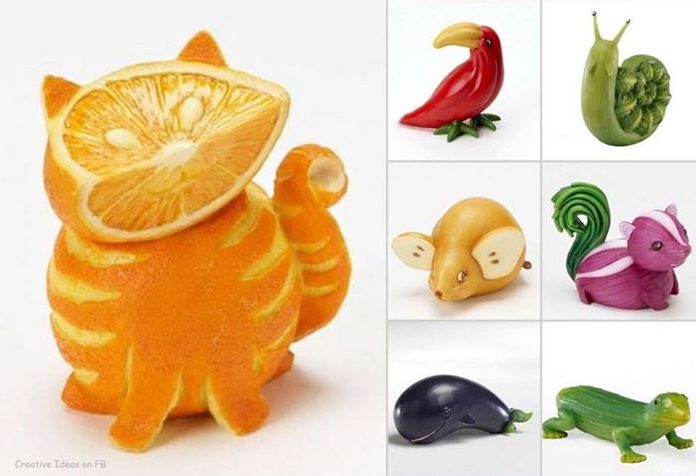
HOPES, INTENTIONS & PROMISES
When we report an intention, hope or promise, we use an appropriate reporting verb followed by a that-clause or a to-infinitive:
"I'll pay you the money tomorrow." He promised to pay me the money the next day. He promised that he would pay me the money the next day.
Other verbs used in this pattern include: hope, propose, threaten, guarantee, swear.
Examples
"I'll be back by lunchtime."
He promised to be back by lunchtime.
He promised that he would be back by lunchtime.
"We should arrive in London before nightfall."
They hoped to arrive in London before nightfall.
They hoped they would arrive in London before nightfall.
"Give me the keys to the safe or I'll shoot you!"
He threatened to shoot me if I didn't give him the keys to the safe.

Slide 14


Summary of reporting verbs
1.Verbs followed by 'if' or 'whether' + clause:
Ask know remember say see
2.Verbs followed by a that-clause:
Add admit agree announce answer argue boast claim comment complain confirm consider deny doubt estimate explain fear feel insist mention observe persuade propose remark remember repeat reply report reveal say state suggest suppose tell think understand warn
3.Verbs followed by either a that-clause or a to-infinitive:
Decide expect guarantee hope promise swear threaten

Slide 15
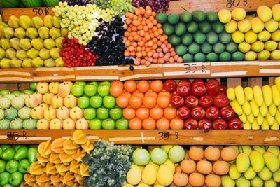

4. Verbs followed by a that-clause containing should (but note that it may be omitted, leaving a subject + zero-infinitive):
Advise beg demand insist prefer propose recommend request suggest
5. Verbs followed by a clause starting with a question word:
Decide describe discover discuss explain forget guess imagine know learn realise remember reveal say see suggest teach tell think understand wonder
6.Verbs followed by object + to-infinitive
Advise ask beg command forbid instruct invite teach tell warn

Slide 16
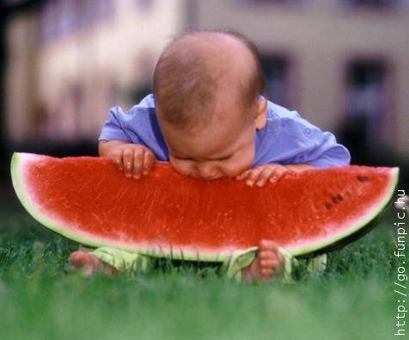
THANK YOU SO MUCH

