Slide 1
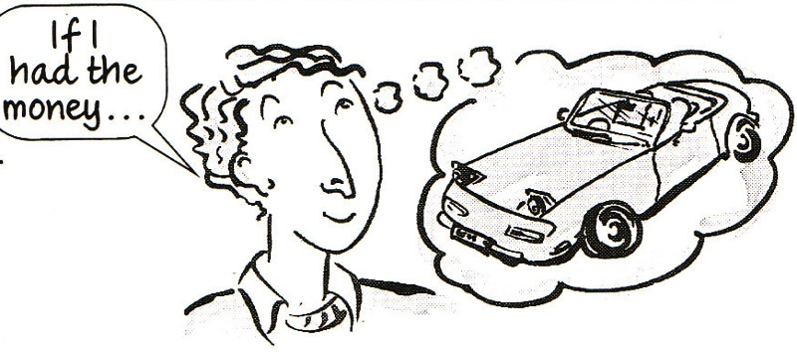
Conditionals
“If ifs and ands were pots and pans…”

Slide 2
General Truth (zero)
If-clause
If + present simple
Main clause
present simple
Used to express something which is always true. We can also use when instead of if.

Slide 3

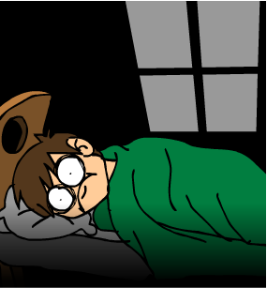
Zero Conditionals
Main clause
I don’t sleep well.
If-clause
e.g. If I drink coffee at night,

Slide 4
Real / possible present (first)
If-clause
If + present simple
Main clause
Will + verb
Used to express real or very probable situations in the present or future.

Slide 5


First Conditionals
If-clause
If you call me (which you might)
Main clause
I will go to the cinema with you

Slide 6
Unreal present (second)
If-clause
If + past simple or past continuous
Main clause
Would + verb
Used to express hypothetical situations which are contrary to the facts in the present, and therefore, are unlikely to happen in the present or future.

Slide 7

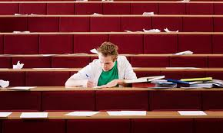
Second Conditionals
If-clause
If you studied harder (which you never do)
Main clause
you would know that (which you never do)

Slide 8
Unreal past (third)
If-clause
If + past perfect
Main clause
Would have + participle
Used to express hypothetical situations which are contrary to the facts in the past. Also used to express regrets or criticism.

Slide 9
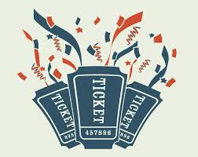

Third Conditionals
If-clause
If I had bought a ticket (which I didn’t)
Main clause
I would have gone to the concert (but I did not)

Slide 10
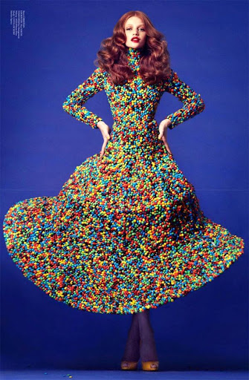
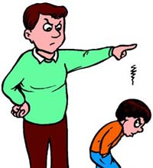
In pairs, complete the sentences so that they are real for you:
If I wore whatever I pleased to school...
I will be grounded for life if...

Slide 11
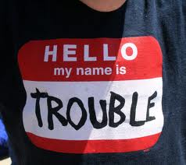
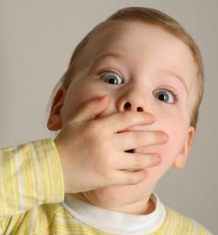
A couple more examples:
My best friend wouldn’t have gotten into trouble if...
If I could voice all my opinions freely...

Slide 12
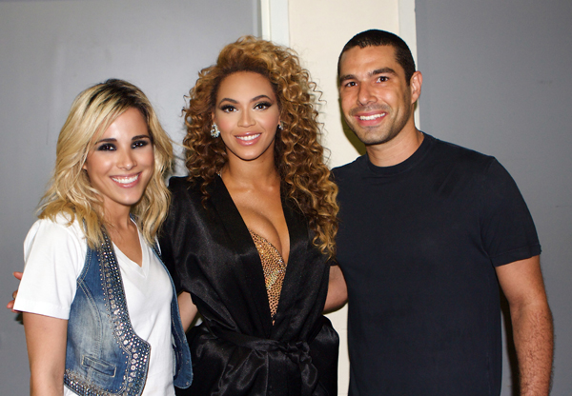
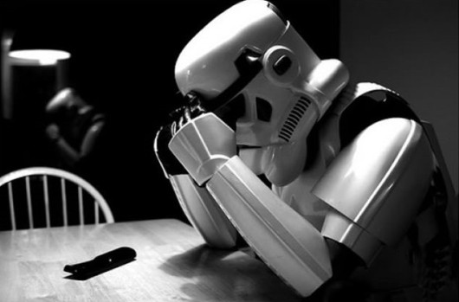
And others...
If I became friends with somebody famous...
If I had made different decisions in life...

Slide 13
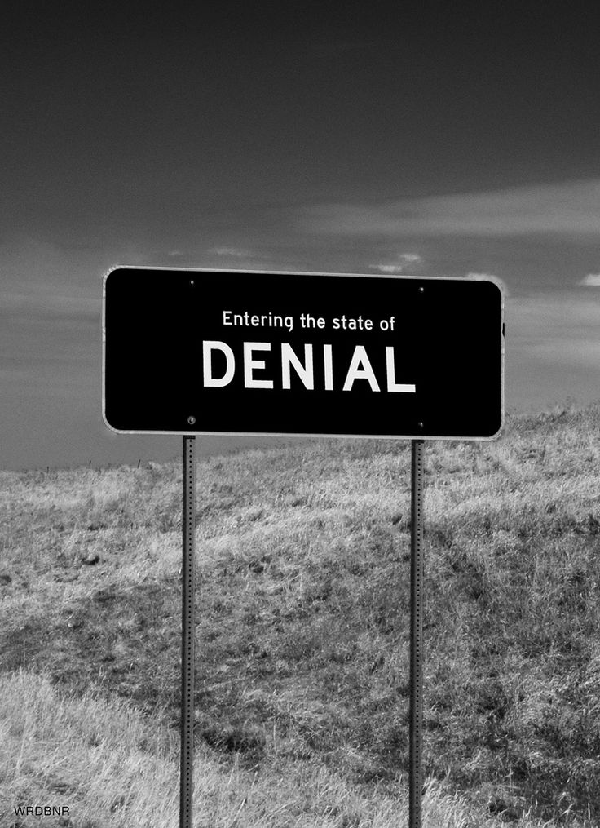

And two more for the road:
I won’t tolerate school if...
My grades would’ve been different if...

