Slide 1
How much do you know about London?
Present Perfect Simple
Edited by Milton P. Jr. ☺ educationnow@yahoo.com.br

Slide 2
Since & For
Duration of Events
Edited by Milton P. Jr. ☺ educationnow@yahoo.com.br

Slide 3
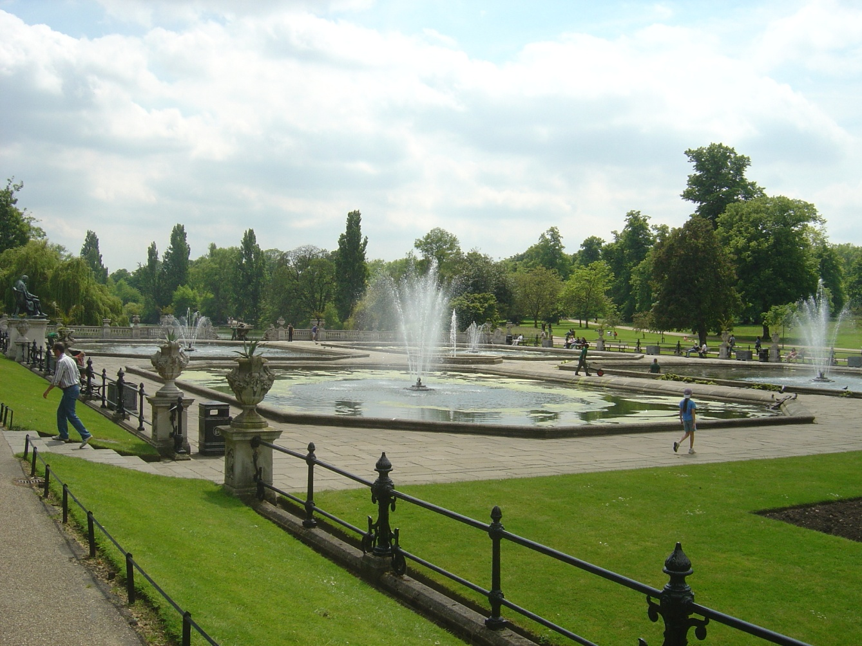
The Hyde Park has been open to the general public SINCE 1637.
1637
A long time
The Hyde park has been open to the general public FOR a long time.

Slide 4
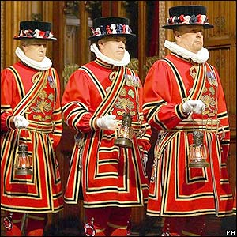
The Beefeaters have been the guards of the Tower of London SINCE 1400.
The 1400s
Six centuries
The Beefeaters have been the guards of the Tower of London FOR centuries.

Slide 5
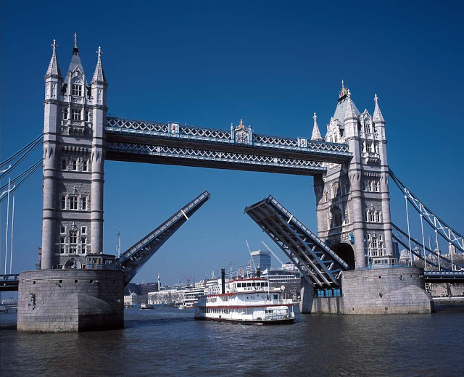
The London Bridge has been in service SINCE 1894.
In 1894
More than 100 years
The London Bridge has been in service FOR more than 100 years.

Slide 6
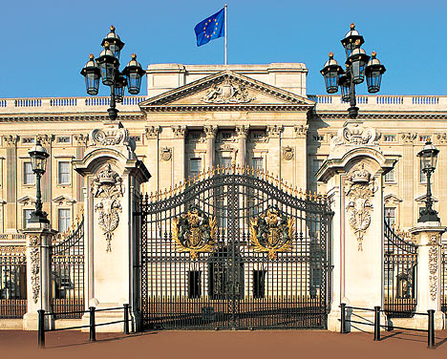
The British Royal Family have lived at the Buckingham Palace SINCE 1837.
Nearly two hundred years
1837
The British Royal Family have lived at the Buckingham Palace FOR nearly two hundred years.

Slide 7
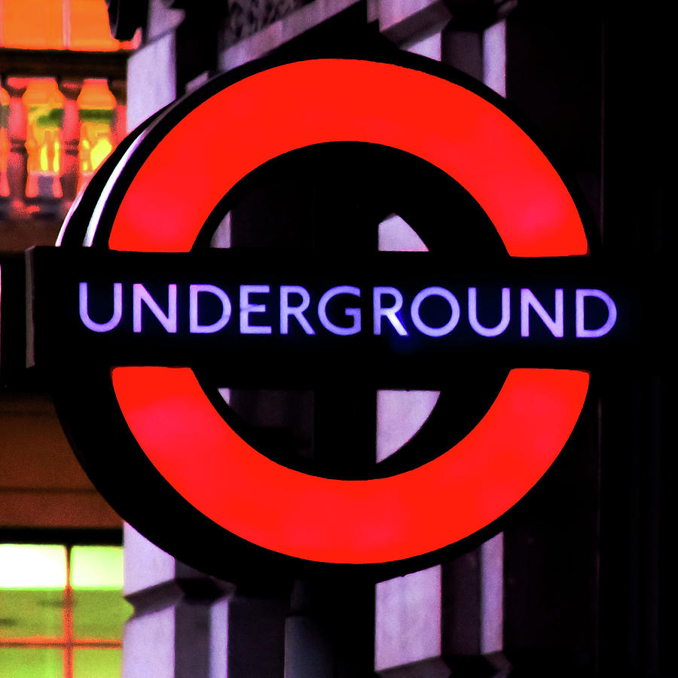
There has been an underground system in London SINCE 1863.
1863
More than 149 years
There has been an underground system in London FOR more than 149 years.

Slide 8
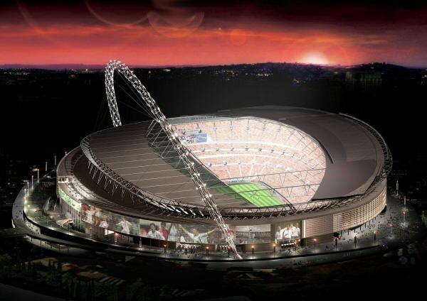
Footballers have played in the new Wembley Stadium SINCE 2007.
2007
A few years
Footballers have played in the new Wembley Stadium FOR a few years.

Slide 9
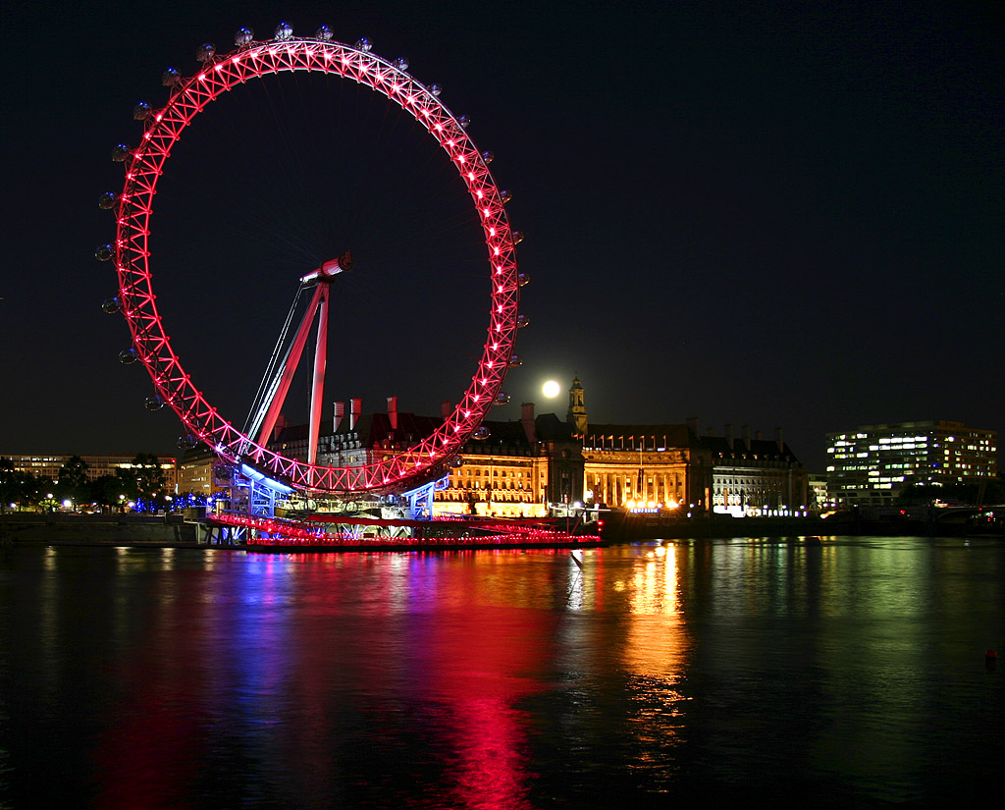
Tourists have taken a ride on the London Eye SINCE 2000.
2000
More than 10 years
Tourists have taken a ride on the London Eye FOR more than 10 years.

Slide 10
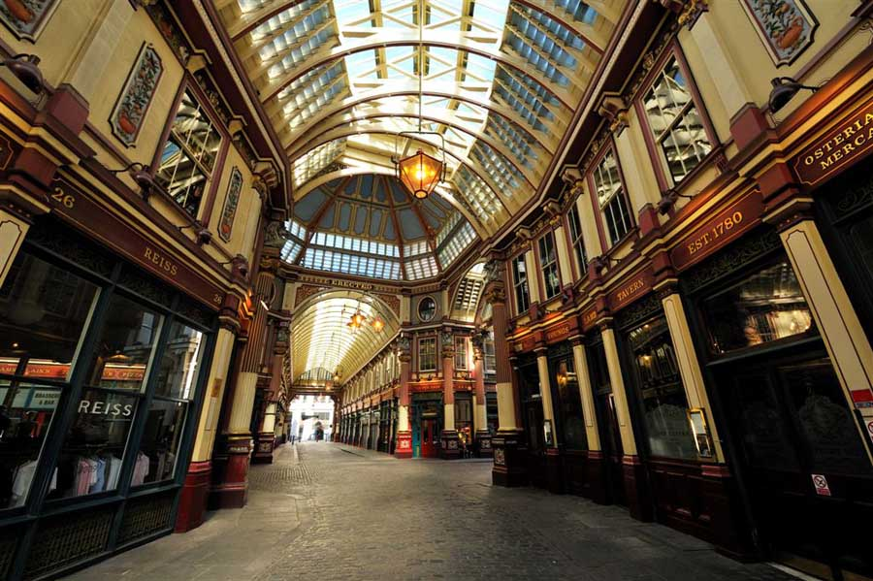
Shoppers have spent millions at
Leadnhall Market SINCE the 14th century.
14th century
More than 500 years
Shoppers have spent millions at Leadnhall Market FOR more than 500 years.

Slide 11
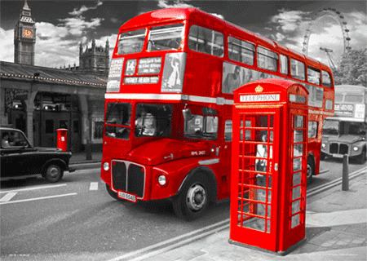
Double-decker buses have been used SINCE 1829.
1829
More than 150 years
Double-decker buses have been used FOR more than 150 years.

Slide 12
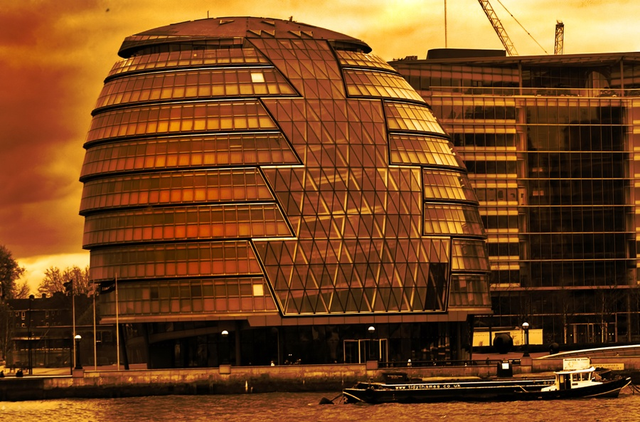
This building has been the London City Hall SINCE 2002.
2002
More than 10 years
This building has been the London City Hall FOR more than 10 years.

Slide 13
HAVE YOU BEEN TO LONDON?
THANK YOU FOR YOUR TIME !
Edited by Milton P. Jr. ☺ educationnow@yahoo.com.br

