Slide 1


Dra. Pilar Couto Cantero pilar.couto@udc.es
Centro de Formación y Recursos de Vigo
Potenciación de las lenguas extranjeras desde la metodología AICLE/CLIL/EMILE
29 de enero, 2025 16:30- 20.30h.

Slide 2

Mi compromiso…
Los participantes serán capaces
de comprender el enfoque CLIL como metodología activa para la e-a de lenguas extranjeras
1
Conceptos clave del enfoque CLIL
2
Familiarizarse con el enfoque CLIL
3
Saber preparar, implementar y evaluar situaciones de aprendizaje a través del enfoque CLIL
4
Compartir más experiencias didácticas relacionadas con el enfoque CLIL

Slide 3

Tabla de contenidos
Conceptos clave en la E-A de lenguas extranjeras a través del enfoque CLIL.
Teorías de aprendizaje sobre las que se nutre el enfoque CLIL.
Básicos sobre CLIL.
Creación y adaptación de materiales CLIL.
Evaluación en CLIL.
Ejemplos de unidades CLIL.
Avances metodológicos en la e-a de LEs. Otros temas de posible interés...

Slide 4
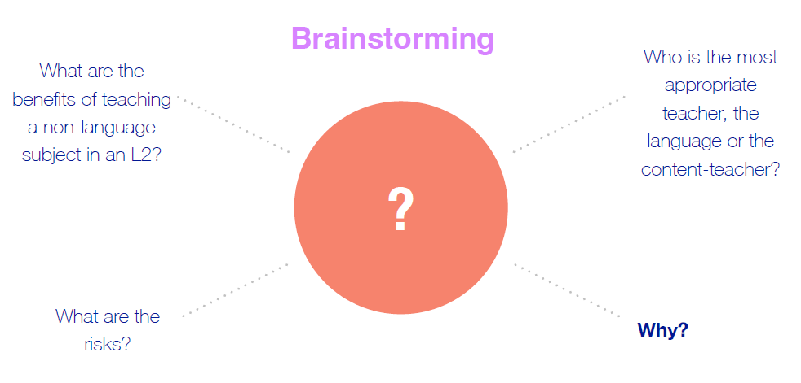
Para empezar…

Slide 5
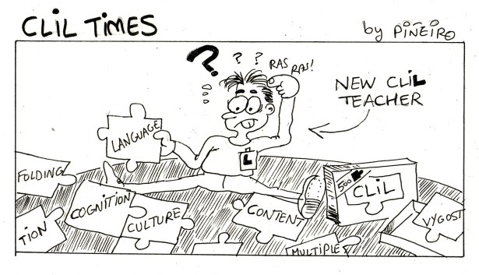
1. Conceptos Clave

Slide 6
1. Conceptos Clave
CLIL
Content and Language Integrated Learning
AICLE
Aprendizaje integrado de contenidos y lenguas extranjeras
EMILE
Enseignement d’une matière par l’intermédiaire d’une langue étrangère

Slide 7
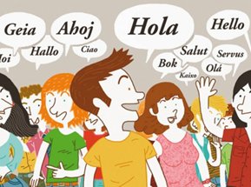
Conceptos Clave
Definición
Concepto: “bilingüe/multilingüe/plurilingüe”
CEFRL (2001, 2018) Plurilingüismo
Definición oficial de bilingüe: la habilidad para hablar fluidamente y sin acento en dos lenguas.
DRAE: Del lat. bilinguis. 1. adj. Que habla dos lenguas.
Definición holística: Persona que usa dos o más lenguas en su vida diaria (F. Grosjean).
Cambridge Dict.: Bilingual C1 (of a person) able to use two languages equally well or (of a thing) using or involving two languages.

Slide 8
CLIL and CEFRL
Conceptos Clave
PLURILINGUALISM
Plurilingualism takes a step further from multilingualism: “It builds up a communicative competence to which all knowledge and experience of language contributes and in which languages interrelate and interact” (CEFRL, 2001: p. 4).
PLURICULTURALISM
“Plurilingualism has itself to be seen in the context of pluriculturalism. Language is not only a major aspect of culture, but also a means of access to cultural manifestations” (CEFRL, 2001: p. 5).

Slide 9


Do you consider yourself…?
Monolingual
Bilingual
Plurilingual
Other (explain)

Slide 10
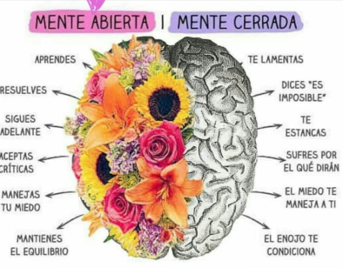
Conceptos Clave
Mente plurilingüe Mente monolingüe

Slide 11


Code-switching & Translanguaging
Conceptos Clave
El translingüismo puede referirse a un proceso pedagógico que consiste en utilizar más de una lengua en una actividad educativa o puede usarse para describir la forma en que las personas bilingües usan sus recursos lingüísticos para crear sentidos e interactuar con el mundo que los rodea.
La alternancia de código o cambio de código es una locución en lingüística que se refiere al uso de dos o más idiomas en un mismo discurso, enunciado o frase, sin violar las reglas fonológicas o sintácticas de ninguna de las lenguas.
According to Ferjan Ramírez… “Using codeswitching/mixing is a sign of linguistic sophistication”.

Slide 12

Do you think that using code-switching and/or translanguaging strategies could be useful for teaching and learning languages in your classrooms?
Yes
No
Other (explain)

Slide 13
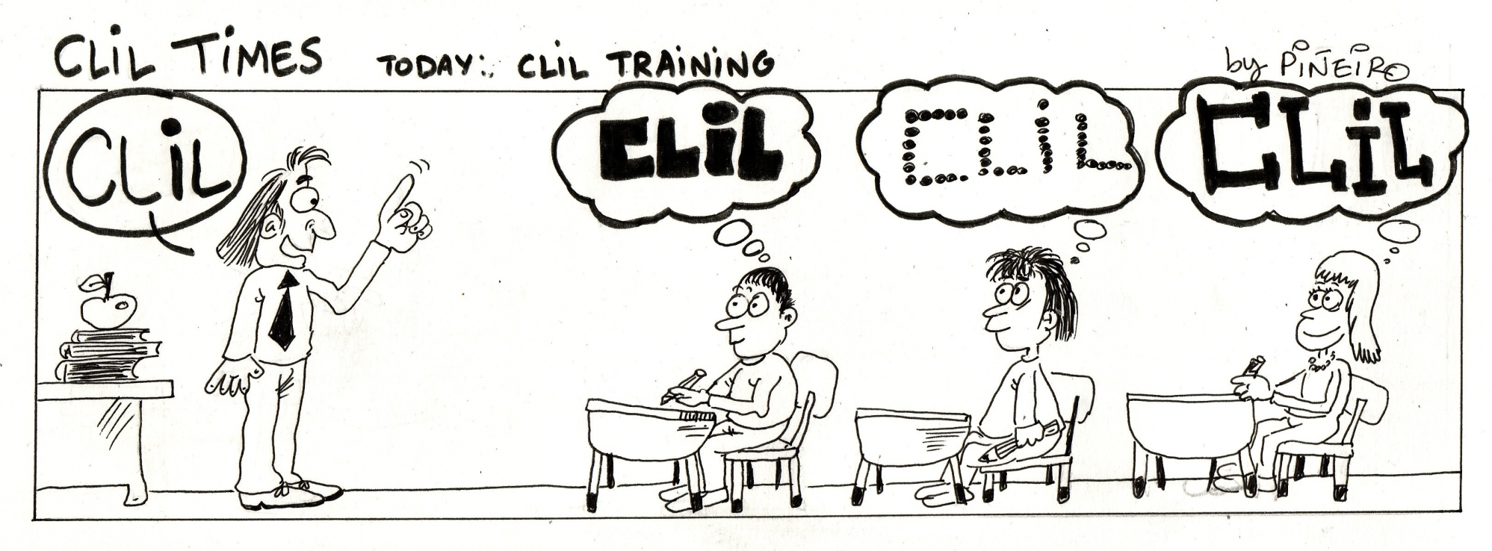
2. Learning Theories behind CLIL

Slide 14
2. Learning Theories behind CLIL
Lev Vigotsky's scaffolding.
Revision of Bloom's taxonomy of Thinking skills. LOTS & HOTS.
Krashen’s Language Learning vs. Language Aquisition.
Jim Cummins' common underlying linguistic competence. BICS & CALP.
Howard Gardner’s Theory of Multiple Intelligences.

Slide 15
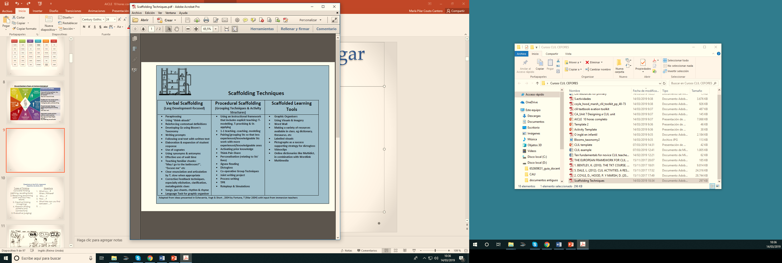
Lev Vigotsky's scaffolding (andamiaje)

Slide 16
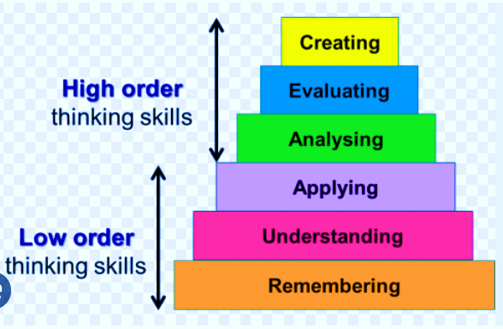
Revision of Bloom's taxonomy
LOTS & HOTS

Slide 17
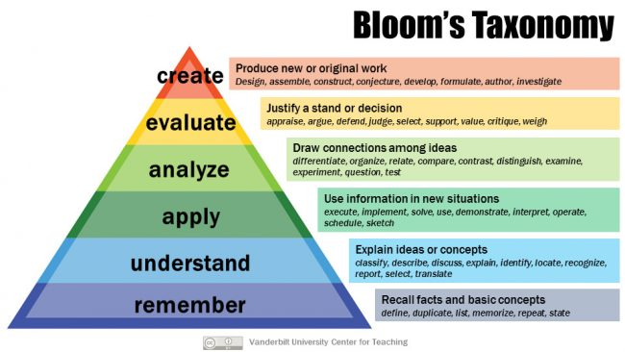
Revision of Bloom's taxonomy

Slide 18
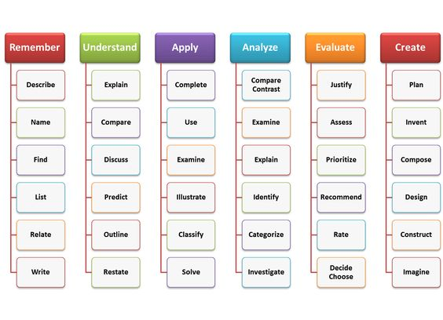
Revisión de la taxonomía de Bloom
---------- LOTS ---------- ---------- HOTS ---------

Slide 19

Krashen´s Language Learning vs. Language Aquisition
According to Krashen…
Learning is a conscious process
Learning is the conscious acceptance of knowledge 'about' a foreign language
Acquisition is a subconscious process
Acquisition involves the subconscious acceptance of knowledge where information is stored in the brain; this is the process used for developing native languages

Slide 20
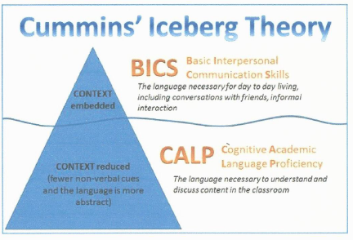
Jim Cummins' BICS & CALP

Slide 21
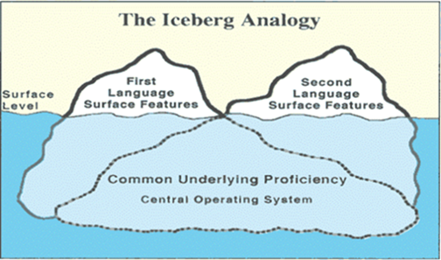
Jim Cummins' BICS & CALP
Adapted from Key Bentley (2015: p. 8)

Slide 22
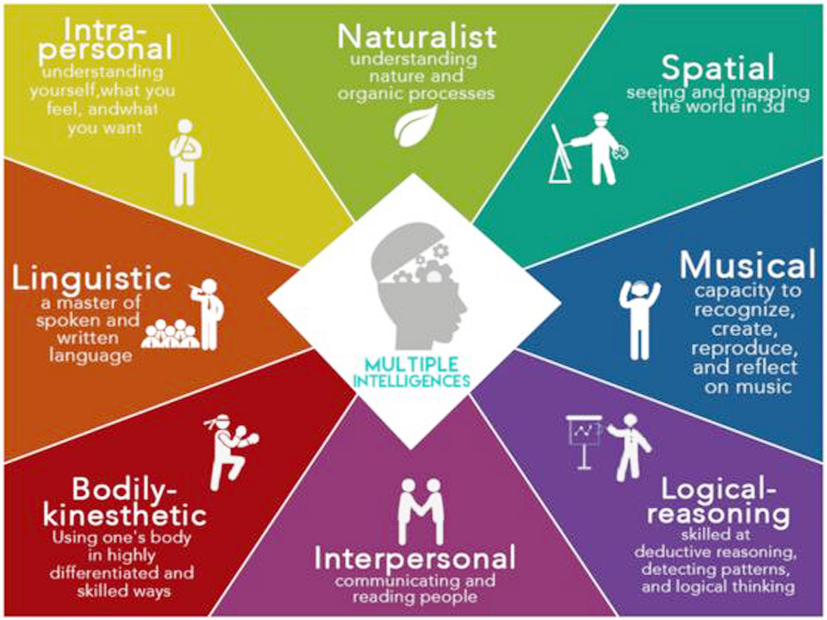
Howard Gardner’s Theory of Multiple Intelligences
Classroom activities
Music and rhythmic patterns. Very sensitive to sounds in the environment.
Team activities of all kinds.
Outdoors activities, animals, plants, and almost any natural object.
Word games, poetry and story-telling.
Physical movement, dancing, roleplaying making and inventing thing
Individual work.
Experiments, puzzles and other problems, cosmic questions
Drawings, paintings, designs, patterns, clay-modelling, arts and crafts.

Slide 23
3. Básicos sobre CLIL

Slide 24
Questions in the CLIL Classroom
Questions
What is a….?
When..?
Where?
Why….?
How …?
What links can you find between ….?
…
Types of Thinking
1. Concrete thinking
(defining, recalling facts)
2. Reasoning (examining parts and how they relate)
3. Creative thinking (Imagining)
4. Abstract (finding patterns and connections)
5. Evaluative (judging)
Adapted from Key Bentley (2015: p. 22)

Slide 25
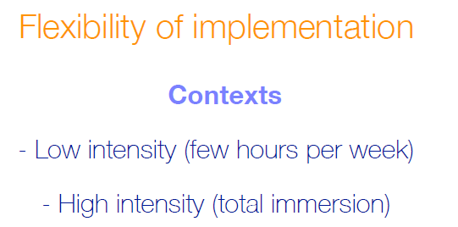
3. CLIL BASICS
Types of CLIL Programmes
Soft CLIL Programmes
Hard CLIL Programmes

Slide 26
3. CLIL BASICS
4 Cs
  CONTENT
  COMMUNICATION (language)
  COGNITION (LOTS & HOTS)
  CULTURE
Scaffolding strategies
BICS & CALP

Slide 27
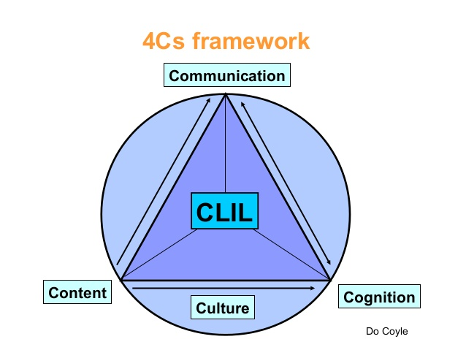
CLIL BASICS
The 4 C’s of CLIL

Slide 28
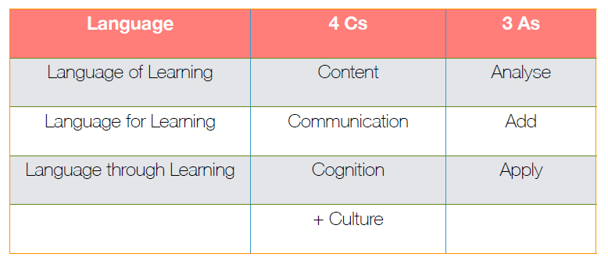
The 4Cs + 3As framework
CLIL BASICS
Starting point for classroom planning (Coyle, 1999)

Slide 29
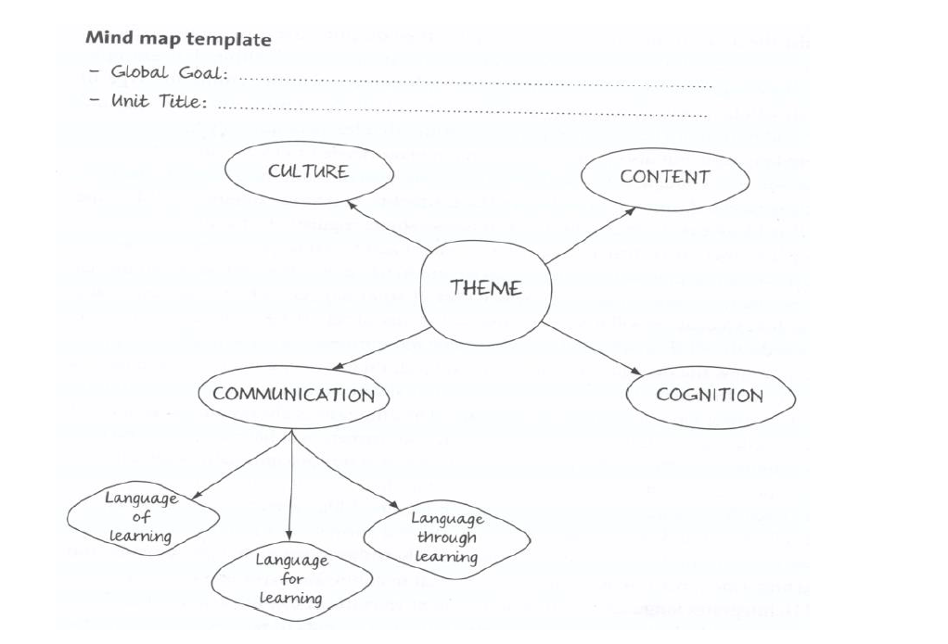
CLIL UNIT MIND MAP TEMPLATE
From Coyle, Hood and Marsh (2010)

Slide 30
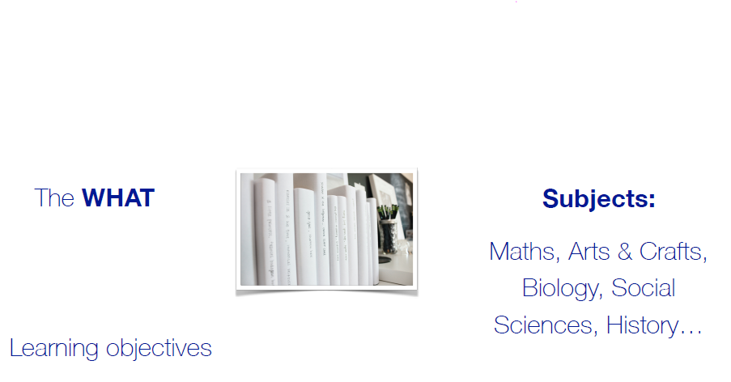
CONTENT

Slide 31
CONTENT

Slide 32
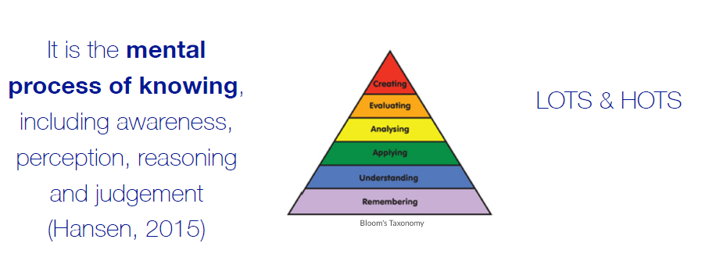
COGNITION

Slide 33
COGNITION

Slide 34
CULTURE
Learners learn about the role of culture to be able to understand themselves and other cultures.
Learners may need to communicate in a non-native language with learners who may have different home languages as well as different social and cultural backgrounds.
Learners need knowledge about those who live in other regions or countries.
Learners can be introduced to a wide range of cultural contexts.
Learners need to develop positive attitudes and become aware of the responsibilities of global as well as local citizenship.
Bentley, K. (2010) The TKT Course: CLIL Module Cambridge: CUP

Slide 35
CULTURE

Slide 36
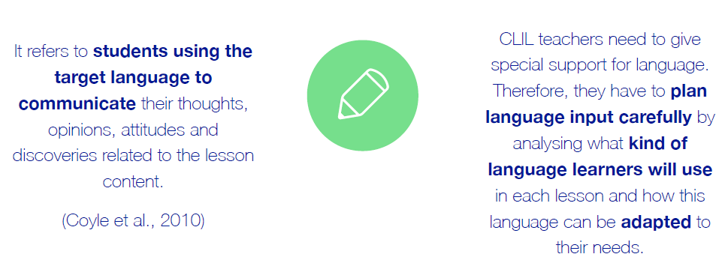
COMMUNICATION

Slide 37
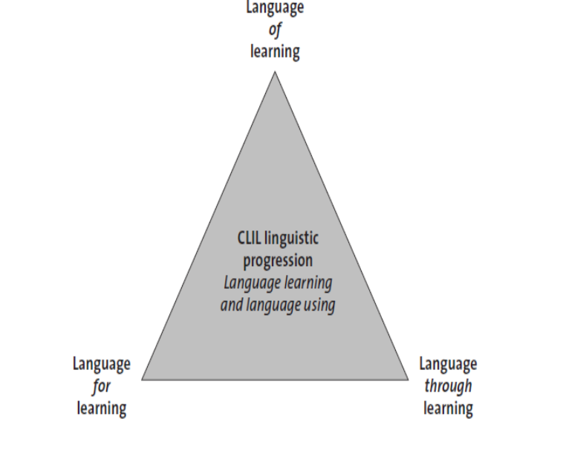
Language Triptych
COMMUNICATION

Slide 38
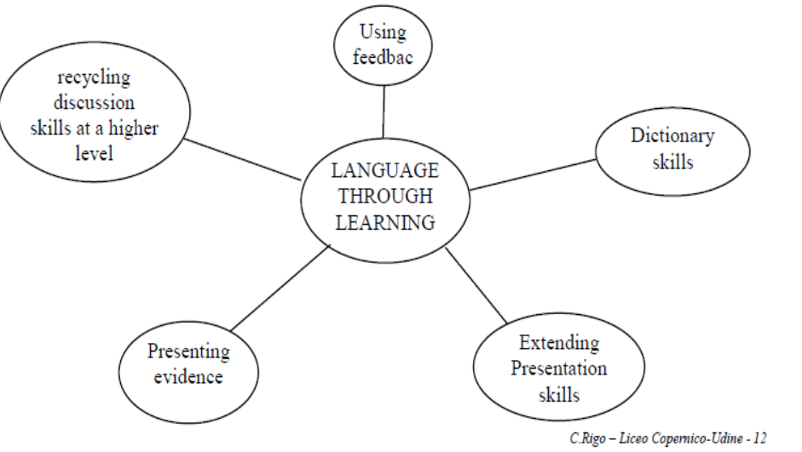
COMMUNICATION
COYLE, HOOD AND MARSH (2010) : CLIL TOOLKIT

Slide 41
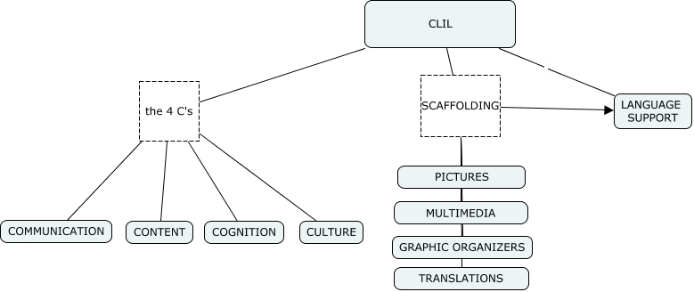
Scaffolding
Source: http://cursa.ihmc.us/rid=1P6881808-1TF233X-4Q0F/CLIL.cmap

Slide 42
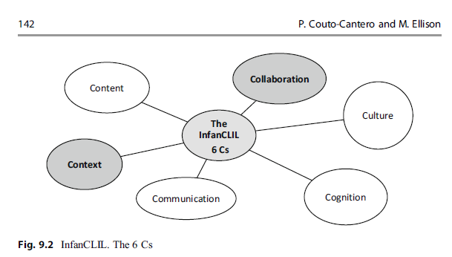
CLIL BASICS
Couto-Cantero, P. & Ellison, M. (2023). InfanCLIL: A model for implementing plurilingual projects in pre-primary in Spain and Portugal. In Otto, A. & Cortina-Pérez, B. (eds.) Handbook of CLIL in Pre-Primary Education. (pp.133-152). Springer. https://doi.org/10.1007/978-3-031-04768-8

Slide 43
Activity
Look at these materials from coursebooks. Which are from ELT books and which are from CLIL books?
How do you know?
Think of the 4Cs and the BICS and CALP.
Bentley, K. (2010) The TKT Course: CLIL Module Cambridge: CUP

Slide 44
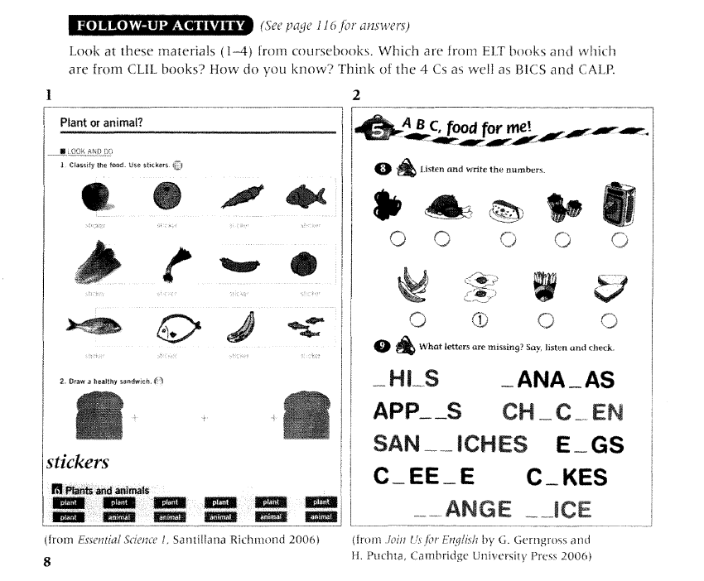

Slide 45
Answers
Primary CLIL coursebook: The tasks help children to learn about the types of food and which foods are healthy (content). The tasks are classifying (cognitive skill), and drawing a healthy sandwich (communication). The different sandwiches can focus of different types of health foods (culture).
Primary ELT coursebook: The first activity is simply identifying and numbering food. The second activity is spelling the names of the food.
Bentley, K. (2010) The TKT Course: CLIL Module Cambridge: CUP

Slide 46
Activity about cognition
Decide whether the items are Lower (LOTS) or Higher Order Thinking Skills (HOTS).
To remember information
To develop reasoning skills
To order information
To develop enquiry and discussion
To define objects
To develop creative thinking
To check understanding
To evaluate the work of oneself and others
To review learning
To hypothesise about what could happen

Slide 47
LOTS – Lower Order Thinking Skills | HOTS – Higher Order Thinking Skills
To remember information | To develop reasoning skills
To order information | To develop enquiry and discussion
To define objects | To develop creative thinking
To check understanding | To evaluate the work of oneself and others
To review learning | To hypothesise about what could happen

Slide 48
Activity
Look at this picture and the tasks beside it. The cognitive skills progress from lower to higher order. Which cognitive skills are developed?
Bentley, K. (2010) The TKT Course: CLIL Module Cambridge: CUP

Slide 49
Activity
Bentley, K. (2010) The TKT Course: CLIL Module Cambridge: CUP

Slide 50
Answers
Picture 1
Remembering (the names of the fruits and vegetables) and identifying them in the picture.
Comparing/contrasting, then identifying.
Dividing/classifying.
Predicting/reasoning.
Creative thinking/synthesis.
Bentley, K. (2010) The TKT Course: CLIL Module Cambridge: CUP

Slide 51
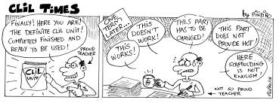
4. Creación y adaptación de materiales CLIL

Slide 52
Adaptando materiales según el enfoque CLIL. Las 4 S’s
Shorten
Simplify
Supplement
Shape
(Tanner, R., 2010)

Slide 53
How has this text been adapted?
One of the most famous land-use models is one based on concentric rings. Each ring forms a land-use zone. This model suggests cities have grown outwards with the newest and most expensive housing on the edge of the city.
Adapted text:
One of the most famous land-use models is one based on concentric rings. Each ring forms a land-use zone. This model suggests cities have grown outwards with the newest and most expensive housing on the edge of the city.
Adapted from www.teachers.cambridgeesol.org

Slide 54
Highlighting Key Vocabulary
Highlighting serves as a
visual reminder

Slide 55
How has this text been adapted?
This close up of a plant shows spore stalks. Here you can see a seed germinates and has put out a tiny root. Trees are groups of plants called vasular plants as they have vascular tissue to support them.
Adapted text:
This close up of a plant shows spore stalks. Here you can see a seed germinates and has put out a tiny root. Trees are groups of plants called vasular plants as they have vascular tissue to support them.
Germinate: to sprout
Spore: a single cell that can grow into a plant
Vasular tissue: tissue that supports plants and carries food and water
Adapted from www.teachers.cambridgeesol.org

Slide 56
Including a Glossary
In CLIL, a glossary is either in the target language with target language meanings or in the target language with L1 meanings.

Slide 57
How has this text been adapted?
Greek farmers grew many crops and kept different animals. Among the most important crops and animals were olives for eating and for olive oil, grain for flour to make bread, grapes for eating and for wine, sheep and goats for wool, milk and meat.
Adapted text:
Greek farmers grew many crops and kept different animals. Among the most important crops and animals were:
olives for eating and for olive oil
grain for flour to make bread
grapes for eating and for wine
sheep and goats for wool, milk and meat.
Adapted from www.teachers.cambridgeesol.org

Slide 58
Changing the Text Layout
A clear layout helps reading.
In the previous slide, part of the text was presented in point form rather than a long paragraph.

Slide 59
How has this text been adapted?
Bird strikes were a potential danger, owing to the train’s high speed. Having received instructions in how to use the cannon, designers subsequently fired it at their prototype. The effects were devastating, consequently, the engineers stopped the test.
Adapted text:
Bird strikes were a possible danger because of the train’s high speed. Having received instructions in how to use the cannon, designers then fired it at their first working model. The effects were very bad so the engineers stopped the test.
Adapted from www.teachers.cambridgeesol.org

Slide 60
Simplified Text
« A text should contain no more than 15 new words per page for the students: 90% of the vocabulary should be at the right level to enable students to pick up language and ideas from the text. Therefore if there are too many new words for your students, the text needs to be simplified»
(Tanner, R., 2010)
Sentences can be shortened.
Grammatical structures can be changed e.g. passive to active.

Slide 61
How has this text been adapted?
The heart is a very important organ. It is a muscle which pumps blood around your body. Blood leaves the heart and moves away from it in blood vessels called arteries. The blood returns to your heart in vessels called veins.
Adapted text:
The heart is a very important organ. It is a muscle which pumps blood around your body. Blood leaves the heart and moves away from it in blood vessels called arteries. The blood returns to your heart in vessels called veins.
heart
organ
blood
vessel
arteries
veins
Adapted from: www.teachers.cambridgeesol.org

Slide 62
Add a Word Bank
A word bank can be used to:
Pre-teach
Support input
Help learners remember key subject vocabulary

Slide 63
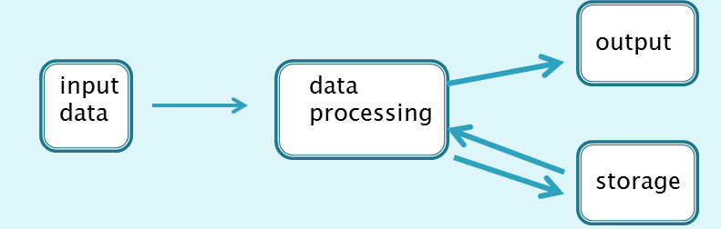
How has this text been adapted?
Computer output is the visible or audible result of data processing-information that can be read, printed or heard by the user. It is processed as a result of instructions by programs which input raw data.
Adapted text:
Adapted from: www.teachers.cambridgeesol.org

Slide 64
Add a Visual Organiser
Visual organisers/graphic organisers such as diagrams and charts are used to help learners remember new information by making thinking visual. They involve writing down or drawing ideas and making connections.

Slide 65
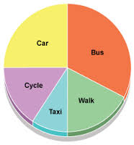
Organising information
Handout: Using visual or graphic organisers
Through visual or graphic organisers learners:
Connect knowledge and ideas presented in CLIL.
Understand and recall information.
Select, transfer and categorise information.
Produce oral and written language.
Think creatively.

Slide 66
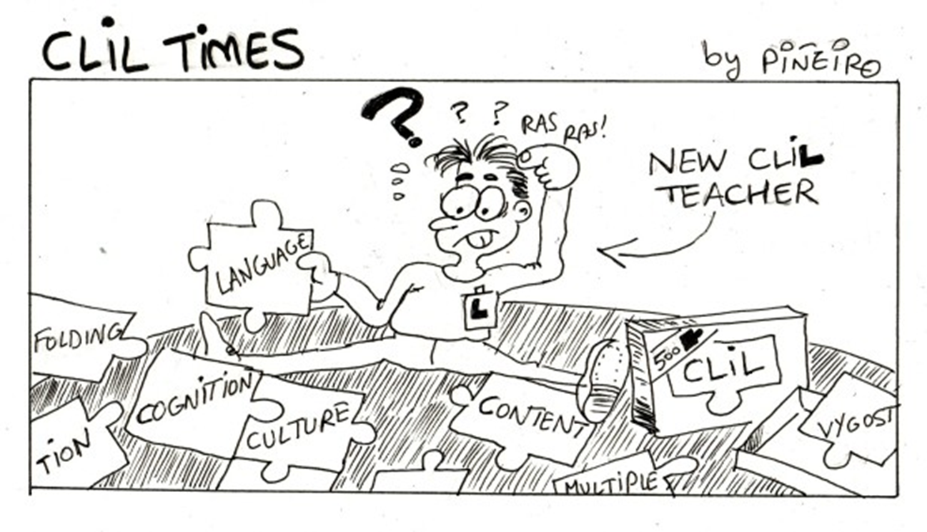
5. Evaluación con el enfoque CLIL

Slide 67
Assessment
What do you assess when you are using CLIL?
Content or language or both?
Bentley, K. (2010) The TKT Course: CLIL Module Cambridge: CUP

Slide 68
CLIL assessment
CLIL assessment can focus on:
Areas of subject content e.g. answers to maths questions.
Areas of language area e.g. conditional forms in hypotheses.
Areas of content and language e.g. those used in the description of a process (technical vocabulary, sequencing, present tense verb).
Bentley, K. (2010) The TKT Course: CLIL Module Cambridge: CUP

Slide 69
CLIL Assessment
Soft Hard
CLIL CLIL
Programmes Programmes
A focus on language is more common in Soft CLIL programmes which are often part of language courses.
Hard CLIL programmes focus on content and language or sometimes just content.
Bentley, K. (2010) The TKT Course: CLIL Module Cambridge: CUP

Slide 70
CLIL assessment
CLIL assessment can also focus on:
Communication skills.
Cognitive skills (learners think about what they learned and also how and why they learnt it).
Practical skills (e.g. carrying out investigations, doing experiments, measuring, drawing).
Learning to learn.
Bentley, K. (2010) The TKT Course: CLIL Module Cambridge: CUP

Slide 71
Assessing effectively
To assess effectively:
Learners need to be placed at the centre of the process.
We need to find out what standards are achievable when they study subject content in a non-native language.
We need to be aware of the language levels and the learning needs of the learners in different curricular subjects.
Learners must be aware of what the focus of assessment is.
Bentley, K. (2010) The TKT Course: CLIL Module Cambridge: CUP

Slide 72
CLIL assessment
Why do we assess learners?
To find out what learners know about our subject?
To find out strengths and areas for improvement in subject content and use of language in order to give learners feeback on these?
To find out what motivates our learners?
To monitor progress in thinking skills, practical skills and learning?
To identify support strategies needed?
To encourage learners about their progress in learning content and languages?
To find out if our planning and teaching of subject content have been effective?
To inform colleagues, parents, authorities?
To give them a qualification at the end of the course?
  Or is it a combination of the above?
Bentley, K. (2010) The TKT Course: CLIL Module Cambridge: CUP

Slide 73
Assessing skills and attitudes
We also need to assess:
  Communication skills.
  Cognitive skills.
  Attitudes towards learning.
Bentley, K. (2010) The TKT Course: CLIL Module Cambridge: CUP

Slide 74
Task
Put the following examples from CLIL assessment into the correct column in the table by identifying the main focus of assessment.
Agree on three questions which you could ask about reducing our use of plastic.
Draw a diagram to show where the ocean plates and the continental plates lie.
Demonstrate three warm-up and three warm-down activities for a PE lesson.
Tick the reasons for the differences in living standards between those in developed and those in developing areas of the world.
Use one of the percussion instruments to play a mixture of three different rhythms: fast, slow and regular.
Find similar patterns and trends shown in the two line graphs.
Describe two different ways you could use features of desktop publishing to make this advertisement more effective.
Make three sketches of a plant at different times of day and using different kinds of paper.
Communicative Skills | Cognitive Skills | Practical Skills
Bentley, K. (2010) The TKT Course: CLIL Module Cambridge: CUP

Slide 75
Answers
a | communicative skills (learners are collaborating to decide on the questions
b | communicative and practical skills (learners communicate information through the diagram and use practical skills to draw it accurately
c | practical skills (learners show their ideas by demonstrating them using physical skills)
d | cognitive skills (learners show their ideas by demonstrating them using physical skills)
e | practical skills (learners use practical skills to play the different rhythms)
f | cognitive skills (learners compare and analyse graphs to find the similar trends and patterns)
g | cognitive, communicative and practical skills (learners analyse the features, then communicate their effectiveness using practical skills to do the desktop publishing)
H | Communicative and practical skills (learners communicate their ideas through drawing)
Bentley, K. (2010) The TKT Course: CLIL Module Cambridge: CUP

Slide 76
Types of assessment
Summative assessment is assessment of learning.
To review learning of subject content
To know what learners have achieved at as specific time.
At the end of a unit of work / course.
Formative assessment is assessment for learning.
Continuous assessment.
to know how much and how well our learners are learning about subject content.
It gives us information about our learners.
We can give them feedback on their progress.
provides feedback to change or adapt our future teaching.
Summative tests
Standardised tests
Diagnostic test
Formative tests
Performance assessment
Peer assessment
Self-assessment
Needs analysis
Portfolio assessment
Bentley, K. (2010) The TKT Course: CLIL Module Cambridge: CUP

Slide 77
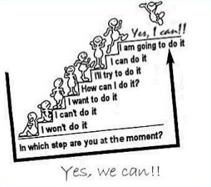
‘Can do’ statements
Often used to describe the assessment criteria for both summative and formative assessment.

Slide 78
6. Ejemplos de unidades CLIL

Slide 79
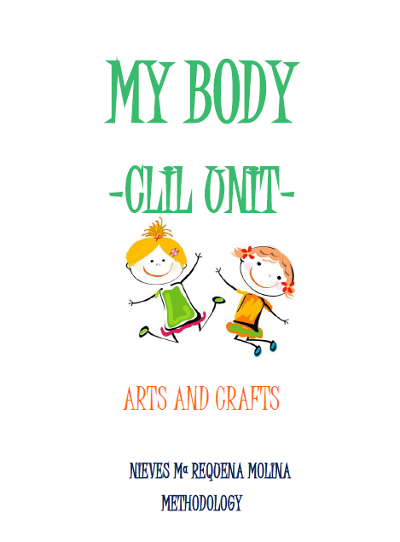
Sample of CLIL Unit for Primary
http://keepcalmandenjoyenglishclass.blogspot.com/2015/06/clil-unit-for-arts-and-crafts-subject.html

Slide 80
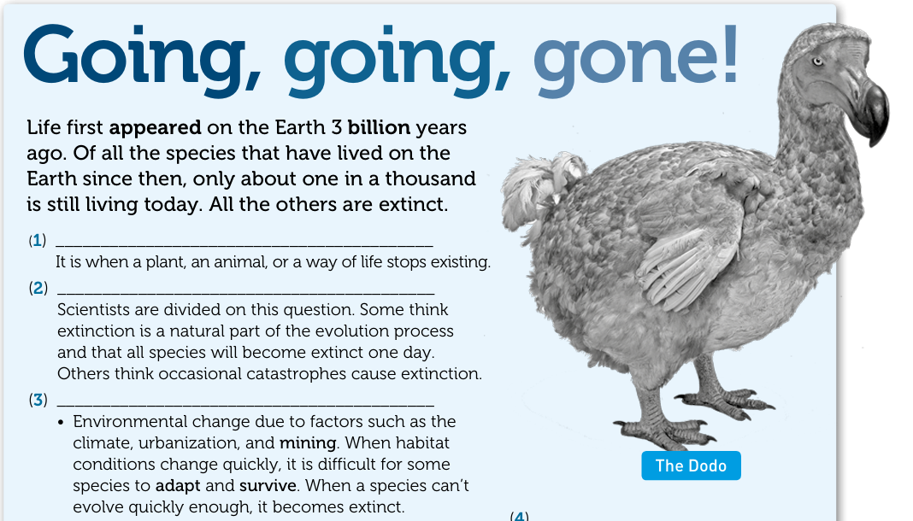
Sample of a CLIL Biology lesson
https://elt.oup.com/elt/students/networkitaly/clil/Network_2_CLIL_Lessons.pdf

Slide 81
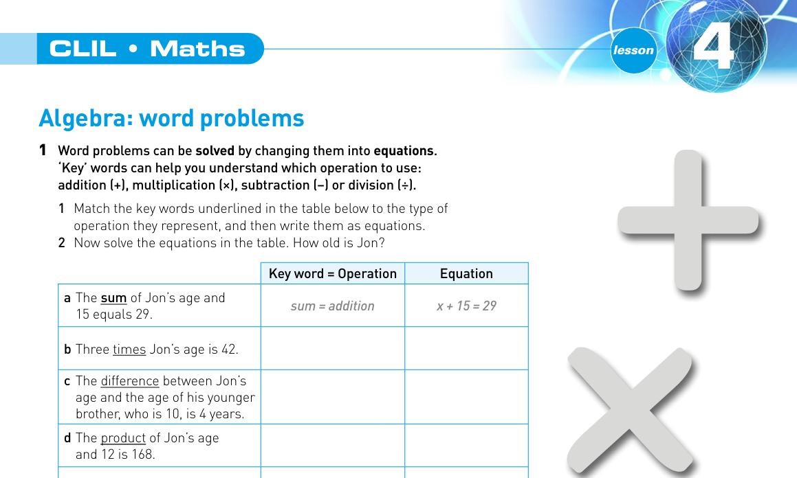
Sample of a CLIL Algebra lesson
https://elt.oup.com/elt/students/networkitaly/clil/Network_2_CLIL_Lessons.pdf

Slide 82
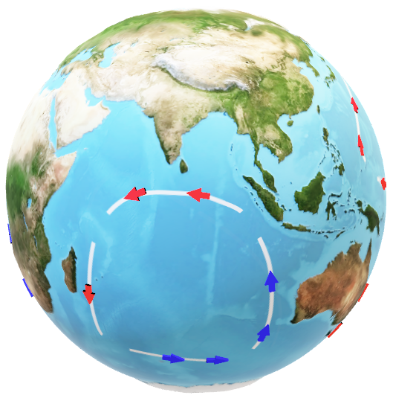
Diálogo, conclusiones y reflexiones entre los participantes
Lista de palabras clave

Slide 83
Palabras clave de esta sesión sobre CLIL
Scaffolding
Language
LOTS
HOTS
BICS
CALP
Analyse
Add
Apply
Codeswitching
Translanguaging
Plurilingualism
Pluriculturalism
Communication
Culture
Cognition
Content
Context
Collaboration
Shorten
Simplify
Supplement
Shape
…
…

Slide 84
7. Avances metodológicos en la e-a de LEs. Otros temas de posible interés...

Slide 85
7. Avances metodológicos en la e-a de LEs. Otros temas de posible interés...
-Expeditionary Learning
-Aprendizaje y servicio
-Gamificación
-Design for Change
-Diseño Universal para el Aprendizaje (DUA)
-Ambientes de aprendizaje
-Cultural Responsive Teaching
-TAD (proyecto TRADILEX)
-El modelo de la Transpodidáctica Textual (MTT)
-The AWKE Project

Slide 86

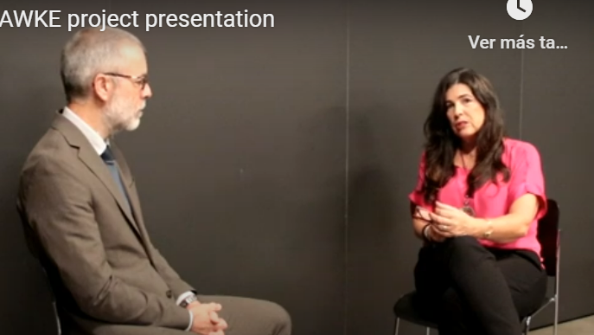
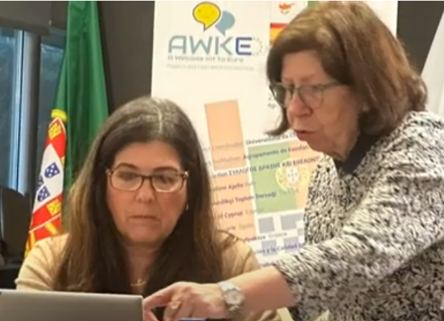
The ERASMUS + European project
A Welcome Kit to Europe (AWKE)
Website: https://awkeproject.eu/presentation/
https://www.youtube.com/watch?v=cNI4O2RD1ZA
https://www.youtube.com/watch?v=_GyAVMCqosU

Slide 87
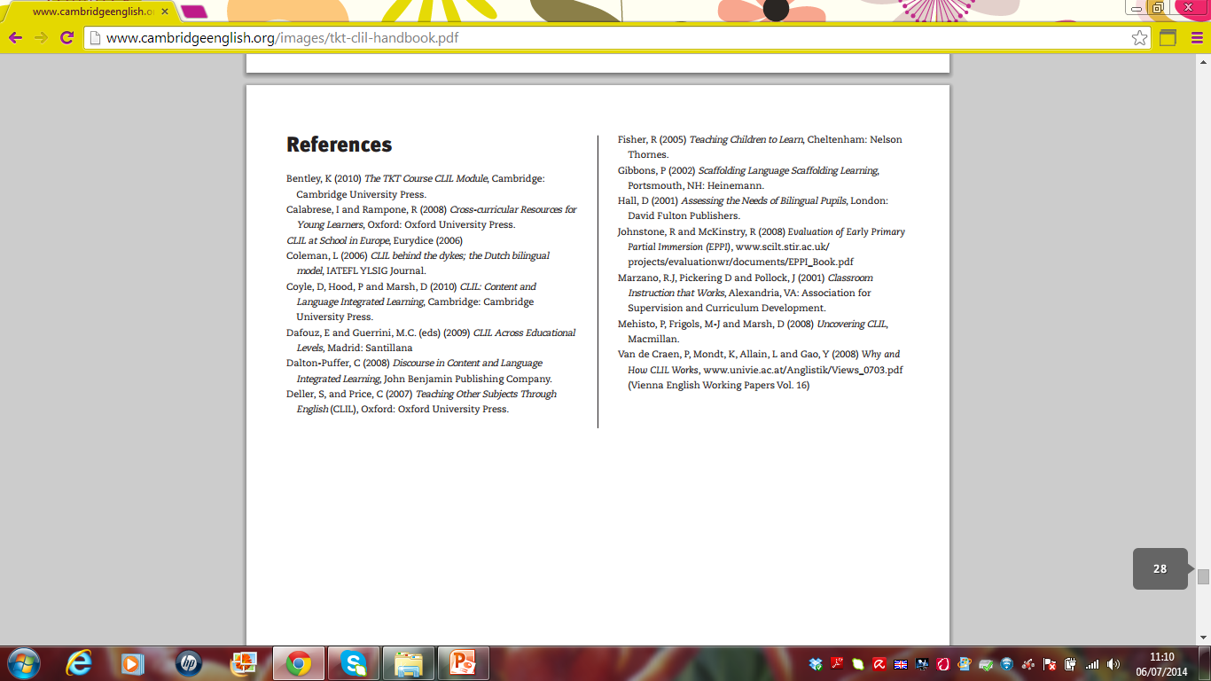
Referencias
http://www.cambridgeenglish.org/images/tkt-clil-handbook.pdf

Slide 88
Referencias
Council of Europe (2018). Common European framework of reference for languages: learning, teaching, assessment. Companion Volume with new Descriptors. Council of Europe Publishing. https://bit.ly/3cA6AJG
Couto-Cantero, P. & Fraga-Castrillón, N. (2023). El uso del translanguaging y el enfoque CLIL en educación primaria. Porta Linguarum Revista Interuniversitaria de Didáctica de las Lenguas Extranjeras, (39), 281-298. https://doi.org/10.30827/portalin.vi39.24492
Ferjan Ramirez, N., & Kuhl, P.K. (2017). The brain science of bilingualism. Young Children, 72(2), 38-44.
Fraga Castrillón, N., & Couto-Cantero, P. (2021). Aprendizaje de lenguas extranjeras: Estudio sobre las percepciones del futuro profesorado en Educación Primaria. DIGILEC: Revista Internacional de Lenguas y Culturas, 8(0), 66–82. https://doi.org/10.17979/digilec.2021.8.0.8632
García, O. & Otheguy, R. (2019). Plurilingualism and translanguaging: Commonalities and divergences. International Journal of Bilingual Education and Bilingualism 23(1), 17-35. https://doi.org/10.1080/13670050.2019.1598932
Gómez Parra, M. E., Huertas-Abril, C. A., y Espejo-Mohedano, R. (2021). Factores clave para la evaluación del impacto de los programas bilingües: empleabilidad, movilidad y conciencia cultural. Porta Linguarum Revista Interuniversitaria de Didáctica de las Lenguas Extranjeras, (35), 93-104. https://doi.org/10.30827/portalin.v0i35.15453
Grosjean, F. (2010). The bilingual as a competent but specific speaker-hearer. In Cruz-Ferreira, M. (Ed.). Multilingual Norms. Peter Lang, 2010 (19-31).
Krashen, S. (1981). Second language acquisition and second language learning. Prentice Hall.

Slide 89
Referencias
-Bentley (2010). The TKT Course: CLIL Module. CUP
-Coyle, Hood and Marsh (2010). CLIL. CUP.
-Dale and Tanner (2012). CLIL activities: a Resource for subject and language teachers. CUP.
-Mehisto, Marsh, Frigols (2008). Uncovering CLIL: Content and Language Integrated Learning in Bilingual and Multilingual Education.

Slide 90
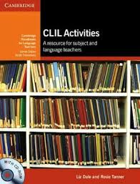
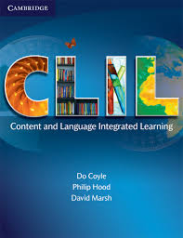
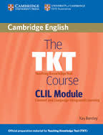
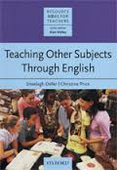
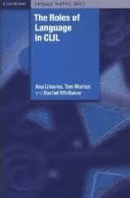
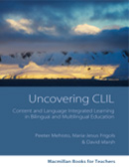

Slide 91
Portales educativos
FactMonster-Learning Network
Education Index
Education Planet
DiscoverySchool.com
BBC School
Enchanted Learning
British Council Learn English Kids
British Council http://www.teachingenglish.org.uk/teaching-teens/resources/clil
http://www.isabelperez.com/clil/clicl_m_5_1.htm

Slide 92

Agradecimientos
A Natalia Regueira.
Al profesor Marcos Lago, con quien compartí docencia en un curso 2021/22 'Enfoque CLIL en el aula de STEAM’.
A los participantes en este curso.

Slide 93



¿Preguntas?
¿Dudas?
¿Sugerencias?

Slide 94
Dra. Pilar Couto Cantero pilar.couto@udc.es
Centro de Formación y Recursos de Vigo
Potenciación de las lenguas extranjeras desde la metodología AICLE/CLIL/EMILE

