Slide 1
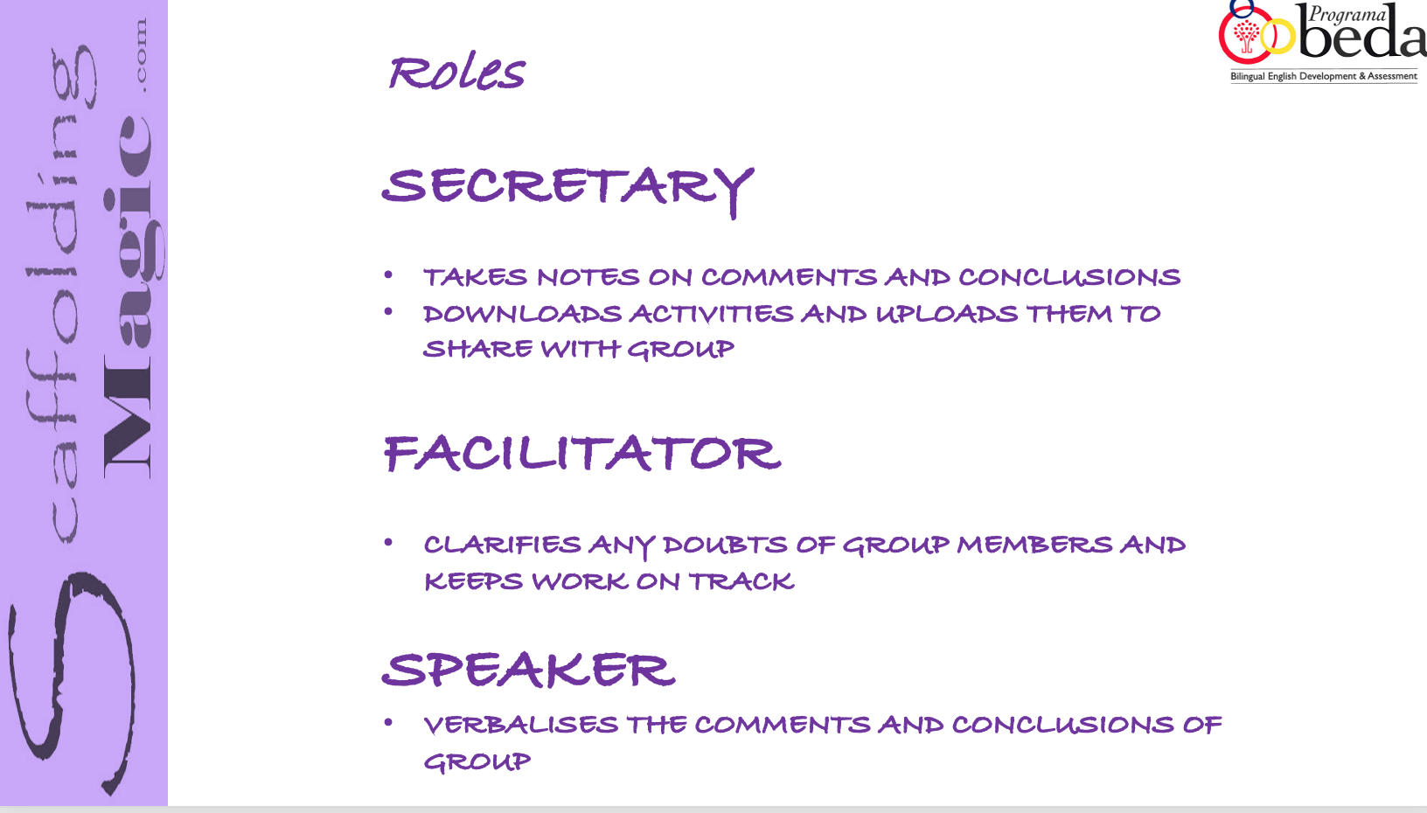
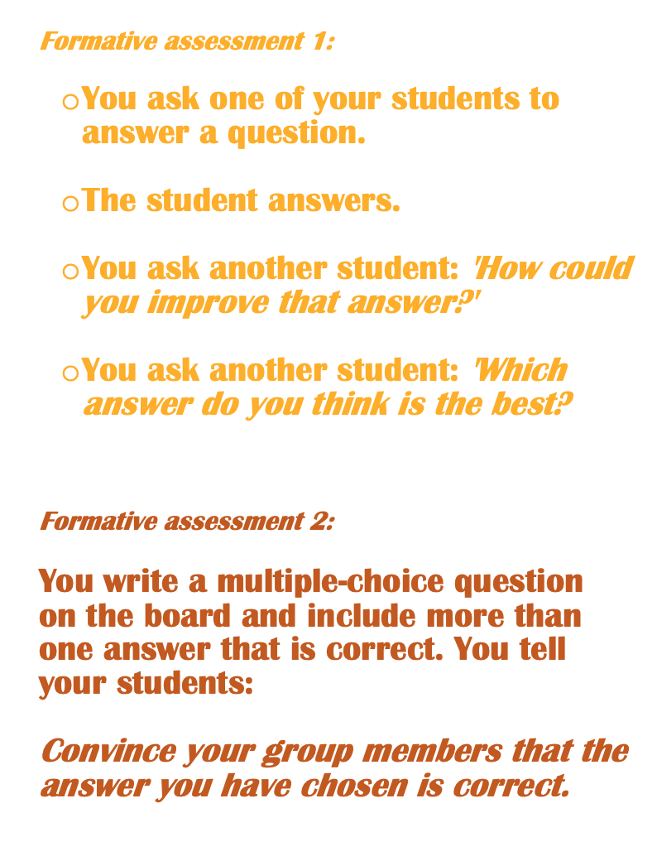
Choose Roles
Secretary Shares screen with PPT
Read the 16 formative assessments in the next slides.
Choose 3 of them you will use in your classes before the winter break.

Slide 2
Formative assessment 1:
You ask one of your students to answer a question.
The student answers.
You ask another student: 'How could you add to that answer?'
You ask another student: 'Which answer is most understandable to you?
Formative assessment 2:
You write a multiple-choice question on the board and include more than one answer that is correct. You tell your students:
Convince your group members that the answer you have chosen is correct
Formative assessment 3:
Your students have written an essay on the common characteristics of four (4) historic figures. You tell them:
In pairs, read your partner’s essay and in the margins, write the strongest and weakest points.

Slide 3
Formative assessment 4:
On the board, you put 20 facts about ancient civilizations, half of them with deliberate errors. You tell your students:
In pairs, identify the 10 correct and 10 incorrect facts.
Formative assessment 5:
A group of your students is going to present information about the typical music of Andalucía.
You tell the rest of the students:
Write down 2 direct and 2 open-ended questions to ask your classmates at the end of the presentation.
Formative assessment 6:
Collect students’ essays. Instead of writing comments on the essay itself, write them on strips of paper.
Give groups of students their essays and the strips of paper and they have to decide which comments belong to which essay

Slide 4
Formative assessment 7:
Make statements instead of questions:
‘Which country was most to blame for the outbreak of World War I?’
‘Russia was most to blame for the outbreak of World War I.’
Or
‘Are all squares rectangles?’
‘All squares are rectangles.’
The students have to respond thoughtfully than simply ‘yes’ or ‘no’.
Formative assessment 8:
(Preparing for a traditional exam)
In pairs, students write an exam that best represents the material they’ve been studying.
They exchange their exams with another pair.
After completing the exams, the pairs return their work to the original pair who then correct them – for both language and content.

Slide 5
Formative assessment 9:
(Correcting exams)
You correct students' exams. Instead of indicating where each mistake is, you write down the total number of mistakes you've found, with clues as to what types of errors they are:
LW = inappropriate linking word (4)
GE = grammatical error (6)
WC = inappropriate word choice (3)
CL = colloquial language (instead of academic language) (2)
The students know that 10% of the final mark of the exam is based on language (90% on content). They have three (3) days to identify and correct the errors. If they do this, you will raise their mark.

Slide 6
Formative assessment 9:
You write a division problem on the board.
You tell your students:
‘In less than 30 words, write an explanation of why this is not a multiplication problem.’
Formative assessment 10:
You return a quiz or exam to your students. You tell them:
‘In your groups, use the best answers of all of your tests to create the best exam possible.’
Formative assessment 11:
Your students have finished a portrait in art class. You choose two of them or two from past years, and ask your students:
‘Why is this portrait a good example of the style of art we’re studying, and why is this other portrait not a good example of this style?’

Slide 7
Formative assessment 12:
Use ‘why’ questions:
Instead of…’Is a square a trapezoid?’
Say…’Why is a square a trapezoid?
Instead of…Is a bat a mammal?
Say…’Why is a bat a mammal and a penguin is not?’
Formative assessment 13:
(Preparing for a traditional exam)
You give students a draft of an exam.
Students take the exam.
Instead of you correcting them, students spend time discussing their answers and coming to an agreement on the best ones of all of them – for both content and language.
Formative assessment 14:
Math (or any subject) quiz. Write on the top of the quiz:
‘There are 8 incorrect answers. Find them and correct them.’

Slide 8
Formative assessment 15:
Your students watched a video. You tell them:
‘In your groups, you have 3 minutes to write a summary of the video.
Include sequencing terms such as: ‘In the beginning’, ‘In the middle’, ‘At the end.’
Formative assessment 16:
As soon as a student gets a grade, the learning stops. One way of providing incentives is to allocate 50% of the mark on the first submission and 50% on the improvement as a result of responding to the feedback.

