Slide 1
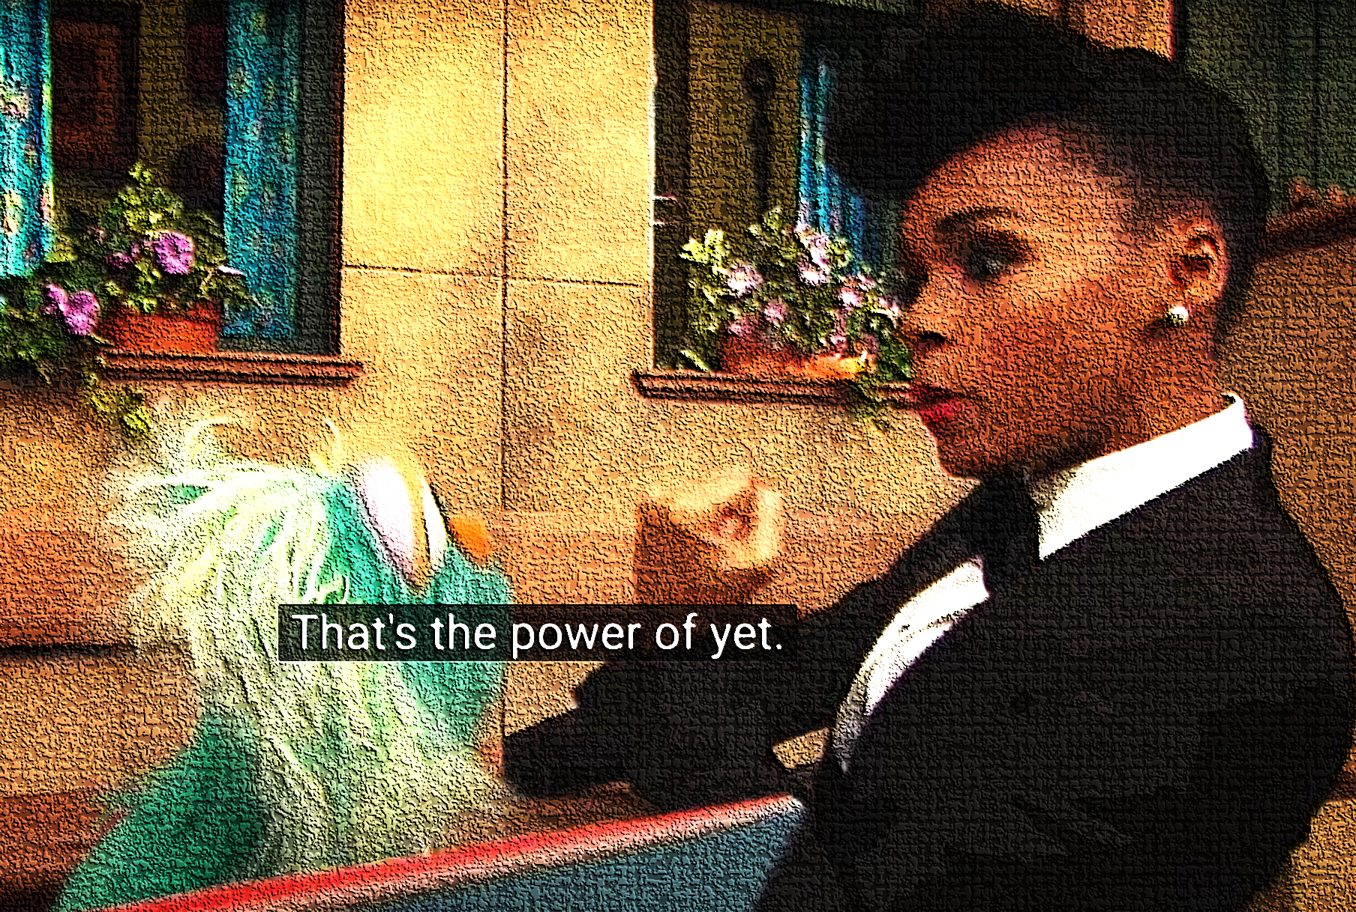
10ª Mini-Lesson B
Choose Roles
Secretary shares screen
Slide 2: Explain what appears to have gone wrong in each fotos
Slide 3: Based on the lyrics of the song, predict what the connection is between the images from Slide 2 and this image.
Notes:
Find this slide in the Google Drive.

Slide 2
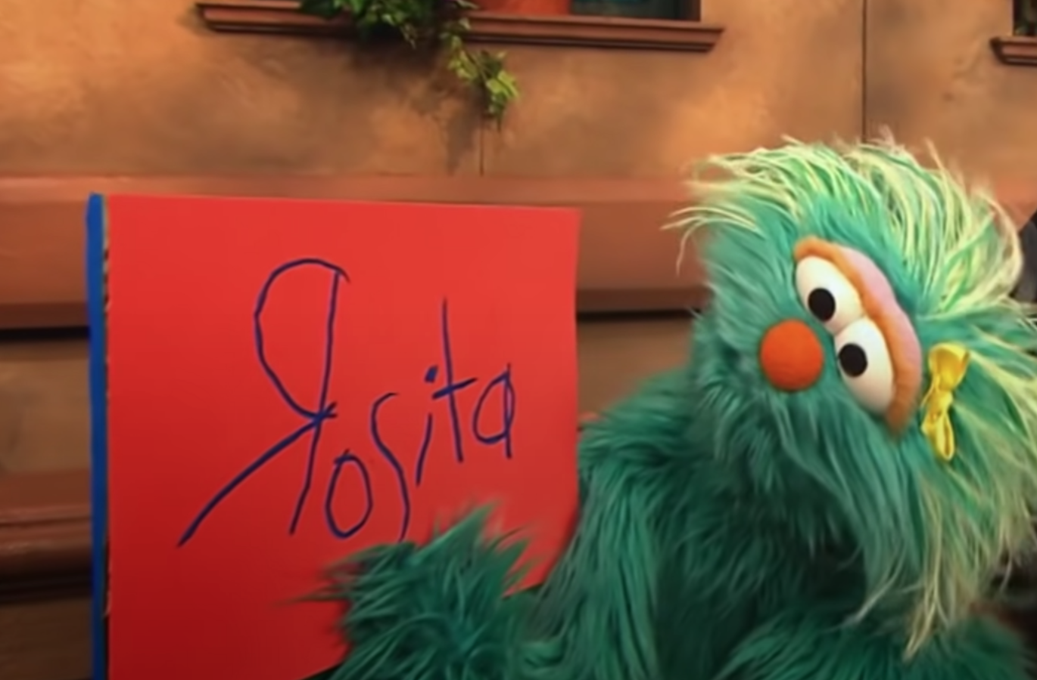
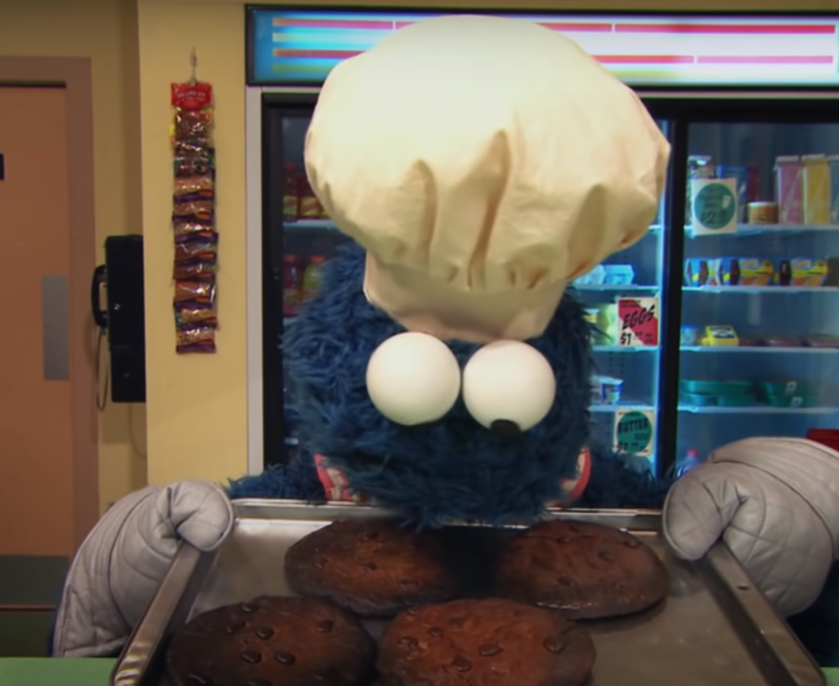
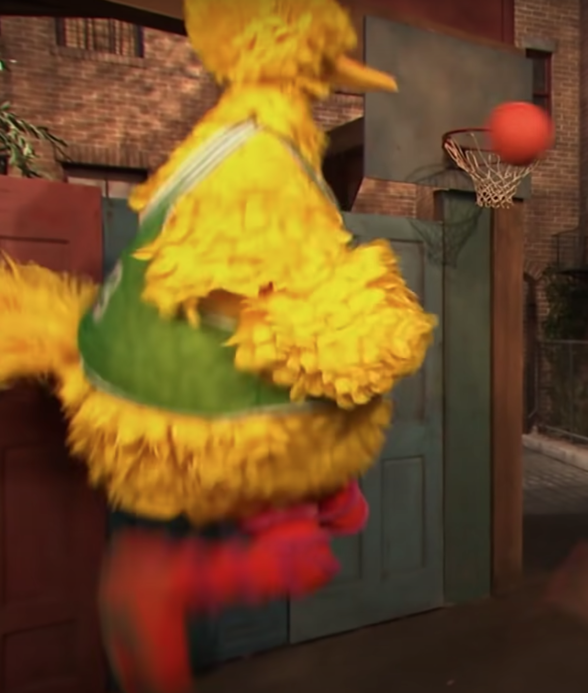
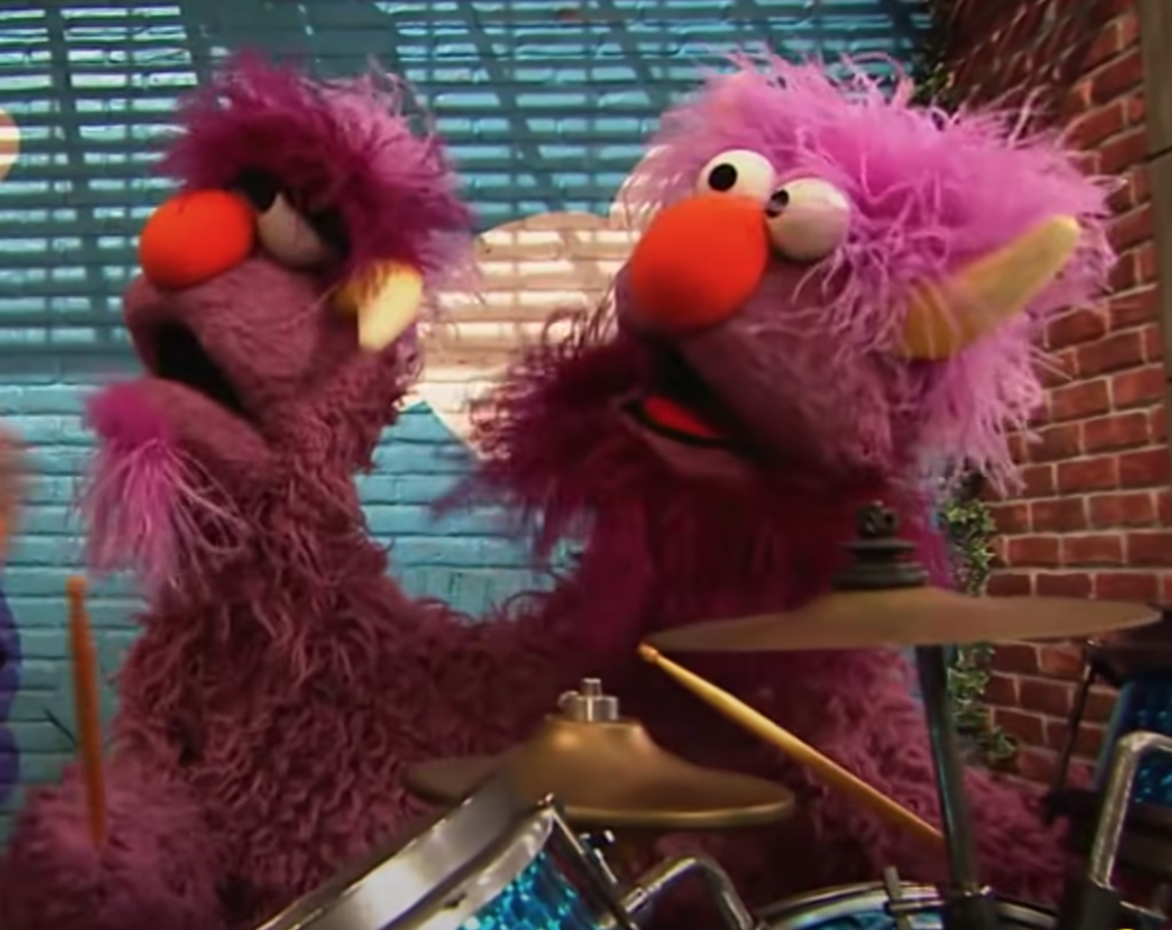
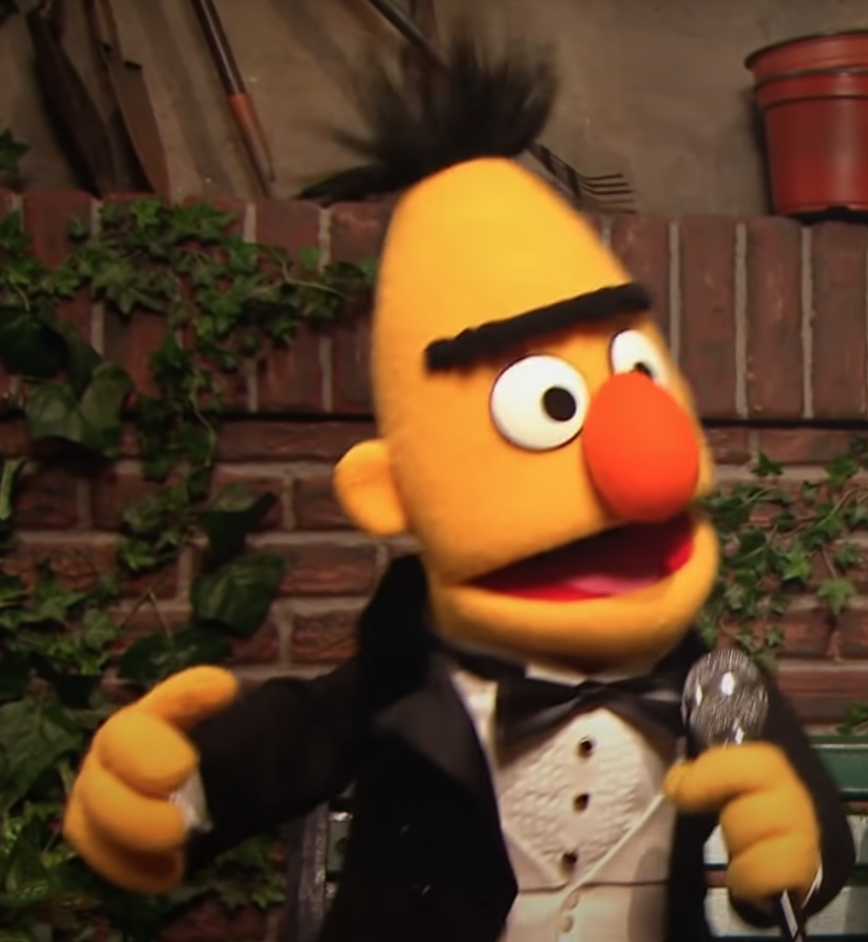
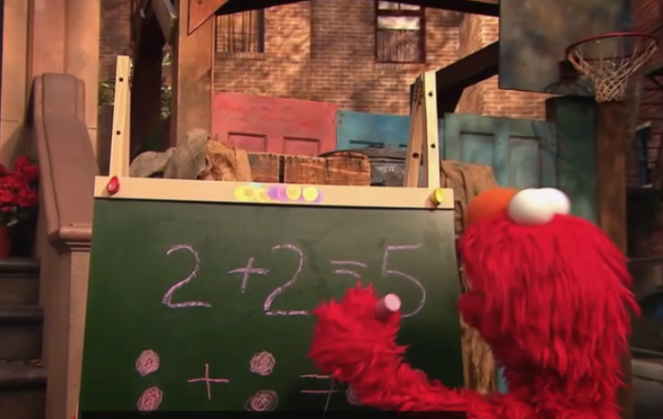
What went wrong?
__________________________
__________________________
__________________________
What went wrong?
__________________________
__________________________
__________________________
What went wrong?
__________________________
__________________________
__________________________
What went wrong?
__________________________
__________________________
__________________________
What went wrong?
__________________________
__________________________
__________________________
What went wrong?
__________________________
__________________________
__________________________

Slide 3
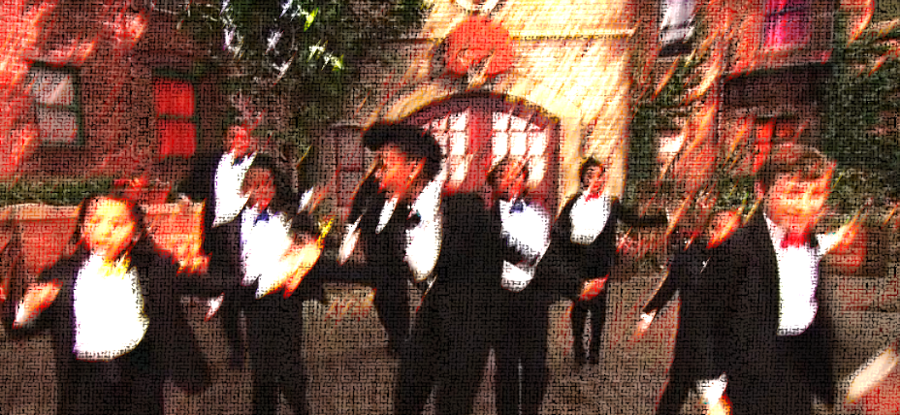
Based on the lyrics of the song, predict what the connection is between the images from Slide 2 and this image.
The Power of Yet
La, la, la
Oh, how does it go?
These don’t look right…
Oh, we’ll never get this.
2 + 2…oh boy, Elmo will never get it right.
You try to add but the numbers came out wrong
You tried to sing but you didn’t know the whole song,
You tried to cook but the food didn’t taste right
You tried to dunk but you didn’t get enough height
You didn’t do it right now
But you’re trying and you’ll learn how
You just didnt’ get it yet
But you’ll get it soon I bet
That’s the power of yet!
This is what you get, with the power of yet!
Come on…
You tried to write but you couldn’t make the letter ‘r’
You tried to jump but you didn’t make it that far
You tried to drum but you couldn’t find the downbeat
You tried to dance but you tripped on your own feet

Slide 4
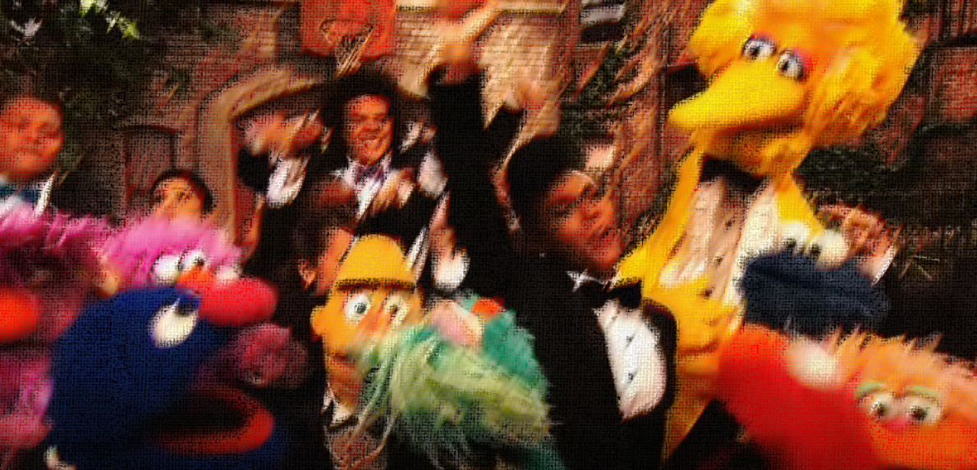
The Power of Yet (continued)
Just breathe, don’t lose control
Keep trying and you’ll reach your goal
You just didn’t get it yet
But you’ll make it soon I bet
That’s the power of yet!
Ready get set – with the power of yet!
There’s no mountain you can’t climb
It just takes a little time
Because you got what it takes
Just learn from your mistakes
Try and try again and one day you’ll step up and then
You…
Try to add and you get the right answer
You sing a song and you beome a great dancer
You dunk a ball and you make the right letter
Everything you do you do better
This is what you get with the power of yet!!!

Slide 5
This is what we think the connection is between the images in Slide 2 and the lyrics of The Power of Yet:
____________________________________________________________________________________
____________________________________________________________________________________
____________________________________________________________________________________
____________________________________________________________________________________
____________________________________________________________________________________
____________________________________________________________________________________
____________________________________________________________________________________

