Slide 1
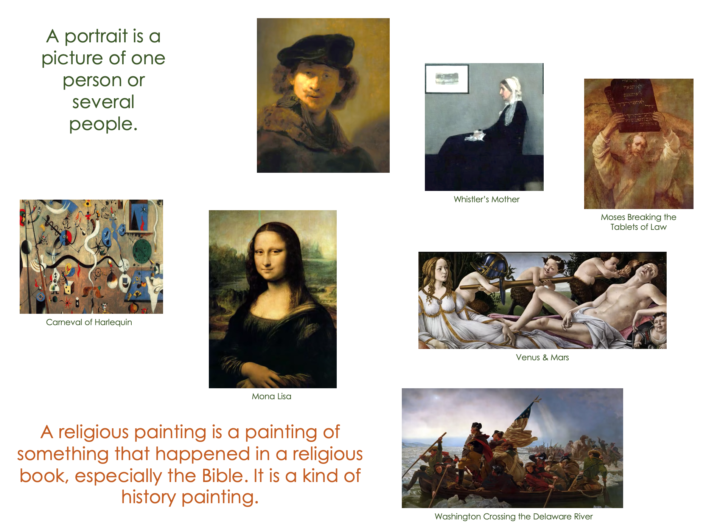
11ª Mini-Lesson
Genres of Art
Match image and description
Choose Roles
You’re going to see a video. Before you do:
Secretary shares screen with PPT
Slides 2 & 3: Match the description with a corresponding image. (There are no single correct answers, but only those you can justify.)
What extra language support would your students need to be able to participate confidently? Write down those words/phrases.
Notes:
https://www.youtube.com/watch?v=jWNEr4eHL18
Biko
Peter Gabriel

Slide 2
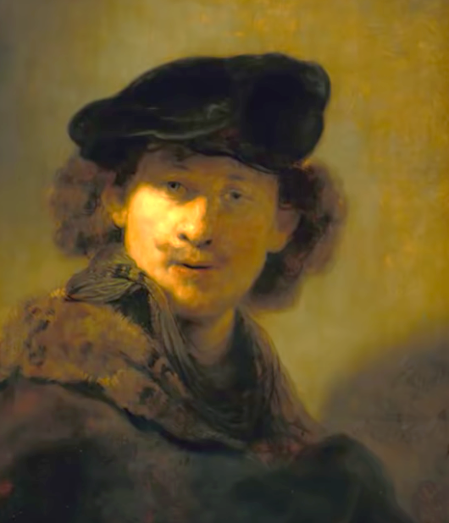
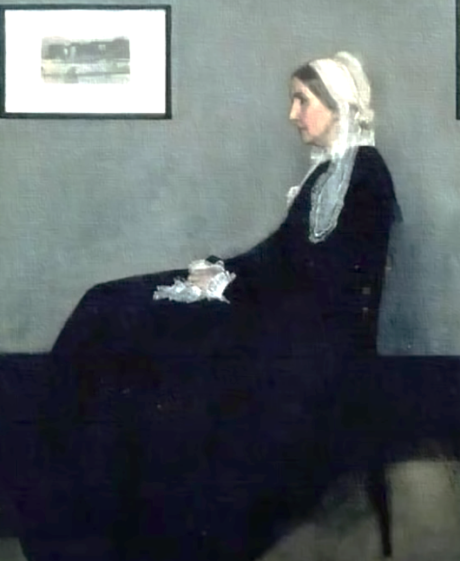
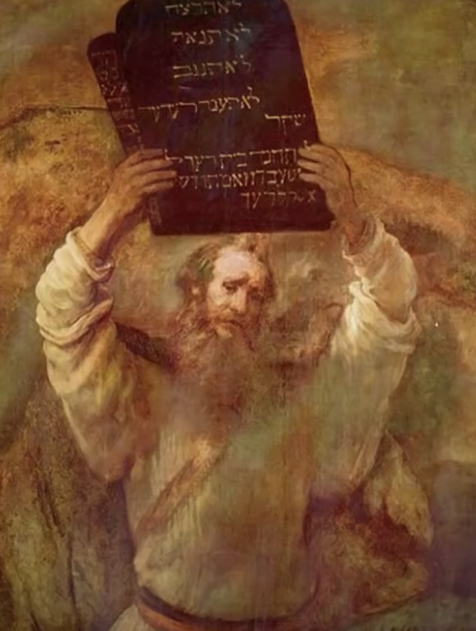
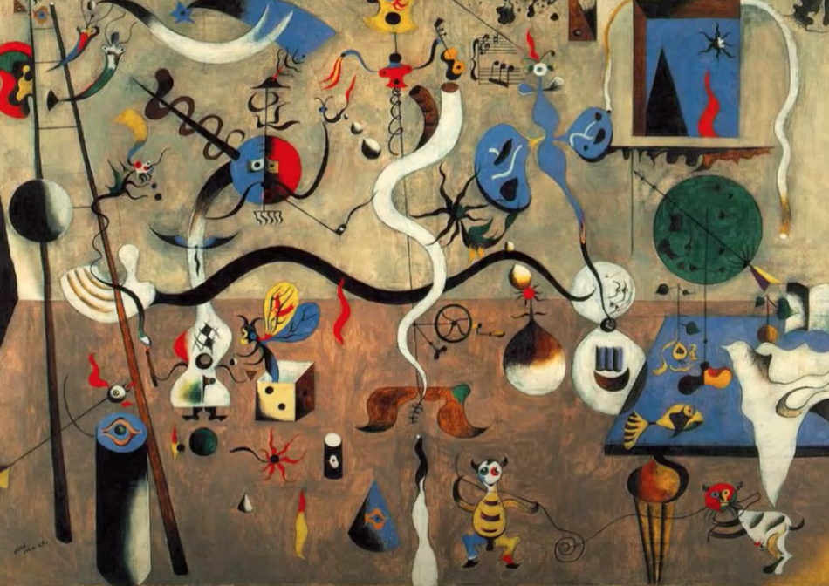
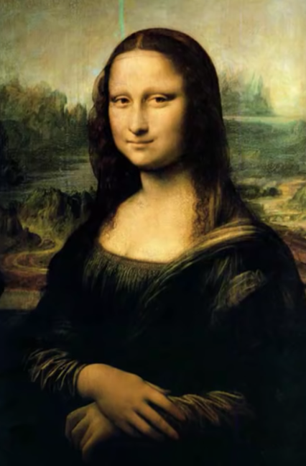
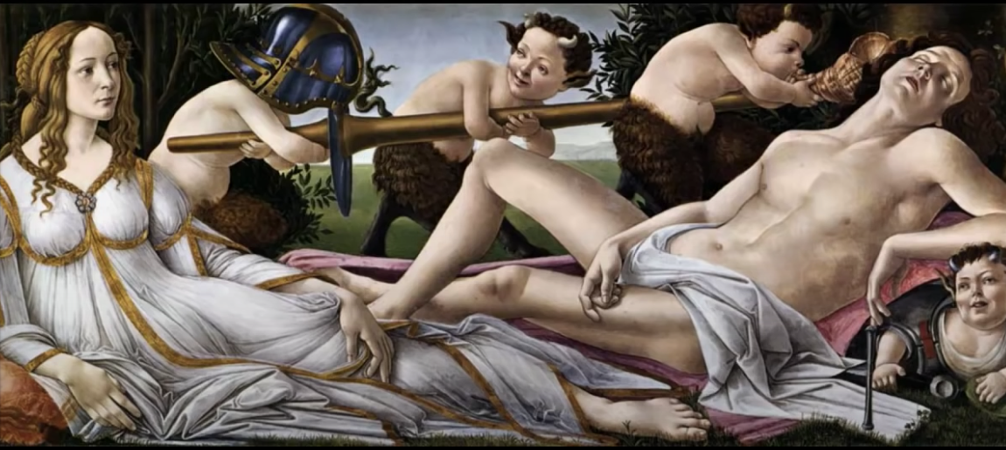
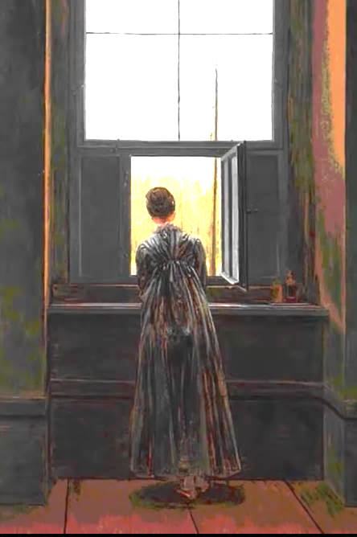
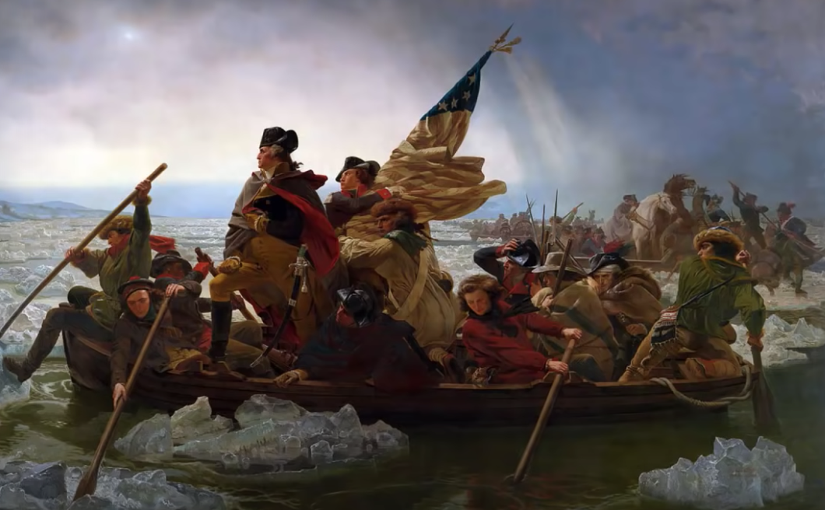
A portrait is a picture of one person or several people.
A history painting is a painting of a story. Some stories in history paintings actually happened. Others did not.
Man with a chapeau
Whistler’s Mother
Moses Breaking the Tablets of Law
Carneval of Harlequin
Venus & Mars
Mona Lisa
A religious painting is a painting of something that happened in a religious book, especially the Bible. It is a kind of history painting.
Woman at the Window
Washington Crossing the Delaware River

Slide 3
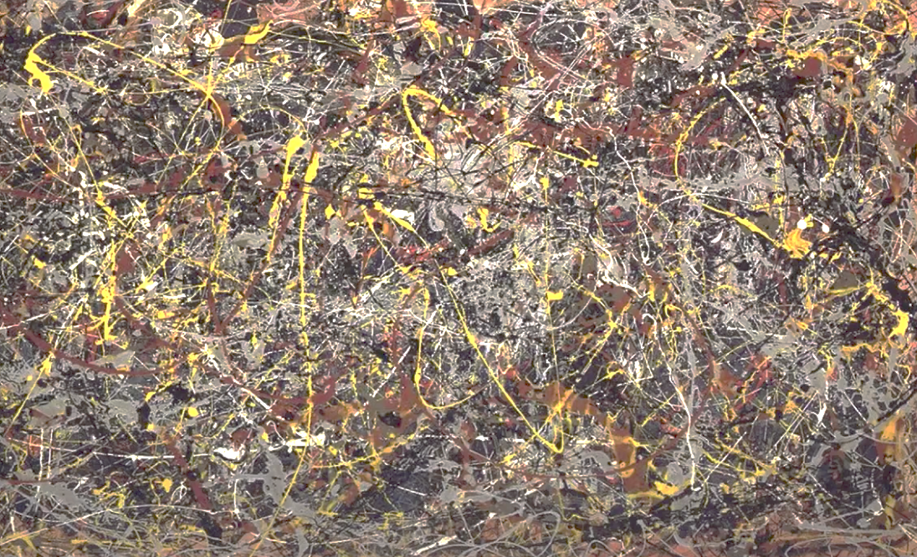
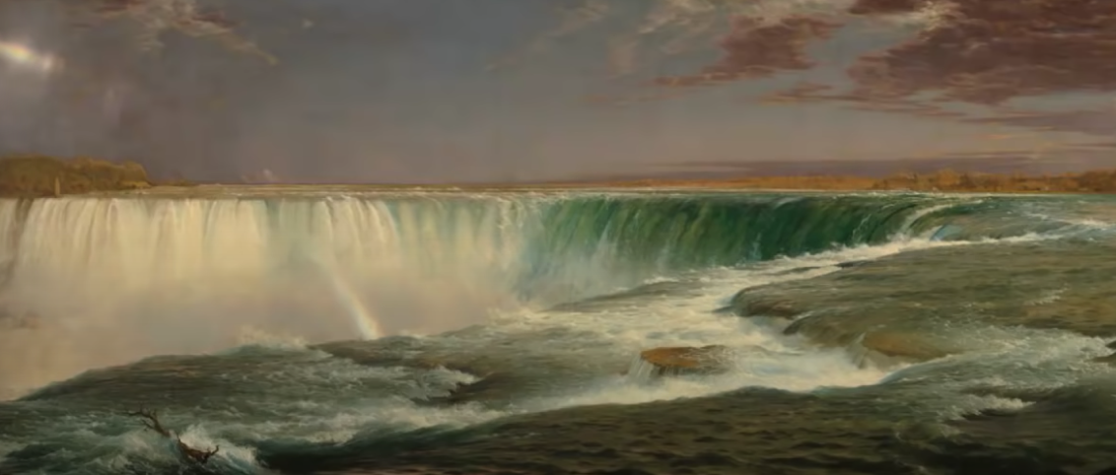
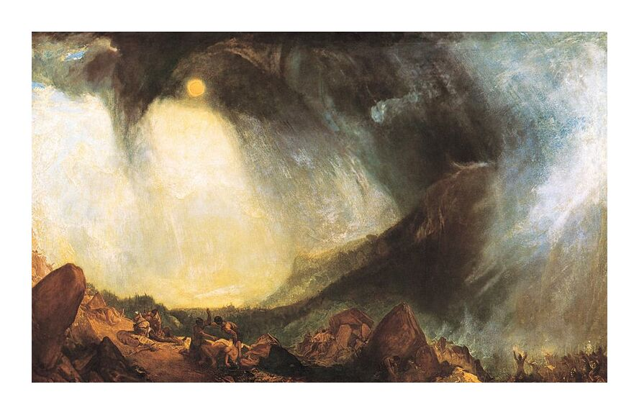
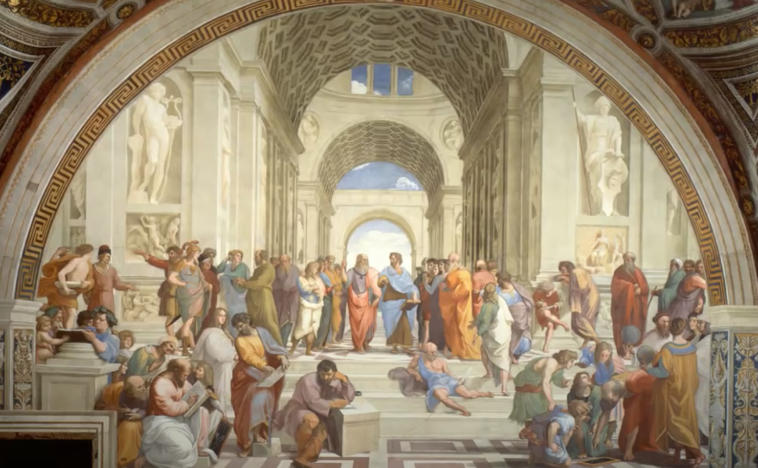
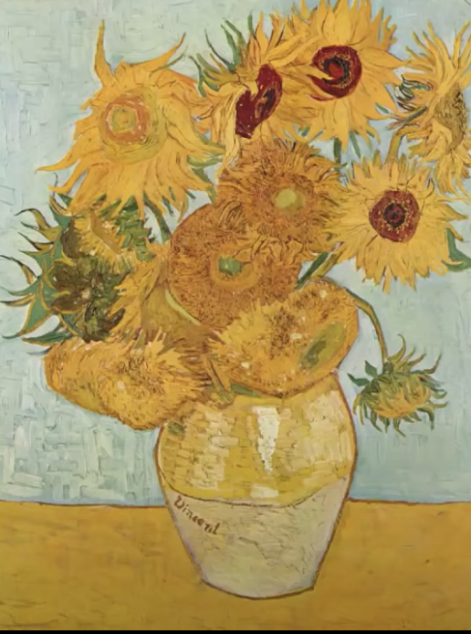
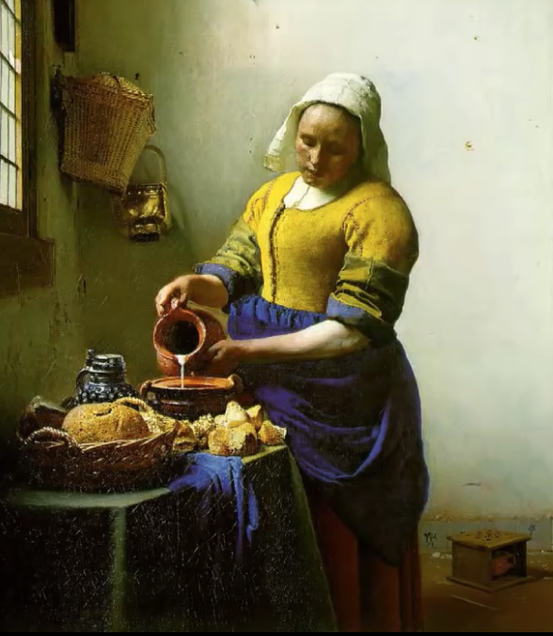
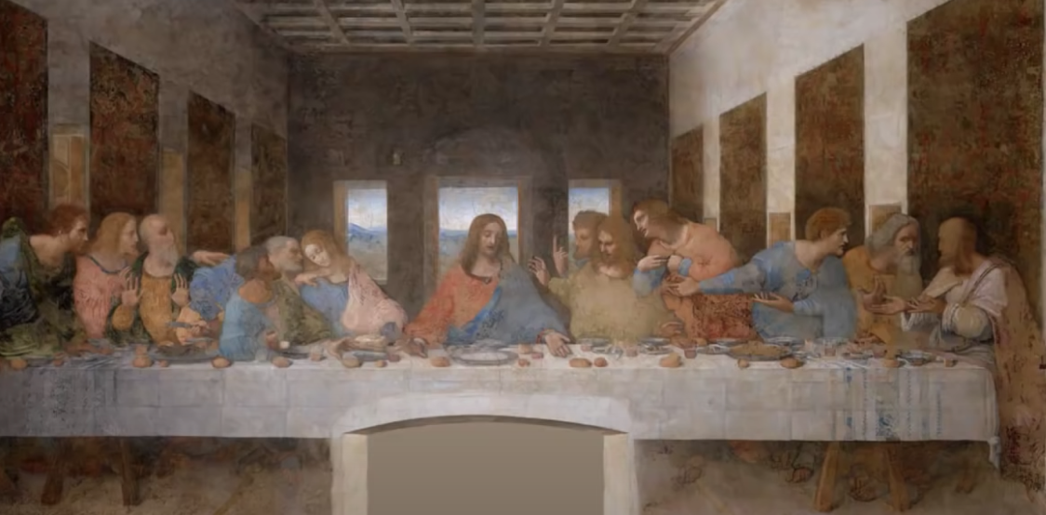
A genre painting is a painting of a scene from every day like, like a painting of regular people, musicians, a train, or farming life.
Miagra
Number 5
An abstract painting is a painting that doesn’t show anything from real life. It is a design, or an expression of feelings.
Remember, a ‘history painting’ includes religious and mythological paintings. They are all paintings of stories, and often have a lesson - do this, don’t do that!
Snow Storm: Hanibal and His Army Crossing the Alps
School of Athens
A landscape painting is painting of nature, like mountains and trees and animals.
The Milkmaid
The Last Supper
Sunflowers

Slide 4
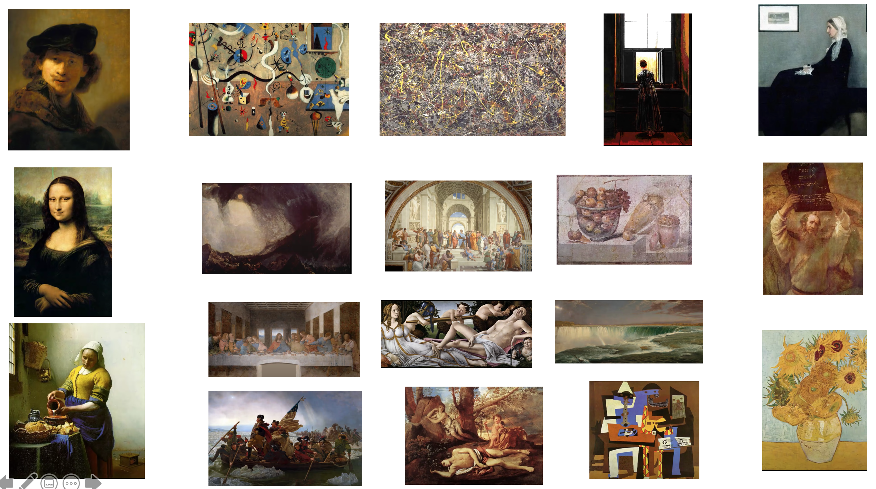
10ª Mini-Lesson (Alternative version)
Identify the Image
Choose Roles
Secretary shares screen
You’re going to see a video. Before you do:
read the information in the table and then look at the images in Slide 3
identify which painting you believe each description refers to
write the number of the painting next to the description in the table
Notes:
https://www.youtube.com/watch?v=jWNEr4eHL18
Biko
Peter Gabriel

Slide 5
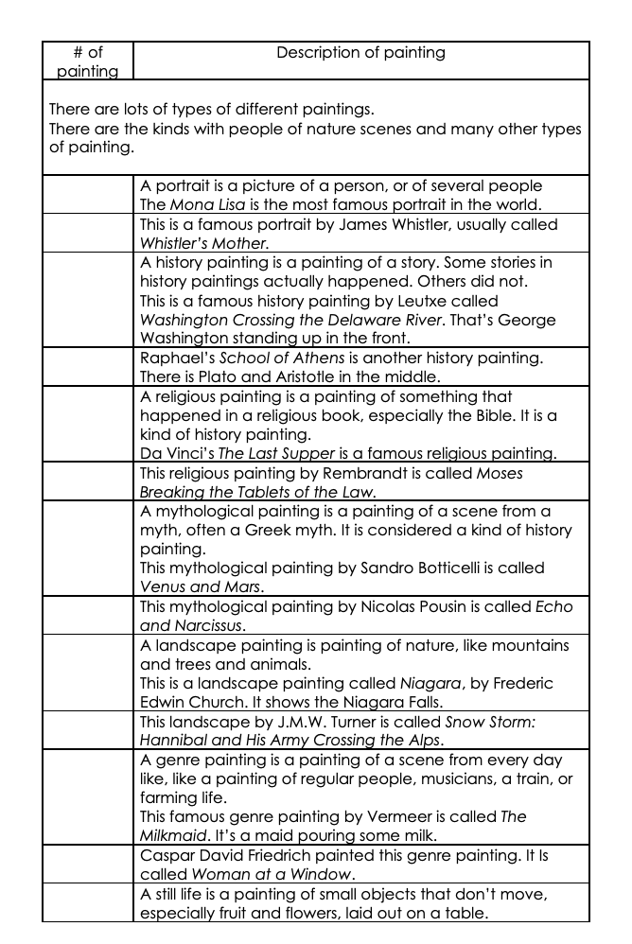
Download this table in Word format from the platform.
‘12ª Mini-Lesson ‘Identify the Image Table’

Slide 6
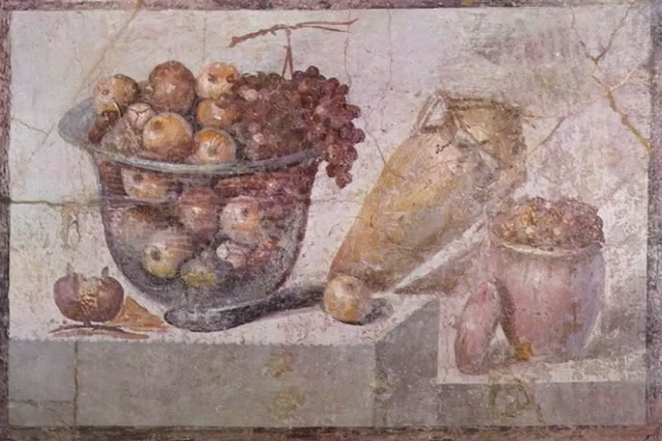
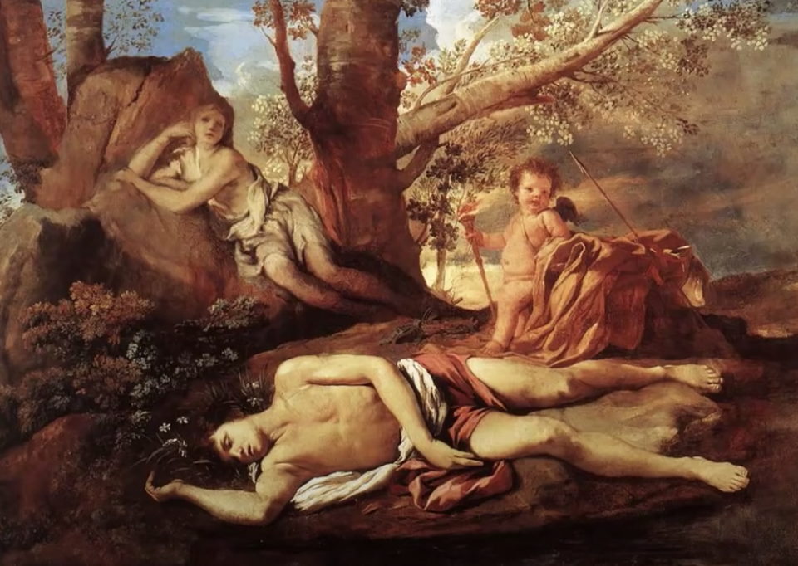
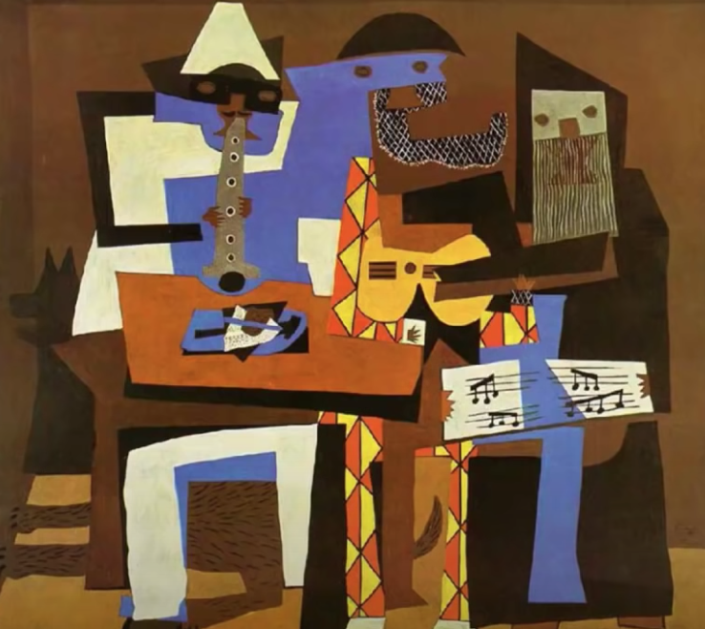
2
3
4
1
5
1
7
8
9
10
6
11
12
13
15
16
17
18
14

