Slide 1
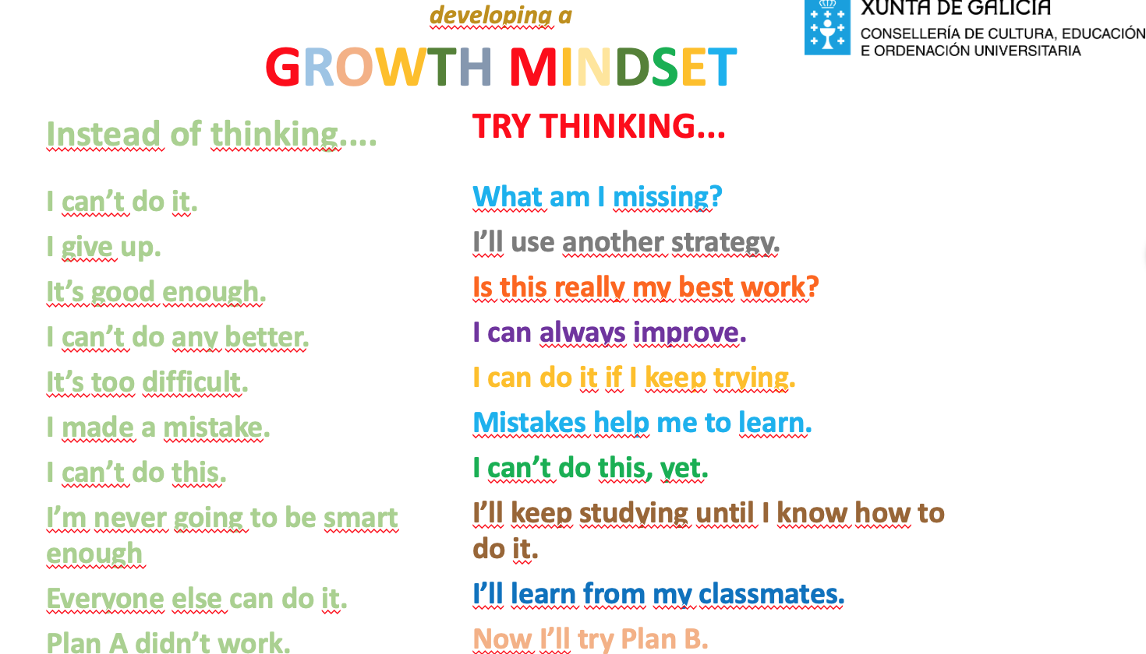
10ª Mini-Lesson
Choose Roles
Secretary shares screen
Based on the information in table on Slide 2, write 2-3 sentences about what your group believes the Growth Mindset is.
Notes:
Find this slide in the Google Drive.

Slide 2
developing a
GROWTH MINDSET
Instead of thinking....
I can’t do it.
I give up.
It’s good enough.
I can’t do any better.
It’s too difficult.
I made a mistake.
I can’t do this.
I’m never going to be smart enough
Everyone else can do it.
Plan A didn’t work.
TRY THINKING...
What am I missing?
I’ll use another strategy.
Is this really my best work?
I can always improve.
I can do it if I keep trying.
Mistakes help me to learn.
I can’t do this, yet.
I’ll keep studying until I know how to do it.
I’ll learn from my classmates.
Now I’ll try Plan B.

