Slide 1
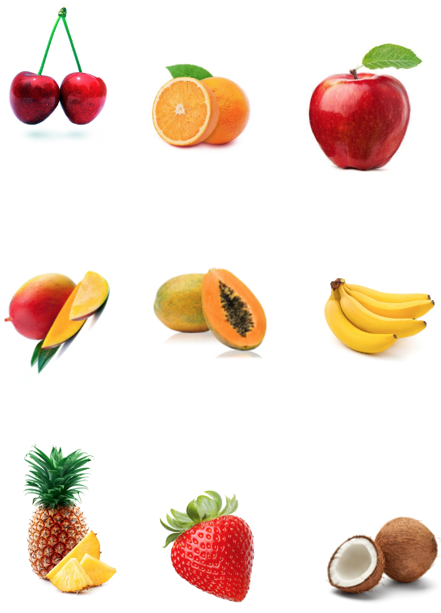
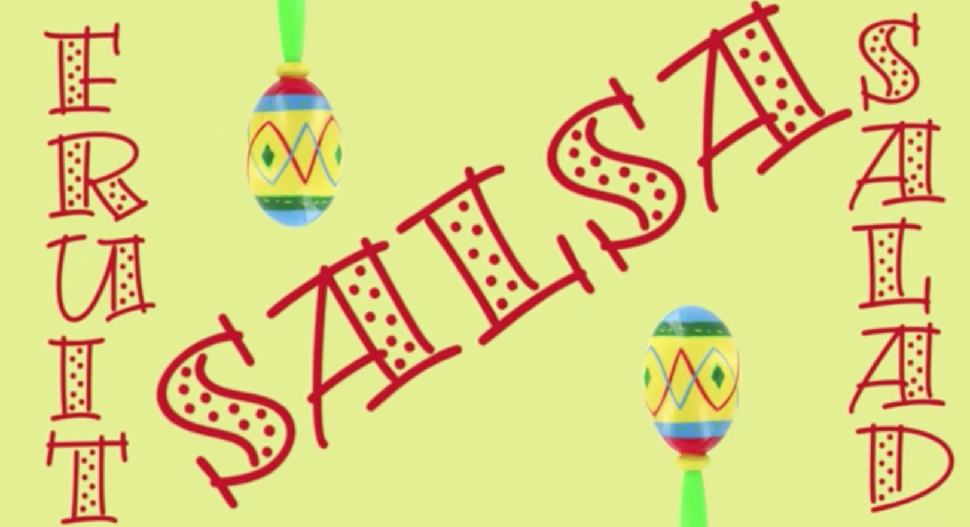
9ª Mini-Lesson
Rhyming & Fruit
Choose roles
Secretary shares screen with PPT
Look at the images. Take turns reading the rhyming words for each fruit.
Write 3-5 rhyming words in Spanish.
Notes:
https://www.wordhippo.com/what-is/words-that-rhyme-with/banana.html

Slide 2

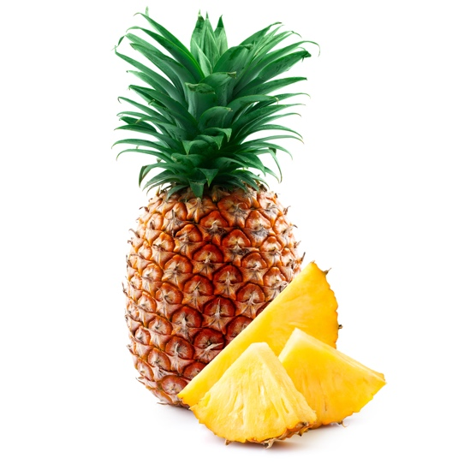
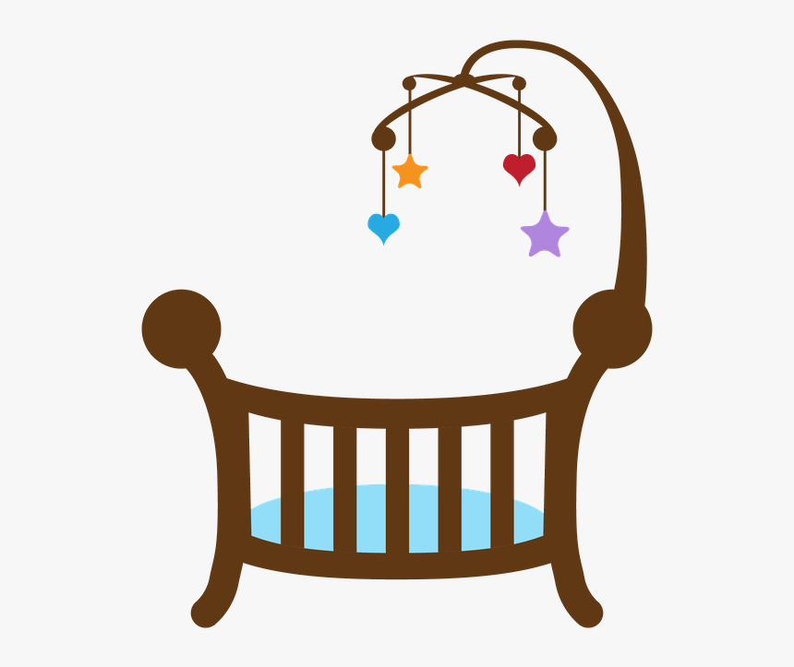

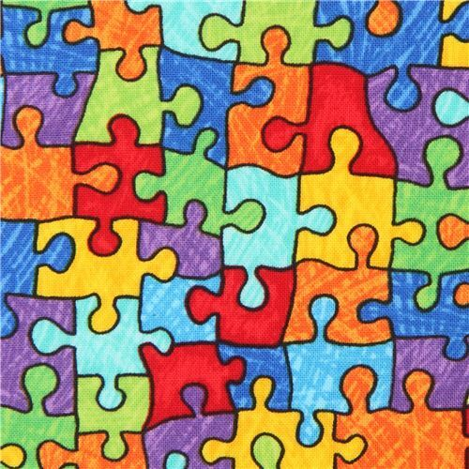
Pineapple
cradle
whistle
puzzle
candle
Rimas en español:
____________
____________
____________

Slide 3


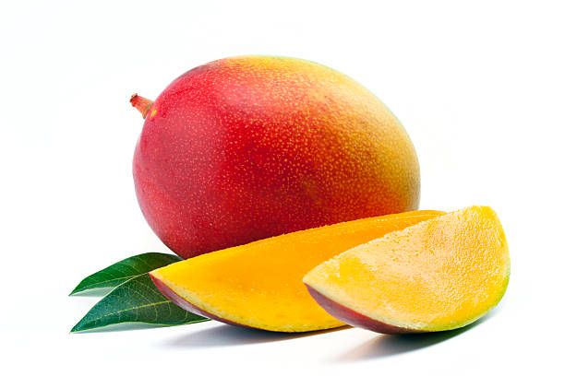
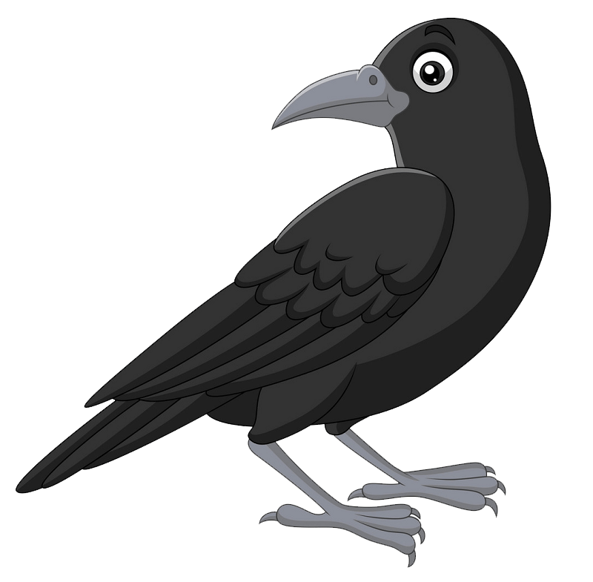
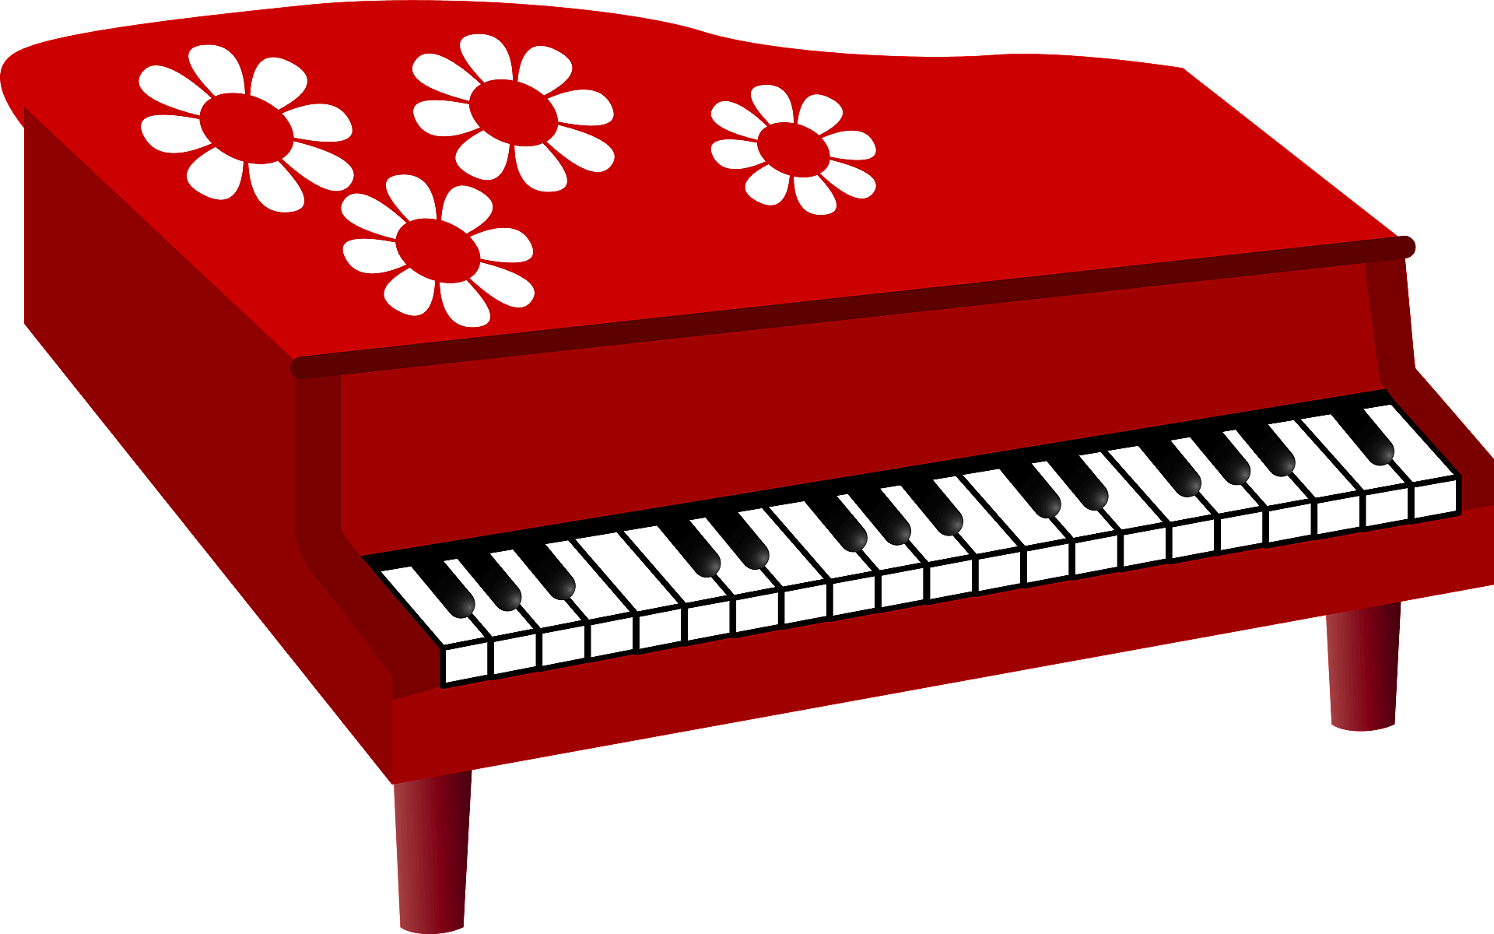
Mango
window
piano
crow
meadow
Rimas en español:
____________
____________
____________

Slide 4
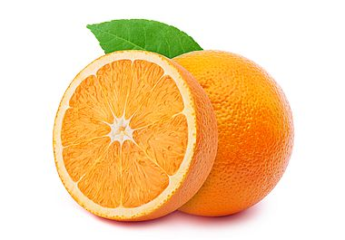
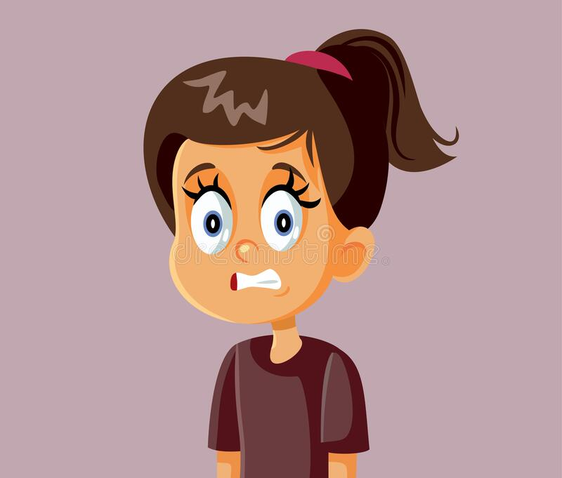
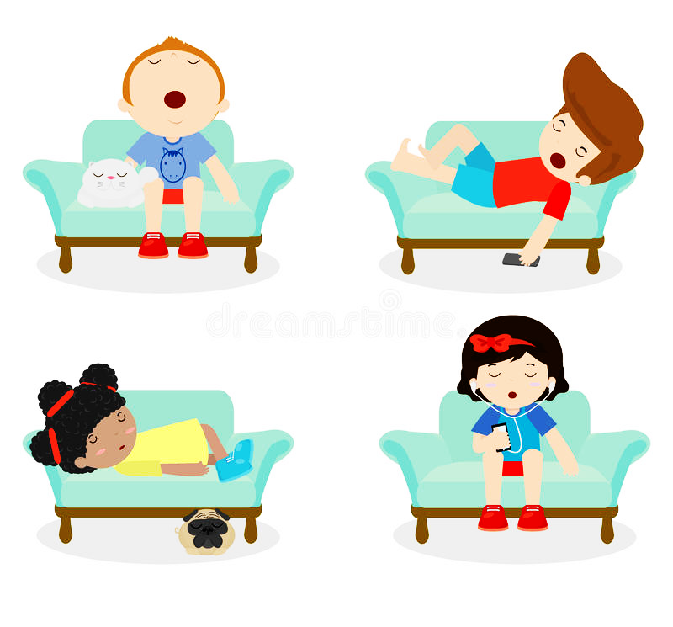
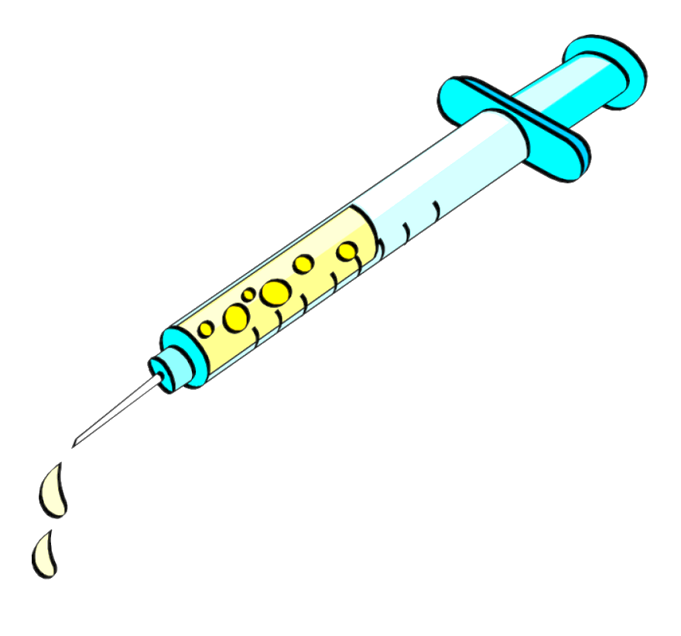
Orange
cringe
syrInge
lounge
Rimas en español:
____________
____________
____________

Slide 5
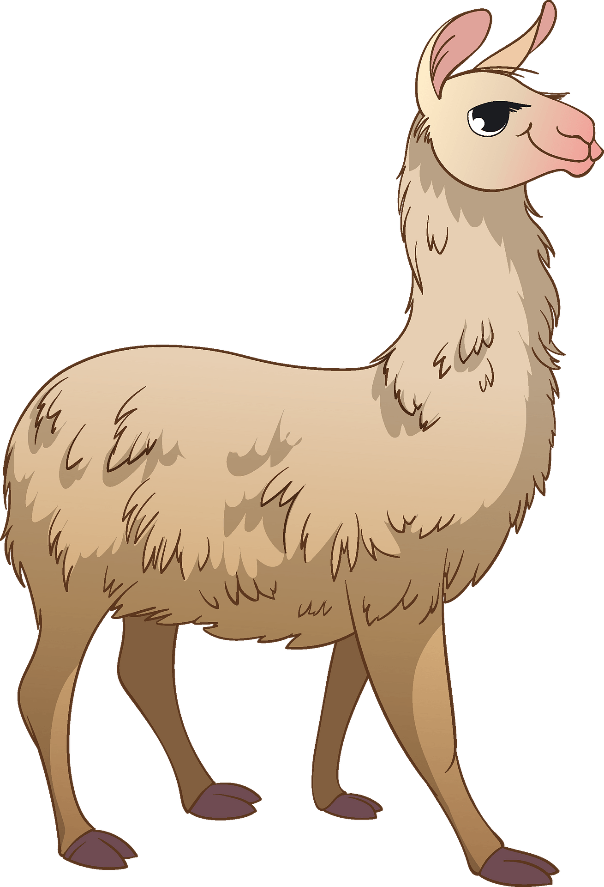
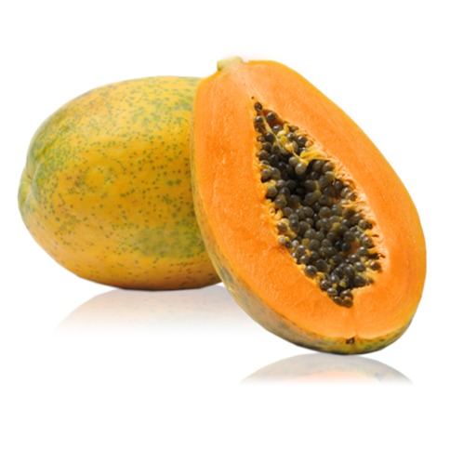
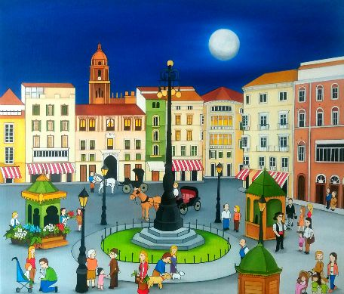
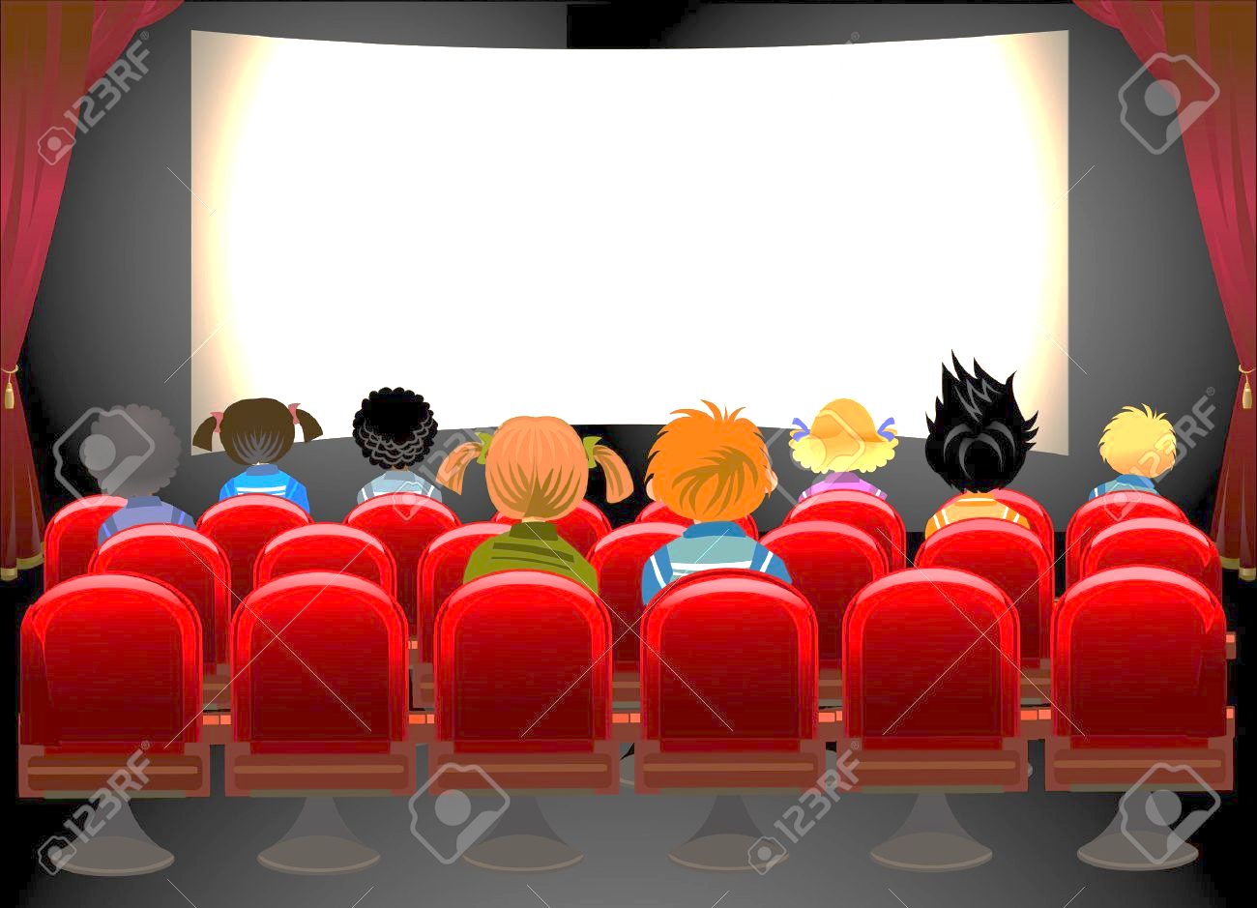

Papaya
umbrella
cinema
plaza
llama
Rimas en español:
____________
____________
____________

Slide 6
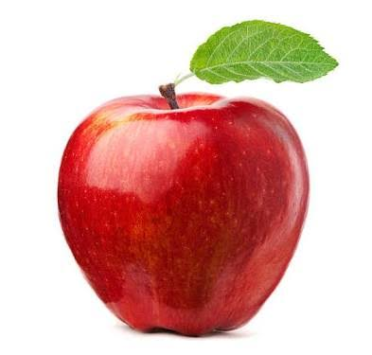
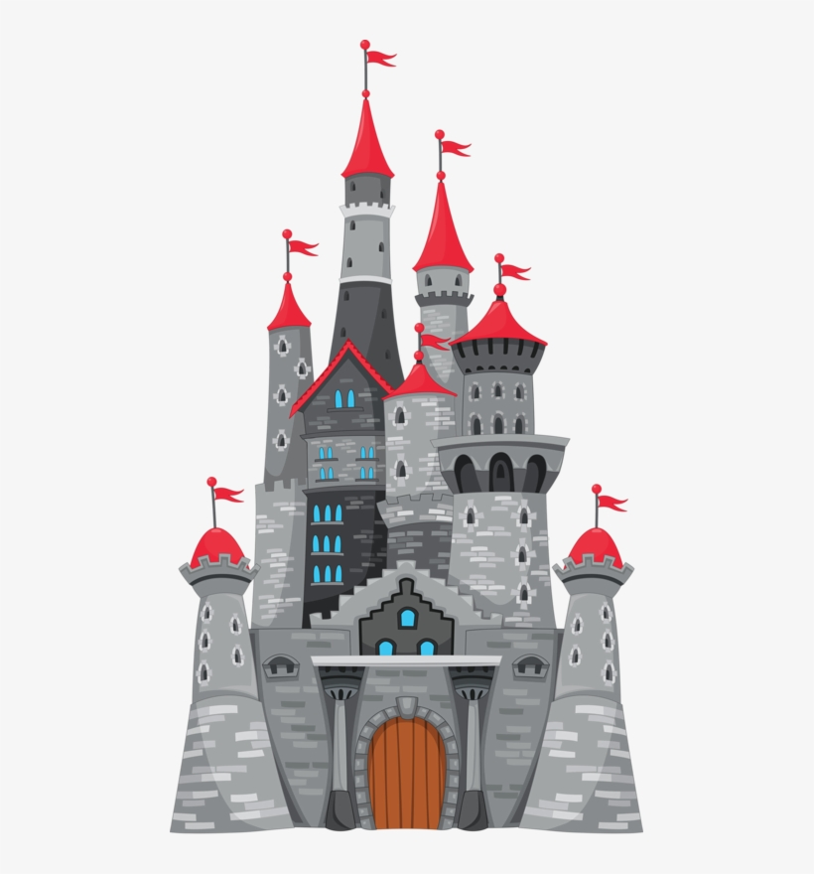


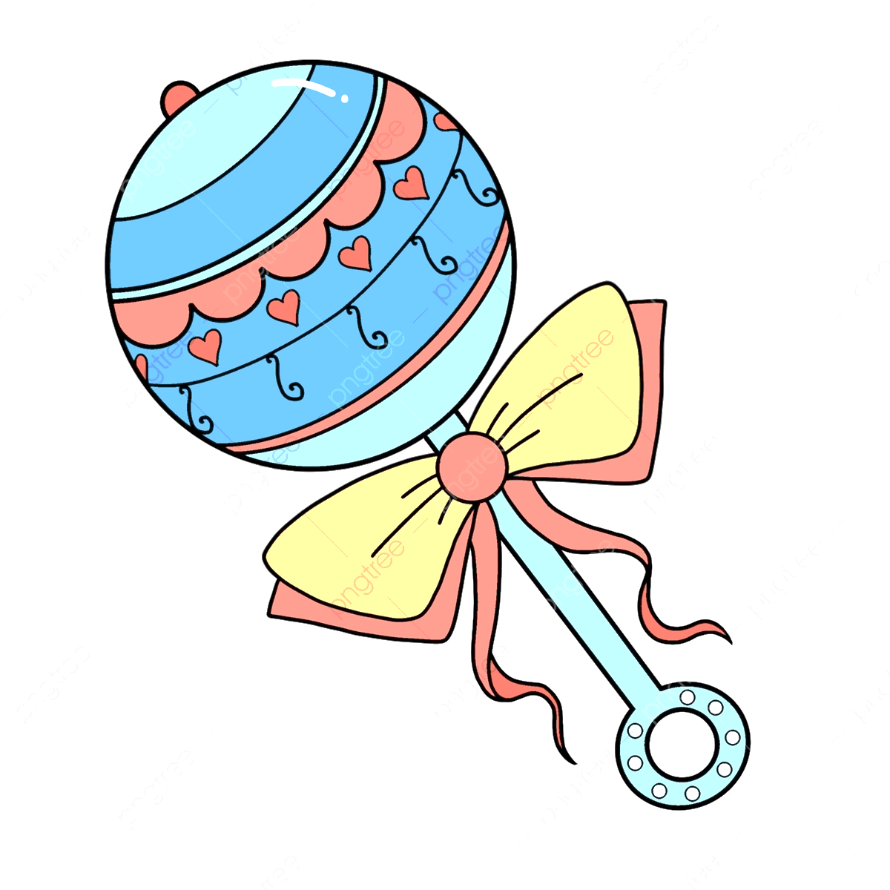
Apple
castle
purple
rattle
bubble
Rimas en español:
____________
____________
____________

Slide 7
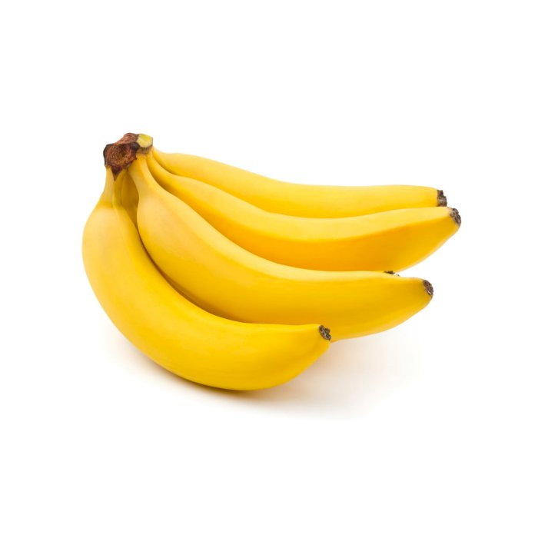
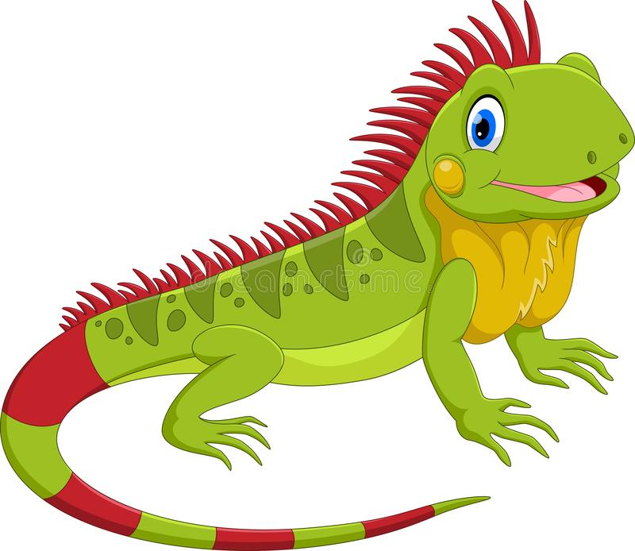

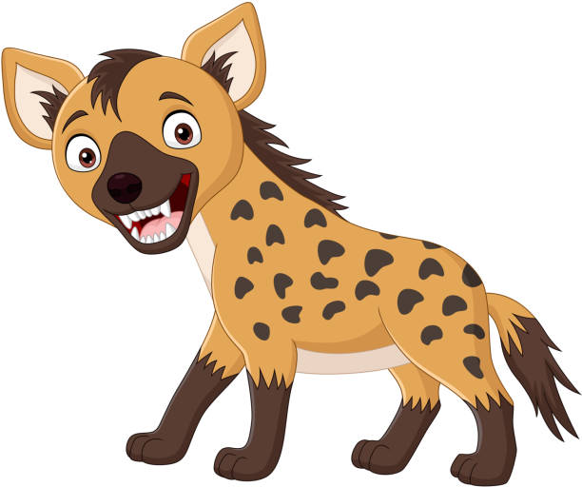

Banana
iguana
Havana
cabana
hyaena
Rimas en español:
____________
____________
____________

Slide 8
Here comes the mango with one hand out.
And here comes the apple with one hand out.
And here comes papaya with one hand out.
All for the fruit salad salsa.
Here comes the pineapples – shake, shake, shake
Here comes the oranges – shake, shake, shakes.
Here comes bananas – shake, shake, shake.
All for the fruit salad salsa.
And then they jump a-jump a-jump, into the bowl.
They jump a-jump a-jump into the bowl.
And they jump a-jump a-jump into the bowl.
All for the fruit salad salsa.
Then all the fruits they go spinning around.
Spinning and tumbling and mixing around.
Then all the fruits they go spinning around.
All for the fruit salad salsa.
And everybody goes in, in, in and shake, shake, shake.
And everybody goes out, out, out and shakes, shake, shake.
And everybody goes in, in, in and shake, shake, shake.
All for the fruit salad salsa.
I hear the mango say ‘Let’s eat’.
I hear the apple say ‘It’s time to eat’.
I hear papaya say ‘Let’s eat’.
All for the fruit salad salsa.

