Slide 1
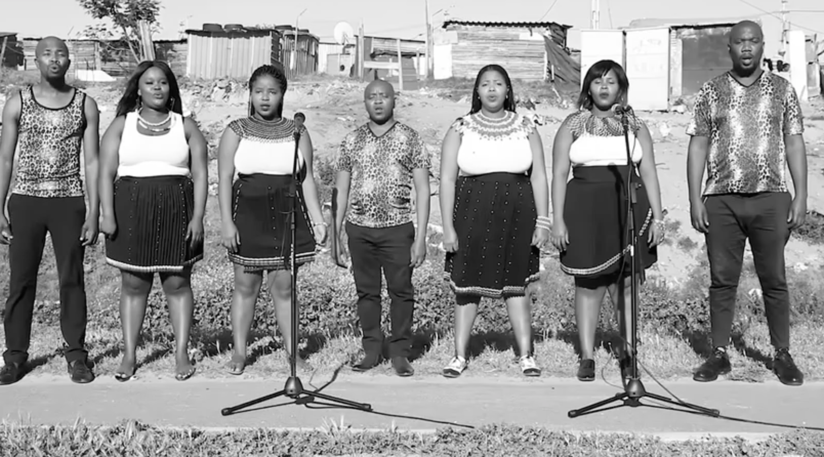
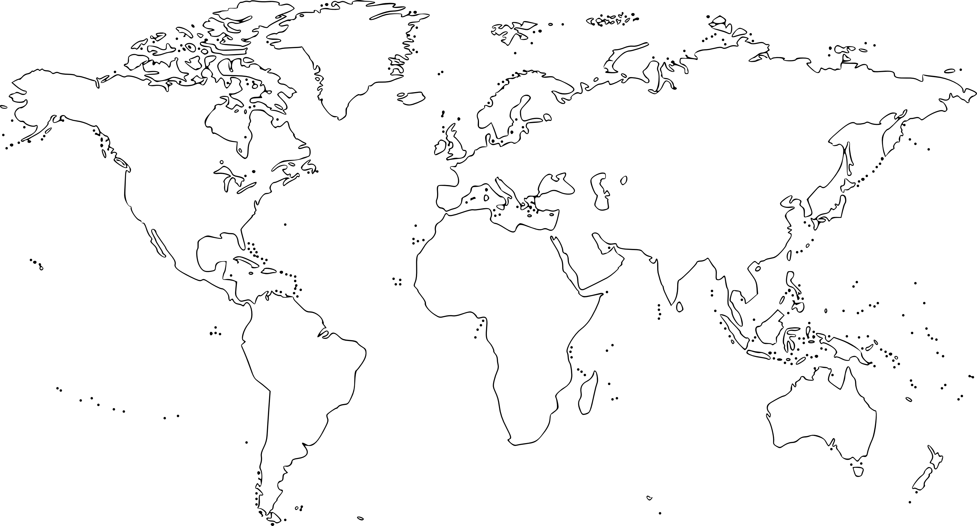
8ª Mini-Lesson Extension
Social Sciences
Apartheid/Global Consciousness
(Biko)
Choose Roles
Secretary shares screen
You’re going to see a video. You’ve already done one scaffold for this video (Which doesn’t belong?) Now do one more.
Follow the instructions on slides 2 and 3 and have fun!!
Notes:
https://www.youtube.com/watch?v=jWNEr4eHL18
Biko
Peter Gabriel

Slide 2
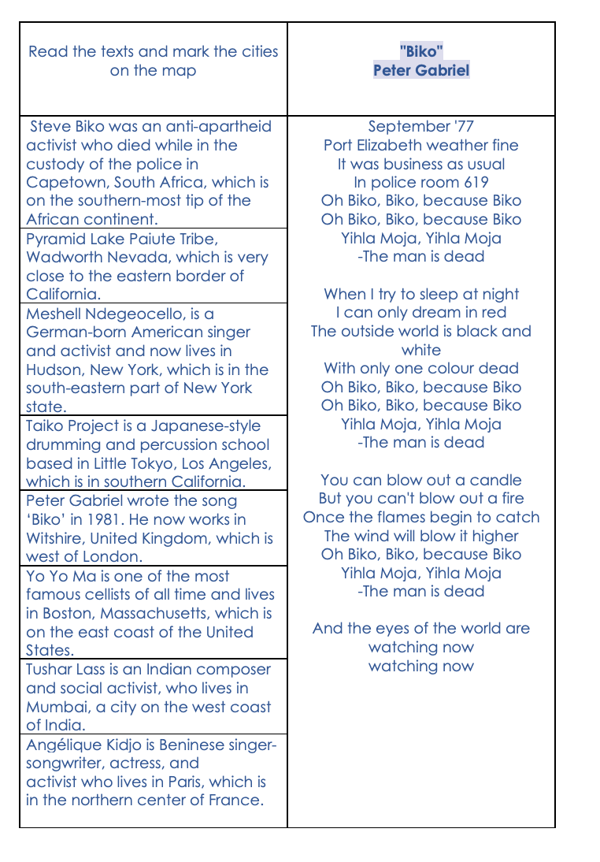
Use this information to mark on the map (Slide 3) the different homes of the singers you’ll see in the video.

Slide 3
