Slide 1
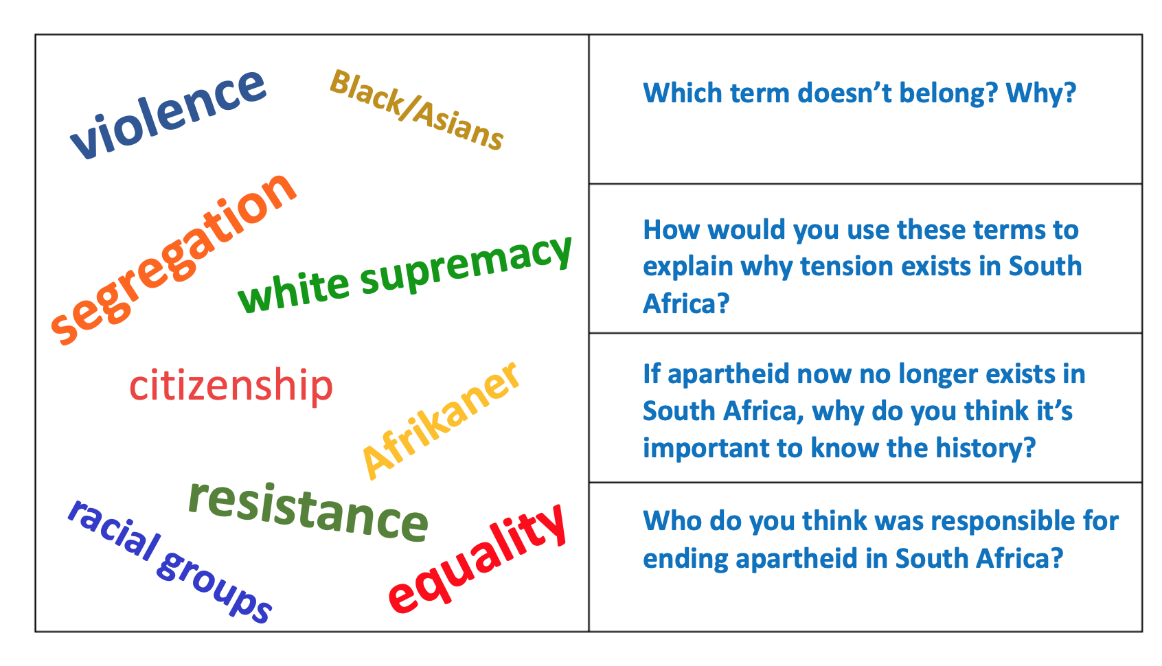
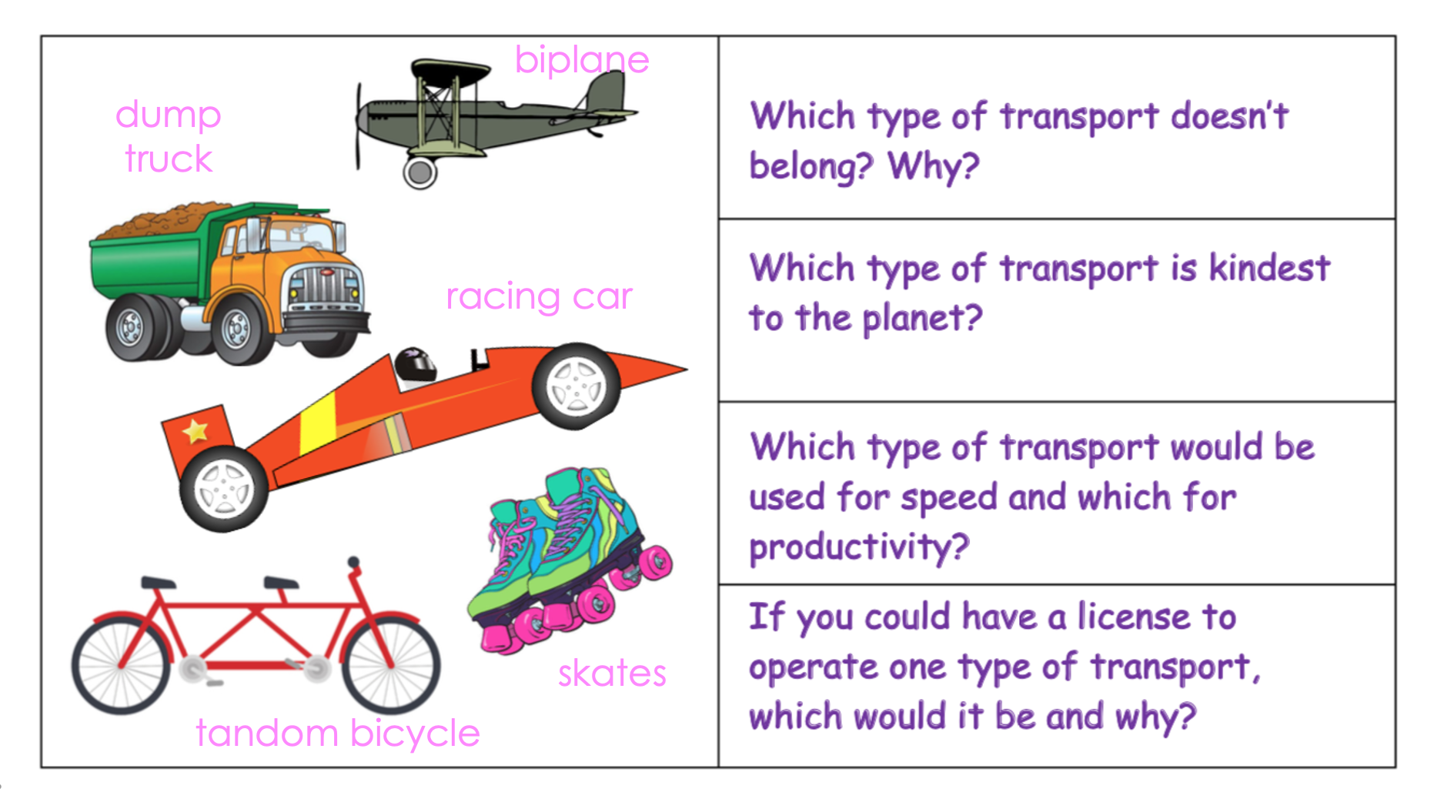
8ª Mini-Lesson
Which doesn’t belong? Activity
Choose Roles
Secretary shares screen
Read the questions and follow instructions.
***There are no ‘correct’ answers – only those you can justify!!!
Notes:
Find this slide in the Google Drive.

Slide 2
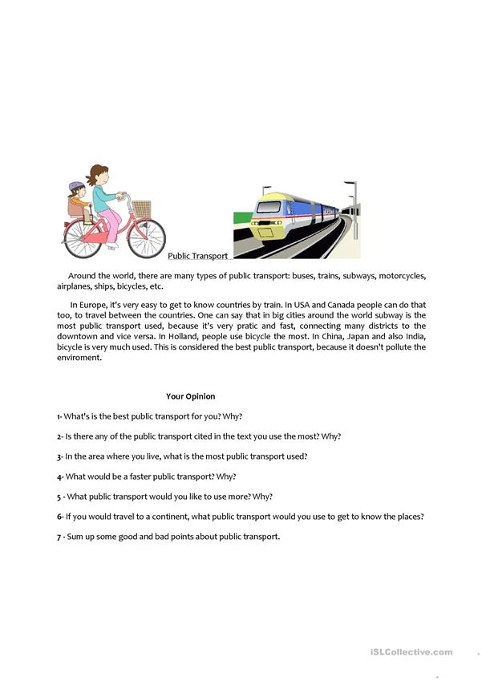
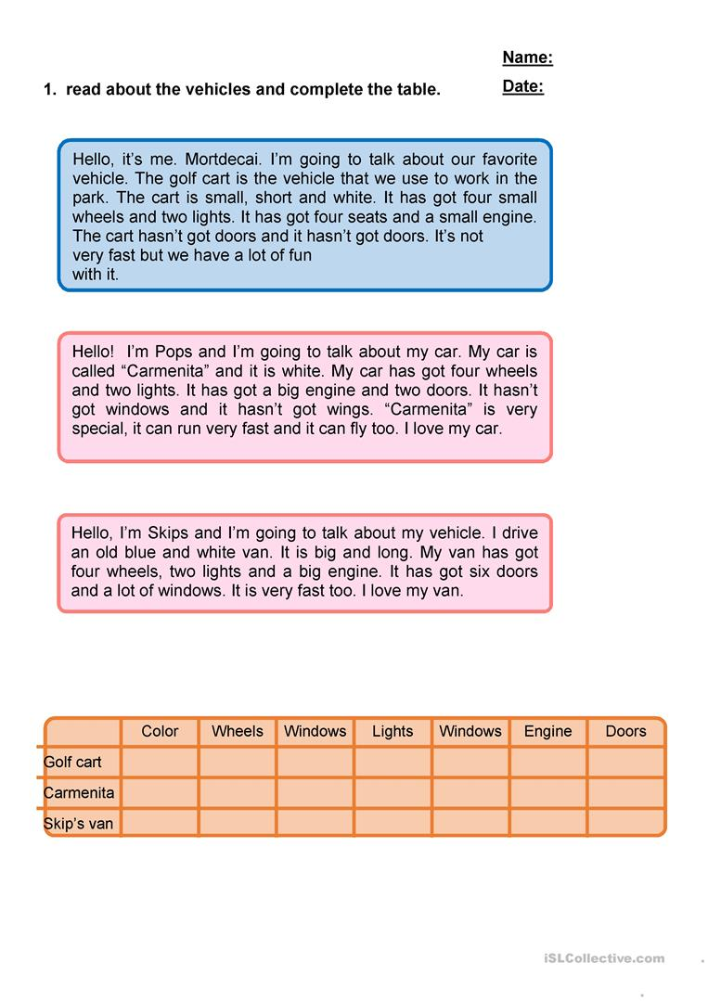
Your students are going to begin a unit on Transport
Before that, they do this scaffolding activity:

Slide 3
***There is no one correct answer for any of these questions - only answers you can justify…

Slide 4
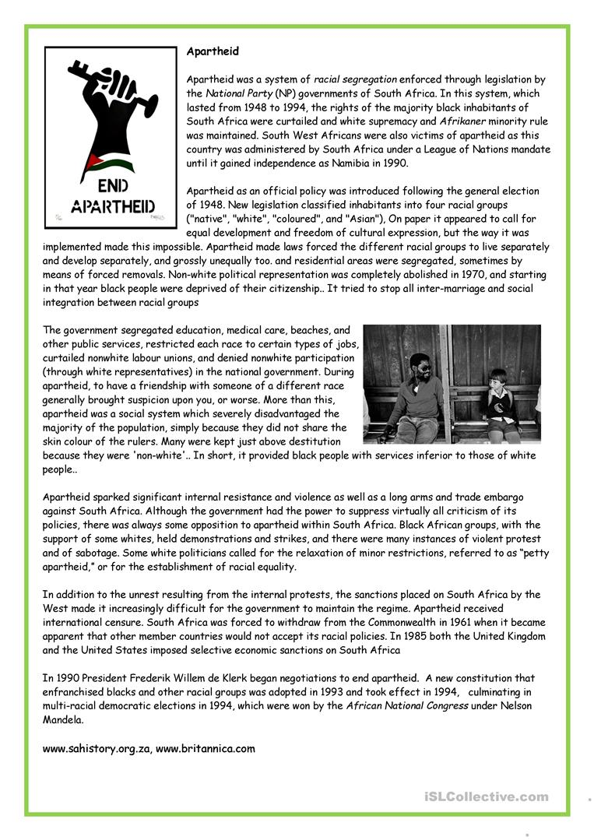
Your students are going to begin a History unit on apartheid in South Africa:
Before that, they do the following scaffold:

Slide 5
***There is no one correct answer for any of these questions - only answers you can justify…

