Slide 1
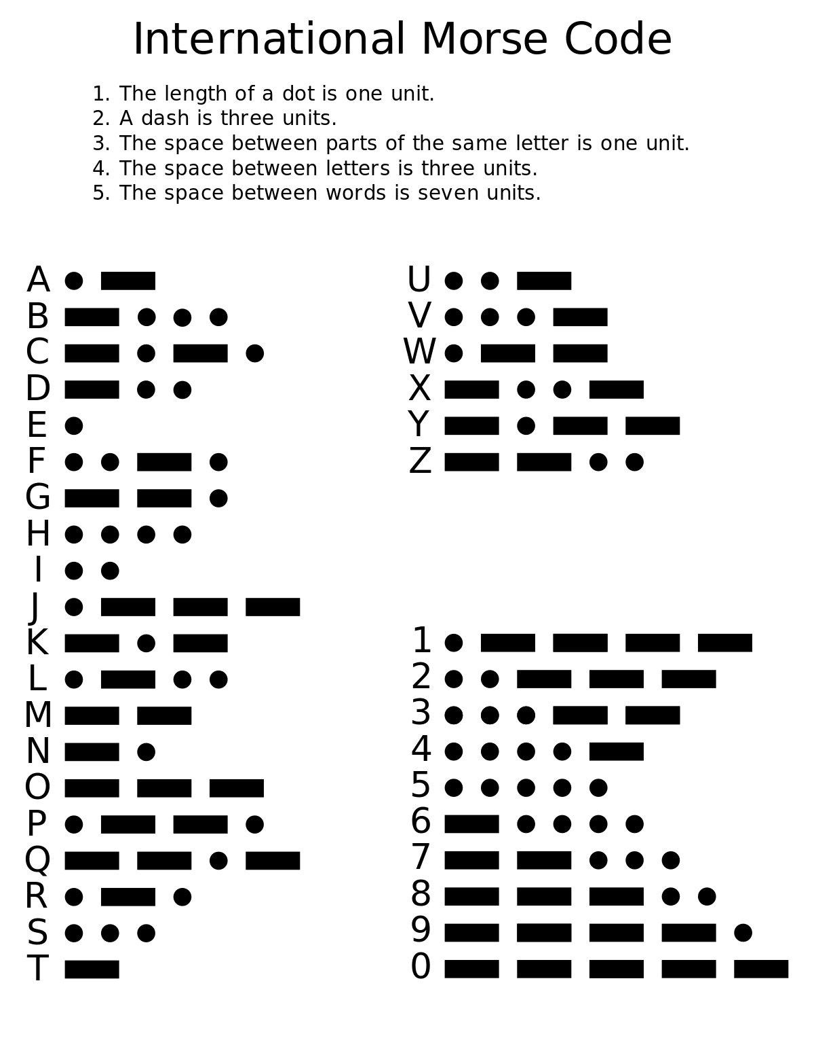
7ª Mini-Lesson
International Morse Code
and Language Acquisition
Decipher the sentence in Slide 2.
Rewrite that sentence at the top of Slide 3.
Write 5 sentences predicting how the sentence and the other images are connected. *
***There are no ‘correct’ predictions – only those you can justify!!!
Notes:
Find this slide in the Google Drive.

Slide 2
.-.. .- -. --. ..- .- --. . _______________
.. ... _______________
.- _______________
... -.- .. .-.. .-.. _______________
- .. . -.. _______________
- --- _______________
.-.. .. ...- .. -. --. _______________
.-- .. - .... .. -. _______________
.- _______________
... --- -.-. .. . - -.-- .-.-.- _______________

Slide 3
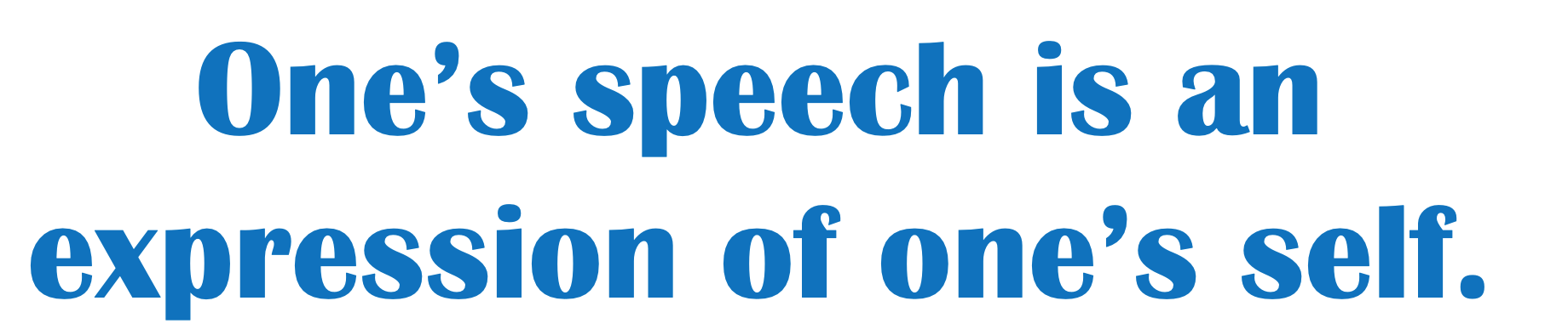

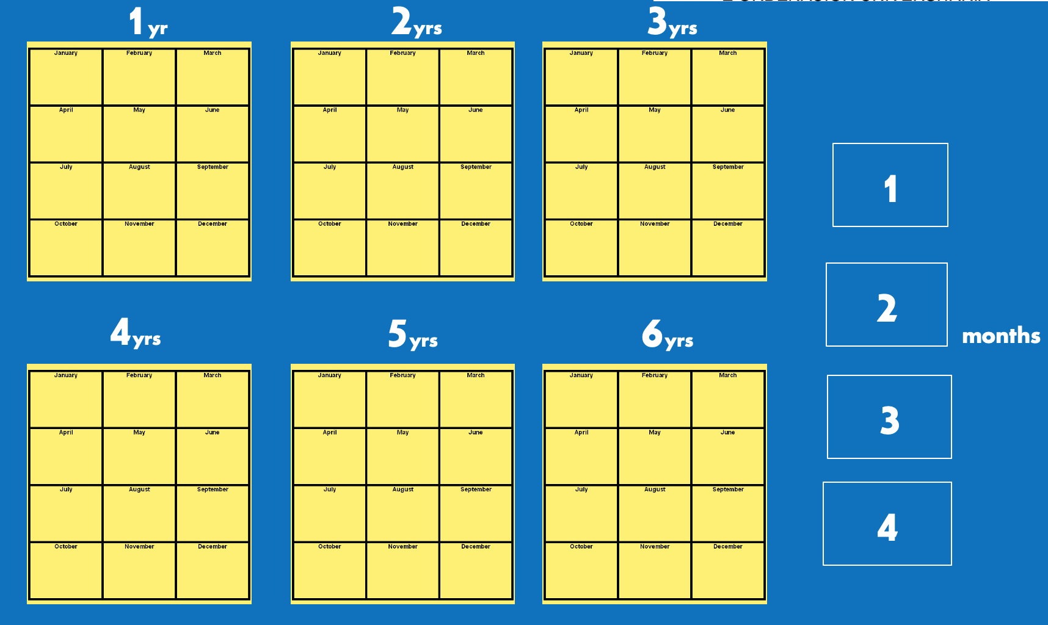

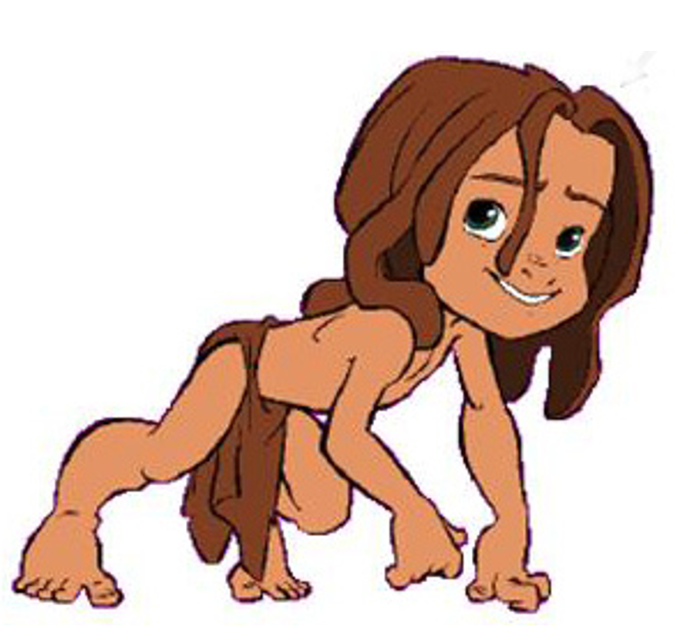

_____________________________________________________________________________________
(Sentence deciphered from Slide 2)
How might some of these images be connected? (English, Spanish or Galician)
__________________________________________________________________________
__________________________________________________________________________
__________________________________________________________________________
__________________________________________________________________________
__________________________________________________________________________

