Slide 1
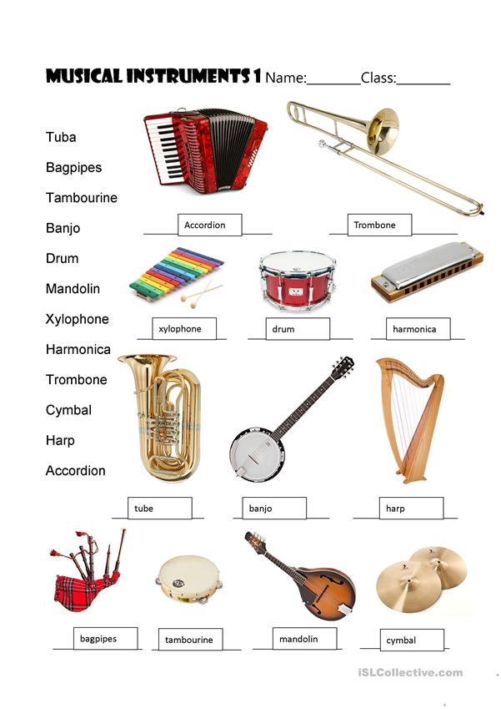
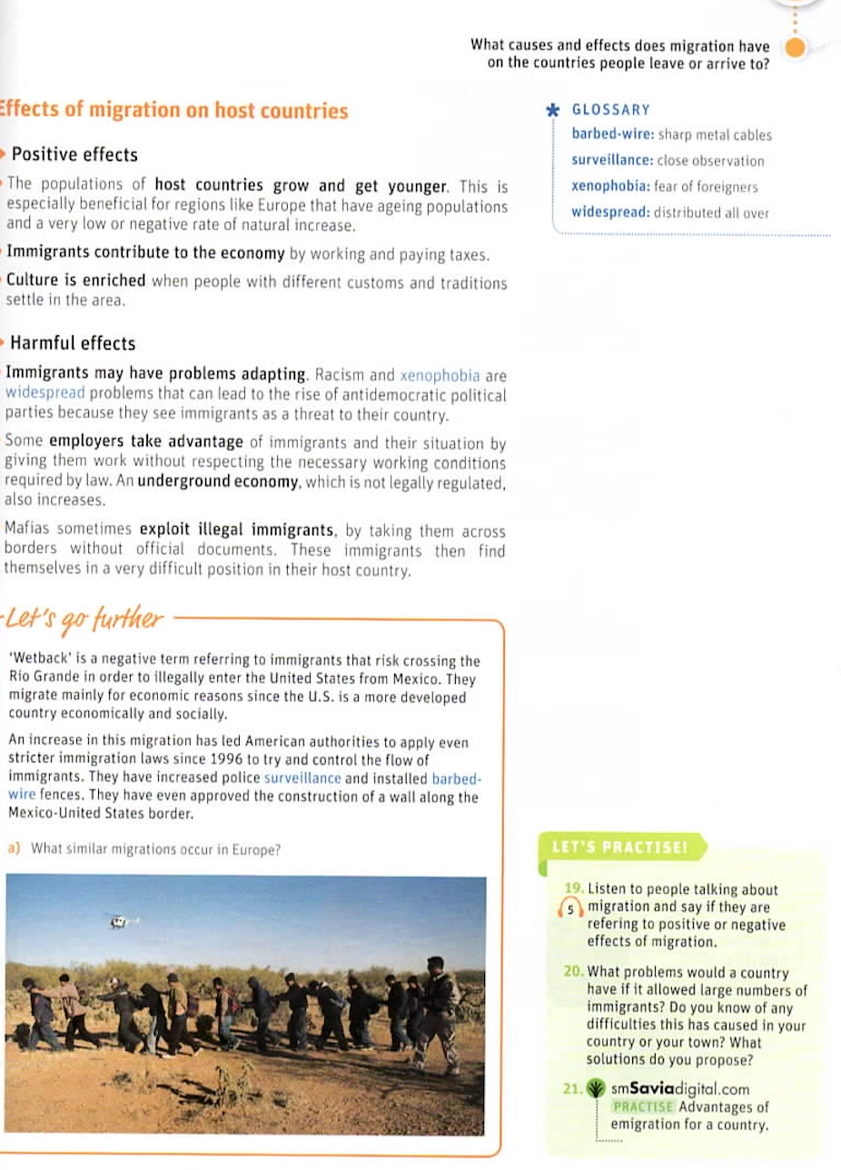
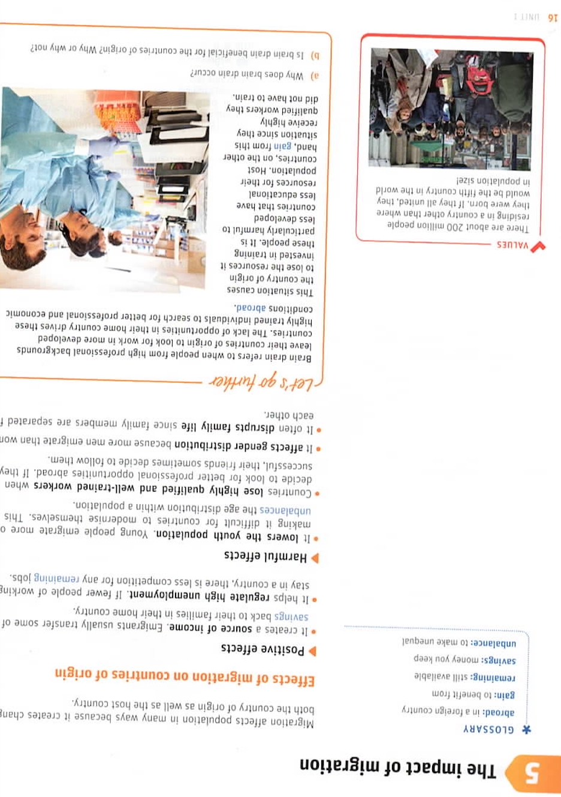
5ª MINI-LESSON
Choose Roles
Invent a gesture for the academic language in Slides 2 & 3
You will share some of your gestures
Notes:
Now we’re going to do it again, this time beginning with a scaffolding activity.

Slide 2
Invent a gesture for each instrument

Slide 3
Invent a gesture for each term
barbed wire: sharp metl cables
survelllance: close observation
xenophobia: fear of foreigners
widespread: distributed all over
abroad: in a foreign country
gain: benefit from
remaining: still available
savings: money you keep
unbalance: to make unequal
Notes:
https://www.unir.net/educacion/revista/la-metodologia-aicle-clil-como-aplicarla-en-la-ensenanza-bilingue/

