Slide 1
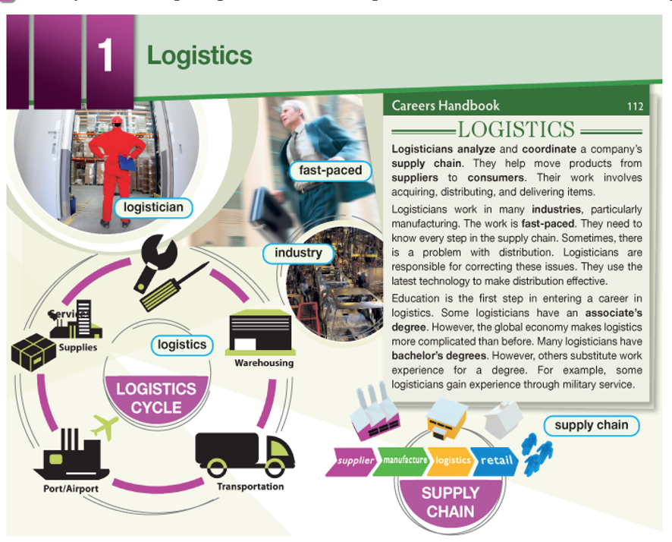
4º Mini-Lesson
Logistics - Tiras
Your students are going to begin Unit 1. Before they begin, they’re going to participate in this activity:
Put the PPT en modo de presentación
In the 2ª slides, look at one strip (tira) at a time.
One person reads everything on that strip and predicts what information will appear on the strips to the right and left.
The next person reads the second strip and predicts what information wil appear on the left/right.
Continue this dynamic until your group has read all the strips.
Read the page on the 3rd slide and answer the question.

Slide 2

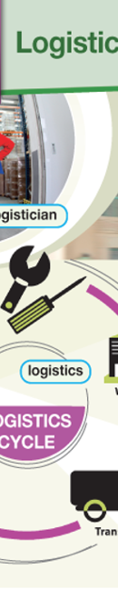
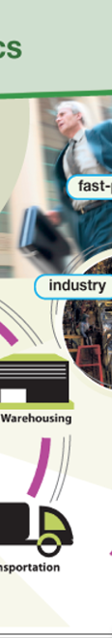
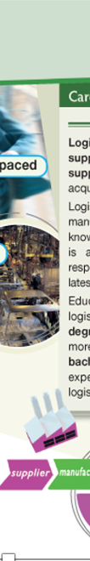


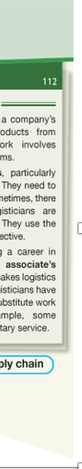
4ª Mini-Lesson
Logistics
Tiras

Slide 3
Was it easier for you to understand this text after particating in the scaffold? Why?
What are logisticians main responsibility?
If you were to create this scaffold with other material, would you make the strips wider or thinner? Explain.
Notes:
https://www.unir.net/educacion/revista/la-metodologia-aicle-clil-como-aplicarla-en-la-ensenanza-bilingue/

