Slide 1
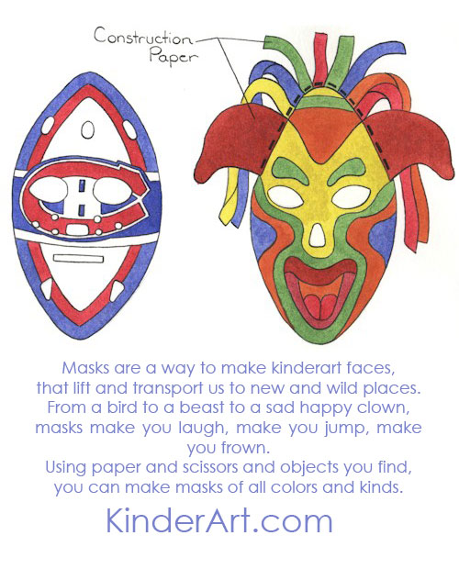
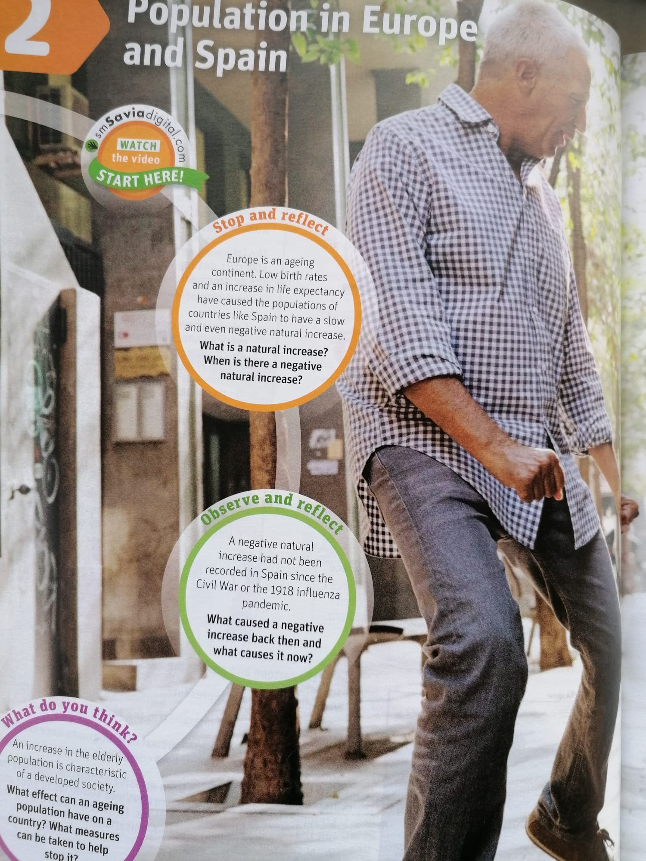
3ª MINI-LESSON
Download: ‘3ª Mini-Lesson Which is the best paraphrase/translation’
Choose Roles
Secretary Shares screen with PPT
Choose the best paraphrase or translation for each instruction. Underline the words that distinguish the differences
Notes:
In a face-to-face class, each team member has a whole set of strips.
One person puts down a strip, says it’s number, and follows instructions above.
Continue in this way until all strips are visualised.
Each member of the group (3 in each group) has a set of the strips with numbers on them
Member take turns choosing a strip, describes everything on it, predicts what’s missing, and the others have to identify it by the number.
Second member of the group verifies predictions of previous student before continuing activity.
Continue until all the strips are described, predicted, verified.

Slide 2
Which is the best paraphrase?
(Underline the words that highlight the main differences.)
Europe is an ageing continent. Low birth rates and an increase in life expectancy have caused the populations of countries like Spain to have a slow and even negative natural increase.
Europe is a continent that is old. Many people are born short and there is an increase in expectations people have about life. This means that populations in countries like Spain have slow and even negative increase in nature.
Europe is a continent with a lot of elderly (older) people. Not many babies are born and people live longer. This means that in countries like Spain, there is a slow and even a negative increase in the population.

Slide 3
Which is the best translation?
(Underline the words that highlight the main differences.)
An increase in the elderly population is characteristic of a developed society. What measures can be taken to help take care of the elderly in this type of society?
A. El aumento de la población de edad avanzada es característico de una sociedad desarrollada. ¿Qué medidas se pueden tomar para ayudar a cuidar a los ancianos en este tipo de sociedad?
B. El aumento de la población de los mayores es contrario a una sociedad desarrollada. ¿Qué podemos dar a los ancianos para que se cuiden de si mismo en este tipo de sociedad?

Slide 4
Which is the best paraphrase?
(Underline the words that highlight the main differences.)
Masks are important in many cultures and during the celebrations of many winter holidays. We wear masks not just during the holidays, but every day. What mask do you wear?
Many cultures like to use masks, especially when they celebrate the seasons of the year. We all wear masks and change them every day to have fun. What mask are you wearing today? What culture is it from?
Masks are important in the celebration of many different winter holidays for different types of people. In fact, masks are not justs for the holidays. We wear them every day. When we feel sad but smile, we are wearing a mask. Are you wearing a mask right now?
Notes:
https://kinderart.com/art-lessons/crafts/colorful-paper-masks/

Slide 5
Which is the best translation?
(Underline the words that highlight the main differences.)
Draw an oval shape on a large piece of paper. The larger, the better, because masks can cover more than just the face. Cut the oval out of the paper.
Traza una forma de una ovula en una pieza pequeña de papel. Sería mejor que no sea grande porque las máscaras cubren tan solo la cara. Deja la ovula en la papel.
Dibuja una forma ovalada en un papel grande. Cuanto más grande, mejor, porque las máscaras pueden cubrir más que la cara. Recorta el óvalo del papel.

Slide 6
