Slide 1
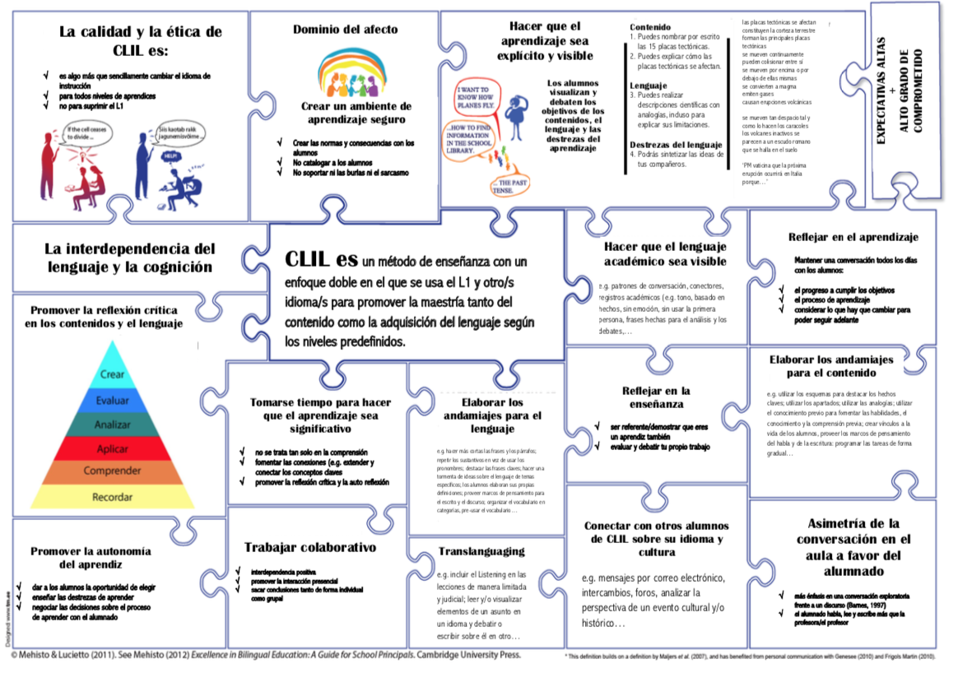
Choose Roles
Secretary Shares screen with PPT
Use Negotiating Phrases on Slide 2.
Together, put the 14 educational practices on Slide 3 in order:
most influential to learning
to
least influential to learning
Notes:
https://visible-learning.org/hattie-ranking-influences-effect-sizes-learning-achievement/

Slide 2
NEGOTIATING PHRASES…
Would you reconsider…
I’m wondering if…
How would you feel if…
I believe that…
How about if we reconsider…
I believe we could change…
Actually, I think all we need to do is…
I believe _______ means ________.
Perhaps ________ could also be placed…
In this case, I believe what you mean is…
I see what you mean; however, I wonder if…
I agree up to a point. Would you consider…
I would like to interject another point of view.

Slide 3

