Slide 1
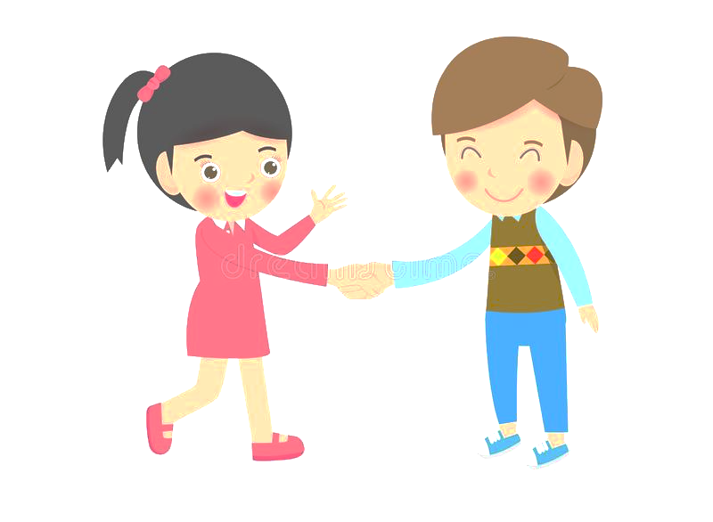
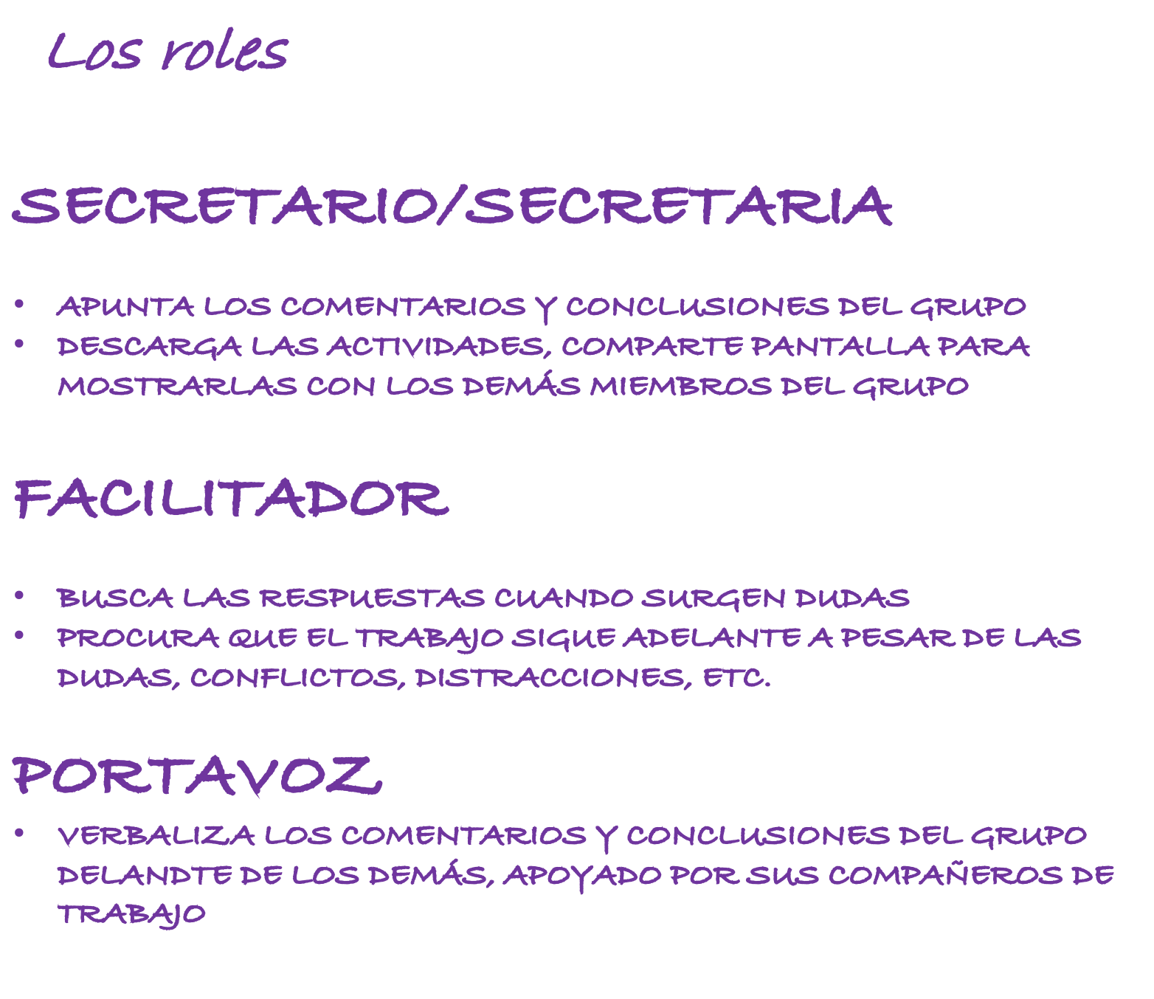
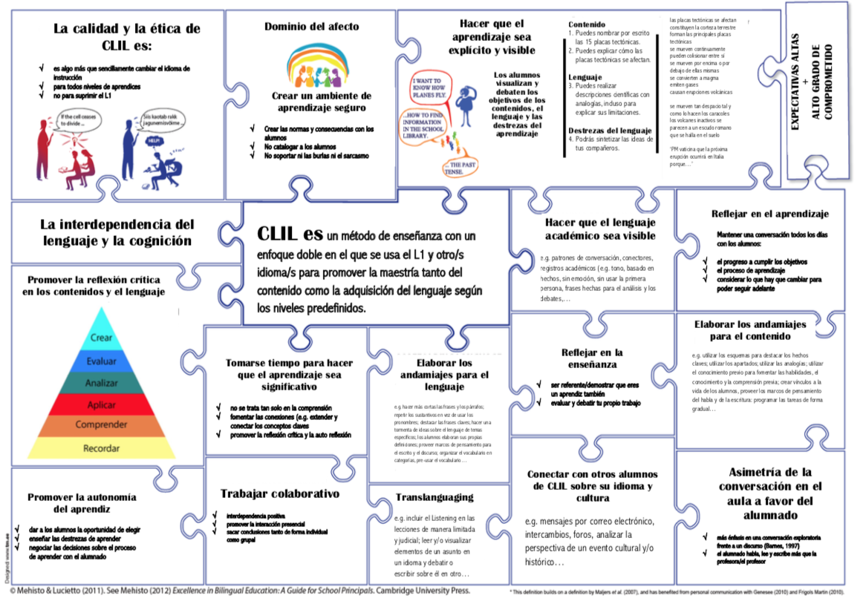
ACTIVITY 1
Getting to know each other
Translanguaging…CLIL
In your groups:
Choose a role
Introduce yourselves
your name
teaching level
where live
where you work
Say something personal the others might not know about you that’s kind of fun
Share what you know about the CLIL approach
Translate to Spanish or Galician
The Secretary will copy this information in the chat when we come back to the Main Room (English, Spanish, Galician).

Slide 2
Roles
SECRETARY
TAKES NOTES ON COMMENTS AND CONCLUSIONS OF THE GROUP
DOWNLOADS ACTIVITIES AND SHARES SCREEN SO GROUP CAN WORK ON THEM TOGETHER
FACILITATOR
FINDS ANSWERS TO DOUBTS AND QUESTIONS
KEEPS WORK ON TRACK EVEN WHEN THE GROUP HAS QUESTIONS, DOUBTS, DISTRACTIONS, ETC.
SPEAKER
VERBALISES THE COMMENTS AND CONCLUSIONS OF GROUP TO THE CLASS, ALWAYS SUPPORTED BY THE OTHER GROUP MEMBERS

Slide 3
Los roles
SECRETARIO/SECRETARIA
APUNTA LOS COMENTARIOS Y CONCLUSIONES DEL GRUPO
DESCARGA LAS ACTIVIDADES, COMPARTE PANTALLA PARA MOSTRARLAS CON LOS DEMÁS MIEMBROS DEL GRUPO
FACILITADOR
BUSCA LAS RESPUESTAS CUANDO SURGEN DUDAS
PROCURA QUE EL TRABAJO SIGUE ADELANTE A PESAR DE LAS DUDAS, CONFLICTOS, DISTRACCIONES, ETC.
PORTAVOZ
VERBALIZA LOS COMENTARIOS Y CONCLUSIONES DEL GRUPO DELANDTE DE LOS DEMÁS, APOYADO POR SUS COMPAÑEROS DE TRABAJO

