Slide 1
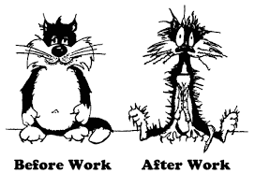
Teachers
Teachers get tired.
teachers get stressed.
teachers get laughed at
sitting on a desk!

Slide 2
LOUD AND PROUD….OUT OF THE BOX

Slide 3
Session 1
Loud & Proud Introduction
What do you want to achieve?
First day. Get the ball rolling
Blind Man’s Bluff memory game
Let’s Bingo!
All About Me (Primary)
The think Tank. All About Me (Secondary)
Word categories stopwatch
Incredible Stories
Time Out for feedback

Slide 4
1.Loud & Proud Introduction
Loud & Proud is aimed at focussing and encouraging speaking in the classroom.
Oral Skills among students of English as a foreign language is quite a challenge.
This is due to many factors but perhaps the most significant is class size.
Teachers often ask themselves …
What do we do with a class of thirty?????

Slide 5
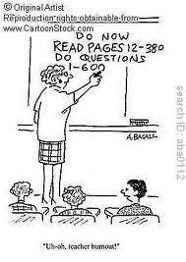
1. Loud & Proud Introduction
The answer is not always easy and many a time the teacher reverts to a written exercise.

Slide 6
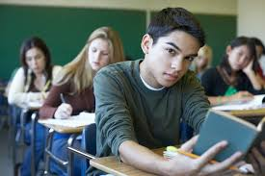
1. Loud & Proud Introduction
  Listening's and videos are a great resource for hearing and so increasing their capability to understand different sounds, pronunciation…
  But What about speaking?
  How can we get them to practice?
  Feel less conscious about speaking in a foreign language?
  Many students are reluctant to talk out loud in their mother tongue, let alone in a foreign one.

Slide 7
1. Loud & Proud Introduction.
The sessions of Loud & Proud will try to give a response to this question and with the response ideas to put into practice.
In order for the sessions to be effective, we will be doing all the exercises to see how the teachers take to them and at the same time have a test run ☺
The sessions will cover both primary and secondary levels.
In session 1 we will concentrate on activities to break the ice in class. They can be used at the beginning of the school year or after the term has already started.
A great idea is to go back after a whole term and do a refresher’s class on these activities. This helps students revise what they have learnt and it helps the teacher see the improvement achieved.

Slide 8

Loud & Proud Introduction.
The activities will get the Little ones excited and ready to play, whilst they will break the silence barrier with the older ones.

Slide 9
2.What do you want to achieve?
This space is blank for you to fill in ☺

Slide 10
3. First Day. Get the ball rolling.
First day nerves for all including teacher…
A ball is a great toy for both young and older.
A ball can make a big difference.
Do a brief introduction about the class and what you intend to achieve with them.
Tell them you are going to throw the ball to a student and he/she has to tell the class something about themselves. You can start with yourself…
So let’s get started!!!!☺

Slide 11
4. Blind Man’s Bluff memory game
Now that we have started with the ball the next step is to see how much they remember about their class mates.
Take out a blindfold
Ask for a volunteer
Then blindfold the student and ask a question about a fellow student.
Get other students to ask them what they are wearing or where in the classroom they are sitting.
Go on to ask if they can remember the colour of their hair, etc.
After two questions change the student. This way they all get a turn.
The blindfold helps them concentrate and they don’t have to see the rest of the class.
Now let’s try this out!☺

Slide 12
5. Let’s Bingo!
A bingo is a great class game.
Bingo is a great vocabulary builder
Bingo is a great grammar assistant in class.
When you say the word Bingo, children simply light up.
For primary simply use images. At this stage we are doing the class bingo about me.
Choose images that illustrate birthday, favourite colour, food, clothes, etc.…
1 and 2P cannot engage in complete questions but they can ask name, favourite colour, etc.…
Get them to go through the class and ask fellow students.

Slide 13
5. Let’s Bingo!
5. The first to complete the chart shouts bingo.
6. If you have a big class, divide in two groups. Get each student to ask a question to other team and so on and so forth until there is a winner.
7. For secondary, you can have a bingo like the template I have passed out. Make sure you pre teach question asking, or simply revise as they are simple questions. Follow previous instructions.
8. As a follow up for secondary get students to revert bingo ask them to fill in with the questions. Use blank template for this.
9. Now think of how you can use this for another topic, say food, transport, daily routines, etc.…
Now for a test run☺

Slide 14
6. All About Me (Primary)
This activity is aimed at helping children give personal information.
Start with the template given and do this as a group activity.
What’s your name?
What’s your favourite colour?
Family
What’s your favourite animal?
All About me

Slide 15
7. Think Tank. All About Me (Secondary)
All About Me
School
Hobbies
Friends
Family

Slide 16
7. Think Tank. All About Me
(Secondary)
This template will help children elaborate on their personal information.
Get them to add points to their chart in each area.
Always encourage the use of simple sentences.
Simple sentences leave less room for mistakes, thus leading to self assurance and improvement of self esteem when using a foreign language.
Our aim is to get them to tell us about what they have written down.
Start off by asking questions. Then get the rest of the class to follow your lead.
Remember our aim is to improve oral skills. So a simple yes and no reply is more than one word, it means the student has understood the question.
Therefore, our goal has been achieved.

Slide 17
8. Word Categories Stopwatch.
Many a time a teacher thinks on how they can reinforce vocabulary, action words, adjectives, adverbs, etc.
Word categories could be a way to do this.
Get your older students in groups of two or bigger if the class is big. Say, groups of four.
Give them a sheet like the template or simply a plain piece of paper and divide it in four areas.
Give each area a heading/ category
Give them five minutes to get at least five words in each category.
Repeat with another set if you want.
Get each team to pick a word from each category and make four sentences.
Now let’s put this into practice☺

Slide 18
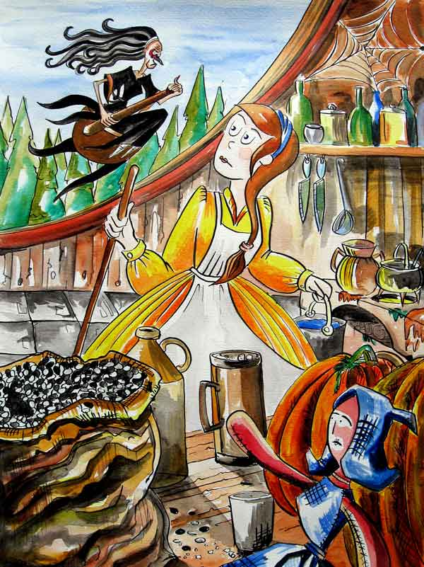
9. Incredible Stories
For older secondary students, get them to create a story that includes words from their categories.
Encourage incredible stories. Give an example.
They must then read them out loud to the class.
This leads to active reading in class.
Get the class to give opinions about the stories.
Let’s try this out ☺

Slide 19
10. Time Out for Feedback
Again a blank canvas for you to fill. ☺

Slide 20
Thank you
That’s all for now…

