Slide 1
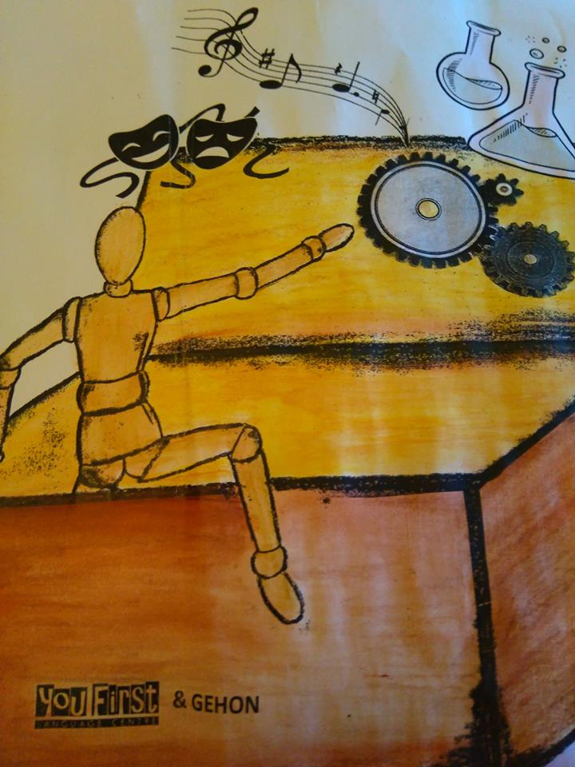
Think ºut of the box shirley ellis the clapping song.wmv
Notes:
Introduction:
We are all very excited about doing other subjects like Art , Music and Sciences in English, but how do we break free from paper-based materials and word lists?
How do we take advantage of this double opportunity to make a subject more interesting and English more alive?
If we aren’t careful, we can decrease our enthusiasm for both.

Slide 2
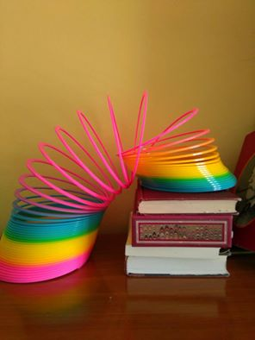
A Slinky
Problem solving:
Make it walk.
SLINKY TOY COMMERCIAL 1962.wmv
Slinky + Escalator = WIN[1].wmvS
LINKY Chair Made From Recycled Cardboard[1].wmv
Notes:
Show how a slinky works as it goes down some steps. Maybe play the YouTube with an old advert. Then get teams of pupils to rearrange objects in the classroom to make Slinky to walk in the classroom: it can go from the chair to the table to the chair to the floor. Simplicity and scant resources = resourcefulness, an element of STEM and something very young learners have and older learners lose.

Slide 3
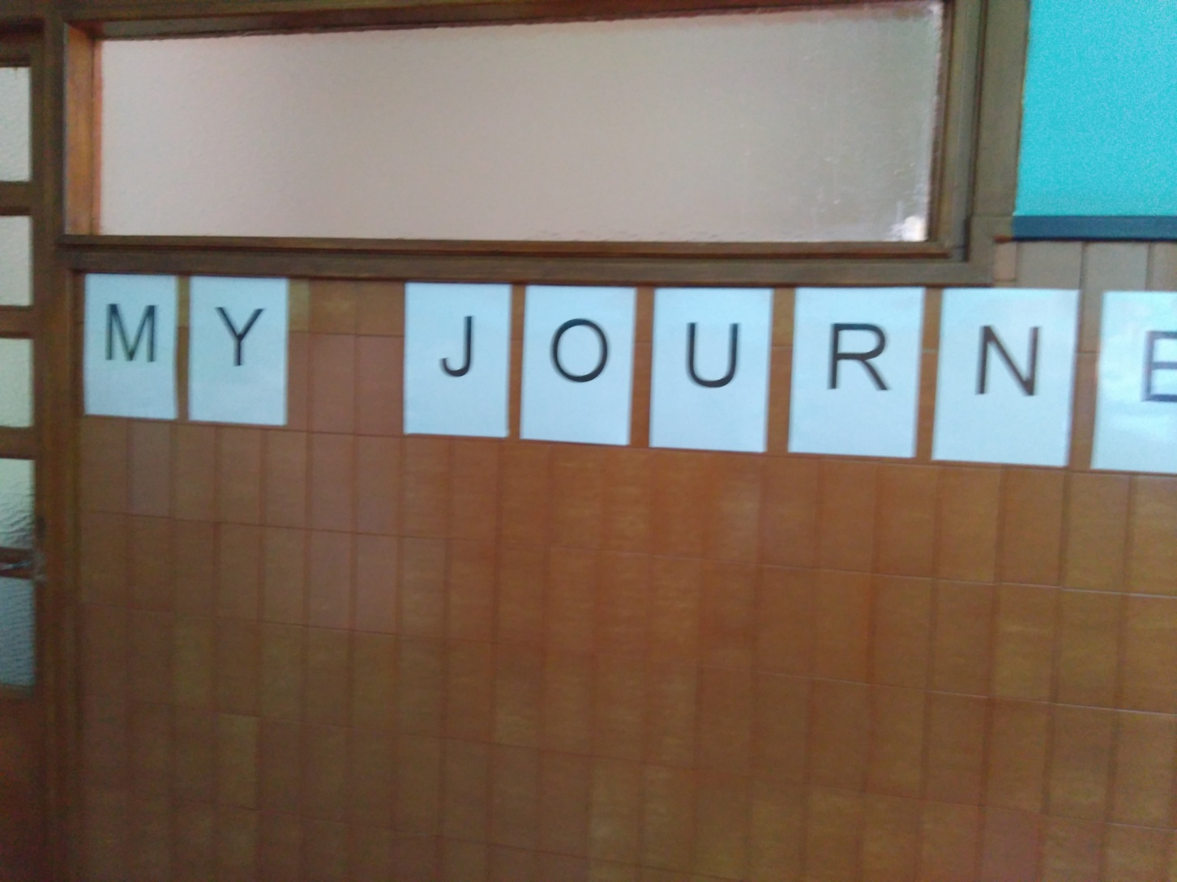
Start with a journey
Notes:
Hmmmm…I saw this in a school serviced by the British Council. What is it about?

Slide 4
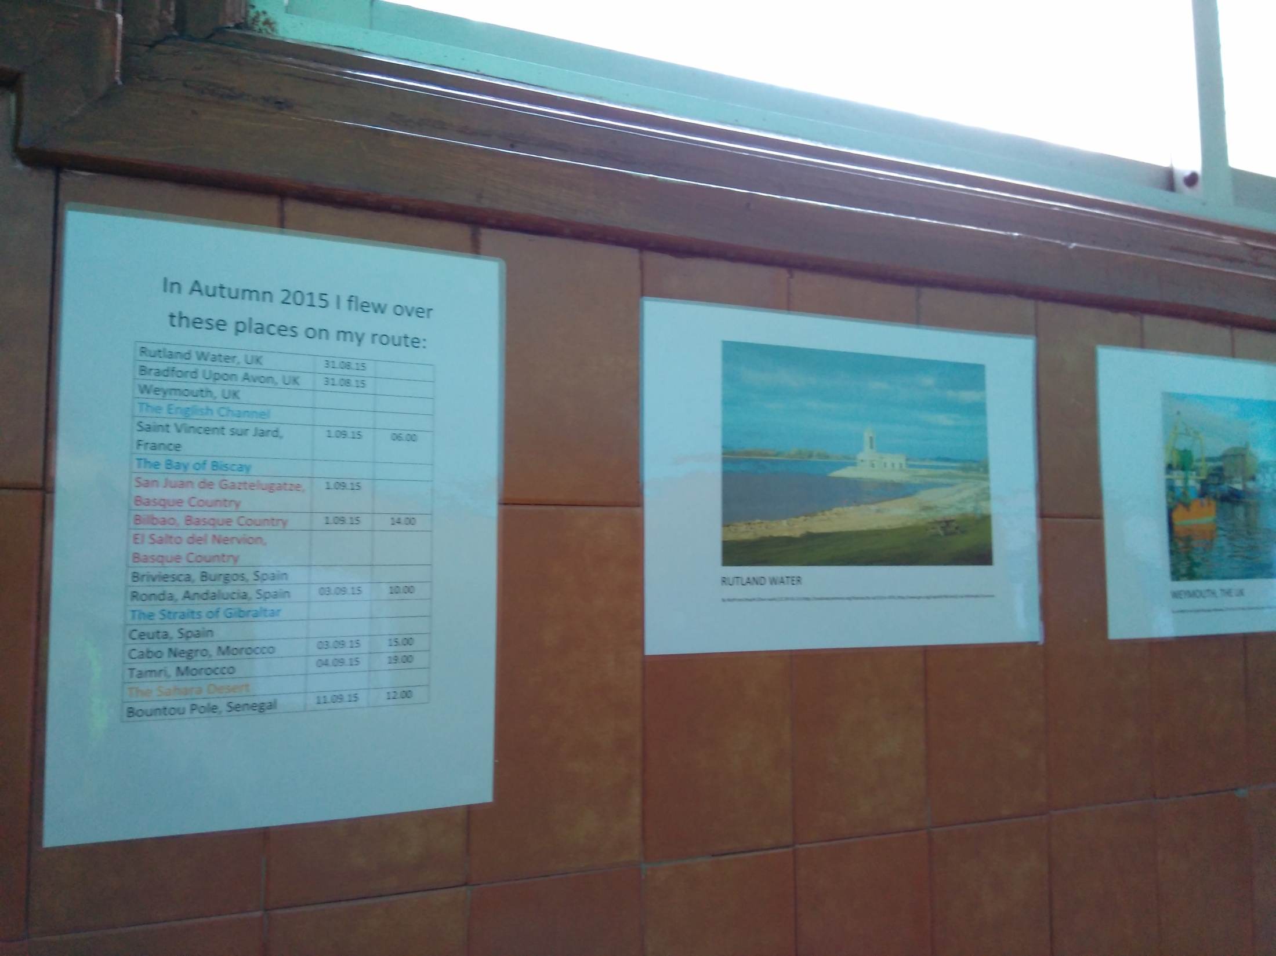
Notes:
Hmmm.

Slide 5
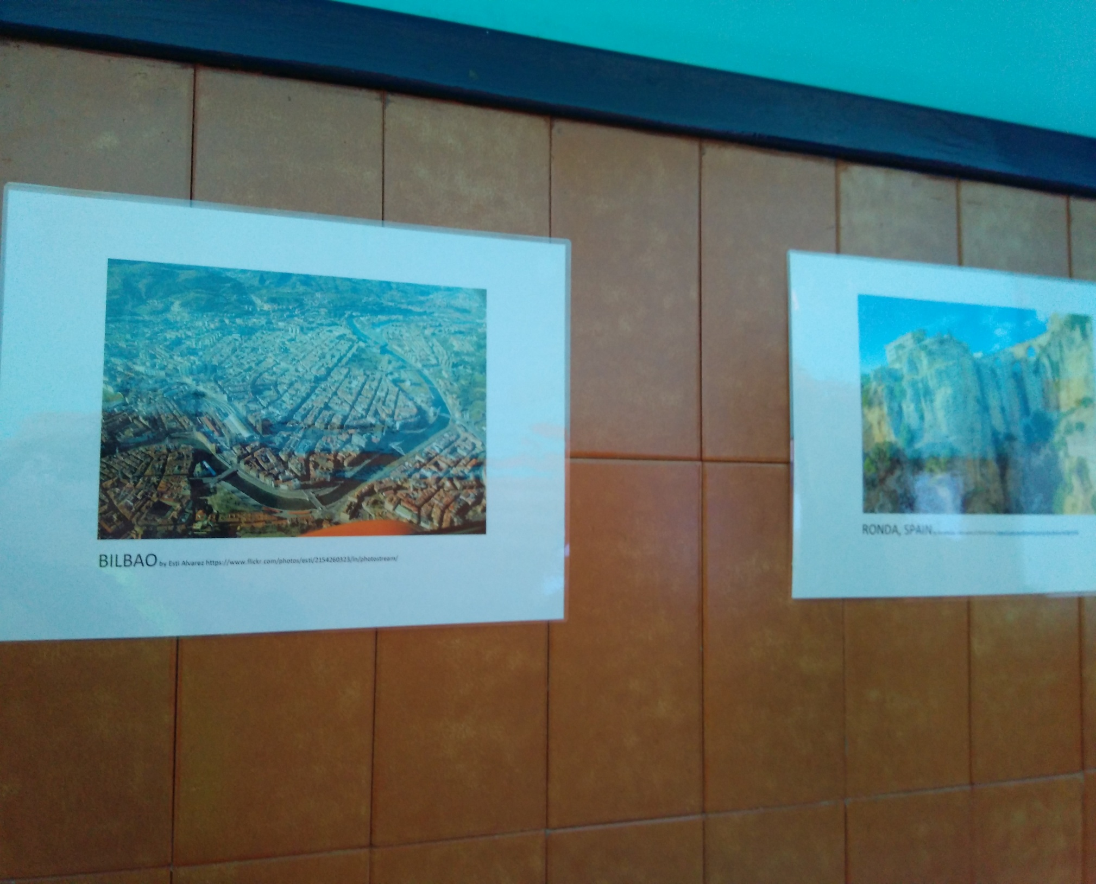

Slide 6
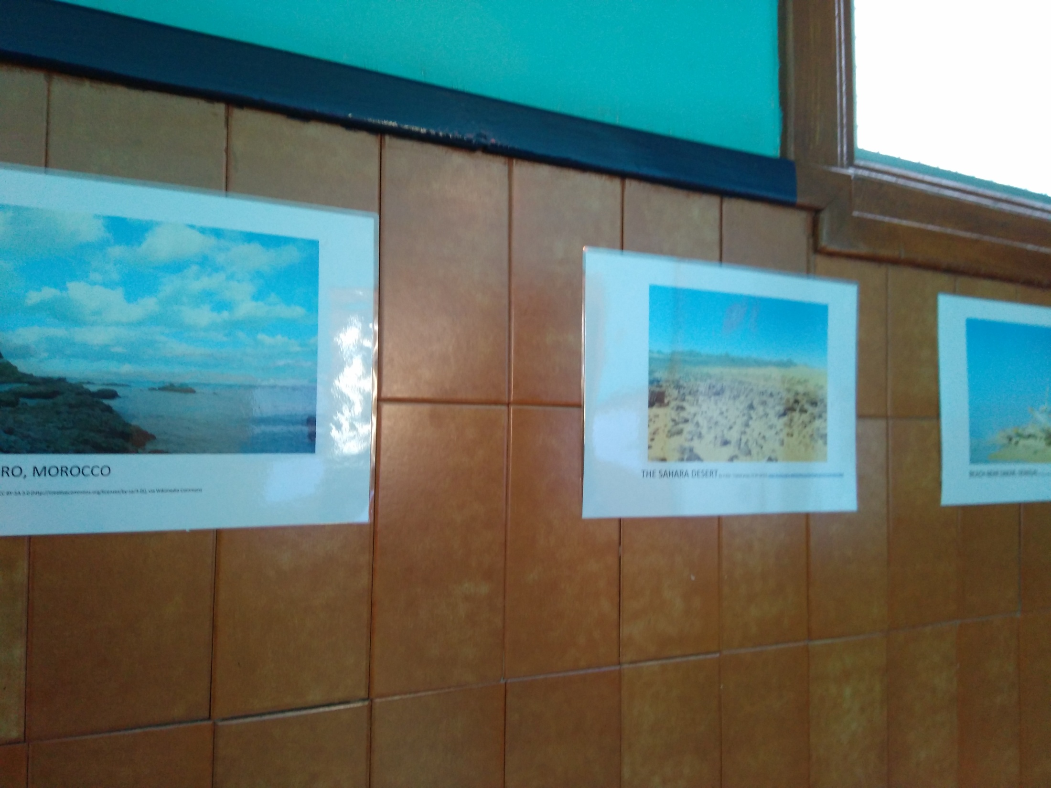

Slide 7
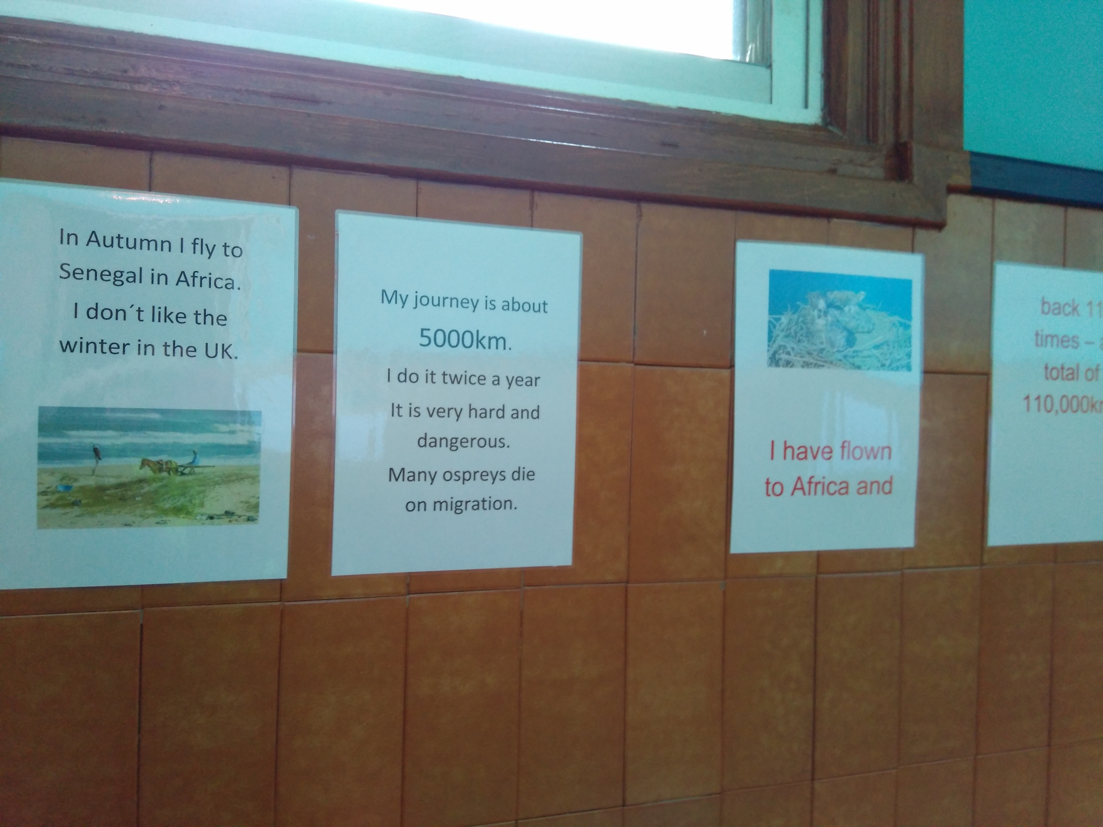
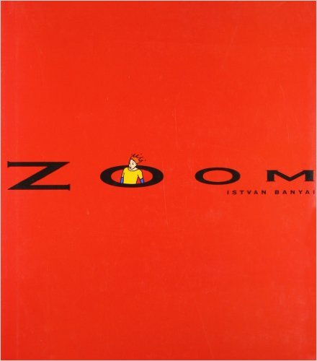
Notes:
Oh! It’s from a bird’s perspective. We then read Zoom, which toy with perspectives. Changing perspectives helps us think out of the box.

Slide 8
AN ALTERNATIVE RO_ TE
What’s missing?
U = YOU! To take on the HOTS, including creativity
Look beyond your sector/subject/comfort zone.
Little and often! Slip them in!
Innovation prevents burn-out

Slide 9
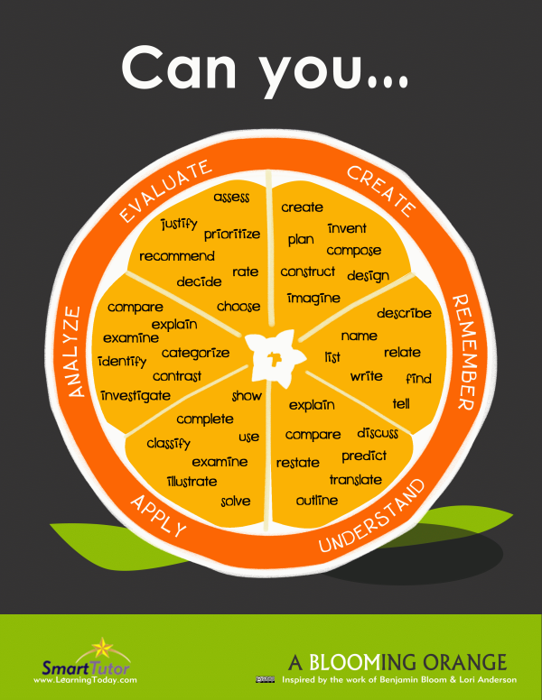
sergio.pdf : creative but not logical
Notes:
Nice scheme. Then there’s the idea that the top might be divided into two (next slide). A pupil may be creative (refer to pupil Sergio’s booklet) , but not logical, and vice versa. But we can all learn how to be one or the other.

Slide 10

Start at the end of the HOTS journey
Notes:
Some people actually separate them as parallel HOTS.

Slide 11
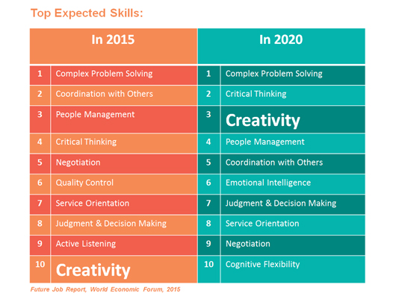
Is creativity important?
The four dimensions of curiosity.wmv

Slide 12
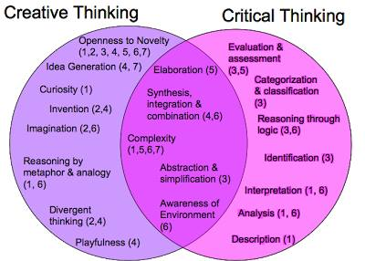

Slide 13
And by asking a question…
Are there parallels between creativity and the HOTS leading to evaluation?
Right environment New eyes
Examples & scaffolding Multiple angles
Freedom in discipline Confidence, patience
Teacher training to change chip, influence by example
Notes:
Right environment = not black and white, many options and therefore allow them time and give them confidence; new eyes= can be another approach; examples and scaffolding for reference and talking your way through one before letting them go alone; angles= problem solving technique; freedom in terms of knowledge and structure; confidence and patience to experiment and modify; new role away from transmission means that the teacher is a facilitator and may be out of her or his comfort zone

Slide 14

TOPICS IN COMMON
Food
Animals
School
Ourselves
Notes:
Guess which ones are probably common

Slide 15
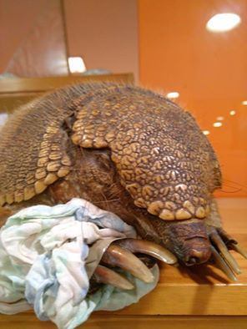
Activity one: Ay Carmela!
Observe and draw
Describe &
draw conclusions
Compare and contrast
Imagine: her routine,
how she got to Galicia: He opened the bag and was shocked!
Notes:
First: animals are in your classroom and oral work. How? Use of realia: the stuffed armadillo is shown for two minutes and then hidden away. Ss draw her from memory. Then they make connnections between her characteristics and the way she lives. A comparison can be made between her and a turtle, for example.

Slide 16
Other beastie activities
Elephant jigsaw listening Body part parallels
Animal brainteasers Animal popcorn
Popcorn Original Song.wmv
Dino card game Little Red Riding Hood in… web3.MP4
What if… Declan’s game
Notes:
Try them and say if they are more creative or HOTY, if HOT, where on the orange and, for both, wh… Jigsaw = elephants, brainteasers, dino cards= take out two and say how they are different or similar (but you cannot repeat the same sentence), Declan’s game = read facts like “Penguins can dive ten metres” y but say blah, blah, blah instead of the number and have Ss take turns estimating

Slide 17
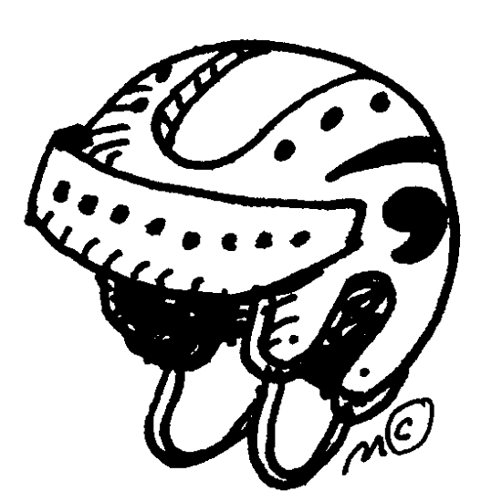
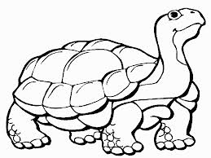

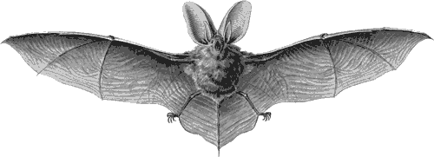
Explain the relationship...
Notes:
See something here? What activity is this from? Similarities....Top ones= easy. Bottom = less so. Language? Making it more difficult = why, seeing trends after doing a complete exercise (some are similar in appearance; others for function). Game with random cards: find relationships.

Slide 18
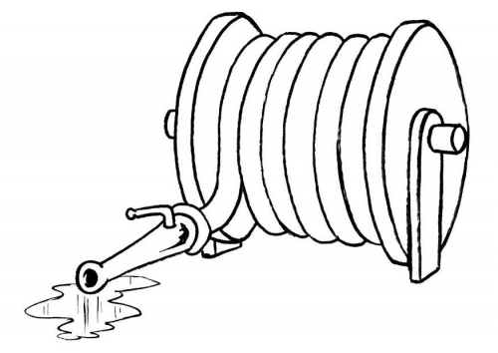
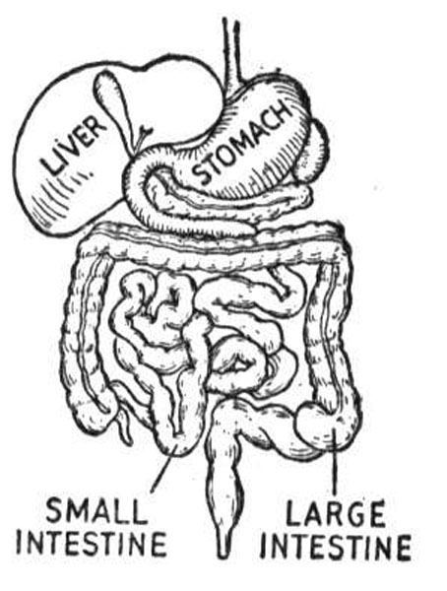
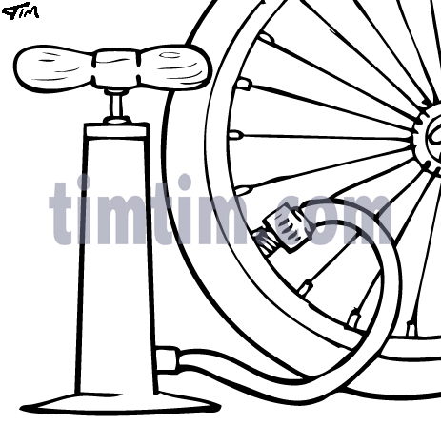
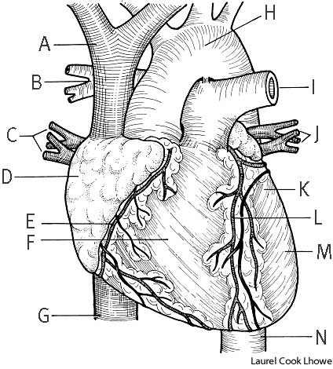
and?
Notes:
More...we start to see the relationship between form and function, an important aspect of Art, Science and Design/Technology.

Slide 19
What if
Imagine Carmela has
Imagine
long legs
a turtle shell
a big mouth
a polar bear moves to the dessert
a camel moves to the North Pole
your cat goes from your house to the street

Slide 20
What can we see?
Not one answer Practice needed
Compare and contrast different levels
Models: What a Good One Look Like (WAGOLL)
Multidisciplinary

Slide 21
Our grandparents’ toys
loose parts.wmv
street.jpg plus tube.jpg plus one child =
a lovely experience/a Physics experiment !
street3.mp4

Slide 22
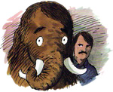
From STEM to STEAM
A story: Mamouth sinking on raft (The Way Things Work)
A problem: take a lump
of playdough and make a
vessel. Predictions made.
Different solutions tested

Slide 23
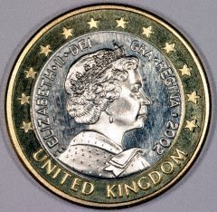
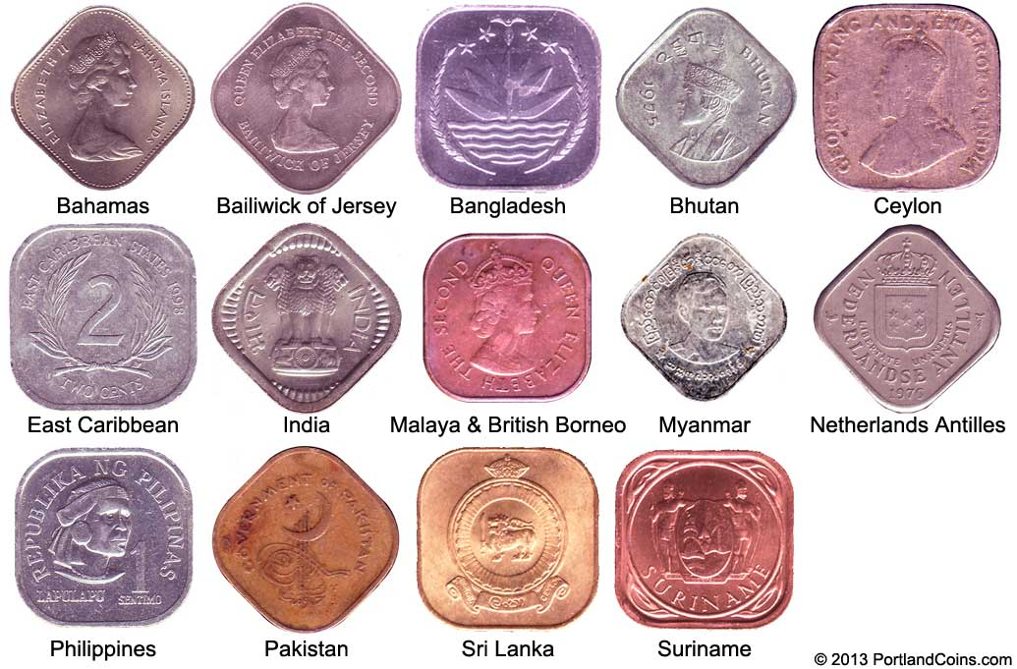
Coins: Surprise!

Slide 24
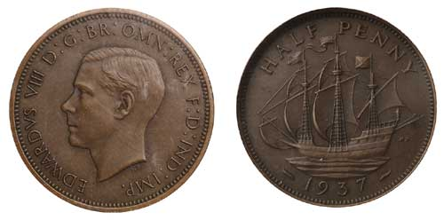
Coins
IMG_20160309_080017 (2).jpg
IMG_20160309_080325 (4).jpg
Notes:
Coins: Do warmers related to coins: they ask yes/no questions to guess how much/how many with coins in a bag and do surveys on spending habits. Brainstorm the common characteristics of coins and then examine them to test their hypotheses. Have them report back about strange coins. Talk about customs with coins.

Slide 25
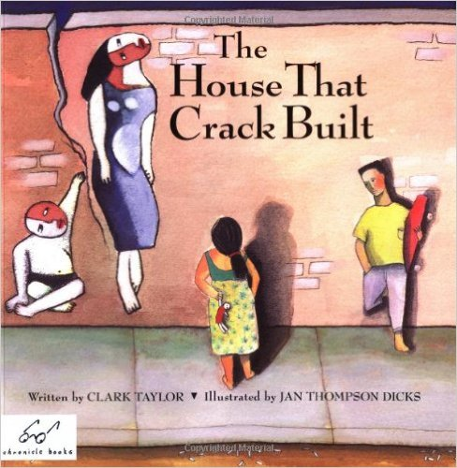
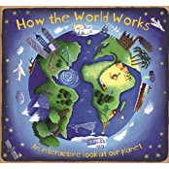
Not too far from English
Telling stories/Adding a twist
St George and the Dragon.wmv
Mo4PandD.avi classroom.jpg
This Is The House That Jack Built Video[1].wmv The Red Tree.wmv
Manipulating paper: folding and cutting
Foldables.pdf
Using other devices, like our voice, inner eye, senses, movement, emotiºn
Red Ribbon Week 2014.wmv
Notes:
Sandie Morao’s blog, Picture Books in ELT, deals with using this resource for all ages, including Secondary. Stories activities include shaggy dog with a difference: action noise verbs substituted with a verb and teams guess what they are; next line begins with un/fortunately/but; told from the perspective of other characters or even objects. Manipulating papers for all ages: cause and effect with cut and fold, compare and contrast, running summaries, running dictations… Instead of a picture dictation, the teacher describes a scene and Ss just listen. Then they represent it in Art class and justify their choice of material and composition (Marion Richardson). Represent scientific processes with words and drama sketches.

Slide 26
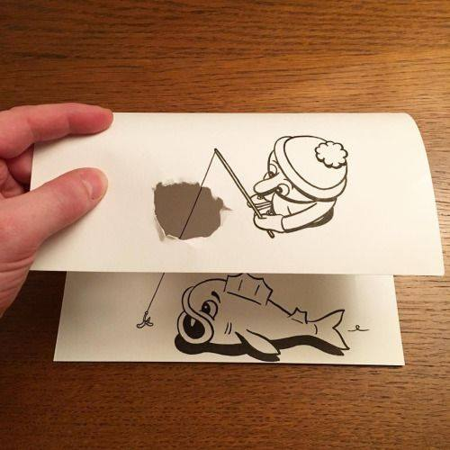

Slide 27
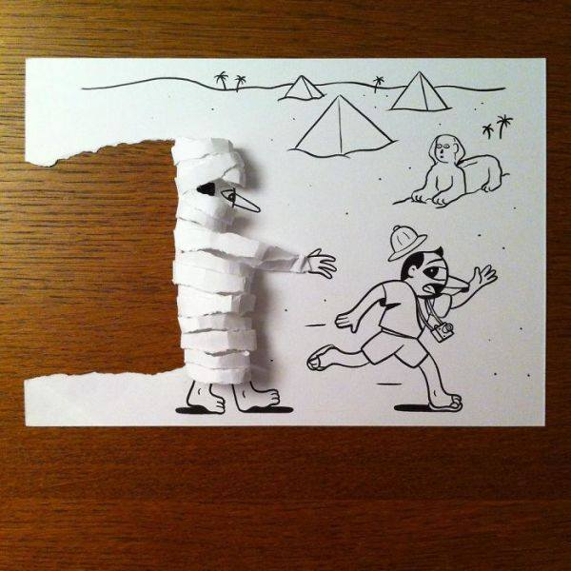

Slide 28
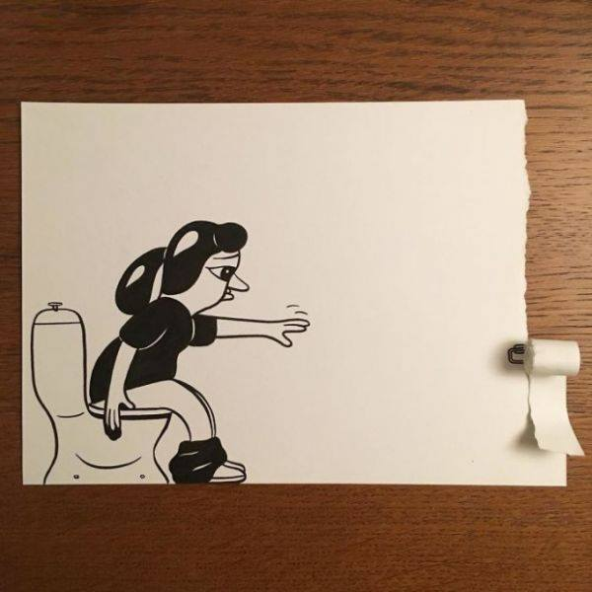

Slide 29
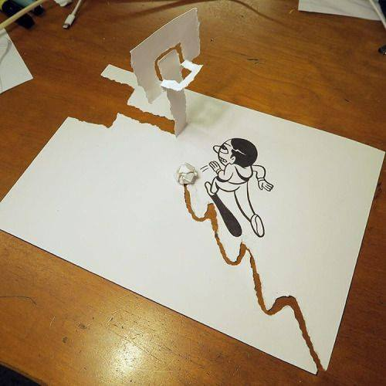

Slide 30
Slipping HOTS into your teaching

Slide 31
Which way will you go?
A little by
A lot by
Adding twists to typical activities: finish the story, change the subject
Scaffolding to support pupils/Ss with something new: with models, options
Taking a multidisplinary or multisensual approach
Doing a full-blown project: find examples of creativity in the community
Looking at and talk about what the word means
Celebrating examples of creativity among students and staff, as well as outside in the community

Slide 32
Going small
Assessment
flower.pdf
Something unexpected in a pic dictation
classroom.jpg
Memorable pronunciation tricks
fruitsuit.pdf

Slide 33
Big: Creativity on the Street
donkey.jpg
dress.jpg
blinds.jpg
drinks.jpg
plates.jpg
duck.jpg
graf.jpg
Notes:
Young people can find examples of creativity in the street: grafitti, fashion, decoration, traditional products re-thought, graphic arts…and say why they thought it was an example

Slide 34

Multisensory warmers
Take an object and…
feel it
listen to it
observe it
Notes:
Realia here serve all ages and bridges creativity and analytical skills. Example 1: feeling objects wrapped in napkins and then drawing them by touch. Example 2: looking at household items (or components from these items) and guessing function. Another activity: listening to unseen objects (an old clock, a hotel bell, a plastic dinosaur that roars and a music box and then drawing them unseen. Older students attempt to describe them: by shape, material, size and how they work. After they are revealed, pupils/students find what they have in common and what makes them different.

Slide 35
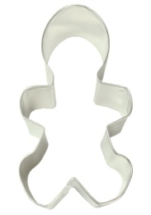
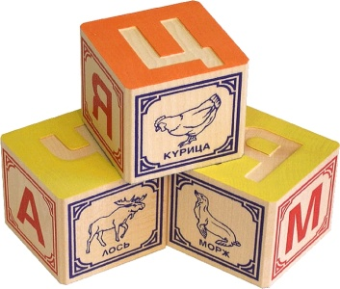
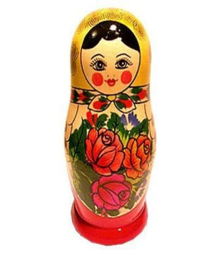
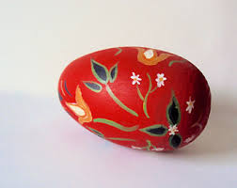
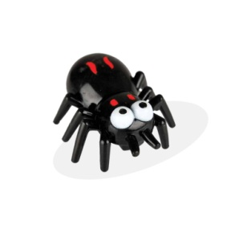
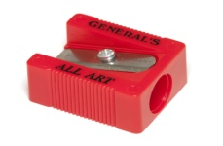

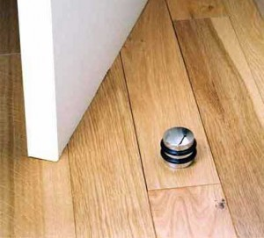
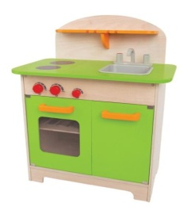
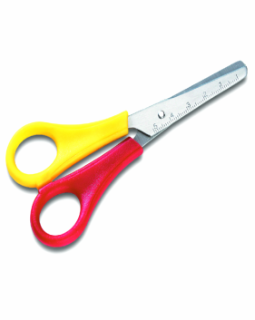
Classify these objects
Notes:
More than one way and unexpected too

Slide 36
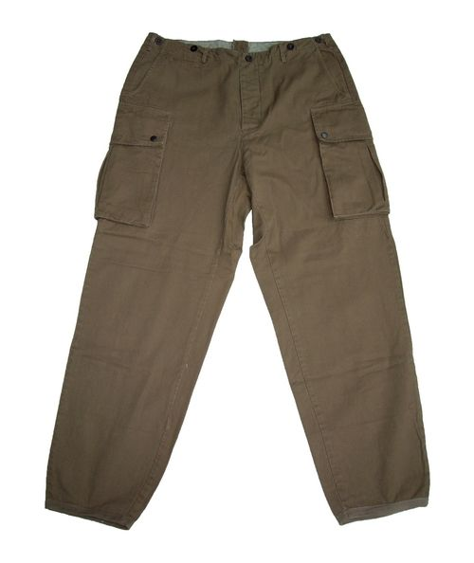

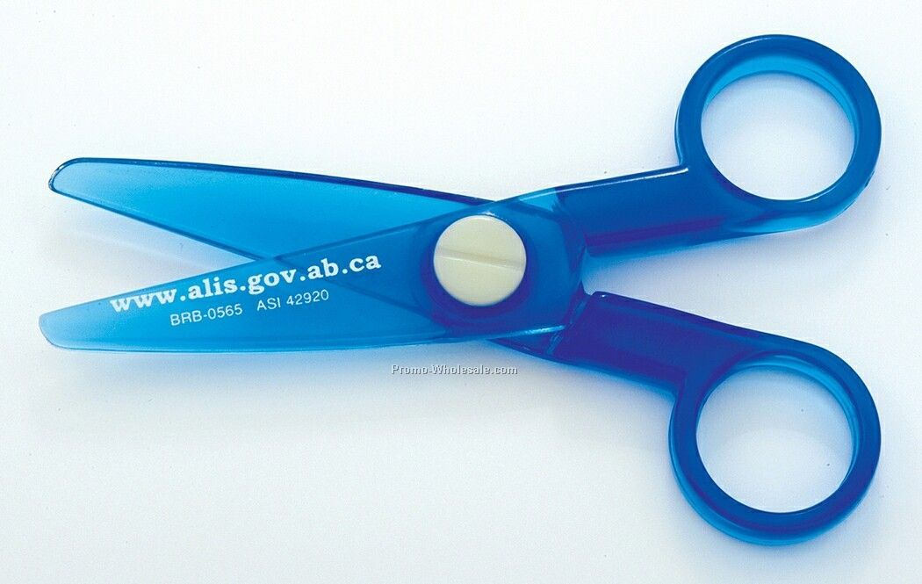
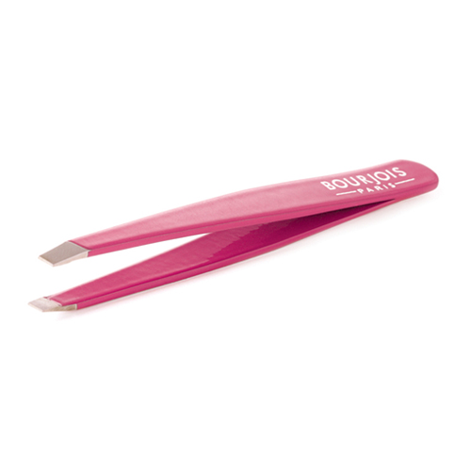
What do they have in common?
Notes:
Find a relationship that is LINGUISTIC to drive home a grammar point across the subjects.

Slide 37

And if you want them to speak…
secondary, laboratory
diagonal, rectangle, industry
surface, mountain, pencil
Notes:
Other trends in pronunciation: the last syllable is eaten, there is a cha-cha-cha, the first syllable is big and the second one little in sound. Going from the example to the rule.

Slide 38
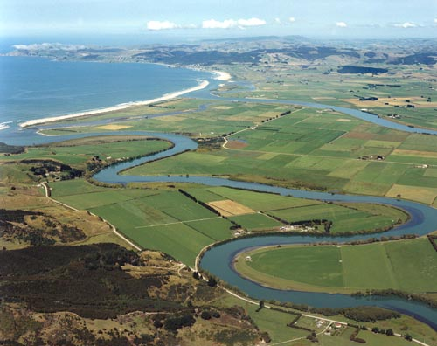
I’ve got a mouth, but I’m not an animal.
I can run, but I haven’t got legs.
I’ve got a face and hands, but I’m not a person.
Notes:
Here, riddles not only help consolidate concepts. They also make pupils aware that everyday language reappears in technical concepts. And the second example shows how these words may differ from equivalents in the L1s.

Slide 39
A footballer had an accident on the field and went to the hospital to see a doctor.
The doctor and the footballer had the same mother, but weren’t brothers.
Notes:
Example of how riddles challenge assumptions and put red herrings in. I will dip into the appendix of my handout (longer animal riddle) just to get audience to consider how they would solve it themselves and then scaffold the task so that the pupils learn how to do this in a systematic way.

Slide 40
My niece’s favourite
What´s Beethoven doing in his tomb?
Decomposing.
Notes:
Can’t resist.

Slide 41
Odd-man-one-out
Apple – carrot – pear – banana
Cheese – yogurt – banana – yogurt
Bed – cooker – cupboard – sink
Cheese cake – pizza – hot dog – ice cream
Notes:
Not just enough to do it. Explain why. Justify. Use communication strategies: I don’t know dairy, but I can say food from milk.
Will add something on classifying. Alternatives….

Slide 42
Huh?
day hemisphere year flat street planet
island town hour letter mountain sea second
hill droplet forest isle word lake jungle
state village drop paragraph valley rainforest
province ocean pond hour month
Notes:
Need to increase the challenge? Don’t give pupils the categories or the order and see if they can work out what is going on. Classify is lower down the HOTs scale than categorise. Alternatively, give out cards and get them to move around to form groups.

Slide 43

Looking at ART
Representing vocab
Using picture prompts and books
Discussing images and colours

Slide 44
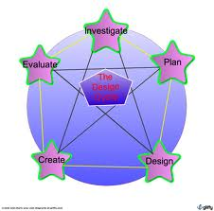
The processes behind an Art class:
think, brainstorm, practise,
experiment,
evaluate,
improve,
revisit…
Notes:
The same process is found in Art, Technology, Science and Language classes.

Slide 45
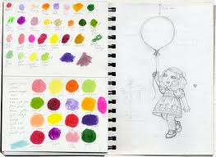
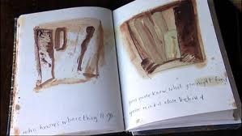
Is there room for a sketchbook?
Notes:
Here, a sketchbook is more like an ideas book for all subjects: a diary or an observation and planning book for Technology or Science or Art.

Slide 46
“You won’t know when I’m thinking, but you will know when I have thought.”

Slide 47
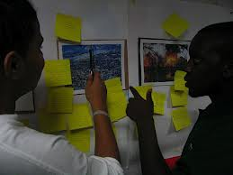
Forming opinions
Is there time for a plenary or gallery stroll?
Notes:
Converting your English class into a gallery that Ss stroll around and complete a survey. Or they can match music with a picture.

Slide 48
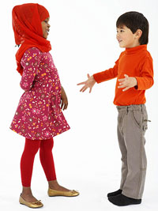
Words – pictures - words
Comment on own and others’ work
“Read” a work
Express their ideas
Define their tastes and express their opinions
Articulate what they have learnt

Slide 49
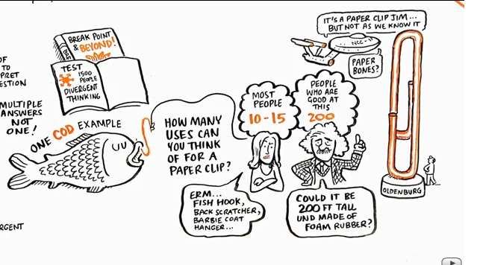
Creativity goes down with age.
Notes:
And Robbinson’s example about all the uses of a paperclip. How do we keep it up?

Slide 50
From word to mage...
Richardson: tell a story,
not a picture dictation
Colour poem

Slide 51
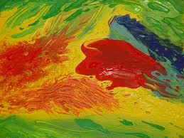
Close your eyes...
It’s like a winter sky.
It’s like a cat’s eye.
It’s like a princess’s hair.
It’s like the king’s chair.
It’s like my favourite fruit.
It’s like my grandfather’s suit.

Slide 52
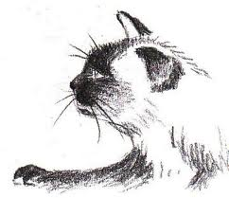

Problem solving in Art
What’s the difference between a 2B and 6B pencil? Which one is better for drawing the skin of an elephant or the fur of a cat? Why?

Slide 53

How can we show how colours mix to form new ones?
With crayons? Board chalk? Felt tips?
Pastels? Paints? M&Ms?
Notes:
Show some of the results of chromatography experiments: splashing water on M&Ms and nonpermanent felt tips.

Slide 54

Enjoy your journeyGoing to School in a Mud Desert (How Some Children Go To School in India Gujarati) Trailer.wmv

