Slide 1
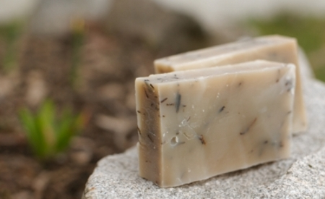
Castelo de xabóns

Slide 2
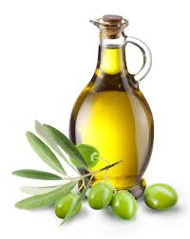
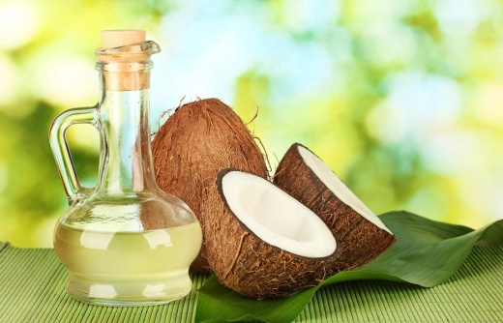
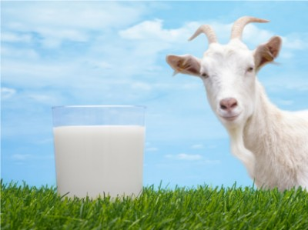
Goat milk soap
Ingredients:
- Olive oil --- 680 g
Coconut oil--- 50 g
Sodium hydroxide --- 93 g
Fresh goat milk--- 230 g
Essential oils ( for fragance).
Food colouring.

Slide 3

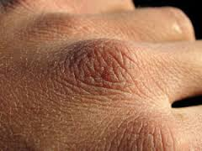
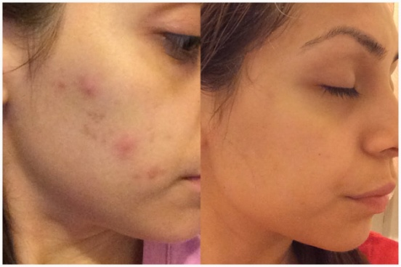
Benefits:
Delays signs of skin aging: the skin appears smoother and more youthful.
Good for people with dry or sensitive skin.
Reduces acne.

Slide 4
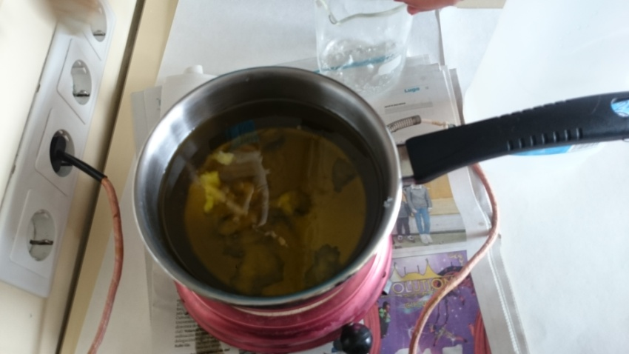
Steps:
First, coconut oil, olive oil, sodium hydroxide, and fresh goat milk are measured.
Then, the olive oil is mixed with the coconut oil and stirred

Slide 5
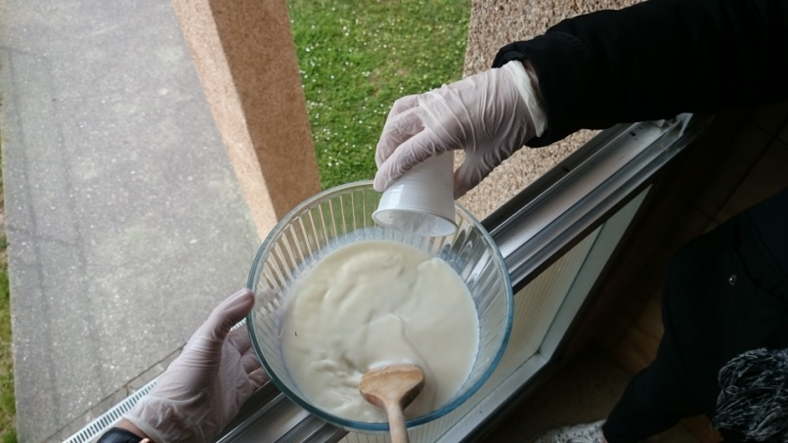
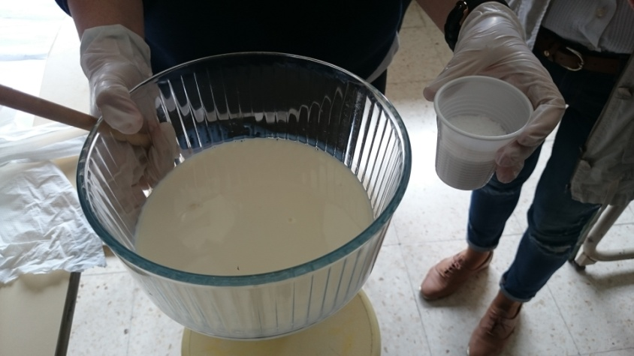
Meanwhile , the goat milk is poured in another beaker and then the sodium hydroxide is added. ( In this part we must be careful because the mixture is dangerous and our hands can be burned. In this step you should be next to a window and use gloves).

Slide 6
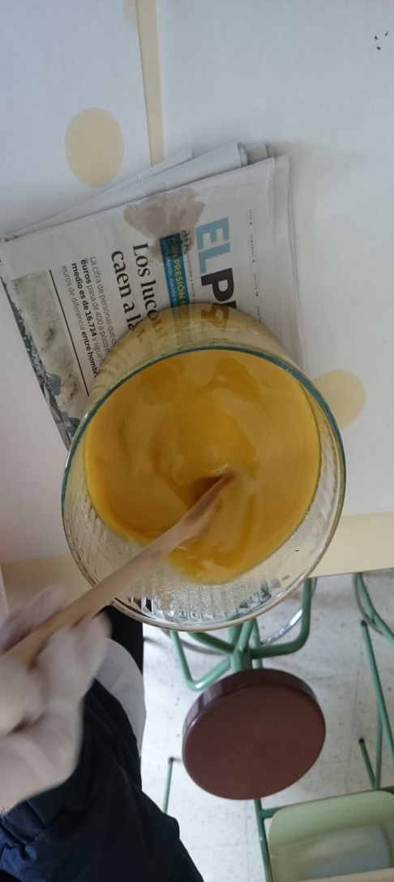
After mixing and stiring all, the olive oil is poured in to the bowl with the milk and sodium hydroxide . Stir until it’s not liquid or it becomes a paste.

Slide 7
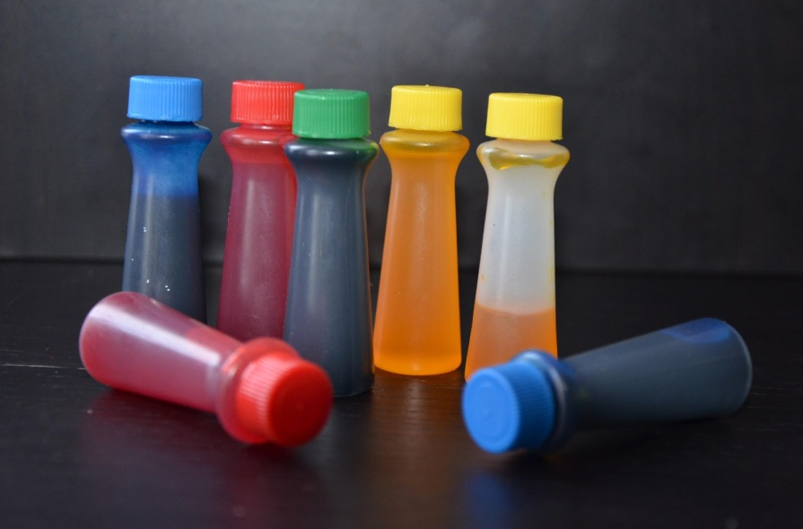
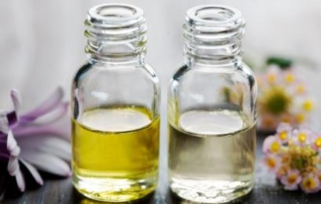
Finally colour and essence are added.
Then soap is poured in the shape molds .
Leave for three days and remove from the mould.

Slide 8
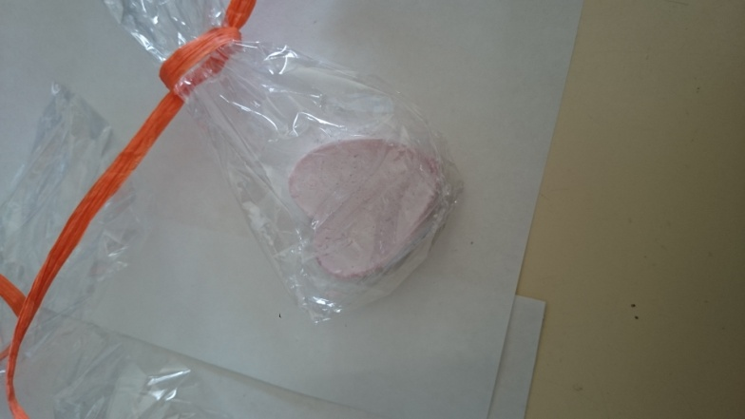
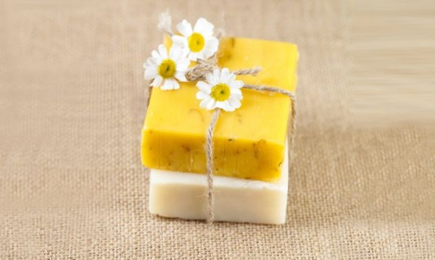
The soap is left for a month to dry. When the soap is dry, wrap it in a beutiful plastic paper and it is ready to be sold.

