Slide 1
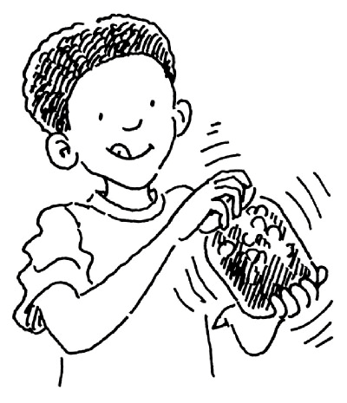
Grupo de traballo: ciencias
Notes:
Introduction:
We are all very excited about doing other subjects like Art , Music and Sciences in English, but how do we break free from paper-based materials and word lists?
How do we take advantage of this double opportunity to make a subject more interesting and English more alive?
If we aren’t careful, we can decrease our enthusiasm for both.

Slide 2
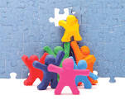
Working together to
Gain wider perspective: year to year, school to school, backgrounds
Notes:
Elicit from the audience. Compare with what children have said...Play the “how observant are you?” game: close your eyes and answer questions about the room we’re in. Maybe say that Science is also counterintuitive with an experiment like the big/little dinosaur floating one or the Diet versus normal Coke one. floating .

Slide 3
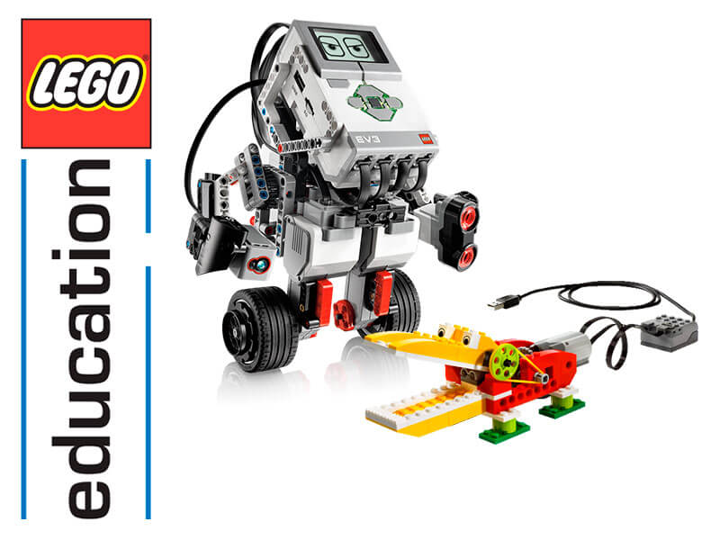
Share activities, skills, even material

Slide 4
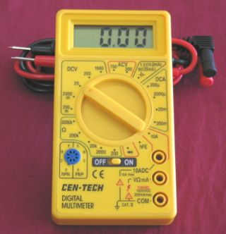
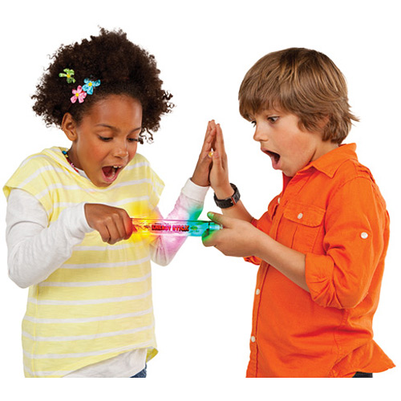
Boost confidence: magic moment

Slide 5
Surprise!
We learnt about what is in our own schools!
We saw a great deal of repetition in the syllabus: rain cycle, planets, machines.
We found time to meet despite our busy timetables!

Slide 6
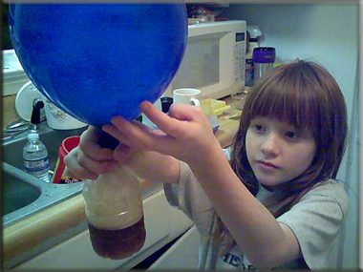
Objectives
Map out topics
Think about the skills set
Work through tricky areas: geography, scale, electricity

Slide 7
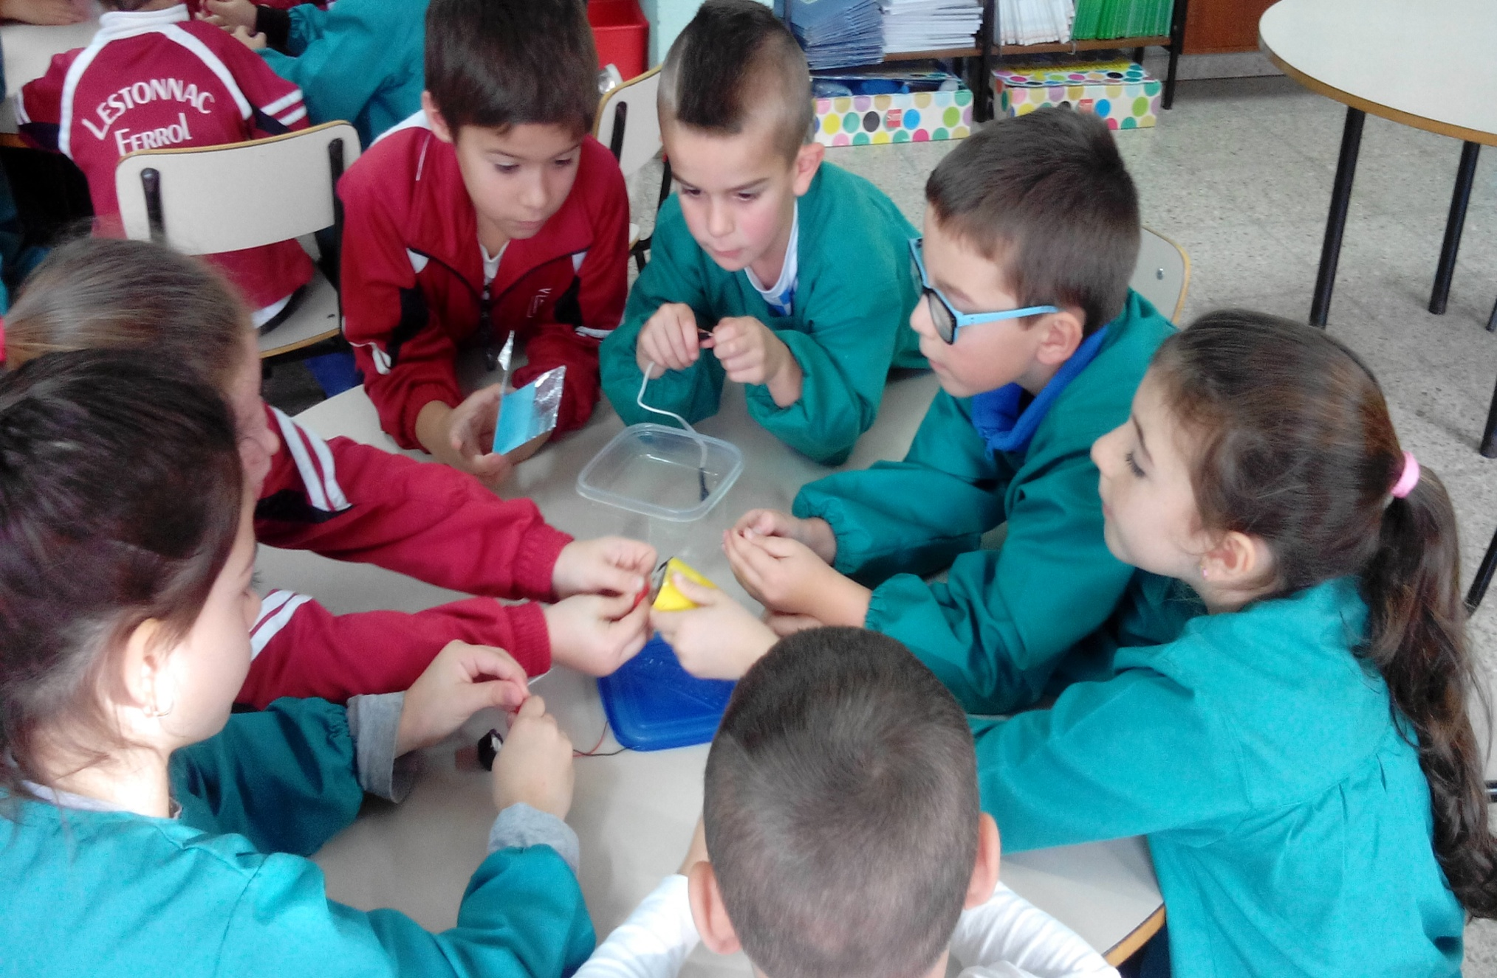

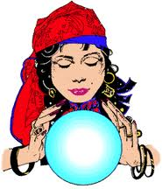

Celebrate good practice..
Notes:
To get them to think of the four questions in chant. Maybe we will also get them to think of other routines for the practical part of a class. Like putting on a lab coat.

Slide 8
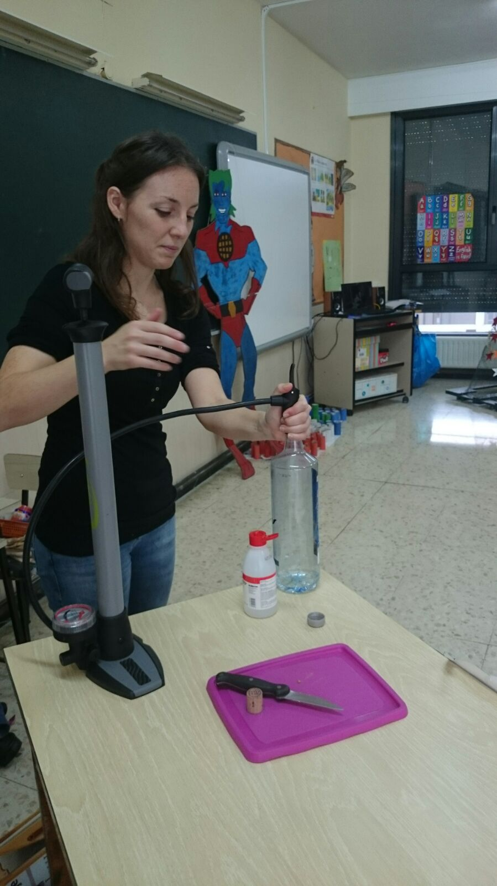

Slide 9
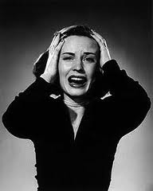
And moan!

Slide 10
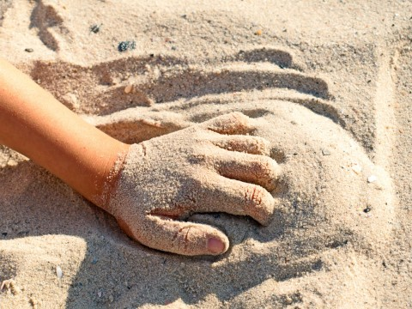
BASIC IDEA
If you can’t feel it, you can’t learn it! Cris and María: cell memory

Slide 11
One
SCALE

Slide 12
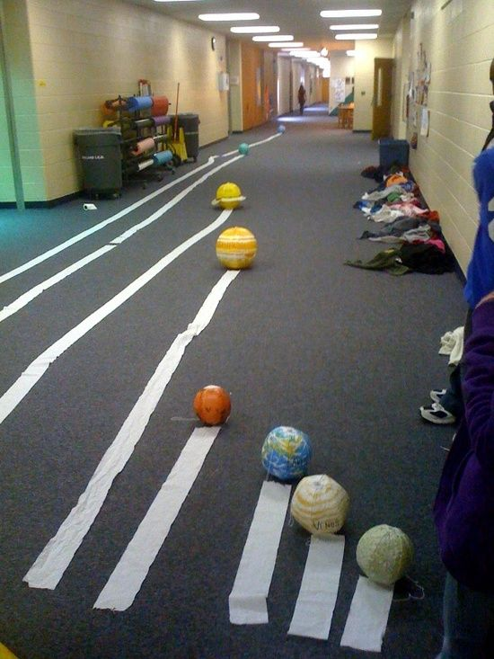
DISTANCE & TIME
First: planet distance from the Sun
Then: time for historical periods (Carlos)
Notes:
Clues given first, again as Helen suggested.

Slide 13
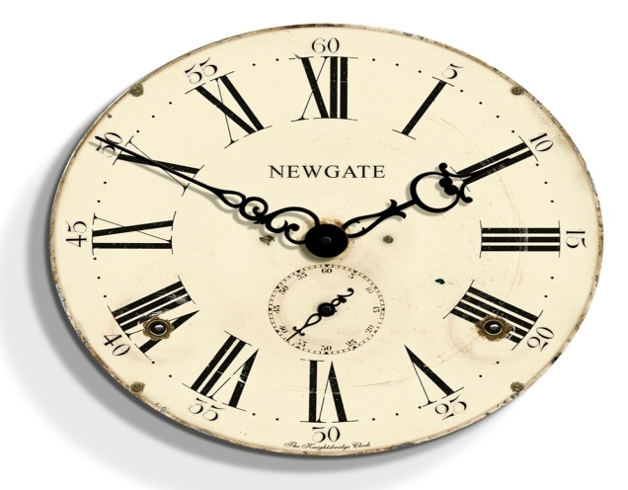
A SENSE OF TIME
Let’s go back.
How many years are in my sack?

Slide 14
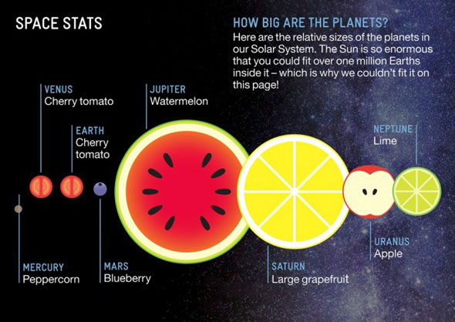
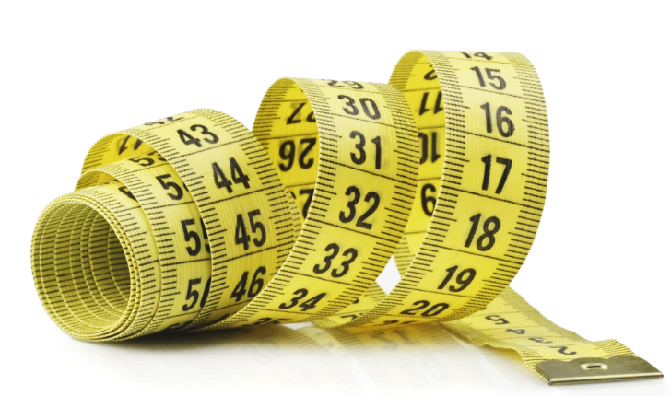
SCALE: SIZE
Representing
Doing
Rebecca: real Maths

Slide 15
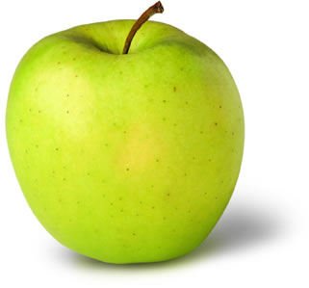
OTHER WAYS: INÉS
231 days 11 hrs 32 min ?
………………………………………
The peel on 1/32 of an apple

Slide 16
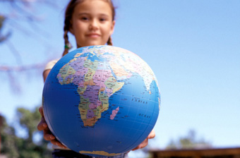
TWO
MAKING GEOGRAPHY
REAL

Slide 17
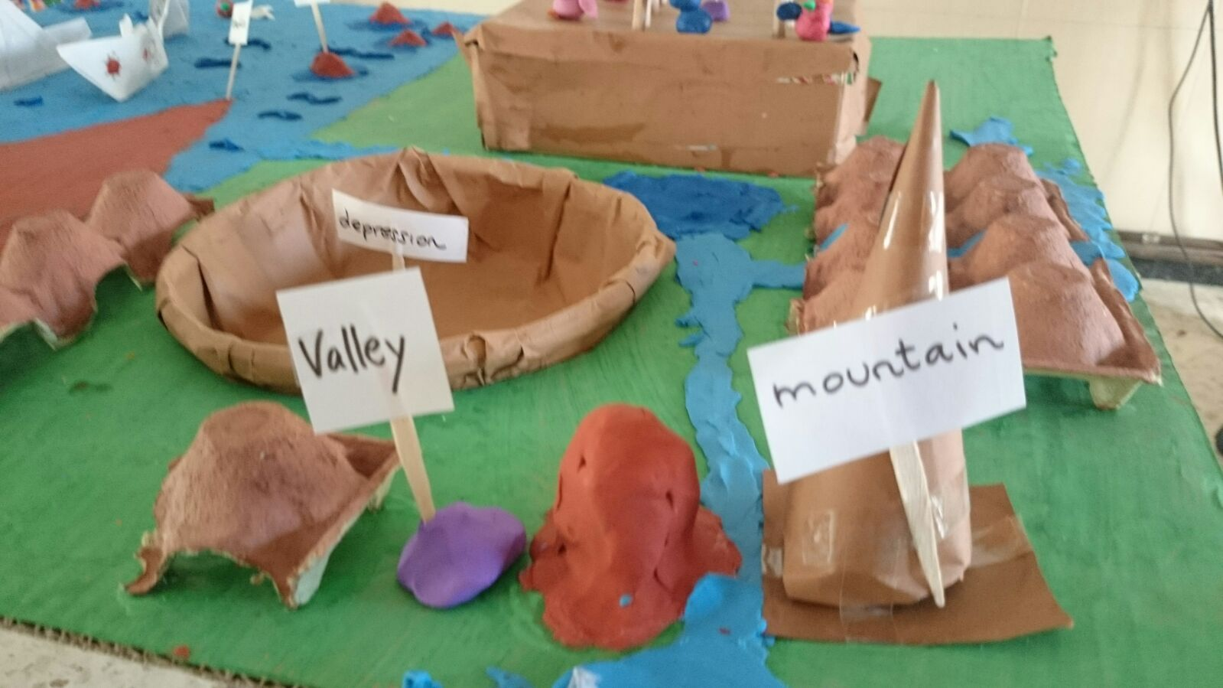
Rebecca: Hands on and across the class
Carlos: Continent corners

Slide 18
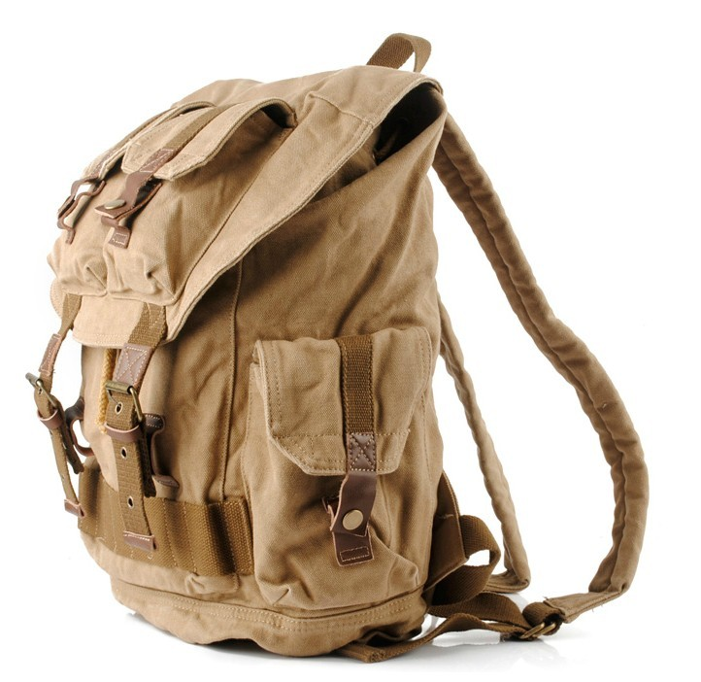
Journeys?
María’s holiday
Imaginary: Hannah’s apple
magic apple (2).pdf

Slide 19
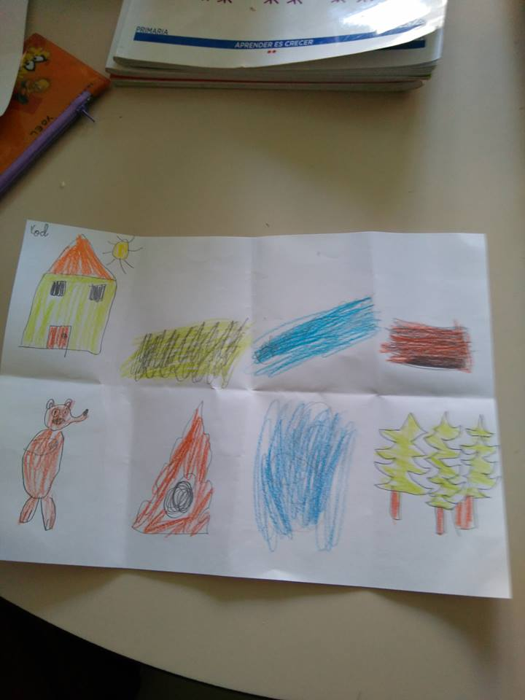
Bear and lions

Slide 20
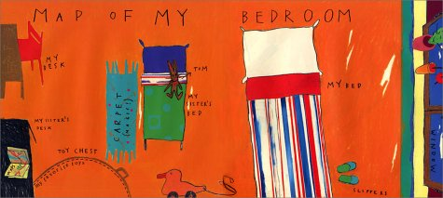
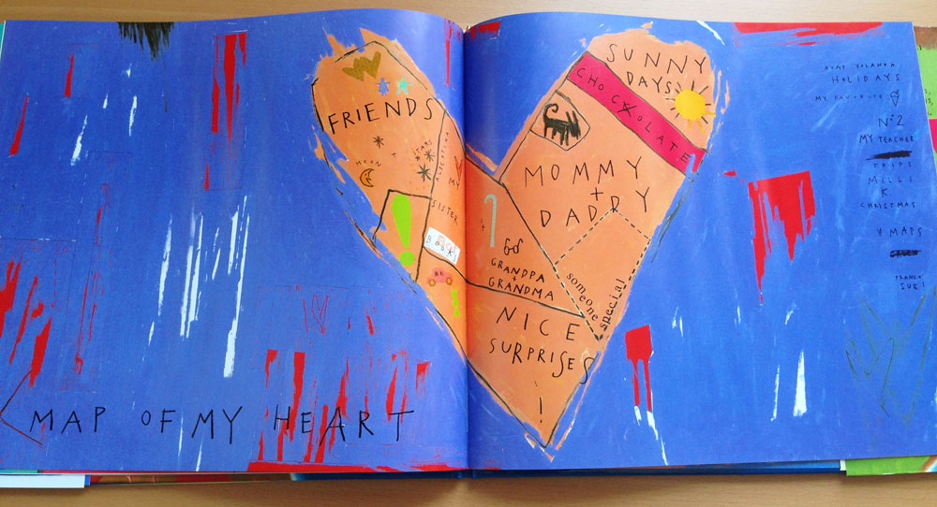
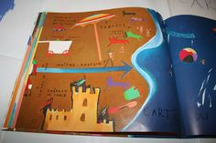

Slide 21
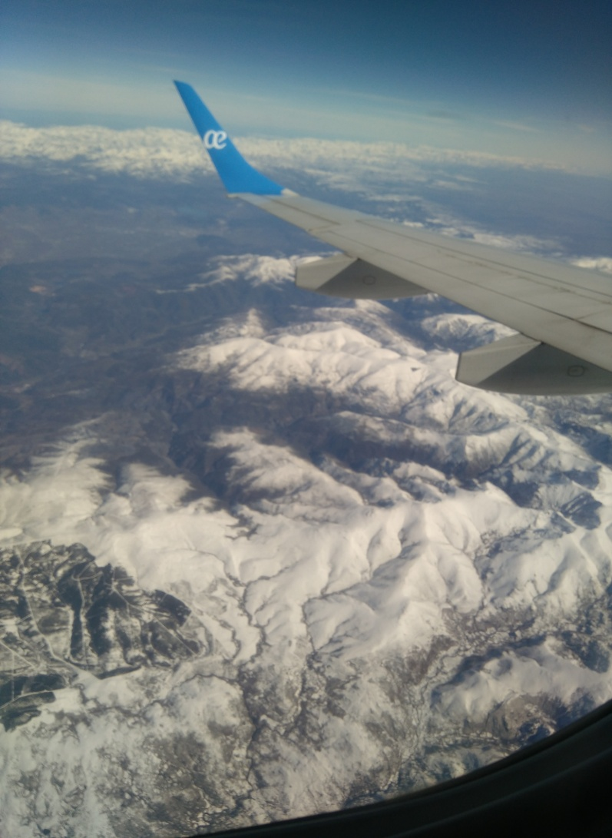
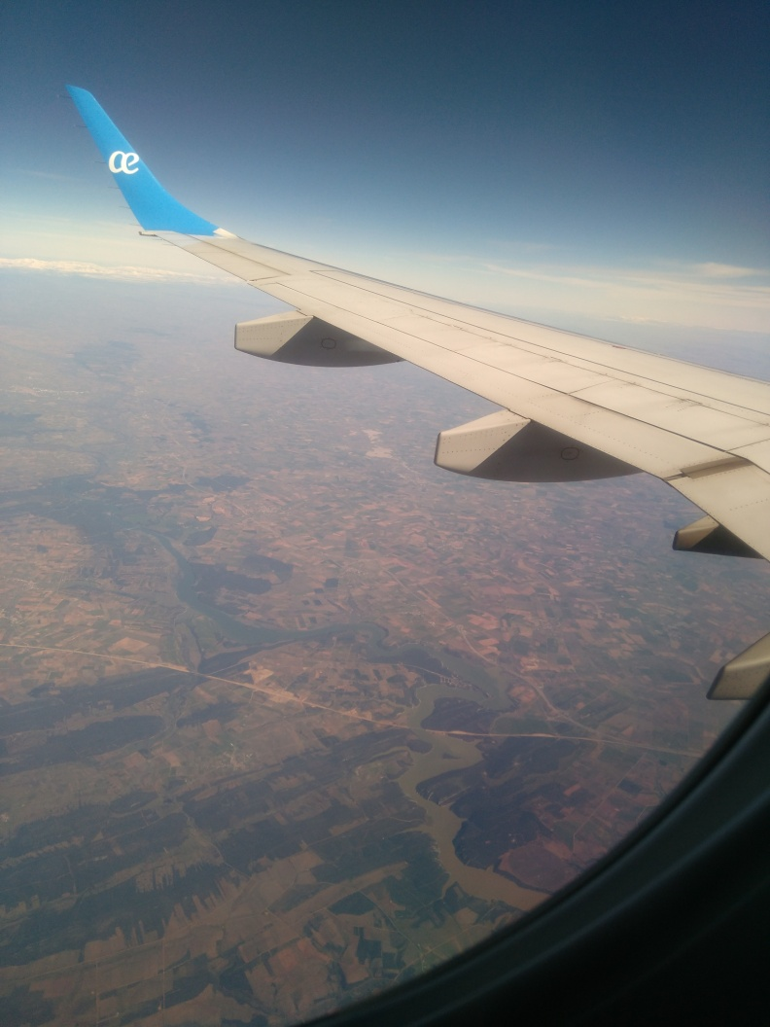
And airplanes

Slide 22
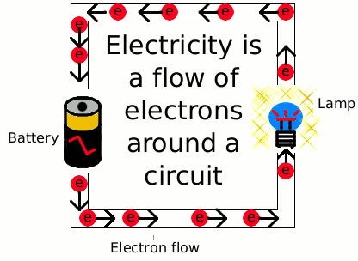
Three
ELECTRICITY
& MACHINES

Slide 23
Four
Assessment
for
Learning AfL

Slide 24

Concerns
Will the syllabus change AGAIN?
CONTENT versus HANDS-ON/SKILLS
Blah, blah: non-linguists DISCONNECT

Slide 25
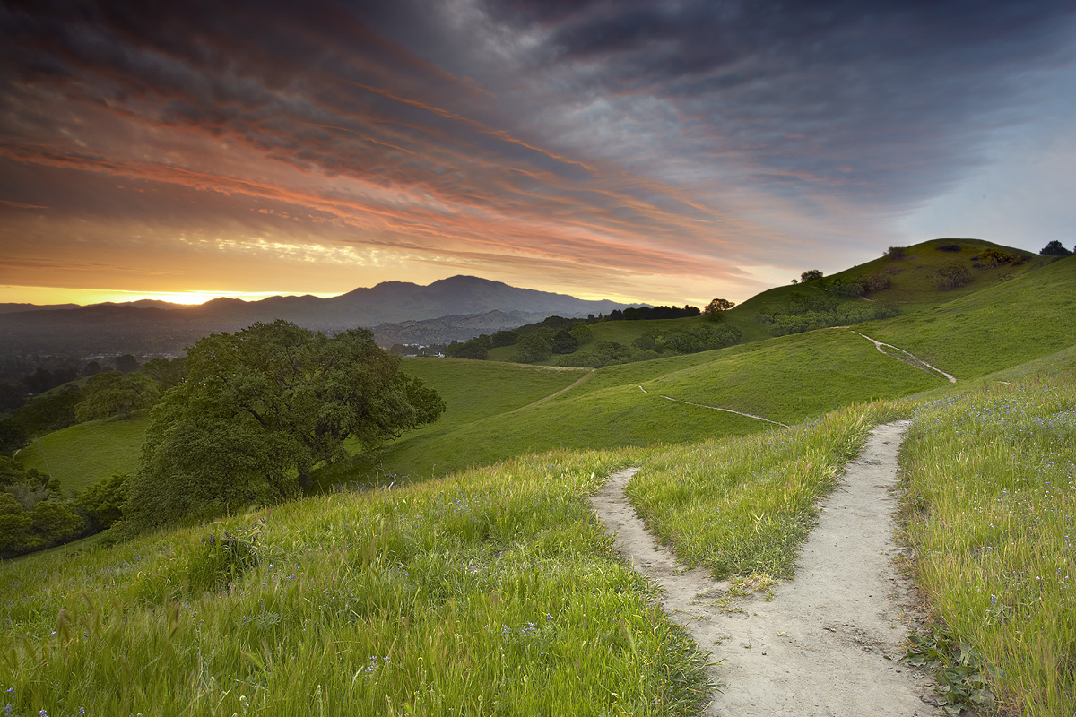
The Future
More skills mapping & AfL
Communications
Infants

