Slide 1
FRANKENSTEIN QUIZ
READING ACTIVITY
EOIOU SECCIÓN CELANOVA
MAIO- XUÑO 2013
COLABORA:

Slide 2
Henri Clerval was an only child with an unhappy life. His mother died when he was very young and he and his father didn’t get on very well because he didn’t want to be a merchant. He loved reading books. He had a friend, Victor Frankenstein, who belonged to a very rich family. They were interested in arts and in science, like Henry.

Slide 3
“That’s my sister,” Victor said. “ Or rather, we’ve been brought up together as brother and sister. She is, in fact, Italian.”

Slide 4
At school Henri noticed that Victor had an unusual power of mind, and it wasn’t always easy to be with him.
Henri used to play with Victor’s brothers, Elizabeth and William. One day they found an old book and Frankenstein began to study it every day. Henri and his friends enjoyed helping Frankenstein with his experiments. He was trying to find the magic liquid. He thought that with that liquid man could live forever.

Slide 5
Henri Clerval was born in Geneva in 1775. He was the son of a cloth merchant. His best friend was Victor Frankenstein. The Frankensteins, a Swiss family, were also merchants, but richer and more important than the Clervals. They adopted a girl, Elizabeth, when they were living in Italy.

Slide 6
The Frankesteins had two houses: one in Geneva and another in the country near a lake. They liked the quiet life there, and they lived there more and more after the birth of his second son, William. Justine, a happy country girl of our age came to look after him.
Victor was very interested in science, and he started to study magic when she was a child. Instead, Elisabeth and Henri liked to write little pieces to be acted, but they helped Victor in some of his experiments. One day, while Victor and Henri were walking down the mountains a lightning fell near them, and from that day Victor started studying modern science.

Slide 7
The very next day I took the public carriage from Geneva to Lausanne and from there to Berne. It was a four-day journey across Switzerland to Lake Constance, then into South Germany by Ulm to Ingolstadt.

Slide 8
When Victor was 17 her father decided to send him to the University of Ingolstadt, in Germany, but before they went there his mother died. He met Dr. Krempe, a friend of his father’s, and Dr Waldman at University. Both convinced Victor to study Science there.
Meanwhile Henri had to return to his father’s shop. At first Victor wrote letters quite often, but after a year his letters stopped. He didn’t come to Geneva for holidays and he left University. His father sent Henri to Ingolstadt to know what Victor was doing. When Henri arrived in Germany, Victor’s room was a complete mess and Victor was very thin and careless. Victor showed him the body of a dead man in a bathtub.
His experiment was about creating life with parts of dead human bodies. Henri was scared but he decided to keep there and look after Victor until the end of his experiment.

Slide 9
Frankenstein then spoke: ” I am now ready. I am only waiting for the right conditions.” He went across the window and opened it. we heard the sound of thunder. It was hot and the air was humid.
“Great! A thunderstorm! We can’t wait. This is the moment,” he said.

Slide 10
At first Henri felt feared and he thought that Victor was mad. Victor told him: ”I created a body and now we have to give it life”.
One night a storm began and they prepared everything to complete the experiment. They wanted to give life to the body with the power of a storm. They connected the body to a kite and the kite flew into the storm.
But when the thundercloud finished, the body didn’t have life. The experiment failed.

Slide 11
“It was about half-past four. Henri sat up in bed. He was wet with fear and horror. I looked around. The curtains were closed, and everything was very dark. There was no more thunder. I saw a shadow. The shadow became a shape. The shape entered the room where I was. My blood was cold. Something was standing very close to my bed”.

Slide 12
“Then I heard a sound from the other bed. Frankenstein was also awake. He opened the curtains. The light of early morning entered into the room and I could see at once that the shape was the body in the bath, now alive and breathing. But it was not perfect. He was standing and without clothes. He was wet and he had long hair. He was nearly 2 metres tall. His skin was yellow and dry like old paper. His smile was unnatural and his eyes were red. He was a Monster!”

Slide 13
Frankenstein was filled with horror. He looked at the Monster and the Monster looked back at him.
At first, I felt fear but a few minutes later I understood that there was no reason for fear. This was not a wild animal. He didn’t attack us. He even began to look friendly. Did he want to thank its creator for its birth? He came up to Frankenstein. I think he was going to kiss his foot, but he did not do it because, with a cry of horror, Frankenstein kicked out at him and the Monster fell back. The Monster got up very quickly. It looked very heavy but it was strong and active.
“Out!” he cried. !Out of my rooms! Out of my sight! You are disgusting !

Slide 14
It was the first time we heard the voice of the Monster. Its voice was deep and rough. We were surprised. We realized that he could think and that he had feelings.

Slide 15
The next day, when Victor and Henri woke up they realized that the creature was alive. But he was horrible, very thin and with yellow skin. He was a Monster. They felt horror and Victor threw him out of the room. Henri could see the Monster walking in the street. Victor thought: “the Monster was a mistake” and decided to return home.

Slide 16
One day, while he and Victor were sitting eating in the living room, Henri said: “the creature you are making will be strong, beautiful and clever, but will it be good?
“It is prepared,” said Frankenstein. “ I have plans to take him to live in a place far from the bad example of man. Man is always born good. We are going to treat him well and he will be good.”

Slide 17
Victor returned home and Henri remained in Ingolstadt. He didn’t stop thinking about the Monster. He began to investigate and he found out that the Monster was living in the forest. He decided to visit him. When he saw him, the Monster was wearing some clothes and carrying a basket with food. He decided to follow him to his cave.

Slide 18
At first, nobody talked about the Monster so he thought it was dead, but few months later people started saying that a wild man was living in the forest. Henri went there and was looking for him. After several days he found the Monster, but instead of talking, he decided to follow him to see where he lived.

Slide 19
Henri followed him to a house. The house belonged to a French family and when the Monster left the house Henri knocked at the door. The family told him that the Monster was good and helpful. Then he returned to Ingolstadt.

Slide 20
Three weeks after his first visit, Henri went back to the French family’s house in the forestThe house was destroyed by a fire and nobody survived. He came back to the city and tried to forget it. But in December Henri’s father sent him a letter. In the letter he could read “Justine killed William”, so Henri decided to go to Geneva.

Slide 21
When Henri arrived in Geneva, he could see how Justine was hanged. Then he visited Victor, who was crying in his house. He felt that he was responsible for Justine’s death. He told Henri “the Monster killed my brother William and I have to prove it”. But he was not successful.
Finally Victor promised to destroy the Monster. ”I am going to destroy the creature I made”, he said.

Slide 22
Victor was looking for the Monster all winter, spring and part of summer, without success. In August Henri and Victor took a holiday and went to Chamonix, the village that was on the foot of Mont Blanc. They were walking round some glacier cracks when they saw the Monster coming to them. They felt that that was the end of them both.

Slide 23
The Monster began to speak to them. He told them: “I tried to approach people but everybody was afraid of me. But when I found the Lacys’ house they let me stay with them. I fell in love with the Lacys’ daughter and I told her about my love. She felt horror and I felt very angry…”
The Monster decided to destroy this family and he burnt their house and killed them. Since then he hated humans. But he wanted human company and he tried to be friend with a child, Victor’s brother. He tried to take the boy to a mountain to live together and he had to fight with Justine, the woman who looked after him. Accidentally he killed the child.
When the Monster finished his story, he asked
Victor to make a wife for him. At first
Victor refused to help him but then the Monster
told him that he would kill all his family
if he didn’t help him.

Slide 24
When the Monster arrived he started to tell Victor and Henri his story; how he survived in the forest, how he met the French family at Inglostadt, why he killed them and how he killed William by error. Finally he asked Victor for a wife like him. Victor refused to create another creature like him, but the Monster threatened to kill all her friends and family if he didn’t do it.

Slide 25
Victor agreed to help the Monster but he didn’t begin working until a few weeks later.
Victor went to a cottage in the forest to create the Monster’s wife, but before that he asked Elisabeth to marry him. She accepted but he had to be out for two months. Elisabeth didn’t know really what Victor’s experiment was. The Monster was watching Victor’s work all the time.

Slide 26
Frankenstein finished the job, the New Woman was complete, and she was disgusting and very ugly. But there was a problem. The weather was very good and there was not storm. So they had to wait. They waited for days and Victor decided to send Henri home. Henri left the hut with the feeling that something was wrong.
Three days later he was sent to the town by Frankenstein’s father. There a friend told him that Victor was in prison because the police thought that he had killed someone.
The police found some parts of a
human body in the river and
they sent Victor into prison.

Slide 27
Henri arrived at Frankenstein’s house and saw that Victor’s father was there. He told him that his son was in prison and that they were in danger. Elizabeth was in the hut in the valley with a servant so Henri left the house to find them. He arrived at the hut but there was empty. He looked around and he found the servant. He was dead. Later he found one of
Elizabeth’s shoes.

Slide 28
The next day they found several clothes of Elisabeth, which helped them to pursue the Monster. Finally they saw him at the edge of a cliff, but when they reached them, the Monster threw Elisabeth to Henri and started to fight with Victor. Suddenly a lightning ended the fight. It killed Victor and the Monster, master and creature, and it only damaged Henri and Elisabeth, so both could
came back home.
Finally Henri married Elisabeth and they had a son called Victor.

Slide 29
The next morning they started to look for again. They found the other shoe, and later Elizabeth’s handkerchief. The Monster left these things to guide them somewhere. Finally they found the Monster and Elizabeth at the edge of a cliff. There the Monster threw Elizabeth and he began to fight with
Victor, who was holding a knife.
Then there was a blue flash and when Henri woke up he could see that his coat was on fire.
He and Elizabeth were alive but Frankenstein and the Monster were dead. Their bodies were joined in a blackened mass forever. This happened because knives attract the flash.
Elizabeth and Henri went back to Geneva,
they got married and they had
a son named Victor.

Slide 30
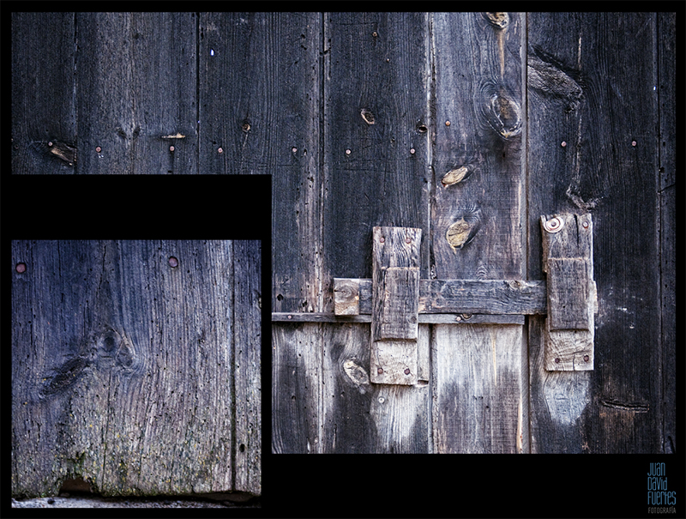
FRANKENSTEIN QUIZ
DON’T BE AFRAID AND ANSWER THE QUESTIONS.
THEY ARE VERY EASY.
YOU CAN WIN A PRIZE!!!!

Slide 31


Slide 32
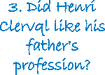
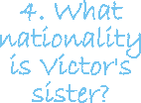

Slide 33

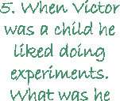

Slide 34

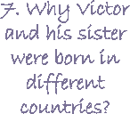

Slide 35

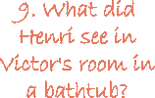

Slide 36
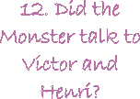
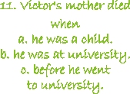

Slide 37

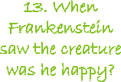

Slide 38
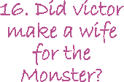
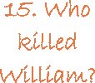

Slide 39
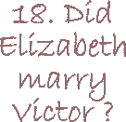


Slide 40
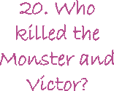
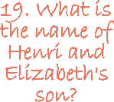

Slide 41
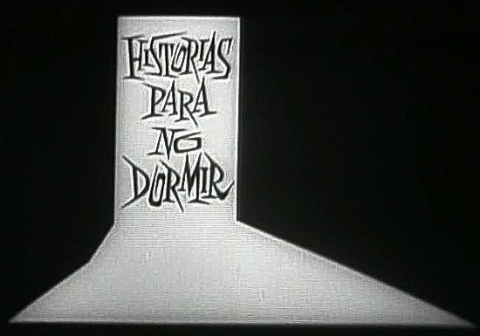
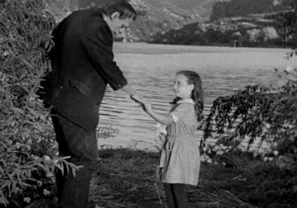
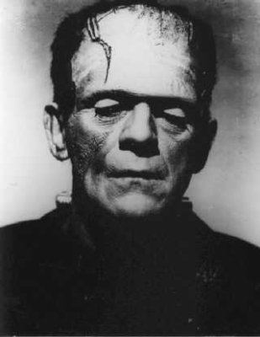
For
Further
information:
FILMS
The original:
Frankenstein, James Whale, 1932.

Slide 42
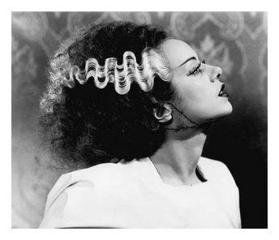
For
Further
information:
FILMS
Where his girlfriend was born:
Bride of Frankenstein, James Whale, 1935.

Slide 43
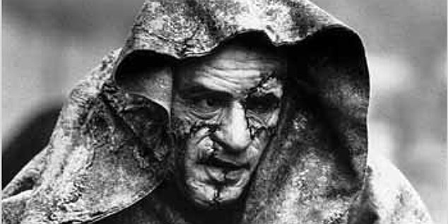
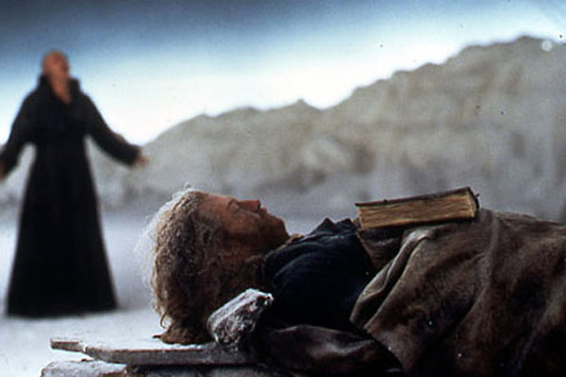
For
Further
information:
FILMS
Kenneth Branagh’s version:
Mary Shelley’s Frankenstein, 1996

Slide 44
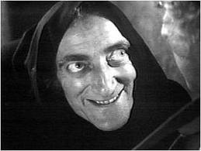
For
Further
information:
FILMS
Taking it as a joke:
Young Frankenstein, Mel Brooks, 1974

Slide 45
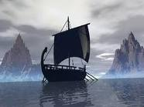
For
Further
information:
FILMS
Abouy the myth:
Remando al viento, Gonzálo Suárez, 1987

Slide 46
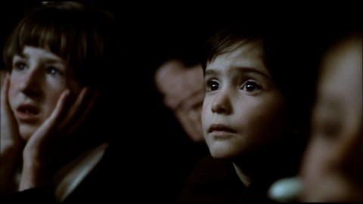
For
Further
information:
FILMS
Cinema within cinema:
El espíritu de la colmena, Víctor Erice, 1973

Slide 47
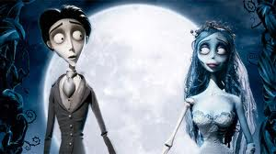
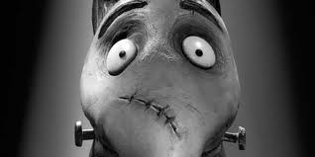
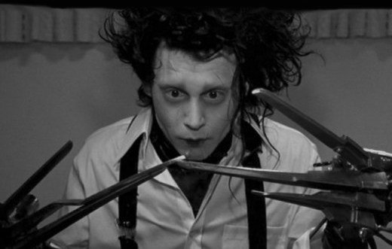
For
Further
information:
FILMS
Almost everything about Tim Burton :
Corpse Bride, 2005
Frankenweennie, 2012
Edward Scissorhands,1990

Slide 48
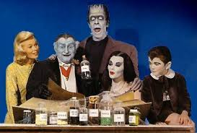
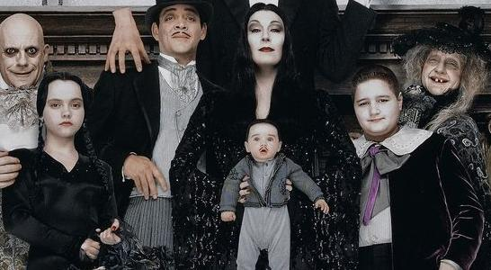
For
Further
information:
TV SERIES
The Munsters
The Addams Family

Slide 49
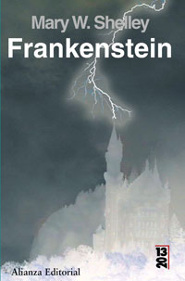
For
Further
information:
AUDIOBOOKS
http://www.youtube.com/watch?v=AAPx-4yd3Gw

Slide 50
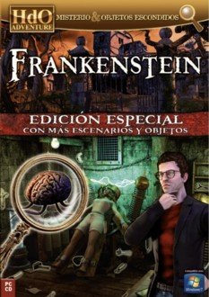

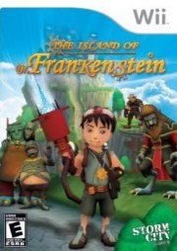
For
Further
information:
VIDEOGAMES

Slide 51
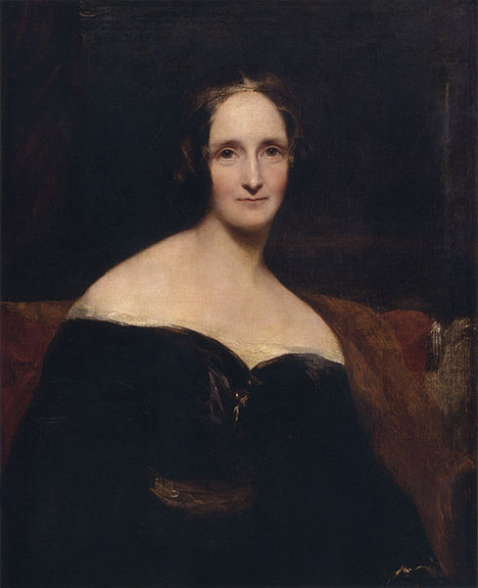
For
Further
information:
ABOUT THE AUTHOR
http://en.wikipedia.org/wiki/Mary_Shelley

