Slide 1



Bienvenue chez nous!
Ferrol, January 2024

Slide 2
INDEX
SPANISH EDUCATIONAL SYSTEM
STUDIES OFFERED IN CIFP FERROLTERRA
ADDED VALUE IN CIFP FERROLTERRA
COMPANIES IN FERROLTERRA REGION
FUTURE PROJECTS, QUESTIONS

Slide 3
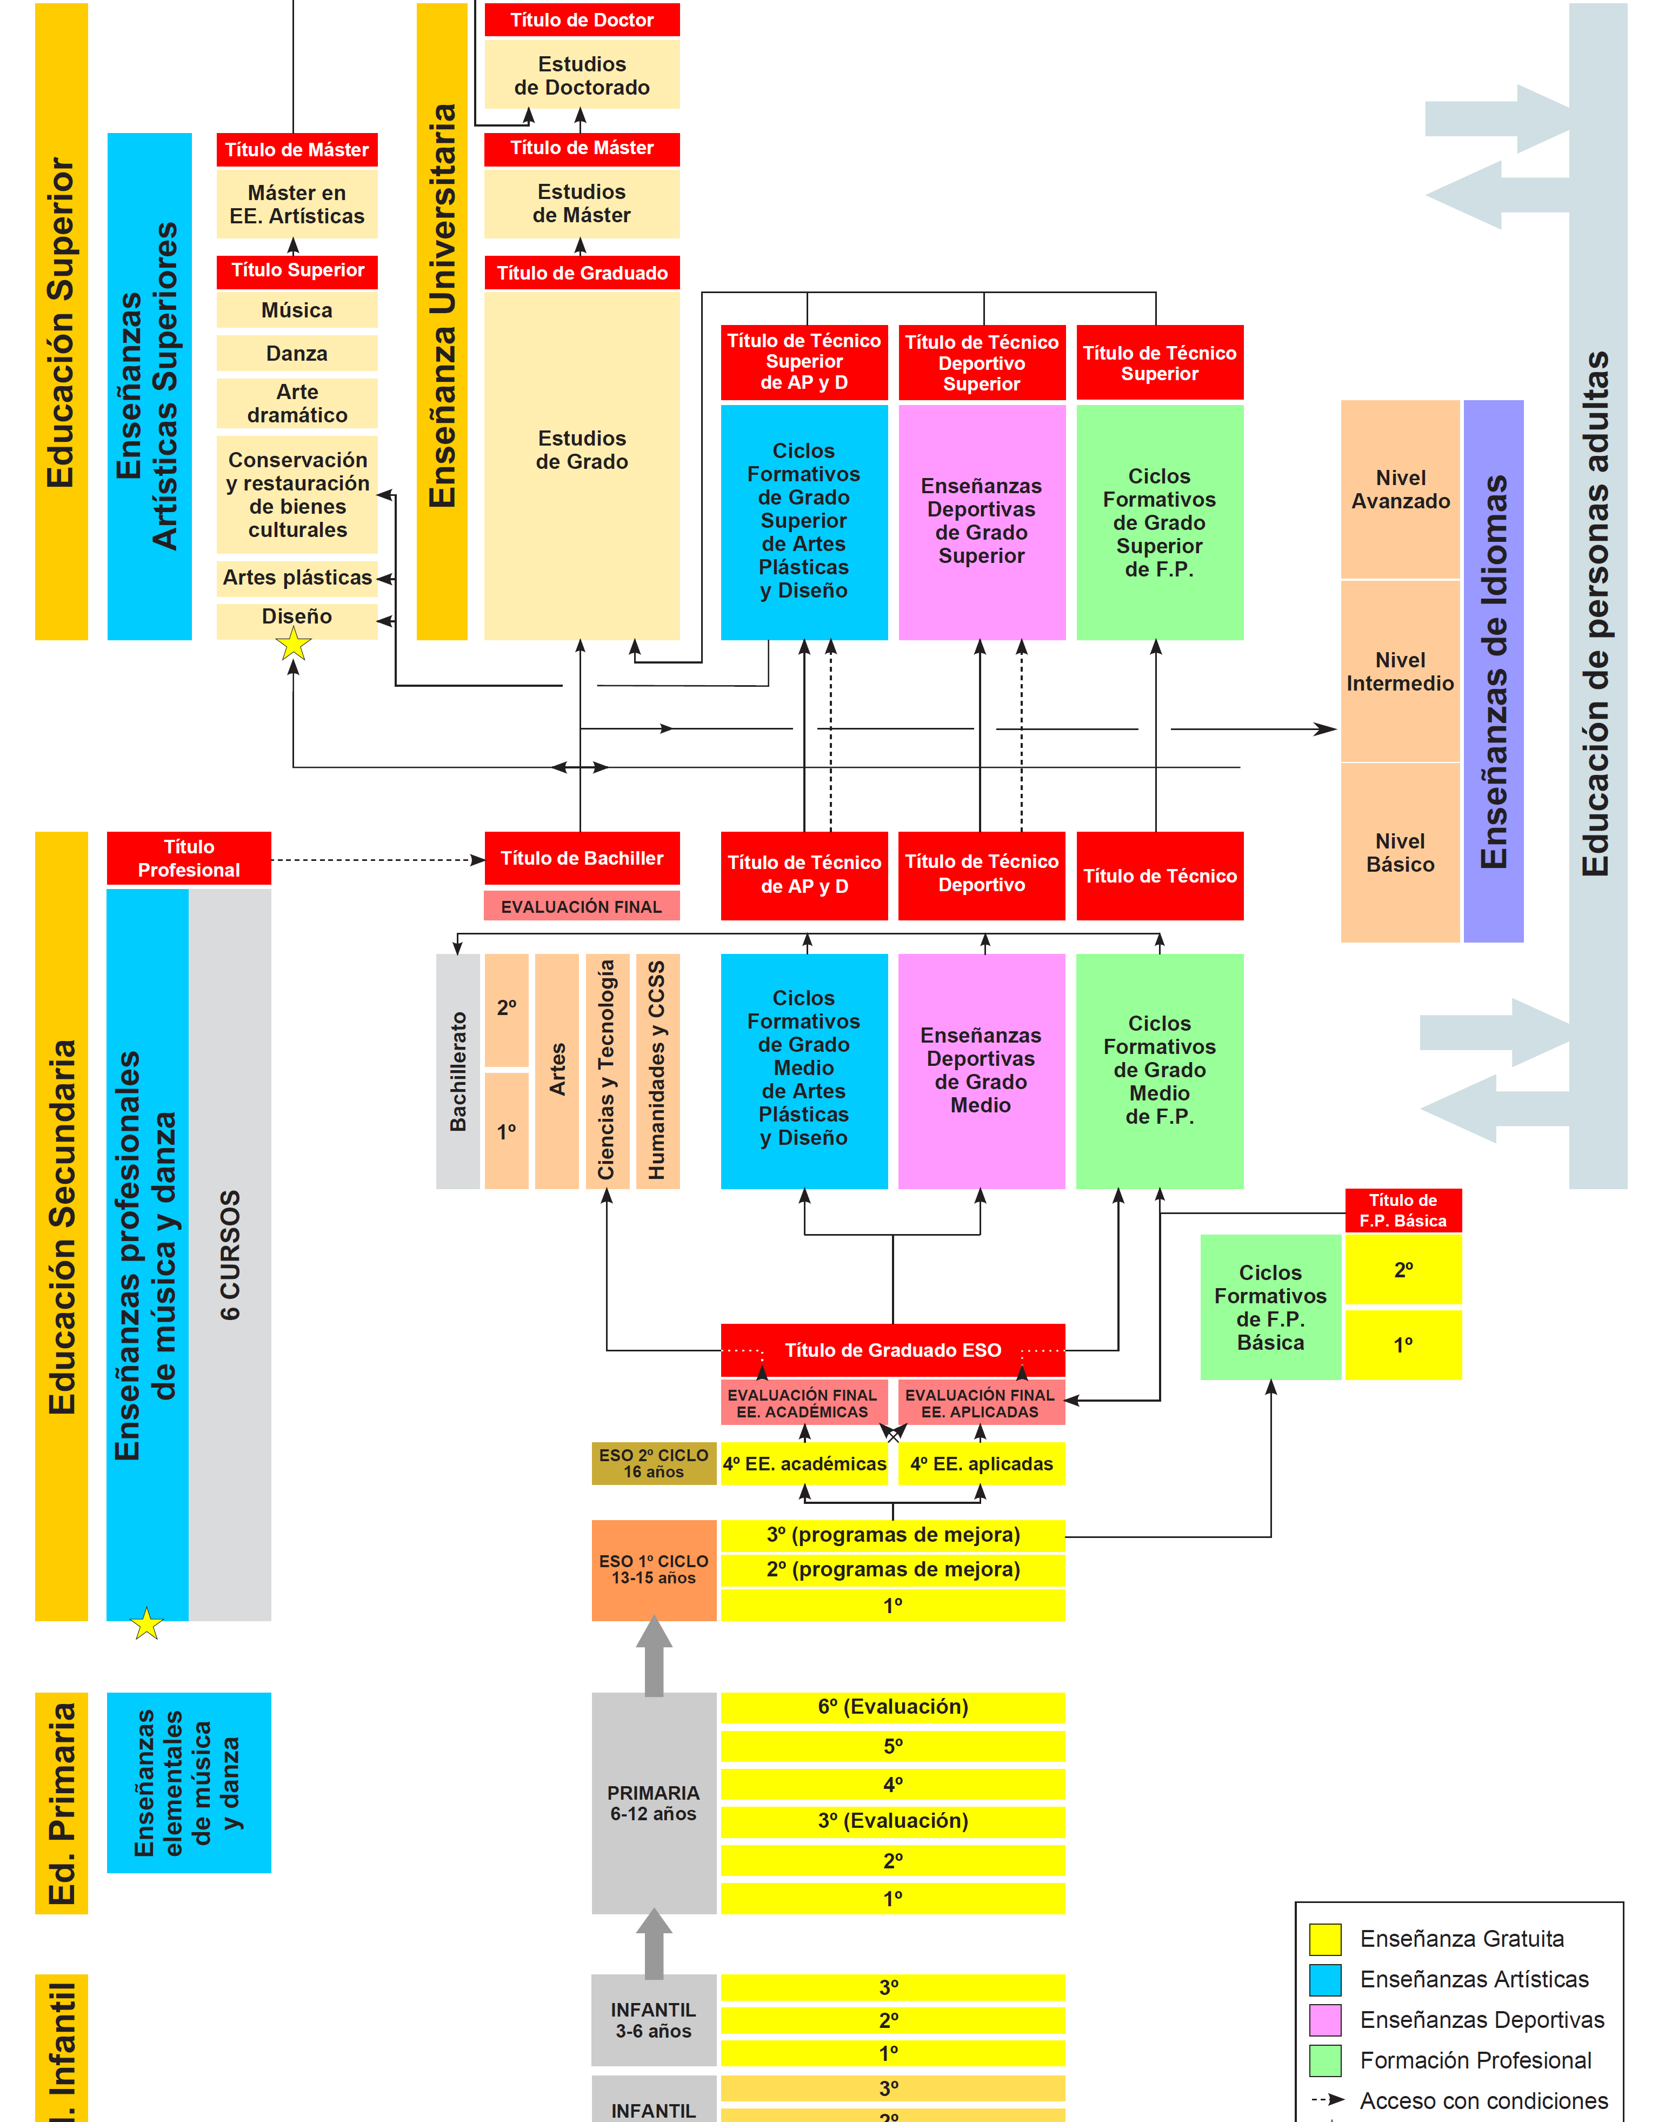
SPANISH EDUCATIONAL SYSTEM

Slide 4
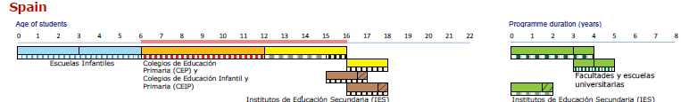
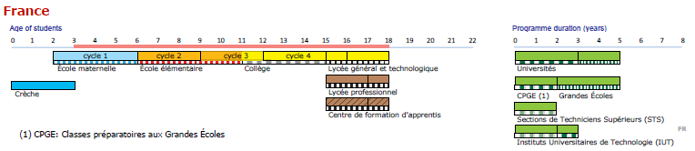
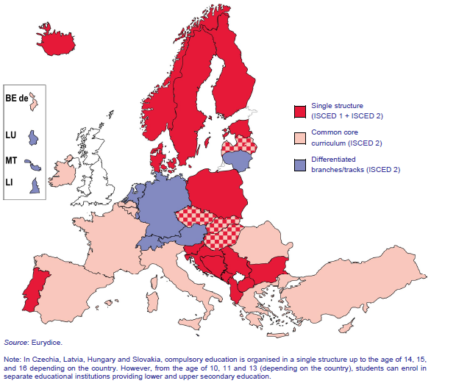
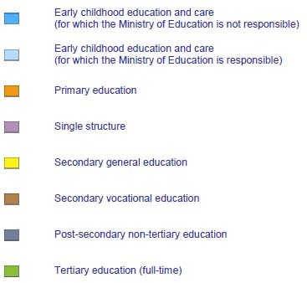
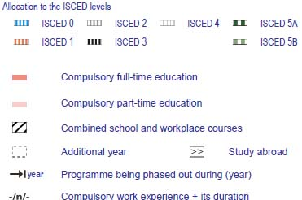
SPANISH EDUCATION SYSTEM AND FRENCH EDUCATION SYSTEM
FP BÁSICA
CICLOS FORMATIVOS GRADO MEDIO
CICLOS FORMATIVOS GRADO SUPERIOR
Font: The structure of the European education Systems: schematic diagrams.
European Commission. Eurydice Highlighs

Slide 5






CIFP FERROLTERRA
OUR EDUCATIONAL OFFER
Technical VET School
Mechanic Manufacturing
Electricity and Electronics
Transport and Maintenance of Vehicles
Energy and
Water
Installation and Maintenance
Wood, Furniture and Bark
Approximately 1000 students and 100 teachers

Slide 6
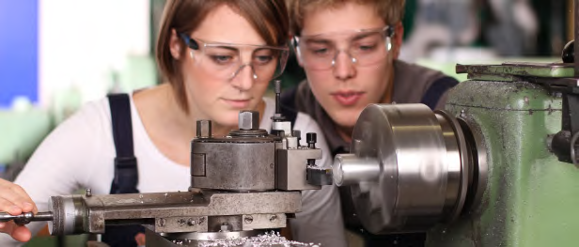
CIFP FERROLTERRA SPECIALITIES.
BRANCH Mechanic Manufacturing
Intermediate Level VET in Machining
Students use tool machines to shape solid pieces. They prepare machines and systems, programme CNC and robots, and verify mechanized products.
Intermediate-Level VET in Welding and Boilermaking
Students learn techniques of metal construction: cutting, forging and joining structures in ferrous or steel materials by means of welding, machining and forming techniques.

Slide 7
CIFP FERROLTERRA SPECIALITIES.
BRANCH Mechanic Manufacturing
Higher-Level VET in Mechanic Production Scheduling
Students plan, programme and control the manufacture by machining and assembly of equipment, based on process documentation and the specifications of the manufacturing products, assuring the quality of the management and the products.
Higher-Level VET in Metal Construction
Students design boilermaking products, metal structures and industrial pipe installations, plan, program and controlle production, taking into account the documentation of the process and the specifications of the products to be manufactured. They learn how to use software programmes as Autocad, CYPE-CAD and Inventor.
Higher-Level VET in Mechanical Manufacture Design
Students design mechanical manufacturing products, sheet metal processing tools, moulds and models for polymers, foundry, forging, stamping or powder metallurgy. They manage industrial design software programmes (Inventor, Autocad and Solidworks).

Slide 8
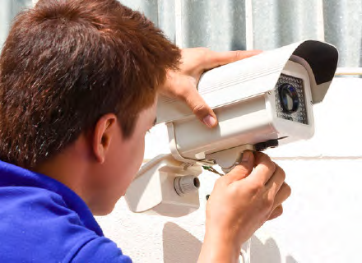
CIFP FERROLTERRA SPECIALITIES.
BRANCH Electricity and Electronics
FP Básica Electricidad
Students get Compulsory Secondary Education and access to Medium Level VET studies. https://www.edu.xunta.gal/fp/fpbasica
Intermediate-Level Training VET in Electrical and Automatic Installations
Students assembly and maintain low-voltage distribution networks and auxiliary elements, associated equipment and pipelines, as well as electrical and automated installations, photovoltaic solar in buildings, and install and maintain electrical machines. They become authorized low voltage installers.
Intermediate-Level Training VET in Telecommunications Installations
Students assemble and/or maintain electronic installations, telecommunication systems (telephony, radio and TV), computer systems.

Slide 9
CIFP FERROLTERRA SPECIALITIES.
BRANCH Electricity and Electronics
Higher-Level VET in Electrotechnical and Automated Systems
Students learn how to work in electrical installations in buildings, domotic systems, low voltage electrical networks and automated systems.
Higher-Level VET in Telecommunication and Computer Systems
Students get the necessary knowledge to develop and supervise telecommunication (telephony, radio and TV), computer systems and audiovisual production systems.
Higher-Level VET in Industrial Automation and Robotics
Students do the maintenance of automatic installations in all kind of companies with automated Systems.
Higher-Level VET in Industrial Electronic Maintenance
Students configure electronic circuits, diagnose dysfunctions in equipment or systems, supervise and/or execute maintenance processes.

Slide 10
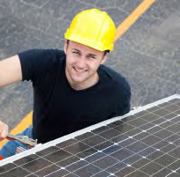
CIFP FERROLTERRA SPECIALITIES.
BRANCH Energy and Water
Medium-Level VET in Heat Generation Installations
Students assemble and maintain heating, solar thermal and fluid installations
Higher-Level VET in Energy Efficiency and Solar Thermal Energy
Students install solar energy, water and heating systems and learn how to configure and evaluate the efficiency of energy and water installations in buildings, as well as manage their assembly and maintenance.
Higher-Level VET in Renewable Energies
Students work in companies dedicated to develop, assemble, exploit and maintain wind and photovoltaic energy installations intended to produce electric power.

Slide 11
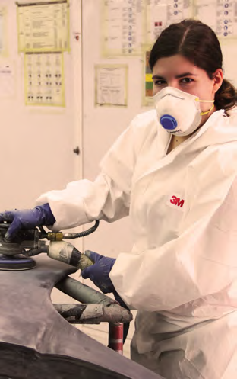
CIFP FERROLTERRA SPECIALITIES.
BRANCH Transport and Maintenance of Vehicles
Intermediate-Level VET in Electromechanics of Automobile Vehicles
Maintenance operations in the areas of mechanics, electricity and electronics of vehicles
Intermediate-Level VET in Machine Electromechanics
Maintenance in mechanics, electricity and electronics in the sector of agricultural machinery, and building and civil works machinery
Intermediate-VET in Bodywork
Students carry out repair, assembly accessories and transformation of the vehicle in the field of bodywork, frame, cabin and equipment. They learn also to prepare and beautify and paint vehicle bodies.
Higher-Level VET in Motor Vehicles
Students maintain and repair cars, motorcycles as well as agricultural machinery and heavy vehicles. and take care of the electrical, mechanical, pneumatic, bodywork and painting works

Slide 12
CIFP FERROLTERRA SPECIALITIES.
BRANCH Wood, Furniture and Bark
FP Básica Carpinteria
Students get Compulsory Secondary Education and access to Medium Level VET studies
Intermediate-Level Training VET in Joinery and Furniture Making
Students are able to manufacture carpentry elements and furniture, carrying out the processes of machining, assembly, finishing, storage and dispatch of products.
Intermediate-Level VET in Maintenance of boats
Maintenance of wood boats
Higher-Level VET in Design and Furnishing
Students design furniture and joinery manufacture

Slide 13
CIFP FERROLTERRA SPECIALITIES.
BRANCH Installation and Maintenance
Higher-Level VET in Industrial Mechatronics
Students plan and organize maintenance plans for machinery and industrial equipment, as well as coordinate and supervise the execution of maintenance processes and carry out the installation of machinery and industrial equipment at plants, and also develop projects for the improvement or modification of machinery

Slide 14
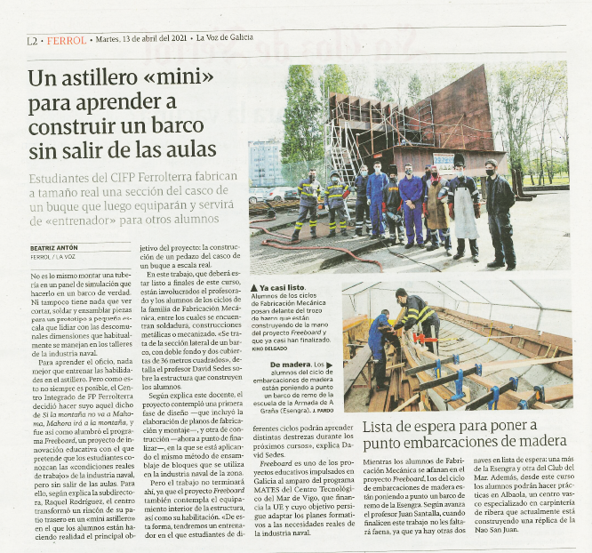
MORE ABOUT CIFP FERROLTERRA
JOB CENTRE: http://www.fpferrolterra.com/bolsadeemprego/
FREE ENGLISH LESSONS
ERASMUS HE CHART and VET CHART 20-27
INTERNATIONAL MOBILITIES
INTERNATIONAL PROJECTS: SKILLS ALLIANCE
DUAL SYSTEM VET
COMPLEMENTARY TRAINING
INNOVATION PROJECTS & PRICE
COMPETITIONS: SKILLS
TRAINING FOR UNEMPLOYED
SKILLS ACCREDITATION / ACCRÉDITATION DES COMPÉTENCES
3 SPECIALIZATION COURSES: 3D + HIBRID & ELECTRIC VEHICLES + ROBOTICS
SME INCUBATOR FOR STUDENTS →ENTREPRENEUR
QUALITY SYSTEM

Slide 15
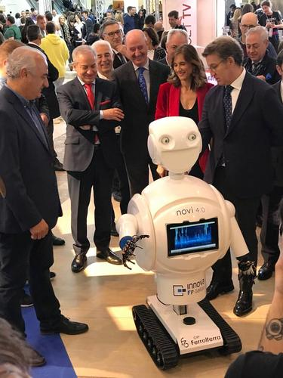
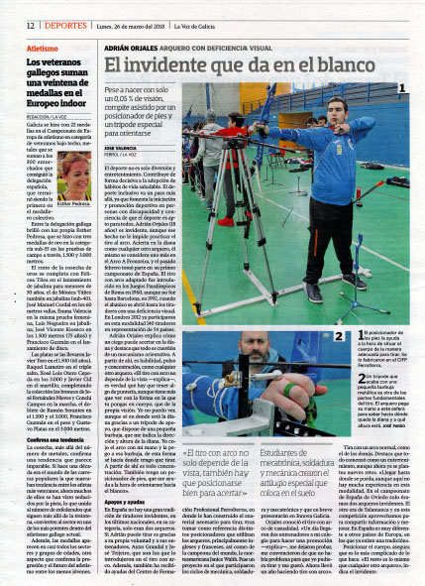
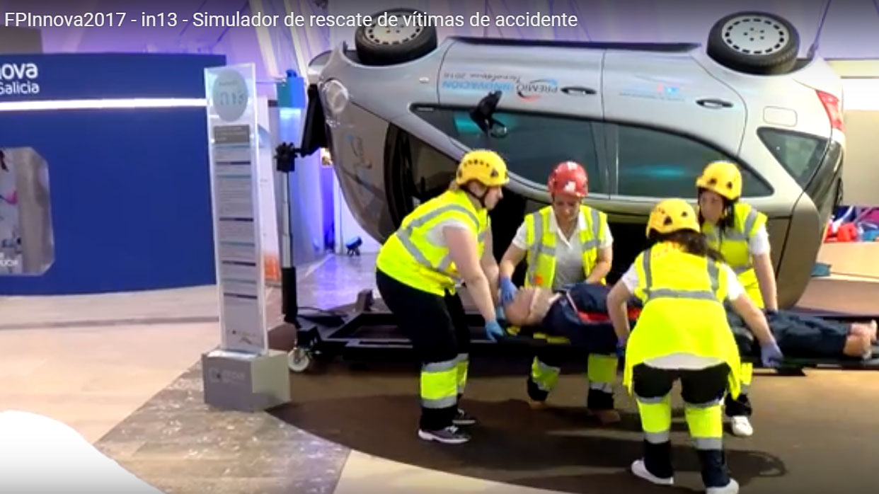
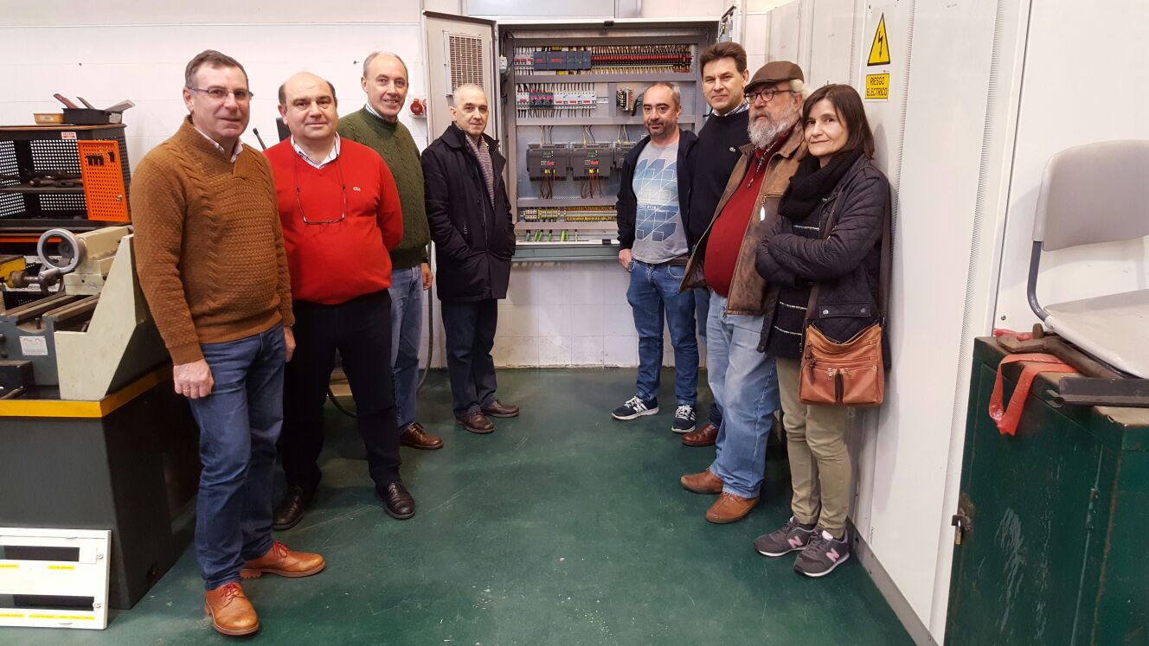
MORE ABOUT CIFP FERROLTERRA http://www.edu.xunta.gal/centros/cifpferrolterra/node/1122
INNOVATION PROJECTS
Simulator rescue of victims of traffic accidents
Autonomous travel system for people with reduced mobilitycontrol.
Construction of the Robot image of FPInnova
Foot and Tripod Positioner for Tactile Visor for Blind Archers
Modeling of 3D pieces with Siemens control and ABB Robot.
Automation of gas extraction processes in a welding workshop.
Foot and Tripod Positioner for Tactile Visor for Blind Archers

Slide 16
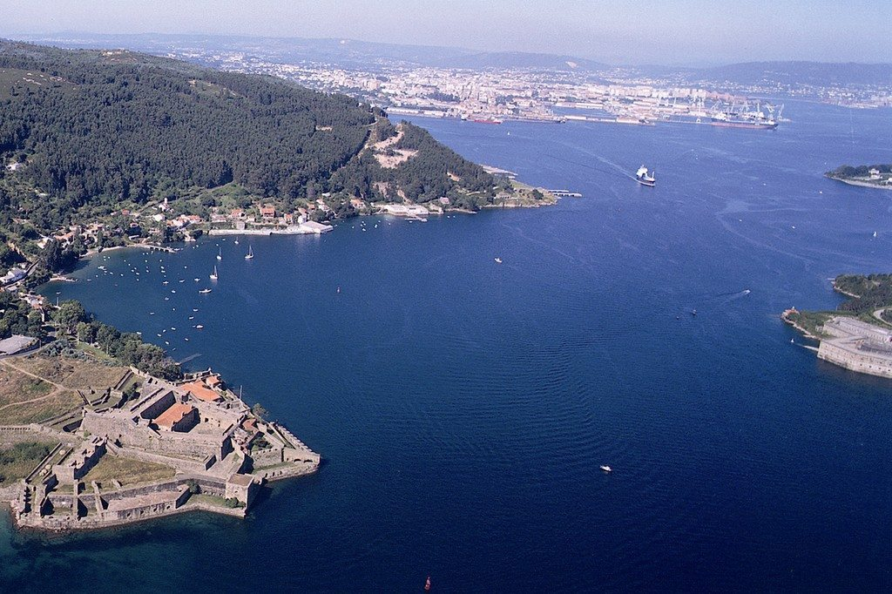
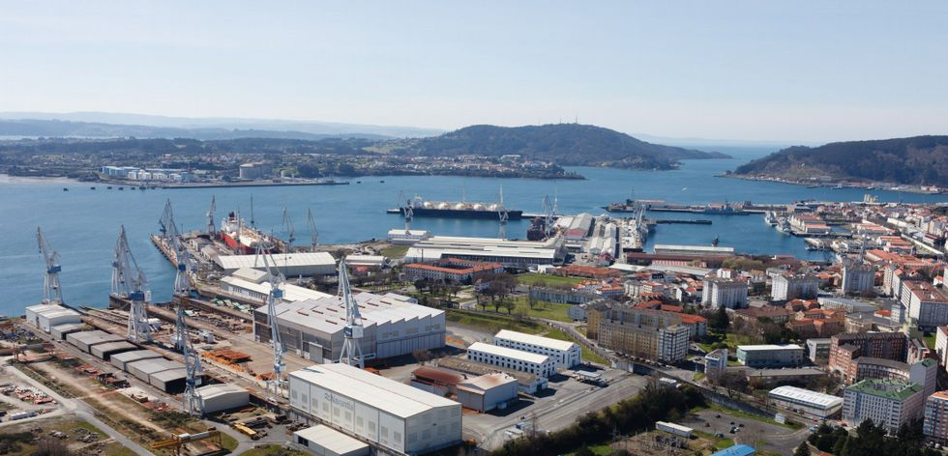

COMPANIES IN FERROLTERRA REGION
CIFP Ferrolterra → technical VET school placed in Ferrol, where it is also settled Navantia, that is one of the most important shipyards in Europe.
When our students finish their studies they usually get a job at Navantia or in an auxiliary company related to it.

Slide 17
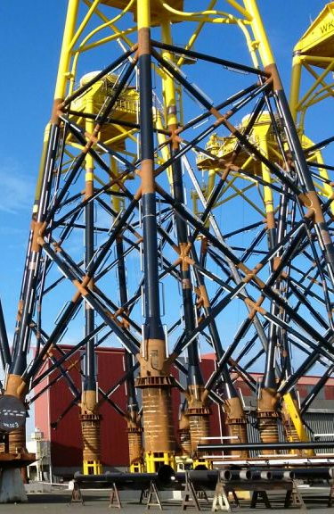
COMPANIES IN FERROLTERRA REGION
NAVANTIA https://www.navantia.es/interior.php?id_sec=2&id_pag=7
WINDAR https://windar-renovables.com/
GABADI http://gabadi.net/
EINSA http://www.einsa.es/
Metal Ferrol http://www.metalferrolsal.es/
INTAF http://www.intaf.com/
MEGASA www.megasa.com/
Grupo Caamaño http://www.grupocaamano.es/castellano/empresas_del_grupo/caamano_sistemas_metalicos.html
Cándido Hermida http://www.candidohermida.com/
GAMESA http://www.gamesacorp.com/es/
Talleres Mecánicos Galicia S. L http://www.tamega.es/

Slide 18
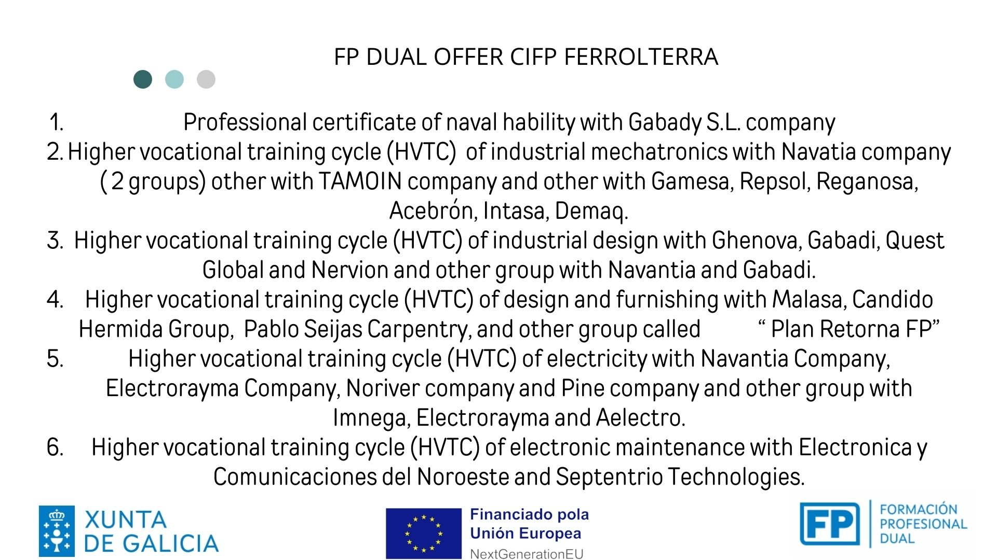
OFERTA DUAL CURSO 23/24

Slide 19
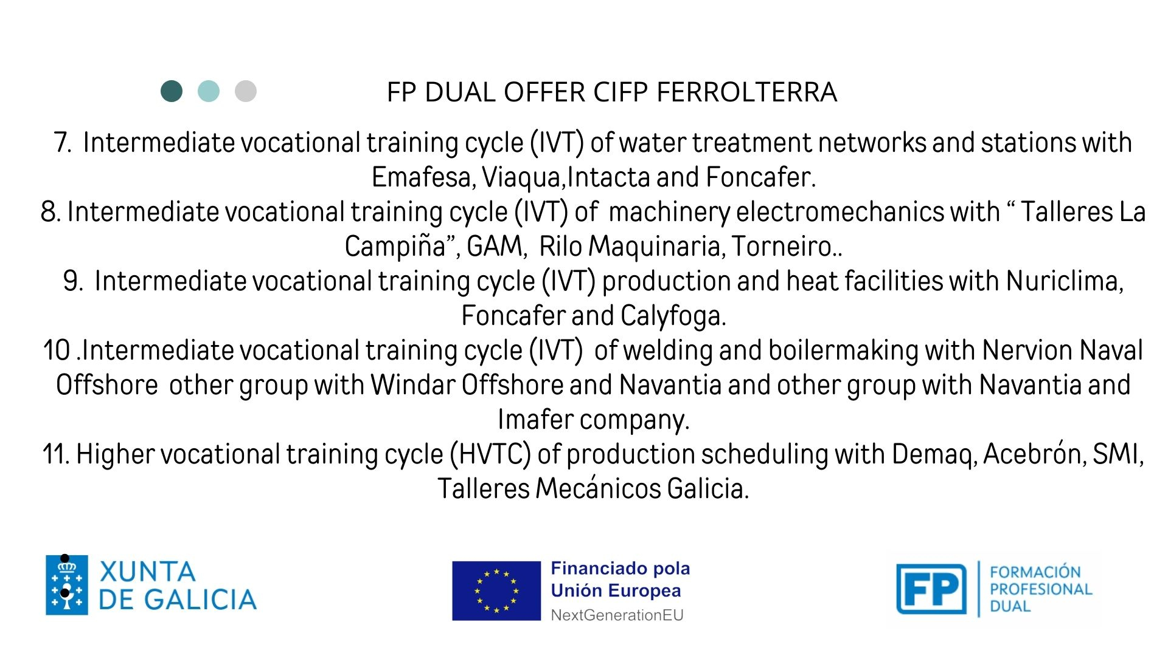
OFERTA DUAL CURSO 23/24

Slide 20

FUTURE STEPS
OUR MAIN INTEREST
Sending students for apprenticeship:
  On-the-job trainning period to complete their studies
  Practices as recent graduate
  Students have their own Erasmus Grants
  Insurance policy for accidents and a liability insurance policy by our government / school
  Sending teachers for jobshadowing
Establishing lasting relationships with schools all around Europe:
Common projects (innovation, teaching, staff/student mobilities…)
YOURS?

