Slide 1





CLIL in Primary

Slide 2


What’s does a
successful teacher do?
Seeks out a mentor & is reflective!
Enjoys their work & knows their subject well!
Sees the whole learner & adapts to their needs!
Is funny & positive!
Sets high expectations !
Has clear objectives & a sense of purpose!

Slide 3



What does a successful teacher do?
What do you think?
What the research says …
Collaborates with colleagues
Creates community & a sense of belonging
Respects students
Is a skilled leader = shared decision making & teamwork
Is warm, accessible, enthusiastic & caring!
grows in their own knowledge & teaching

Slide 4

Four styles of Classroom management
Baumrind ‘71
Indulgent
High learner involvement but low teacher control
overly friendly
lots of free learner expression
Authoritarian
high level of teacher control
low learner involvement
strict rules & seating
direct instruction
lots of silence
Authoritative
High control & high involvement
firm but fair / consistent rules / understands challenges & needs / encourages autonomy
Permissive
Low teacher control
low learner involvement
low preparation & interest
Which are you?

Slide 5

The Young learner is…
A little person
different
ready to learn
capable
energetic
fun
interested
& so much more!
engaged
powerless

Slide 6

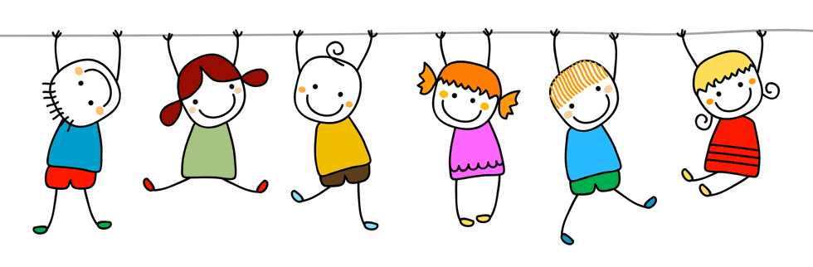
The YL teacher…
Plans &
Considers
Routines
Pace
Variety
Setting high expectations
What do our learners need to feel safe, secure & ready to learn?
Are we giving our learners enough chance to grow & develop…?
How much can our learners do & how do we best keep them engaged, challenged & learning.

Slide 7

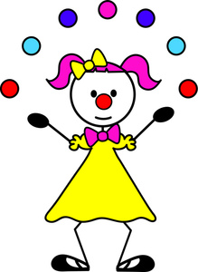
and we should try to …
oh & have fun!
meet everyone’s expectations – parents, school, government…
manage the space
encourage – attempts & development
think about behaviour (yours & theirs)
think about the whole child
be flexible – processes & outcomes
be authentic

Slide 8


Let’s think & reflect
Empiricist
Nativist
A child is an empty vessel to be filled, a lump of clay to be moulded by adults.
A child is biologically pre-programmed to develop & unfold in certain directions.

Slide 9



How about …
Interactionist
A child is partly an empty vessel & partly pre-programmed, with an interaction within & between the two.

Slide 10


Vygotsky
&
Z.P.D
present level
Children’s cognitive development
extend learning & understanding with the right intervention at the right time
potential level

Slide 11


Thoughts & Reflections on …
Brunner Scaffolding
suggest alternatives
Adult-supported
child-centredness
keep on task / track
Offer experiences, opportunities & interactions that match & then challenge the level of competence & maturity of a child.
simplifying
manageable steps

Slide 12

Practically,
what can we do?
Simplifying
Suggest alternatives
Instructions
Our input / language
KISS =
Keep it short & simple
What about doing / trying …
Have you tried / thought about…
What are the others doing?
How have you done this before?
Manageable steps
Keep on task / track
Staged input
Activity management –
time reminders / monitor & praise

Slide 13

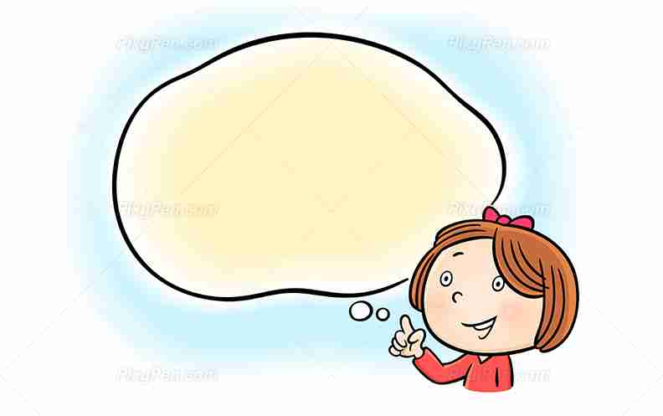
Let’s look at
L1 acquisition

Slide 14




What we know
Silent time
Positive reinforcement
Extend
Repetition
Context
rhythms, rhymes & songs
Imitation

Slide 15

What we do, say & feel (sometimes)
“Imagine you’re in a shop…”
“We’ve done that!!”
insist on full sentences
“In English, please”
Start & end the class differently every time
“Ok, fine”
Insist / force instant production
“Shhhhhh”

Slide 16
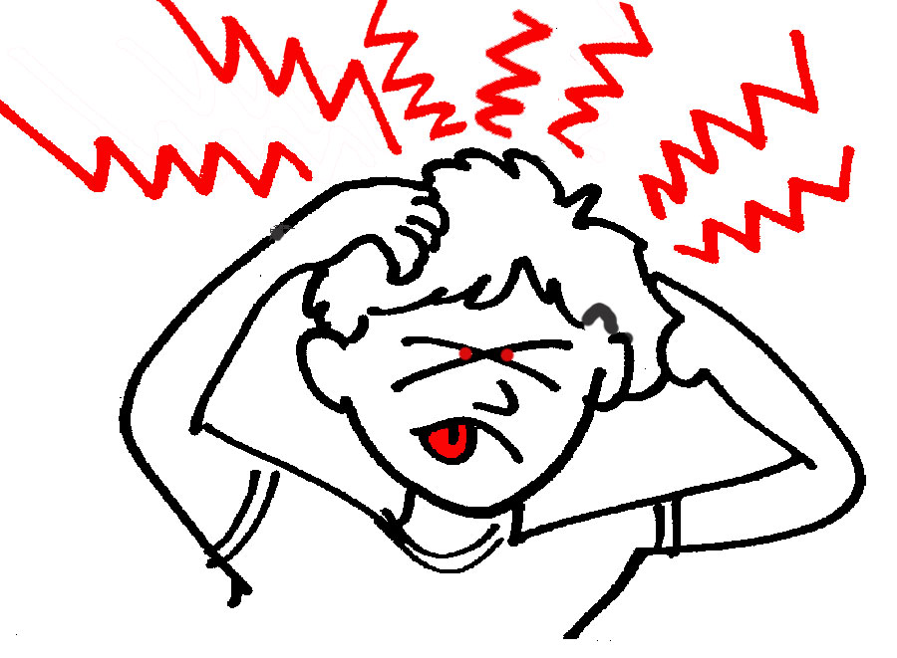

And…
bidding for attention
Transitions in a day / week – what do you know about them?
waiting to speak / be heard
going to the bathroom
waiting in line
waiting to eat / drink

Slide 17


Start point = what children can do & what they can nearly do
Should we make children ready for schools or should schools be made ready for children?
Learning = holistic & interconnected
Childhood is more than a preparation for the future.

Slide 18



Language teachers
in a CLIL setting
What’s it like for them (you)?
Topic knowledge / confidence
-specialised vocabulary & expressions
Fixed concepts of ‘level’ appropriacy
Assessment / evaluation beyond linguistic competency
Focus on accuracy
What do they (you) normally do?

Slide 19

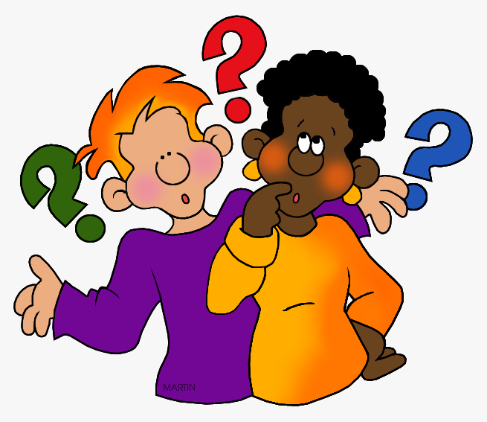
Language teachers
in a CLIL setting
Start from the topic
What specialised vocabulary / expressions do my learners need?
What language do they already know & can be recycled?
How can I stimulate cognitive skills?
What are the cultural aspects?
Questions to ask yourself

Slide 20
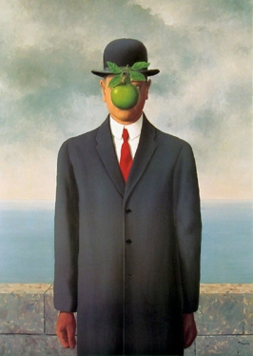
Language teachers in a CLIL setting
Let’s try it out!
1. Describe and Draw
The main objective of this activity is to spark active listening in the target language. You’ll be giving your students direct instructions that they’ll use to create a piece of artwork, though they don’t know what the final image is supposed to look like until the end. This activity is easily adaptable to classes of any proficiency level.
You’ll need:
Paper, colored pencils and erasers for every student.
An image of a work of art that’s big enough to display in the front of your class.
A list of instructions for how to recreate this image, which you’ll read one-by-one.
Work together & try to answer the Qs
Notes:
Handout 3

Slide 21

Language teachers in a CLIL setting
Remember – the instructions can help to identify the language needed.
Follow-up tasks / activities?
1. Draw the outline of a man from his knees up, putting his shoulders at the canvas’ vertical and horizontal center.
2. Put a beige brick wall behind him, up to just above his wrists.
3. Color the rest of the background blue for the sea up to his elbow, and gray with clouds for the sky above that.
4. Put him in a buttoned black jacket over a white shirt with red tie and a hat.
5. Draw a green apple floating in front of his face.

Slide 22


Language teachers in a CLIL setting
Avoid explicit form focused teaching
& try to facilitate meaning-focused learning
(de Graaff et all 2007)
use examples & confirmation checks
use authentic & relevant productions tasks
create real / authentic need for new language

Slide 23


Subject teachers
in a CLIL setting
What’s it like for them (you)?
maintaining engagement / interest
avoiding communication breakdown
identifying key language needed
when / how to support language use
meeting curriculum needs
What do they (you) normally do?

Slide 24

Subject teachers in a CLIL setting
Questions to ask yourself
How do you “normally”…
present ideas
encourages learners to collaborate / write / talk
give examples & explanations
encourage reactions & full participation

Slide 25

Subject teachers in a CLIL setting
Think about the type of questions you usually use …
Discuss & match
Procedural questions
Display questions
Referential questions
check understanding & knowledge
aim = authentic response to genuine questions
support classroom management & routines
aim = authentic responses to genuine questions
support classroom management & routines
check understanding & knowledge
Notes:
handout 4 – b)

Slide 26


Subject teachers
in a CLIL setting
English for classroom management & non-lesson interaction
Starting class | Who’s absent? / How are you feeling today? / Have you had a good start to the day? (Choose your greeting!)
During class | Let’s say it together / Can you say it with me? / One more time? / Let’s try & use our quiet voices. / Who wants to try? / Hang on a minute / Your turn / This row / group / pair…/ Look at..
Praise & encouragement | That’s really good / Well done / Let’s try again / You can do it / Nearly …/ Great effort – thank you / Thank you for trying.
During P & R tasks | Who wants to say it / answer? / Can you write / spell it for us?
During games | Let’s swap around / Whose turn is it? / Ready? – go! / Wait your turn, please / Take it in turns / One at a time / No cheating
Transitions & attention | Let’s get back to our tables 1, 2, 3! / Zip-it, lock it put it in your pocket / Story circle –song
Ending class | Great job today! / Thank you / See you tomorrow
Notes:
handout 4 – C

Slide 27


Let’s try to…
use lots of repetition
use physical congruence
embrace translanguaging / code-switching
reformulate
(rather than over correction)
include lots of reflection & evaluation

Slide 28

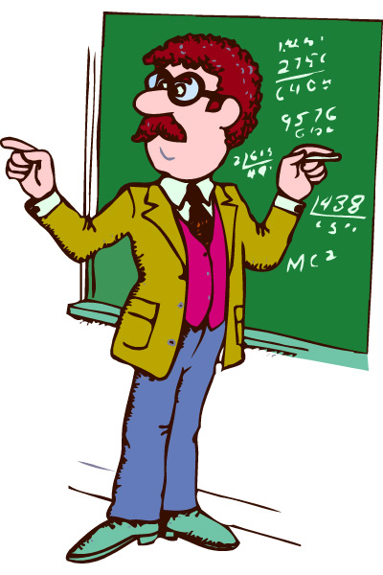

Some generalisations
an English lesson
a school subject lesson
Subject driven
Varied skills focus
Set-time
Definite conclusion
Language input driven
Four Skills
Short or long term
Non definite conclusion

Slide 29


“CLIL models are by no means uniform. They are elaborated at a local level to respond to local conditions &desires”
(Conan 2003)
There are
pedagogical principles underlying CLIL
tools to help implement principles
Is this your experience? Let’s share

Slide 30


The 4 C’s
Content
Content | Communication
Cognition | Culture
Communication
Cognition
Read, complete & share
Culture
Notes:
Friday Handout 2 & 3 = table & text

Slide 31


Content = subject/theme
Could be cross-curricular or integrated studies Knowledge, skills and understanding
Not simply knowledge acquisition
Learning to use language and using language to learn
Beyond the grammar system (but does not reject it)
Using language differently to traditional language lessons Language learning (grammatical progression) v language using (communication and learning demands of the moment)

Slide 32
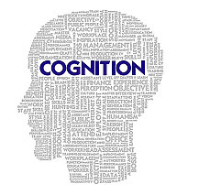

Tolerance & understanding: fostering international understanding
Promote understanding of the concept of‘ otherness’, lead to a deeper understanding of ‘self’
Difference & similarities between cultures
Pluricultural citizenship & global understanding
Create new knowledge & develop new skills
Reflection-Higher-order as well as lower-order thinking
Construct own understandings and be challenged
Relationship between cognitive processing and knowledge acquisition
Plan, discuss, evaluate & practice

Slide 33




The 5th C
Competences
Build reflection habits – content, skill & language
“Can do” statements
journals
feelings chart

Slide 34


A few summary points
Reading = essential skill
Acquisition not enforced learning
Errors = natural part of learning
Long term learning
Language integrated in context
Language = real world situations
Fluency not accuracy
L2 motivation through subject interest
Natural language development – building on other forms of learning
Language knowledge = content knowledge
Is this your experience?
What are your thoughts?

Slide 35



“It is often hard to distinguish CLIL from standard forms of good practice in early language learning”.
Coyle, Hood, Marsh 2010
doing
playing
drawing
trying out
singing
making
exploring

