Slide 1
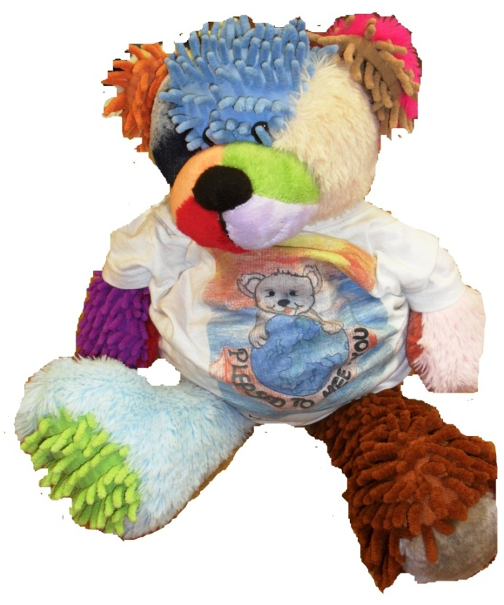
THE TOURING TEDDY
Growing story: 1st, 2nd and 3rd Levels

Slide 2
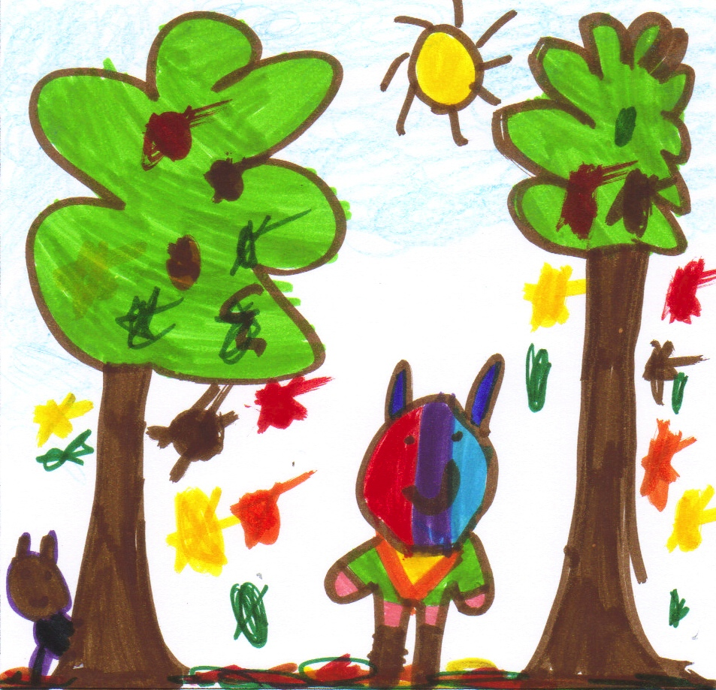

It’s a windy autumn day.
Jan, the touring teddy, decides to go for a walk.
He walks through a magnificent forest with beautiful autumn colors.
In the distance he sees a wild boar.

Slide 3
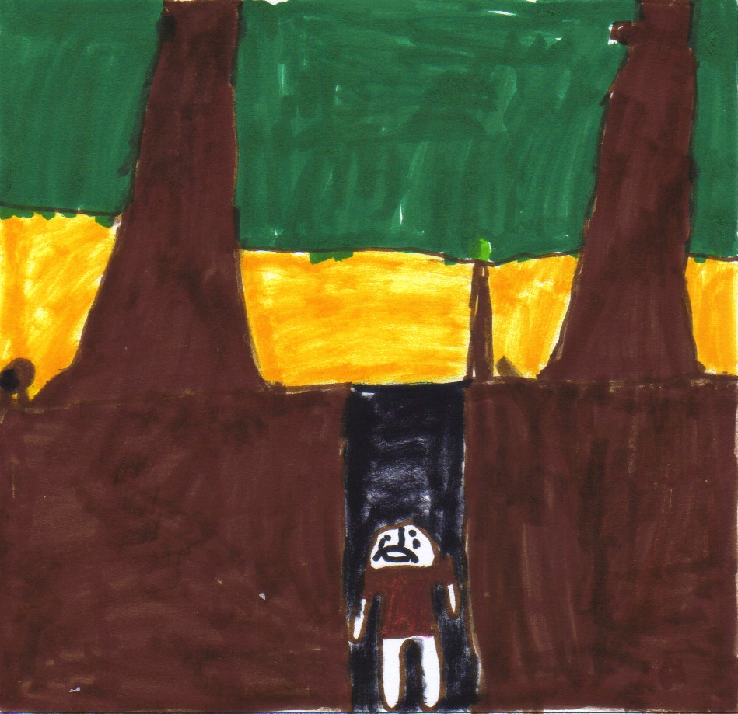
Jan is curious and sneaks a little bit close by.
But the wild boar is afraid and runs away.
Jan resolves to follow the animal.
Suddenly Jan is tripped up by a stone and he falls into a deep hole.

Slide 4
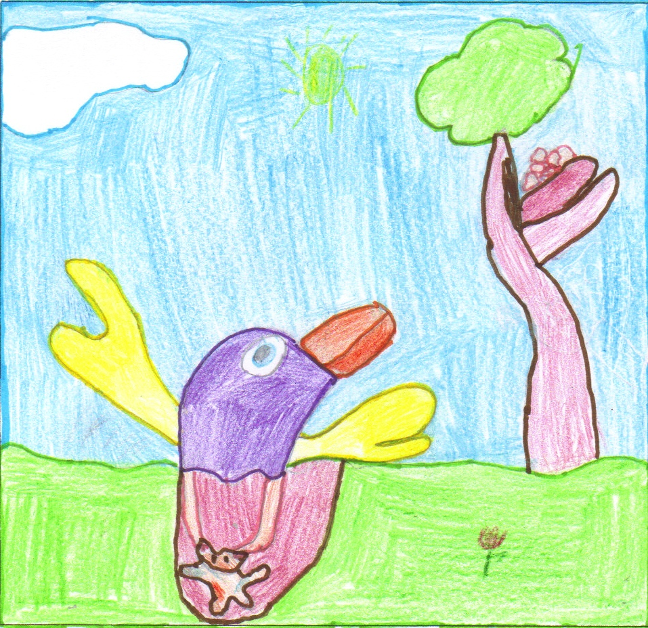
Then a huge bird flies by.
With his claws, he grabs Jan out of the hole.
The bird flies to his nest together with Jan.
The little birds like Jan and think he’s really sweet.
He becomes their cuddly toy.

Slide 5
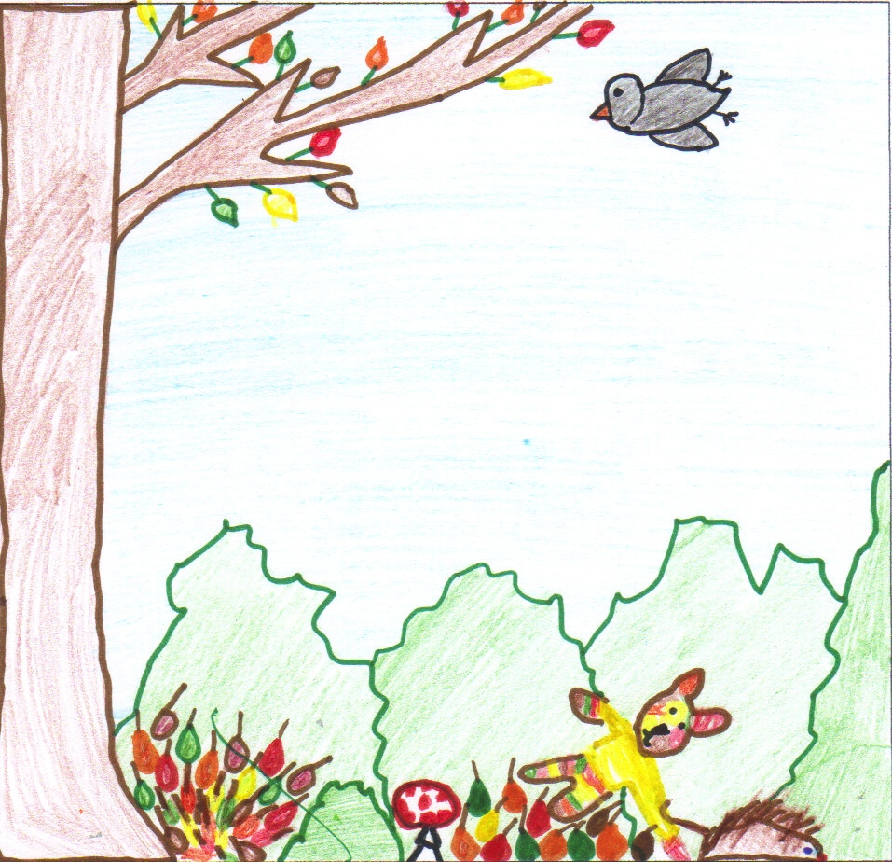
All the birds want to be Jan’s best friend.
They are quarrelling and don’t notice that Jan falls out of the nest.
He lands on a lot of leaves under which a hedgehog is sleeping.
Oh! Jan sticks on his spikes …
The hedgehog drags Jan …

Slide 6
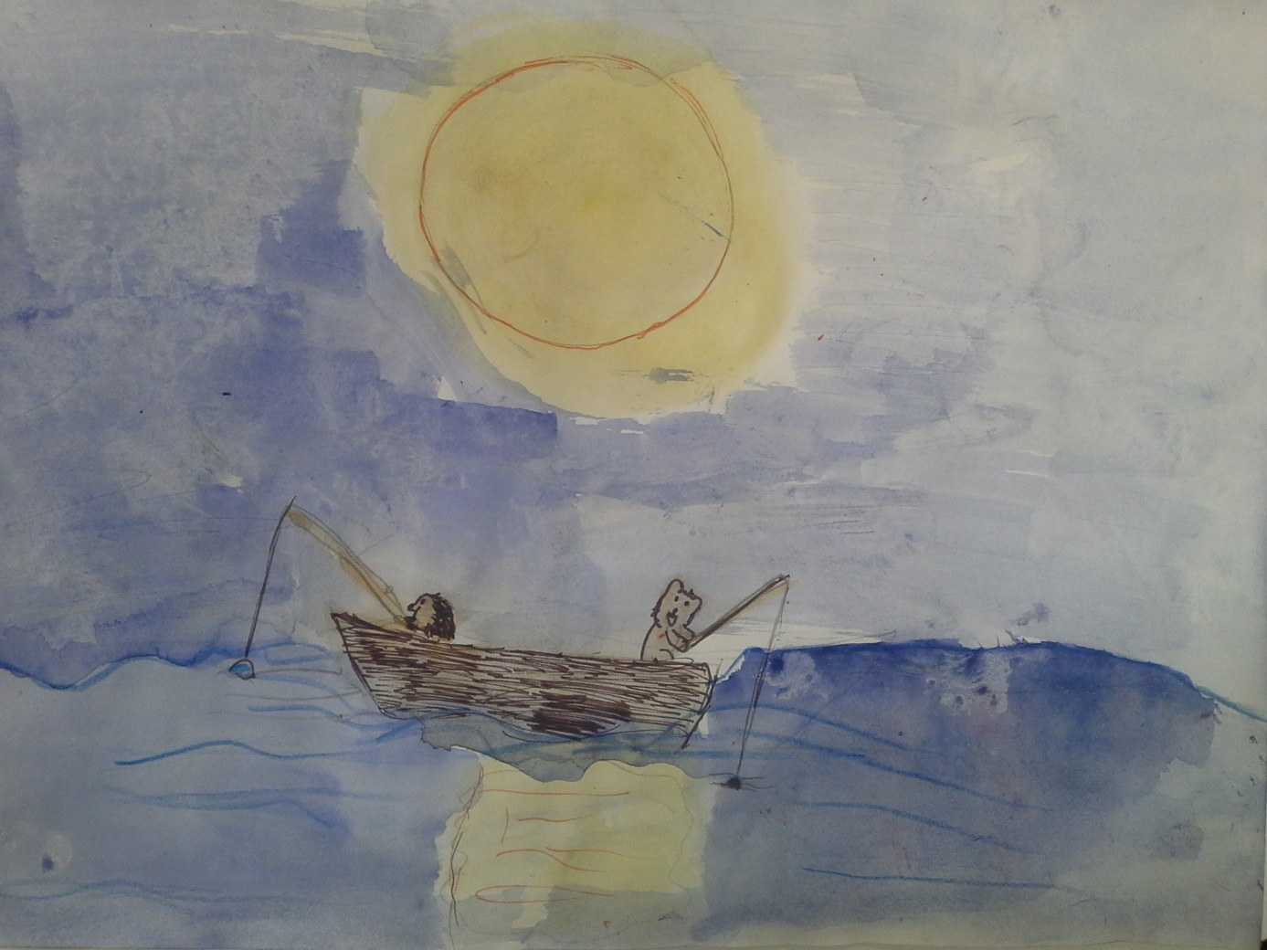

The hedgehog drags Jan to the shore. They build a boat together and go fishing. They catch a fish and then row back to the shore. Jan lights the fire and they fry the fish for lunch

Slide 7
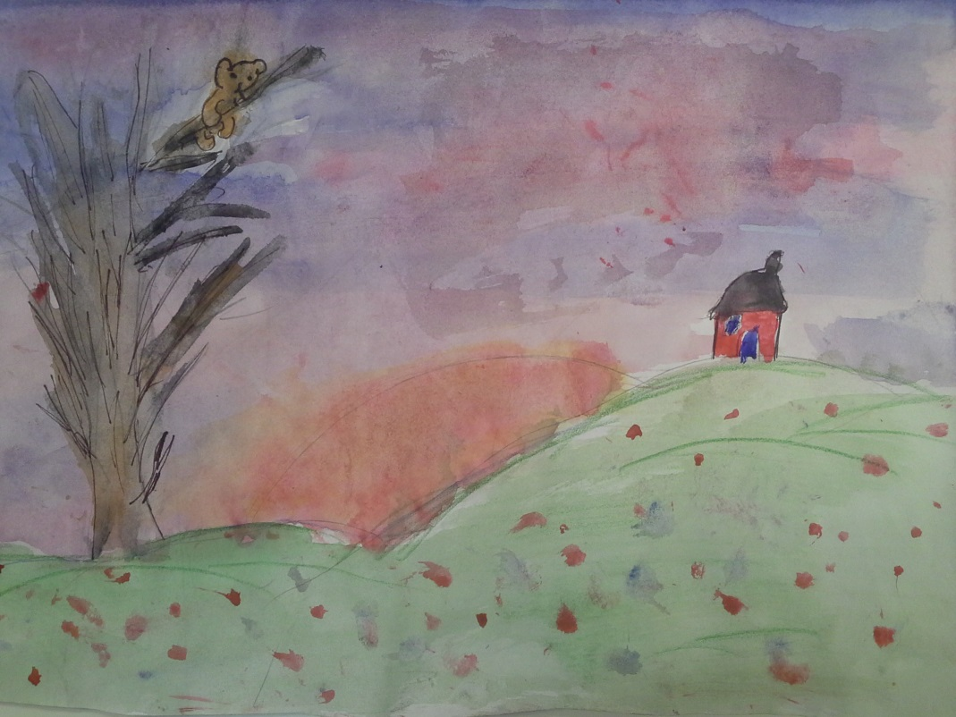
After lunch the hedgehog goes back to his nest to sleep. Jan climbs up a big tree. High up the tree he sees a cabin nearby. He decides to rest the next night in the cabin.

Slide 8
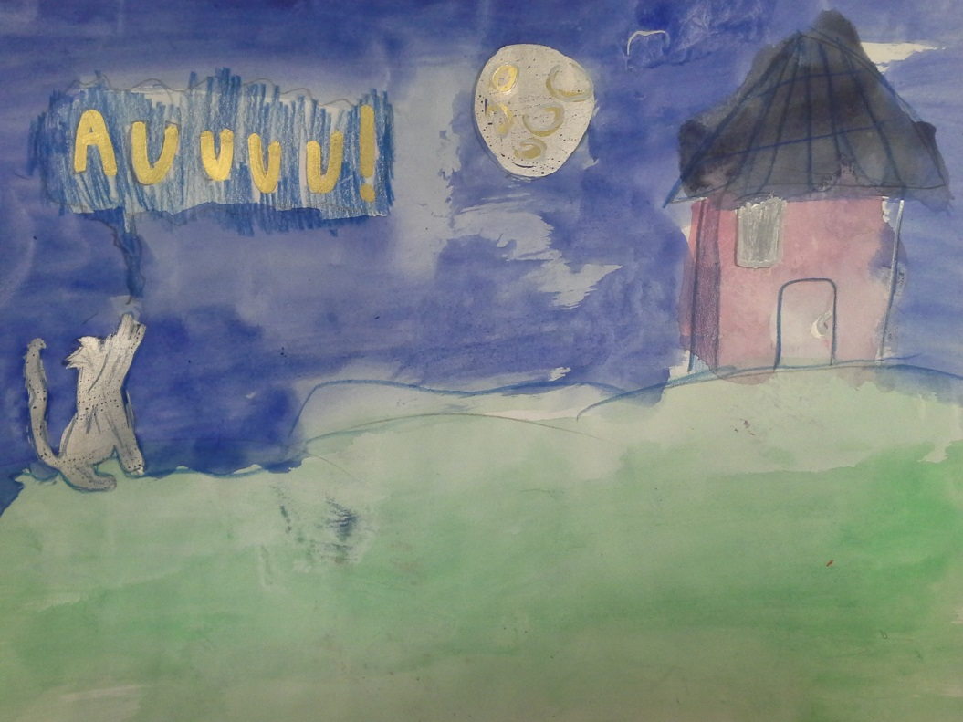
At night Jan hears scary and strange sounds. A wolf howls and a thunder rolls.

Slide 9
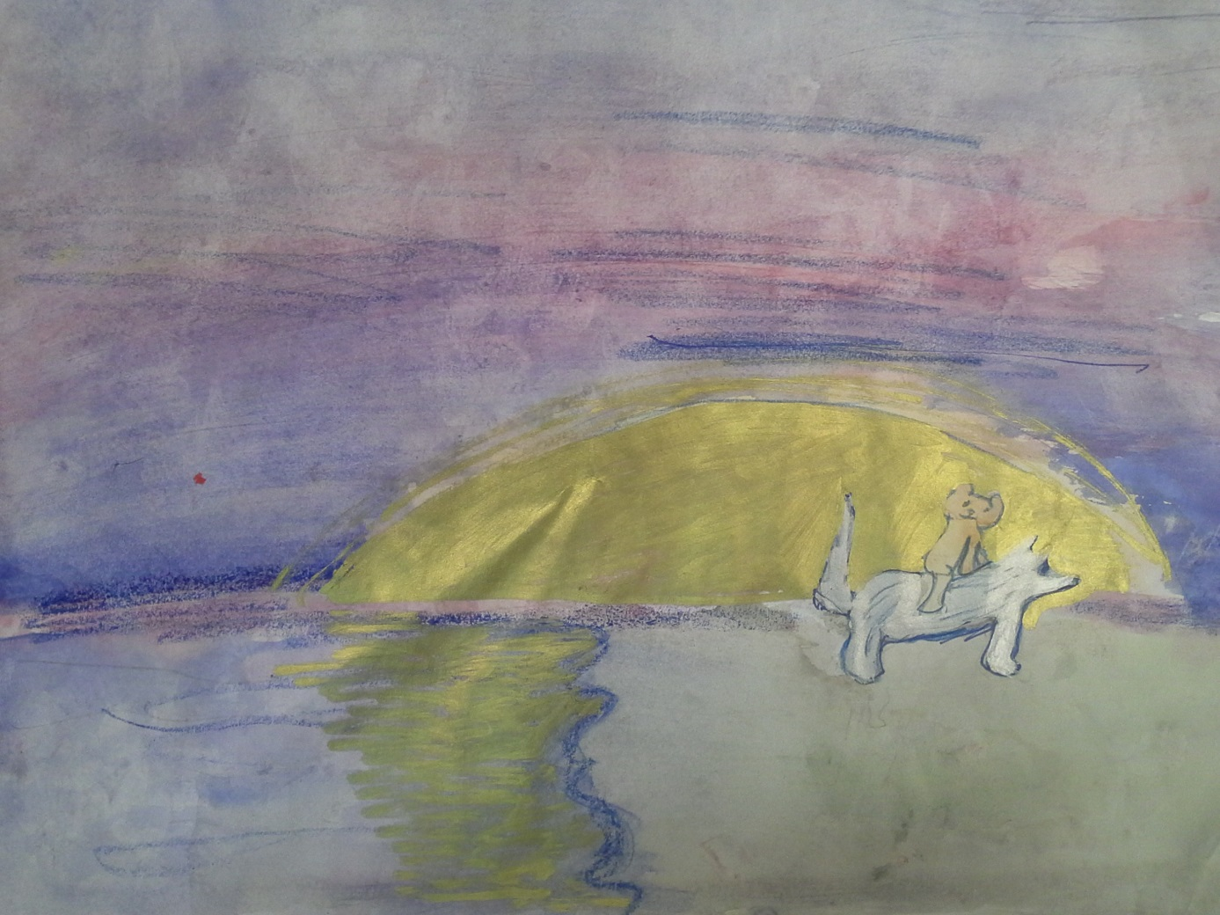
In the morning Jan wakes up and opens the door. There is a wolf at the door but he isn’t scary at all. They become good friends and Jan continues the journey riding the wolf...

Slide 10
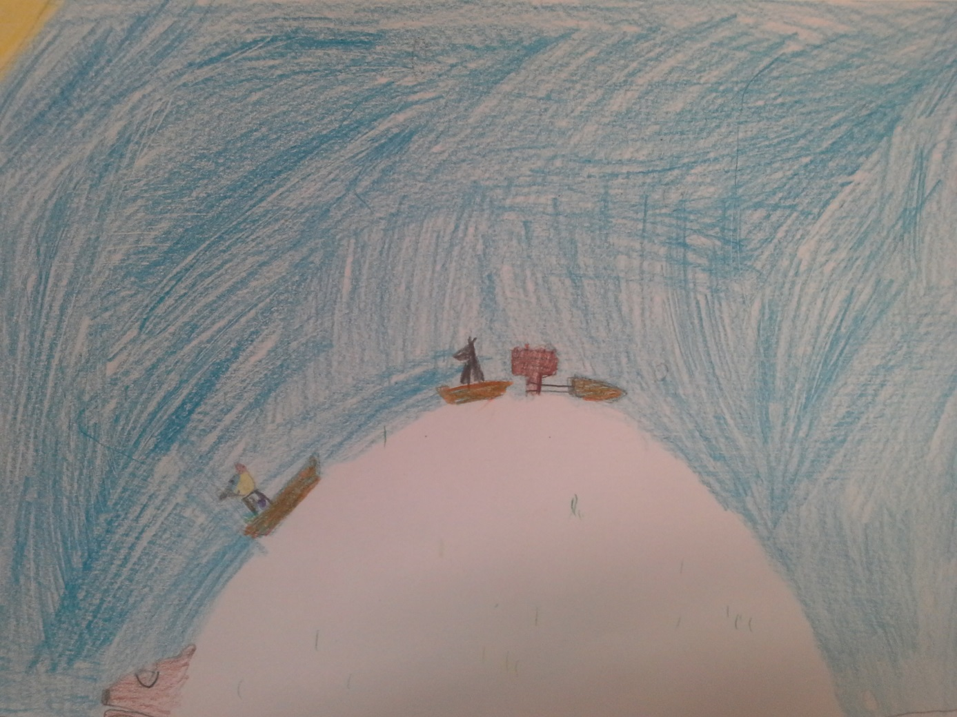
They travel far away to the north. Finally Jan and the wolf come to a big hill. They decide to start sliding the hill. Suddenly the hill starts to move.

Slide 11
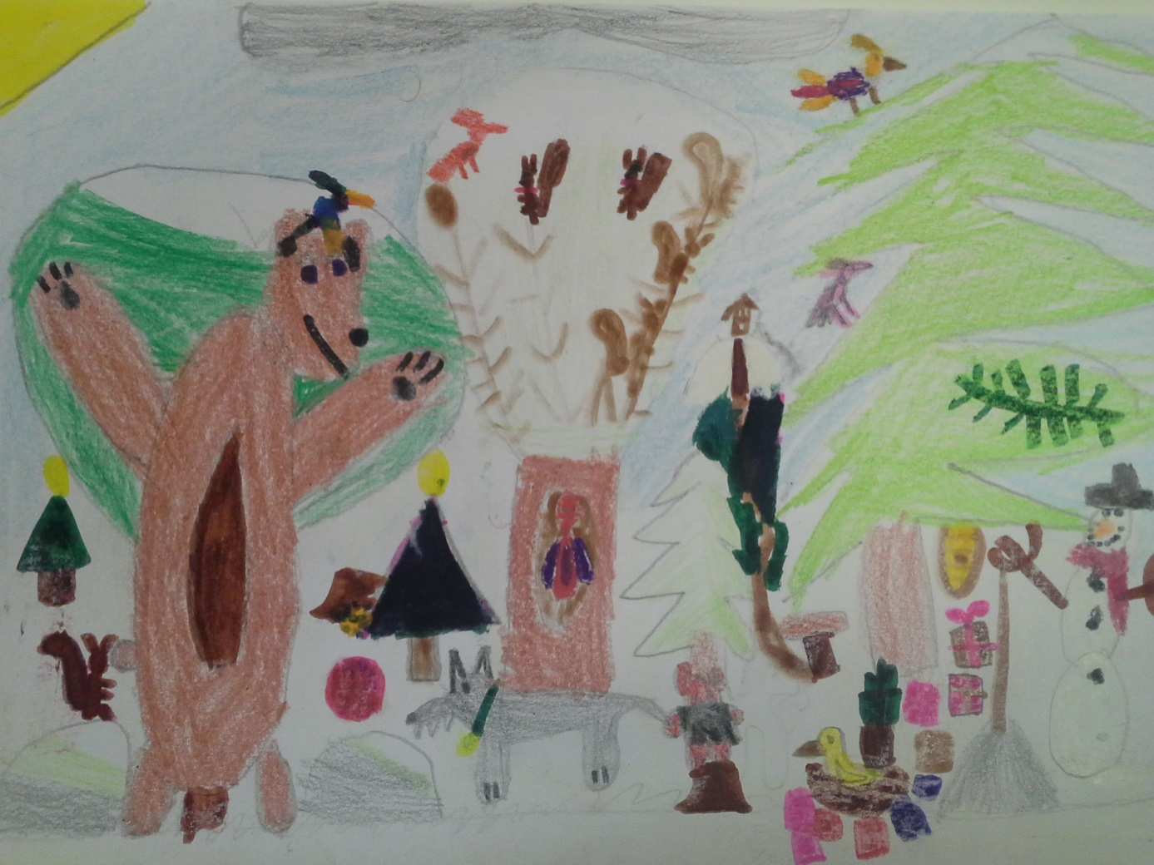
The hill happens to be a bear that has already gone into hibernation. The sleepy bear tells the friends to go and see the elf’s cabin. The elf must be awake. So Jan and the wolf decide to go there.

Slide 12
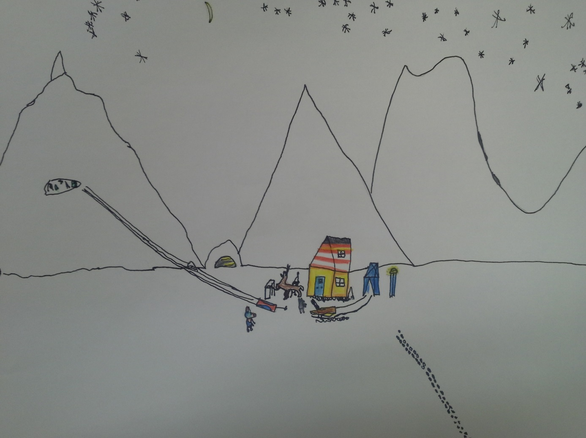
The elf is just making his reindeer ready for leaving to Korvatunturi where Santa Claus lives. Jan jumps into the sledge. The elf and Jan ride through the snow and the wolf runs beside them...

Slide 13
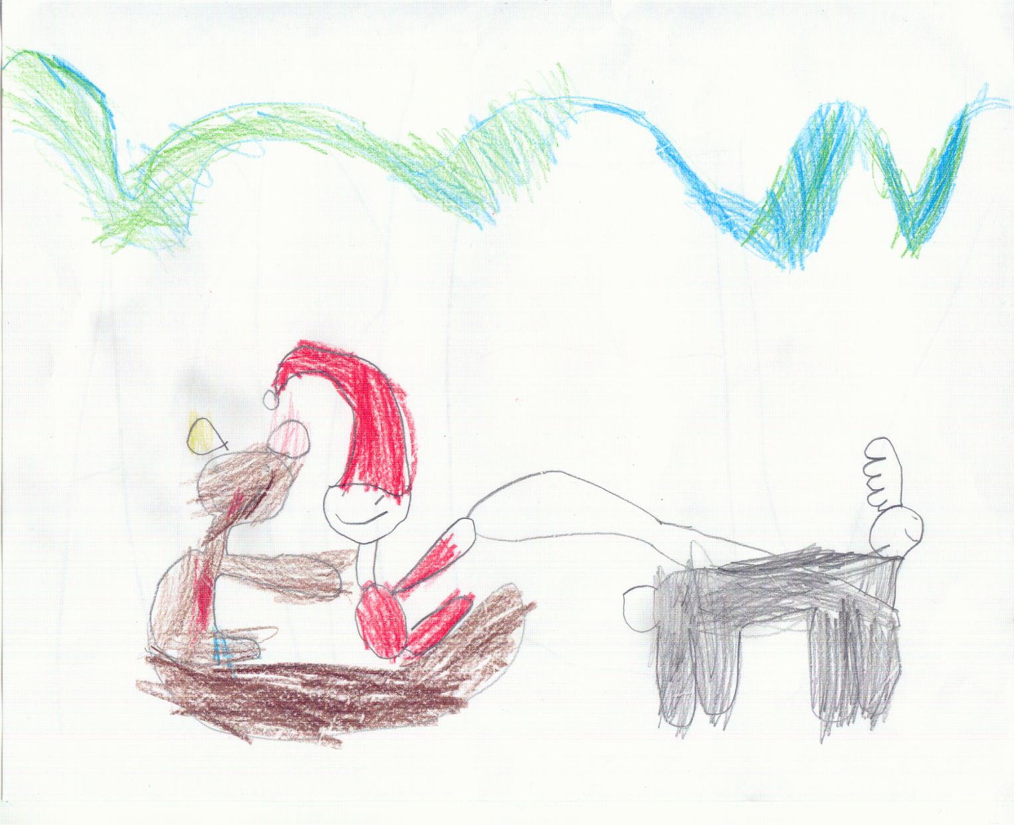
On the way to Korvatunturi they see beautiful northern lights in the sky.

Slide 14
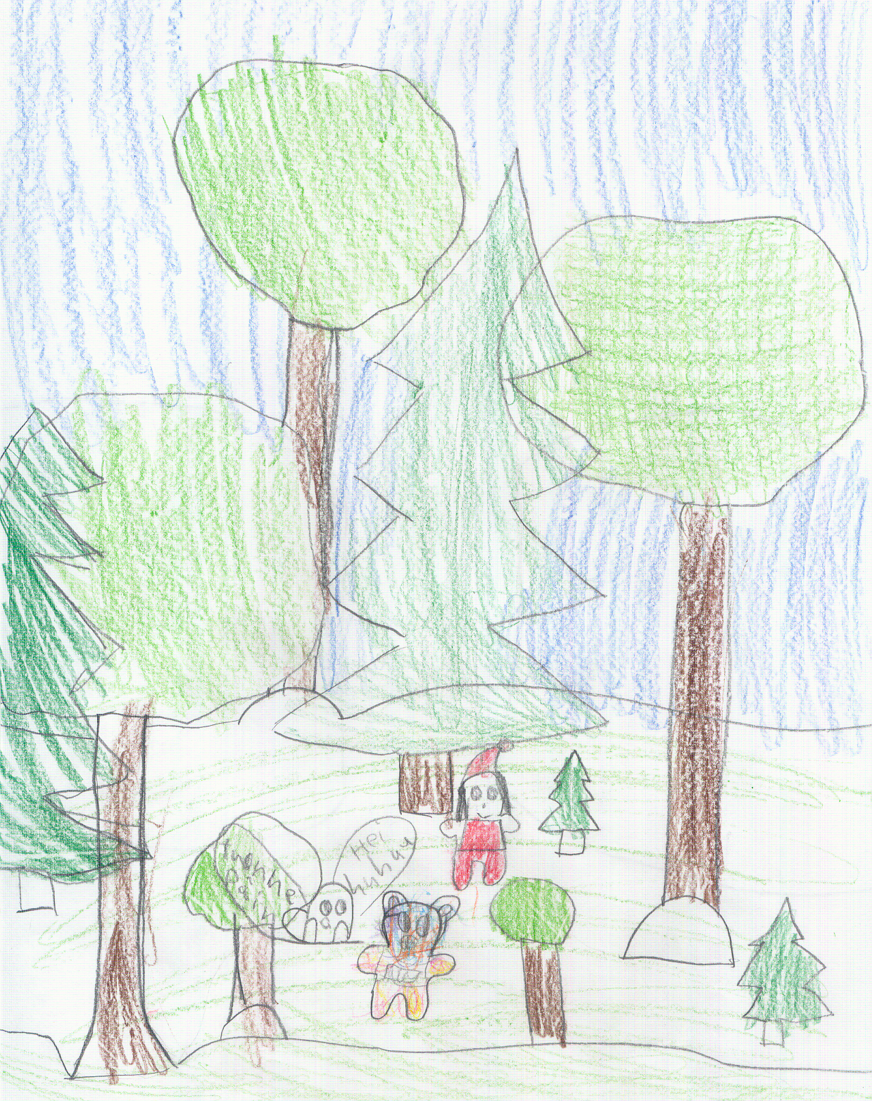
The ride goes on, through a big dark forest. They get lost, but luckily they meet a wise owl who tells them the way to Korvatunturi .

Slide 15
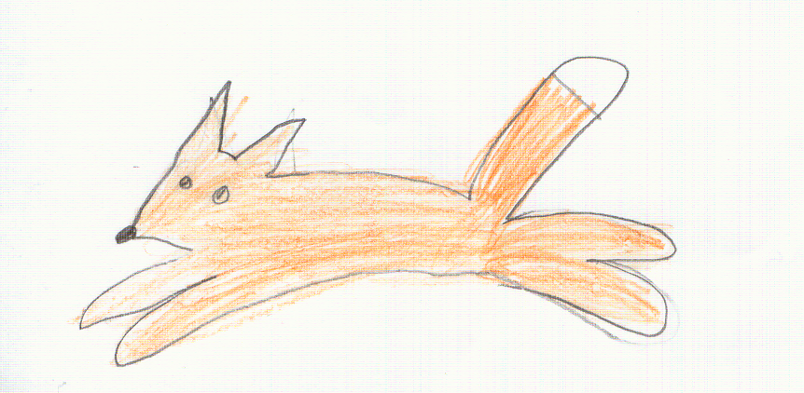
They thank the owl for the advice and go on. Suddenly a fox jumps in front of the reindeer. He tells Jan and the elf that Santa Claus has got ill, because his dear Rudolph the Rednosed Reindeer has disappeared.
Jan and the elf tell the fox the good news. Their sledge is drawn by Rudolph the Red nosed Reindeer. They promise to take him soon to Korvatunturi. That’s where they are going anyway, because Santa Claus needs a lot of helpers at the time just before Christmas.

Slide 16
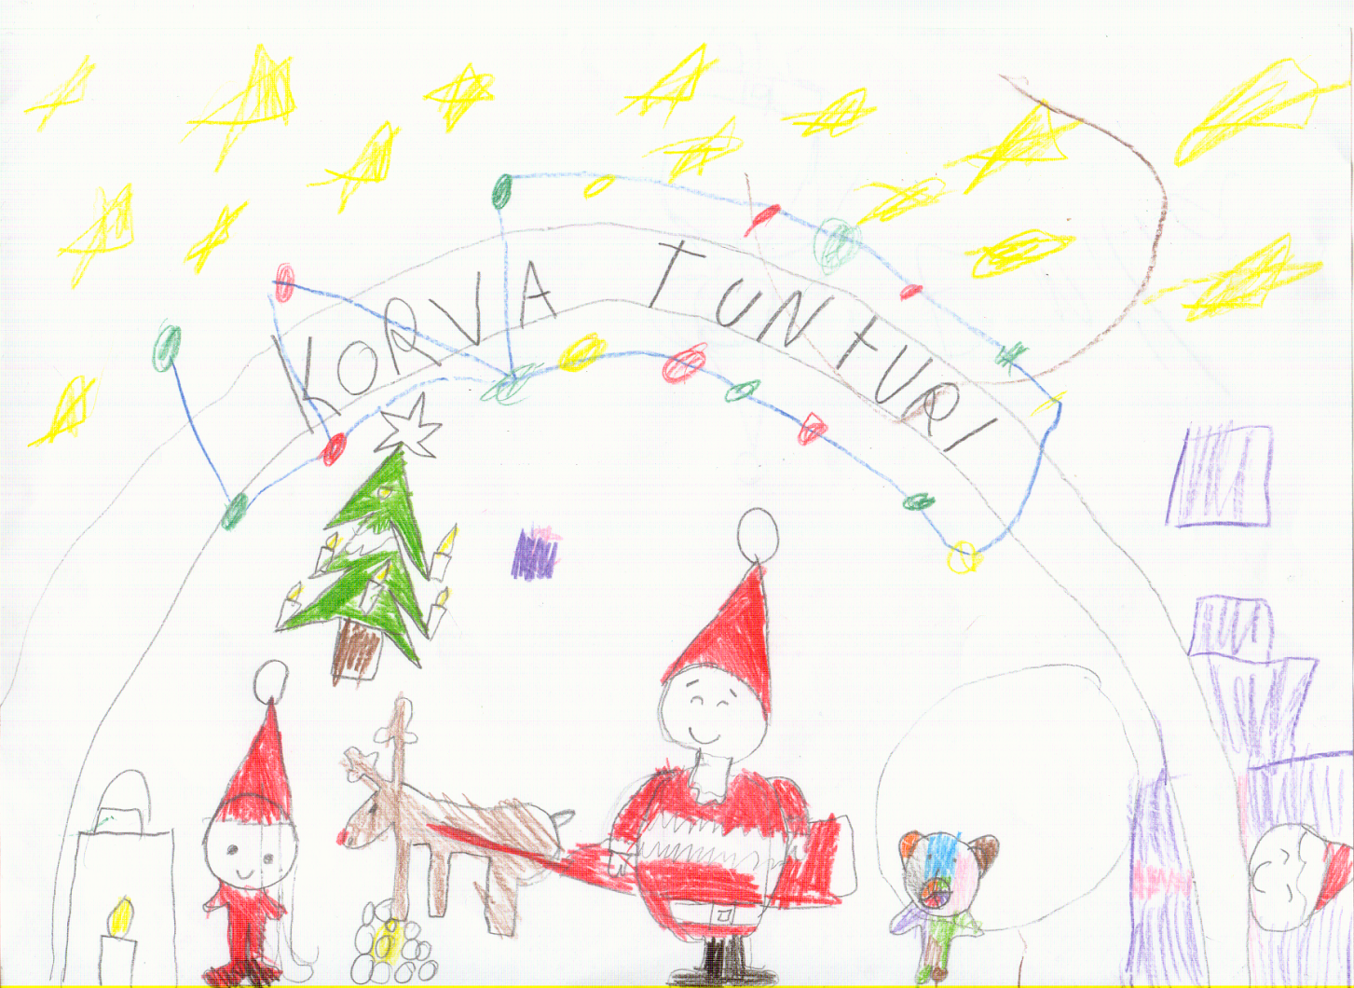
Soon they are at Korvatunturi. Santa Claus is happy, because Rudolph the Rednosed Reindeer – who was lost for so long time – is back home again. Everybody rejoice seeing each other again and the Christmas to come

Slide 17
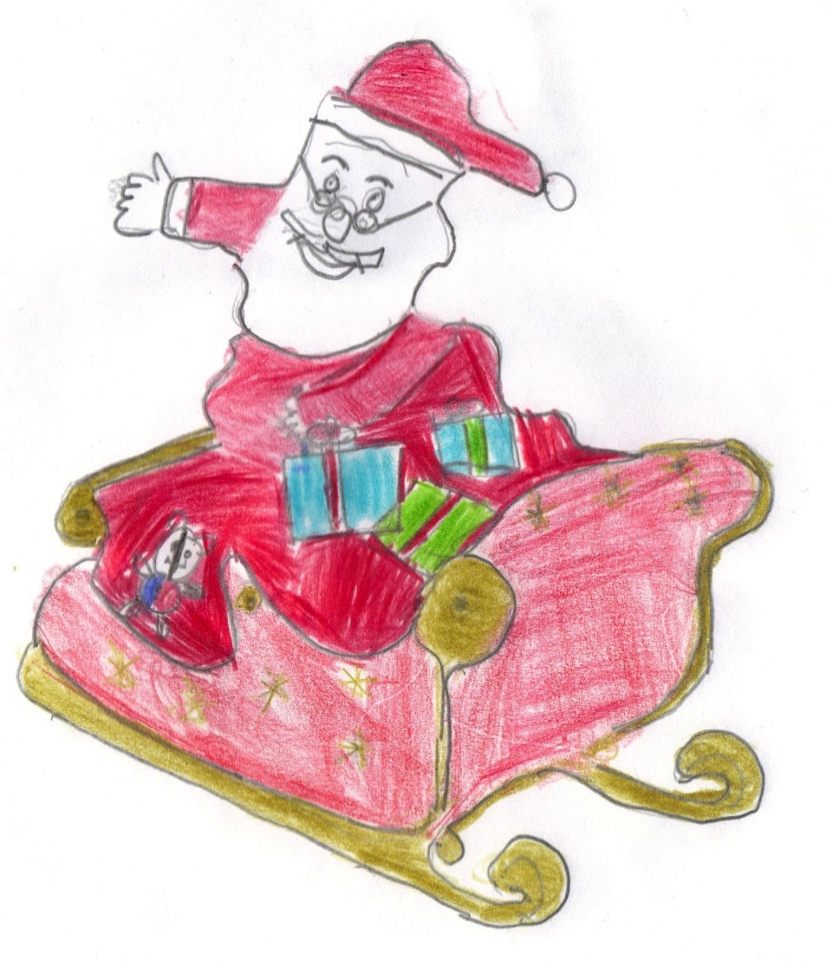

...Santa said to Jan, “If you help me deliver the presents, I can drop you off in Ireland.”
“Yes Santa, I’ll help you deliver the presents,” said Jan very happily.
So Jan and Santa boarded the sleigh and headed off to Ireland.

Slide 18
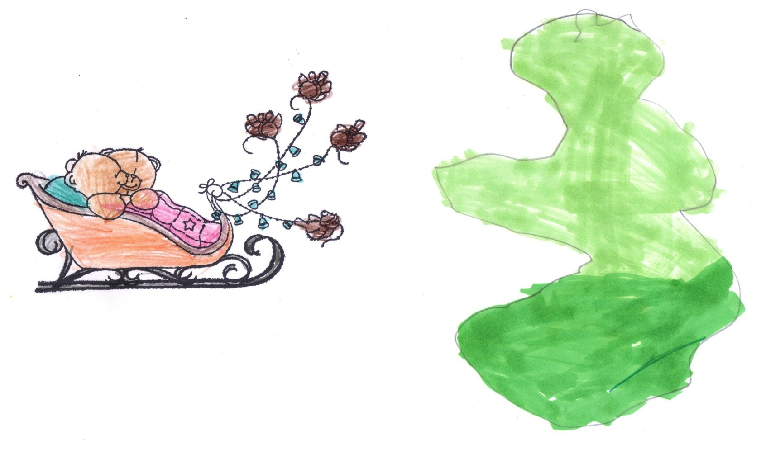
Santa and Jan dropped off lots of presents in other countries. Then they headed off to Ireland.
Jan thought Ireland looked like a teddy when they were up in the air.
They landed in a town called Dungarvan, Co. Waterford, beside the sea.

Slide 19
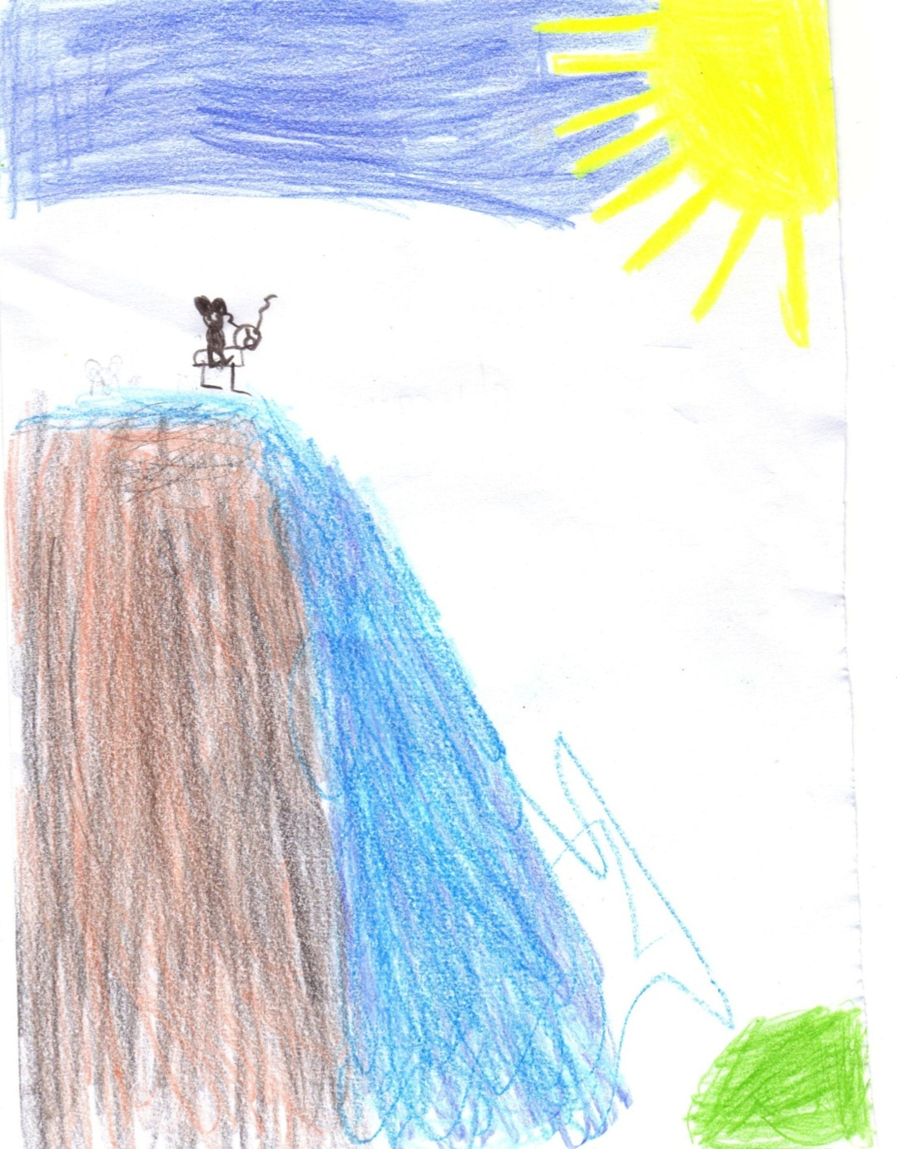
Jan met a deer and they became great friends. They travelled to Colligan woods. As they were crossing the bridge, it broke and they fell into the river.
The river took them to a waterfall. They fell down the waterfall at high speed. Jan jumped on the deer’s back and the deer swam to calmer water.

Slide 20
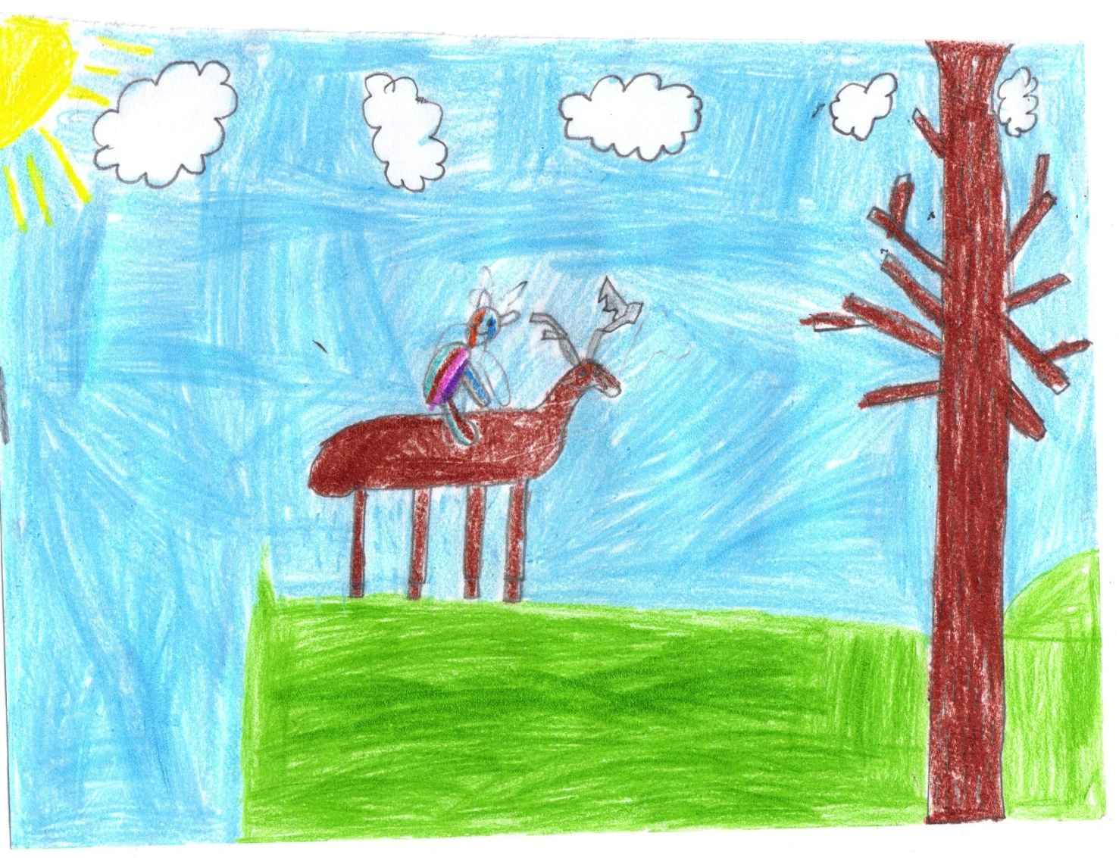
They swam to the shore in a wood. They walked through the woods.
Suddenly it got cold and started to snow. Jan and the deer met a rabbit and a squirrel. The deer said goodbye and Jan started to play with his new friends.

Slide 21
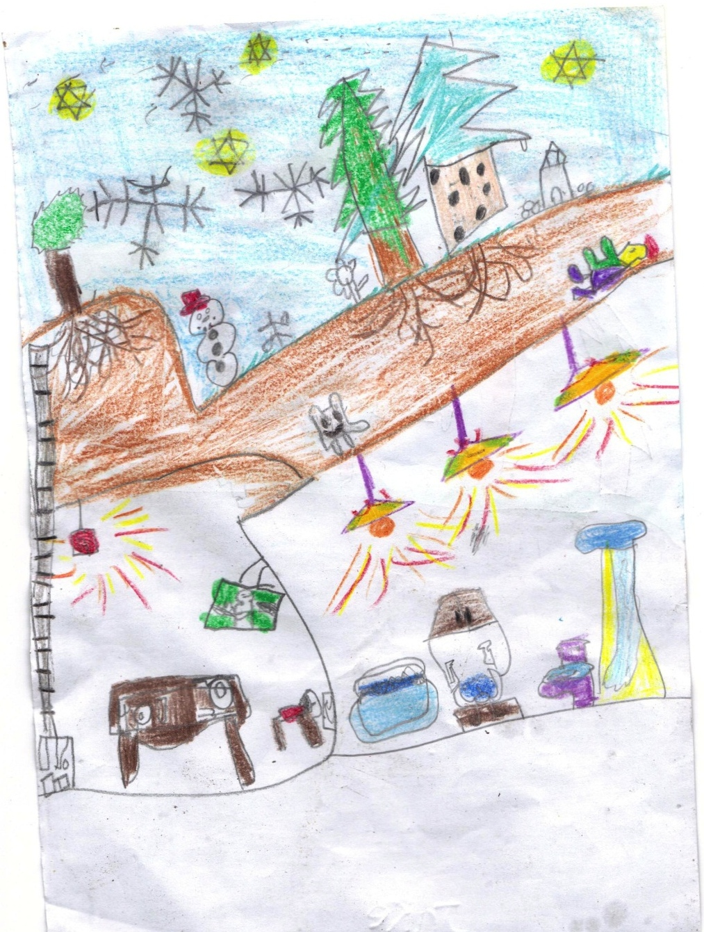
They built a house of snow and had a snowball fight. Then they built a snowman. Jan was feeling very cold. The rabbit said, “Come to my rabbit burrow and warm up.”
So Jan followed the rabbit and said goodbye to the squirrel. Then he slid down the rabbit’s tunnel....

Slide 22
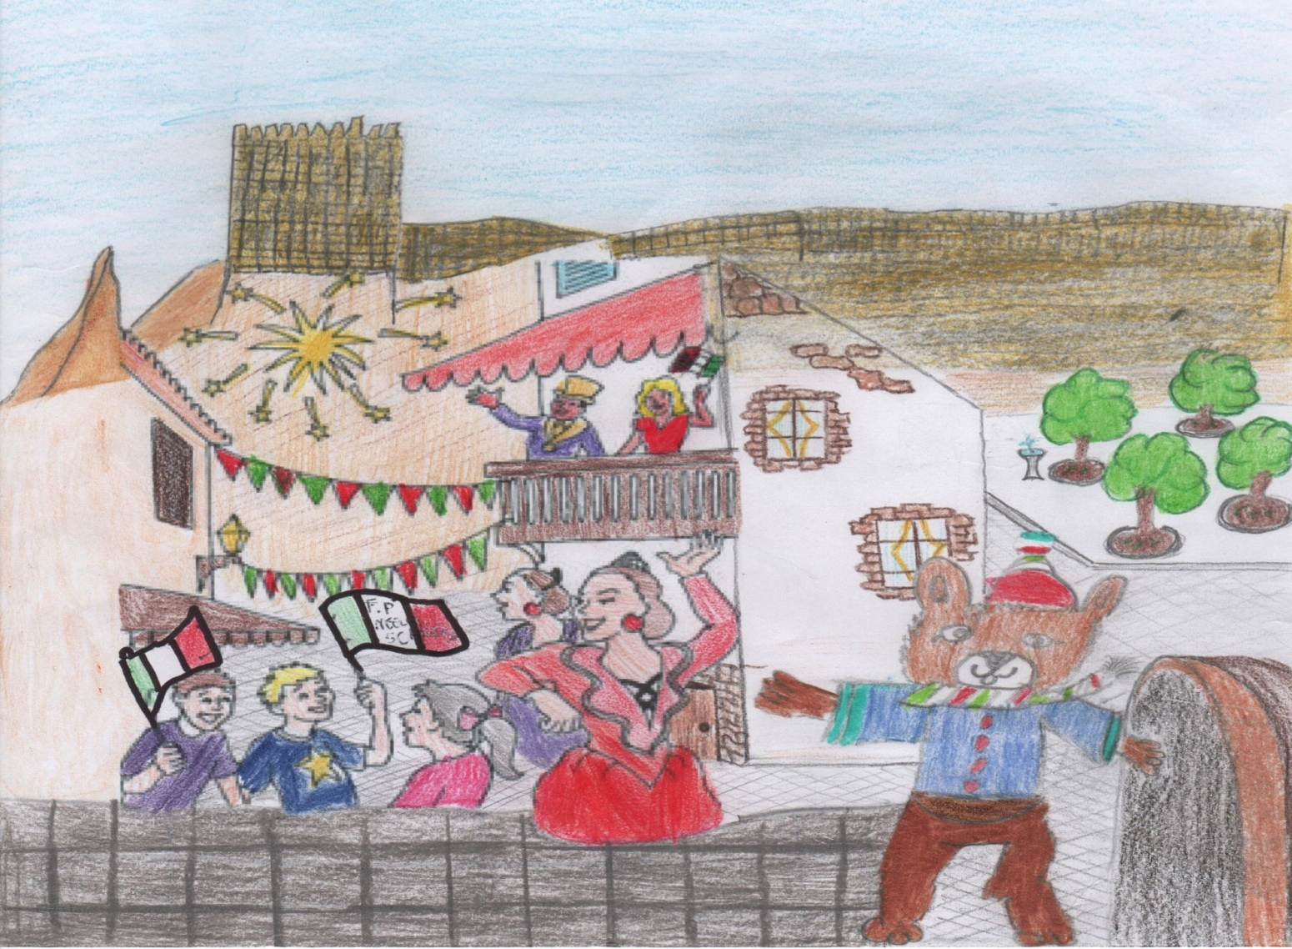

And he arrived in Italy, precisely in Enna, in front of Lombardia’s Castle.
He saw a lot of people that were dancing, singing, laughing and having fun.
While he was walking along the street , met some children of “ F.P. Neglia” school and asked them:” What's happening?”
They answered: “ It’s Carnival time!”

Slide 23
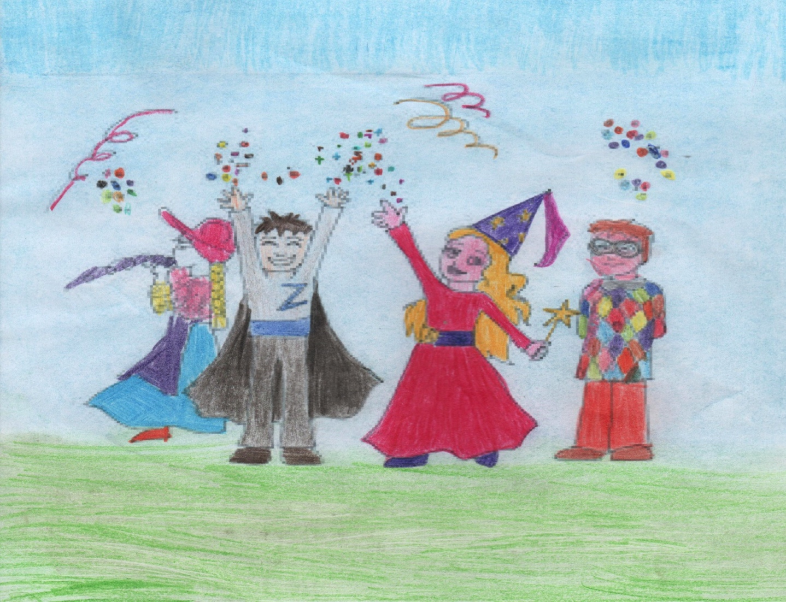
Many masks in the street say: “Carnival has its roots in pagan festivals and traditions but later was adapted to fit into the Catholic rituals.
It is a winter festival celebrated with parades, masquerade balls, entertainment, music, and parties.
Children throw confetti to each other. Jokes and tricks are also common during Carnival, the children say: “ A carnevale ogni scherzo vale!”, “Anything goes at carnival!”.

Slide 24
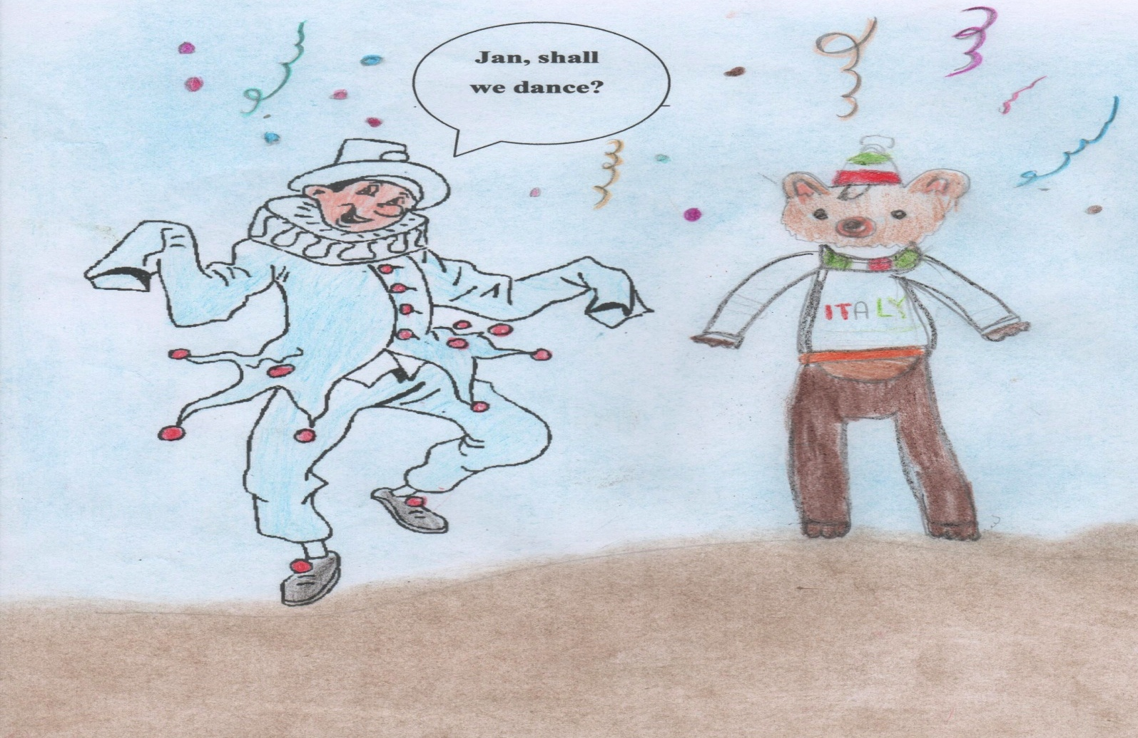
A traditional Sicilian Mask is coming, through confetti and streamers!
He is Peppe Nappa, he is a very nice mask.
He likes staying in the kitchen to eat more!

Slide 25
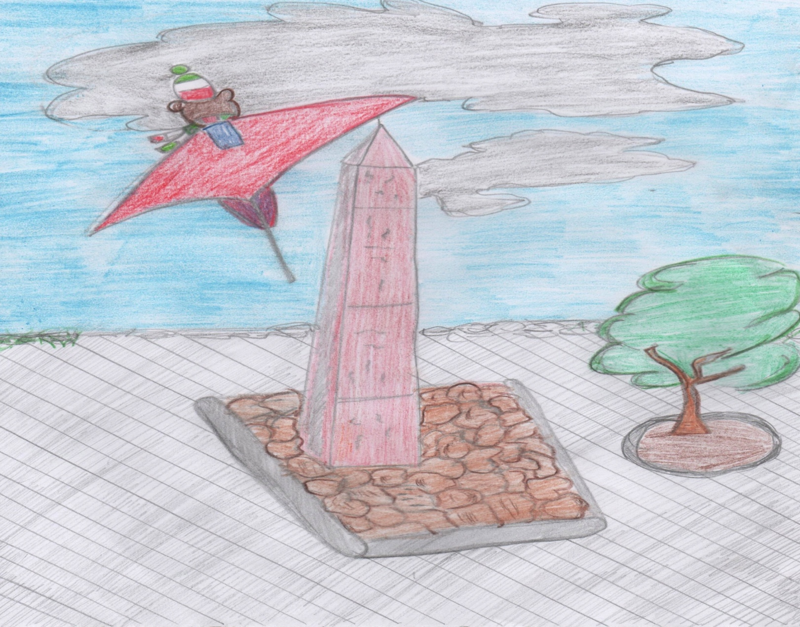
After dancing and having fun, Jan went to Enna´s obelisk (it indicates exactly the centre of Sicily) to fly with the glider to Malta….

Slide 26
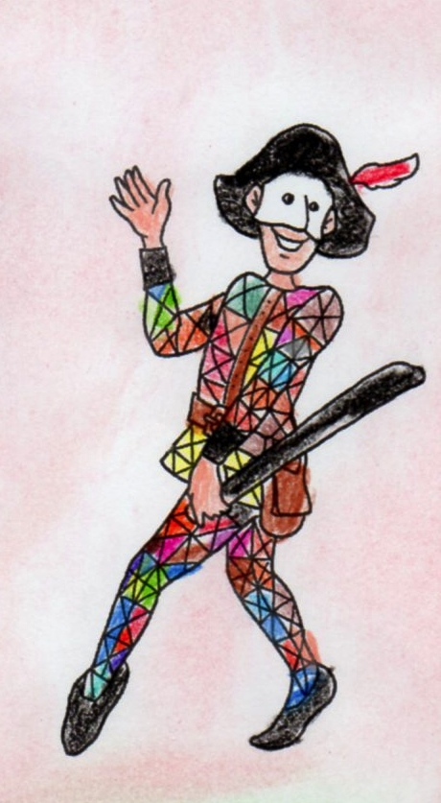
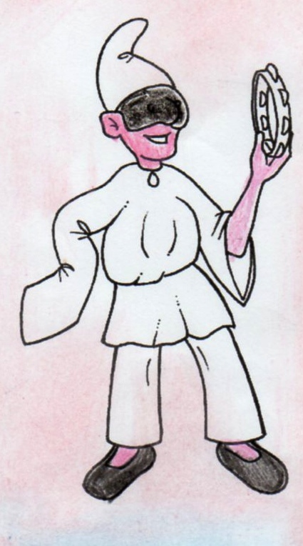
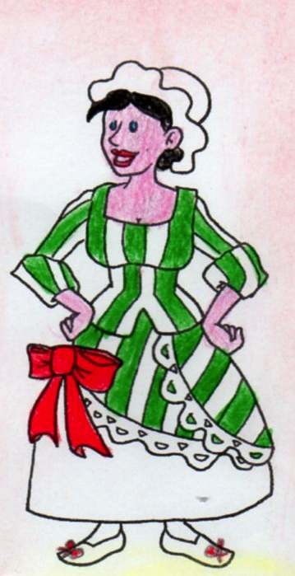
Jan, Look at them!
People dress up for funning and feasting.
We have many traditional masks!
She is Colombina, young and pretty mask!
She’s Arlecchino’ s girlfriend.
He is Pulcinella
He is from Naples!
He is Arlecchino .
His clothes are colorful!

Slide 27
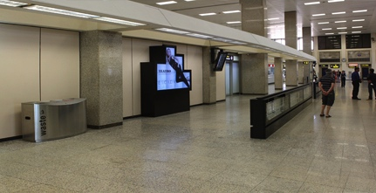
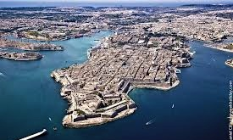

From the centre of Sicily, Jan landed at Malta’s International Airport. This is at Luqa, found in the south-east part of the island. Lovely cheers grew louder and louder as Jan walked out of the Arrivals.
“What a lovely surprise and a warm welcome!” cried Jan as kids from Xgħajra Primary School and their teachers ran towards him.
“We’re so happy you’re here to celebrate Carnival with us!” said Jayden, one of the kids.
“Let’s go to Valletta, right now” said Kaya. “You have to meet King Carnival and so many others!”
Jan walked hand in hand with Martina and Kristy and the rest of the kids and their teachers followed.
Carnival holidays 2014 were promising to be just great!

Slide 28
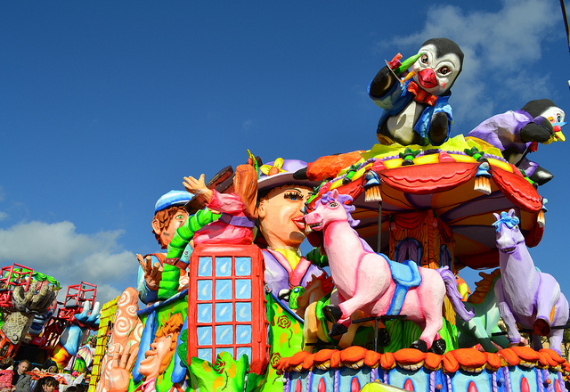
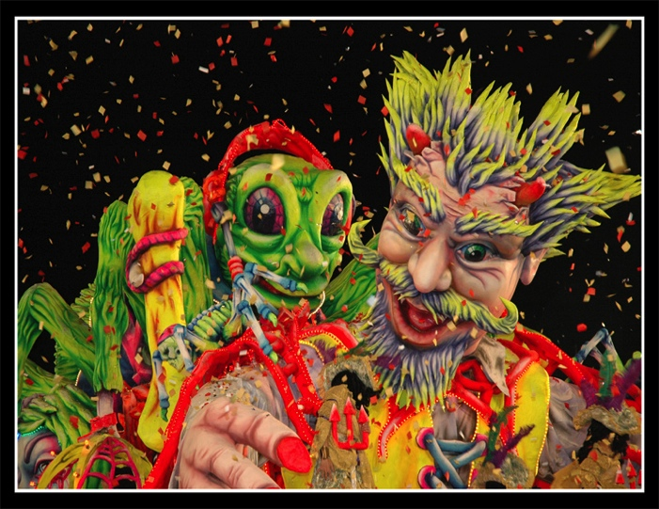
In Valletta, Jan saw lots of people and lots of beautiful colours. They were dancing and everyone was so happy.
He could hear lovely music to the Maltese tune... Viva, Viva l-Karnival. Among others, he saw ponies and elephants and penguins...
But he had never seen anything grander and more majestic than this.
All the kids were excited to see King Carnival. Dejan and Kieran exclaimed, “This is the best of all floats. Jan, please meet the King!”
Jan learned that people make these lovely Carnival floats all year round. As soon as Carnival is over, people start working for next year’s Carnival to promise something nicer and bigger!
“Such people are great artists!” said Jan. “I wish they could make a Carnival float, just like me...”

Slide 29
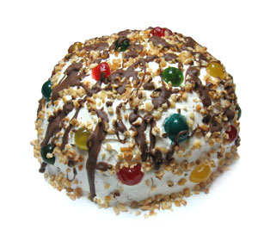
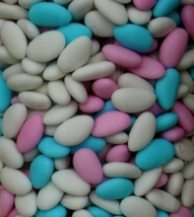
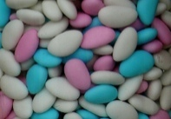
Jan seemed to grow hungry, but before he could say it... Matt, Alaia and Lorence came running towards him with something he had never seen before... but which appeared so yummy!
“You should taste the Prinjolata,” said Nicole.
“And don’t miss the Perlini,” continued Ezelia.
prinjolata
Jan wanted to share such a happy moment with Clarence, Sheldon, Tyrone and all the other kids... so off they went to find a seat and eat the yummy Carnival treats...
perlini

Slide 30
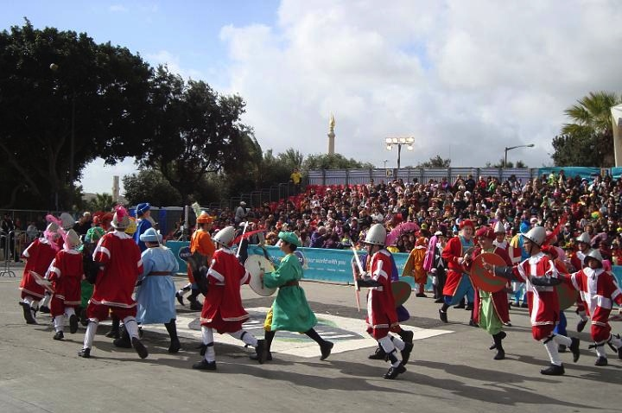
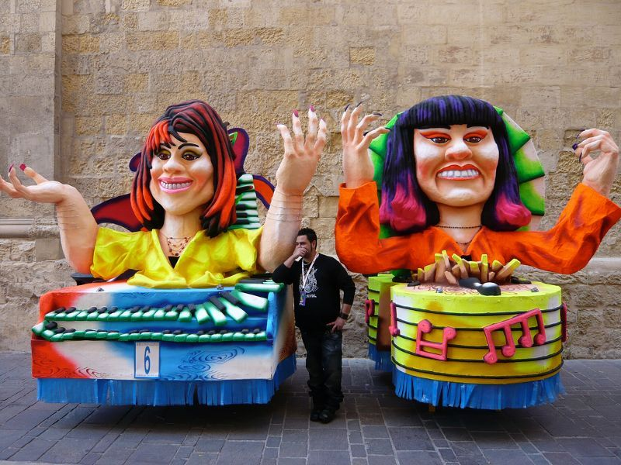
As soon as everyone was seated, the Grand Carnival Spectacle stated with the Carnival Parade, traditionally known as ‘Il-Parata Maltija ’ where a re-enactment of the Knights’ siege against Turks is held in the form a dance. Jan was astonished to see Lars, Emerson, Ismael, Adil, Aidan and Lydon all dressed up as knights!
Jan enjoyed himself so much during the Spectacle that he couldn’t stop jumping up and down! He feasted his eyes with all the colourful and majestic floats and grotesque masks.
Il-Parata

Slide 31

In the evening, Jan met up with Emma, Krista, Liam, Christ and Nirvana and off they went to continue celebrating the Maltese Carnival at Ħal Għaxaq!
Jan was so eager for the ‘Kukkanja’ activity to start!

Slide 32
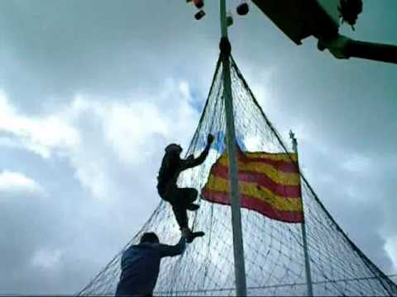
The ‘Kukkanja ’ is a traditional game where participants try to collect as many presents as possible by climb a pole overcoming the obstacles they encounter.
Jan couldn’t believe his eyes when he saw that Mariah, Tyrone, Kylie, Sara and Zillayia were participating in the ‘Kukkanja’…ready, steady GOOO!! Off they went making their way up the pole. Unbelievable! Zillayia won the first prize of €200 Euros!
Il-Kukkanja

Slide 33
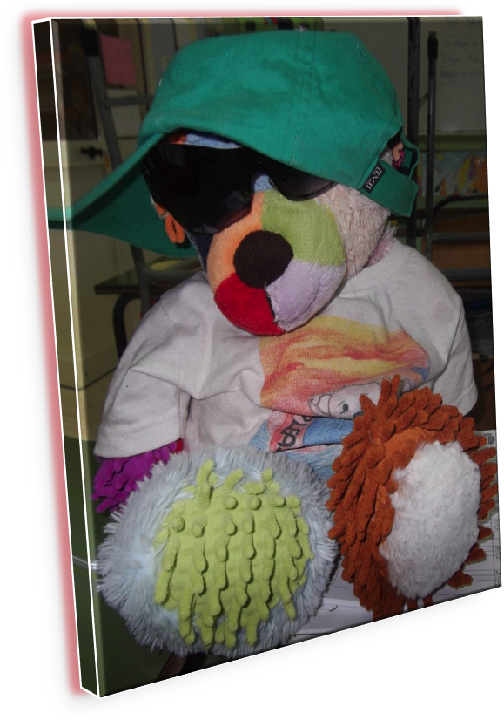
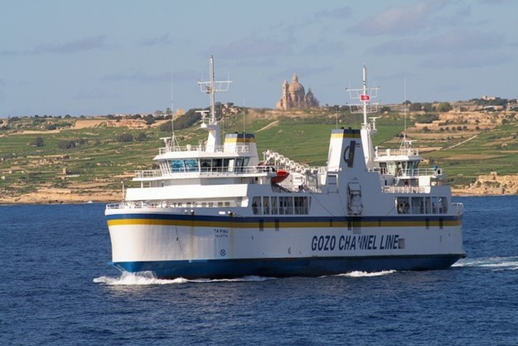
Wow what a surprise! Jan came up with a great idea...”Why don’t we all go to Gozo with your teacher?” he gladly shouted! Everyone agreed and Jan was over the moon with joy!
The following morning Jan met with Mickaylee, Zalle, Gianesse, Kydin, Kieran and the rest of the children at Cirkewwa to board the Gozo Channel ship to visit our sister island!
The sun was shining, the sea was calm and suddenly a gentle breeze blew off Jan’s hat…

Slide 34
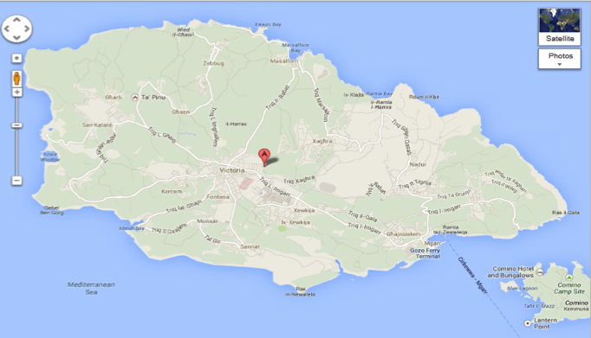
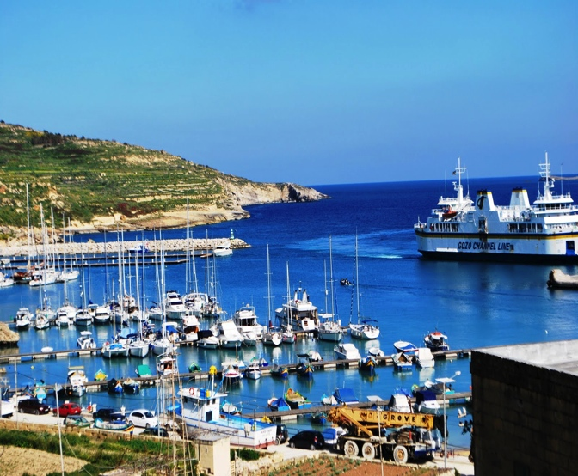
On the ship Jan met Teyzem, Sabrina and Zannushka and they planned how they were going to pass the time in Gozo
After about 20 mins on the ship they arrived at Imgarr Harbour. When they got off the ship they found Kim, Roanna and Adriana waiting for them to take them around Gozo.

Slide 35
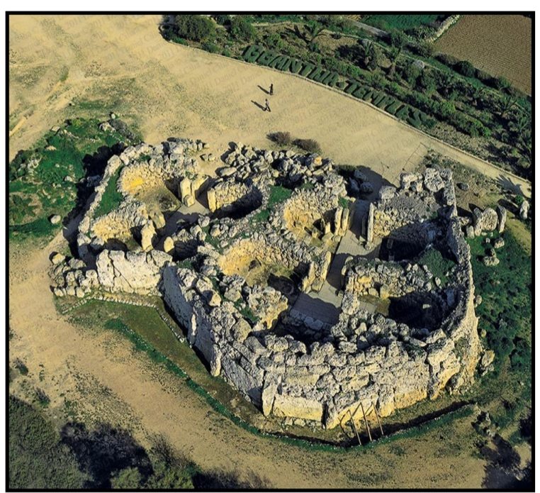
The first place they visited was Ġgantija. Ġgantija is a Neolithic, megalithic temple complex on the Mediterranean island of Gozo. The Ġgantija temples are the earliest of a series of megalithic temples in Malta. The Ġgantija temples are older than the pyramids of Egypt. The temples are built in the typical clover-leaf shape, with inner facing blocks marking the shape which was then filled in with rubble. There Jan met with Liam and Damian and they went to Rabat.

Slide 36
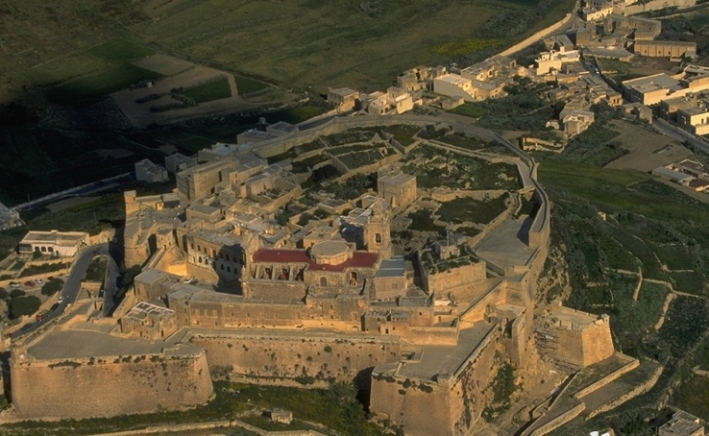
At Victoria they met Neil and Rowan and together they went to visit the Ċittadella . The Ċittadella (also called The Citadel) which lies in the heart of Victoria, Gozo, Malta, is a historic fortified city or castle. The Ċittadella is on Malta's tentative list of future World Heritage Sites by UNESCO, who describe it as a small fortified town. The area is known to have been first fortified during the Bronze Age c. 1500 BC. It was later developed by the Phoenicians and continued development until, by Roman times, it had become a complex Acropolis. Up until the 18th Century it was the only fortified refuge against attack for the inhabitants of the island. From Victoria Jan and his friends went to Għarb

Slide 37
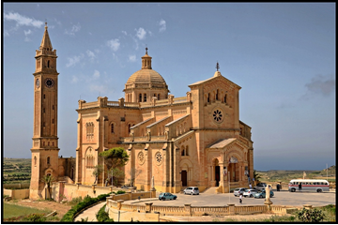
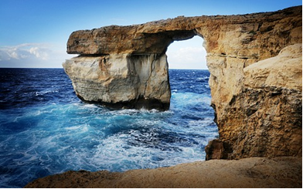
When they arrived at Għarb they met with Cherise , Esilana and Elizajah and together they went to visit the Ta’ Pinu church. The National Shrine of the Blessed Virgin of Ta' Pinu (Maltese: Santwarju tal-Madonna ta' Pinu) is a Roman Catholic minor basilica and national shrine located some 700 metres (2,300 ft) from the village of Għarb on the island of Gozo, the sister island of Malta. The church is dedicated to the Blessed Virgin of Ta' Pinu. The basilica is located on the edge of a cliff in open countryside which allows visitors to enjoy beautiful views of the area. From Għarb Jan and his friends went to Dwejra.
As soon as they arrived at Dwejra they found Deniro, Denilson and Haydon waiting for them to take them around Dwejra. They visited The Azure Window (Maltese: Tieqa Żerqa) which is a Limestone natural arch on the Maltese island of Gozo. It is situated near Dwejra Bay on the Inland Sea. The formation, which was created after two limestone sea caves collapsed, is popular with scuba divers.

Slide 38
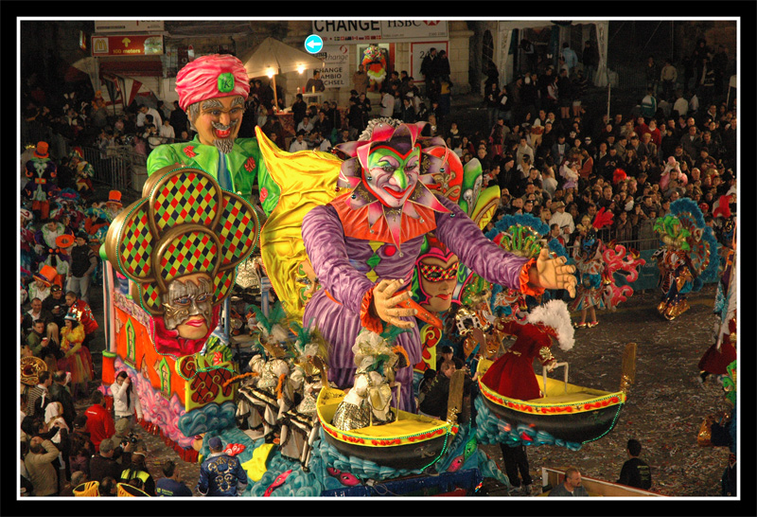
On the way back to the Imgarr Harbour, Jan and his friends stopped at Nadur, where one of the most famous Carnivals in Europe takes place.There they met Hayley and Gilbert. Nadur Carnival is a completely different carnival where no rules apply. It is a people’s carnival where the streets of Nadur are filled up with creatures wearing all types of costumes, most of which outrageous. The spontaneity of this carnival made it quite unique and one of the best carnivals in Europe with regards to this aspect. It is visited not only by the Gozitans but attracts many Maltese people that cross over to Gozo just to experience it.
After going around and enjoying Gozo and the Nadur Carnival it was time for Jan and his friends to board the ship again and go back to Malta. Arriving at the Ċirkewwa Harbour they took the bus to Luqa airport from where Jan was leaving for Romania.

Slide 39
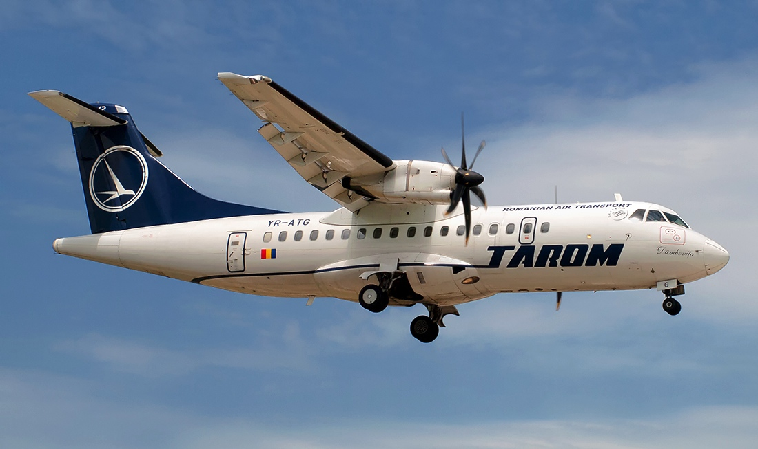
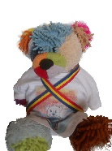

Jan, our friend, decided to pay us a visit in the first month of spring. He arrived on the Otopeni airport with a Tarom flight on a sunny spring day. The clean sky and the sun that made all nature reborn, sent us on a brief walk in the Herastrau park, on a boat ride and for a short visit to the Village Museum where at this time of the year many craftsmen come to exhibit their works for the Martisor Fair.

Slide 40
The martisor is a small adornment tied up with a red and white thread. The name of “martisor” is connected to many folk legends. One of them says that at one time the Sun came down at a village dance disguised as a lad. A dragon was on the watch and kidnapped the sun from among the people closing him up in a cave. Everybody was sad. The birds had stopped singing, the springs had stopped flowing and the children had stopped laughing. Nobody dared face the dragon. But a young lad decided to go and save the sun. Many of the countrymen saw him off and gave him their strength to help him overcome the dragon and set the sun free. His journey lasted all winter. He found the dragon’s lair and they started fighting. They fought for days on end until the dragon was defeated. Weak and wounded, the young man set the sun free. It rose up into the sky cheering and rejoicing everybody, but the poor lad didn’t get to see the spring. The warm blood in his wounds drained into the snow. As the snow melted white flowers raised – the snow drops – the heralds of spring. Even the last drop of his blood drained into the immaculate snow. He died. Ever since the young people interweave two tassels: a red one and a white one. They offer these to the girls they love or to those near to their heart. Red stands for love, for everything that is beautiful, reminding us the colour of the blood of the lad. White stands for good health and the purity of the snow drop, the first flower of spring. Women, men and children get and offer the martisor which they wear during the month of March, as a sign of arrival of spring, of friendship and love.

Slide 42
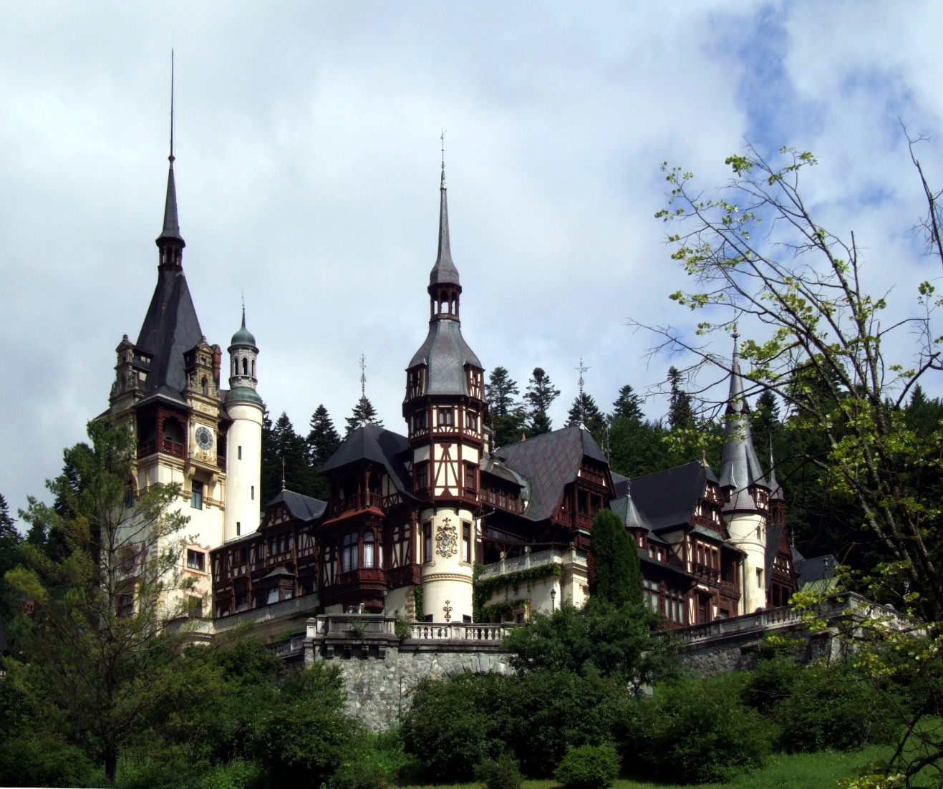

Spring makes nature young and the mountain peaks are still covered with traces of snow. Sinaia was a very enjoyable destination for Jan. He went on a ride in the gondola up to 1400 metres, then he he went to visit the Peles Castle, the summer residence of King Mihai 1st and his family.

Slide 43
As the Romanian people is a good keeper of history and traditions, we offered Jan a visit to the Bran Castle, as well. This is one of the most important vestiges of Romania and its fame spread around the world due to the legend of the Count Dracula of Transylvania. In the beginning it was a defense fortress and it went through major changes in 1920 when it became a castle during the reign of Queen Mary. Strategically placed on a big rock so that the people in the castle were be able to see the enemies from a distance, today the castle is a museum on four levels with ceramics collections, furniture, weapons and knights’ armors; Jan liked most of all going through the secret passage. A large part of the fame abroad of the castle is owed to the Irish writer Bram Stoker, who wrote about Dracula - a vampire who feeds on human blood and has his residence in this castle – having as source of inspiration the Romanian king Vlad Tepes , nicknamed the Impaler.

Slide 44


Slide 45



Also during this month, on the 8th of March, we celebrate the International Women’s Day. Our mothers are the beings who stand by us in the joys and troubles of our lives, our unconditional friend, the first being who holds us tight upon our coming to this world. It is an opportunity for children to make cards which they offer to their mothers with great love, together with a bunch of snowdrops.

Slide 46

Jan liked very much this custom.
Romania is the country where traditions are at home. He promised to come back to enjoy our joy and hospitality again.
Now it was time to travel to Spain.

Slide 47







Jan took a flight to Spain and landed in Santiago de Compostela Airport where dressed up as a pilgrim it was very difficult to tell him apart. Out of the airport he walked to the centre of the city and entered the cathedral. He was very impressed by the size of it and by that special and big incense burner called “botafumeiros” sitting on a bench he fantasized about hanging on it. He left the cathedral and his pilgrim outfit, then he saw a bus going to Burela (this place was familiar for him) so he decided to take that bus. It was a long journey so he fell asleep quickly.

Slide 48







When he woke up he was already in Burela right in front of the harbor. He saw many ships there. The ship master called him and invited him to his ship. He explained Jan that he and his crew fish tuna fish, a delicious kind of fish that makes Burela to be known in many different places. They even have a party for this typical fish also known in the village as “The blue Prince”
They were talking when suddenly a terrible storm occurred and Jan fell into the sea. Deep in the water he saw an enormous magnifying glass. He took some photos and showed them to the master, he explained to him that it wasn’t any magnifying glass but Burela’s lighthouse, due to the terrible weather conditions it has been broken and some of its pieces were in the sea.

Slide 49

After the storm they continued their voyage throughout the Mariña shore. It was then when he saw a dolphin whistling at him. He rode the dolphin and he was taken to a wonderful beach: “Las Catedrales” (a beach where the roaches have different amazing shapes similar to those of the cathedrals) Jan fell in love with this beach and he took a nap there while sunbathing.
When he was sleeping a turtle saw him and thought he was dead. The animal put Jan on his shell and took him to the sea again, after a while he woke up and the scary turtle run away.

Slide 50

Jan was then taken by a seagull but Jan wanted to escape so he made tickles to the seagull and he was liberated falling from the sky into a hole existing in the Burela’s lighthouse . That hole led him to a magic town where all the houses were made out of lighthouses and all the inhabitants were teddy bears like him.

Slide 51

The king of the Teddy Bears invited Jan to a party and there he met Janny, a beautiful teddy bear. She was the princess and they fell in love. They danced all night. Jan had a beautiful partner for his adventures and he was no longer alone.
Janny showed Jan her town and invited him to her house where they spent the night and had breakfast with Janny’s family.

Slide 52

That night Jan had a wonderful dream. He dreamt that he married Janny and that he became the prince of teddy bears. He also dreamt that they went to Burela in their honeymoon. As they have to get out of that hole to reach Burela they used a trampoline and jumped very high ending up in Burela’s cold waters again. It was with that cold water shower that Jan woke up and smiled when he saw Janny by his side.

Slide 53
-The end-

