Slide 1
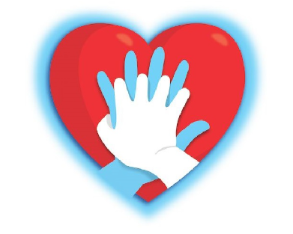
REANIMACIÓN CARDIOPULMONAR BÁSICA (RCP)
C.E.I.P. Ramón Falcón

Slide 2
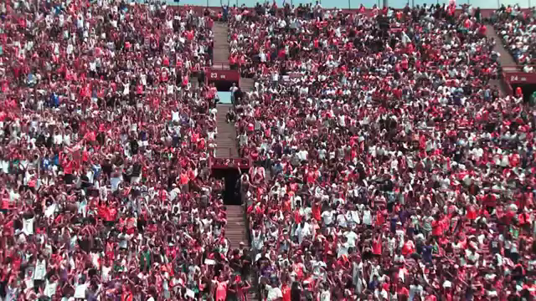
SOPORTE VITAL BÁSICO (SVB)

Slide 3
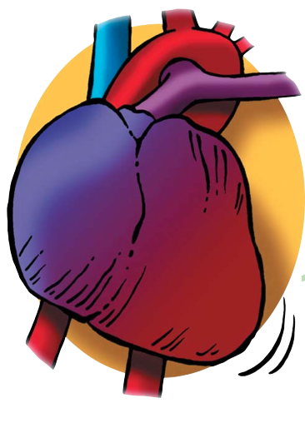
CONCEPTOS CLAVES
PCR
Interrupción brusca, inesperada e potencialmente reversible da respiración e da circulación espontánea.
Distinta de morte por:
- envellecemento fisiolóxico.
- enfermidade terminal.

Slide 4
INTRODUCCIÓN
1.000.000 europeos/ano sofren un episodio de morte súbita.
82% destas mortes súbitas, débense principalmente a enfermedades cardíacas, principalmente ao Síndrome Coronario Agudo
A maioría destes episodios prodúcense por arritmias ventriculares(fibrilación ventricular e taquicardia ventricular) cuxo único tratamento é a administración dunha descarga de desfibrilación

Slide 5
Ritmo Sinusal
Nódulo sinusal
12:56 29MAR96 PADDLES X1.0 HR = 74
Tomado de Physio-Control
Notes:
The electrocardiogram (ECG) is a measurement of the electrical activity in the heart. The impulses from the heart pass through body tissues and reach the skin where they can be detected by disposable electrodes placed on the skin. The ECG of a healthy heart shows
an organized, uniform rhythm called normal sinus rhythm (NSR).
8

Slide 6
FIBRILACIÓN VENTRICULAR
12:57 29MAR96 PADDLES X1.0 HR = ---
Tomado de Physio-Control
Notes:
Sudden cardiac arrest (SCA) means the heart has unexpectedly stopped beating. The most common abnormal rhythm associated with SCA is ventricular fibrillation (VF). VF is an unorganized rhythm of chaotic electrical activity resulting in uncoordinated and ineffective cardiac muscle contractions which prevent the circulation of blood. There is no pulse or blood pressure.
A heart in VF looks like a quivering bowl of jelly. If left untreated VF will virtually always result in death.
9

Slide 7
Taquicardia Ventricular
12:57 29MAR96 PADDLES X1.0 HR = 214
Tomado de Physio-Control
Notes:
Pulseless ventricular tachycardia (VT) is a rhythm that often precedes VF. It occurs when a site in the ventricular muscle fires rapidly and takes over as the dominant pacemaker. As the heart rate increases, there is less time for the ventricles to fill with blood. This reduces the amount the heart can pump and blood pressure falls. If the blood pressure drops severely, consciousness and pulse will be lost. Like VF, if left untreated, pulseless VT will result in death within minutes. Both VF and VT are treated with electrical shocks called defibrillation.
14

Slide 8
DESFIBRILACIÓN:
Único tratamento efectivo
para a Fibrilación Ventricular
300 JOULES DEFIB 20:29 01APR96 PADDLES X1.0 HR = ---
Tomado de Physio-Control
Notes:
Defibrillation is the delivery of a strong electrical shock to the heart. The goal of defibrillation is
to reorganize the chaotic electrical activity of VF and return the heart to a normal rhythm. After
a shock the SA node or another area of the heart can regain control as the primary pacemaker.
10

Slide 9
Asistolia
15:17 29MAR96 PADDLES X1.0 HR = ---
Tomado de Physio-Control
Notes:
Not all rhythms of cardiac arrest can be treated with electrical shocks. Asystole (“flat line” or no electrical activity of the heart) and pulseless electrical activity (“PEA”—electrical activity but no pumping of the heart) are examples of dysrhythmias that do not respond to external shocks.
15

Slide 10
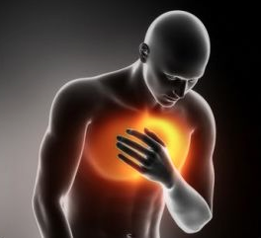
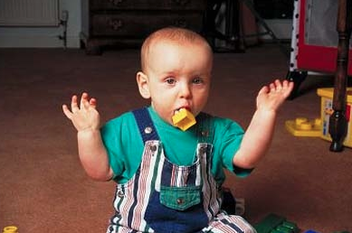

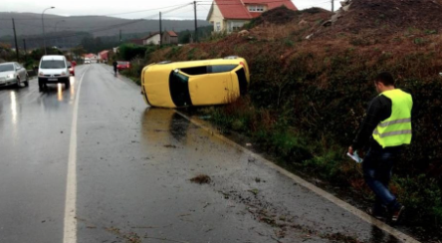
CAUSAS MÁIS FRECUENTES DE PCR

Slide 11


CONCEPTOS CLAVES
REANIMACIÓN CARDIOPULMONAR
Conxunto de manobras encamiñadas a reverter unha PCR.
Substituindo primeiro para intentar restaurar despois a circulación e respiración espontáneas.

Slide 12

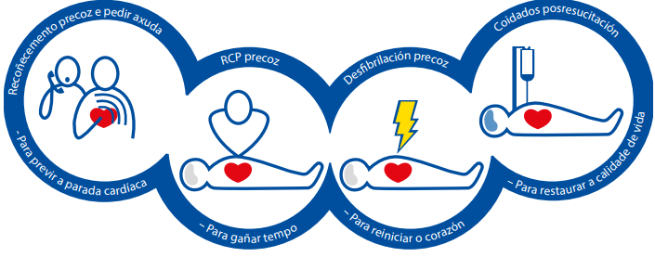
CADEA DE SUPERVIVENCIA

Slide 13
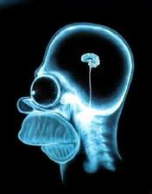
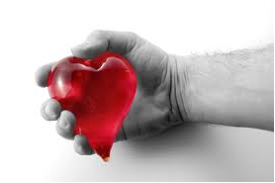
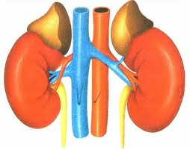
IMPORTANCIA DA RCP
As víctimas de PCR precisan RCP inmediata.
Aporta fluxo sanguíneo ao corazón e ao cerebro.
Aumenta a probabilidade de éxito da desfibrilación.
Cada minuto sen RCP a supervivencia diminúe un 7-10%
A RCP da testemuña duplica ou triplica o éxito da RCP.

Slide 14
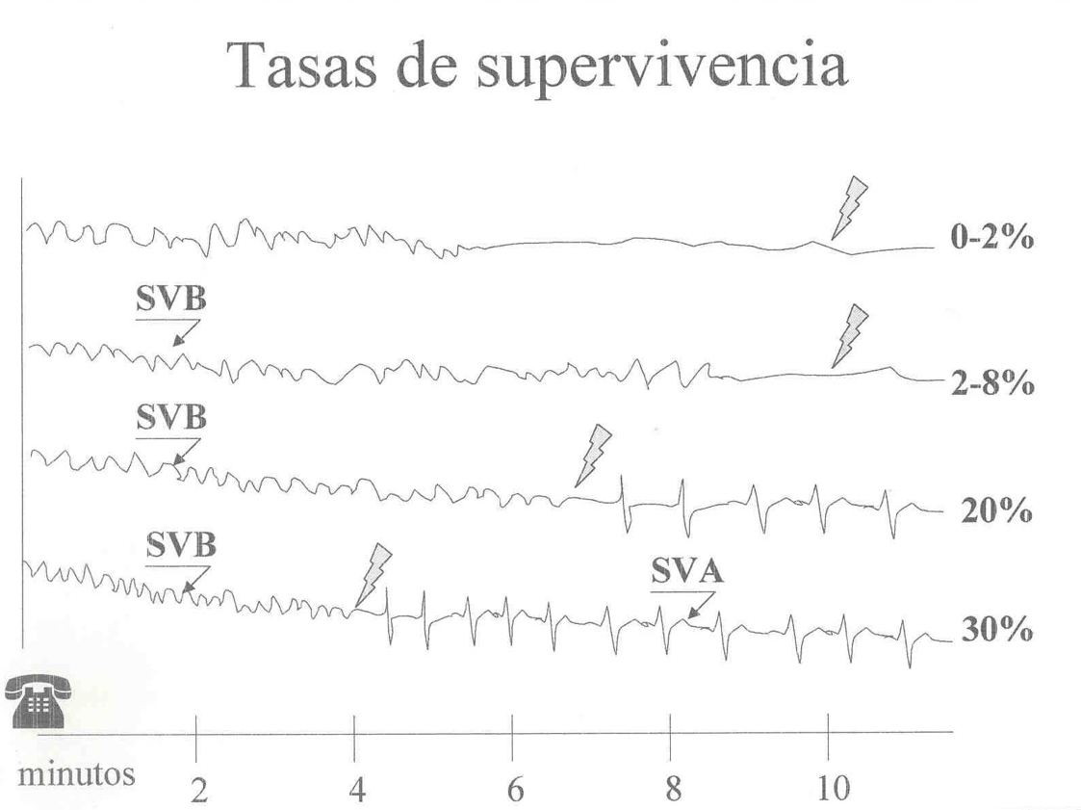
IMPORTANCIA DA RCP

Slide 15


SOPORTE VITAL BÁSICO adulto (SVB)
VALORE A SEGURIDADE DA ESCENA

Slide 16
ALGORITMO SVB adulto
Non responde?
Non respira normalmente?
Chamar ao 061
Compresións Torácicas
Con DESA: Encendelo
Seguir Instruccións

Slide 17
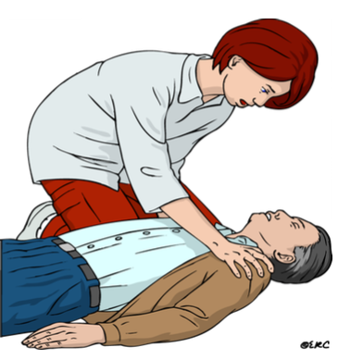
RECOÑECEMENTO DA INCONSCIENCIA
.CHAMAR POLO SEU NOME
.SACUDIR OS OMBREIROS

Slide 18
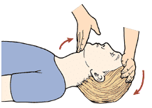
ABRIR VÍA AÉREA
MANOBRA FRONTE – QUEIXO

Slide 19
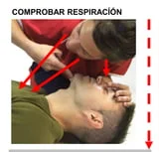
COMPROBAR RESPIRACIÓN
.VER
.OIR
.SENTIR
< 10 SEGUNDOS

Slide 20
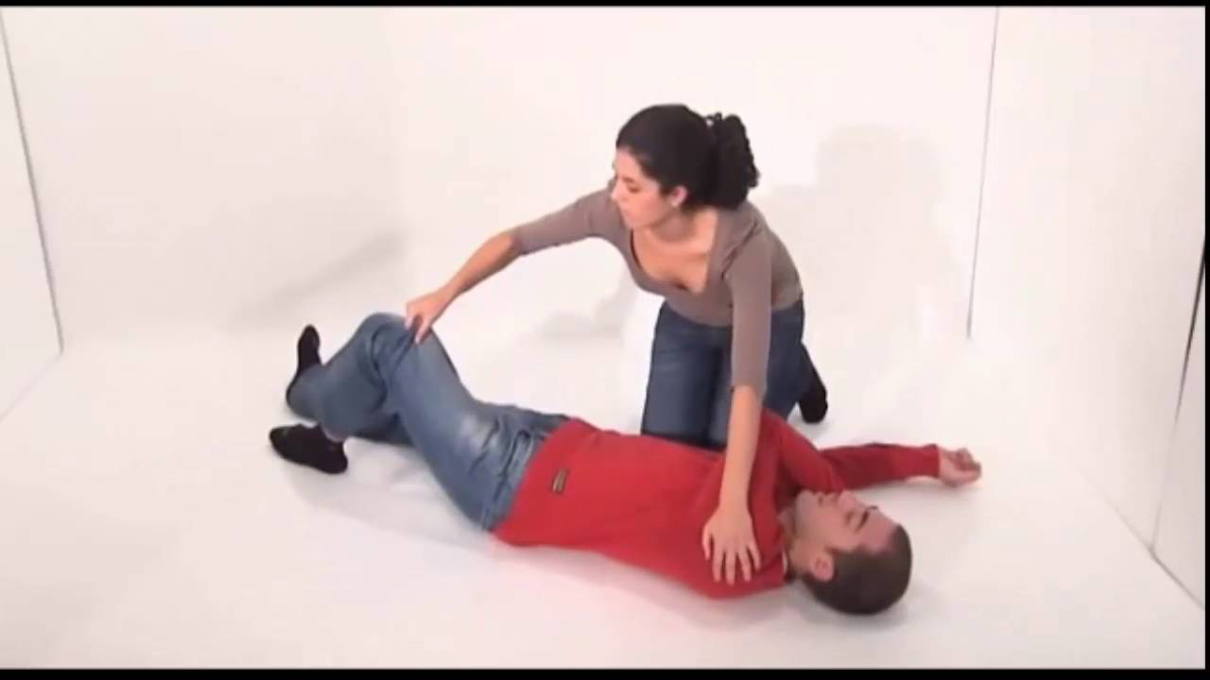
POSICIÓN LATERAL DE SEGURIDADE
INCONSCIENTE QUE RESPIRA

Slide 21
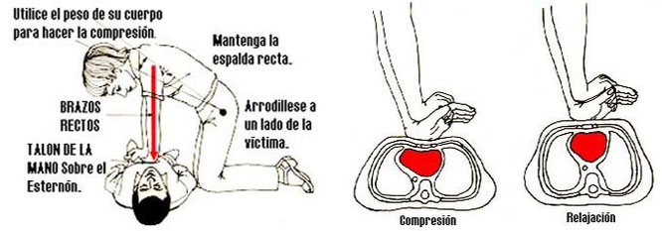
SE NON RESPIRA: RCP
100-120 COMPRESIÓNS POR MINUTO

Slide 22
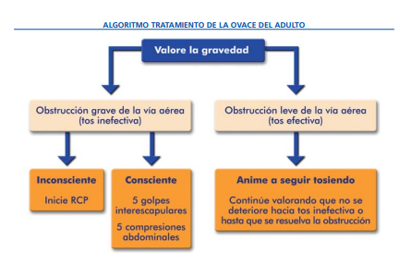
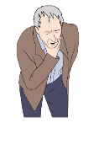
SOSPEITA DE ATRAGOAMENTO

Slide 23

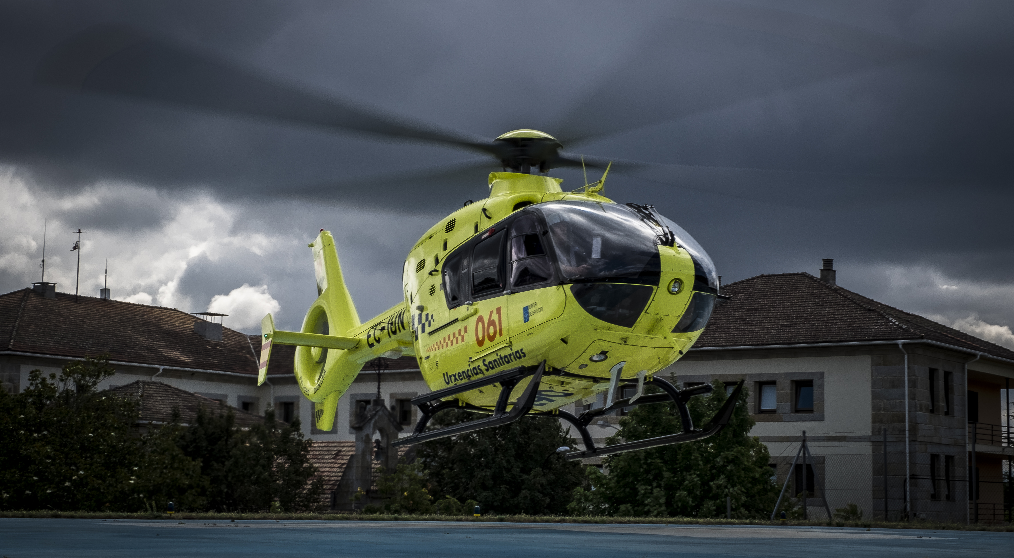
DÚBIDAS…

Slide 24
MOITAS GRAZAS POLA VOSA ATENCIÓN!

