Slide 1

WHICH ARE THE TWO MAIN COLORS IN SPAIN’S FLAG?

Slide 2
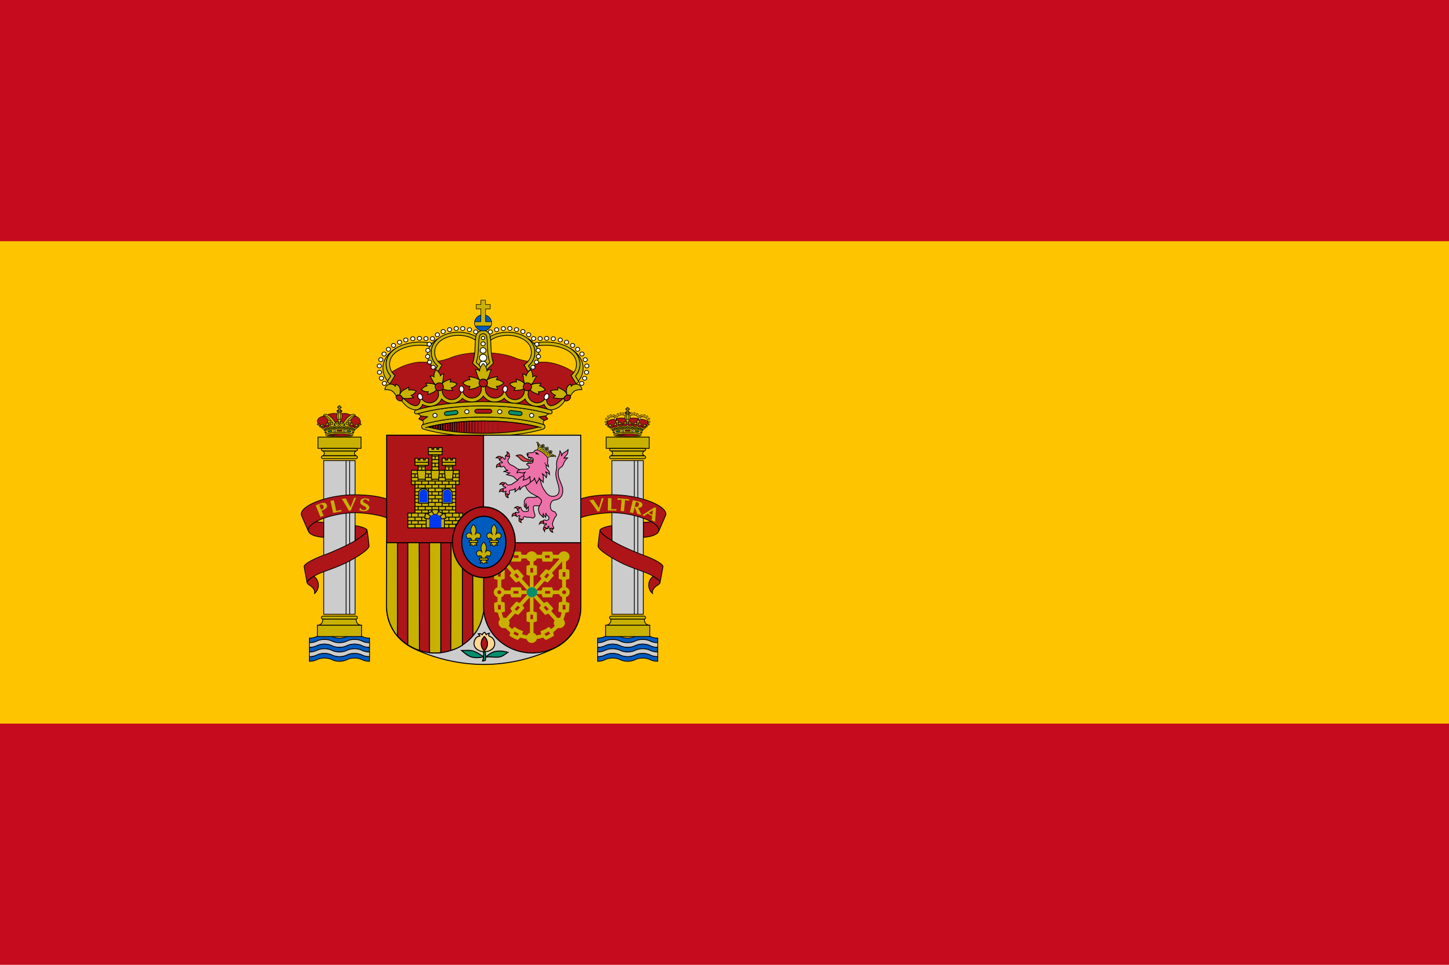
RED AND YELLOW

Slide 3
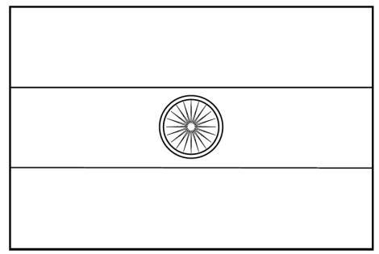
DO YOU KNOW WHICH ARE THE THREE COLORS IN INDIA’S FLAG?

Slide 4
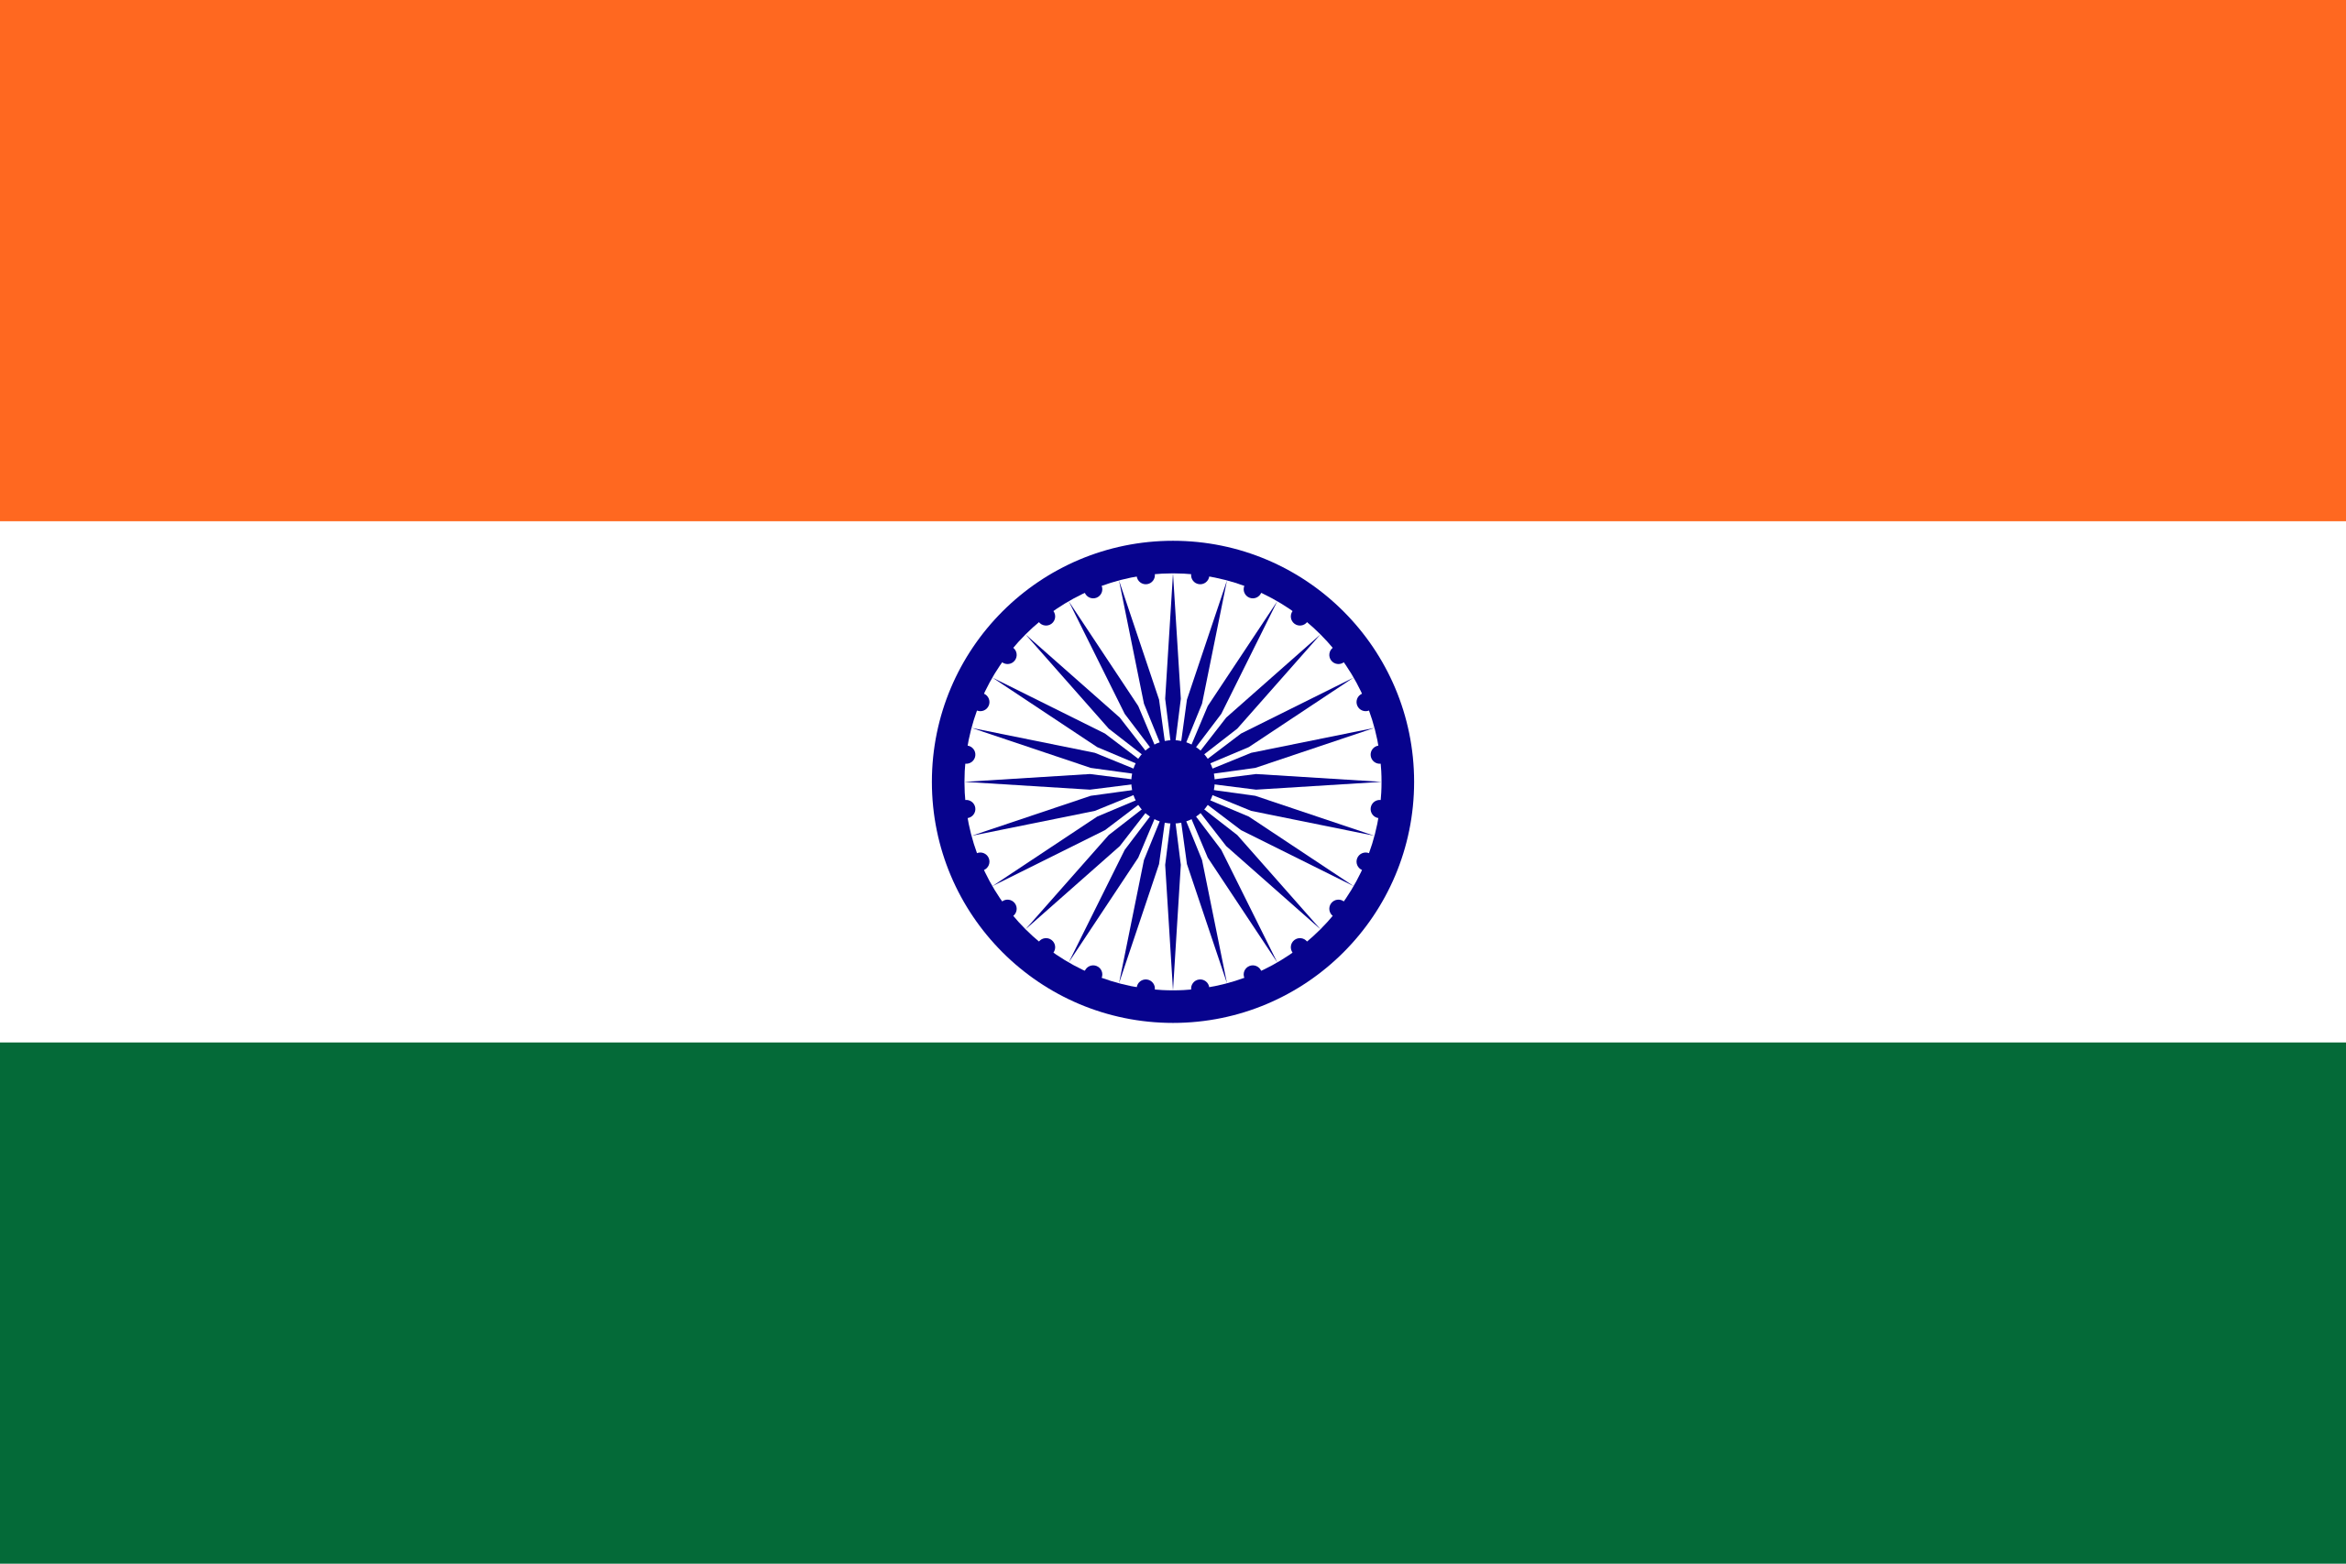
ORANGE, WHITE AND GREEN.

Slide 5
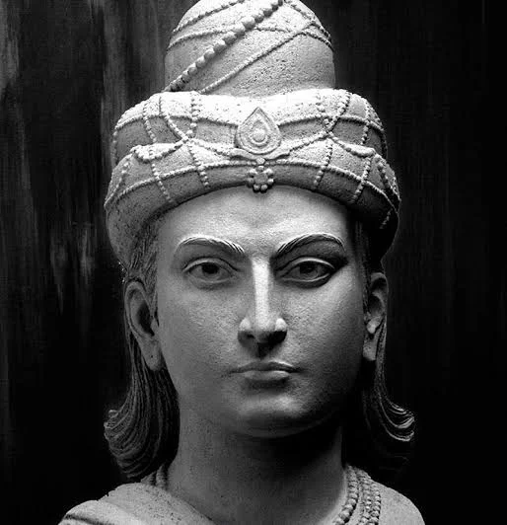
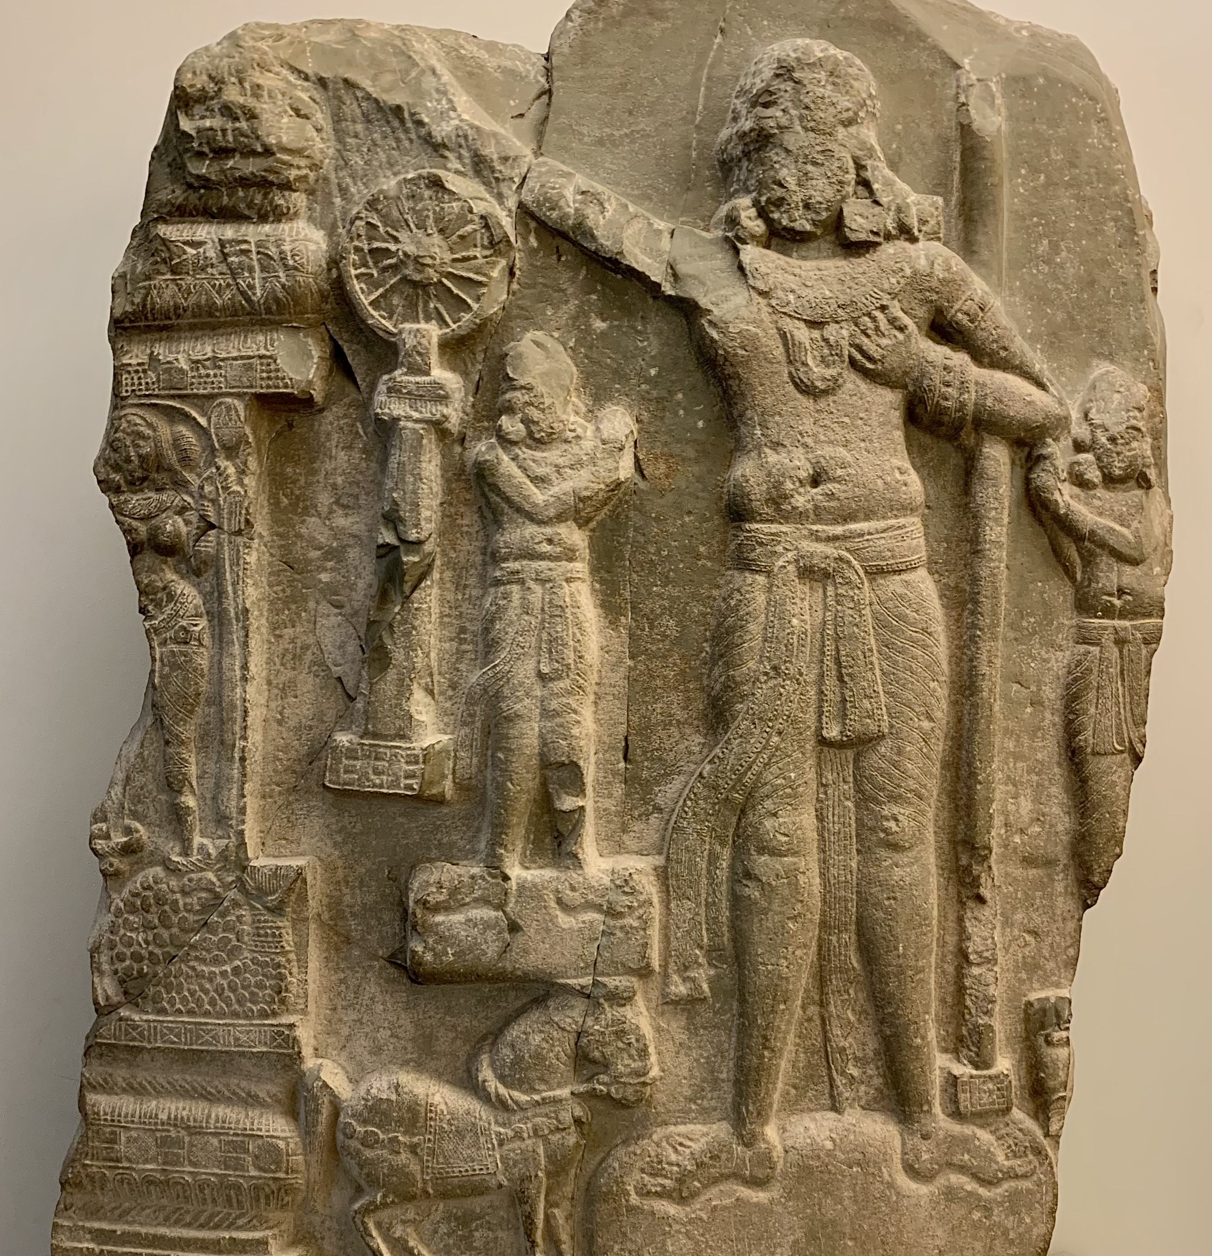
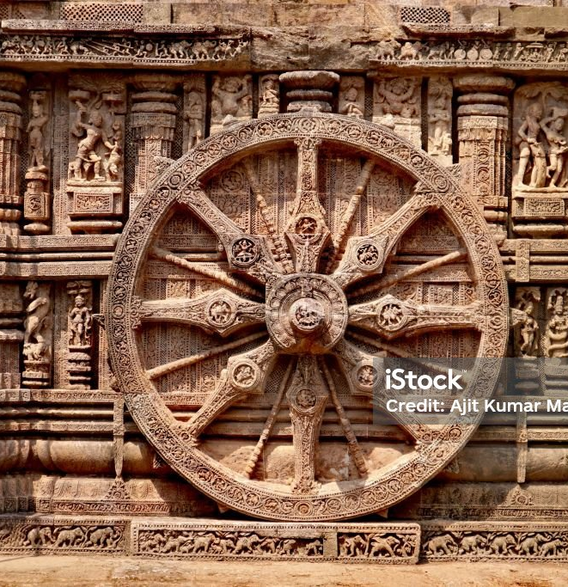
ASHOKA CHAKRA (ASHOKA’S WHEEL)
EMPEROR ASHOKA
(268 BCE TO 232 BCE)

Slide 6

DO YOU KNOW KNOW WHICH IS THE NATIONAL FLOWER OF INDIA?

Slide 7
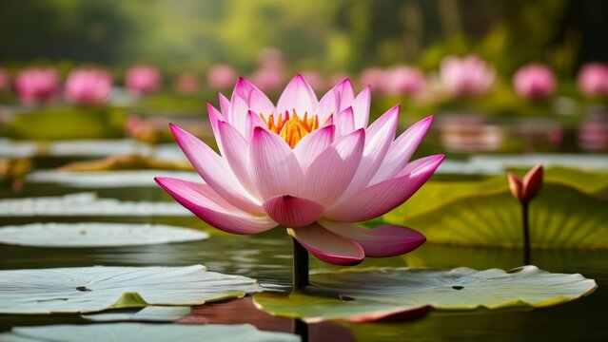
LOTUS

Slide 8
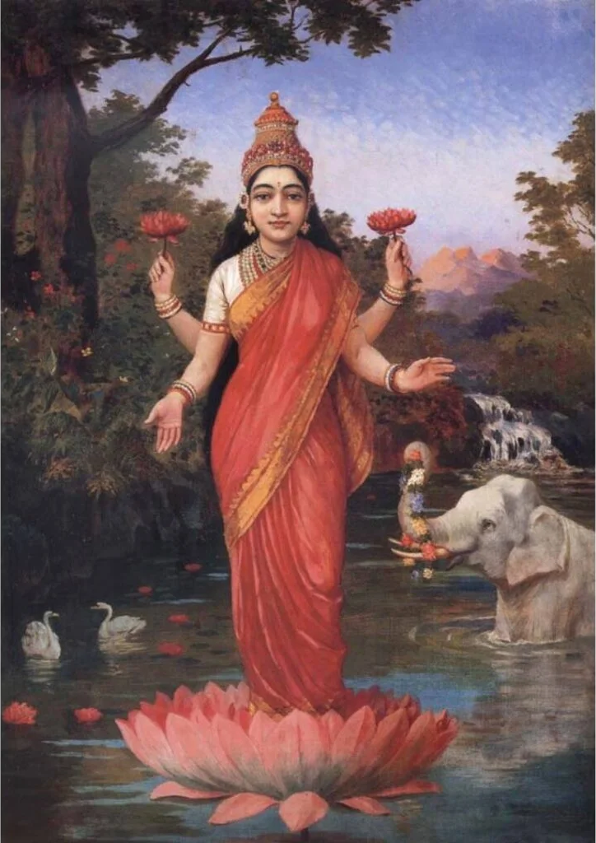
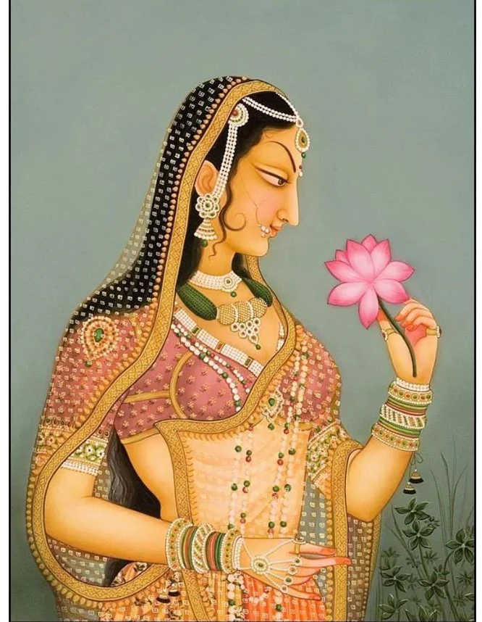
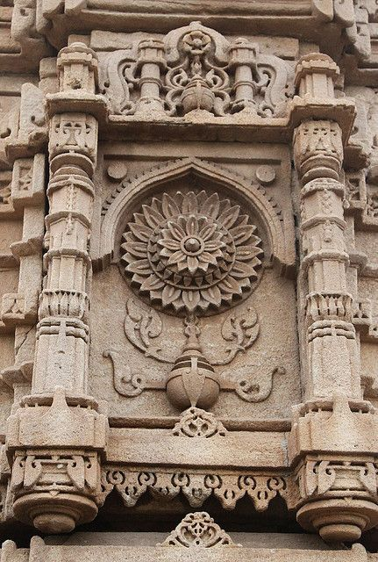
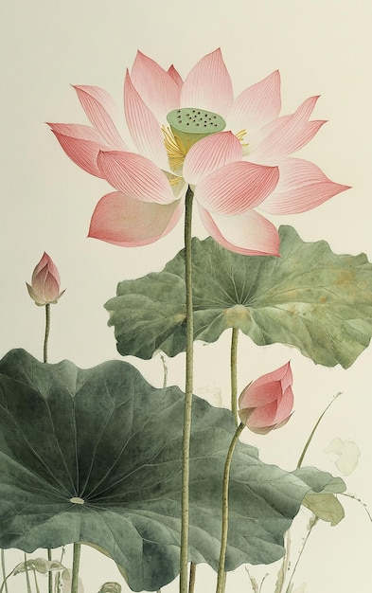
LOTUS IN ART AND ARCHITECTURE

Slide 9
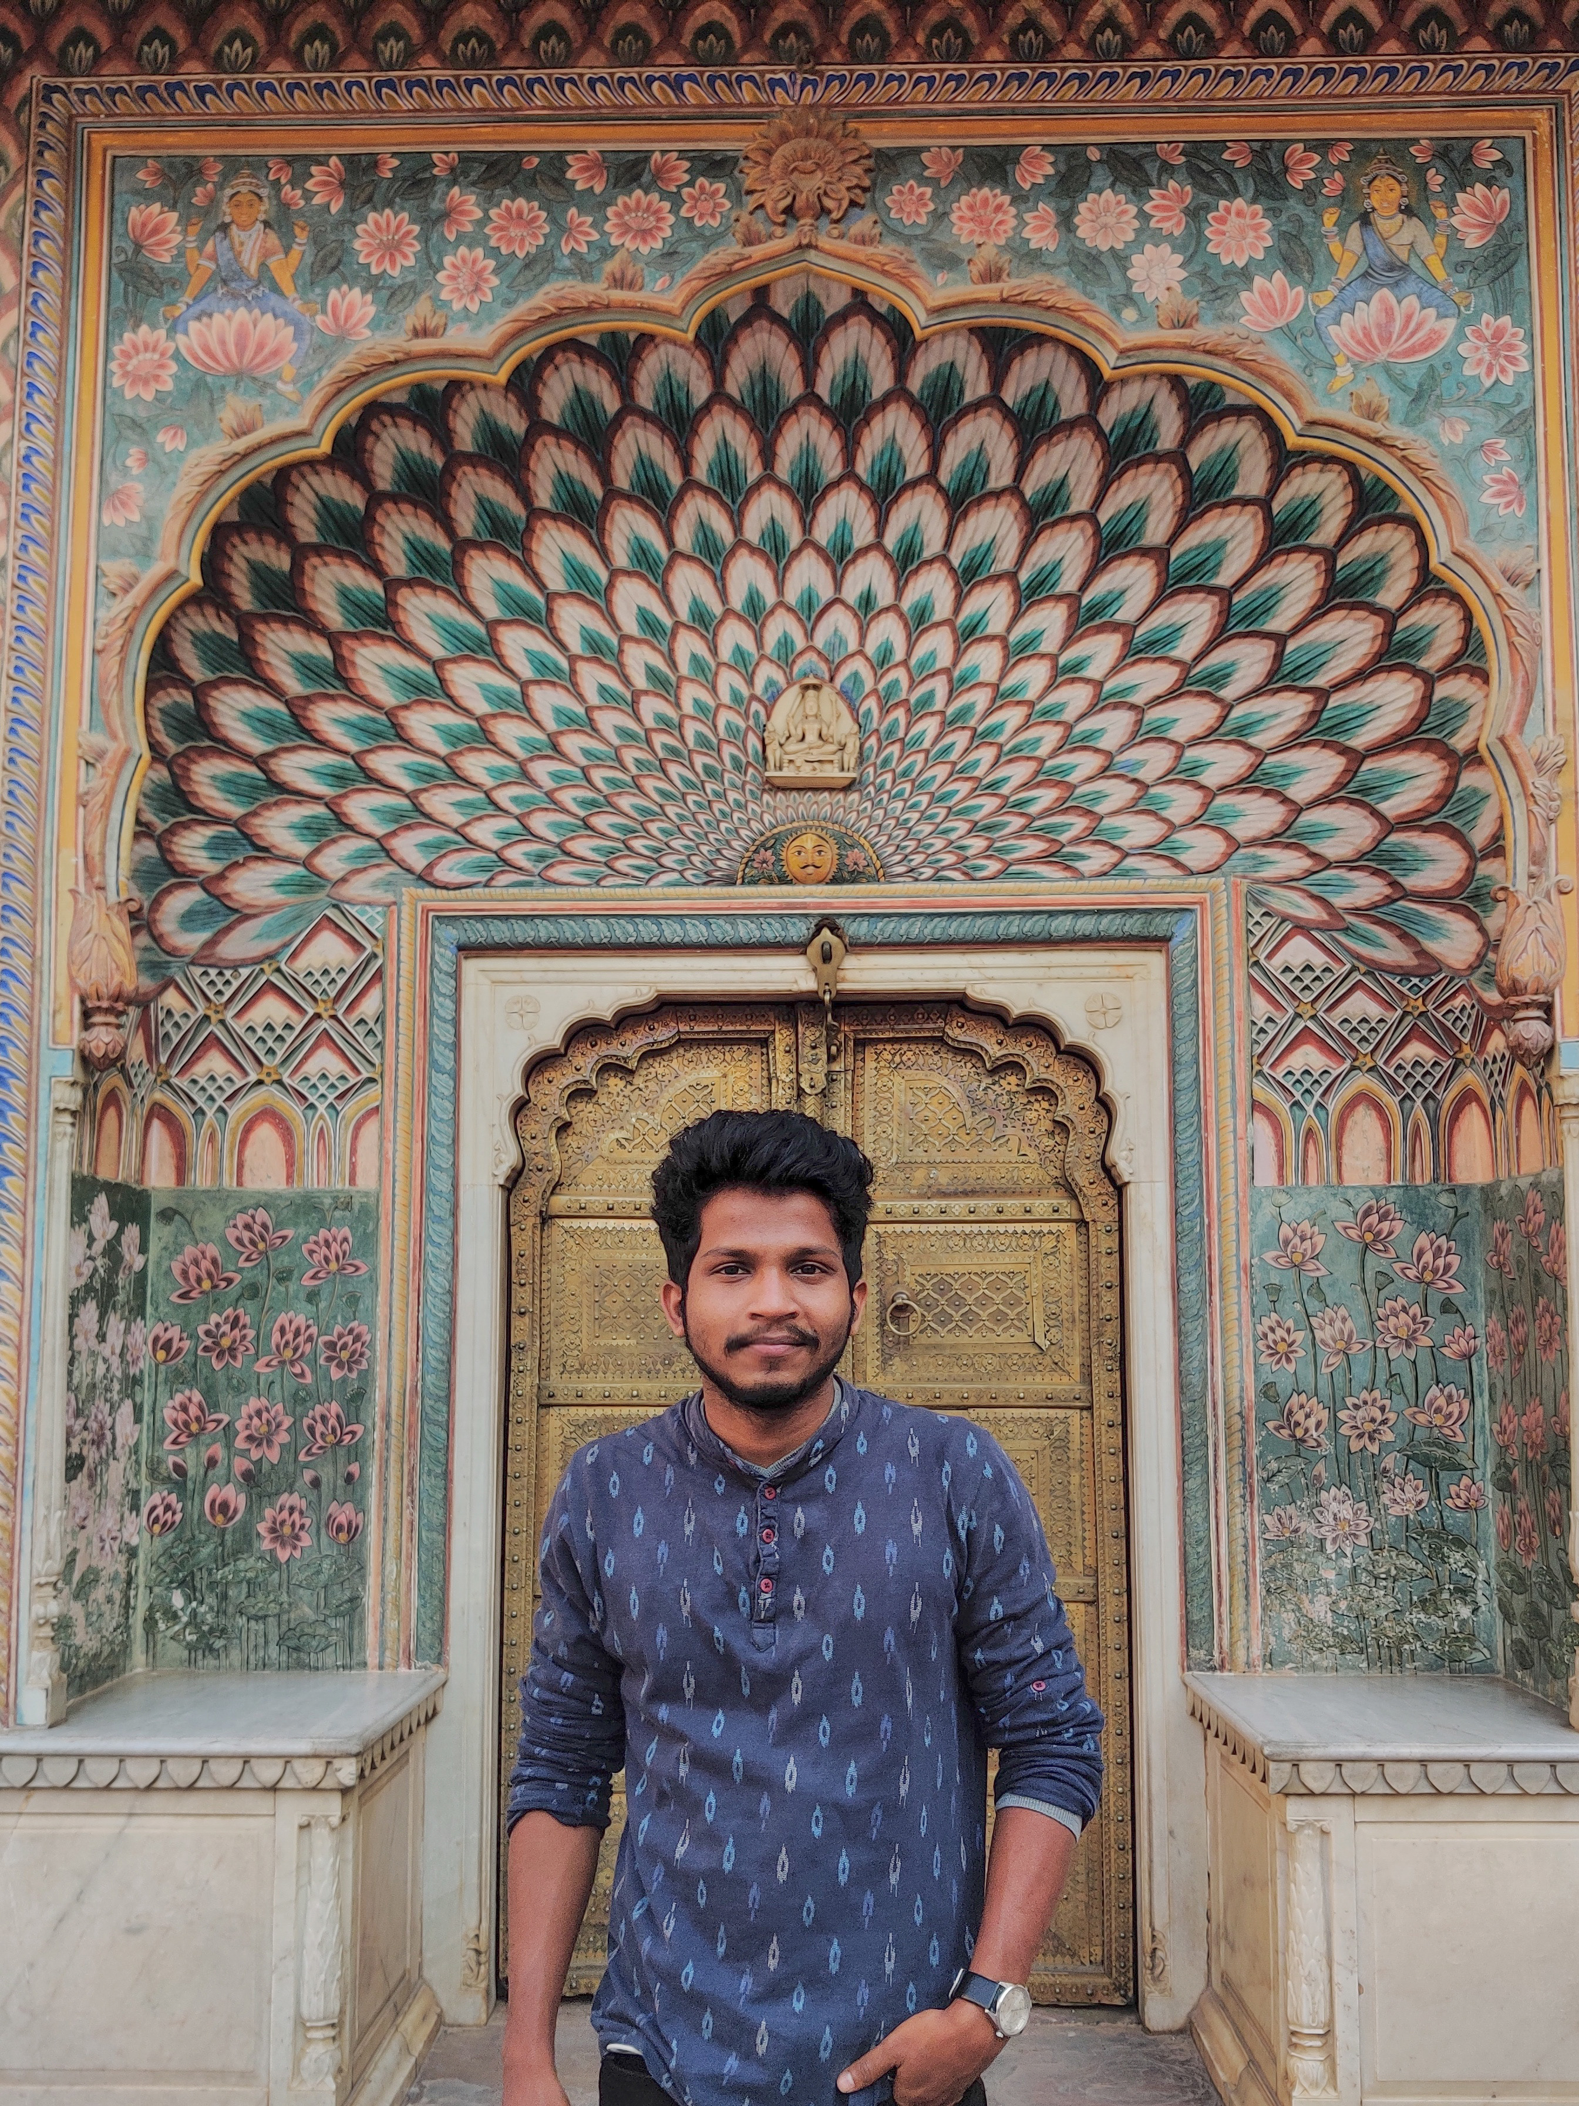
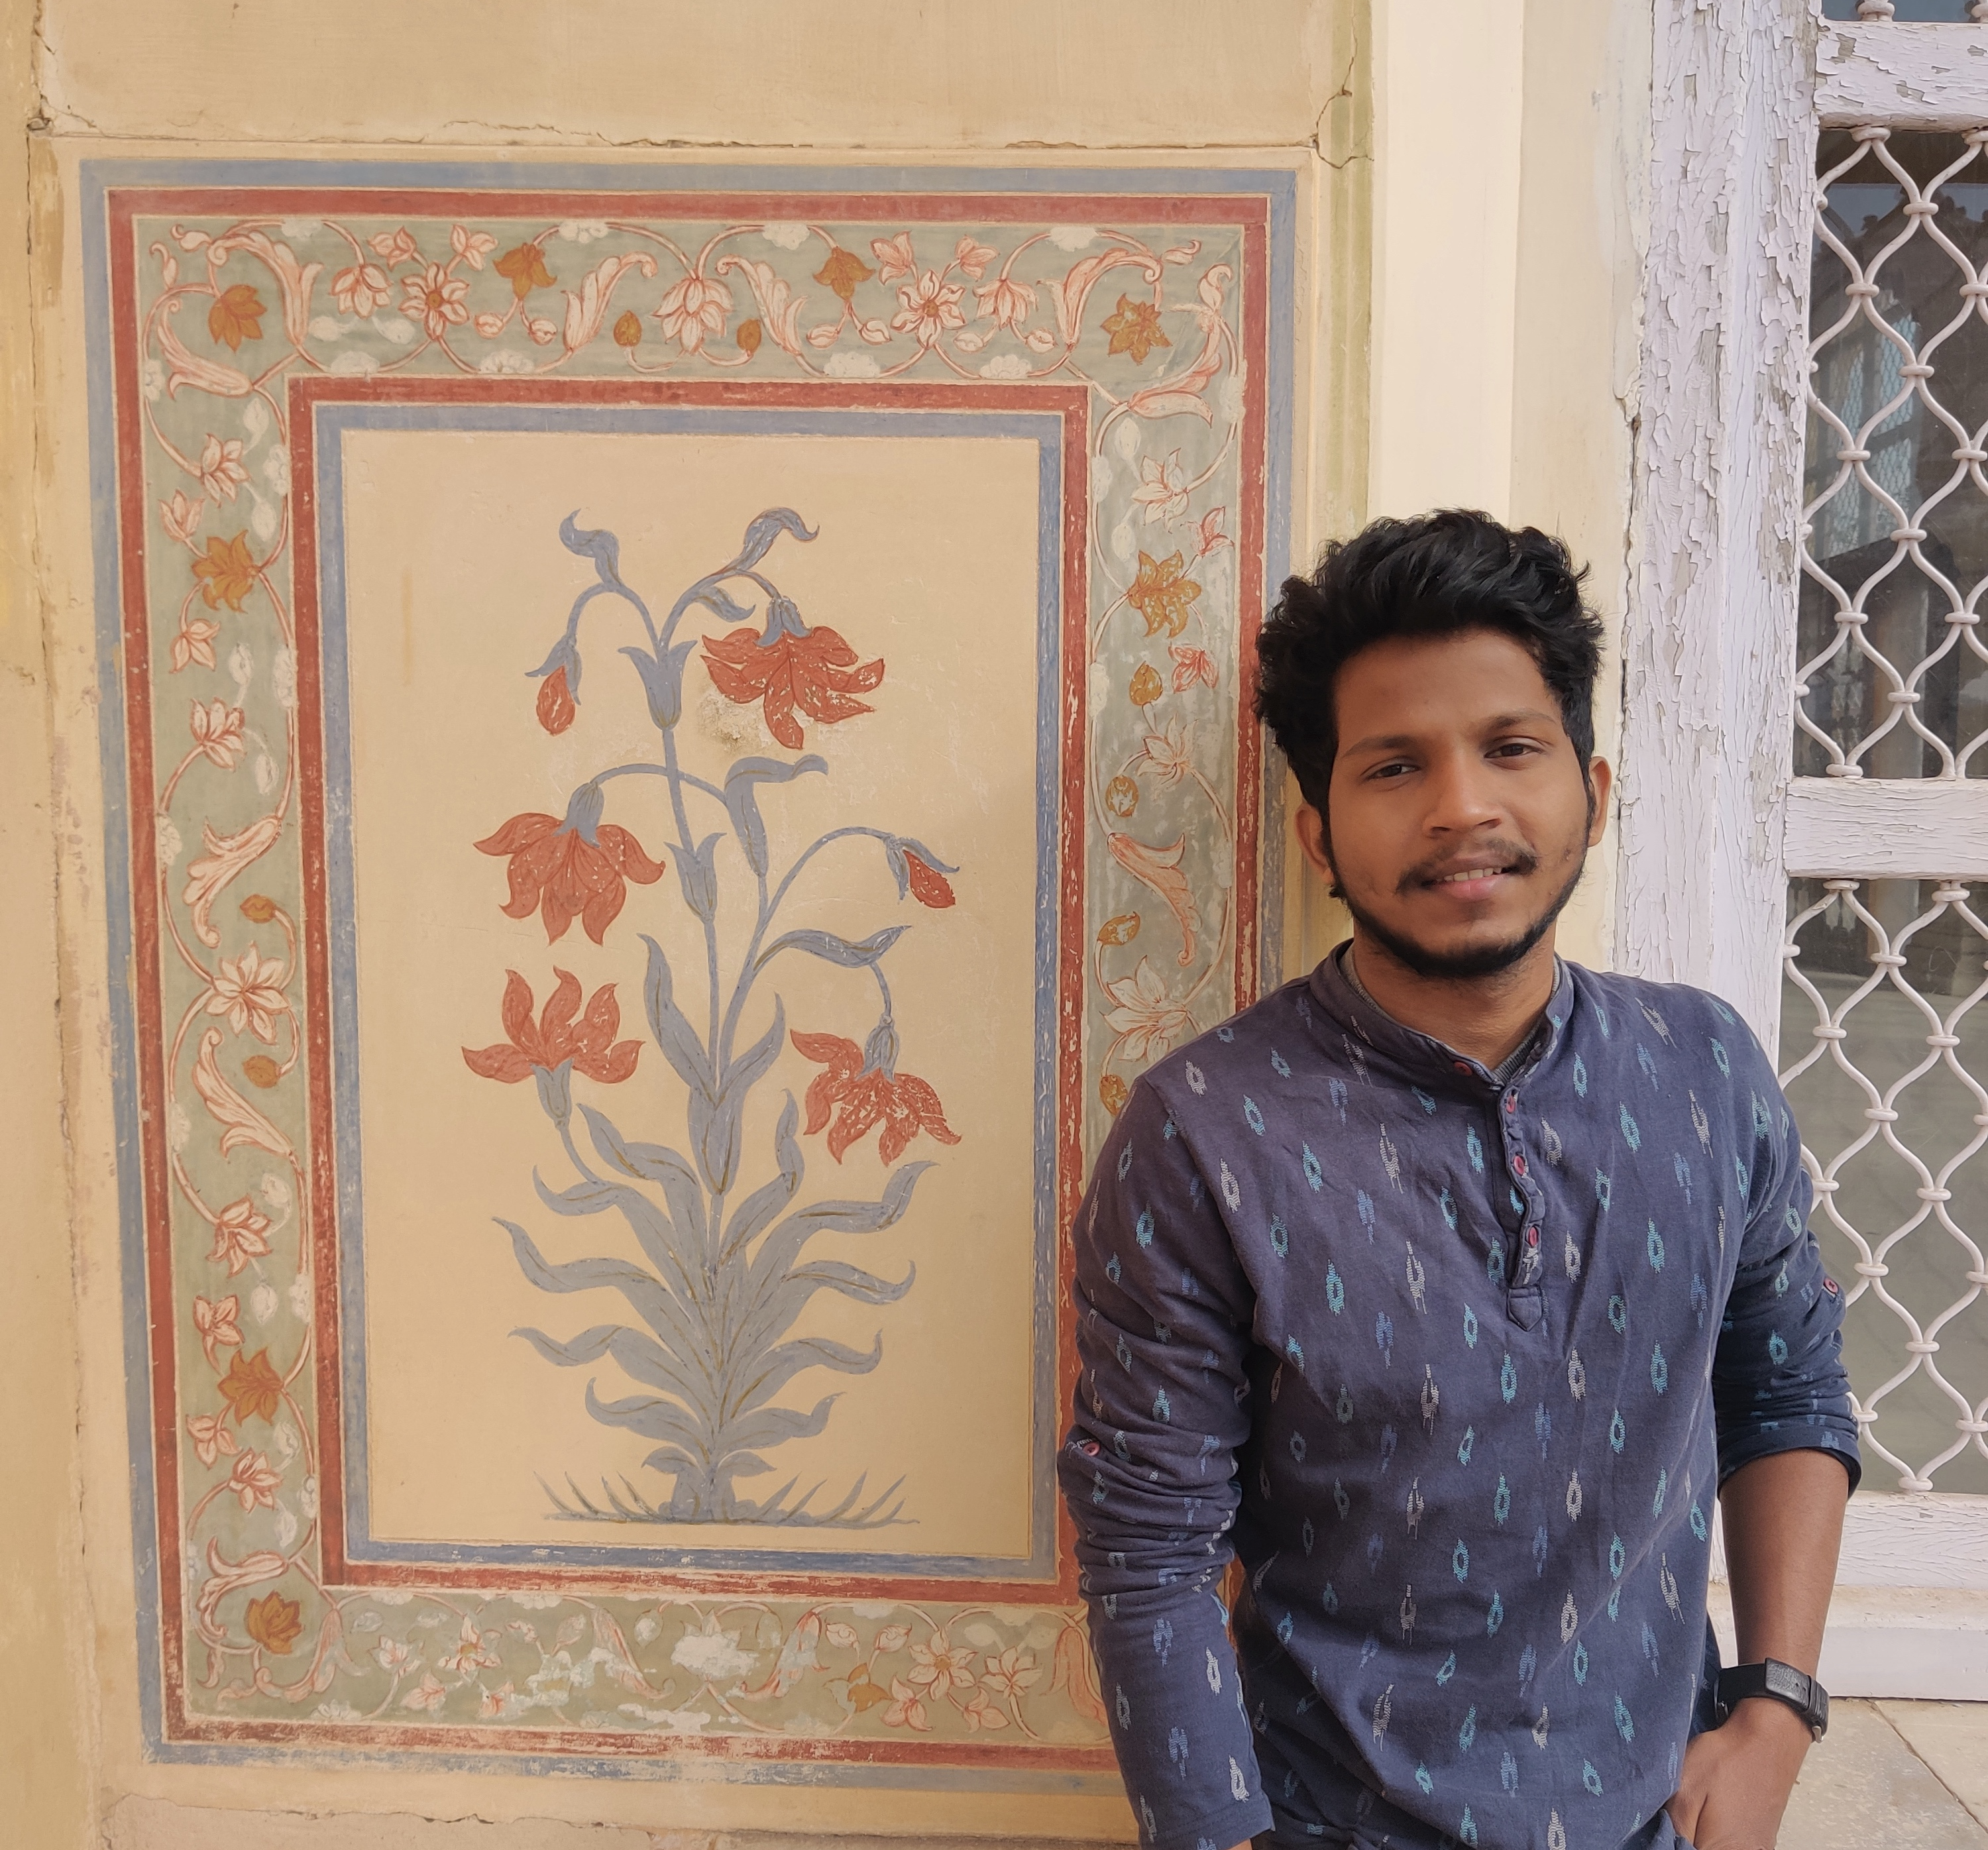
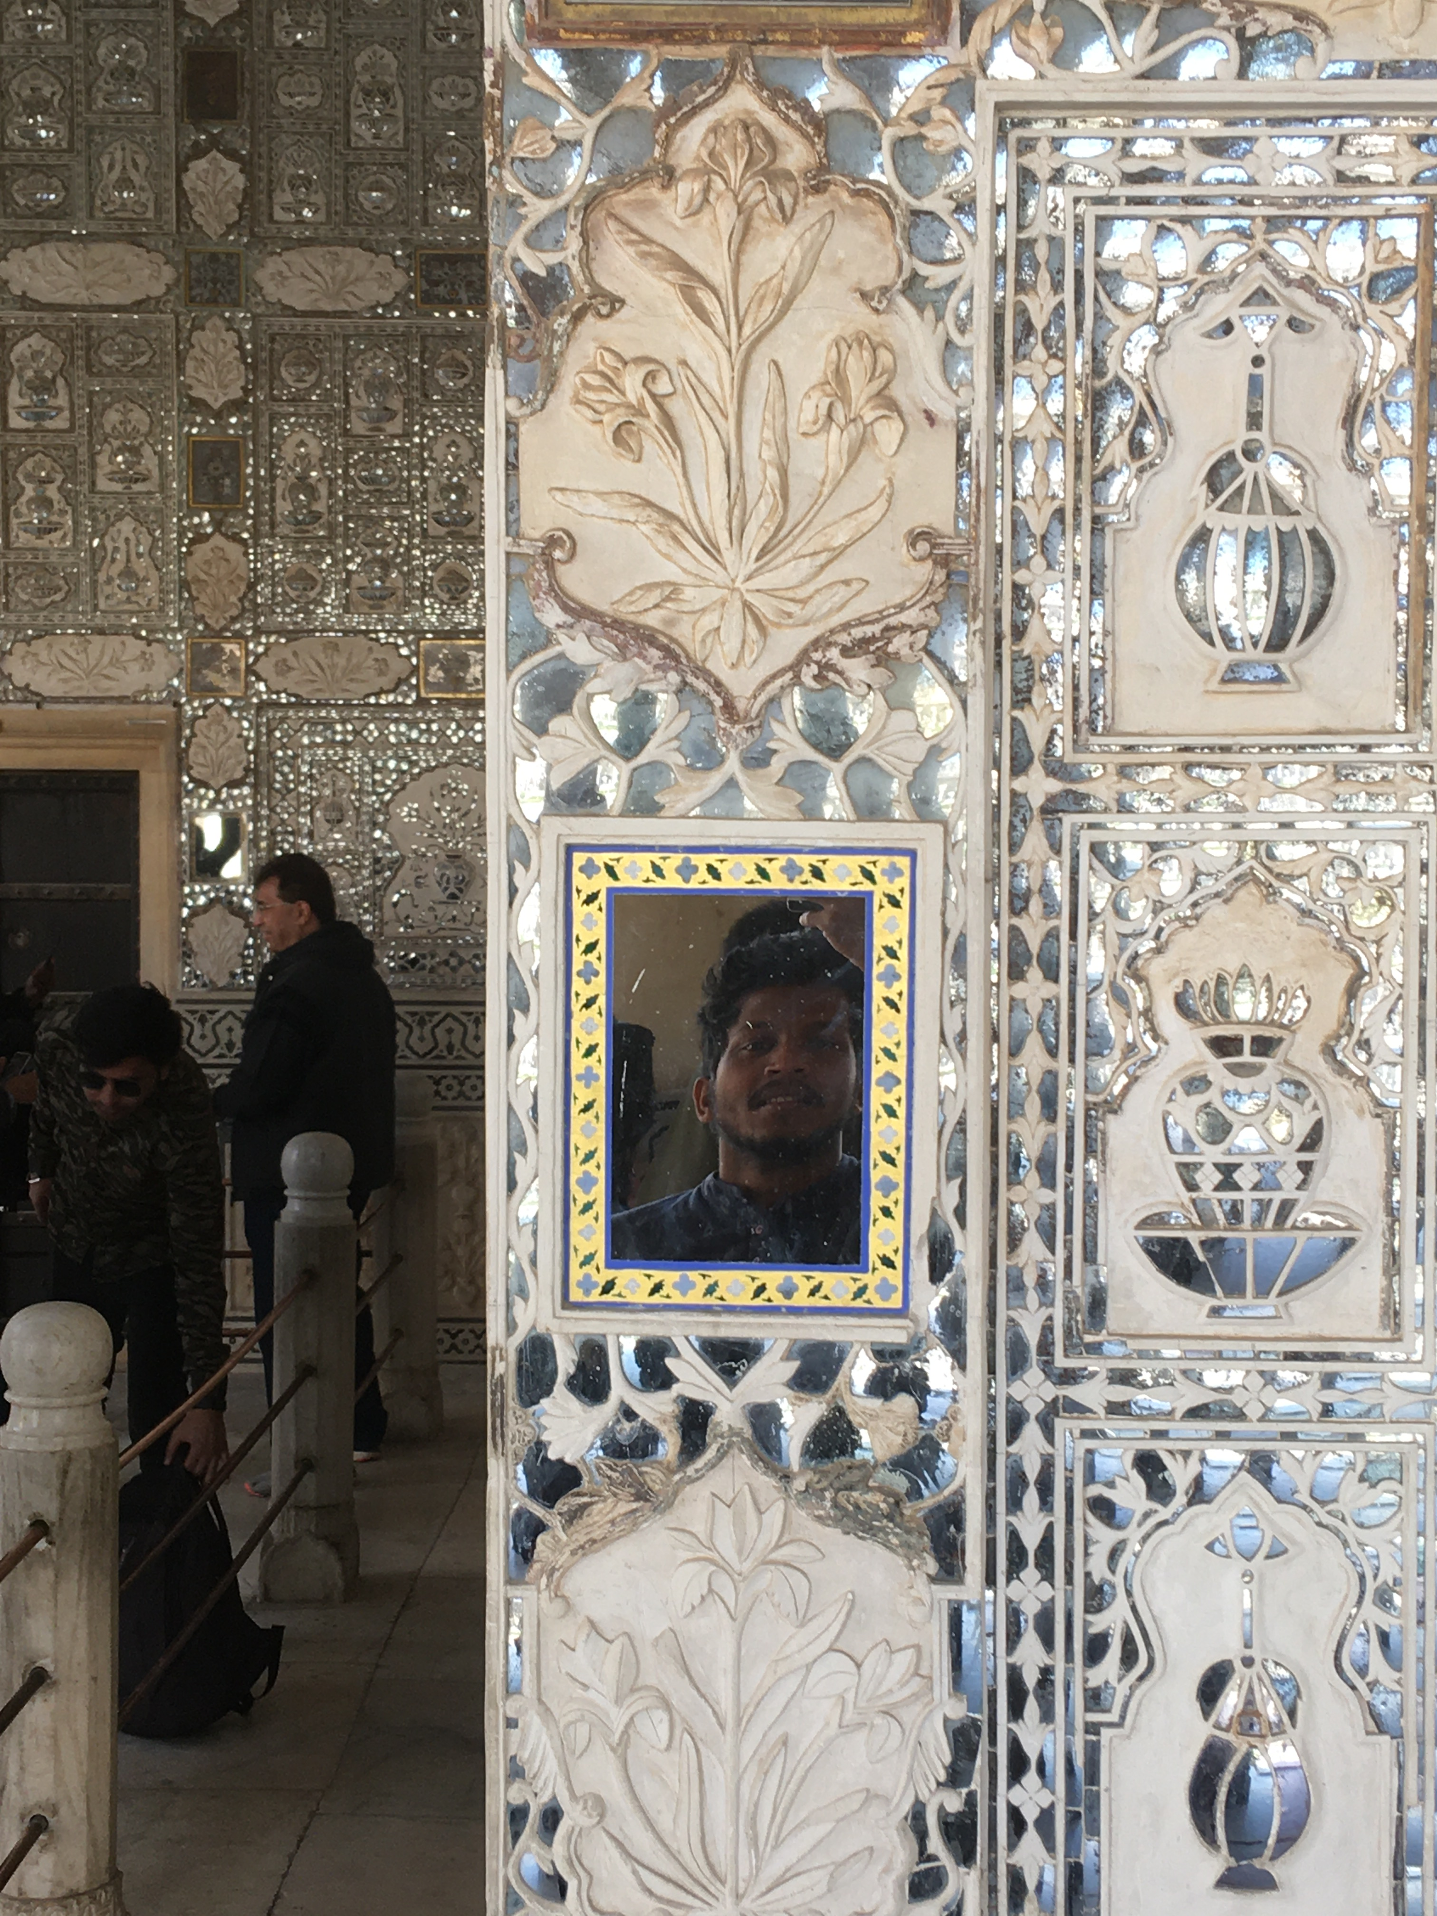
LOTUS IN INDIAN ART AND ARCHITECTURE

Slide 10
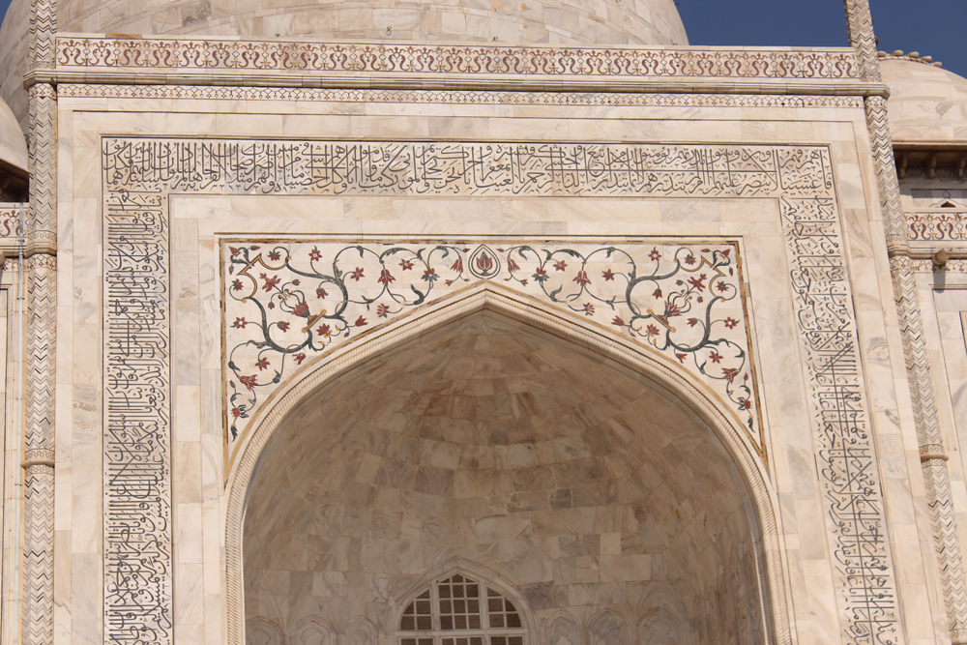
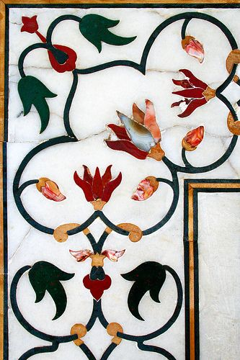
LOTUS IN TAJ MAHAL

Slide 11
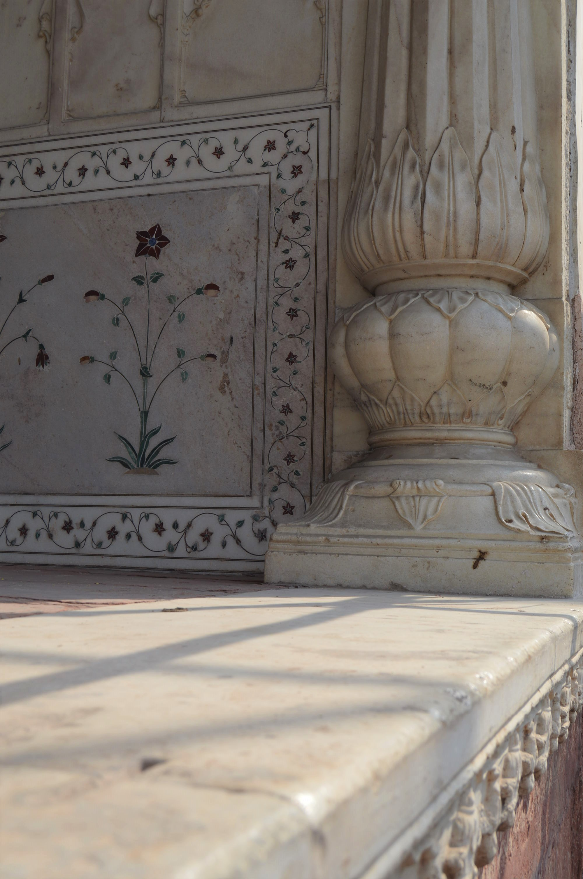
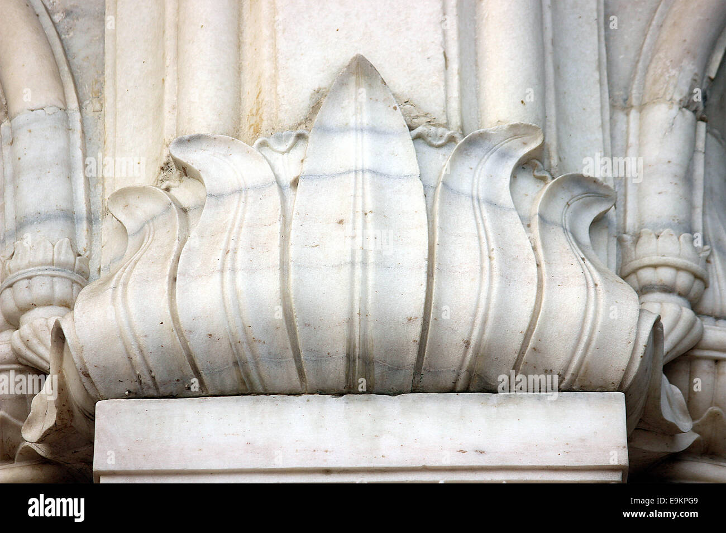
LOTUS IN TAJ MAHAL

Slide 12
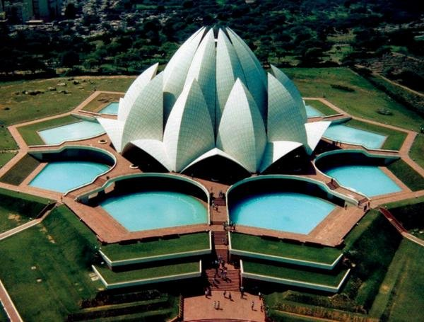
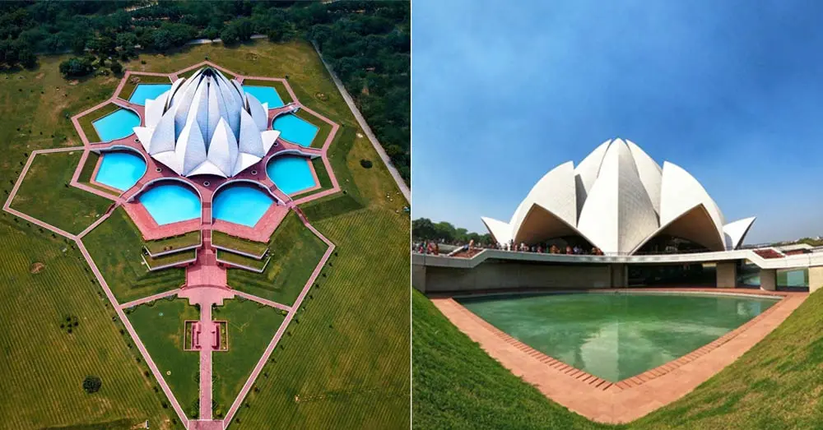
LOTUS TEMPLE

Slide 13
LOTUS ORIGAMI
https://www.youtube.com/watch?v=LWsL-_pgmTc&t=3s

