Slide 1
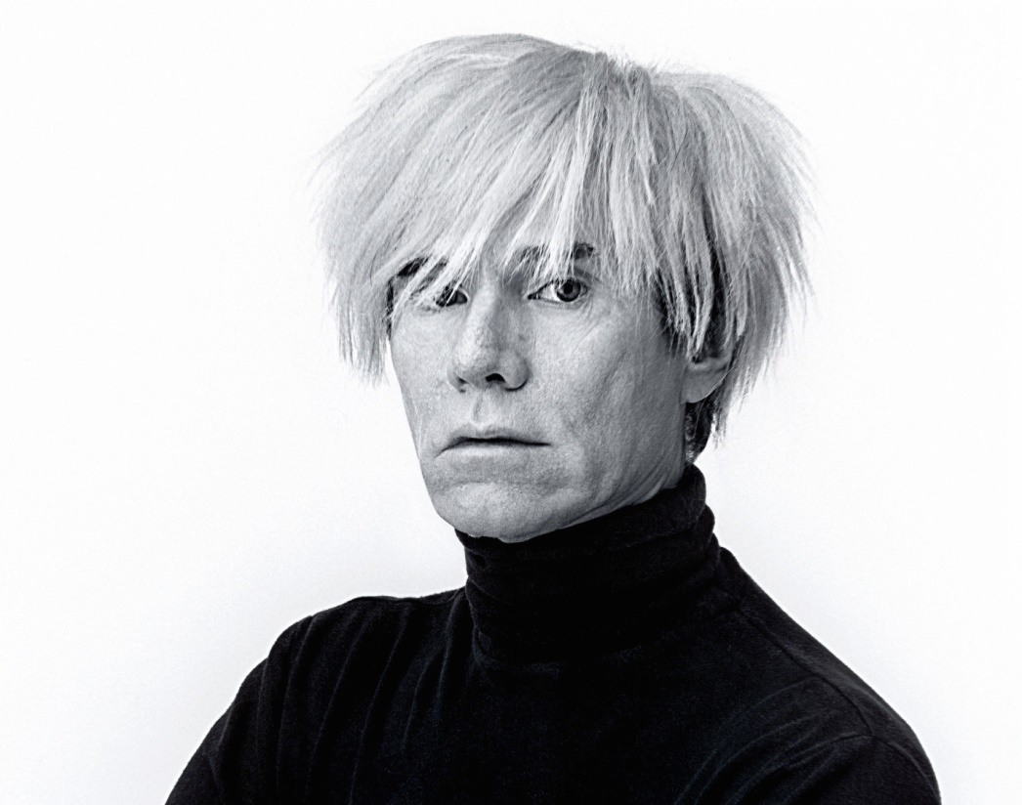
ANDY WARHOL Pittsburgh, 1928 - Nueva York, 1987

Slide 2
Andy Warhol
Born on August 6, 1928, in Pittsburgh, Pennsylvania
Andy Warhol was a successful magazine and ad illustrator.
Died on February 22, 1987, in New York City.

Slide 3
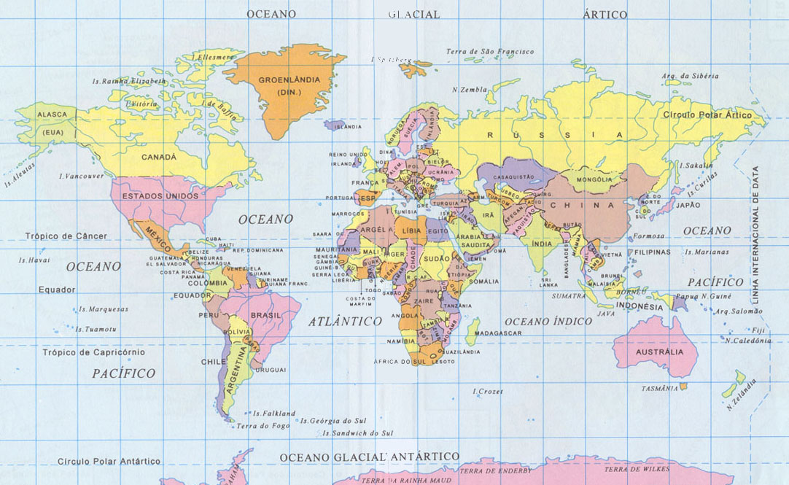

Slide 4
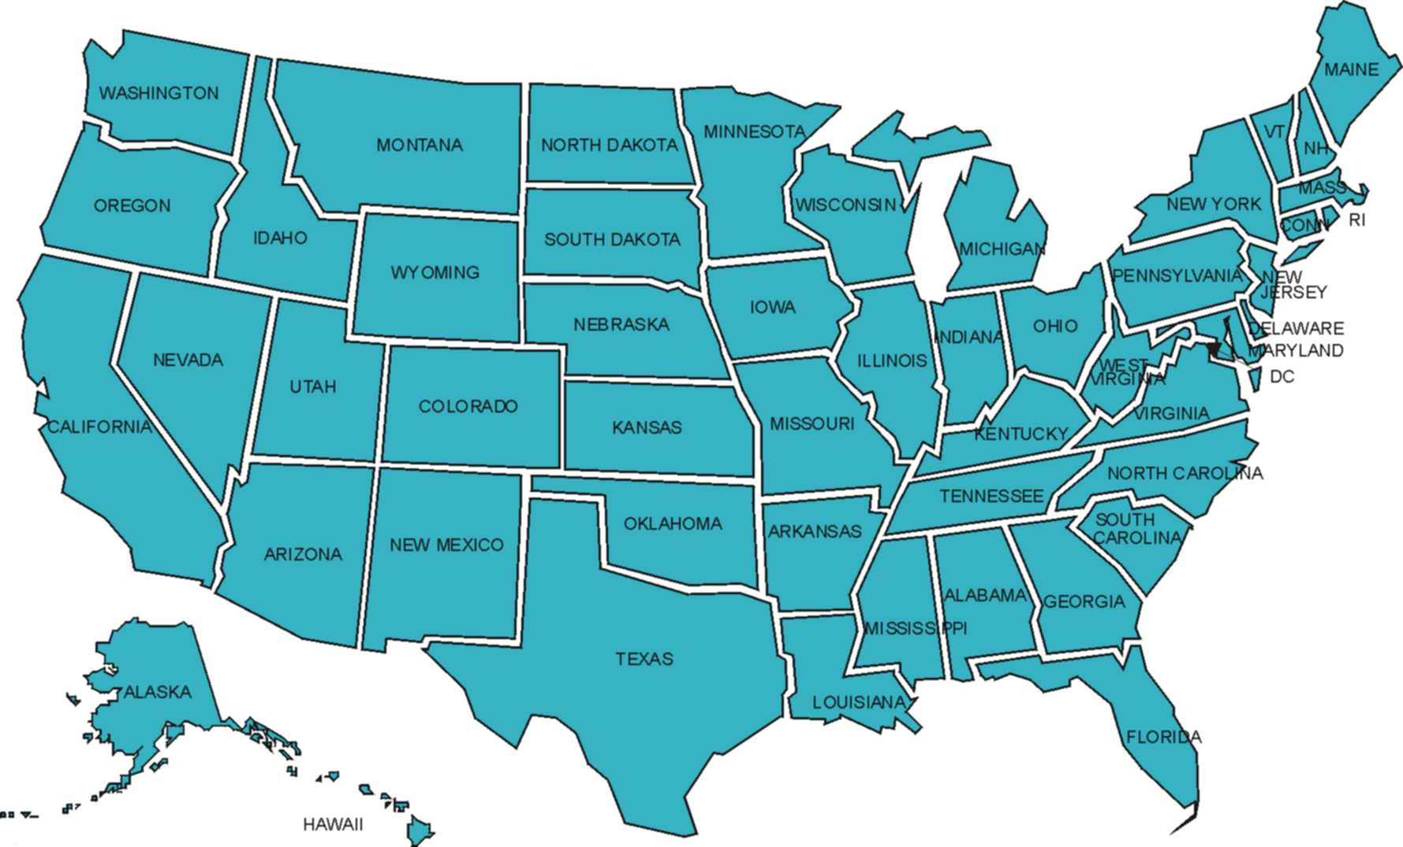

Slide 5
- Pop art is a type of art
- The word “pop” stands for the word “popular”
- Main characteristics: bright colours, popular and the subject is repeated.
- A. Warhol started painting daily objects of mass production ( “Campbell Soup cans”, “Coke bottles”,…)
- Pop Art was born in Europe, but Andy Warhol made it world famous.

Slide 7
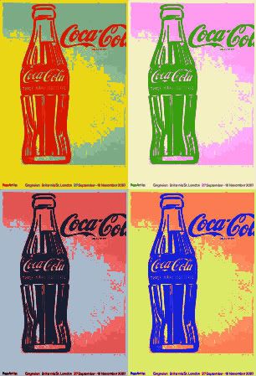
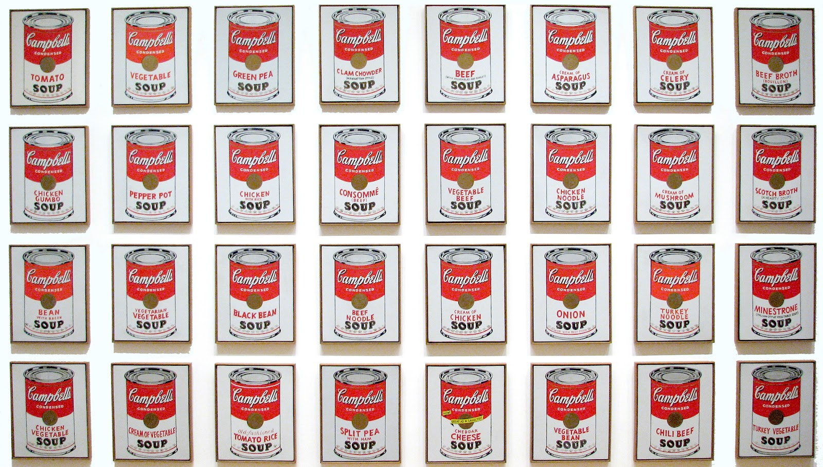
“Campbell Soup cans” “Coke bottles”

Slide 8
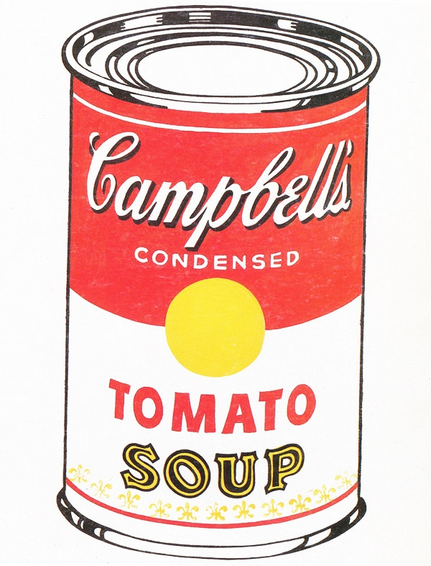

Slide 9
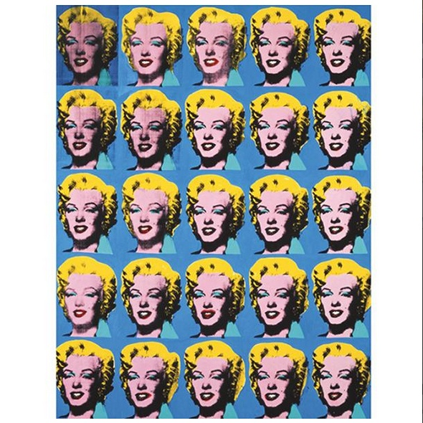

Slide 10
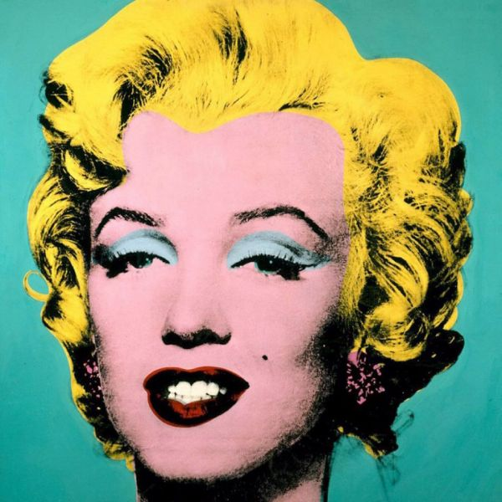

Slide 11
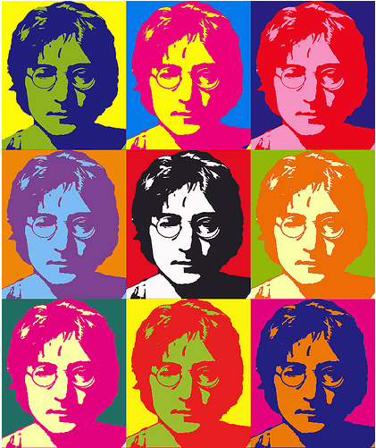

Slide 12
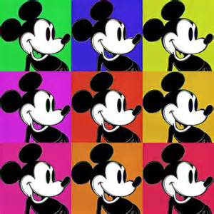

Slide 13
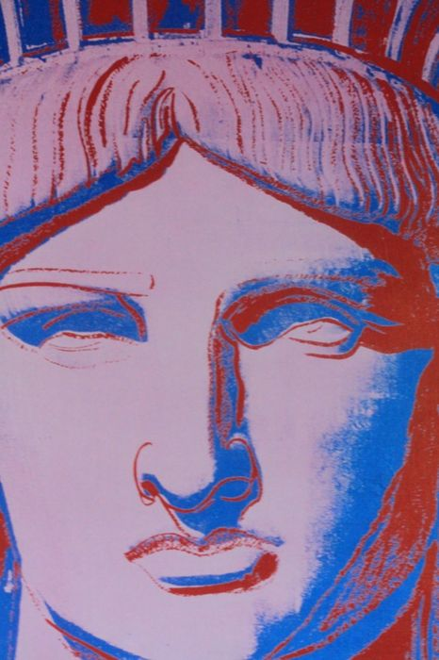

Slide 14
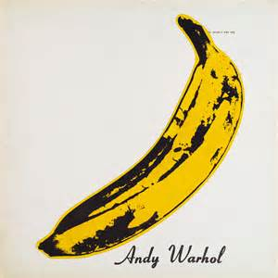

Slide 15
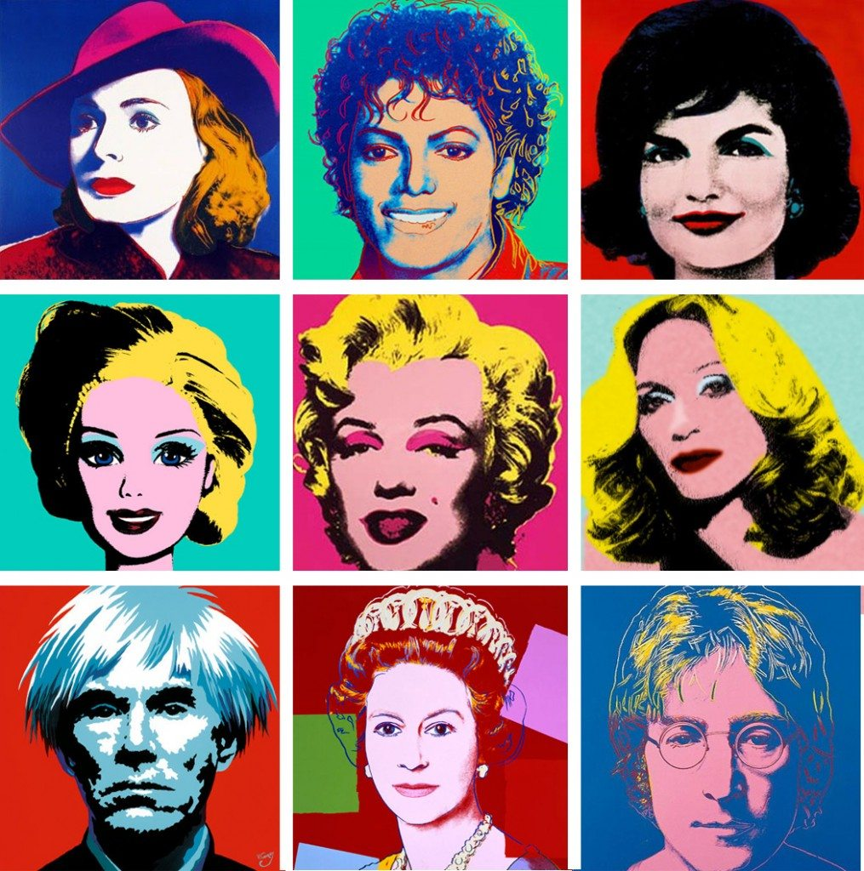

Slide 16
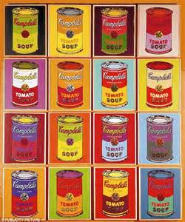

Slide 17
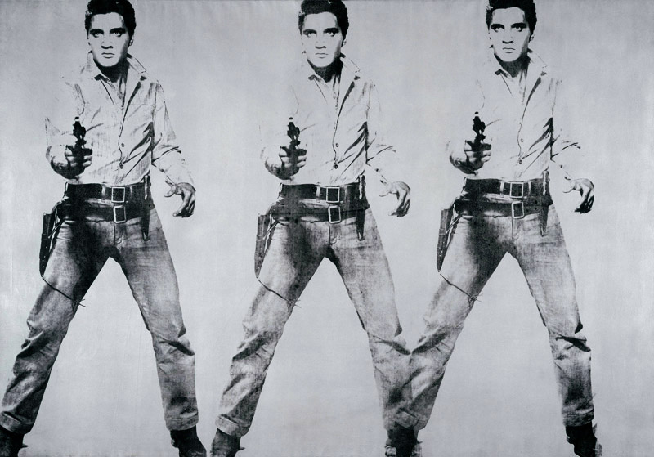

Slide 18


Slide 19
Questions: 1.- What is the name of the artist you learned about ? 2.- What country was he from? 3.- What kind of art was he famous for? 4.- Do you know any “Pop Art” characteristics?

