Slide 1
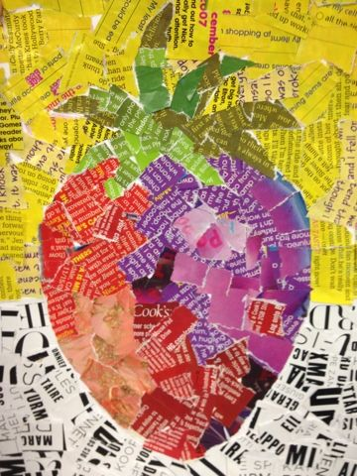
FRUIT

Slide 2
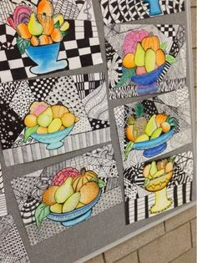
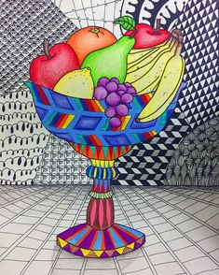

Slide 3
How to make a collage
https://www.youtube.com/watch?v=4OWyVT-4nXA

Slide 4

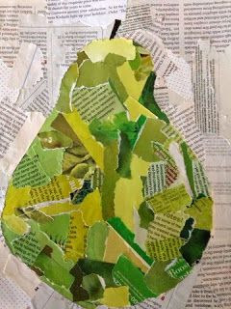

Slide 5
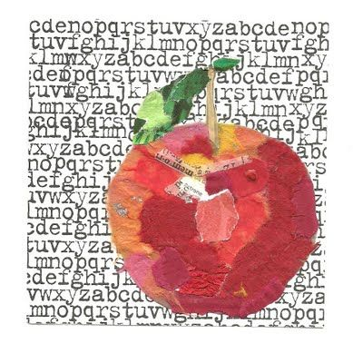

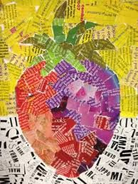

Slide 6
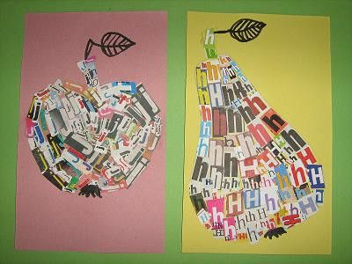
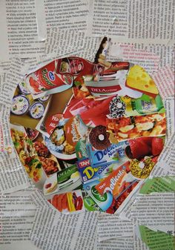

Slide 7
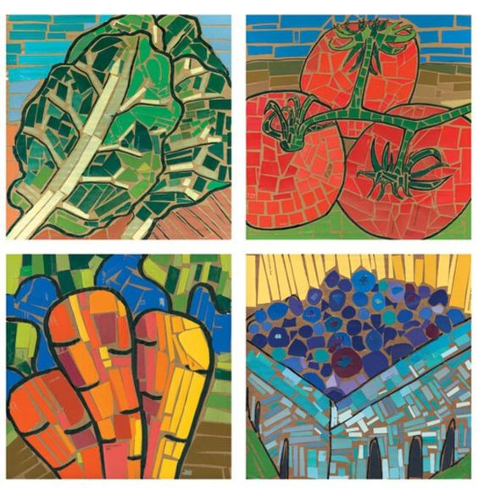
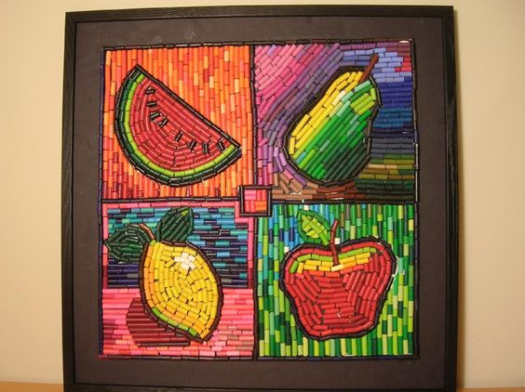
HOW TO DRAW FRUIT

Slide 8
MATERIALS: SCISSORS, GLUE STICK, CONSTRUCTION PAPER.
1. DRAW THE BACKGROUND.
2. SELECT THE PAPERS FOR THE BACKGROUND.
3. DRAW THE FRUIT (BIG FRUIT, PLEASE).
4. CHOOSE THE COLOURS YOU NEED FOR THE FRUIT.

Slide 9
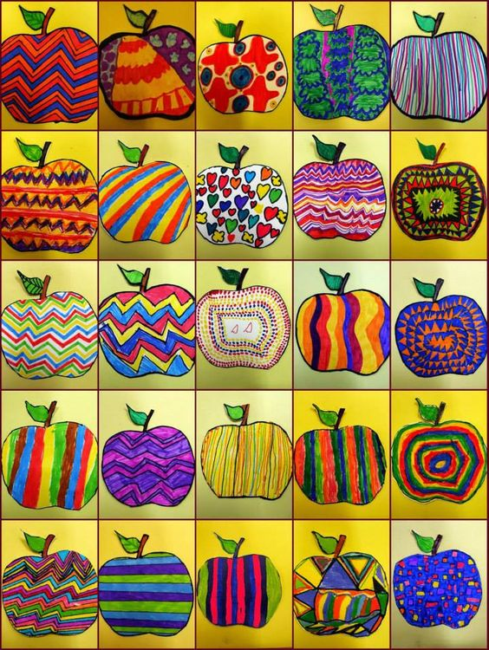
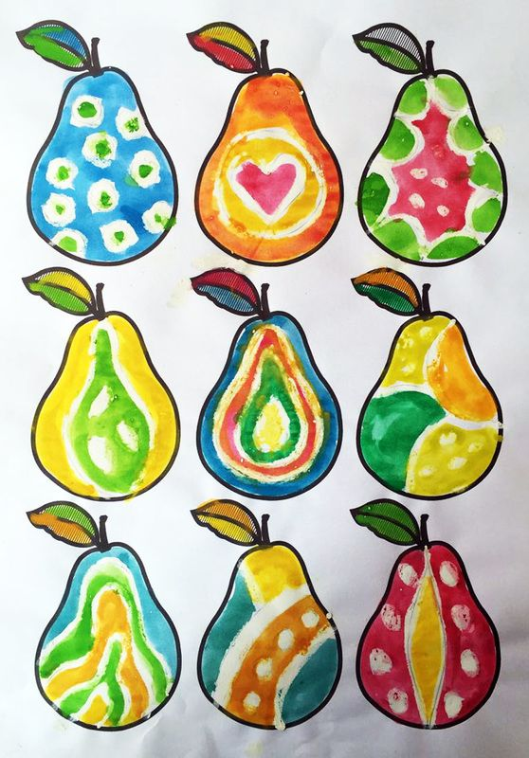

Slide 10
