Slide 1
Medidas de Presión en Motores de Combustión Interna
Noel Alonso
Kistler Ibérica SLU
1
2
3
4
dinamómetro
Notes:
Contents:
Cylinder pressure measurement
Information derived from cylinder pressure measurement
Most common plots
Thermal shock
Pipe oscillations
Applications

Slide 2
Aplicación más habitual:
Medida de presión en Cilindro.
p / Q
Q / V
Cálculos
V
A
Mem.
D
Marcas de ángulo
Referencias Cíclicas
Notes:
The coloured (grey) areas in above measuring chain represent the range of products we are offering for combustion R&D:
p/Q
represents a piezoelectric pressure transducer. Its output is an electric charge corresponding to the change of cylinder pressure.
Q/V
stands for a charge amplifier. Charge amplifiers convert electric charge to Voltage and amplify the Voltage signal as needed. Modern amplifiers are designed for operation close to the sensor in order to reduce the risk of electric interference.
Crank angle marks
are needed for triggering the data acquisition in the combustion analyzer.
Cyclic trigger marks
are the reference for the TDC position of a selected cylinder.
Like a. m. crank angle marks the cyclic trigger marks are a necessary input for the combustion analyzer.
The white areas are function inside of a combustion analyzer.

Slide 3
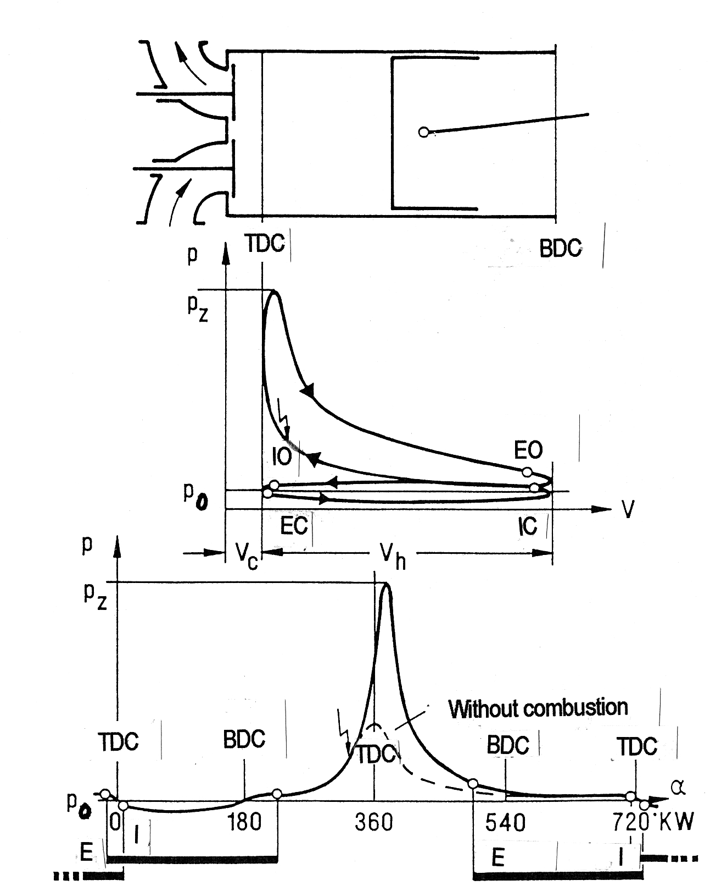
Ciclo en un motor de 4 tiempos.
TDC Top dead center
BDC Bottom dead center
IO Inlet opening
IC Inlet closing
EO Exhaust opening
EC Exhaust closing
I Inlet
E Exhaust
V_{h} Displacement
V_{c} Compression space
Notes:
The 4-stroke combustion process can be plotted in 2 types of diagrams:
1. Pressure versus cylinder volume, called p-V diagram
2. Pressure versus crank angle, called p-Alpha diagram
In most cases cylinder pressure curves are displayed for one specific combustion cycle at a time, i.e. 720° crank angle.

Slide 4
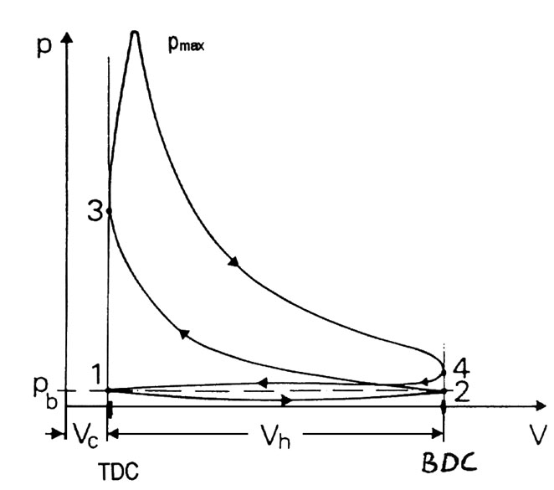
Información proporcionada por la medida de presión en cámara (1)
IMEP:
Medida de trabajo
Determinación de
• Pérdidas por fricción
• Pérdidas por int.
de gases
• Variaciones ciclo a
Ciclo. Estabilidad.
• Fallos de encendido.
• Respuesta.
V_{c} = Volumen de compresión.
V_{h} = Desplazamiento.
p_{b} = Presión ambiente.
+
-
Notes:
Knowledge of the pressure is the key to controll the combustion process.
Close up view on the pressure versus cylinder volume diagramm.
Intake
Compression
Combustion: Pressure on piston produces torque
Exhaust
IMEP:
Indicated mean effective pressure translates directly into available work (normalized).
High pressure curve is positive.
Low pressure loop is work put into the process.
Charge cycle loss, heat release and transfer directly influence the pressure loop.

Slide 5
Presión Media Efectiva:
Combustión – Pérdidas.
Notes:
The „family“ of mean effective pressures:
Gross mean effective pressure (high pressure portion of 4-stroke cycle)
Indicated (net) mean effective pressure
Break mean effective pressure
Friction mean effective pressure
Power output of a 4-stroke engine:
P_{i} = (n/2) W = (n/2) imep.V_{s}
P_{e} = P_{i} - P_{r}

Slide 6
Información proporcionada por la medida de presión en cámara (2)
Notes:
Further information derived from cylinder pressure measurements:
Mechanical load on drive train
Knocking
Combustion noise
Combustion efficiency
Left cursor line: Crank angle position of start of combustion
Center cursor line: Crank angle position of 50% heat release
Right cursor line: Crank angle position of 90/95% heat release (end)
Qualitative emission values
Quality of the ignition system
Energy balance
Cylinder charge, residual exhaust gas, backflow
Formation of fuel/air mixture
Ignition system

Slide 7
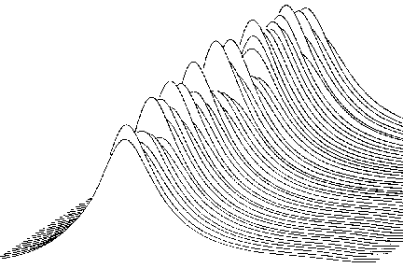
Curvas más habituales:
Curvas relativas al TDC / ciclos.
Measurement
40
30
20
10
0
bar
Result values
Cylinder pressure
3.4
bar
3.0
IMEP
α
-60 0 60 120 180
20
deg
0
deg CA
α(p_{max})
0 20 40 60 80 100
Cycle
Statistics
Maximum
Mean value
Minimum
Coefficient of variance
IMEP
Notes:
How are sensor specifications related to the needs of customers?
For a user of sensors it is convenient to relate sensor specifications not only to basic properties such as sensitivity and linearity but, also to typical combustion parameters. These sensor specifications on the basis of typical combustion parameters allow for more precise selection of the required quality (type) of sensors according to the specific application.
The following specifications of cylinder pressure sensors are directly related to combustion parameters. The values are given for the 6052C High Temperature Pressure Sensor:
Calibrated ranges 0…50 bar, 0…100 bar, 0…150 bar
and 0…250 bar
Natural frequency of sensor only 160 kHz
Sensitivity shift <= +/- 0.5 % at 150…250 °C
<= +/- 2 % at 23…350 °C
Short term drift (thermal shock)
Reference conditions Speed 1500 rpm, load 9 bar imep
∆ p <= +/- 0.5 bar
∆ imep <= +/- 2 %
∆ pmax. <= +/- 1 %

Slide 8
Choque Térmico
Encapsulado del sensor
Elemento de medida piezoeléctrico
Diafragma del Sensor
Notes:
Reason for thermal shock
Thermal shock (also called short-term drift) is a short-term measuring error that arises periodically in each combustion cycle. It is caused by time-dependent thermal stresses in the sensor diaphragm induced by the heat flow of the hot combustion gases, which can reach temperatures of over 2000°C for a few milliseconds.
Impact on sensors
The deformations of the diaphragm create the illusion of a change in pressure. The extent to which the measurement result is falsified depends on the sensor, its mounting arrangement and the operating point of the engine. Thus in a given engine the error depends on the injection/ignition point, speed, load, etc.
Sensor specifications
The magnitude of the thermal shock is measured relative to a reference pressure sensor. As this reference sensor itself should exhibit the lowest possible thermal shock, a water cooled 7061B is used, which thanks to its low temperature error is ideal for precision thermodynamic measurements. The thermal shock corresponds to the maximum deviation between sensor under test and reference sensor.
The values relate to measurements in a test engine at 1500 rpm and 9 bar imep.

Slide 9
Oscilaciones por resonancia.
El gas en el canal de montaje puede ser excitado en forma de resonancia acústica denominada oscilaciones por resonancia debida a cambios rápidos de presión a la entrada.
Debido a las restricciones impuestas por el espacio de montaje o por el propio sensor, los sensores no pueden siempre ser montados enrasados con la cámara de combustión.
Notes:
Typical installations involving a pipe are:
How is a pipe oscillation started?
Which options do we have?

Slide 10
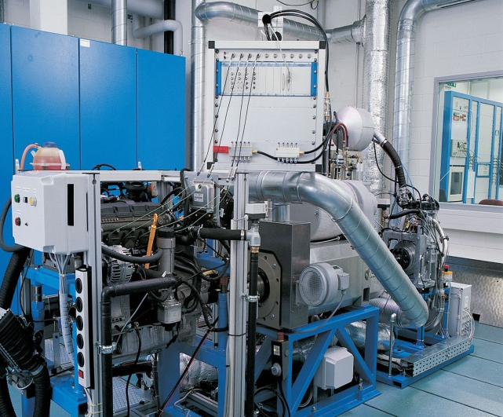
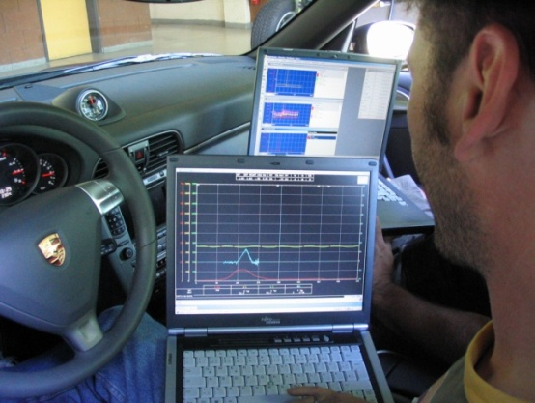
Diferentes entornos de aplicación.
Aplicación | Calibración |  | Análisis de combustión.
Análisis de intercambio de gases | Monitorización de combustión Instrumentos de campo.
Pérdidas de fricción
Análisis Termodinámico
Arranque en frío.
Análisis de detonación.
Ajuste de Motor
Monitorización Equilibrado de cilindros
Notes:
In-Vehicle Engine Calibration requiring Standard Combustion Parameters
In-vehicle combustion analysis is mostly used for engine mapping in a specific type of vehicle. Mapping means ECU tuning based on combustion parameters etc.
Important characteristics: No combustion analysis focus but ECU calibration focus.
Mean effective pressure (IMEP, NMEP,..)
Peak cylinder pressure
Location of combustion (start, 50% MFB, α(pmax))
Knock
Combustion noise level (gradient, dBA)
Injection timing, ignition delay
Combustion Analysis in Test Cell Environment
Engine test cell with close to engine measuring equipment (Front End) in boom box. The location of instruments close to the engine is called Front End. A front end arrangement of instruments involves special environmental product requirements.
Important characteristics: Functional extensions for combustion development
Combustion Monitoring in Test Cell Environment
Important characteristics: Minimum cost of ownership.
Peak cylinder pressure
Knock
Handheld Instruments for Ship Engine Monitoring and Cylinder Balancing
Important characteristics: Big hands of operators.

