Slide 1

Making Trends into Friends
Languages 2024
Trends, Horizons, Opportunities
David Marsh
Xornada galega de linguas estranxeiras. Curso 2023-2024
Saturday 11 May 2024

Slide 2

7 Trends
Fotolia

Slide 3
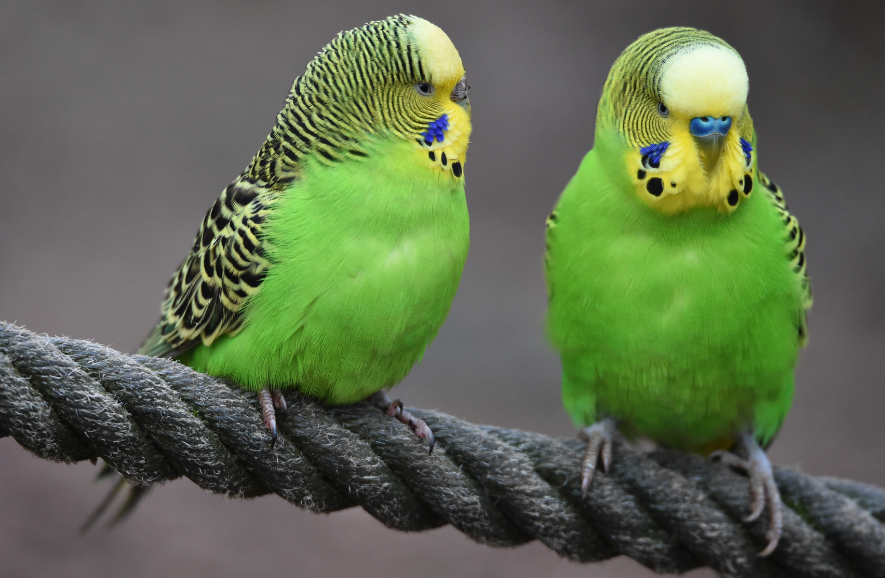
Activity 1
Please turn to the people next to you and answer:
What is special about the number 7?
Fotolia

Slide 4

2024-2030 time of major change
Fourth Industrial Revolution (4IR)
drives
Education 4.0
Fotolia

Slide 5

Integration
AI
Wellbeing
Trends
2024
Inclusion
Agency
Efficacy
Future
Readiness
Learning
Spaces

Slide 6

At the heart of these trends are the mindsets of young people
Source Macmillan

Slide 7

Activity 2
Please turn to the people next to you and answer:
Can you see changes in the way young people in Galician schools today think, feel, behave?
Choose an age range
4-7 years
8-13 years
14-18 years

Slide 8

Wellbeing
mental &
physical
Active Learning
transmission & interaction

Slide 9
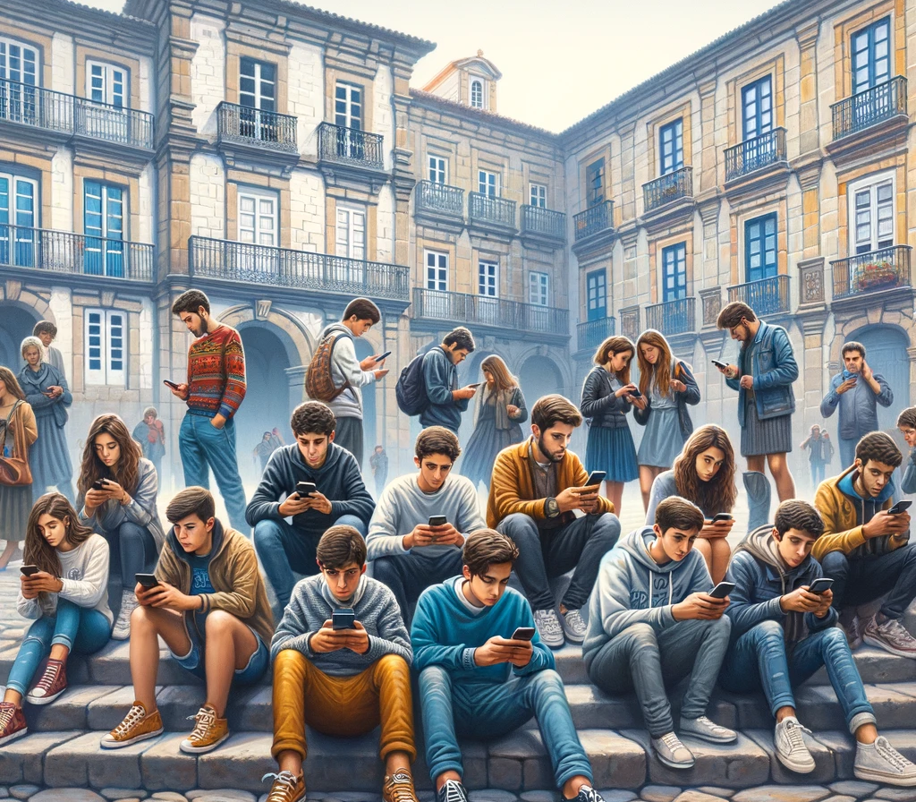
Activity 3
How many hours a week (7 days) is a 15-year old on screentime?
using digital devices

Slide 10
”the arrival of smartphone rewired an entire generation
what did we think would happen to them?”
Jonathan Haidt

Slide 11
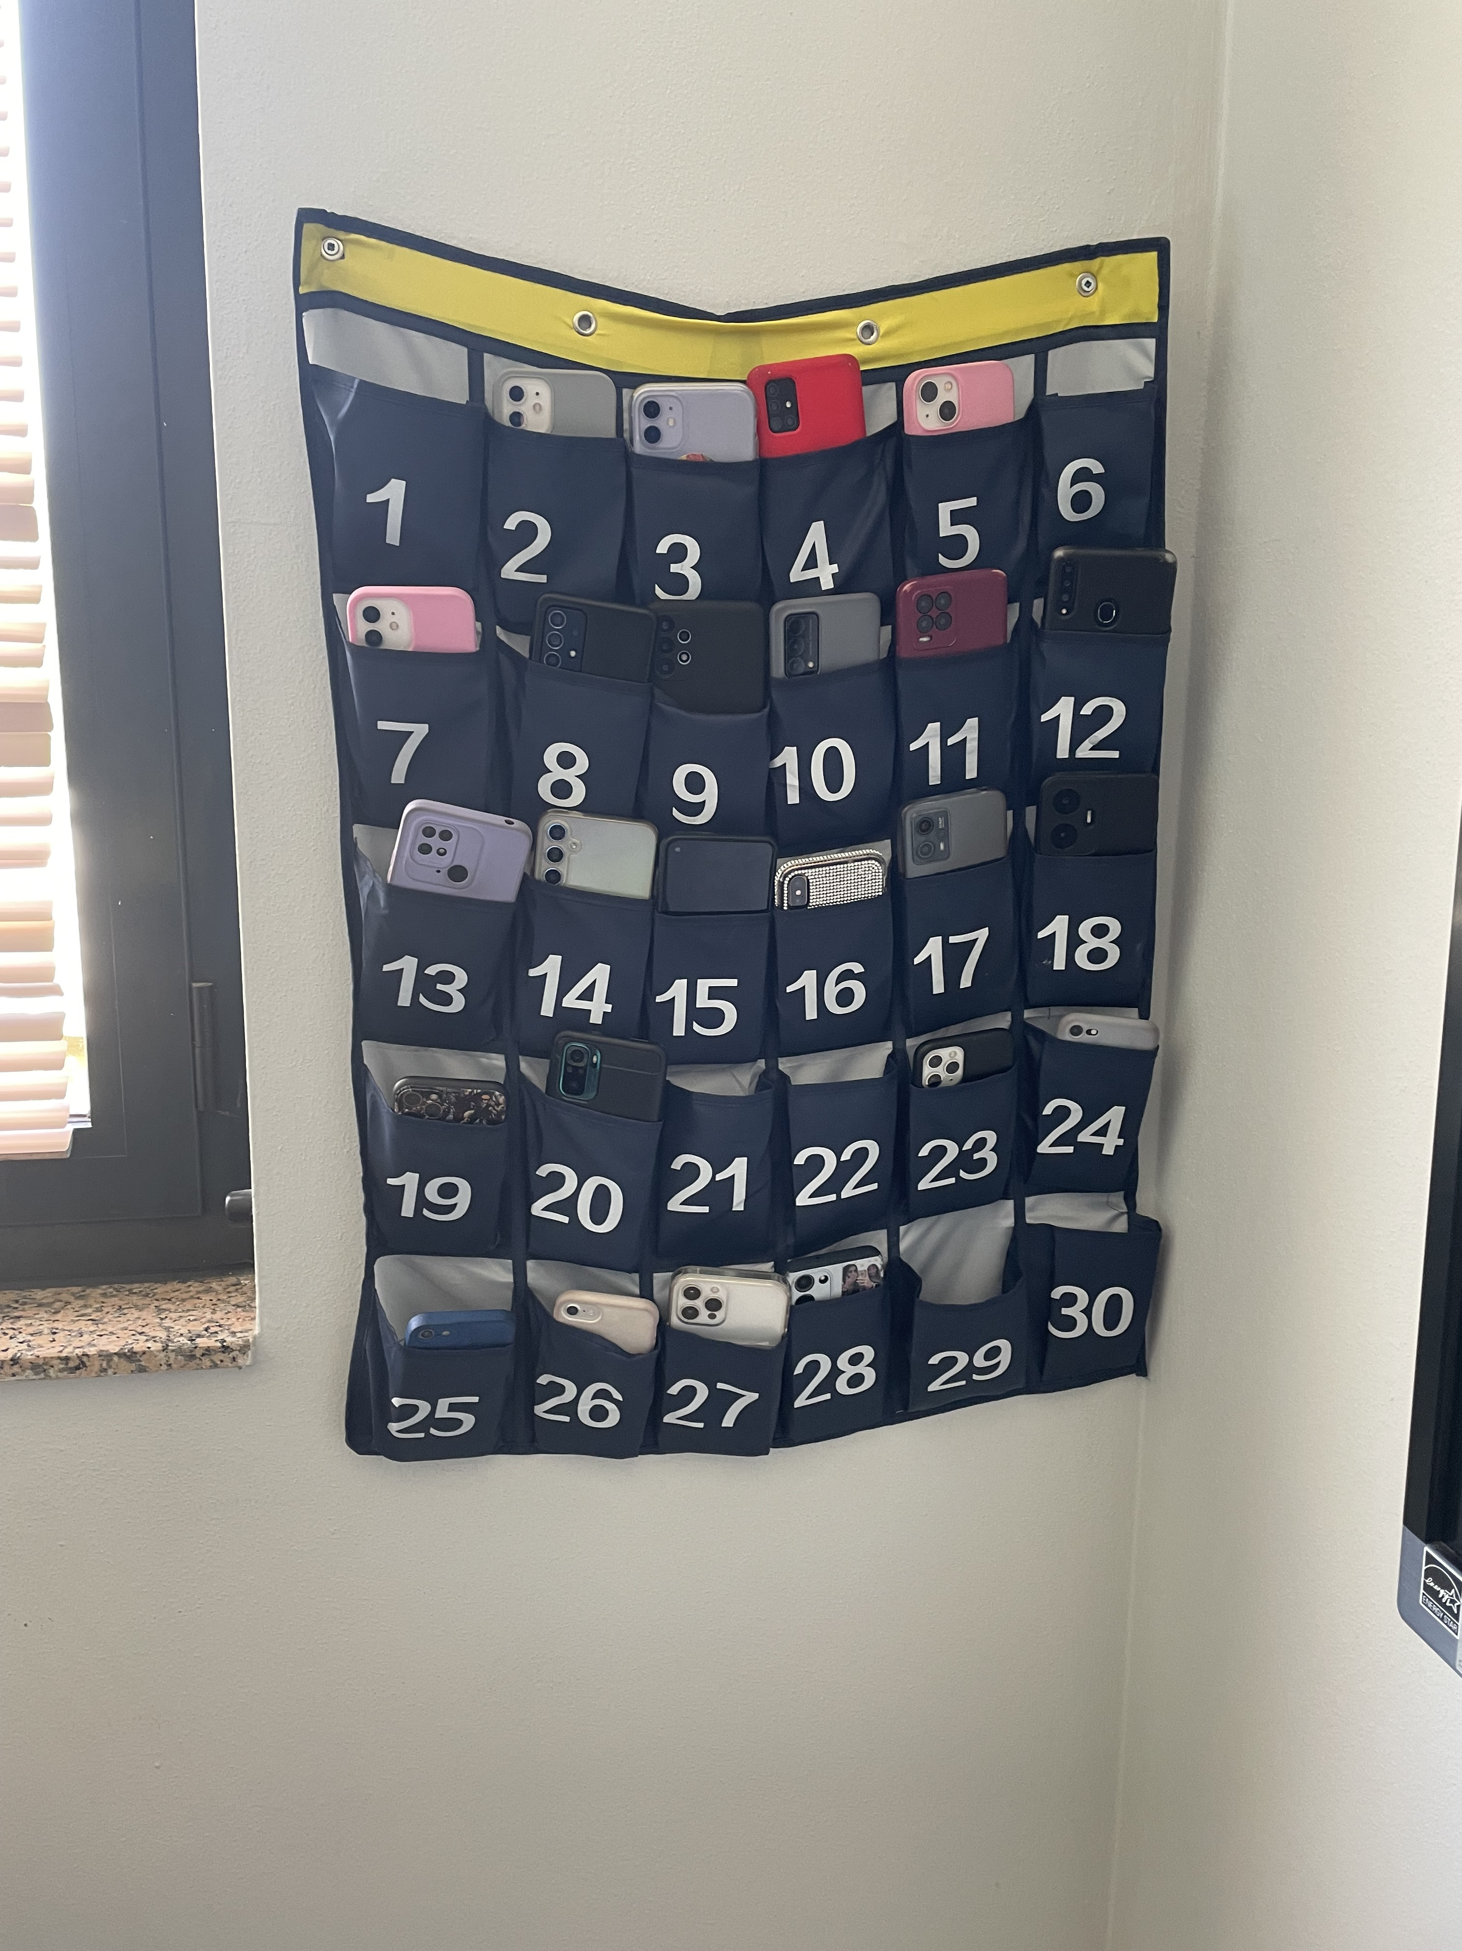
Italian High School
Phone Park

Slide 12
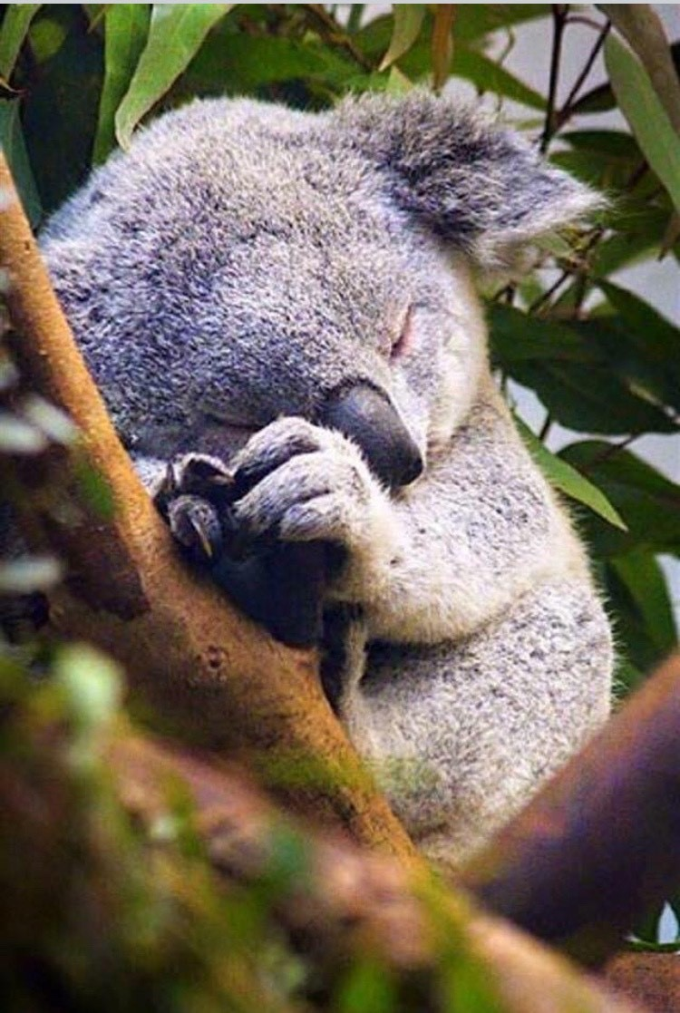
Activity 4
What would you say to a parent who asks you
What is Passive Learning?
Fotolia

Slide 13
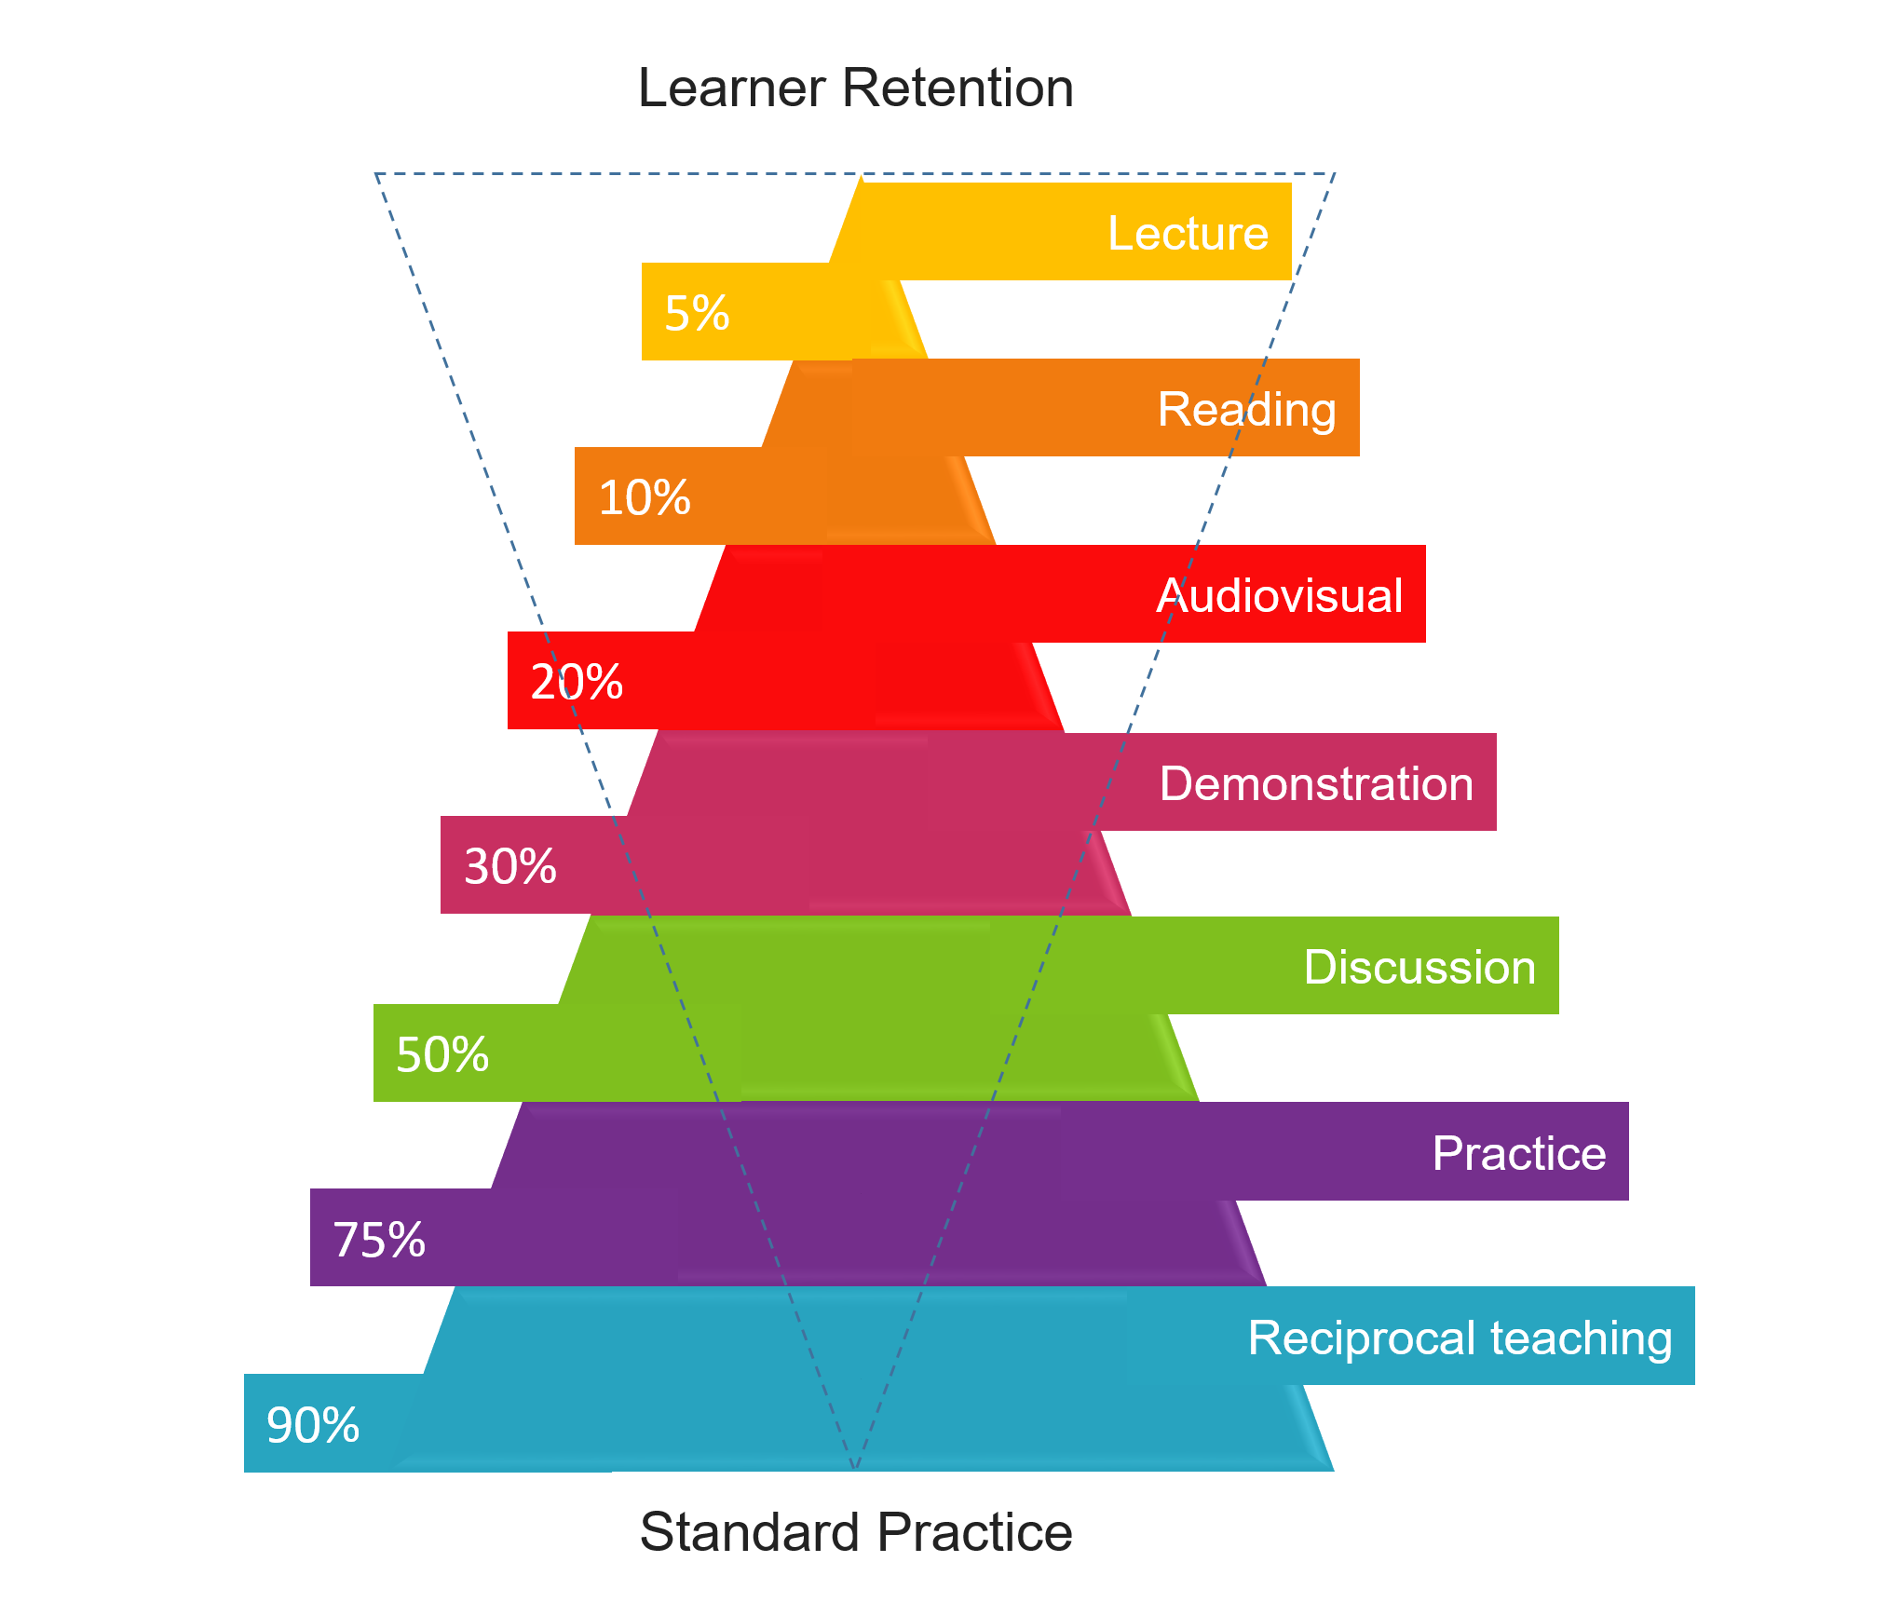
From short-term to long-term memory
Achieving deep learning
NB! Look at John Hattie Visible Learning
Representation only from National Training
Laboratories Institute 1960’s

Slide 14
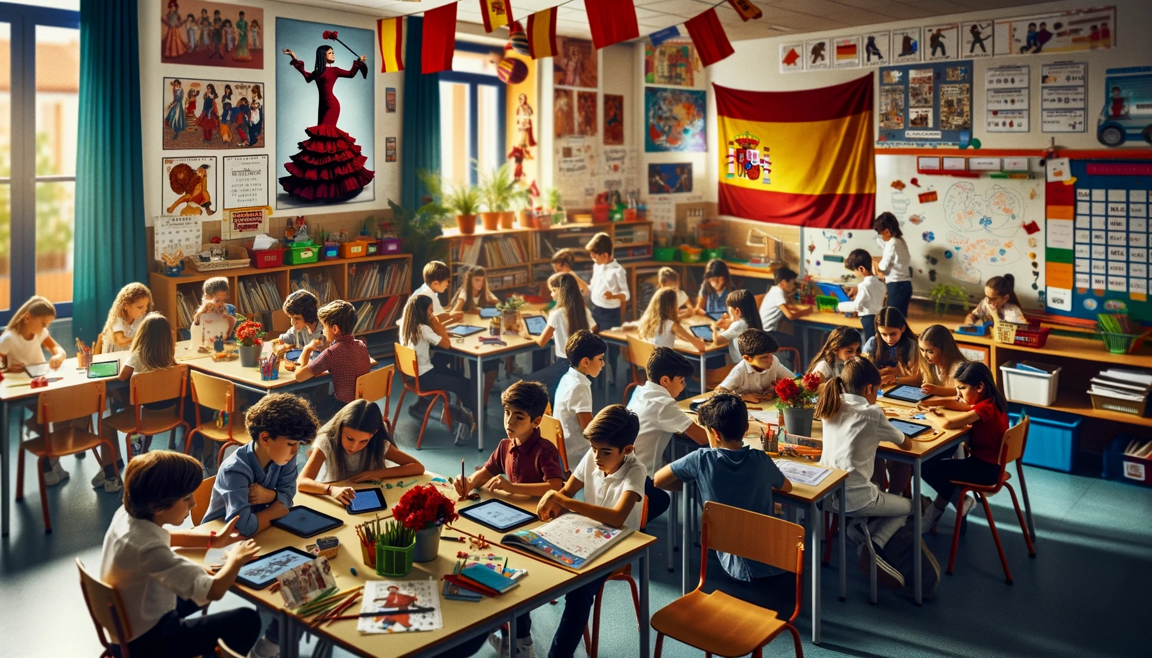
CLIL an example of integration
Teaching through an additional language
Adapted pedagogies
= bilingual approach
Successful for majority

Slide 15

If you change the language but not the pedagogies....
For example
EMI
English as Medium of Instruction
Non-adapted pedagogies
= monolingual approach
Successful for minority
Fotolia

Slide 16

CLIL
A Signature Pedagogy
Distinct teaching & learning
techniques & processes
Understanding of
the value and benefits for learners
Understanding how learners effectively learn
Shulman, 2005, MIT Press

Slide 17

A Story
Once upon a Time in Mexico
High School/College Students
c. A1 + / -
“Surely we can do better”

Slide 18
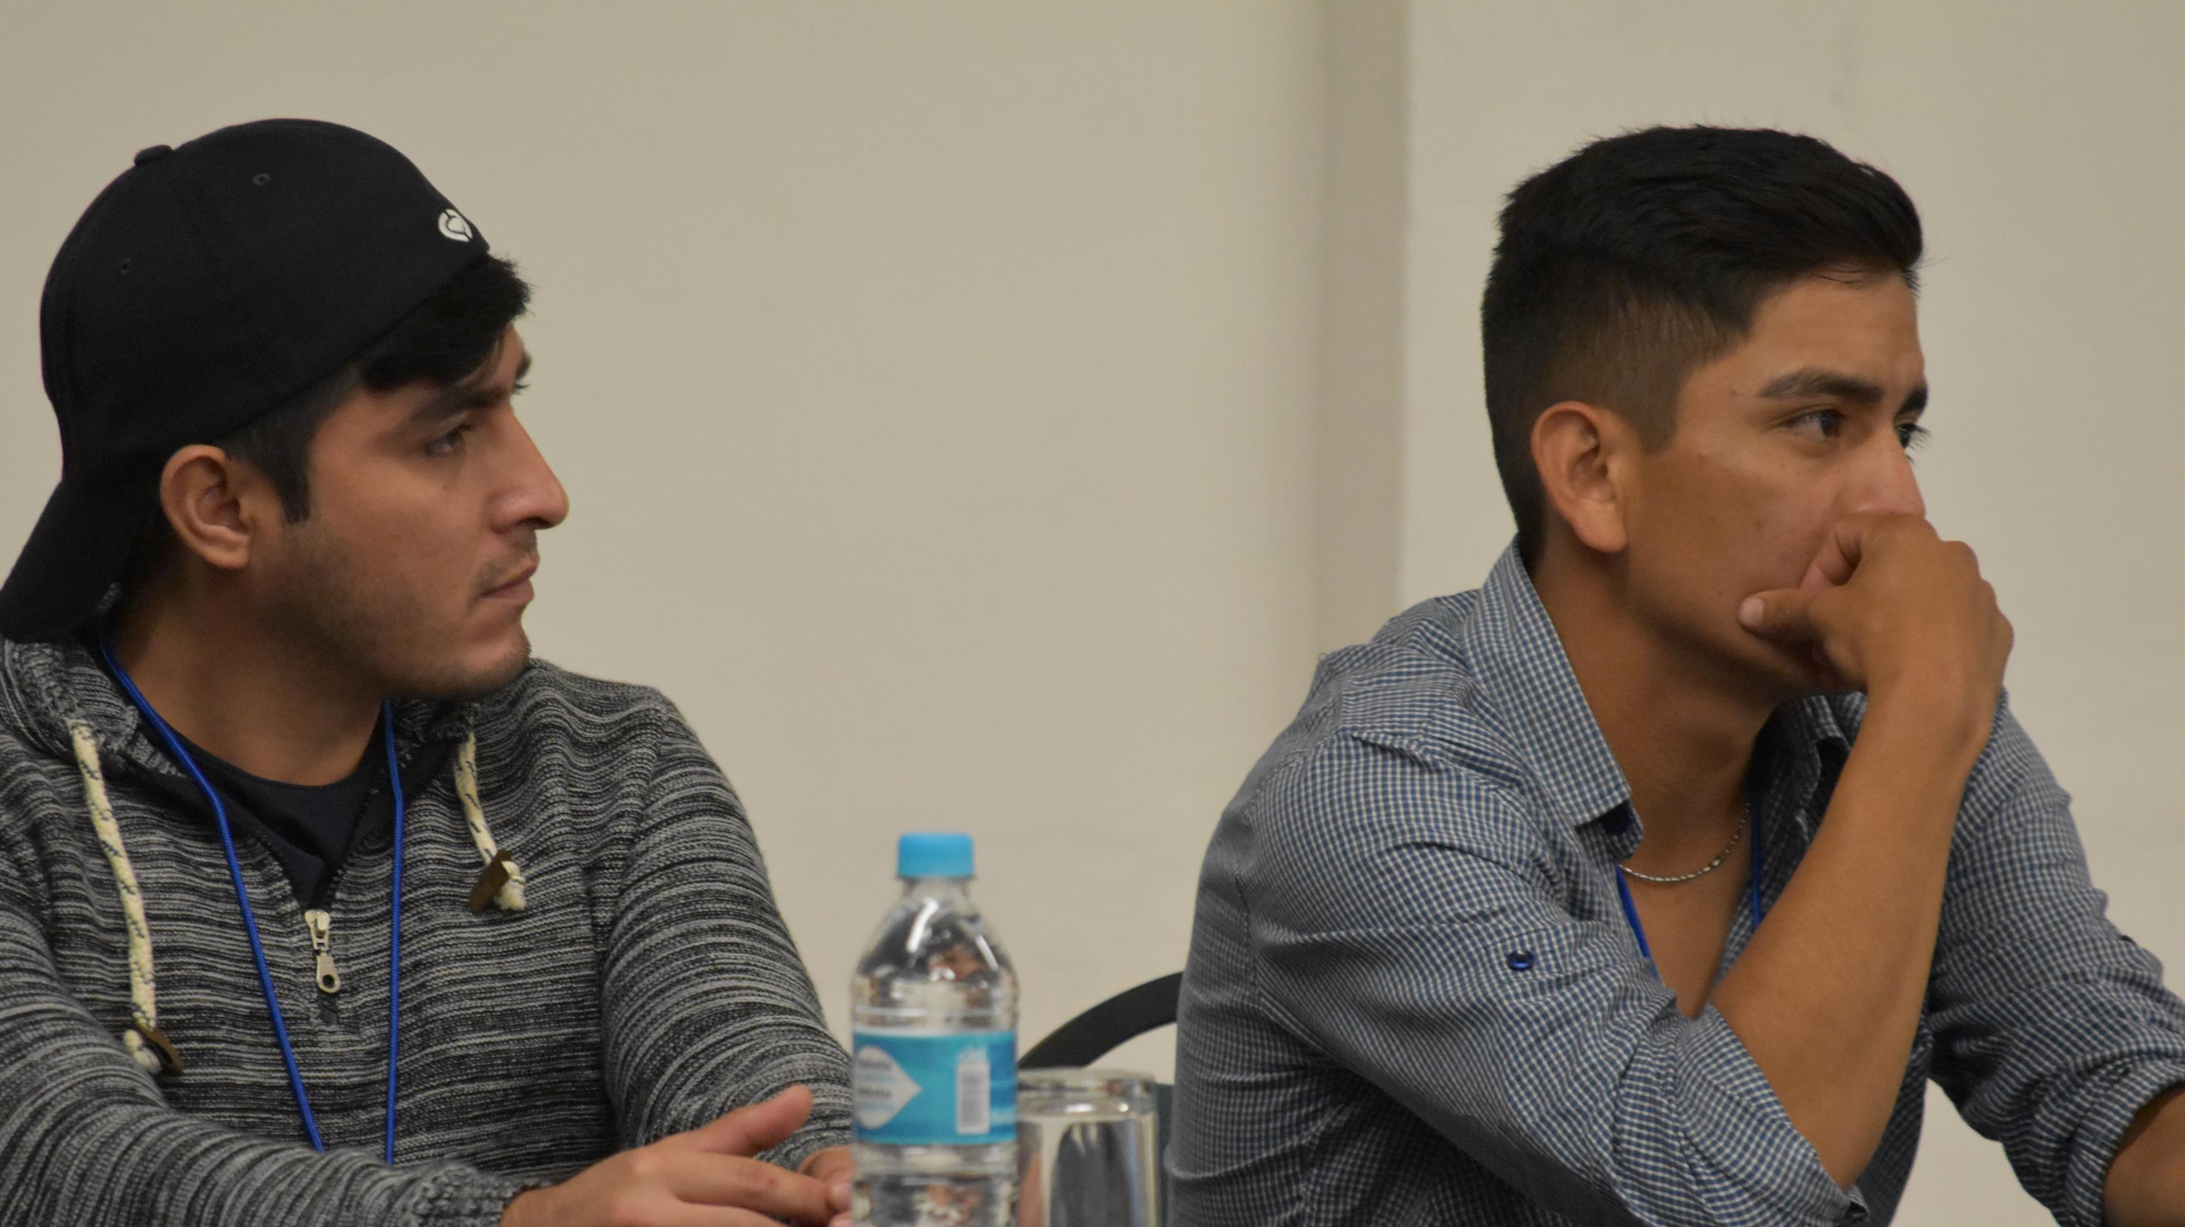
Students
Self-confidence to speak English Very Low
Motivation to learn English High
Satisfaction with learning English at school Low
Awareness of English as global language High

Slide 19
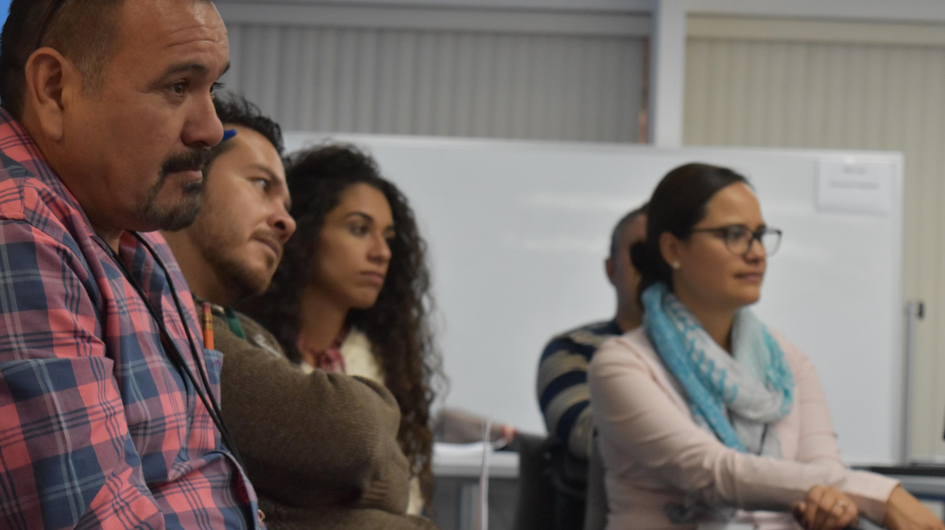
Teachers
Belief in student capacity to succeed High
Access to Internet in class Low
Need for innovative materials High
Satisfaction with textbooks Low
Desire for new approaches High

Slide 20







More Hours of Learning English as a Subject?
– All Schooling
Italy 1 200
Korea 1 000
Japan 928
Spain 888
Finland 684
Brazil 610
Mexico 565

Slide 21
New Textbooks?
Green = Very Good, Blue= Acceptable, Red = Not good enough
Mexico
Thinking Competence Relevance Production Perspective Learning Motivation
Brazil
Thinking Competence Relevance Production Perspective Learning Motivation
Italy
Thinking Competence Relevance Production Perspective Learning Motivation
Korea
Thinking Competence Relevance Production Perspective Learning Motivation
Spain
Thinking Competence Relevance Production Perspective Learning Motivation

Slide 22

A Team created a CLIL solution for Mexican 15-17 year olds
Fotolia

Slide 23

I am learning about life in cyberspace through English
Not
I am learning English about cyberspace

Slide 24


I
I
I am learning about AI through English
NOT
I am learning English about AI

Slide 25



Slide 26
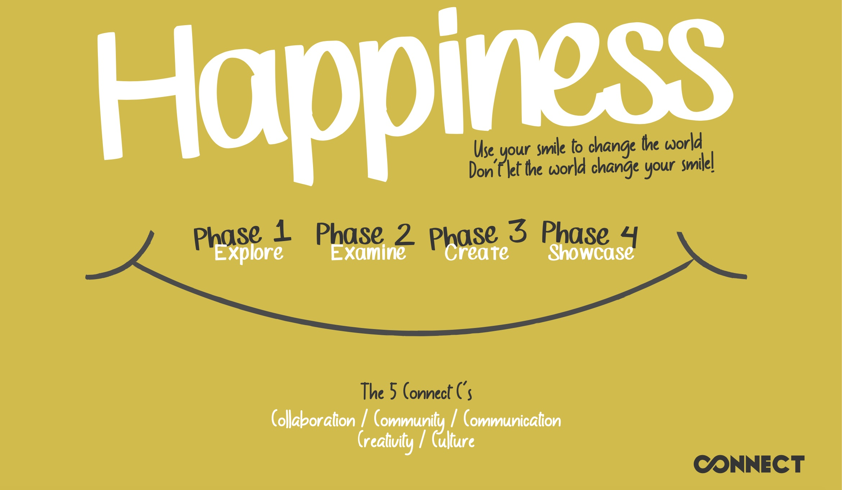
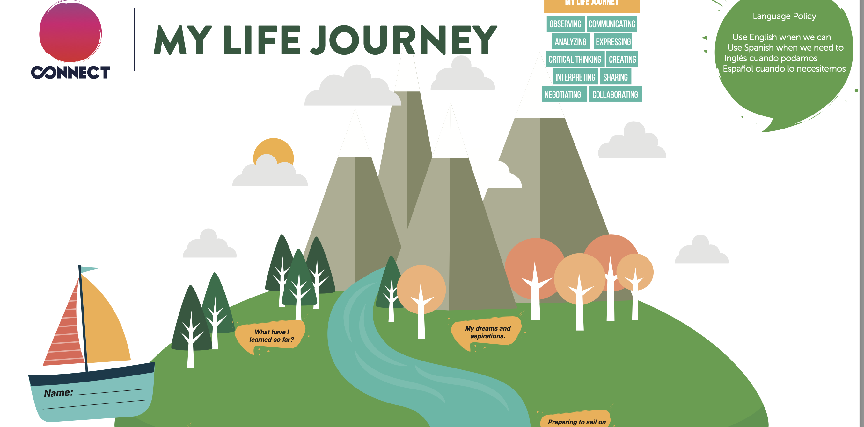

Slide 27
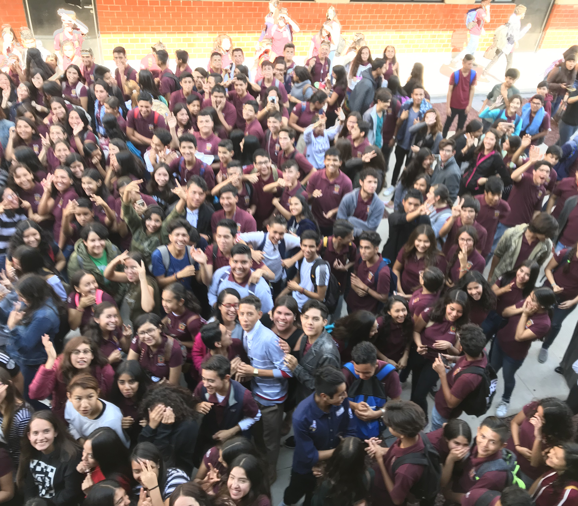
So, what happened?
c.1 500 students
Diverse backgrounds
2 hrs per week

Slide 28

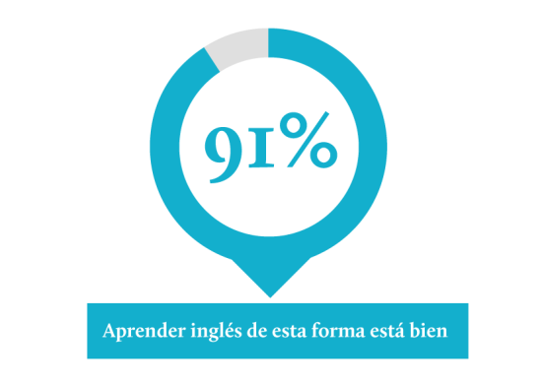
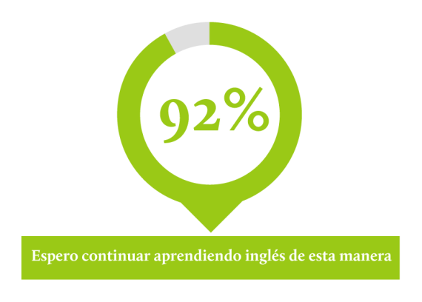
Students
Learning English this way is good
I hope to continue learning English this way

Slide 29
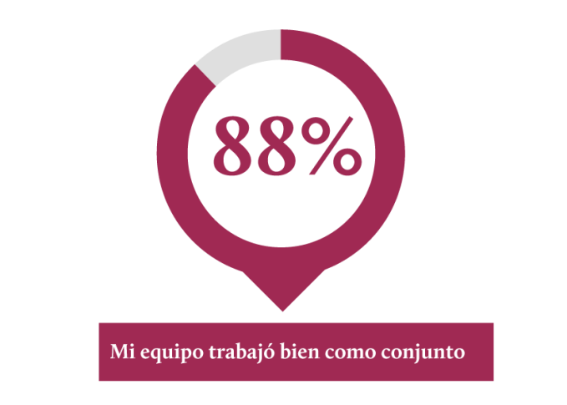
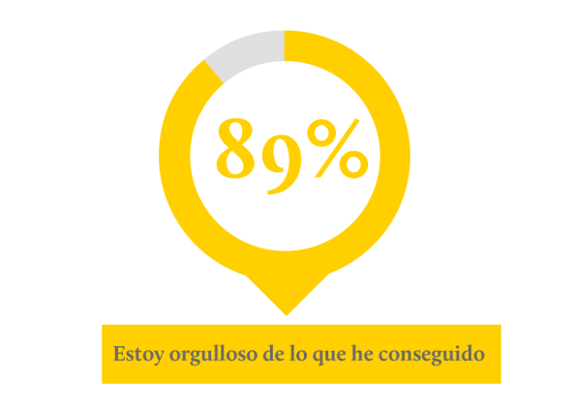
Students
My team has worked well as a whole
I am proud of what I have achieved

Slide 30
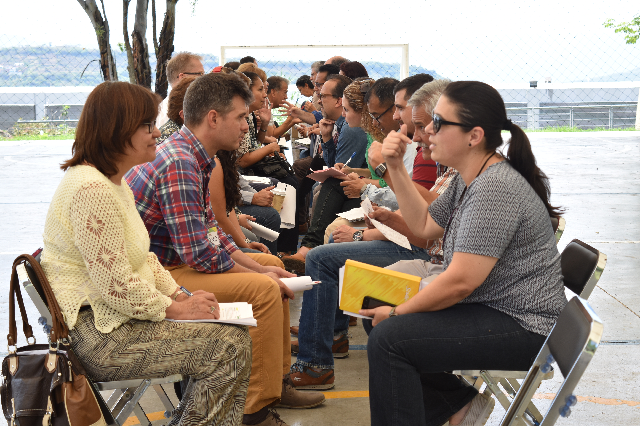
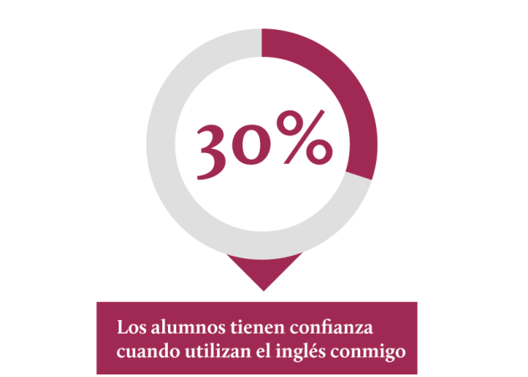
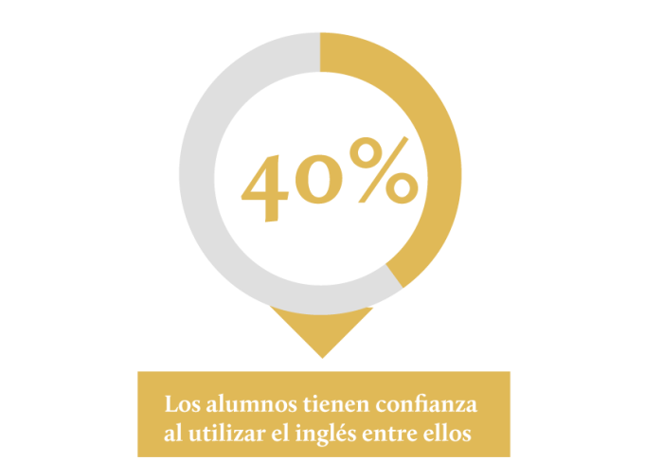
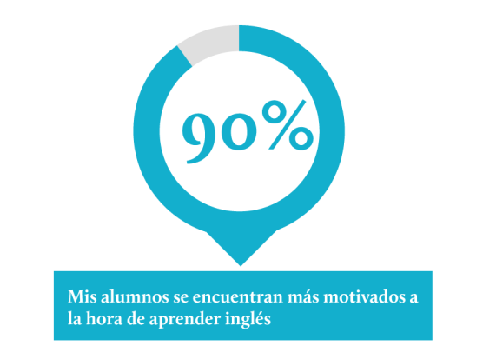
Teachers
Student confidence talking
to me the teacher
Students talking with
other students
My students are more motivated
when learning English

Slide 31

What is an easy way to understand its core?
The eye of the learner is primarily on learning about the topic, not on learning the language
Fotolia

Slide 32

The Affective Filter (Stephen Krashen)
Emotions drive attention
Attention drives learning & memory
In English language teaching feelings are facts

Slide 33
Learning about the language
Unnatural
= you learn about the elements of the language
Learning through the language
Natural
= you learn to think in the language as you learn the language

Slide 34
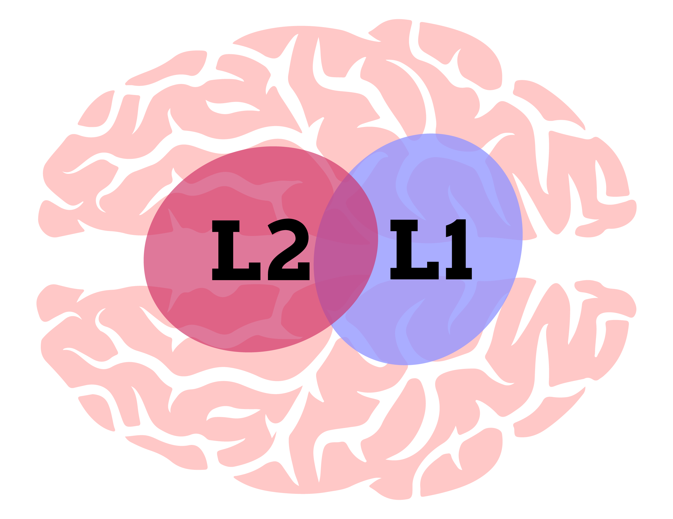
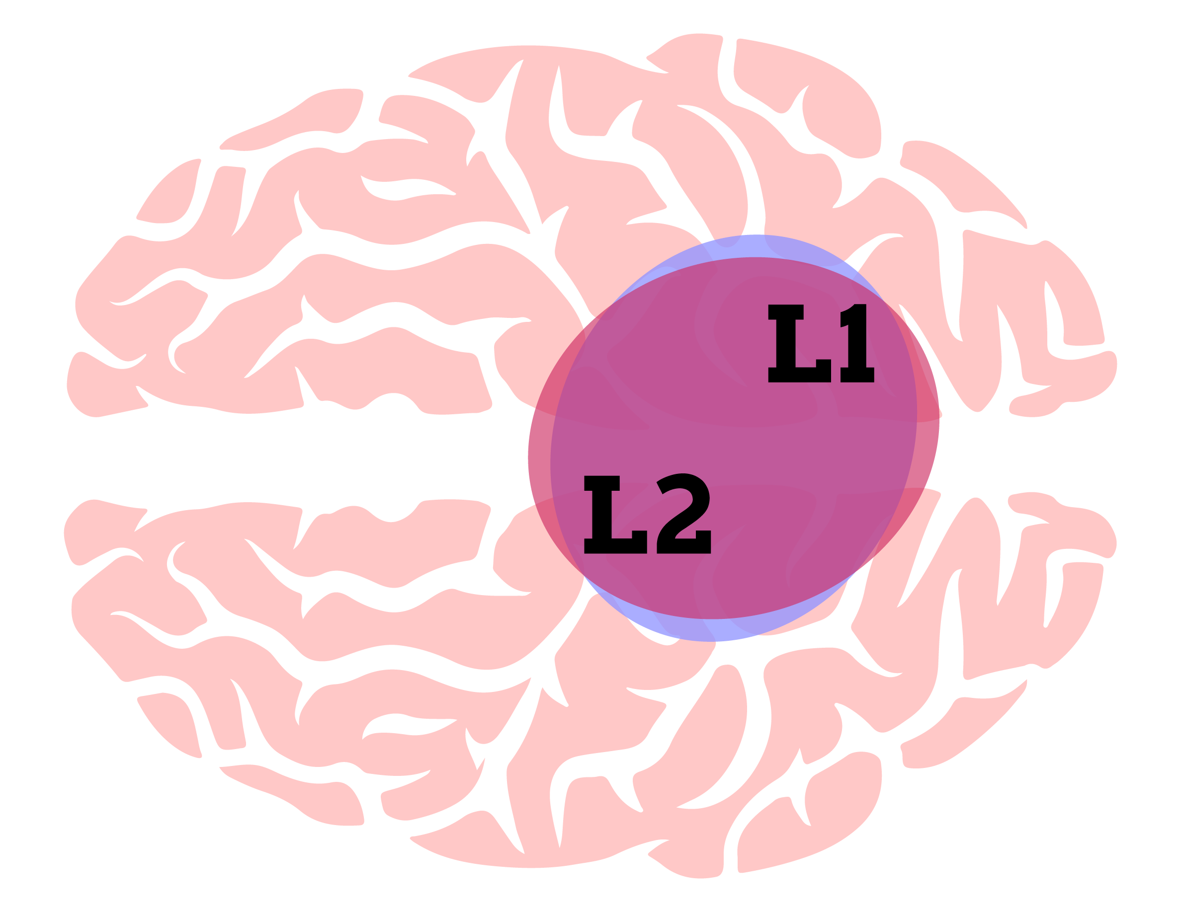
In language teaching we have a choice…
Learning about the language
Learning through the language

Slide 35
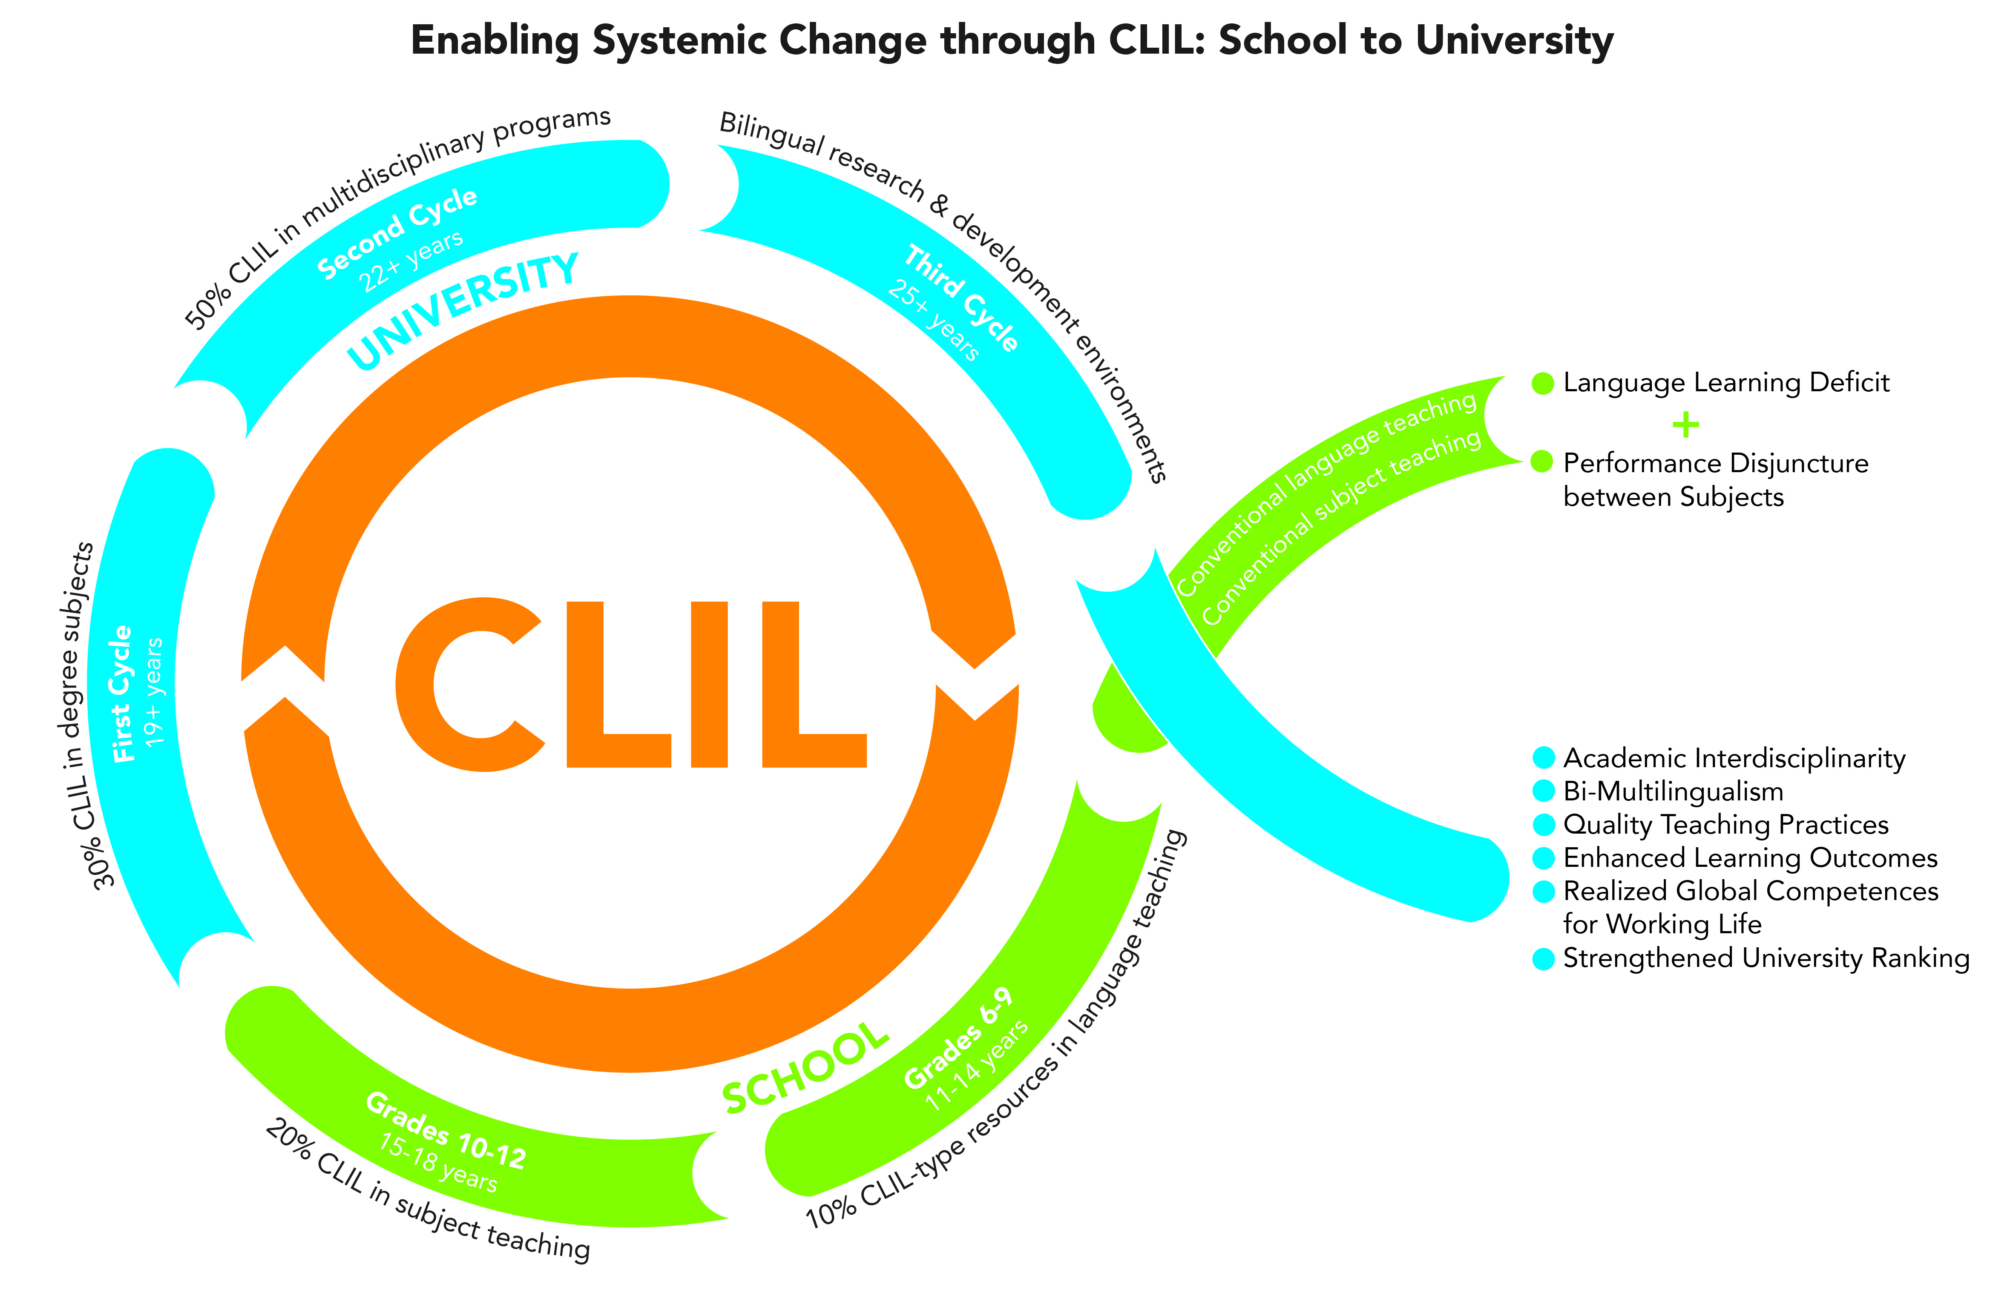


Slide 36
Comments, Questions, Ideas

Slide 37

Learning Spaces
Physical
Social
Psychological
”a space is more than a place”

Slide 38
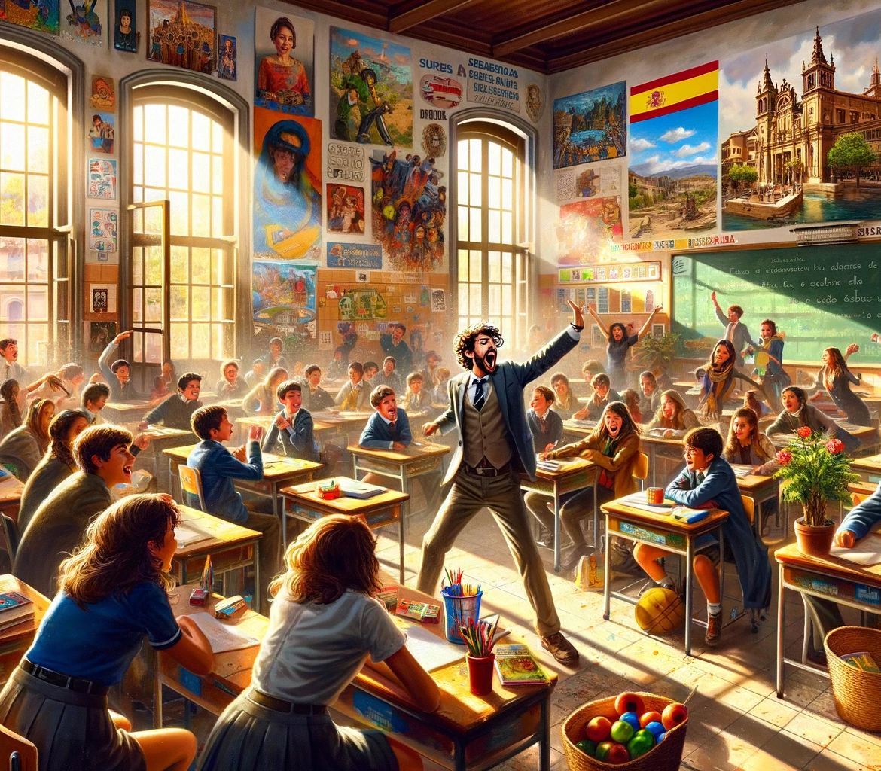
Sound
Decibels dB
Reverberation Time RT
Continuous noise 60-70 db can negatively impact on learning
85+ dB harmful
Activity 5
What are typical noise levels in your
classrooms?

Slide 39

Air
Light
Sound
Furnishings
Technology

Slide 40
AI – In education do we...
ignore it?
Live with it?
Ban it?

Slide 41
Activity 6
Is this cheating?
Yes
No
Maybe
Gives text to AI for editing and submits as own

Slide 42
Is this cheating?
Yes
No
Maybe
Takes text from AI, edits, adds references, and submits as own

Slide 43
Is this cheating?
Yes
No
Maybe
Takes multiple texts from AI, edits selected parts into new text, and submits as own

Slide 44
AI is impacting heavily on education and forcing change
Equpping Teachers
Changing assessment
Formative (peer and self) and Summative
Driving active learning collaborative techniques

Slide 45
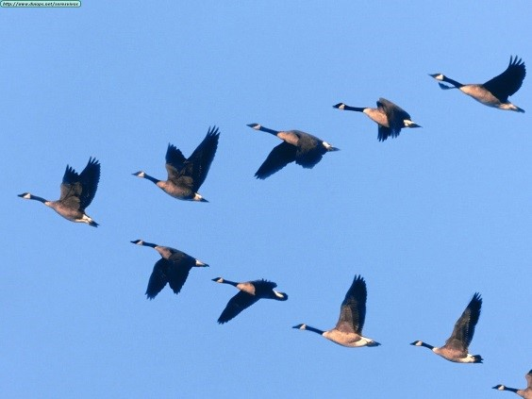
Collaboration
“Working together works”
Activity 7
This is how Canadian Geese fly
Let’s show this in action!
Ingersoll Nature District Club

Slide 46


Working together works

Slide 47
https://davidmarsh.education

Slide 48
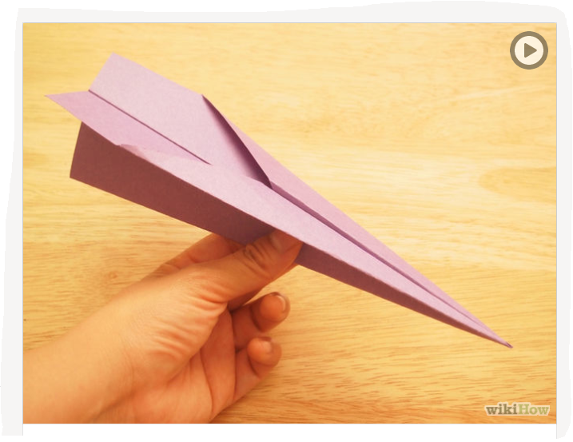
Activity 8
In groups of 3-4
🎈 build a paper plane
🎈 write on a wing one or more ’aha!’ thoughts you will take away from the whole event today!

Slide 49


Time to Fly

Slide 50

https://davidmarsh.education

Slide 51


Thank you!
Thank you!
Moitas grazas!

